Slide 1

Pictures copyright-free from pixabay
Leader: We are a creative community. As we gather together today…
ALL: May our thinking, talking and wondering help us to grow.
Notes:
Slide 1: Gathering
Use the new greeting, with BSL actions if desired.
Leader: We are a creative community. As we gather together today….
ALL: May our thinking, talking and wondering help us to grow.
Here are BSL actions for some of the words:
Leader’s words:
Creative: https://www.signdictionary.co.uk/view/creative?q=creative#title
Community: (we use the word ‘gathering’ as it’s a simpler sign!) https://www.signbsl.com/sign/gathering
Gather together: https://www.signbsl.com/sign/gather (1st video)
Pupils’ response:
Think: https://www.brightbsl.co.uk/signs/think
Talk: https://www.signbsl.com/sign/talk (1st video)
Wonder: https://www.signbsl.com/sign/wonder (1st video)
Grow: https://www.signbsl.com/sign/grow (2nd video)

Slide 2
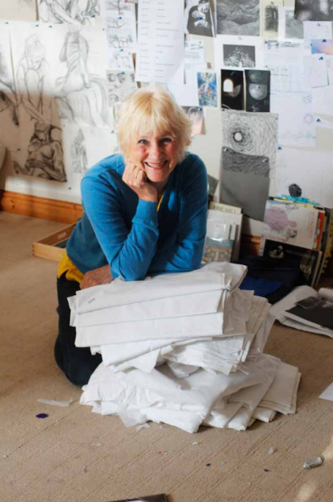
Threads Through the Cross
Notes:
Slide 2: Threads Through the Cross
Today, we will be looking at another of Jacqui’s panels. But first, here’s a question to ponder……

Slide 3

Notes:
Slide 3: Who would you want to meet…..?
If you could meet and chat with anyone, past or present, who would it be? Involve the adults in the room as well for this discussion! [Allow a good period of time for thinking / maybe talking to a partner. Talk together about how it would feel, what you would say to them, what questions you would like to ask etc.]

Slide 4
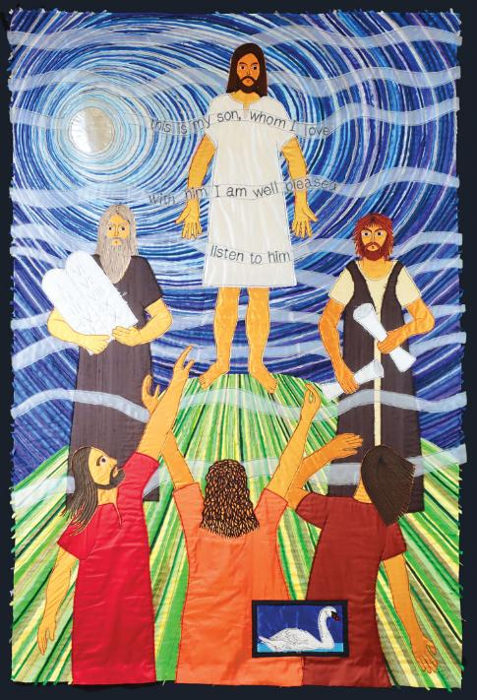
This is my Son, whom I love. With him I am well pleased. Listen to him.
Notes:
Slide 4: Transfiguration
Today’s panel also features an unexpected meeting. Relax, and focus on calm breathing, while I read the words from the Bible (in Matthew chapter 17) which tell the story of this picture:
Six days later, Jesus took Peter, James, and John (the brother of James) up on a high mountain. They were all alone there. While they watched, Jesus was changed. His face became bright like the sun. And his clothes became white as light. Then two men were there, talking with him. The men were Moses and Elijah. Peter said to Jesus, “Lord, it is good that we are here. If you want, I will put three tents here—one for you, one for Moses, and one for Elijah.” While Peter was talking, a bright cloud covered them. A voice came from the cloud. The voice said, “This is my Son and I love him. I am very pleased with him. Listen to him!”
Now can you work out the answers to our thinking questions for this week?!
….Who are the people in this panel?
….How do you know this?
….Who’s holding objects? What are they?
….How are the people feeling? What are the three disciples doing?
….Are there any words to read?
Now spend a few minutes talking about the things you were thinking about….and pick out the words ‘This is my Son, whom I love. With him I am well pleased. Listen to him.’
….Whose words are these? So, who else is on the mountain? [God!]
…I wonder who the disciples were more shocked to meet?!!....
….Can you find the bird? What is it this week?
Some of you might know the story of the Ugly Duckling, which isn’t a duckling after all, but a baby swan which is grey and rather unattractive to look at– in the story, people called it ‘ugly’, until one day, it grew into a beautiful swan. It was transformed, a bit like Jesus in this panel.

Slide 5
This is my Son, whom I love. With him I am well pleased. Listen to him.
Notes:
Slide 5: Transfiguration
This must’ve been a very strange experience for the three friends Peter, James and John who were with Jesus on the mountainside. It maybe felt a little like we would feel if we actually did get to meet our fantasy guest(s), because Moses and Elijah were the most famous of all the prophets from Israel’s history! It must’ve felt very confusing…. They might perhaps have thought that this was a dream, and so not something that would be easy to explain afterwards! Jesus had already performed miracles and told parables, so the disciples knew that Jesus was no ordinary human being, but they had probably not expected to hear God himself speaking….. This is my Son, whom I love. With him I am well pleased. Listen to him.
This mountainside was what some people call a ‘thin place’ – a place where God seemed very close.

Slide 6
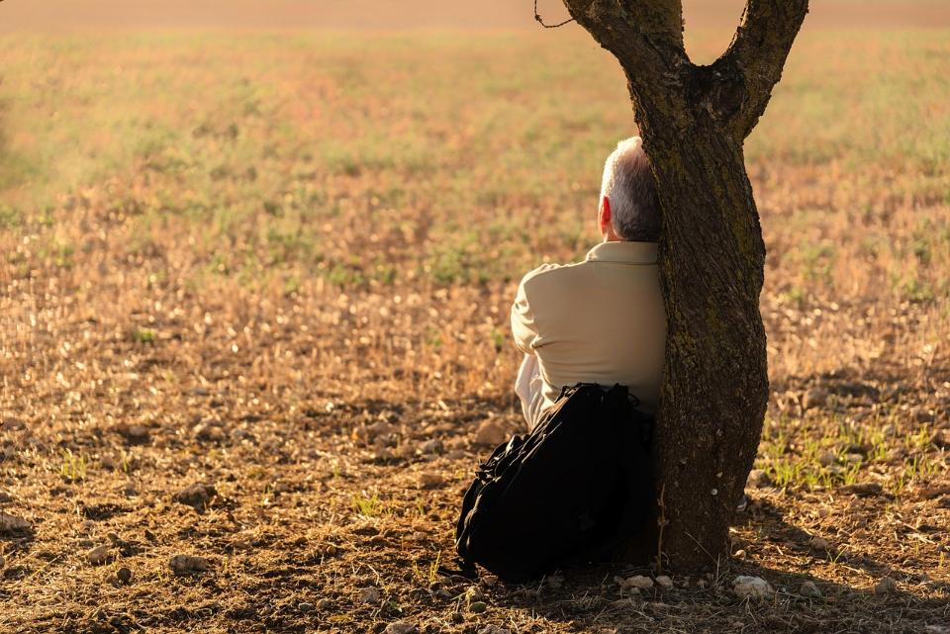
….I wonder whether some of you have special places like this – thin places, where you go to feel close to God, or close to Nature....or just by yourself?....
….I wonder what it is about that place that makes it special for you?....
….or how being there brings you peace?....
Notes:
Slide 6: Thin places
…I wonder whether some of you have special places like this – thin places, where you go to feel close to God or close to Nature…or just by yourself?....
….I wonder what it is about that place that makes it special for you?….
….or how being there brings you peace?....
[you might like to give children some time to talk with a partner]

Slide 7
This is my Son, whom I love. With him I am well pleased. Listen to him.
Notes:
Slide 7: Responding and words for worship
We’ve heard today about Jesus and the three disciples meeting with God in this thin place on the mountainside. We’ve thought about what that might’ve felt like and about our own ‘thin places’……
We’re going to create some space now, here, as we are gathered, because our times together in collective worship might sometimes feel like ‘thin places’ for some…..collective worship offers the opportunity for stillness and reflection in our busy days…..a time to for us to be quiet and thoughtful, or to find God…..there are no wondering questions for us today, so use this peaceful space in a way that feels comfortable for you. You might even want to close your eyes….
[Length of time for this to be decided by you, according to context]
Opportunity for reflection / prayer
As we draw this time to a close, I’m going to use the words of a prayer now. It’s a prayer from the Celtic tradition and speaks of finding God in the natural world around us. If this is something that you feel comfortable doing, then do join in with the ‘Amen’ at the end:

Slide 8
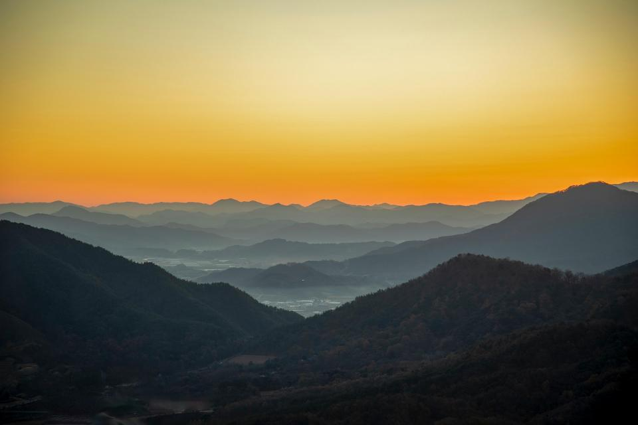
God of rising sun, be the warmth that I feel.
Notes:
Slide 8: God of rising sun, be the warmth that I feel.

Slide 9
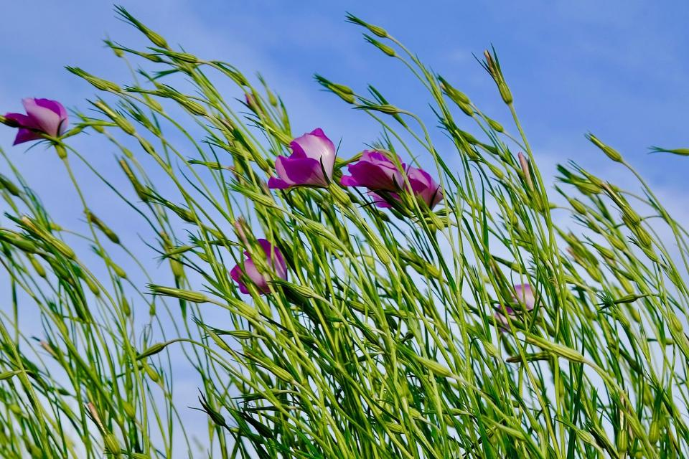
God of gentle wind, be the air that I breathe.
Notes:
Slide 9: God of gentle wind, be the air that I breathe.

Slide 10
God of sacred space, be the peace that I crave.
Notes:
Slide 10: God of sacred space, be the peace that I crave.

Slide 11
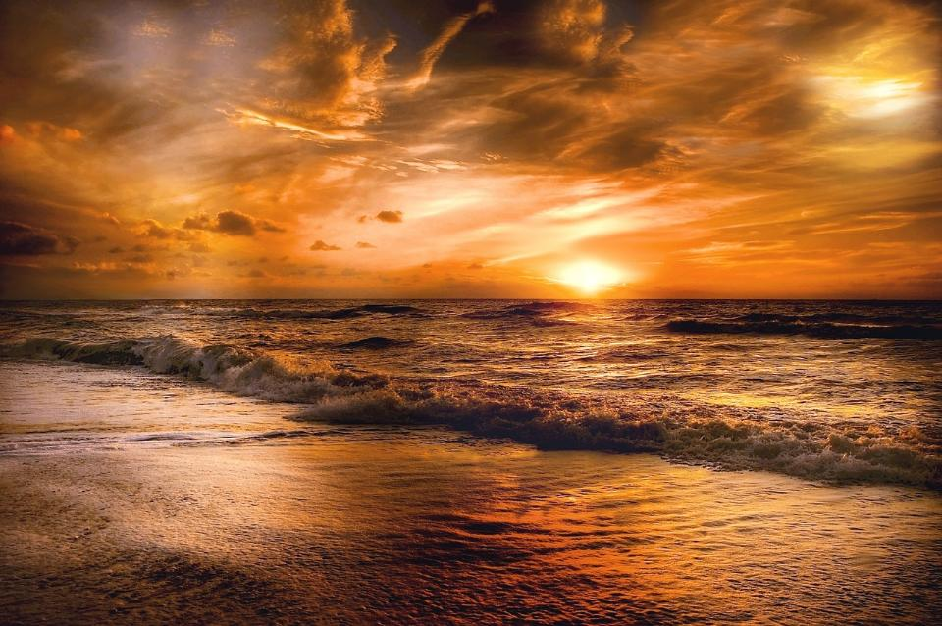
God of setting sun, be the rest I desire.
Notes:
Slide 11: God of setting sun, be the rest I desire.

Slide 12
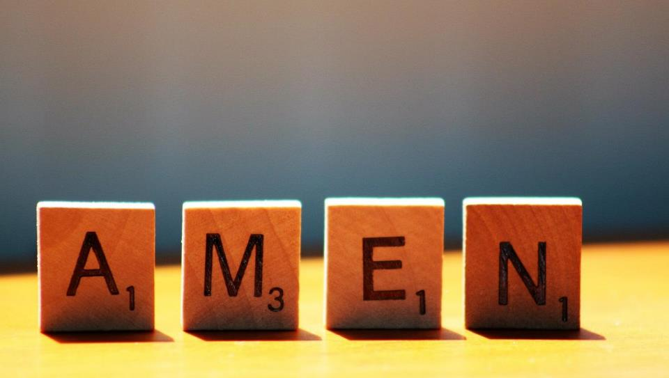

Slide 13
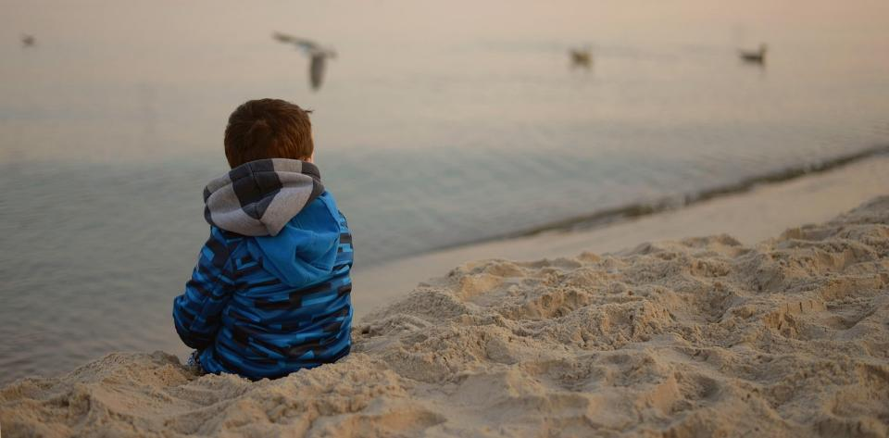


Leader: As we leave this place & time and go into the day ahead…
All: Together, we create a peaceful community!
Notes:
Sending: Slide 13 (NB note different word from last week!)
Leader: As we leave this place & time and go into the day ahead…
All: Together, we create a peaceful community!
BSL Together: https://www.signbsl.com/sign/together (1st video); Helpful: https://www.signbsl.com/sign/helpful
You already have signs for ‘community’

Slide 14

Notes:
Slide 14: Reflective areas – small frames, my ‘thin’ place
Think: Do you have a special place where you like to go to be with God, or with Nature?
Do: Choose a small frame and draw inside it your special place.
Talk: How does it feel to be in our special places?

Slide 15
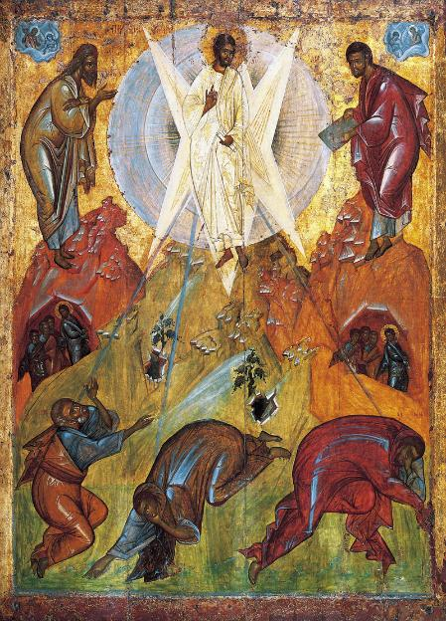
Transfiguration, by Theophanes the Greek and workshop c. 1400 from Art in the Christian Tradition
Notes:
Slide 15: Showing the annunciation from different cultural perspectives
Link to original artwork: https://diglib.library.vanderbilt.edu/act-imagelink.pl?RC=59721, which includes some key information.
Looking at these two creative interpretations of this part of the story may be something that links with your RE curriculum, reflecting the fact that Christianity is a global religion, encouraging pupils to appreciate the diversity that exists across cultures, traditions and geographical areas. It’s important for pupils’ wider understanding that they are given opportunities to think about how Christians show Jesus as being ‘like them’, and that this important story for Christians is imagined in different ways across the world. It also creates an inclusive classroom environment, giving all pupils opportunity to see themselves in the art that they view.
You may wish to consider these questions:
What is the same? What is different?
Which culture / tradition does the 2nd piece come from?
Why do we think this?
What questions might we want to / need to ask?

