Slide 1
Leader: We are here together
Children: With ears ready to hear and hands ready to serve.
ALL: May we be wise in all our actions today.
Notes:
Slide 1: Use our new gathering words. Why not invent your own actions to accompany them?
Leader: We are here together
Children: With ears ready to hear and hands ready to serve.
All: May we be wise in all our actions today.

Slide 2
Notes:
Slide 2: Let’s start with our wise words for today….. and as we journey towards Easter together this half term, later, we’ll be sharing a story from the life of Jesus.

Slide 3
‘A wise child follows their parent’s good advice.’ (Proverbs 3:5)
Notes:
Slide 3: ‘A wise child follows their parent’s good advice’
Like roadsigns, we all have people in our lives whose advice we trust – advice that helps us to make good decisions [you might want to unpack this a bit here]

Slide 4
Know your Highway Code…
Notes:
Slide 4: So today, we’re going to turn to some roadsigns to help us with our story – and our wise words – for today. First, let’s remind ourselves what some of them mean when we see them on our roads – and then we’ll use them in a rather different way!

Slide 12
Notes:
Slide 13: Reduce speed
Like Advent, Lent is a special time of preparation for Christians …. a time to prepare for Easter… a time to live differently….a time to slow down and reflect….as we are going to do today

Slide 13
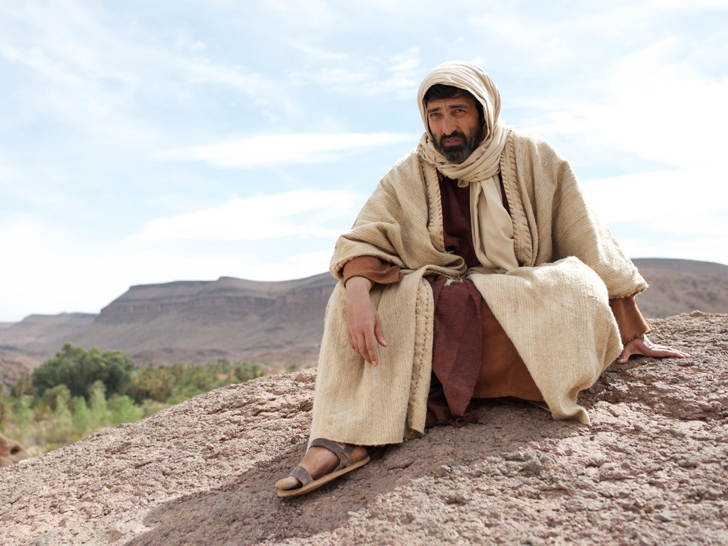
Jesus in the desert
Notes:
Slide 13: Christians look to the life and example of Jesus to help them to know how to live, a bit like the way that road signs help people to know what to do on the road. Christians will be reflecting on the life of Jesus especially during the 40 days of Lent. The story of Jesus in the desert is one of these important stories and has special links to the things that Christians do during this special time of getting ready for Easter.

Slide 14
Notes:
Slide 14: After his baptism….(sorry!),

Slide 15
Notes:
Slide 15: Jesus was led into the desert – which may have seemed like a wrong turn, and not quite what anyone was expecting after such a mountain-top experience. He was there for 40 days.

Slide 16
Notes:
Slide 16: Because Jesus was human, like us, after 40 days without food, he was hungry, and the tempter*, God’s enemy, came to test him.

Slide 17
Notes:
Slide 17: ‘Turn these rocks into bread’ the tempter* told Jesus. But Jesus would not be tempted. ‘It says in the Torah that we are not to depend on the bread that we eat, but on the words that God speaks to us,’ Jesus replied.

Slide 18
Notes:
Slide 18: Then the tempter* took Jesus up to a high place. ‘If you were to jump off here, angels would rescue you.’ But Jesus would not be tempted.

Slide 19
Notes:
Slide 19: Then the tempter* took him up to an even higher place and showed him the whole world. ‘Bow down and worship me and all this will be yours!’ the devil said. But Jesus would still not be tempted.

Slide 20
Notes:
Slide 20: ‘It is written that we should worship only God’ Jesus said. ‘Now leave me!’ he told the tempter*. And he did.

Slide 21
Notes:
Slide 21: And so, the 40 days of Lent give Christians a chance to remember how Jesus followed God’s way, and to try to do the same, loving God and loving others, wherever they go. But it’s not always easy….

Slide 22
Notes:
Slide 22: …in fact, living in this way is hard work!.... because as human beings, we often find it easier to think about ourselves. But the Wise Words we’ve been thinking about so far this term might just help us to do this. Maybe you’d like to be a part of the challenge this Lent, to live according to the good advice we’ve heard, because every little helps! …..

Slide 23
Notes:
Slide 23: The good news is that we’re not doing this alone: we can encourage one another to keep doing good…..and if we want to, we can ask God to help us too.

Slide 24
‘A wise child follows their parent’s good advice.’ (Proverbs 3:5)
Notes:
Responding (and words for worship): slide 24
We heard at the start that ‘a wise child follows their parent’s good advice.’ For Jesus, this was God himself.
Jesus trusted God’s words to help him to overcome the temptations in the desert and to make good choices.

Slide 25
….I wonder what difference Lent makes to Christians?....
….I wonder how it helps them to prepare for Easter?....
….I wonder what difference it might make if we were to live differently during Lent…at school, or at home?...
….I wonder how our Wise Words might help us?....
‘I wonder….?’
Notes:
Slide 25: Let’s wonder together now…. I wonder what difference Lent makes to Christians?.... I wonder how it helps them to prepare for Easter?.... I wonder what difference it might make if we were to live differently during Lent…at school, or at home?... I wonder how our Wise Words might help us?...

Slide 26
God of all wisdom,
Help us to work together to share what we have, so that everyone has what they need.
Help us to build a better world, where each of us can become the best person we can be.
Help us to live differently during this season of Lent.
Amen
Notes:
Slide 26: I’m going to use a prayer that’s been written especially for Lent. You might like to make it your own, or prefer to continue to be still and quiet with your own thoughts:
God of all wisdom,
Help us to work together to share what we have, so that everyone has what they need.
Help us to build a better world, where each of us can become the best person we can be.
Help us to live differently during this season of Lent.
Amen

Slide 28
Leader: As we leave this place & time and go into the day ahead…
All: May today’s words help us to make wise choices.

Slide 29
Notes:
Slide 29: Reflective areas
Look at your school value words: how do they help you to make good choices?

