Slide 1
We are here together….
May our attitudes make our school community a happy place today.
Notes:
Slide 1: Use the new gathering words for this term
Leader: We are here together
ALL: May our attitudes make our school community a happy place today.

Slide 2
It’s not fair!
Notes:
Slide 2: Show children the speech bubble, asking for a show of hands to establish who’s said those words at some time or another, or allowing children time to talk to a partner. [If time allows, you might want to find out some of the things they’ve said.]
‘We’re thinking today about things that are not fair, and to start with, I’m going to be very unfair (which I hope you’ll agree, isn’t like me!).

Slide 3
My unfair school rules
•Children with brown eyes are more important than any other children in the school.
•Only children with brown eyes can use the adventure playground at playtimes.
•At lunchtime, only children with brown eyes can sit at the tables. Everyone else has to stand up.
•Children with brown eyes can bring sweets to school instead of fruit.
•Only children with brown eyes can read to the teacher.
Notes:
Slide 3: I’ve got some very different – and very unfair – school rules. They are not real, so we won’t be changing what our school rules really are, but for a few moments now I want you to imagine how you’d feel if my rules actually became the school rules. [Read them out, leaving a short pause after for children to think, then invite a few responses] ‘It seems really mean, doesn’t it, to be telling children they can’t do certain things just because their eyes are a different colour to everyone else’s. It really wouldn’t be fair.’

Slide 4
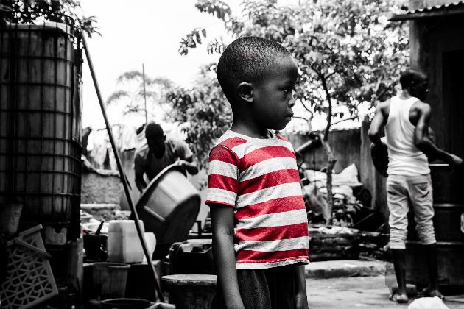
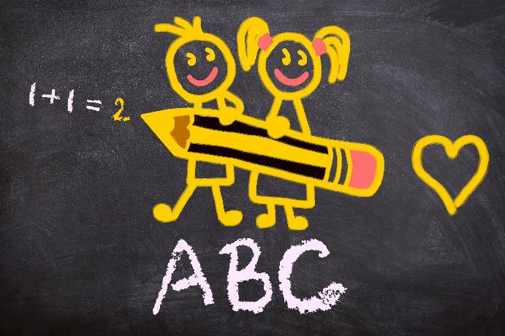
It’s not fair!
Notes:
Slide 4: In many parts of our world, there are some really really unfair things happening, just because you’re a child, or a girl, or from a certain place. Although you might just sometimes moan about going to school, many children around the world don’t ever get the chance to go to school, which means they can’t get a good job – or even any job! – later in life. So actually, in some places, my mean school rules might be a bit more real…..
[Optional section: Listen to these stories: [share pictures on next 2 slides and use the photos script. You may need to re-interpret these in language that suits your age range]

Slide 5
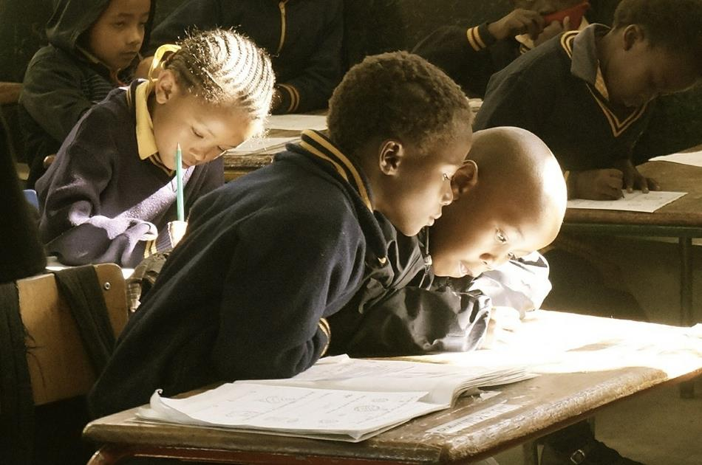
73% of girls in Sierra Leone don’t get to go to secondary school.
In some parts of Uganda, almost half the girls can’t read.
Notes:
Slide 5: Sometimes, you don’t get to go to school simply because you are a girl! In Sierra Leone (a country in Africa) 73% of girls don’t get to go to secondary school, because they live too far away, or they have to get married. In some parts of Uganda, almost half the girls can’t read. Although the Ugandan government introduced free schooling in 2007, the cost of uniforms, transport, books, stationary and school lunches mean that many girls can’t stay on at school. Often, their families decide that it’s more important that the boys get an education.

Slide 6
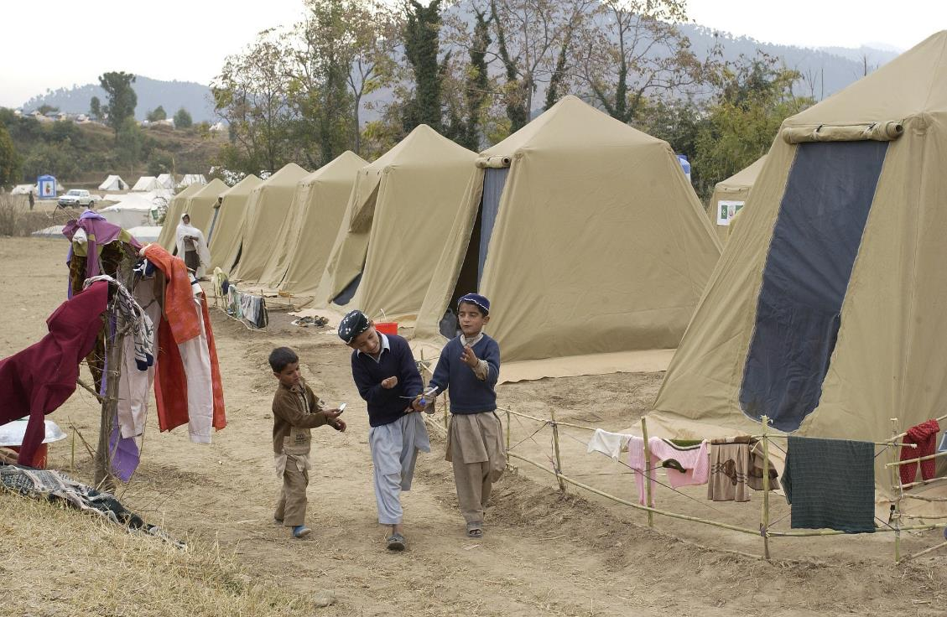
25,000,000 children in Pakistan don’t go to school.
One third of Syrian refugees aren’t able to go to school.
Notes:
Slide 6: Many families simply can’t afford to send their children to school. 25 million children in Pakistan don’t get to go to school, because their parents need them to work to earn money to help support their family. Many of you will know about the war in Syria that’s forced millions of people to leave their homes and their country. Refugee children are permitted to attend Egyptian schools, but going to school costs money. A third of refugee families struggle even to pay for food and shelter, and simply cannot afford the extra cost to send their children to school.

Slide 7
Beatitudes
Beati
‘How-to-be-attitudes’
Notes:
Slide 7: It probably won’t come as a surprise that Jesus had something to say about injustice (that’s a grown-up word for things that really aren’t fair) in the Beatitudes. Actually, justice –being fair, especially to those who were poor and under-valued – was one of the things that he spoke about the most in his time on earth.

Slide 8
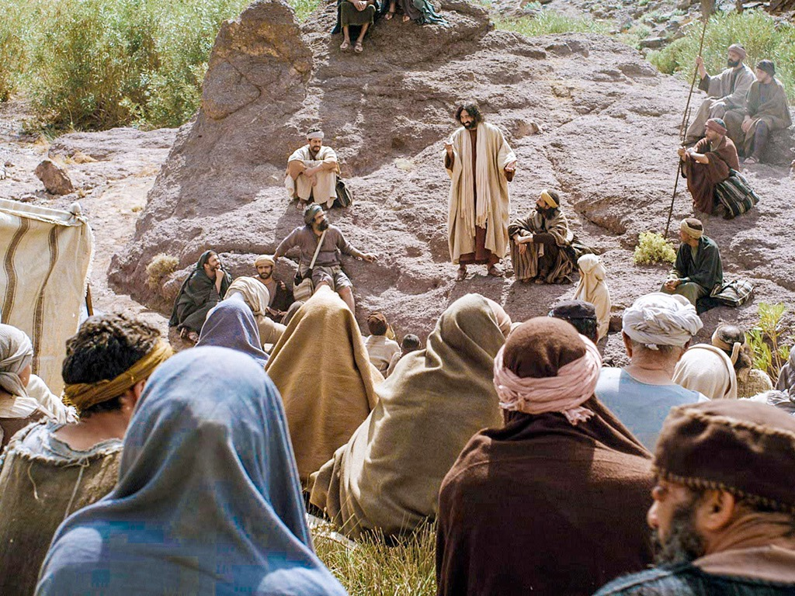
Those who want to act justly more than anything else are truly happy. God will fully satisfy them.
Notes:
Slide 8: Let’s hear his words: ‘Those who want to act justly more than anything else are truly happy. God will fully satisfy them.’
In these words, Jesus was talking about showing justice, being fair, standing up for people who are being treated unfairly. But how might we do this? Well, Jesus himself showed how in the way that he lived his life, but also in what he said to others.

Slide 9
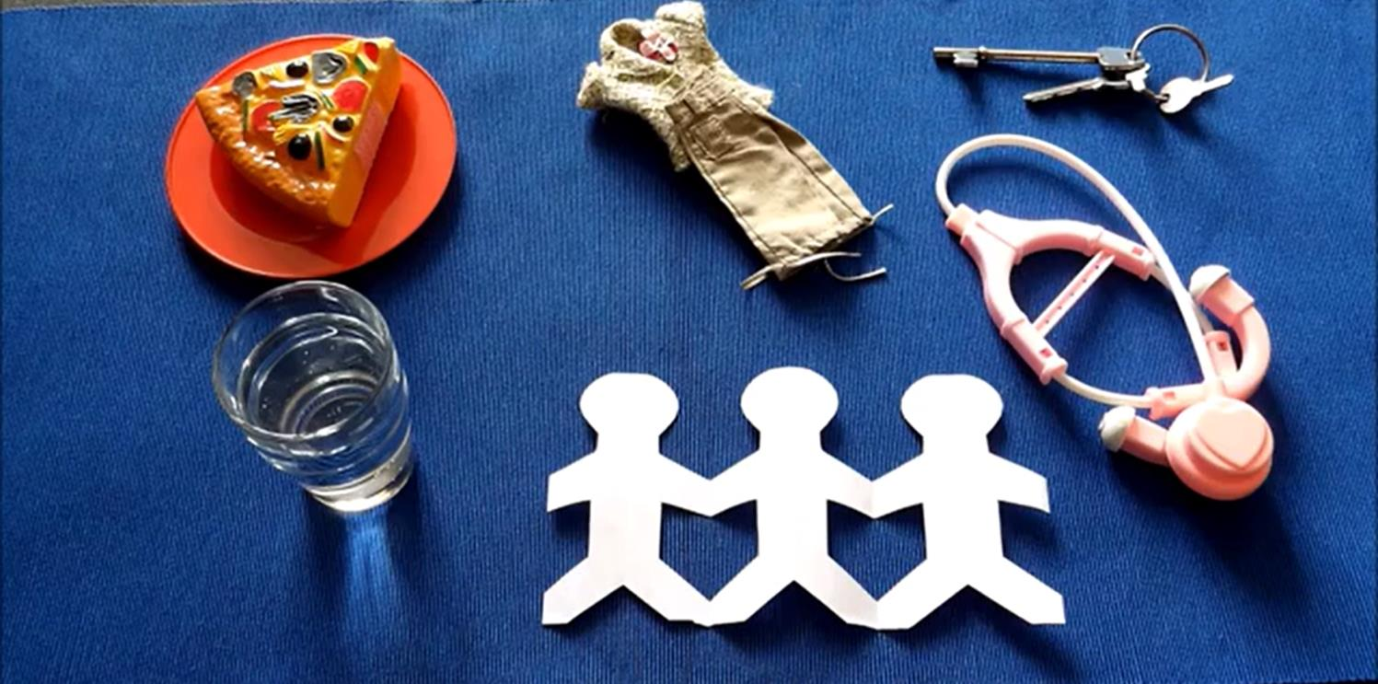
Matthew 25: 34-40
Notes:
Slide 9: People often asked Jesus questions about God’s Kingdom, and how to live, and in these words from the book of Matthew, we will hear how important Jesus said it was to care for others, and make sure that they have what they need, especially those who might get overlooked in our world [use script and objects p.4, or video linked from the picture]
Afterwards, talk together about how each of the actions are to do with showing justice / living justly / making things fair.
Can children think of other examples where people are being treated unfairly? (you could reference the examples on slides 5&6)

Slide 10
….I wonder which words we’ve heard today stand out for you?.....
…..I wonder how they might help us to know how to live justly and treat others fairly?....
….I wonder what opportunities we might have to do this here in our school community?....or in the world?
Notes:
Slide 10: Responding and words for worship
So now let’s bring our thoughts together and reflect on what we might have learned from the words of Jesus about showing justice – our ‘How-to-be-attitude’ for this week…..
….I wonder which words we’ve heard today stand out for you?.....
…..I wonder how they might help us to know how to live justly and treat others fairly?....
….I wonder what opportunities we might have to do this here in our school community?....or in the world?
[Give pupils some time here to talk or to think]
I’m going to use some words from a Christian song about living in this way now, but as a prayer. The words talk about showing justice. [You could also play the song for children to use as a prayer. *Original word in the prayer was ‘singing’.]

Slide 11
God of Justice, Saviour to all,
You came to rescue the weak and the poor,
Chose to serve and not be served…..
We must go – live to feed the hungry, stand beside the broken…..
Stepping forward keep us from just talking*
Move us into action
We must go!
Notes:
Slide 11: Prayer
God of Justice, Saviour to all,
You came to rescue the weak and the poor,
Chose to serve and not be served…..
We must go – live to feed the hungry, stand beside the broken…..
Stepping forward keep us from just talking*
Move us into action
We must go!

Slide 12
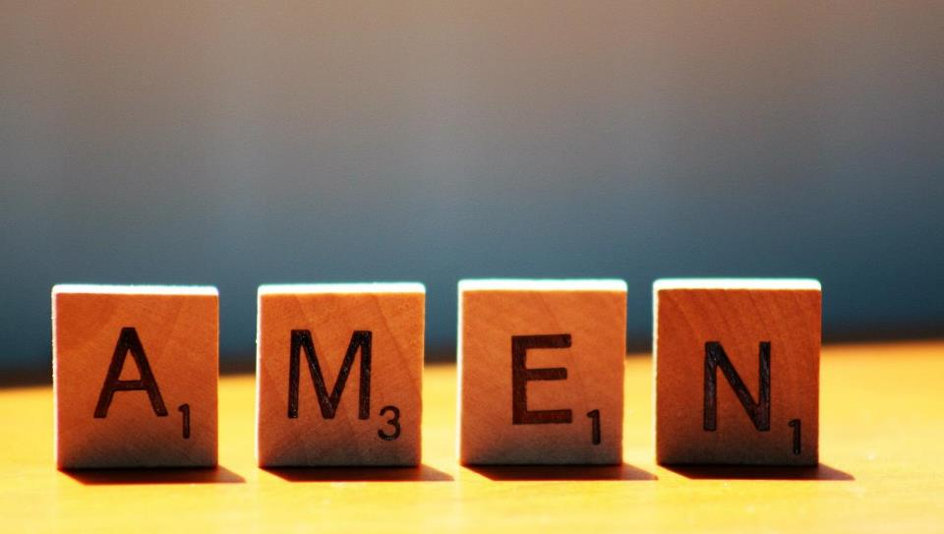

Slide 13
Leader: As we leave this place & time and go into the day ahead…
All: May we live justly and treat others with fairness today.

Slide 14
Notes:
Slide 14: Reflective areas
Put a set of balance scales in your reflective area. The bucket balance scales that can be found in infant classes are ideal. You will also need some blocks or weights with injustices written or stuck on them. There are some examples provided on p.6. Also provide some small pieces of paper and pens, for children to write / draw on.

