Slide 1




All pictures copyright-free from pixabay
Notes:
Slide 1: Rising hearts stilling exercise
Use the stilling slide if desired: the suggested words should be spoken slowly, leaving pauses inbetween to create a sense of stillness.
As you sit quietly, watch the hearts rising….[PAUSE]
Now practise slower breathing…..in…..and out…..in……and out…..keep this going as you continue to look at the hearts….[PAUSE]
You maybe notice that you are feeling calmer and more relaxed….[PAUSE]
We come into this special / sacred space and time to be still….to think deeply…..to be together as a school community…..
In our time together today, we will think about a question together, share a story and then use it to help us to think.
But first, let’s welcome one another as we begin….

Slide 2
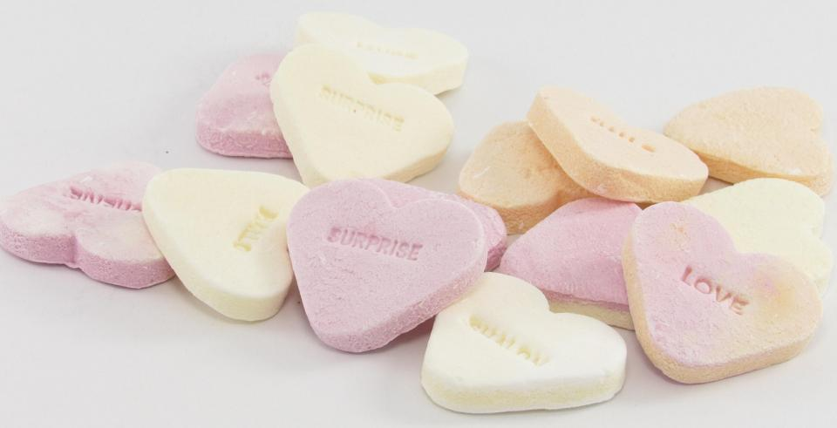
Leader: As we gather together today…
ALL: …we bring our thoughts and our hearts into this sacred space.
Notes:
Slide 2: Gathering
Leader: As we gather together today….
ALL: ….we bring our thoughts and our hearts into this sacred space.
Here are BSL actions for some of the words:
Leader’s words:
Gather: https://www.signbsl.com/sign/gather (1st video)
Today: https://www.signbsl.com/sign/today (1st video)
Pupils’ response:
Thoughts: https://www.signbsl.com/sign/thoughts (1st video)
Hearts: https://www.signbsl.com/sign/heart (1st video)

Slide 3
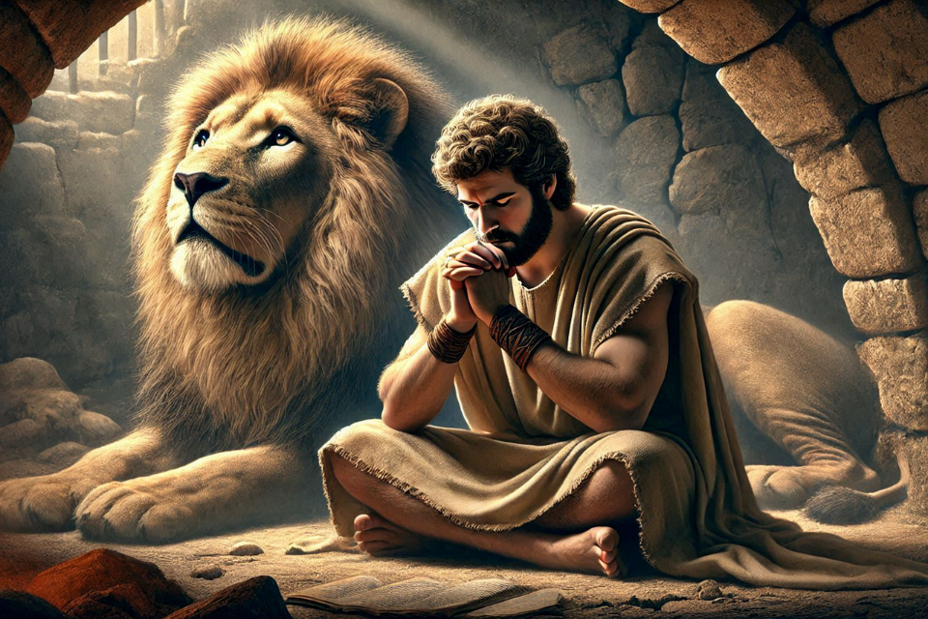
Shine like stars!
Notes:
Slide 3: Before half term, we finished our series based on the life of Daniel – and thought about how his brave actions often stood out, like stars, in the dark times in which he lived. Leading up to Easter, we are going to hear more stories like this, from other people in history whose lives have also shone bright, like stars.

Slide 4
Shine like stars!
Notes:
Slide 4: The stories come from this brand-new book, which some of you may have in your school. It shares the stories of 22 inspirational Christians from across the world, and across history. Like Daniel, each of them had their own challenging life situations. In a moment, we will be hearing about the first of our heroes of hope, but first, a few things to catch up on…..

Slide 5


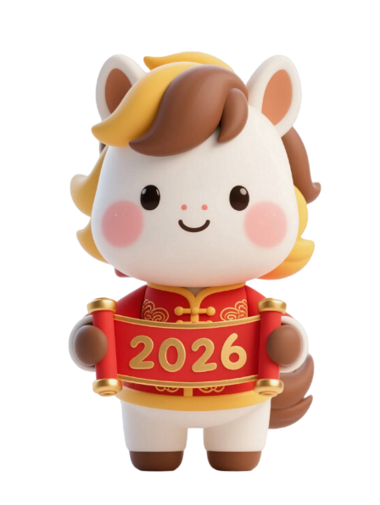

Notes:
Slide 5: Half term was a busy time for special days! It was Valentine’s Day on February 14th, Lunar New Year on the 17th, marking the start of the year of the Horse – the same day as Pancake Day (also known as Shrove Tuesday), followed by Ash Wednesday which marks the start of Lent, when Christians all over the world begin preparations for Easter! A very busy week!!

Slide 6


Love is….
Notes:
Slide 6: Today, we’re going to focus especially on Valentine’s Day to link with our first story. Valentine’s Day is a day when we often think about the people we love and the people who love us. I wonder who these people might be for you? We are going to think together today about a big question about Love: how might we finish the sentence ‘Love is…….’? [you may need to give a few simple examples e.g. spending time with someone / helping them even if we don’t feel like it: or maybe encourage pupils to focus on using your school’s values to help answer the question…]

Slide 7
Love is patient and kind. Love is not jealous, it does not boast, and it is not proud. Love is not rude, is not selfish, and does not become angry easily. Love does not remember wrongs done against it. Love takes no pleasure in evil, but rejoices over the truth. Love patiently accepts all things. It always trusts, always hopes, and always perseveres.
Love never ends.
1 Corinthians 13:4-8
Notes:
Slide 7: Here’s how one person talked about love: these words come from the Bible and were written by St. Paul to one of the churches that he had founded. Listen as I read them:
‘Love is patient and kind. Love is not jealous, it does not boast, and it is not proud. Love is not rude, is not selfish, and does not become angry easily. Love does not remember wrongs done against it. Love takes no pleasure in evil, but rejoices over the truth. Love patiently accepts all things. It always trusts, always hopes, and always perseveres. Love never ends.’ 1 Corinthians 13:4-8
I wonder what you think about these words? I wonder which most fit with your own idea of what ‘Love is….?’ or with our school’s values? [If time allows, you might want to leave some time for pupils to talk here, or share with a talking partner, or take it into your classroom for a time later in the week.]

Slide 8
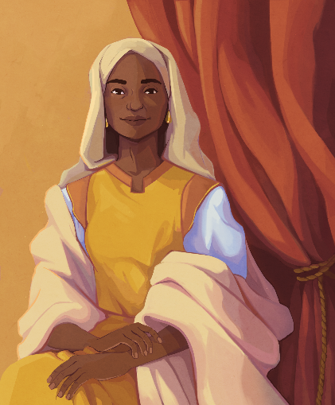
St. Monica (331-387CE)
Shine like stars!
These images © Daniela Gamba & SPCK and must not be used outside of this context
Notes:
Slide 8: Our story for today comes from about 400 years after the birth of Jesus and tells of a mother, showing what ‘love is’ for her in the story of her life. This is St. Monica, the patron saint of mothers, who lived in Algeria, in North Africa and grew up as part of the Roman Empire. You can see where this is on the map….

Slide 9

Notes:
Slide 9: World Map

Slide 10
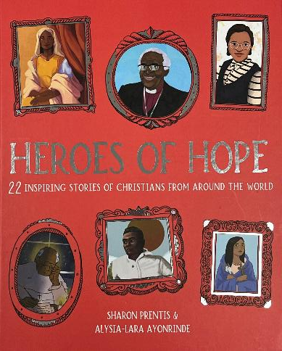
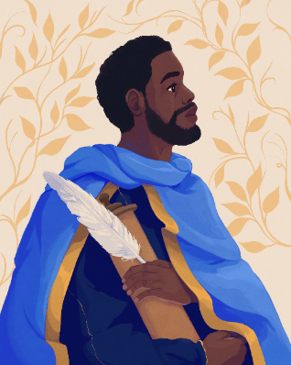
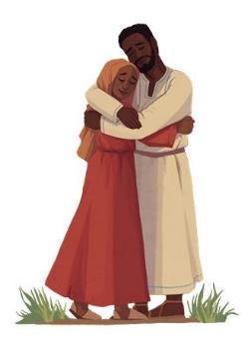
St. Monica (331-387CE)
Shine like stars!
These images © Daniela Gamba & SPCK and must not be used outside of this context
Notes:
Slide 10: She had a son called Augustine, who became one of the most famous Christian writers in history…..but that’s not where this story starts! This story may, in fact, remind you of one of Jesus’ parables! [NB you can find slides from Free Bible Images at the end of this presentation, to tell this story on another occasion, especially with older pupils who should be able to draw parallels between the life of St. Monica and the parable of the prodigal son.]

Slide 11
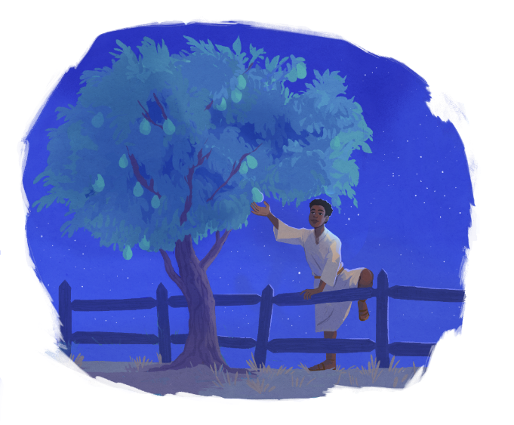
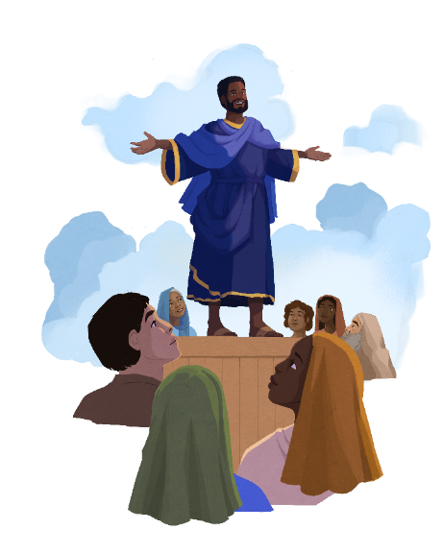
‘planted the seeds of faith’
These images © Daniela Gamba & SPCK and must not be used outside of this context
Notes:
Slide 11: Augustine was very intelligent and wanted to learn all about the world around him. He got himself into a lot of trouble and would often go off on adventures without telling anyone, and not come home for days! Once, when he was 16, he stole pears from his neighbour’s trees – not to eat them because he was hungry, but just because he wanted to smash them to smithereens to see how it felt. Imagine how your parents or carers would react if that was you!! As Augustine became a young man, he decided that he wanted to leave home for good and go and study in another country, and so left Monica behind, full of worry for what might become of him. However, just like Daniel, she turned her worry and her tears into prayer, and faithfully prayed that her son Augustine would stay safe and achieve well in his life.
If you’ve ever worried about a family member or a friend, you might be able to imagine how hard it was for Monica, not knowing whether her son was alive and well, what he was doing, or even whether she would ever see him again….. [pause to let this sink in]
Although Augustine initially ignored all of his mother Monica’s advice, at the age of 31 he read something in the Bible, some words written by St. Paul, that would change his life forever – and he finally understood the significance of Monica’s faith in God. Augustine became one of the most important Christian writers in the whole of history and often wrote about his mother in his books, recognising the part that her faithful love and watchful prayers had played in his life, even when he was so far away from her. In Augustine’s own words, she… ‘planted the seeds of faith.’

Slide 12
Love is patient and kind. Love is not jealous, it does not boast, and it is not proud. Love is not rude, is not selfish, and does not become angry easily. Love does not remember wrongs done against it. Love takes no pleasure in evil, but rejoices over the truth. Love patiently accepts all things. It always trusts, always hopes, and always perseveres.
Love never ends.
Notes:
Slide 12: Looking back at the words we heard earlier about love, as well as some of our own ideas, I wonder what links you might find to the story of St. Monica and her love for her son, Augustine? I wonder which words you might pick out that make you think of her, as I read the words again? [you might want to allow older pupils to articulate their conclusions here.]

Slide 13
Love is patient and kind. Love is not jealous, it does not boast, and it is not proud. Love is not rude, is not selfish, and does not become angry easily. Love does not remember wrongs done against it. Love takes no pleasure in evil, but rejoices over the truth. Love patiently accepts all things. It always trusts, always hopes, and always perseveres.
Love never ends.
Notes:
Slide 13: Maybe these words are words that you linked back to St. Monica’s life?.....

Slide 14
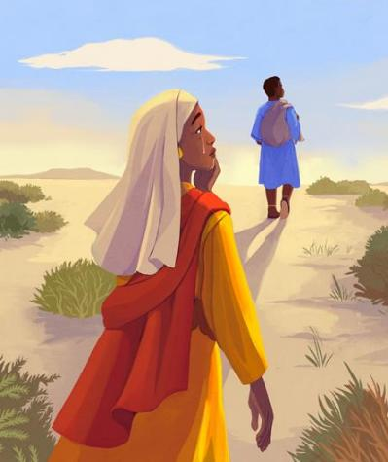
‘Shine like stars’
….I wonder what we might have learned from St. Monica’s actions about what ‘love is’?....
….I wonder how we might follow her example in order to ‘shine like stars’?....
….I wonder which people in our own lives are like St. Monica?....
….I wonder how we might show what ‘love is….’ in our actions this week, or during this season of Lent?….
These images © Daniela Gamba & SPCK and must not be used outside of this context
Notes:
Slide 14: Responding and words for worship
We’ve heard today about the life and faithful love of St. Monica for her son Augustine. As we come near to the end of our time together today, let’s ponder together…..
….I wonder what we might have learned from St. Monica’s actions about what ‘love is’?....
….I wonder how we might follow her example in order to ‘shine like stars’?....
….I wonder which people in our own lives are like St. Monica?....
….I wonder how we might show what ‘love is….’ in our actions this week, or during this season of Lent?….

Slide 15

God who is love
As we try to show love to others, please help us to be patient and kind. Help us not to be jealous or boastful, or to be easily angered. Help us to forgive others and rejoice in what is good and true. May we always trust, always hope and always persevere.
Help us to love like you do.
Notes:
Slide 15: Opportunity for reflection/prayer
I’m going to use the words about love from the Bible that we have been reflecting on today as a prayer, asking God to help us to show love to others.
Now, as I pray, you might like to make the words your own in some way, or join in with ‘Amen’ at the end…..
God who is love
As we try to show love to others, please help us to be patient and kind. Help us not to be jealous or boastful, or to be easily angered. Help us to forgive others and rejoice in what is good and true. May we always trust, always hope and always persevere.
Help us to love like you do.

Slide 16

Faithful God
Thank you for those people in our lives who have loved us even when we have been difficult to love, who have watched out for us when we have gone our own way and have waited patiently for us to return. May we show love for others as we have been loved.
Notes:
Slide 16: Opportunity for reflection/prayer
I’m going to say a short prayer of thanks now for people who have shown us love and faithful commitment: for a few moments before I start, bring those people into your mind now……
Now, as I pray, you might like to make the words your own in some way, or join in with ‘Amen’ at the end…..
Faithful God
Thank you for those people in our lives who have loved us even when we have been difficult to love, who have watched out for us when we have gone our own way and have waited patiently for us to return. May we show love for others as we have been loved.

Slide 17


Slide 18



Leader: As we leave this place & time and go into the day ahead…
All: May we shine like stars!
Notes:
Sending: Slide 18
Leader: As we leave this place & time and go into the day ahead…
All: May we shine like stars!

Slide 19

Notes:
Slide 19: Reflective areas
Print off the ‘loveheart’ © shaped outlines onto pastel coloured paper, if you can.
Think: Think about the stories of Daniel that we have explored so far this term. What have you learned from them?
Talk: Talk about what has helped us to ‘shine like stars’.
Do: Write or draw your thoughts onto a star and add it to your class display.

Slide 20

Notes:
Slide 20: Reflective areas
Make a chain of hearts (video here: https://www.youtube.com/watch?v=lTYPM8B04Hs)
Think: Think about what ‘love is….’ for you, or something you could do to show love for someone else.
Do: Draw or write your ideas onto the hearts.
Talk: At the end of the week, look at all the different ideas that you have collected. Which ideas are most common?

Slide 21

Notes:
Slides 21-31: Optional slides telling Jesus’ parable of the Prodigal Son

Slide 22
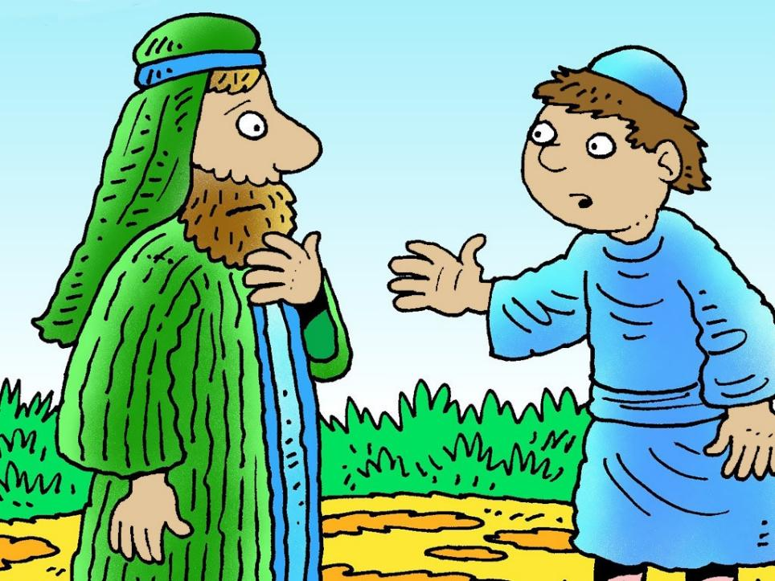
Notes:
One day the younger son went to his father and demanded. ‘Father I want you to give me my share of your inheritance now.’

Slide 23
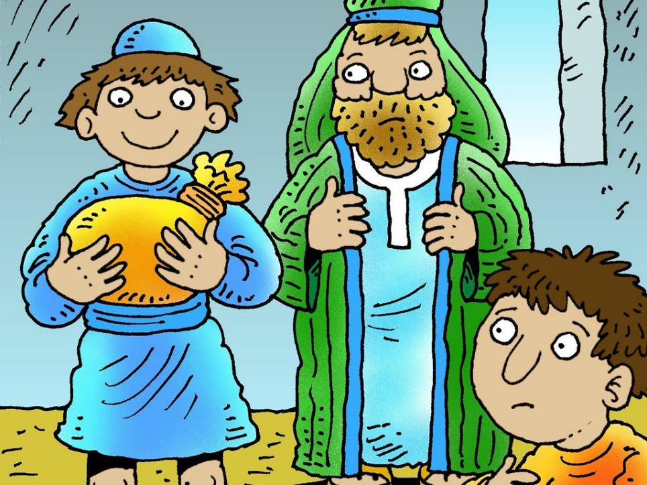
Notes:
The father was sad but reluctantly agreed to give his rebellious son his share of the inheritance.

Slide 24
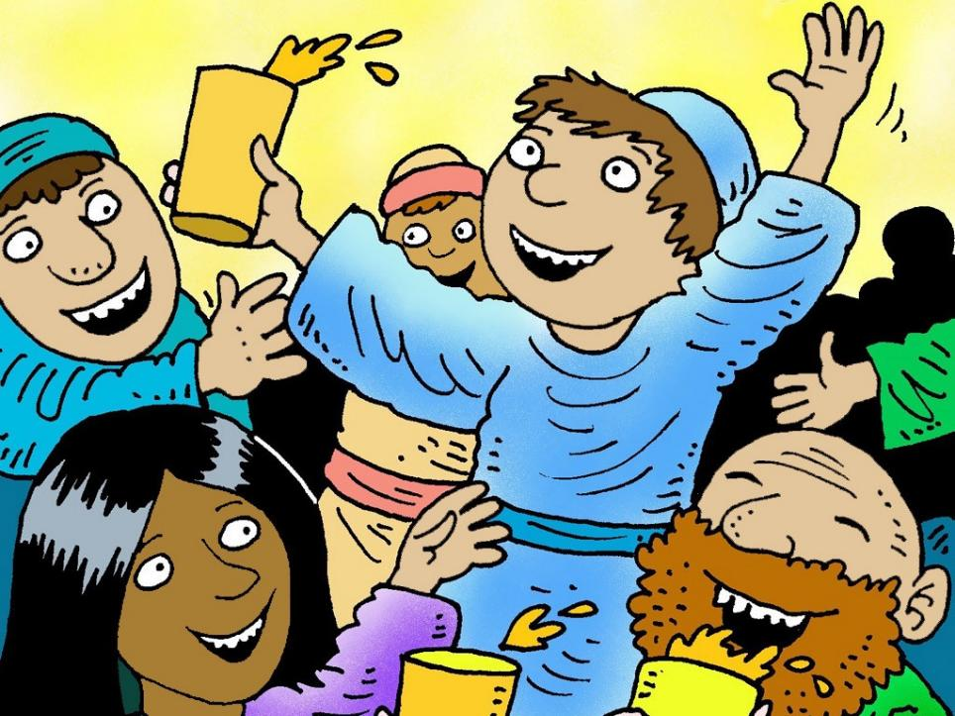
Notes:
The younger son then left home to go to another country. There he wasted all the money on wild living.

Slide 25
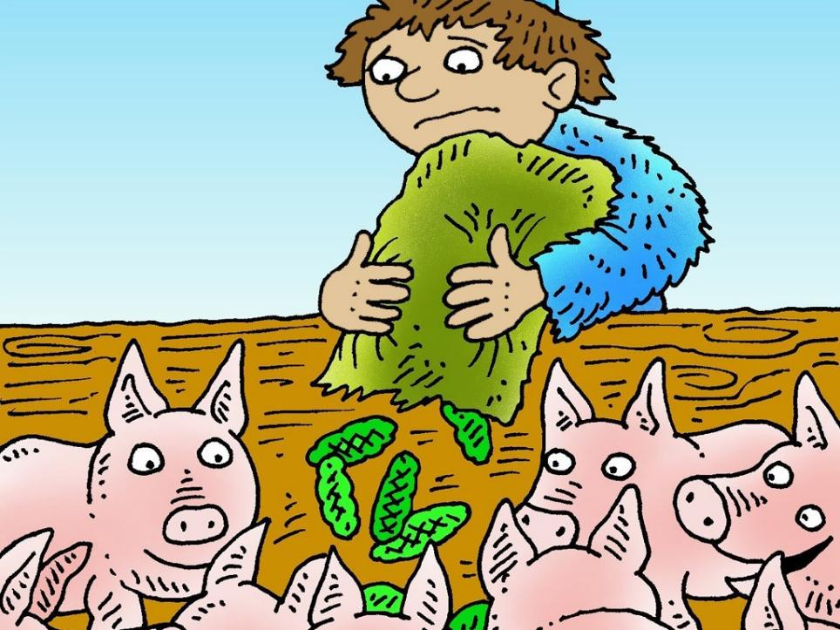
Notes:
He was forced to look for a job but the only one he could find was looking after pigs.

Slide 26
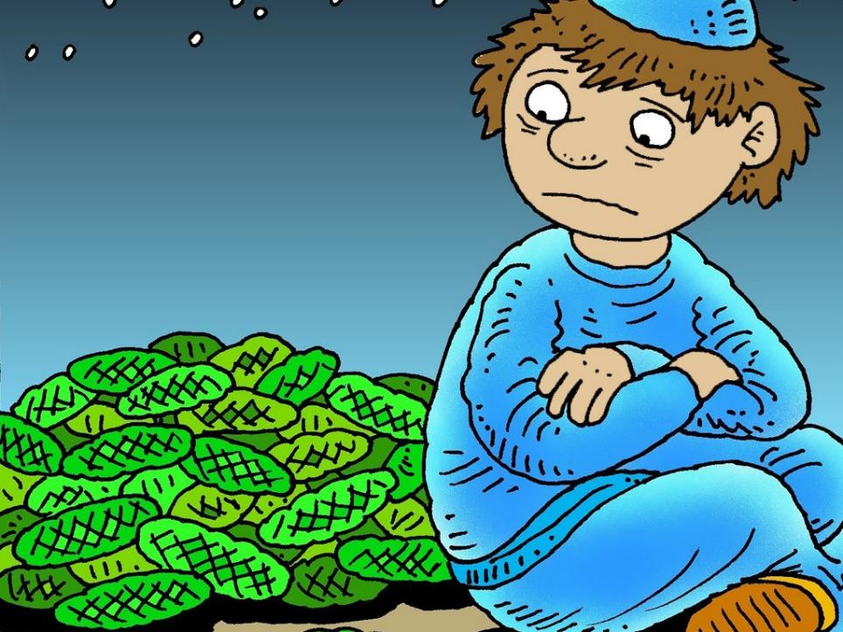
Notes:
He spent many days and nights feeling very lonely and hungry. He was so miserable he longed to eat the food the pigs were eating. He was beginning to starve to death.

Slide 27
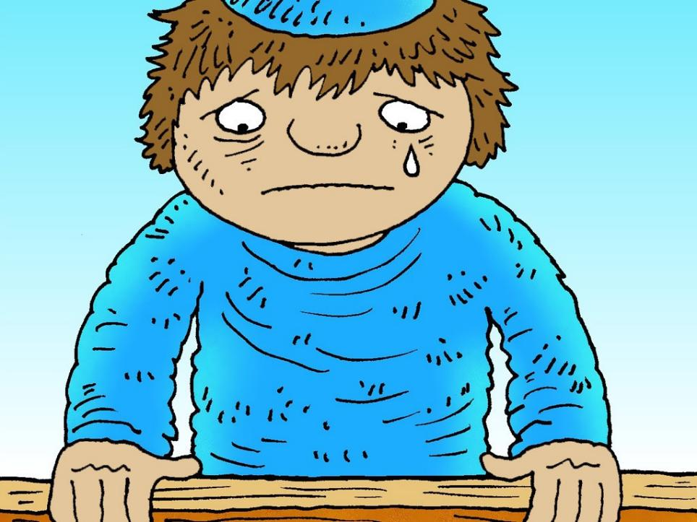
Notes:
At that moment he realized how foolish he had been. ‘All of my father’s servants have food and here I am starving. I will go home again and say, “Father, I have sinned against God and you. I am not good enough to be your son. Please let me be one of your servants.”’

Slide 28
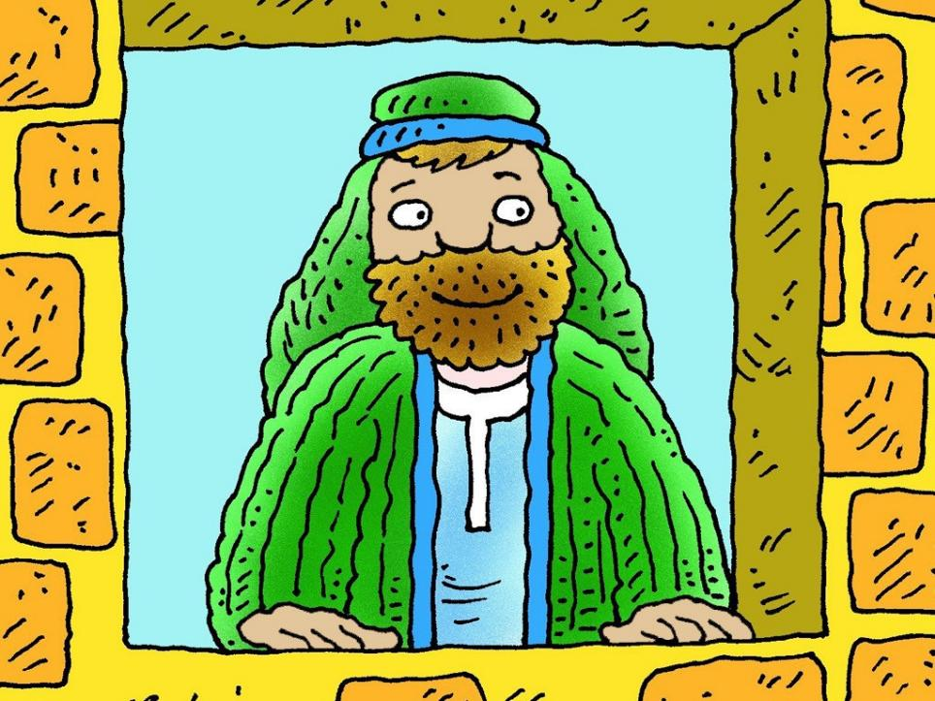
Notes:
His father missed his son and always looked out, hoping he would return.

Slide 29
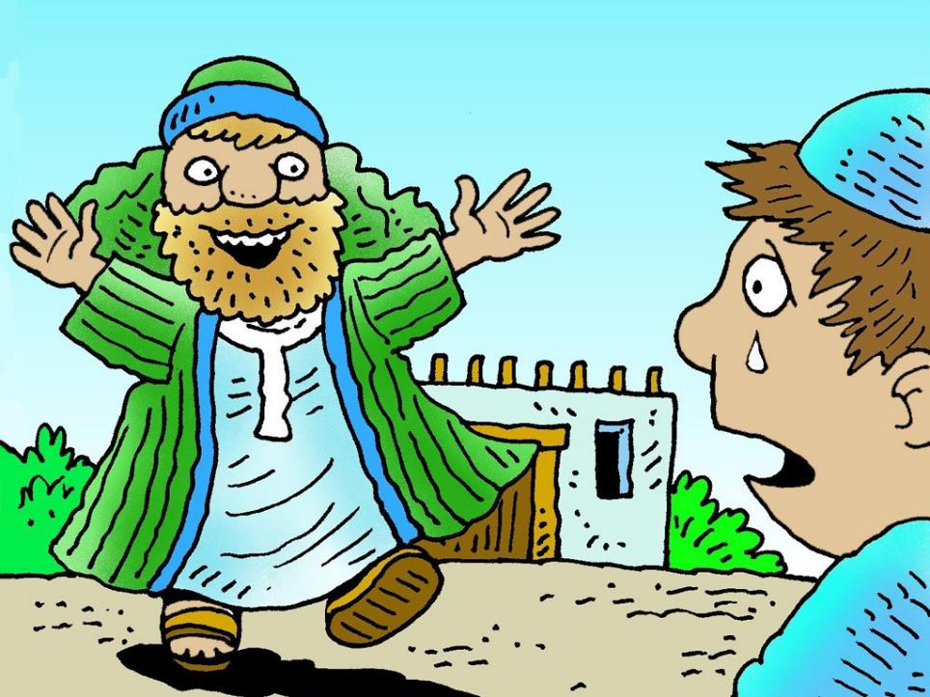
Notes:
Then one day while when he looked out he could see his son a long way off coming down the road. He ran towards his son and threw his arms around him. ‘My son has come home again!’ he cried.

Slide 30
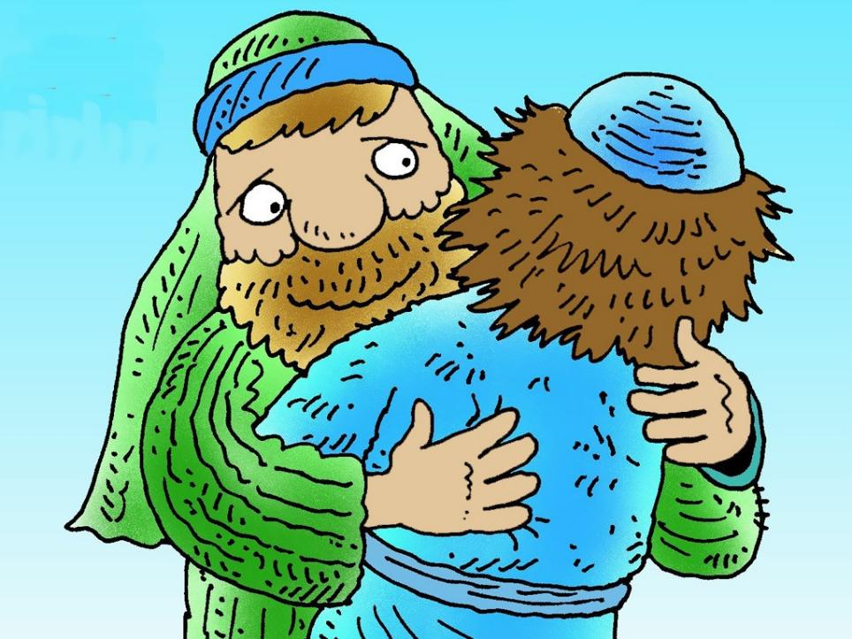
Notes:
His father wiped way the tears from his eyes and replied. ‘My Son, I love you so much and forgive you.’

Slide 31
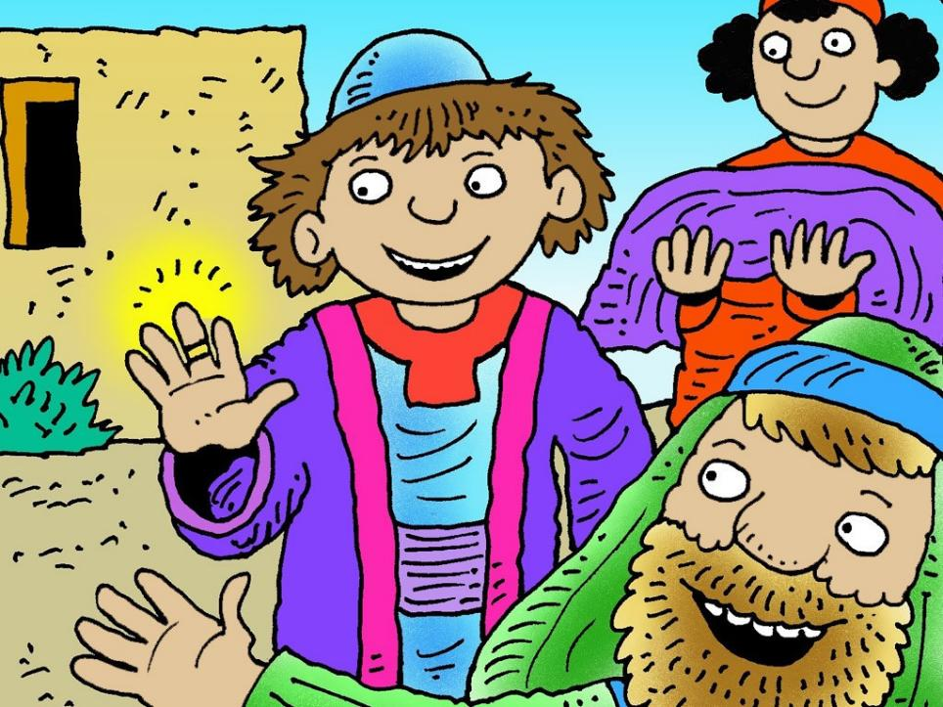
Notes:
The father then called to his servants. ‘Quick! Bring me the best clothes and sandals for my son and a ring for his finger. Then kill the best calf as we are going to have a big feast to celebrate my son returning. My son was dead – now he is alive. He was lost but now is found.’

