Slide 1
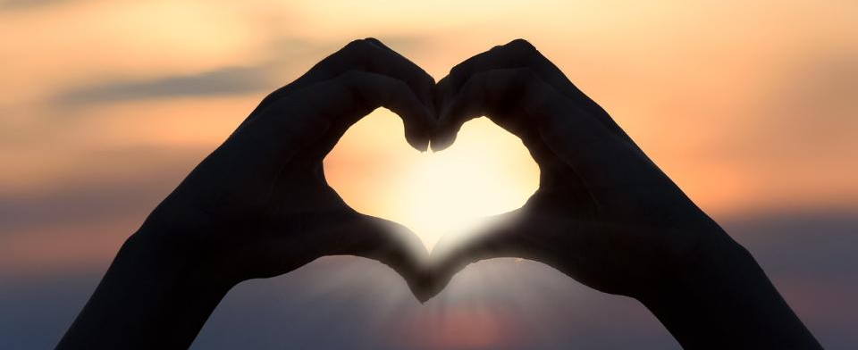
Leader: As we gather together
ALL: …we bring our hearts.
Notes:
Slide 1: Use the gathering words for this term, or your usual greeting if you prefer. The greeting comes with BSL signing; you can view the demos using links under the slide.
Leader: As we gather together,
ALL: …we bring our hearts
Signs for greeting: click on links
Hearts: British Sign Language BSL Video Dictionary - heart

Slide 2

Leader: As we gather together
ALL: …we share our thoughts.
Notes:
Slide 2: Use these new gathering words for this term, or your usual greeting if you prefer. The greeting comes with BSL signing; you can view the demos using links under the slide.
Leader: As we gather together,
ALL: …we share our thoughts.
Signs for greeting: click on links
Thoughts: British Sign Language BSL Video Dictionary - thought

Slide 3





Leader: As community together
ALL: …we serve one another.
Notes:
Slide 3: Use these new gathering words for this term, or your usual greeting if you prefer. The greeting comes with BSL signing; you can view the demos using links under the slide.
Leader: As community together,
ALL: …we serve one another.

Slide 4





Songs from
the heart
Notes:
Slide 4: Songs from the heart
We’re now well into our term’s set of themes ‘Songs from the heart’ – and today we’re going to find out about another of David’s most famous songs. In this psalm, he talks about the things that he really wishes, so we’re going to do the same for ourselves first.

Slide 5
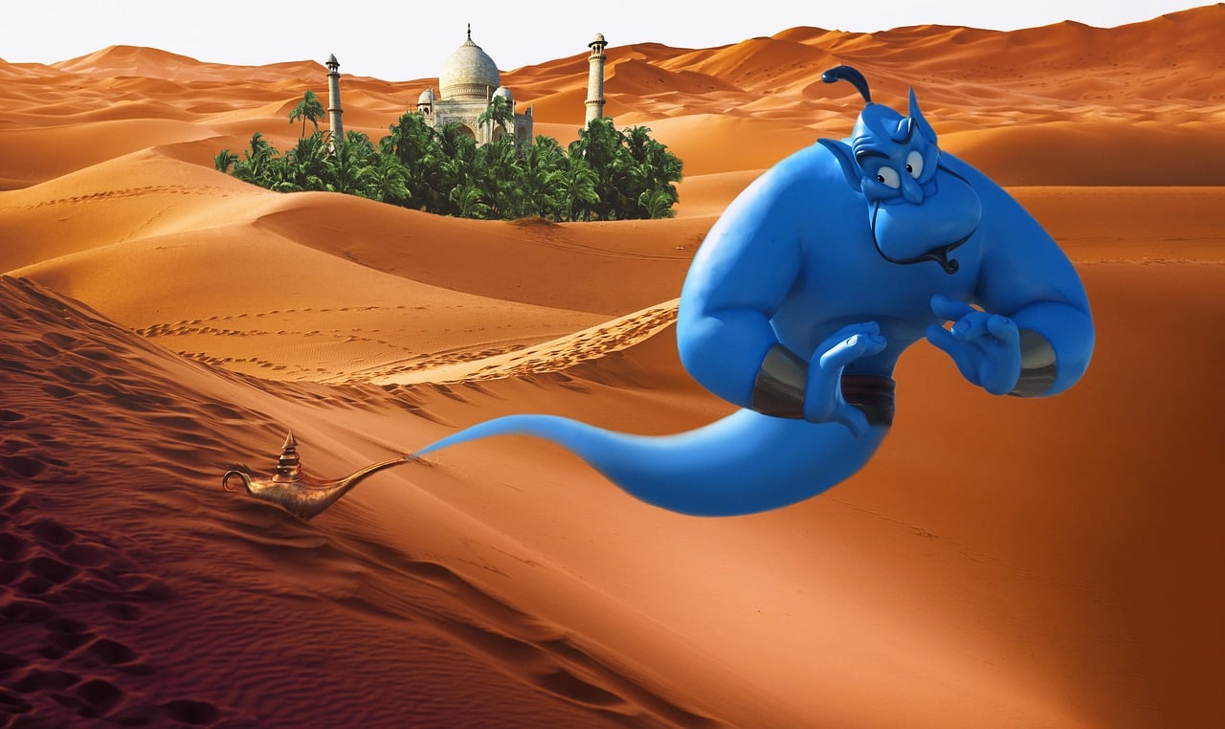

What would you wish?
What’s your ‘heart’s desire’?
Notes:
Slide 5: What would you wish?
Many of you might know the story of Aladdin [go through it very briefly, in case anyone is unfamiliar]
In the story, the genie grants Aladdin 3 wishes – no more, no less.
If you were Aladdin, what would you wish for?
[allow pupils to share their answers]
Now what if you could only wish for one thing?
What’s your ‘heart’s desire’?
You might have to think a bit harder…..
Think quietly to yourself now about these ideas [slides 6-8] – we’ll come back to these at the end of our time together today.

Slide 6
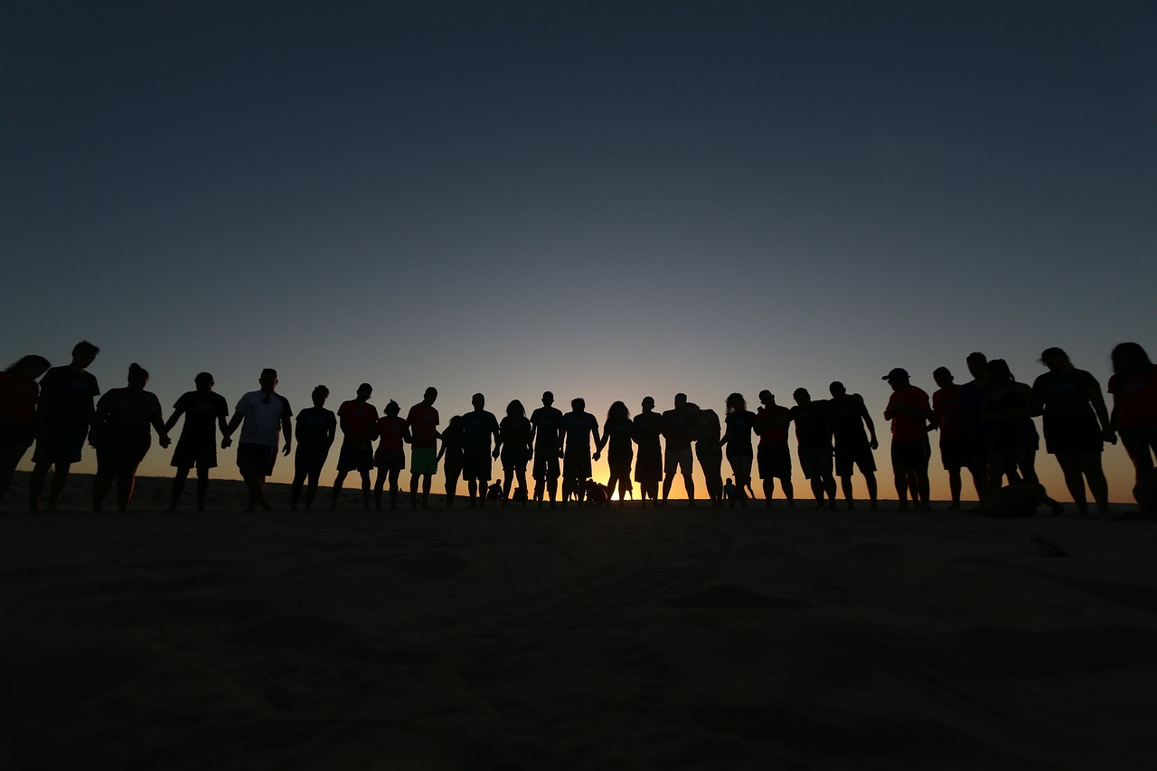
for someone else
Notes:
Slide 6: What about if your wish was for someone else….? [leave a pause for children to think silently]

Slide 7
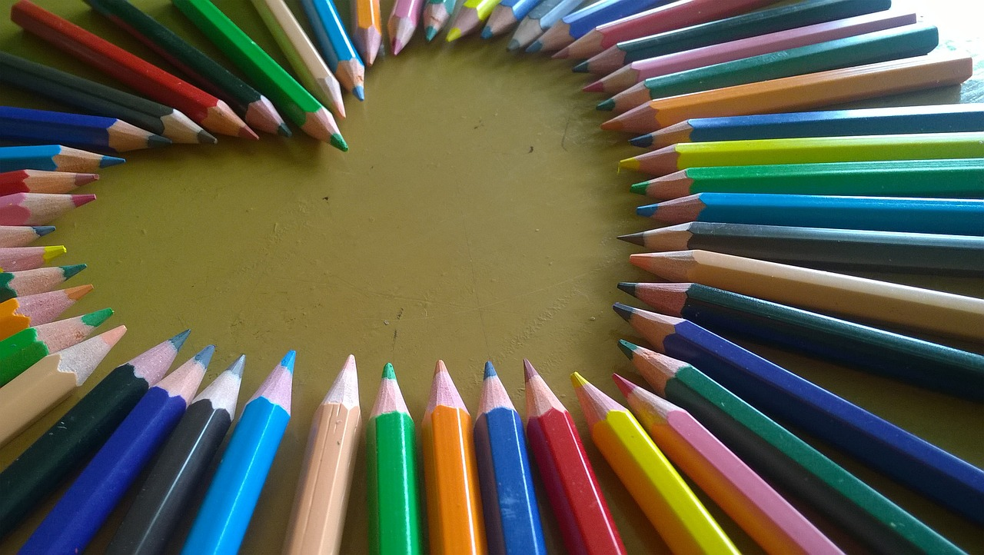
for your school
Notes:
Slide 7: ….or for your school? [leave a pause for children to think silently]

Slide 8
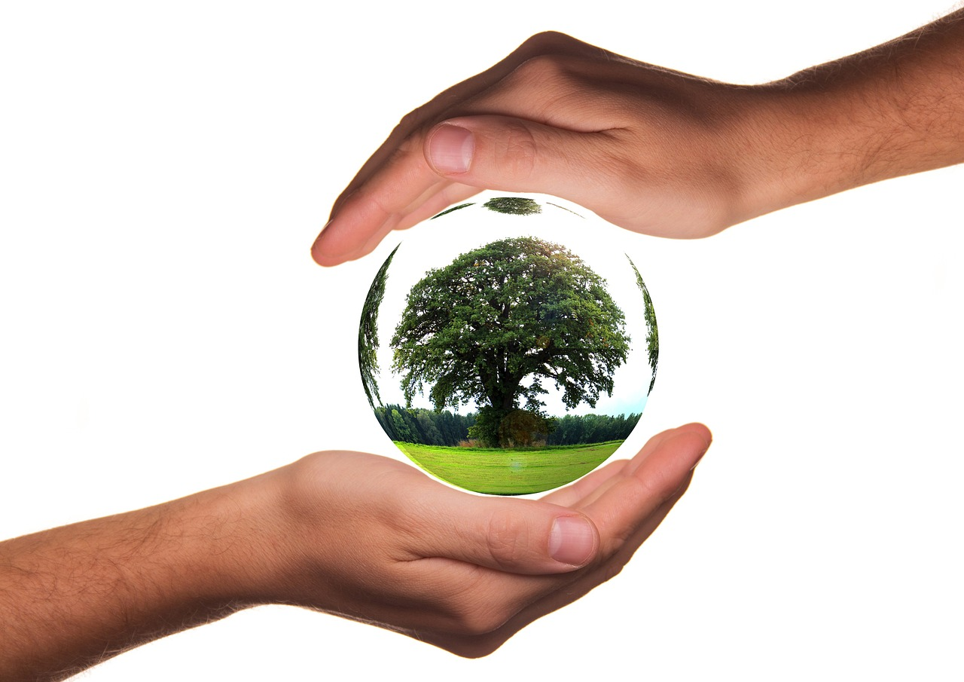
for our world
Notes:
Slide 8: ….or for our world? [leave a pause for children to think silently]
We’ll be thinking some more about these questions in our reflection time later, so do keep hold of your ideas!

Slide 9
Songs from
the heart
Notes:
Slide 9: Songs from the heart
It might not surprise you to know that the Psalms tell us what David’s heart’s desire was! Now although we talked about Aladdin and the genie earlier, this is not how David saw God – as some kind of heavenly genie! The heartfelt prayer we’ll hear in a moment is deeper than a mere ‘wish’.
Before we think about this, using some words from Psalm 25, let’s recall some of the things we know about David from our time together this term so far….
[ask pupils to tell you what they remember e.g. he was a shepherd, a King, a brave warrior etc.]
In Psalm 25, David writes this….

Slide 10
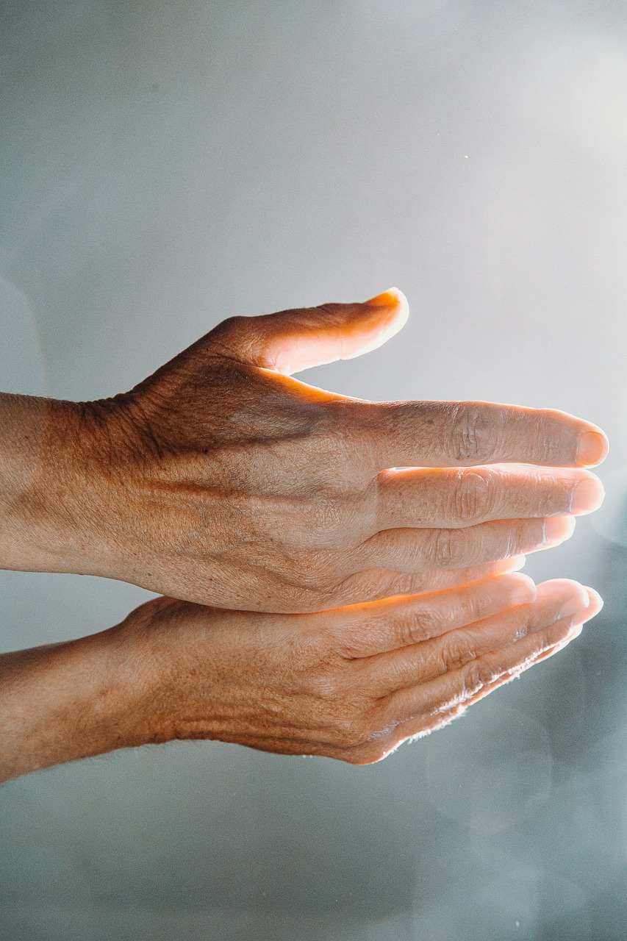
I ask only one thing from the Lord.
This is what I desire…
…let me dwell in the Lord’s house all my life. Let me see the Lord’s beauty. Let me worship him in his Temple. Psalm 25:4
Notes:
Slide 10: I ask only one thing from the Lord. This is what I desire [want]…..
I wonder what you think David’s ‘heart’s desire’ was? [ask pupils to share their ideas, based on what they know about him from previous weeks]
Now let’s hear what David actually said [you might want to comment on how close children got in their ideas]
‘let me dwell [live] in the Lord’s house all my life. Let me see the Lord’s beauty. Let me worship him in his Temple.’ [slightly adapted from the ICB version that’s linked from the overview, to make it easier to understand.]
Spend a few moments unpacking with children what it is that David is asking, using slides 11-13. You will also use David’s ideas to help you wonder together today.

Slide 11
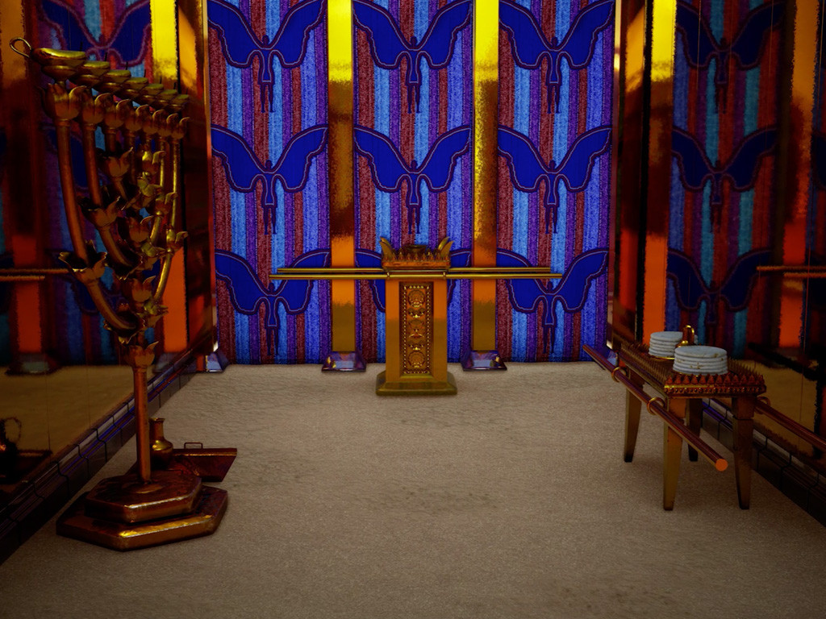
…I wonder if you have a special place that you go to, a place where you like to be still and feel cosy and ‘at home’?...
…or someone you would like to be with all the time?...
‘let me dwell in the Lord’s house all my life’
Notes:
Slide 11: Responding (and words for worship)
‘let me dwell in the Lord’s house all my life’
David wanted to be with God, in his ‘house’. It may seem strange to think that God has a ‘house’, but this was a word that God’s people used to talk about the ‘tabernacle’, where God would meet with his people. You might remember this picture from our series travelling with Moses and God’s people across the desert (Autumn 2023!) – and that it was a special tent that went with God’s people wherever they travelled. By the time David writes these words, this ‘meeting place’ was Jerusalem.
I wonder if you have a special place that you go to, a place where you like to be still and feel cosy and ‘at home’?
Or someone you would like to be with all the time?

Slide 12
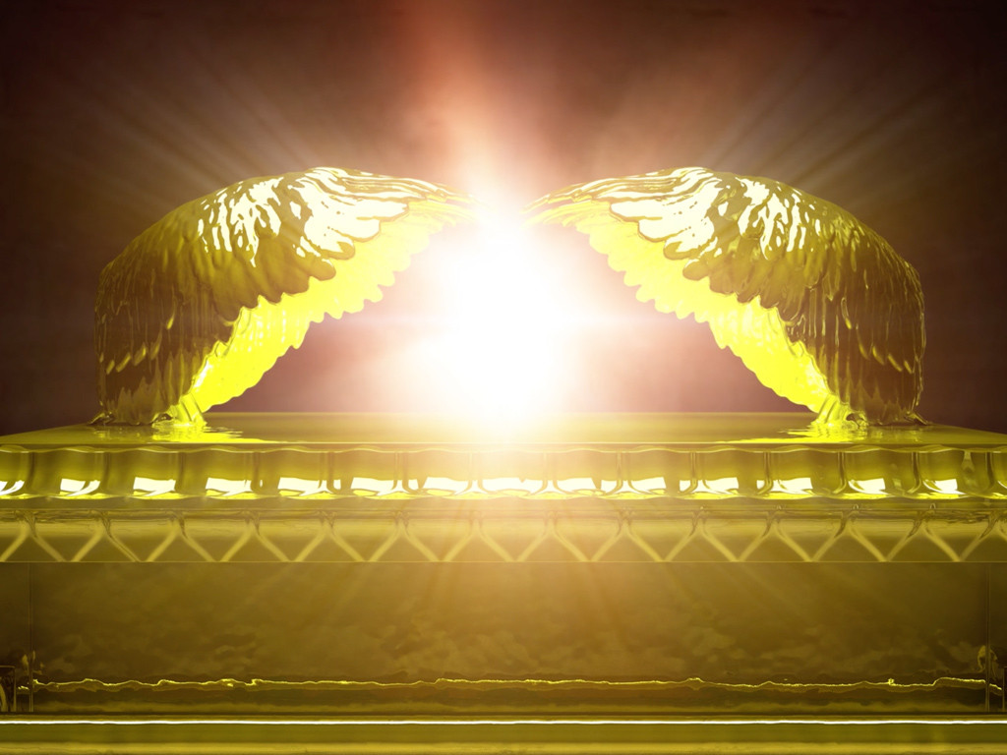
…I wonder where David saw God’s beauty?....
…I wonder where we might see God’s beauty?...
‘let me see the Lord’s beauty’
Notes:
Slide 12: ‘let me see the Lord’s beauty’
This is a very bold request, as in David’s time, no-one was supposed to ‘see’ God!!
…I wonder how David saw God’s beauty…..?
…I wonder where we might see God’s beauty?

Slide 13

…I wonder how David did this in his own life?...
….I wonder how we might do this in our school?...
‘let me worship him in his temple’
Notes:
Slide 13: ‘let me worship him in his temple’
David believed that worship of God was at the very centre of his life – this was his heart’s desire.
…I wonder how David did this in his own life?...
….I wonder how we might do this in our school?...

Slide 14
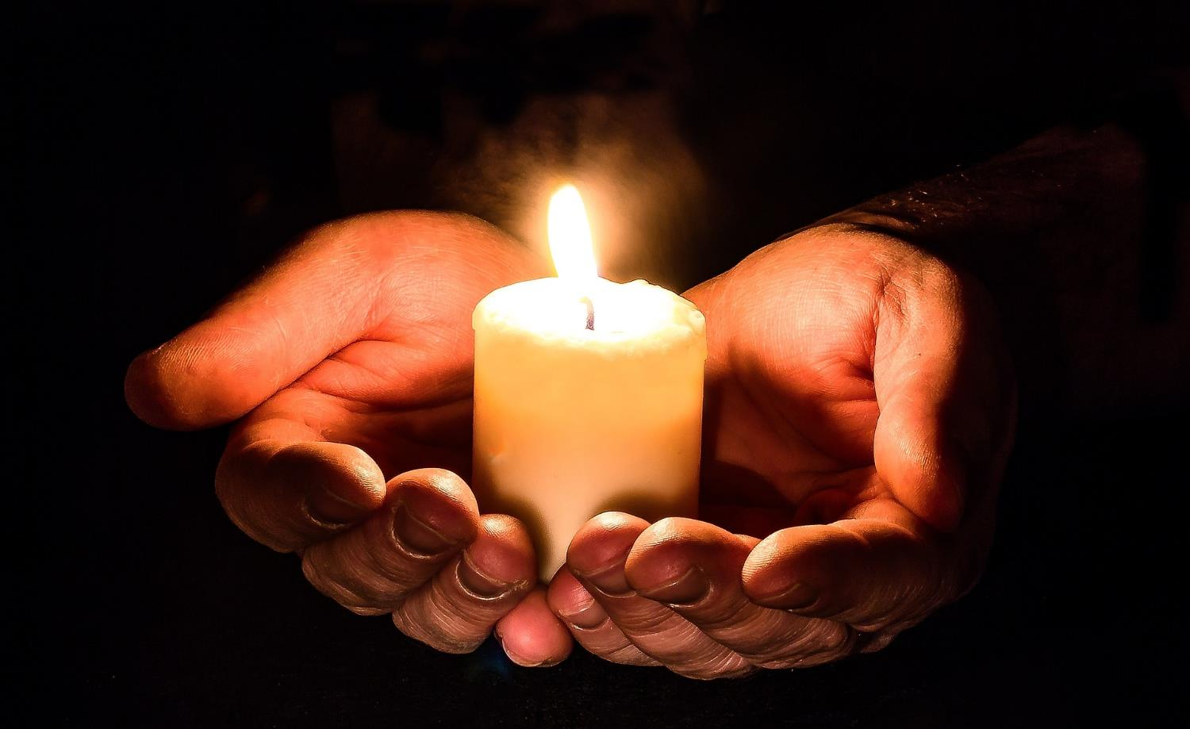
Notes:
Slide 14: Prayer
Now I’m going to pray, using some of the ideas we thought about earlier – the desires of our own hearts.
If you’d like to join in praying with me, then there are some words you can join in with each time you see this slide:

Slide 15



We bring you the desires
of our hearts.
Notes:
Slide 15: ‘We bring you the desires of our hearts’

Slide 16
for someone else
Notes:
Slide 16: Earlier, we thought about our desires for other people. Bring this idea back into your head now….. [leave a pause for children to think silently]

Slide 17
We bring you the desires
of our hearts.
Notes:
Slide 17: ‘We bring you the desires of our hearts’

Slide 18
for your school
Notes:
Slide 18: Bring into your mind now your desires for our school community [leave a pause for children to think silently]

Slide 19
We bring you the desires
of our hearts.
Notes:
Slide 19: ‘We bring you the desires of our hearts’

Slide 20
for our world
Notes:
Slide 20: Bring into your mind now your desires for our world [leave a pause for children to think silently]

Slide 21
We bring you the desires
of our hearts.
Notes:
Slide 21: ‘We bring you the desires of our hearts’

Slide 22
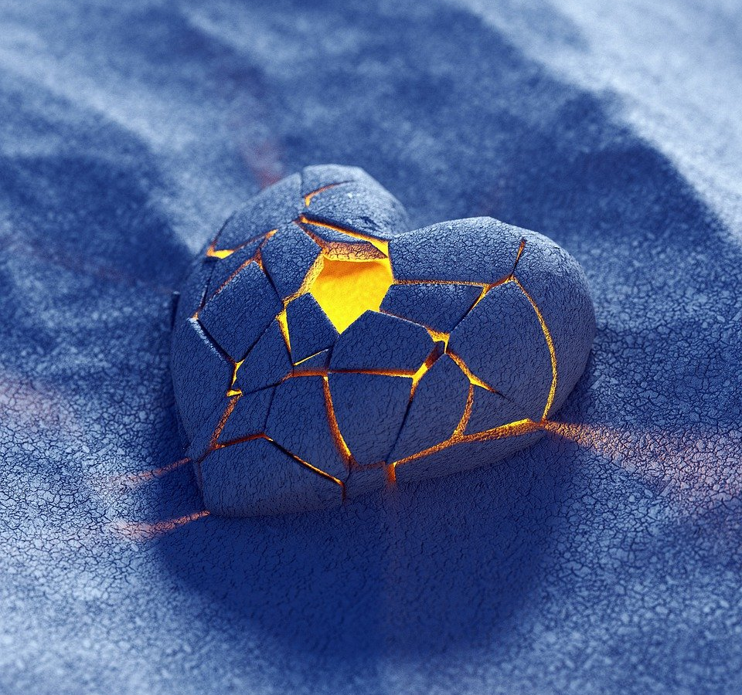
for ourselves
Notes:
Slide 22: And lastly, we bring into our minds our desires for ourselves…. [leave a pause for children to think silently]

Slide 23
We bring you the desires
of our hearts.
Notes:
Slide 23: ‘We bring you the desires of our hearts’

Slide 24
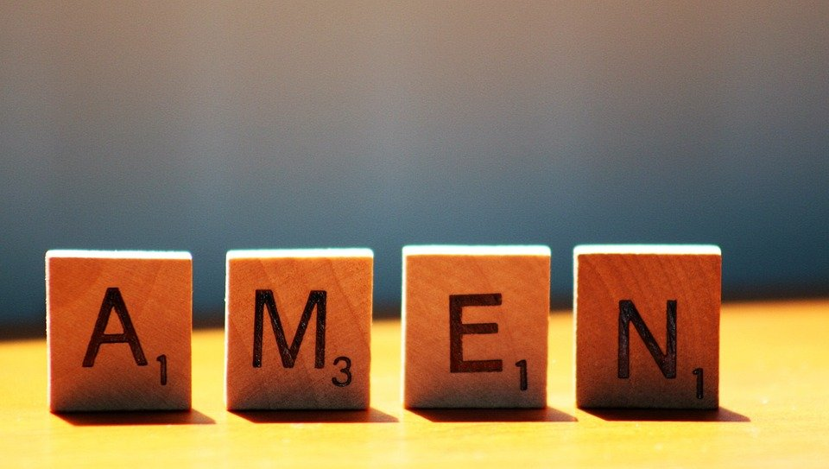
Notes:
Slide 24: ‘Amen’
Just before we leave our time together today, let’s remember that sometimes, we can help to be the answer to our own prayers in the way that we treat others and care for each other in our school family! So….

Slide 25




Leader: As we leave this place & time and go into the day ahead…
All: …may we serve one another in our thoughts and words and actions.
Notes:
Sending: Slide 25
Leader: As we leave this place and time and go into the day ahead,
All: ….may we serve one another in our thoughts and words and actions.
Signs for response: click on links
Thoughts: British Sign Language BSL Video Dictionary - thought (signbsl.com)
Words (use 3rd definition): British Sign Language BSL Video Dictionary - word (signbsl.com)
Actions: British Sign Language BSL Video Dictionary - action (signbsl.com)

Slide 26
Notes:
Ideas for classroom reflection: Heart’s desire
Provide paper hearts on coloured paper, or sticky note shapes if you have them. On these, children can write or draw their ‘heart’s desire’.
If you have a heart-shaped gift box, leave this out as well, to collect the heart shapes.

