Slide 1
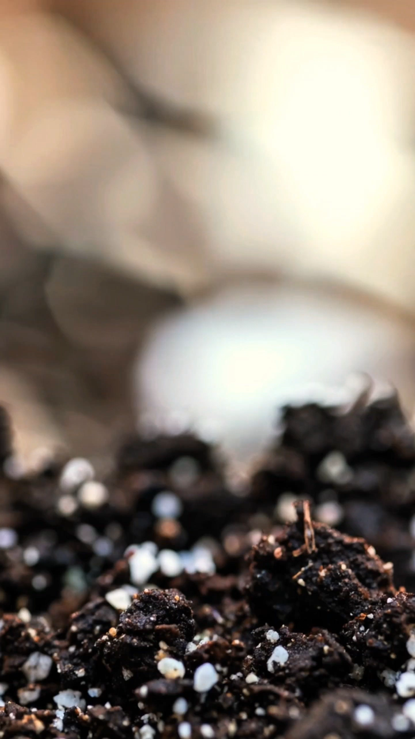
All images copyright-free from pixabay, unless otherwise identified
Notes:
Gathering:
Slide 1: Seed growing stilling exercise
Use the stilling slide if desired: the suggested words should be spoken slowly, leaving pauses inbetween to create a sense of stillness.
As you sit quietly, look at the seed growing [which is on a loop, so seems to re-grow!]….. [PAUSE]
Now practise slower breathing…..in…..and out…..in……and out…..as you watch….[PAUSE]
You maybe notice that you are feeling calmer and more relaxed….[PAUSE]
As you breathe, think about yourself and what you bring into this time today….. [PAUSE]
We come into this special / sacred space and time to be still….to think deeply…..to be together as a school community…..
In our time together today, we will investigate some seeds, share a story, and then think together.

Slide 2

Leader: As we gather to share our story today….
All: May we grow in our understanding of ourselves and others.
Notes:
Slide 2: Use our new gathering words for this term, or your usual greeting if you prefer. These greetings may change slightly each week to reflect the spiritual elements that we will be exploring in each week’s materials.
Leader: As we gather to share our story today….
All: May we grow in our understanding of ourselves and others.

Slide 3

What seeds are these?
Notes:
Slide 2-12: What seeds are these? Look at all the different types of seeds in the PowerPoint: can anyone guess what they might grow into? Show the pictures to see if you’re right.

Slide 4
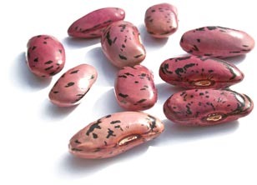

Slide 5
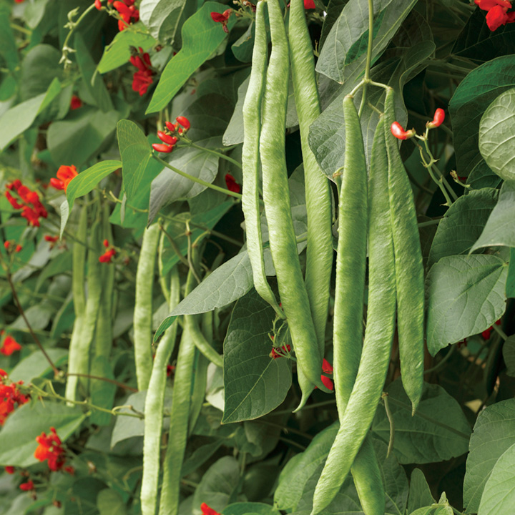
Notes:
Runner beans

Slide 6
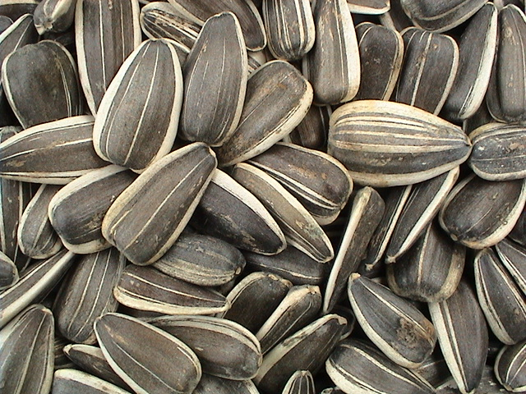

Slide 7

Notes:
Sunflower seeds

Slide 8
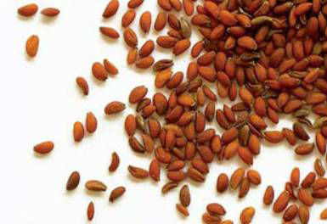

Slide 9
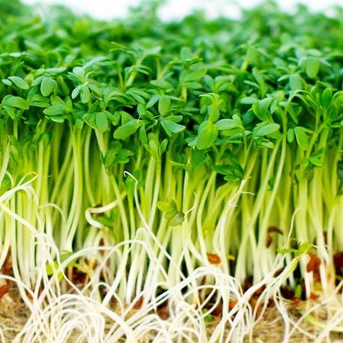
Notes:
Mustard cress

Slide 10
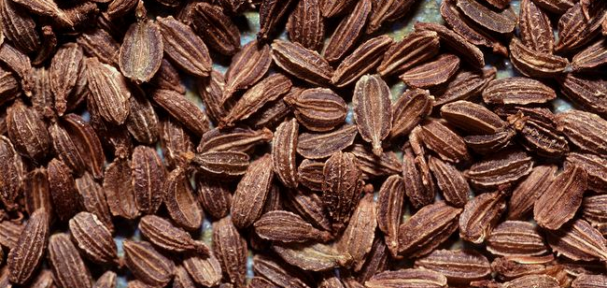

Slide 11
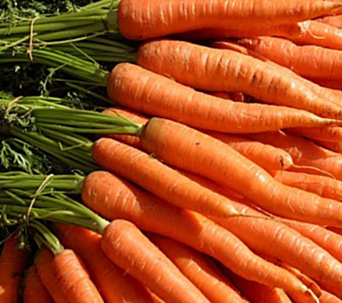
Notes:
Carrots

Slide 12
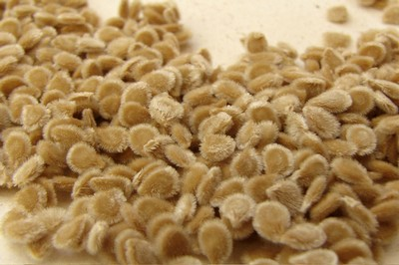

Slide 13
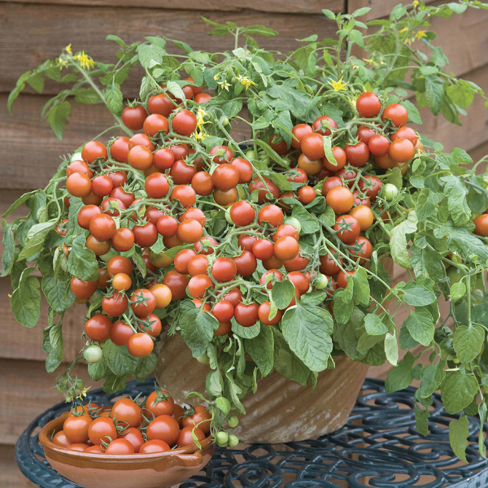
Notes:
Tomatoes

Slide 14
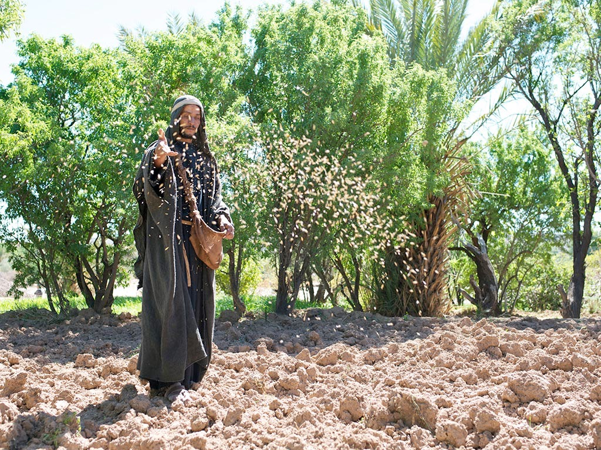
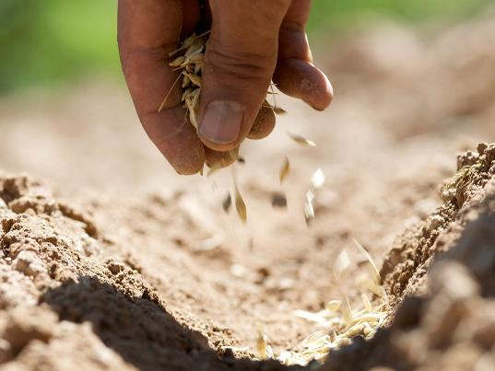
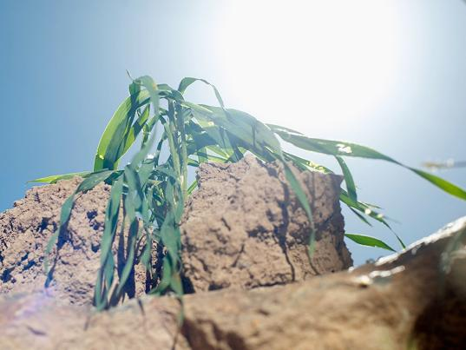
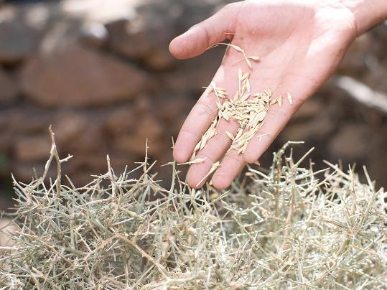
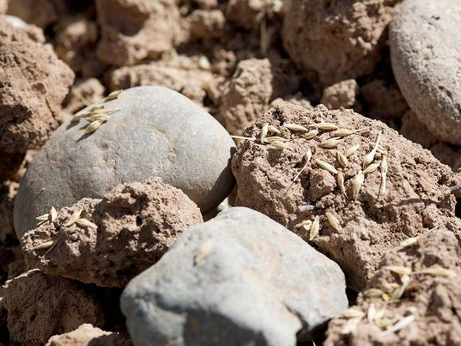

Notes:
Slide 14: We’re going to continue now with a story. Although it’s a story that we heard earlier this term, as with all Jesus’ stories, they’re so well written that you can hear the story over and over again, and ‘hear’ something new each time! (Remember that ‘old and new treasure’ that we thought about a few weeks’ ago?) It’s a story about a farmer and his seeds; as I read, don’t forget to shake those seed packets and remind yourself which seeds grew best and why [use script, with help from adults & their seed packets]
So, which seeds did grow best – and why? [ask children to respond – it’s because they had the good soil]
The other seeds didn’t have good soil: some fell on rocky ground or fell amongst thorns and so they withered and died.

Slide 15
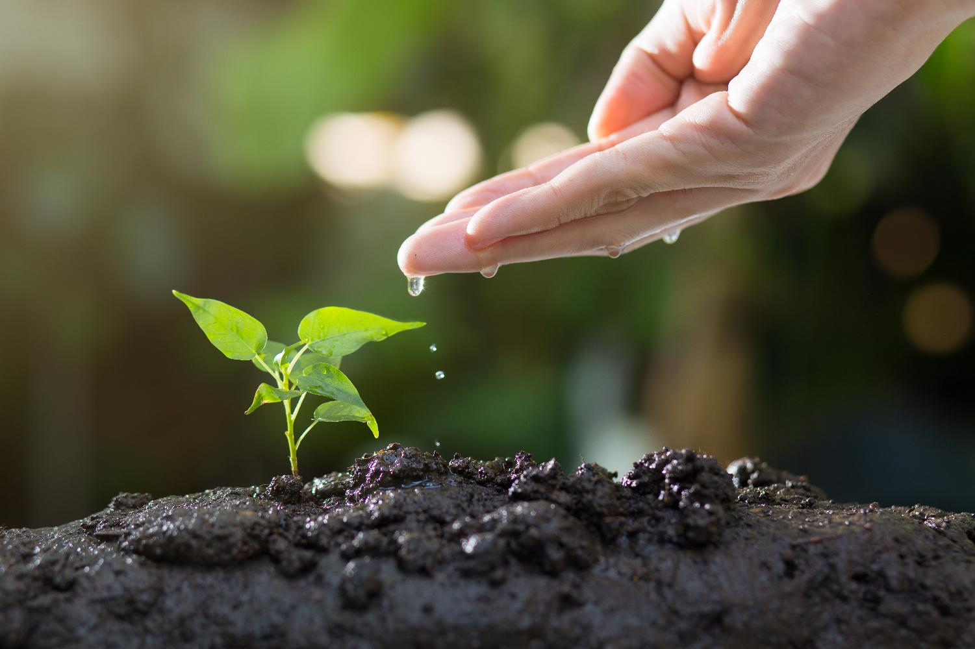
Notes:
Slide 15: For seeds to grow really well, we know they need a safe place where their roots can go deep (unlike some of the seeds in our story!), and they need water and sunshine. They grow even better when someone looks after them properly! And when they are grown, there will be all sorts of fruit (depending on what you planted!) and even more seeds….
After he’d told his story, Jesus explained to the people listening that the seeds that fall on good ground are like the people who listen to what God says and live in a way that pleases him, even when life is difficult. Jesus said that people who do this will grow good fruit in their lives.

Slide 16

‘fruit of the Spirit’
Notes:
Slide 16: You might also recall that Jesus wasn’t talking about real seeds or real fruit, but things like these [ask some children to take one from your fruit bowl.] Talk briefly about any that need explaining e.g. ‘faithfulness’ – being utterly loyal and trustworthy, sticking by people during difficult times; ‘self-control’ – simply controlling yourself, not giving in to things like anger or being rude or jealous. The Bible calls these words the ‘fruit of the Spirit’…..and says that God will help these things to grow in the lives of people who follow him, just like seeds grow into fruit. We saw this in the story we heard last week about the very first Christians and how they lived. Quite simply, the way that they grow stronger is by doing these things as often as possible, because we all know that the more you practise something, the better you get!

Slide 17
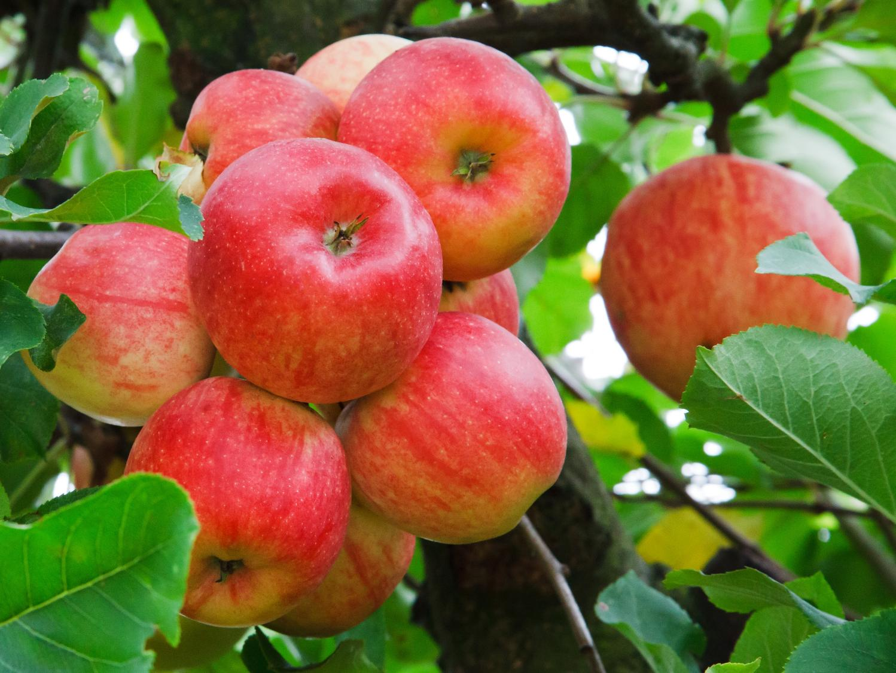
…I wonder how we can grow these good things in our lives?...
…I wonder how our school’s values might help us?...
…I wonder which ‘fruits’ are hardest to grow?....and what might stop them from growing at all?...
‘I wonder….?’
Notes:
Slide 17: Responding (and words for worship)
Let’s stop to ask some wondering questions now:
…I wonder how we can grow these good things in our lives?...
…I wonder how our school’s values might help us?...
…I wonder which ‘fruits’ are hardest to grow?....and what might stop them from growing at all?...

Slide 18
love
peace
joy
patience
kindness
goodness
faithfulness
self-control
gentleness
Notes:
Slide 18: …Today, we’ve been thinking about seeds, fruit and growing….
…as you plant and take care of your seeds, think about the things, the values, that are ‘growing’ in your life….
....maybe it’s one of those ‘fruits’ we talked about…. maybe other values like perseverance or friendship….
…..for seeds to grow, they need to be looked after….
….as I read the apples out again, think about the words and what these things might look like for us at school….[read apples, pausing between each]….
….for this fruit to grow, we need to practise being loving, or patient, or kind, or gentle….
….and every new day gives us opportunities to do this!....
I’m going to pray now, and ask that God will help us to grow this good fruit in our lives. You may want to make this prayer your own, by joining in with the ‘Amen’ at the end, or you may wish to continue to be still and quiet with your own thoughts….
Dear God
Thank you for these good fruits of love, joy, peace, patience, kindness, goodness, faithfulness and self-control. Please help us to live our lives in ways that will encourage these good seeds to grow.

Slide 19

Notes:
Slide 19: Amen
[Alternative prayer: We’re going to sing our prayer today: it's a song that asks for one of those ‘fruits’, God’s peace, to be with us in all that we do.
Use the song ‘Peace be in our waking’, inviting children to join in any words that they would like to.

Slide 20


love
joy
peace
[Slide 4:]
Leader: As we leave this place & time and go into the day ahead…
All: May we grow good things in our hearts and in our lives.
Notes:
Slide 20: Sending
Leader: As we leave this place & time and go into the day ahead…
All: May we grow good things in our hearts and in our lives.

Slide 21
Notes:
Slide 21: Reflection areas
Do: Take an apple out of the bowl and hold it in your hand as you think about the word….
Talk: How might we be more loving, or peaceful, or patient, or gentle here in school?
How do we ‘practise’ these things?...
Think: Take a few moments to think or pray if you’d like to….

Slide 22
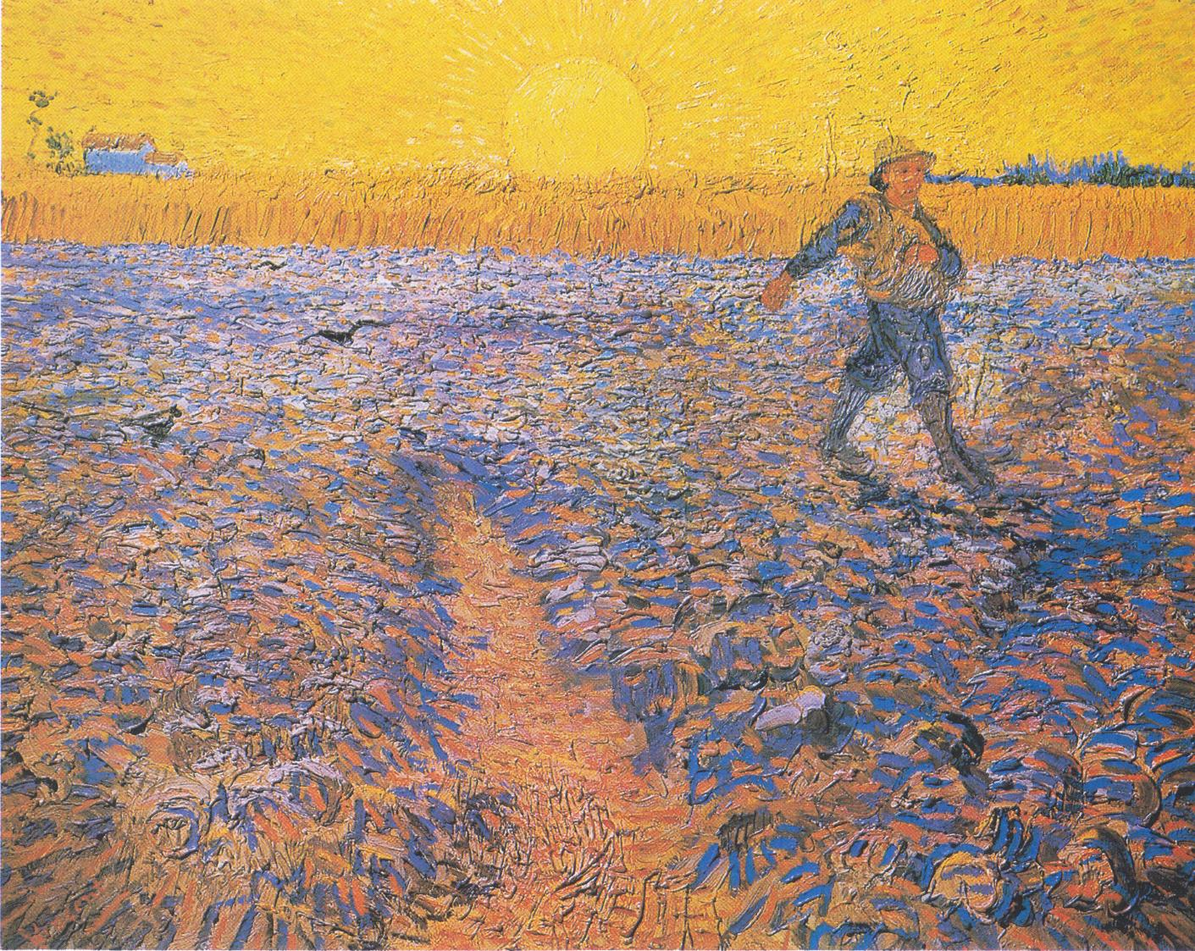
Notes:
Parable of the sower
Sower at Sunset, by Vincent van Gogh, 1888
Original source: https://diglib.library.vanderbilt.edu/act-imagelink.pl?RC=57797

