Slide 1
Follow my
lead!
Notes:
Slide 1: This term, we are thinking about leading, leaders, and followers, so let’s start as we always do….

Slide 2
Leader: As we share these stories of leaders…
ALL: May we follow their example
in thoughts
and words
and actions.
Notes:
Leader: As we share these stories of leaders…
ALL: May we follow their example in thoughts and words and actions.
Signs for greeting: click on links
Thoughts: British Sign Language BSL Video Dictionary - thought (signbsl.com)
Words (use 3rd definition): British Sign Language BSL Video Dictionary - word (signbsl.com)
Actions: British Sign Language BSL Video Dictionary - action (signbsl.com)

Slide 3
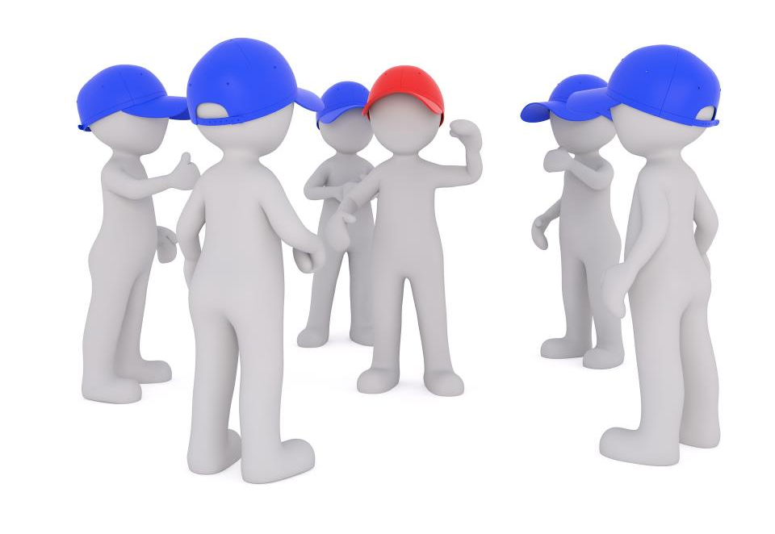
What qualities does a good leader need?
Notes:
Slide 3: I wonder what qualities you think a good leader needs? [talk together. You might want to keep this list to refer to or add to in the coming weeks.]

Slide 4
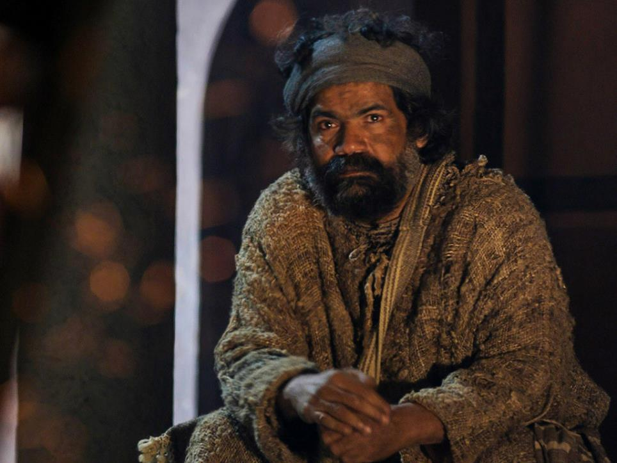
Peter’s second chance
Oh yes he did!
Notes:
Slide 4: We’re going to share together a story about one of Jesus’ disciples – who was part of the story we heard last week, about the arrival of God’s Holy Spirit. This is Peter – who became the very first leader of the Church. I wonder what qualities you think he might have had to do this very important job? [ask some children]
Well, in our story, there might be some parts that surprise you! It’s got some parts for you to join in with: when you hear me say the words ‘Oh no, he didn’t!’ I’d like you to say ‘Oh yes he did!’ in response [use script, encouraging children to join in.]

Slide 5
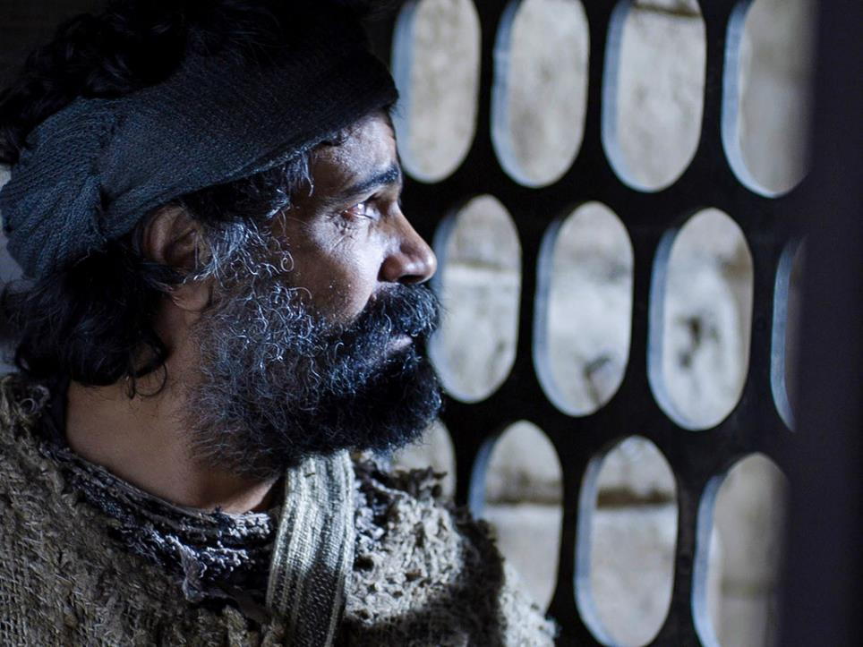
Oh yes he did!
Notes:
Slide 5: Peter had a fierce temper that often got him into trouble.
Oh no he didn’t! Oh yes he did!

Slide 6
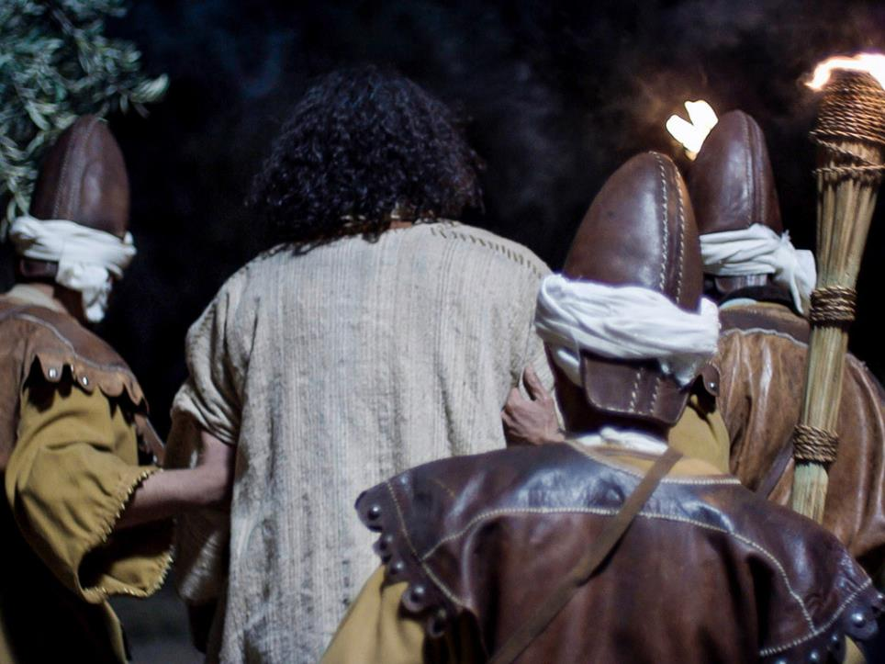
Oh yes he did!
Notes:
Slide 6: In the Garden of Gethsemane, the night before Jesus died, Peter had cut off a soldier’s ear with his sword, then watched as the soldiers led Jesus away, without saying a word!
Oh no he didn’t! Oh yes he did!

Slide 7
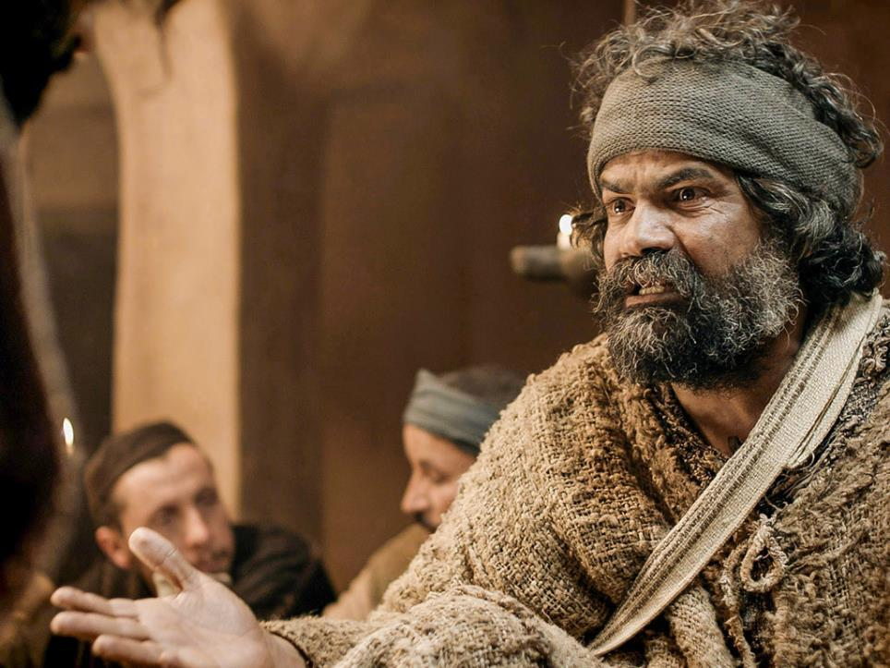
Oh yes he did!
Notes:
Slide7: Jesus had told him at supper that night that before the morning cock crowed, Peter would say he didn’t know Jesus, not once, not twice, but three times!
Oh no he didn’t! Oh yes he did!

Slide 8
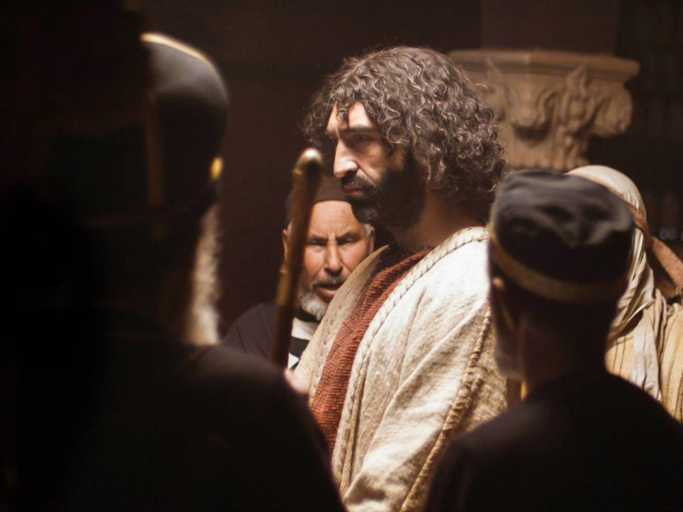
Oh yes he did!
Notes:
Slide 8: But as Jesus stood on trial, it happened just as Jesus said it would. Three times, people said to Peter ‘You were one of his friends, weren’t you?’ And all three times, Peter said ‘I don’t know who you mean!’
Oh no he didn’t! Oh yes he did!

Slide 9
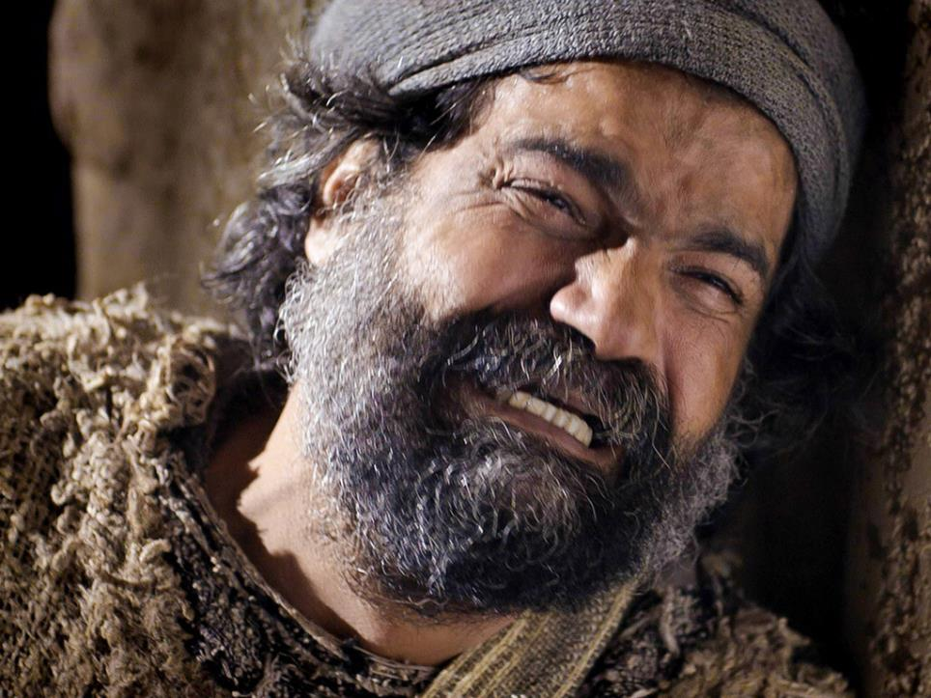
Oh yes he did!
Notes:
Slide 9: Then as the cock crowed with the dawn, Peter remembered what Jesus had said and left, weeping, with his heart broken.
Oh no he didn’t! Oh yes he did!

Slide 10
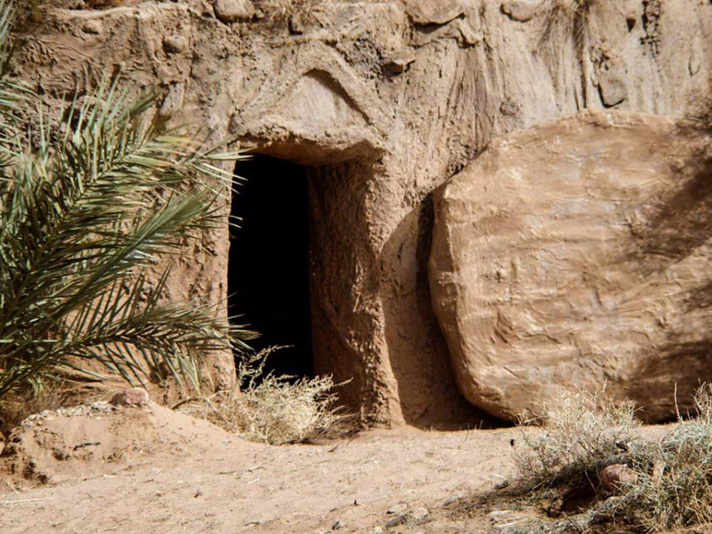
Oh yes he did!
Notes:
Slide 10: But as we know from the Easter story, Jesus died, and rose again!
Oh no he didn’t! Oh yes he did!

Slide 11
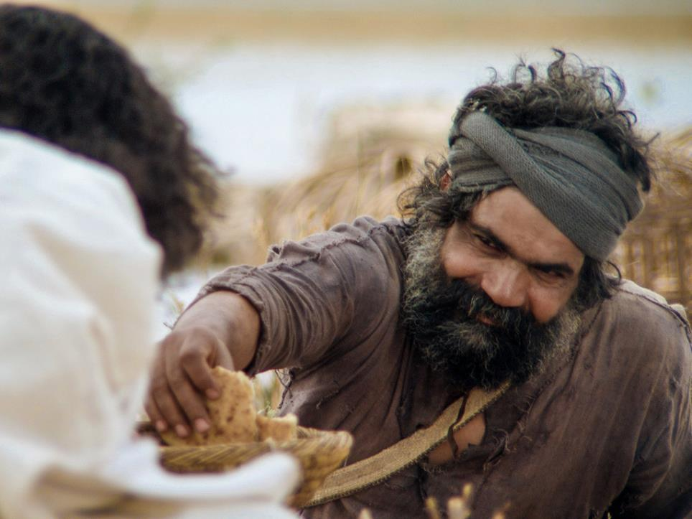
Oh yes he did!
Notes:
Slide 11: So Peter was given a second chance, on a beach with a fishy breakfast, cooked on the fire by Jesus himself!
Oh no he didn’t! Oh yes he did!

Slide 12
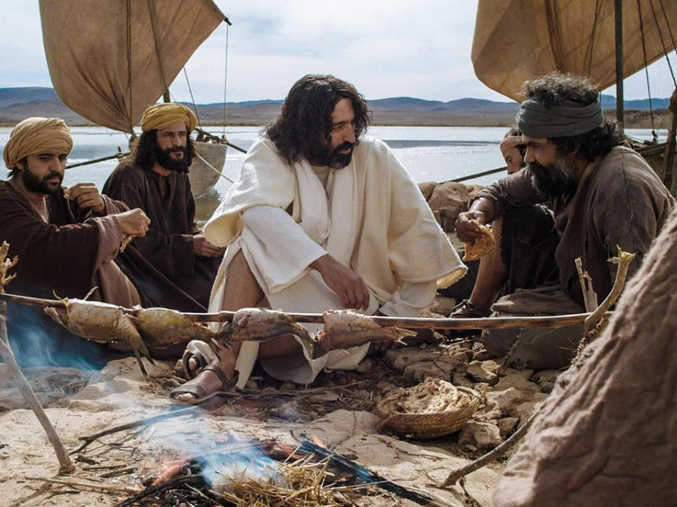
Take care of my lambs!
Take care of my sheep!
Feed my sheep!
Oh yes he did!
Oh yes he did!
Oh yes he did!
Notes:
Slide 12: After breakfast, Jesus sat down next to Peter. ‘Do you love me, Peter?’ Jesus asked. ‘Of course I do!’ Peter replied. ‘Then take care of my lambs’ Jesus said.
Oh no he didn’t! Oh yes he did!
Again Jesus asked ‘Peter do you love me?’ Thinking that perhaps Jesus hadn’t heard him, Peter replied ‘You know I do!’ ‘Take care of my sheep’ Jesus said.
Oh no he didn’t! Oh yes he did!
But then Jesus asked a THIRD time ‘Peter, do you love me?’ and Peter felt a little hurt that Jesus needed to ask three times. ‘Lord, you know everything and you know that I love you!’ ‘Then feed my sheep’ Jesus asked him.
Oh no he didn’t! Oh yes he did!

Slide 13
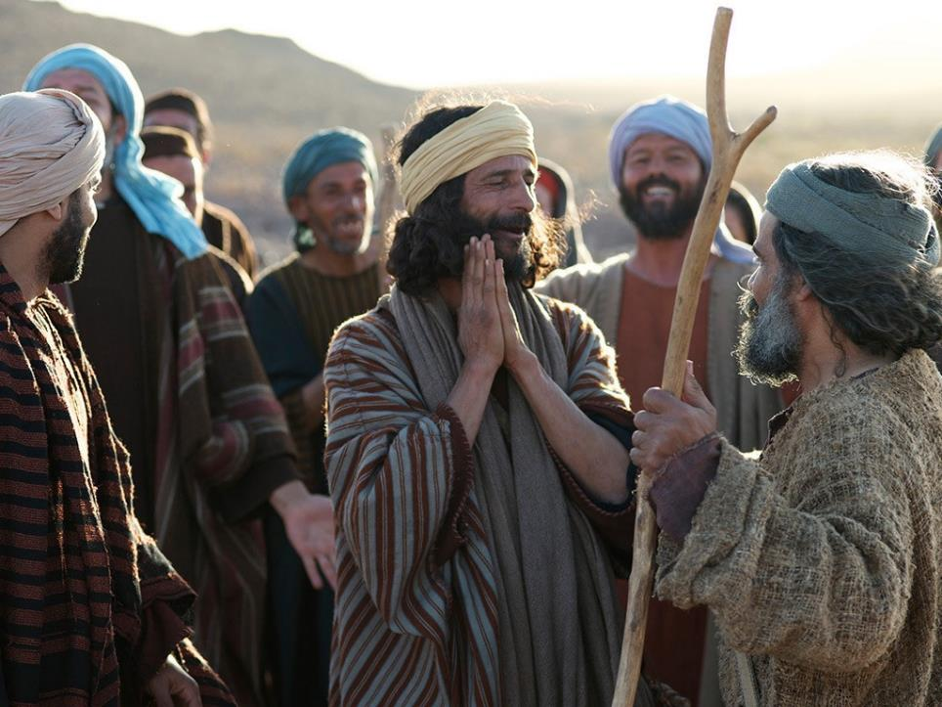
Oh yes he did!
Notes:
Slide 13: And so, despite the many times that Peter had let Jesus down, Jesus gave him a brand new start.
Oh no he didn’t! Oh yes he did!

Slide 14
…. I wonder why Jesus asked Peter the same question three times?....
….I wonder what Jesus meant by ‘take care of my sheep’?....
….and whether Peter did what Jesus asked?....
Notes:
Slide 14: Then talk together (there will be reflective wondering later as well): I wonder why Jesus asked Peter the same question three times?... I wonder what Jesus meant by ‘take care of my sheep’, and whether Peter did what Jesus asked?....
Well, you’ll be glad to know that he did! The ‘sheep’ that Jesus talked about were the very first Church, and after the coming of the Holy Spirit at Pentecost, Peter did just what Jesus had asked him to, and cared for them as if they were his own family. He became the very first – and some say the greatest – leader of the Church.

Slide 15
…. I wonder what you think Peter learned from his mistakes?....or what you think we learn from ours?....
….I wonder what this story might show us about being a leader?....
….I wonder what this story teaches us about the importance of forgiveness?....
Notes:
Slide 15: Responding (words for worship):
….so in the stillness of this moment, let’s spend some time thinking together…..
…we’ve heard Peter’s story and how Jesus gave him a second chance…
….I wonder what you think Peter learned from his mistakes?....
….or what you think we learn from ours?....
….I wonder what this story might show us about being a leader?....
….I wonder what this story teaches us about the importance of forgiveness?....

Slide 16
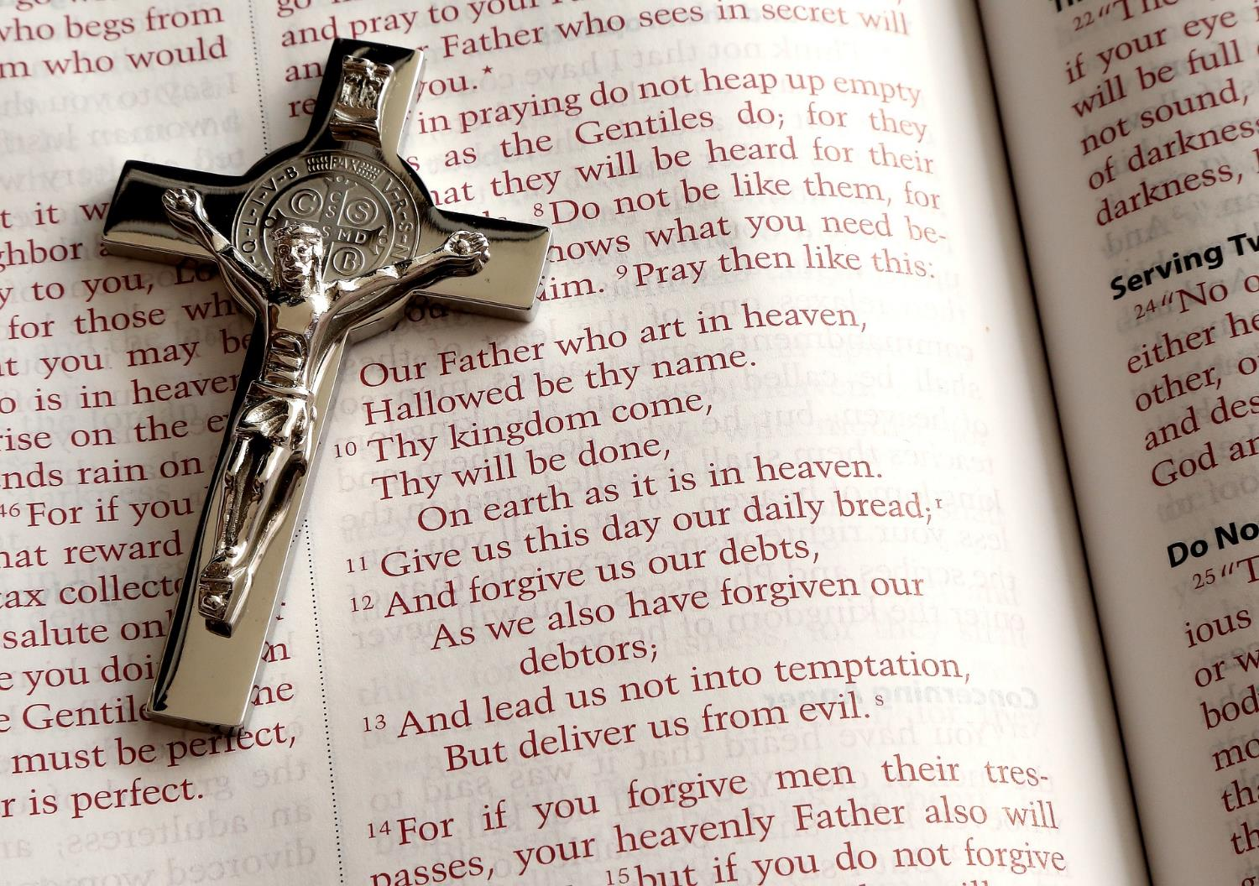
‘Forgive us for the wrong things we do, as we forgive people when they do wrong to us.’
Notes:
Slide 16: Christians often pray a prayer that Jesus taught his disciples – a prayer that Peter himself would have prayed, called the Lord’s Prayer. Listen to these words from it, about forgiveness:
Forgive us for the wrong things we do, as we forgive people when they do wrong to us.
It’s a reminder to Christians that because God has forgiven them, they should forgive others. I’m going to use this idea to help us to pray now. You might just want to listen, or find some way to make the prayer your own….

Slide 17
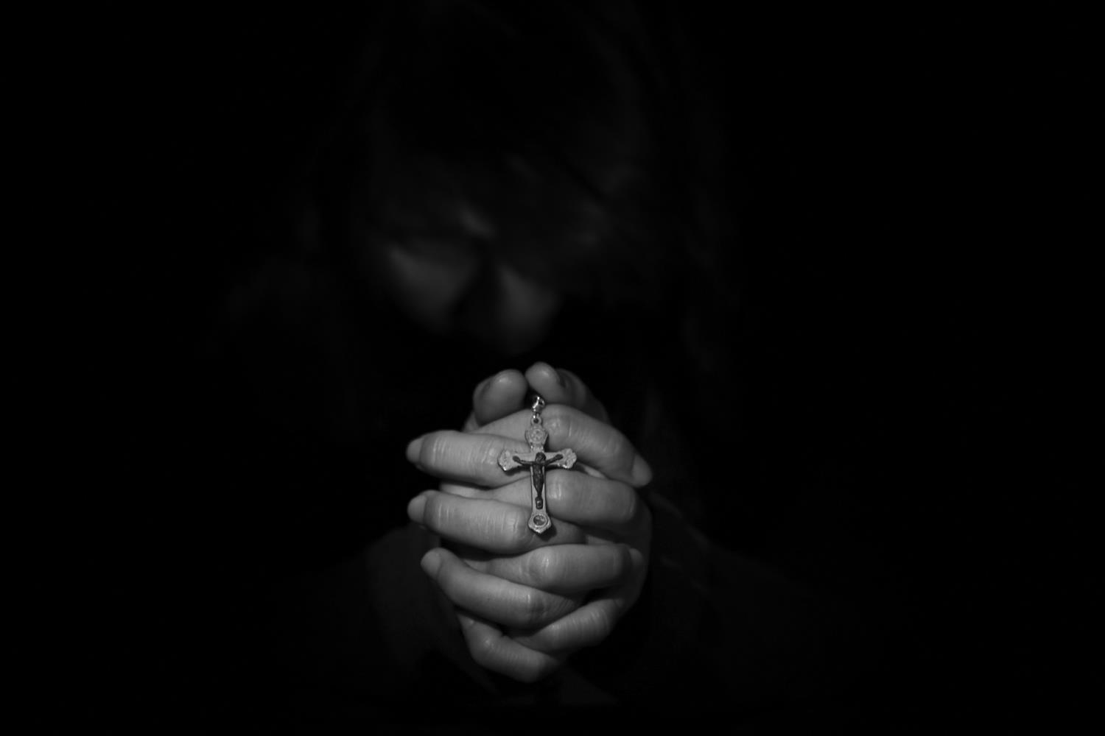
Dear God, who is forgiving,
Thank you for the story of Peter, and what it shows us about being forgiven.
Thank you that he got a second chance, even when he let his friends down.
Help us to be like Peter, to learn from our mistakes and to forgive, as we have been forgiven.

Slide 19
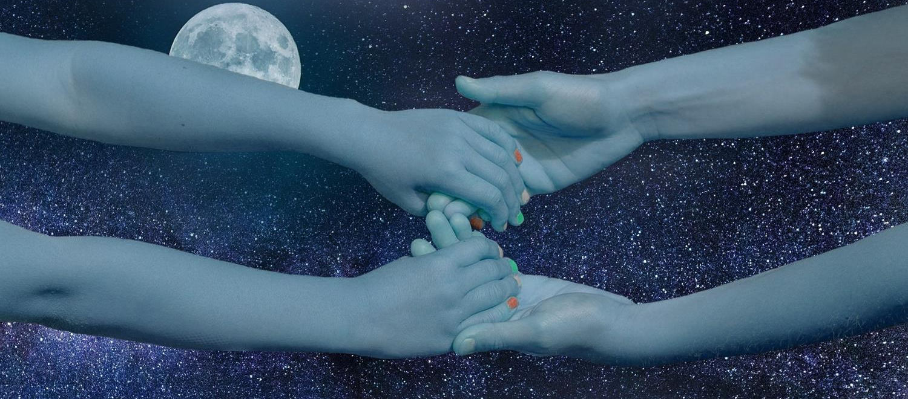
Leader: As we leave this place & time and go into the day ahead…
All: …may we be forgiving.

Slide 20
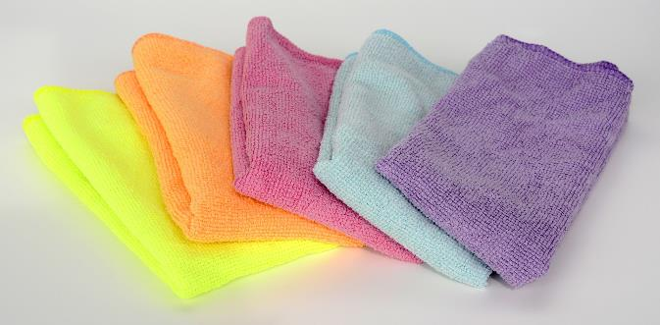
Cloths clean up mess! Hold the cloth and think about the people you care about. Do any of them need to be given a second chance? Or is there someone who needs you to say ‘sorry’ to them?

