Slide 1
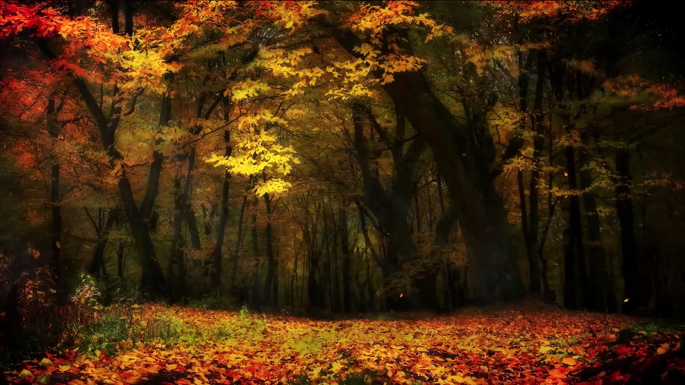
All images copyright-free from pixabay, unless otherwise identified
Notes:
Slide 1: Welcome stilling exercise – Autumn leaves
Use the stilling slide if desired: the suggested words should be spoken slowly, leaving pauses inbetween to create a sense of stillness.
As you sit quietly here, watch the leaves falling from the trees…..and bring your mind into a peaceful place [PAUSE]
Now practise slower breathing…..in…..and out…..in……and out…..keep this going as you continue to watch….[PAUSE]
You maybe notice that you are feeling calmer and more relaxed….[PAUSE]
As you breathe, think about yourself and what you bring into this time today…..and think about how peace has come upon us…. [PAUSE]
We come into this special / sacred space and time to be still….to think deeply…..to be together as a school community…..
In our time together today, we are thinking about Harvest, and we will….. play a game…..share some words together…..think together about this special time of year…..and pause to reflect as we watch a very special Autumn video
But first, let’s welcome one another as we begin….

Slide 2
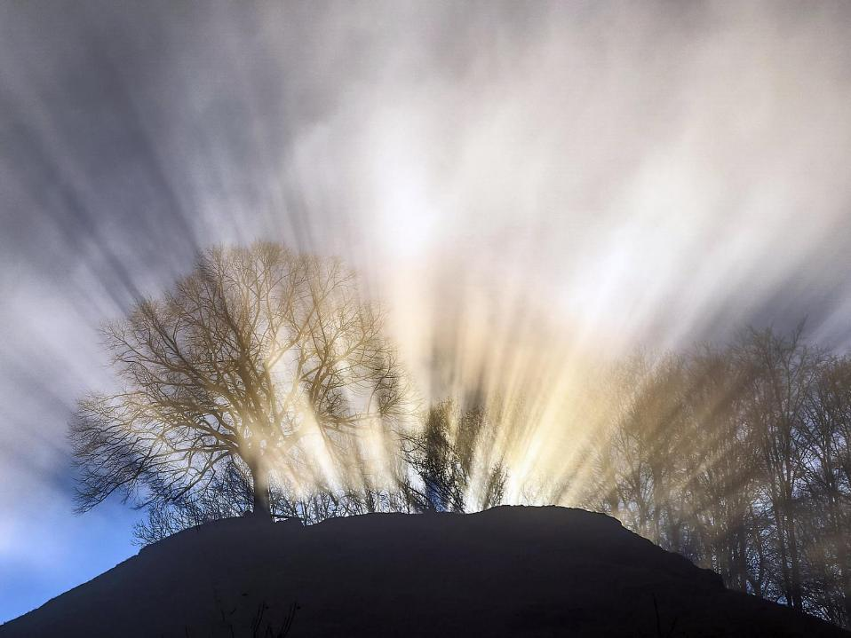
Leader: This is a day that God has made.
ALL: We will rejoice and be glad in it!
Notes:
Slides 2/3: Teach this new greeting to your school community – there are two slightly different versions from the point of view of the leader; choose which best fits your school’s context. One uses words adapted from Psalm 118:24
Leader: This is a day that God has made!
ALL: We will rejoice* and be glad* in it!
OR:
Leader: Today is a brand new day…..
ALL: May we be a blessing to each other!
*There are different BSL signs for rejoicing and joy/gladness. View them here: https://www.signbsl.com/sign/rejoice
Blessing: https://www.signbsl.com/sign/blessing (1st video)

Slide 3
Leader: Today is a brand new day!
ALL: May we be a blessing to each other!
Notes:
Slides 2/3: Teach this new greeting to your school community – there are two slightly different versions from the point of view of the leader; choose which best fits your school’s context. One uses words adapted from Psalm 118:24
Leader: This is a day that God has made!
ALL: We will rejoice* and be glad* in it!
OR:
Leader: Today is a brand new day…..
ALL: May we be a blessing to each other!
*There are different BSL signs for rejoicing and joy/gladness. View them here: https://www.signbsl.com/sign/rejoice
Blessing: https://www.signbsl.com/sign/blessing (1st video)

Slide 4
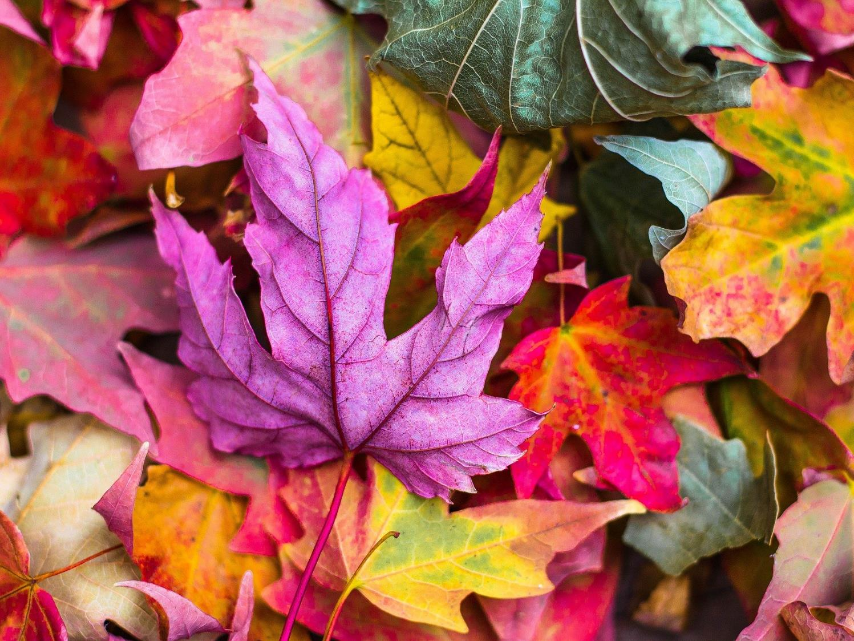
Autumn
Notes:
Slide 4: This term, we are thinking about our blessings – all the good things in our lives. Today we are going to be focusing again on our beautiful world – and how Autumn gives us another chance to be thankful.

Slide 5
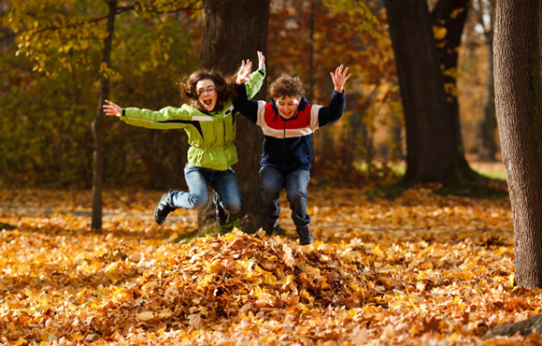
Notes:
Slide 5: I wonder what your favourite thing to do at Autumn time is? Maybe jumping in big piles of leaves?….

Slide 6
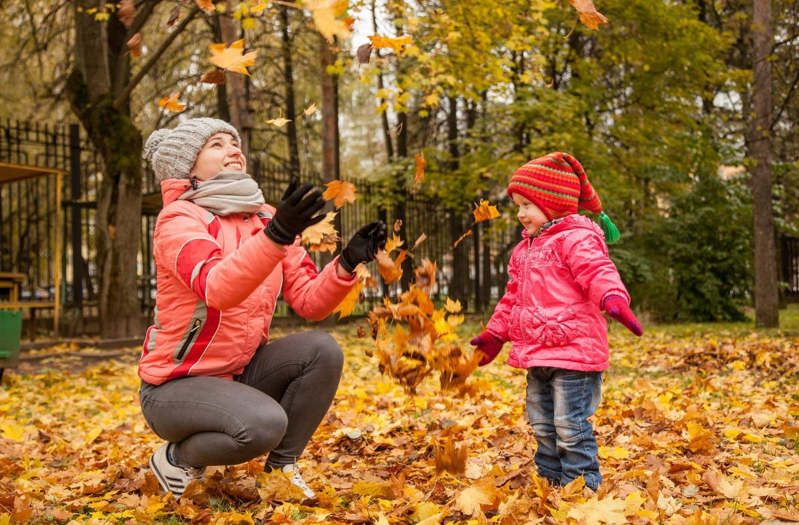
Notes:
Slide 6: Or trying to catch them as they fall?

Slide 7
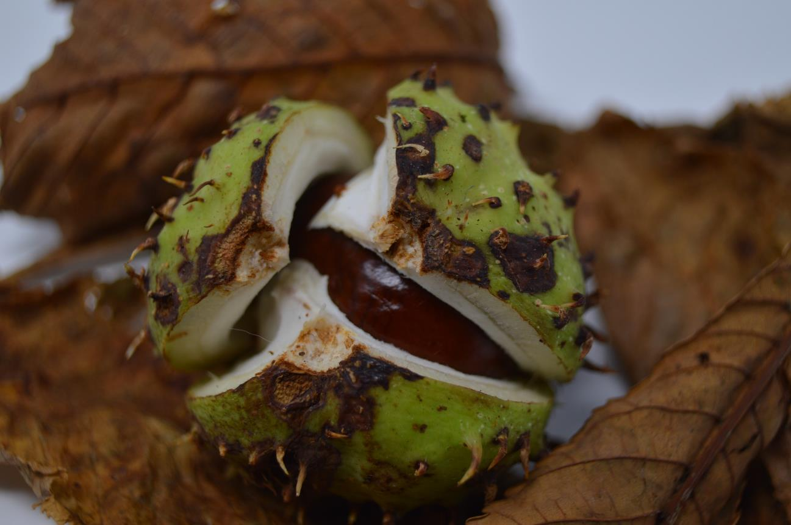
Notes:
Slide 7: Or searching for that perfect conker? [Take a poll using the pictures in the PPT, or just chat together] Every season is different, and beautiful in its own way – and I especially love Autumn because…. [add your own reason]

Slide 8
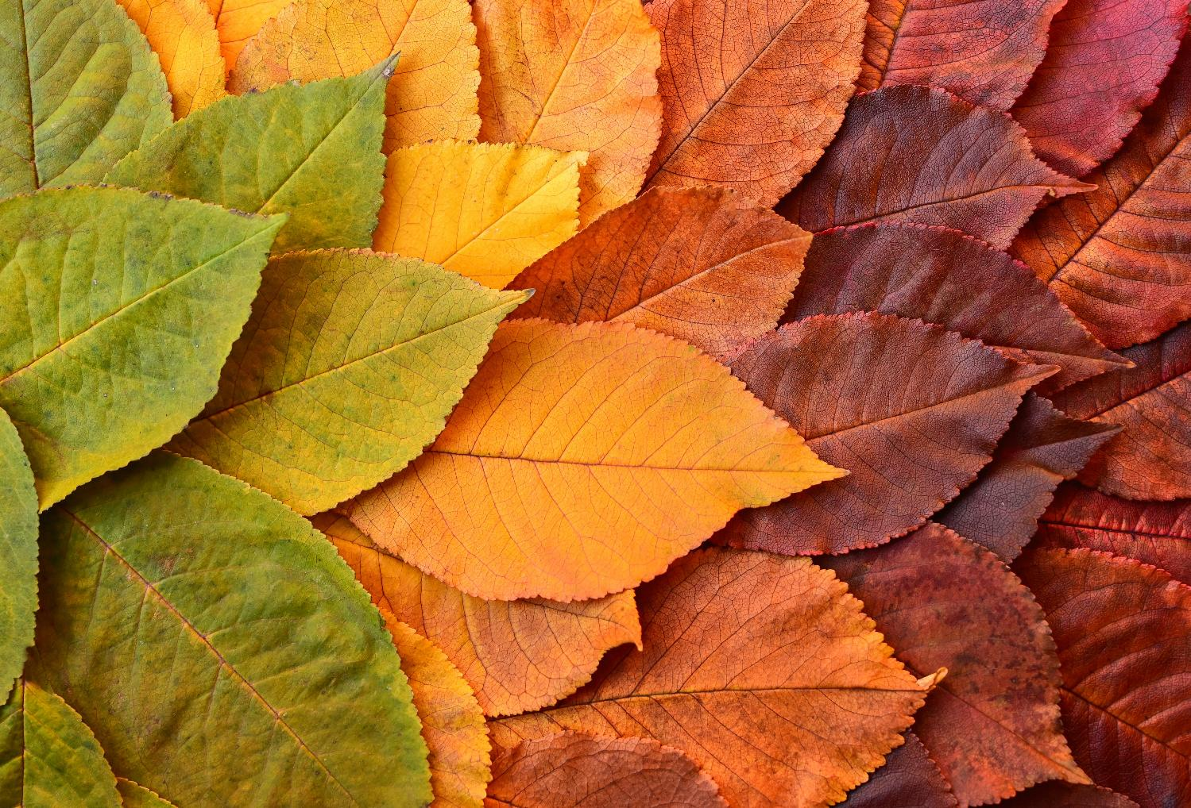
Notes:
Slide 8: The leaves on the trees are especially beautiful at this time of year, and it only happens because the trees are getting ready for their big winter sleep. As they begin to shut down, the leaves change colour, before they drop off and turn into rich soil to feed the trees through the winter and into spring. [Have a look at some Autumn leaves really carefully, and see how different they all are.] How truly amazing Autumn leaves are – and what a picture for us of the beauty and variety of our world, especially at this time of year.

Slide 9
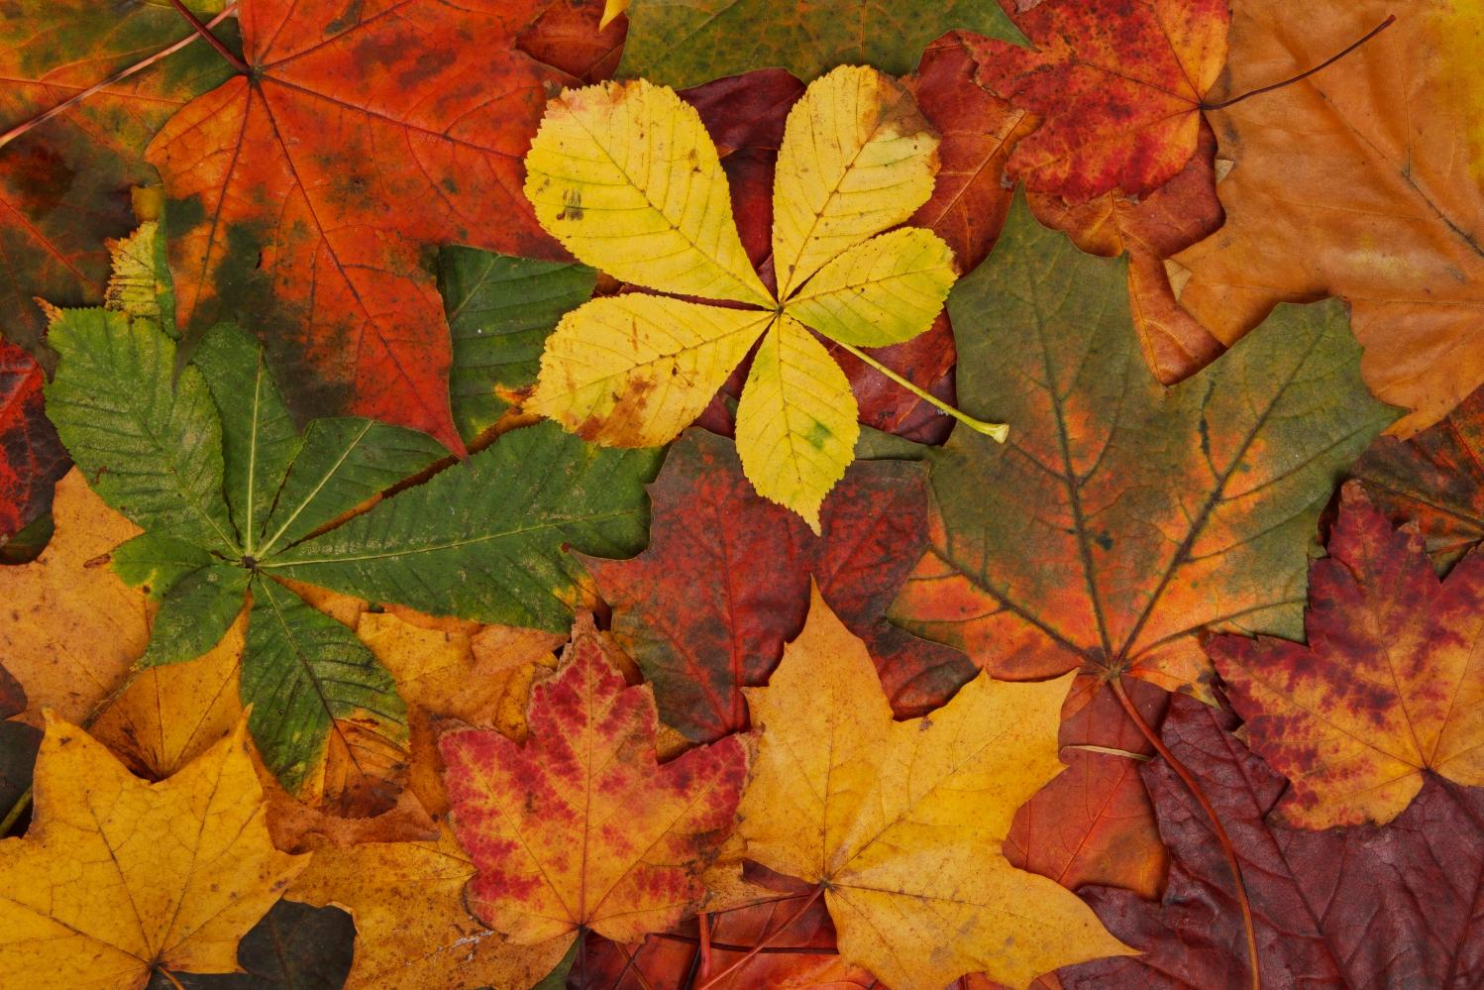
Hunt the leaf!
Notes:
Game 1 (slide 9) Hunt the Leaf: Gather a pile of different Autumn leaves. Children study a leaf chosen from your pile, put it back, shuffle the leaves & see if they can find it again.

Slide 10
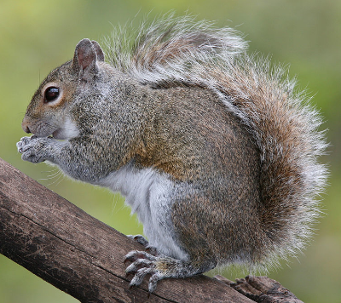
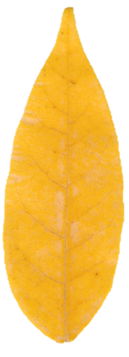
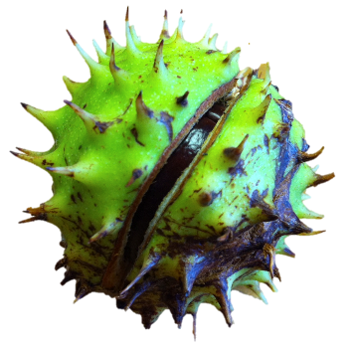
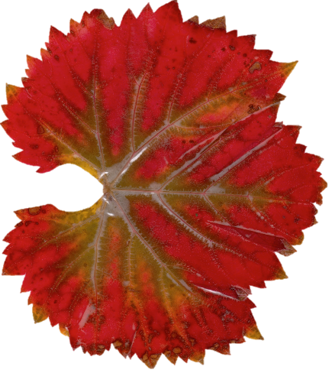
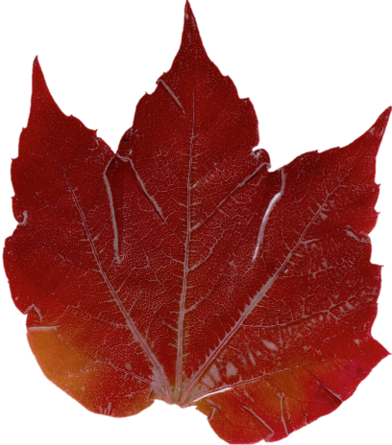
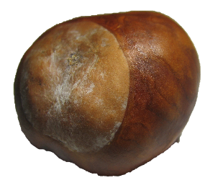
What is it?
Notes:
Game 2 (Slide 10) What is it? – a describing game, without saying the name. You might want to create some extra challenges for older pupils.

Slide 11
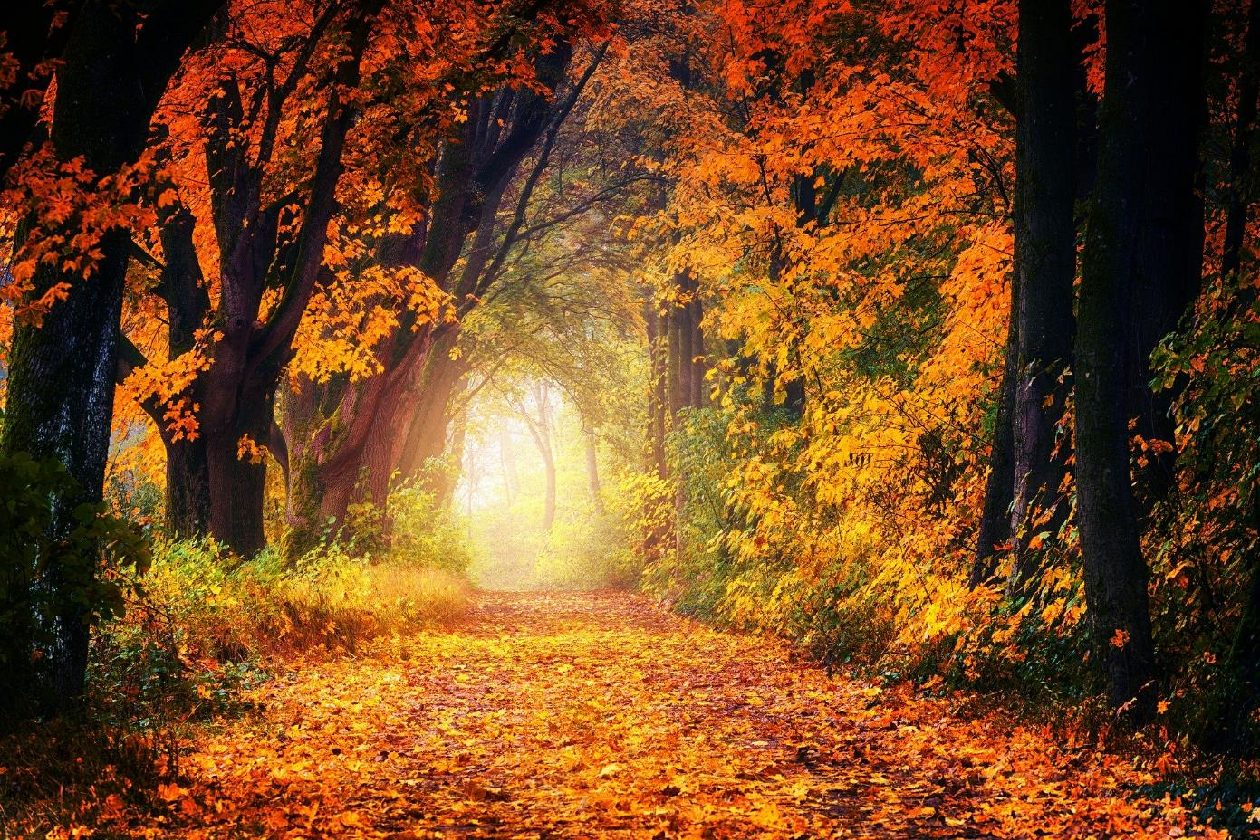
‘at the works of your hands, I sing for joy!’
Psalm 92:4
Notes:
Slide 11: Responding (and words for worship)
Many people find themselves experiencing feelings of wonder at the world during Autumn. When David the Psalmist (who wrote many songs in the Bible) saw something amazing in the world around him, the first thing he wanted to do was to praise God, and he wrote these words (although he probably wasn’t writing about Autumn!): ‘at the works of your hands I sing for joy’ (Psalm 92:4)
….I wonder if you can understand how David felt when he saw something beautiful in the world?....
….I wonder which part of Autumn time David might praise God for?.....
….what’s your favourite part of Autumn?.....
…..think quietly to yourself for a few moments…..
…..we’re going to have a very special time of reflection now, featuring some images of Autumn at its best….with some music written for Autumn by a composer called Vivaldi….
….as you watch, you might want to turn your thoughts into your own prayer of thanks for the beauty of Autumn…. or just enjoy them….. [video is linked from the image on the screen and will activate in another window when you click]

Slide 12
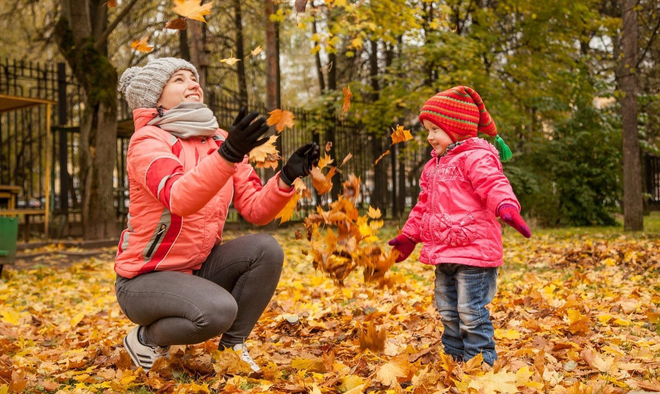
…Creator God, we’re thankful.
Notes:
Slide 12: For walks in crunchy leaves, Creator God, we’re thankful.

Slide 13
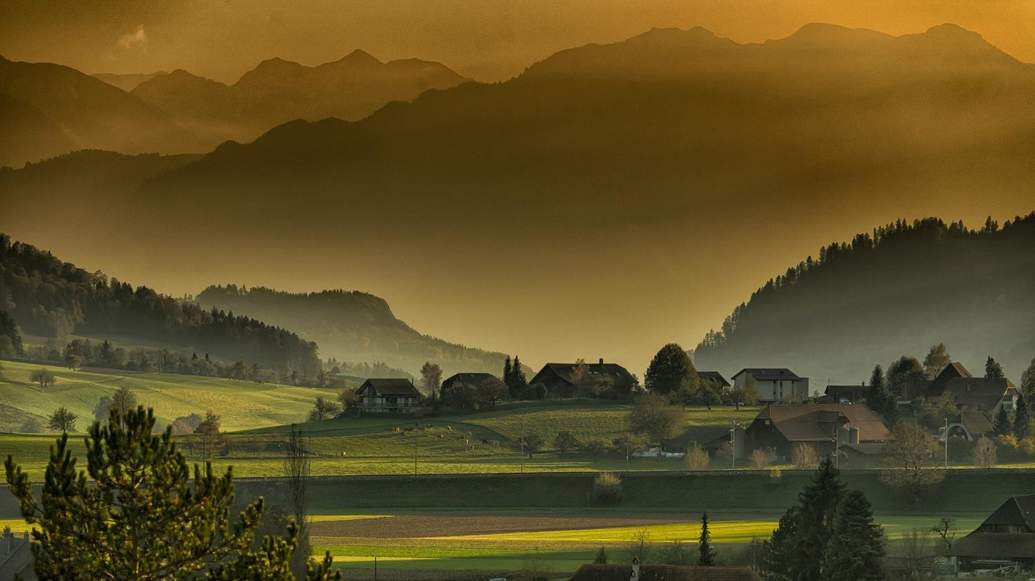
…Creator God, we’re thankful.
Notes:
Slide 13: For misty Autumn mornings, Creator God, we’re thankful.

Slide 14
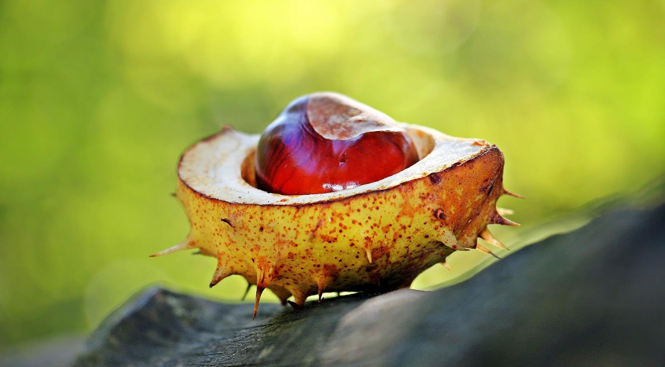
…Creator God, we’re thankful.
Notes:
Slide 14: For shiny, glowing conkers, Creator God, we’re thankful.

Slide 15
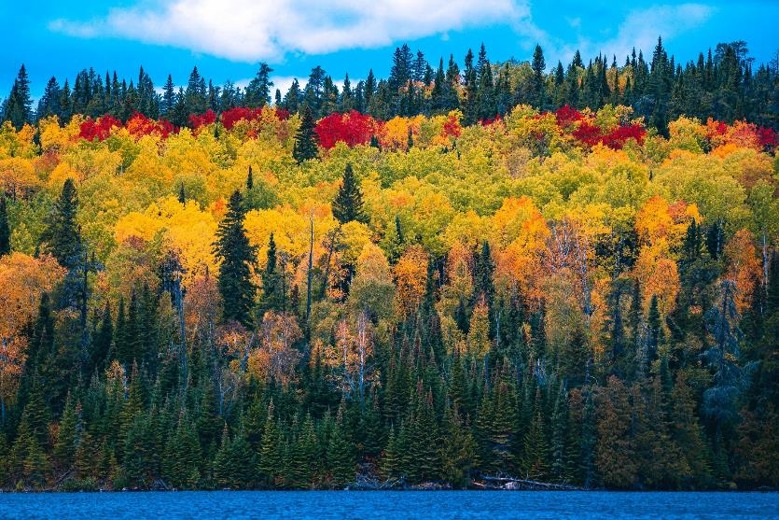
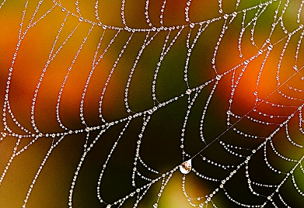
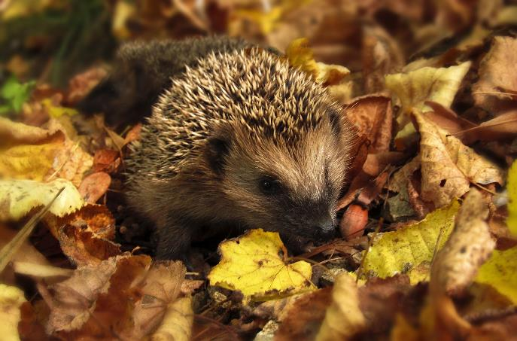

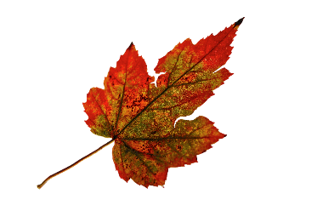
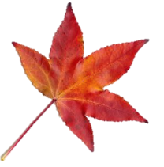
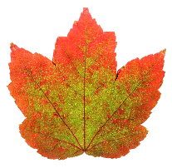
…Creator God, we’re thankful.
Notes:
Slide 15: For all of Autumn’s wonders, Creator God, we’re thankful.

Slide 16
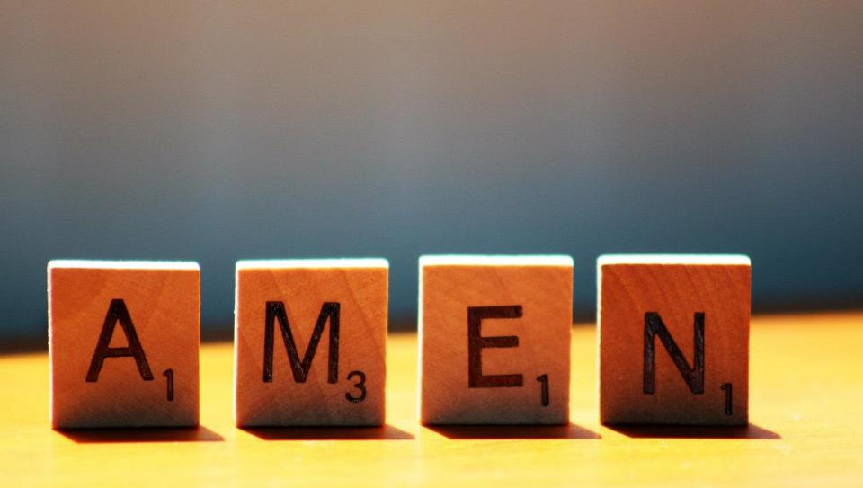

Slide 17
An Autumn challenge:
is every leaf different?
Notes:
Slide 17: A challenge as we part
As you are enjoying the outdoors this week, here’s a challenge! Can you find two leaves that are exactly the same – in order to find out the answer to the question of whether every Autumn leaf is different.

Slide 18



Leader: As we leave this place & time and go into the day ahead…
All: May we open our eyes to the beauty around us!

Slide 19
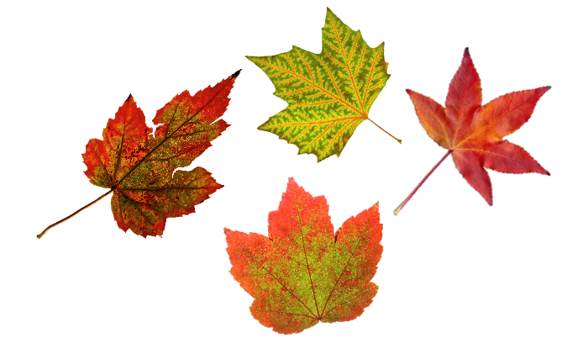
Notes:
Slide 19: Reflection areas
Go outdoors this week and find an Autumn object that you think is beautiful. Discuss with pupils first which things can be safely curated in this way – and which should be left outside!
Gather them in your reflection area or take photos if they can’t be brought indoors. You could also print out some of slides 20-34.
Think: As you look at the objects that have been gathered, which one(s) do you think are the most beautiful?
Talk: Compare your idea with the ideas of other children in your class. Do we all think the same?
Do: Have a go at writing some words a bit like David’s words from the verse in Psalms.

Slide 21
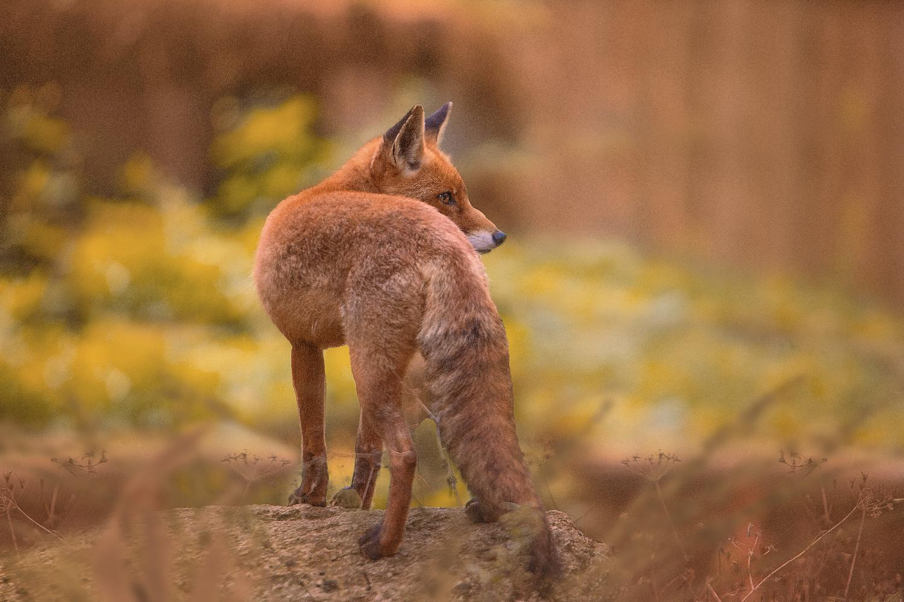

Slide 22
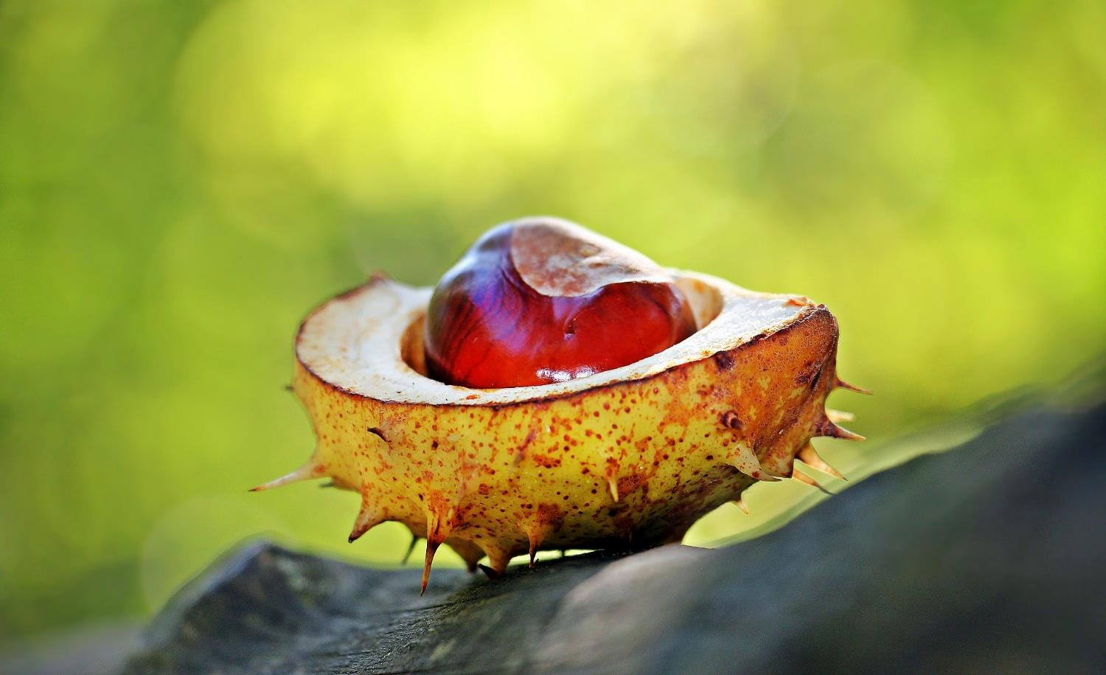

Slide 23
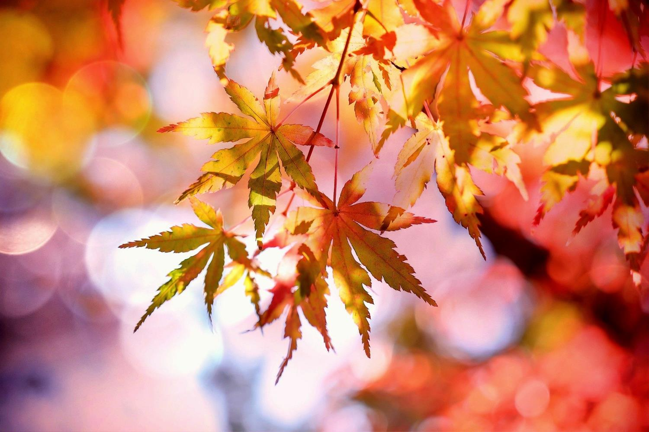

Slide 24
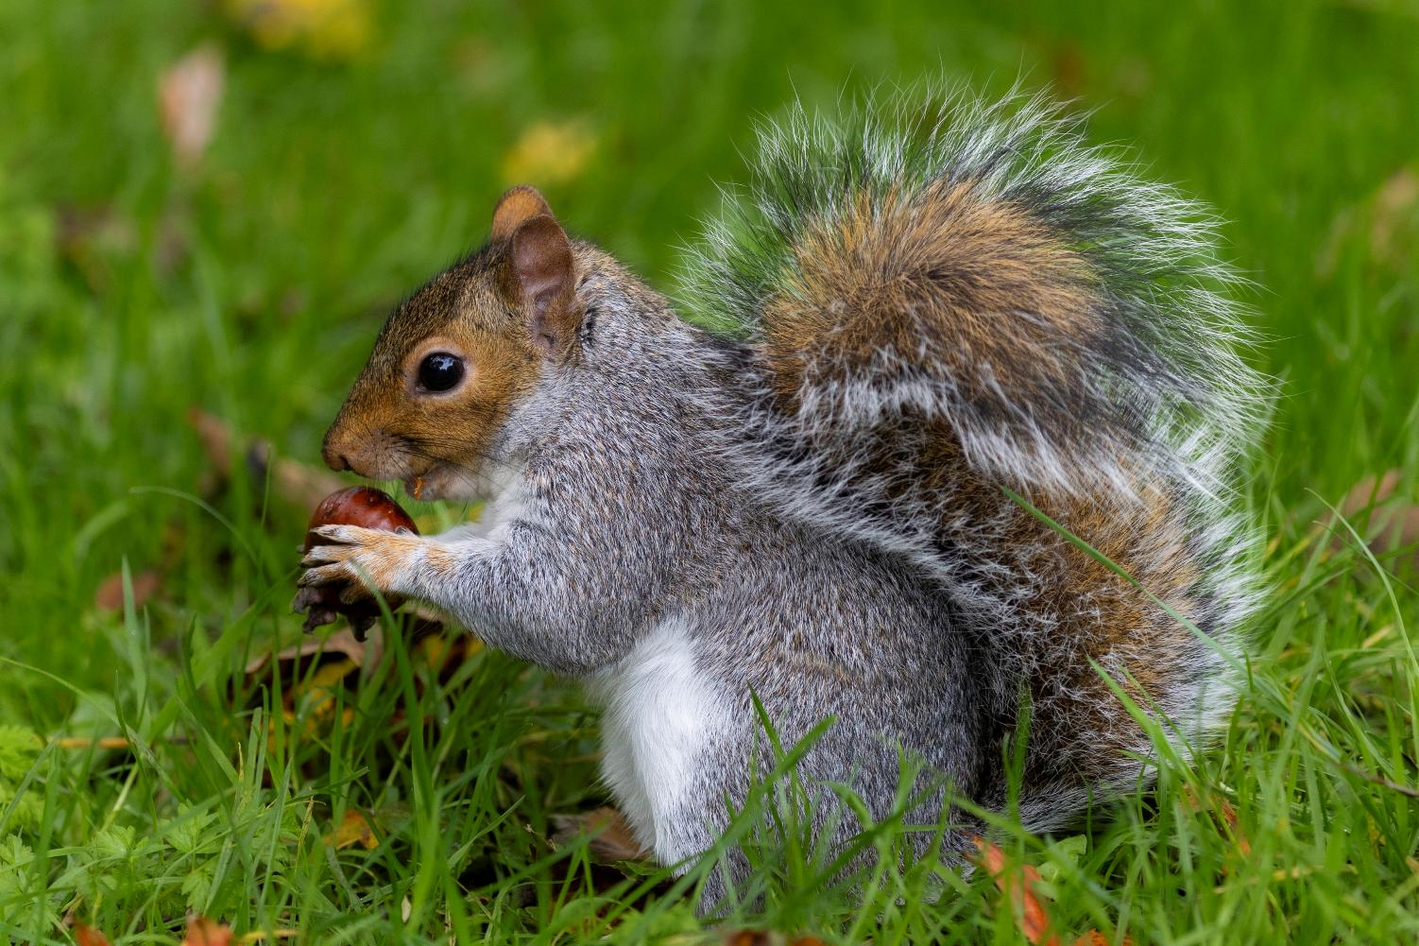

Slide 25
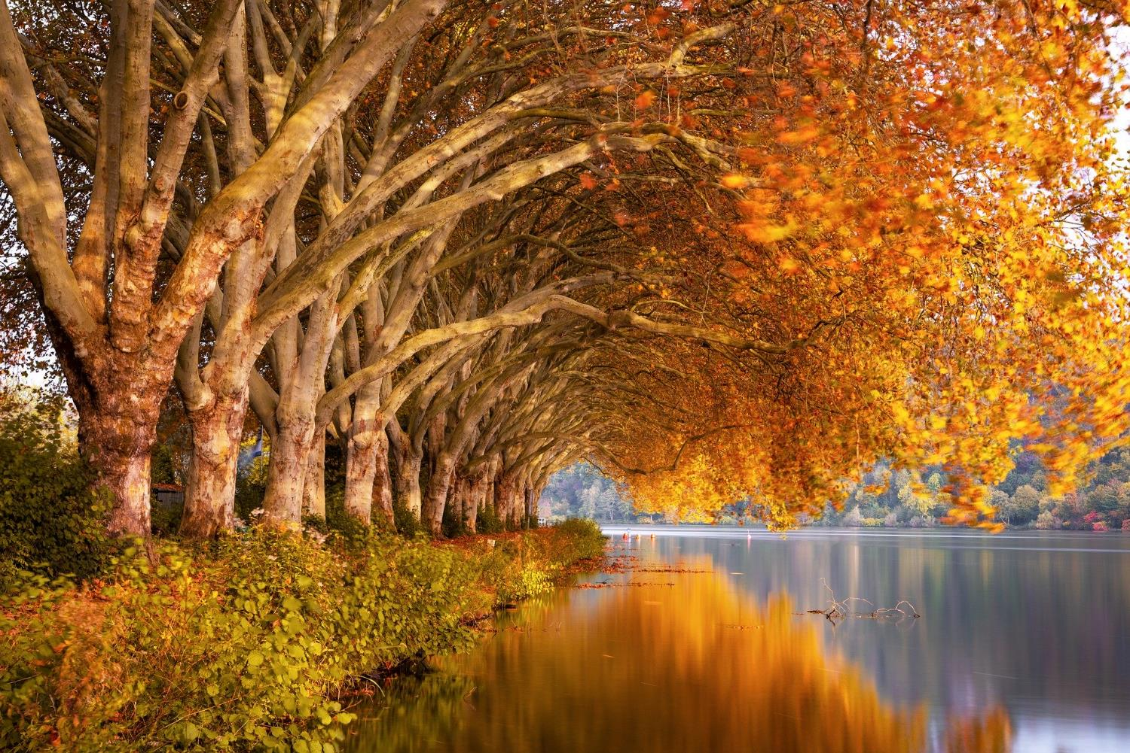

Slide 26
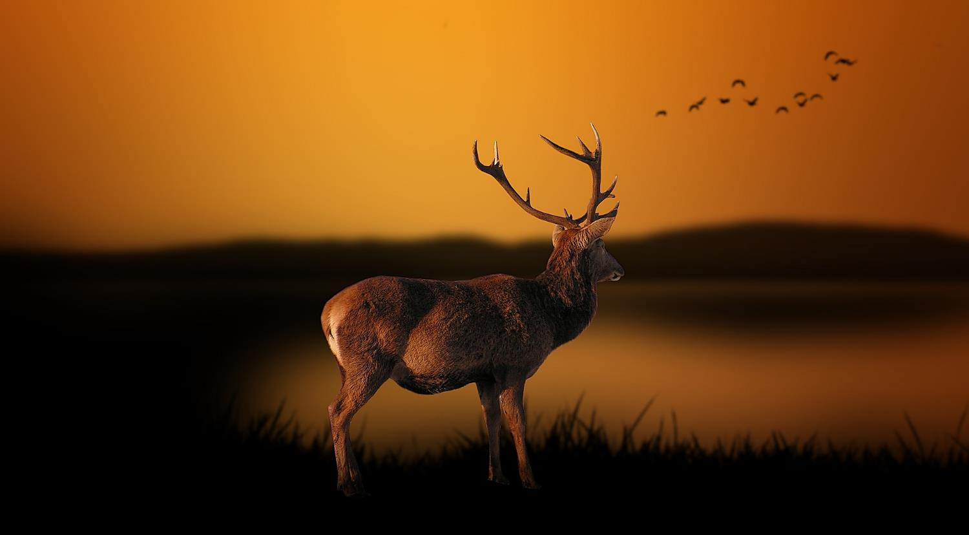

Slide 27
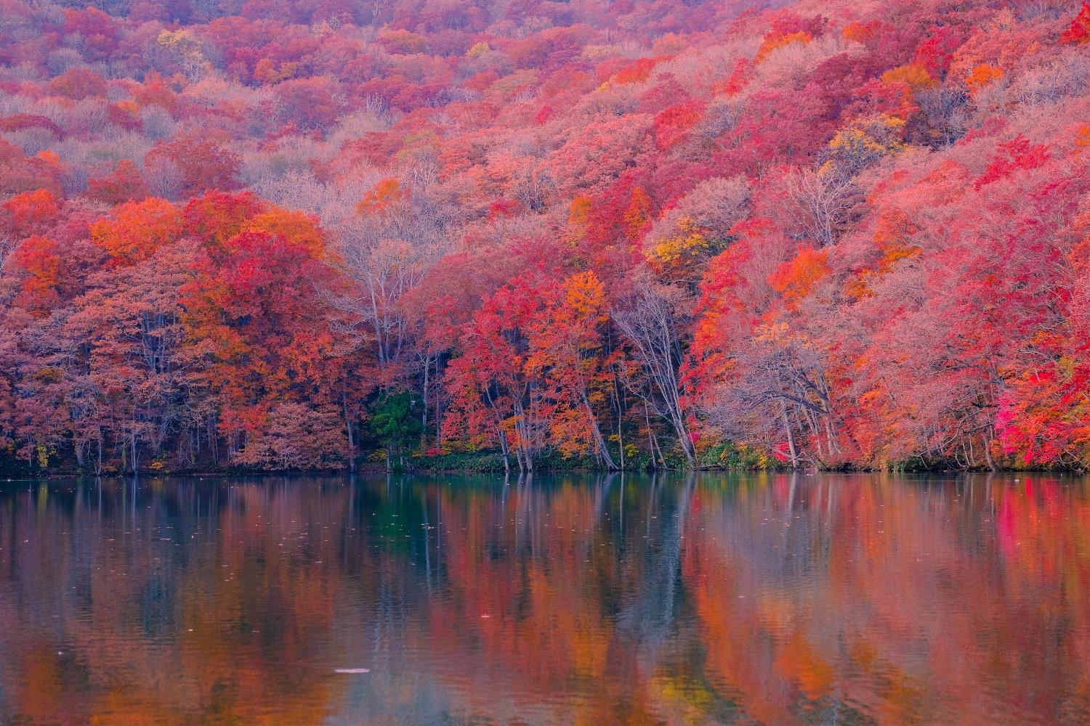

Slide 28
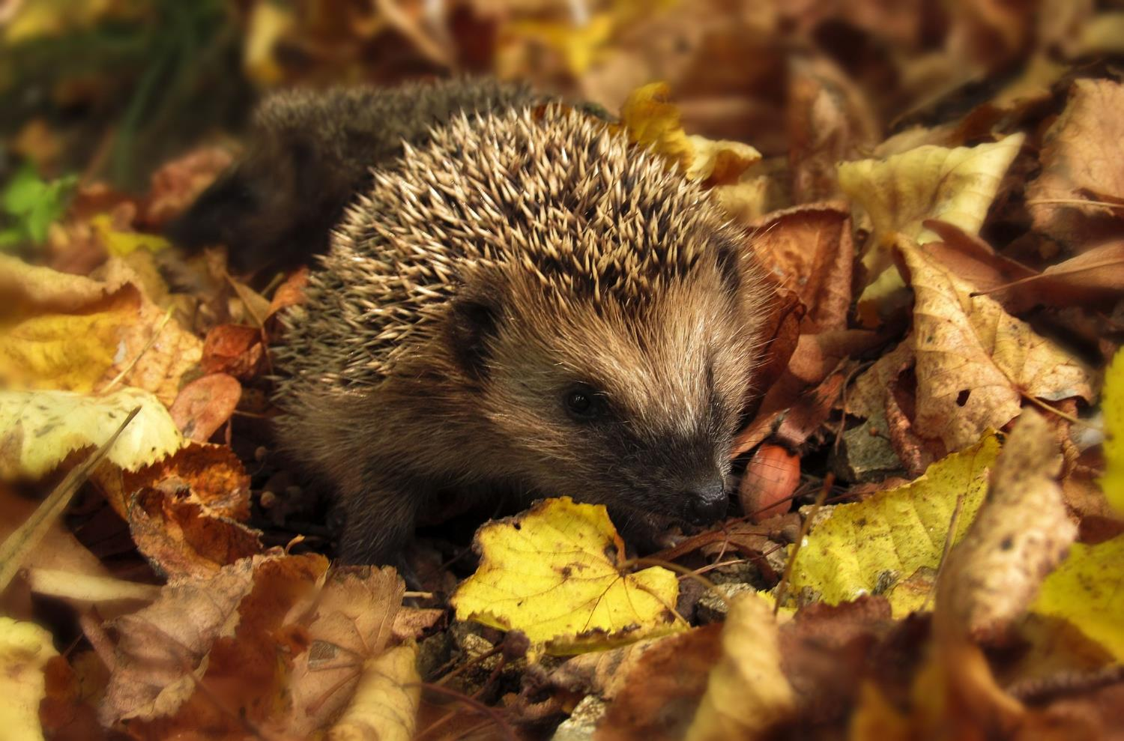

Slide 29
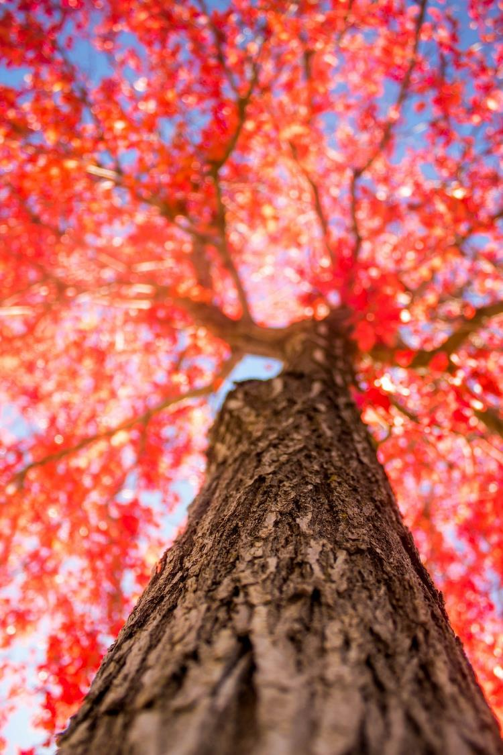

Slide 30
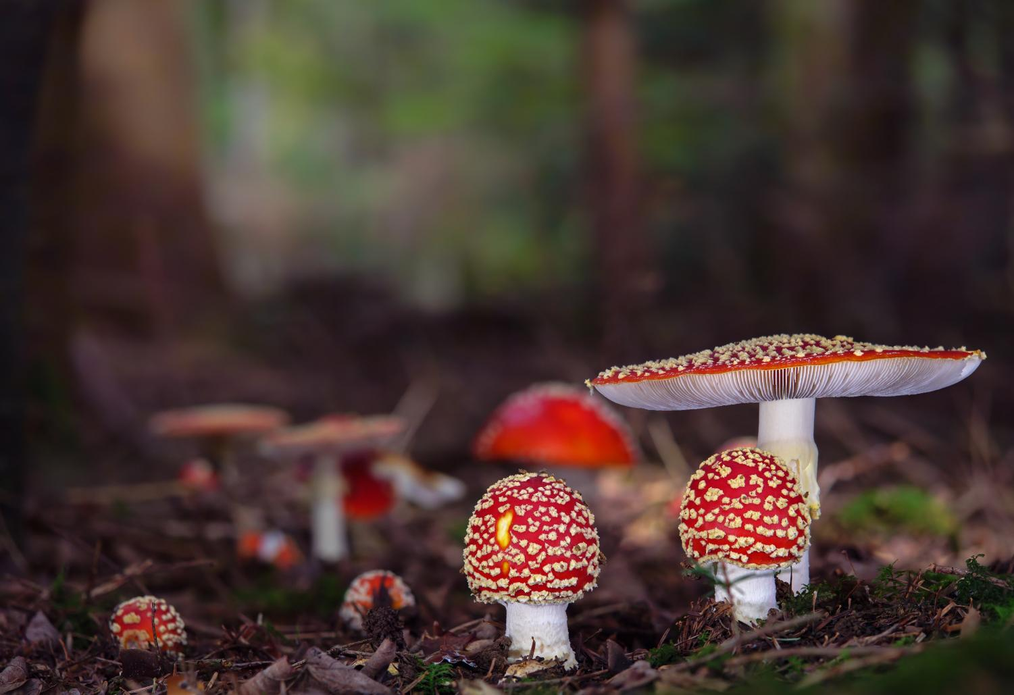

Slide 31
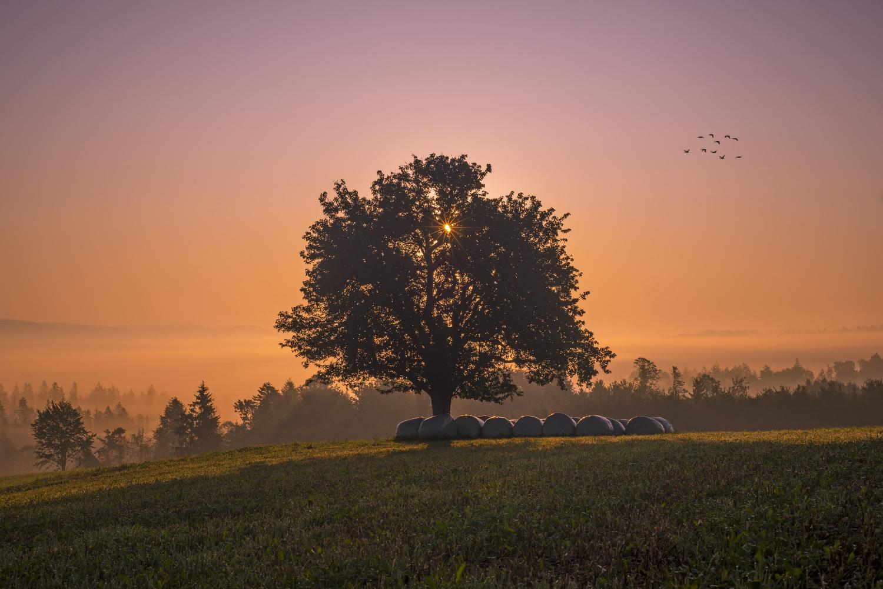

Slide 32


Slide 33
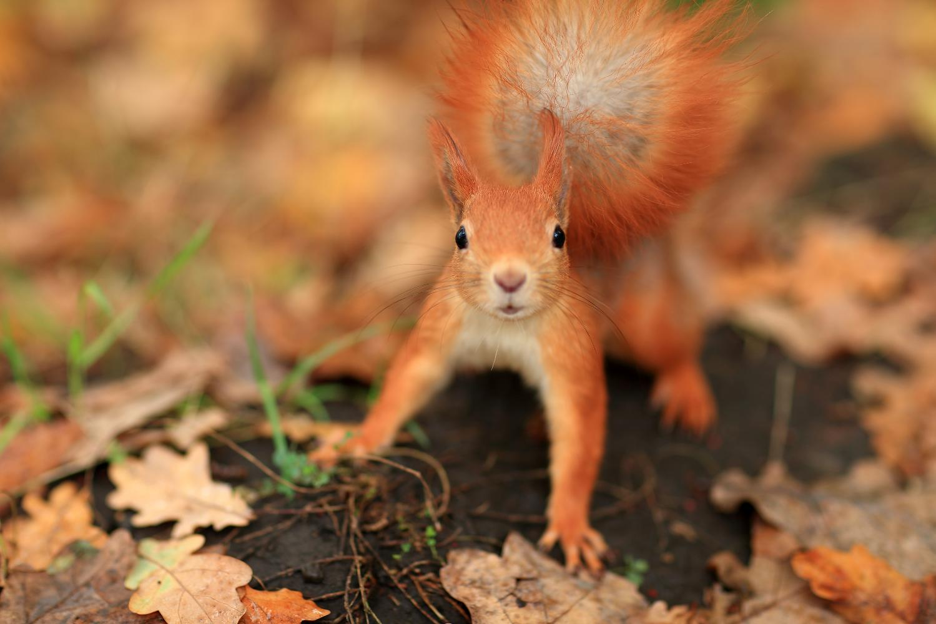

Slide 34
