Slide 1

Leader: We are here together
ALL: May we ‘GO FOR GOLD!’ in our words and actions today!
Notes:
Slide 1: Gathering words
Leader: We are here together
ALL: May we ‘GO FOR GOLD!’ in our words and actions today!

Slide 2

Notes:
Slide 2: Today, we’re going to spend most of our assembly thinking about problems, and how we solve them. In a while, we’re going to hear some more about the Olympics, and a problem that an athlete faced, but first, here are some more familiar problems! Many of the movies that you love to watch have problems at their heart – when we talk about this in our English lessons, these problems called ‘dilemmas’. I have a problem, a ‘dilemma’, to read out to you….. See if you can guess which story it comes from [ask each teacher / child to read their card out, for assembled children to figure out. Show answer pictures on the screen. Some are more challenging than others, so select according to the age / interests of your pupils]

Slide 3

What’s the
problem?
Notes:
Slide 3: ‘What’s the problem?’
Let’s hear some familiar problems from some of our favourite movies….

Slide 4
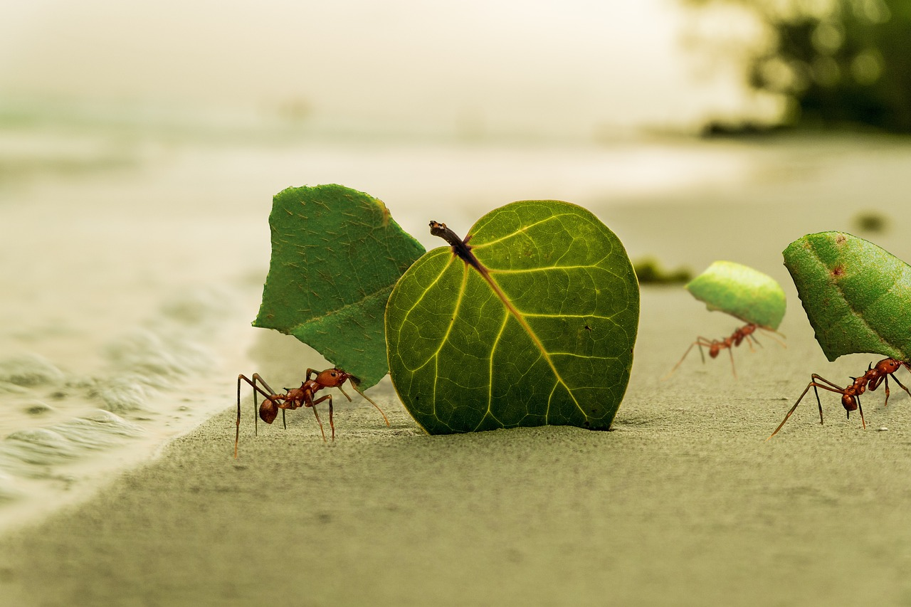
Notes:
Slide 4:
Here’s a problem:
The ants are being bullied by the grasshoppers to gather food for them…..
And the answer is…… A Bug’s Life

Slide 5
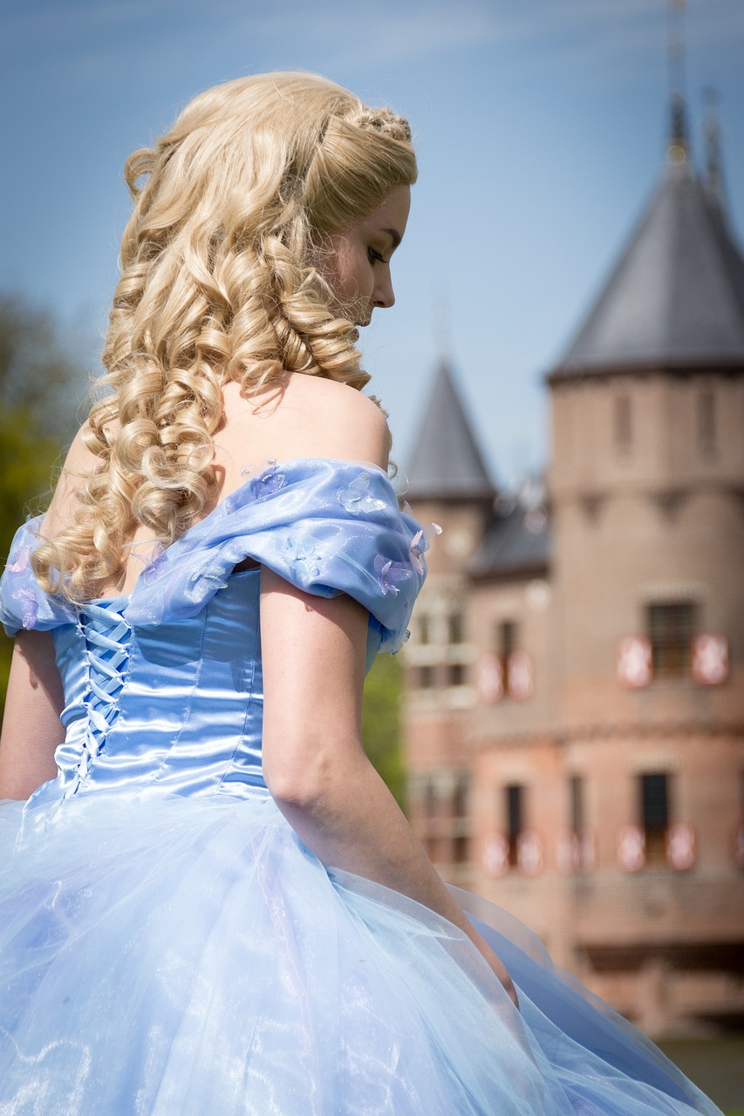
Notes:
Slide 5:
Here’s a problem:
A girl is made to do all the chores by her mean sisters. They are all invited to the Prince’s ball, but all she has to wear are rags…..
And the answer is…… Cinderella

Slide 6
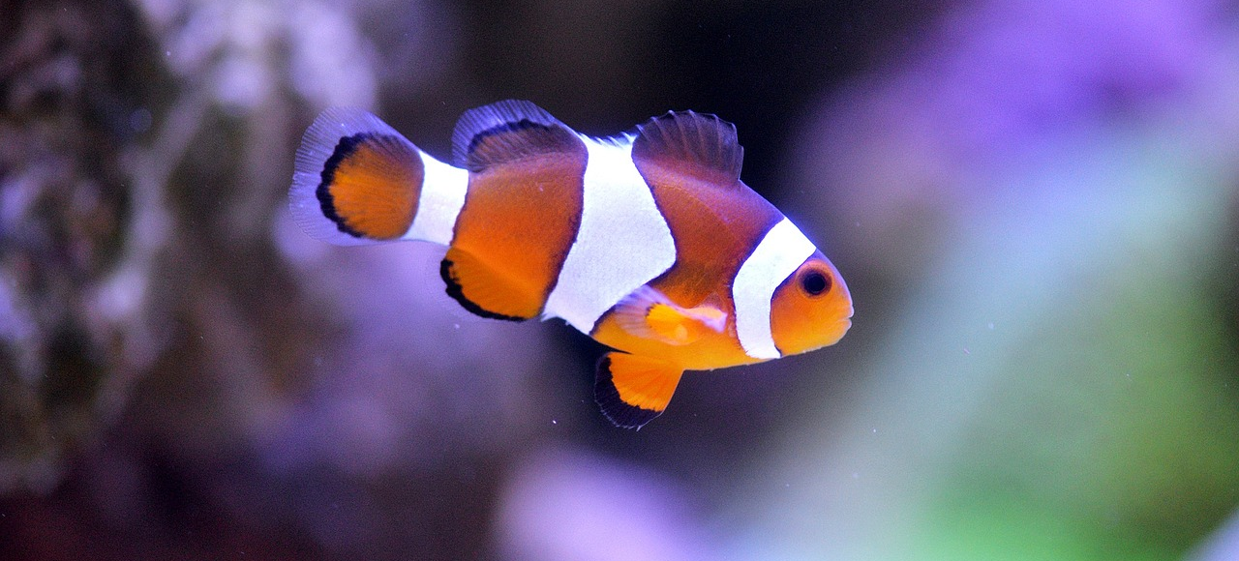
Notes:
Slide 6:
Here’s a problem:
A little clown fish is lost in the ocean, but going to find him means facing many dangers……
And the answer is…… Finding Nemo

Slide 7
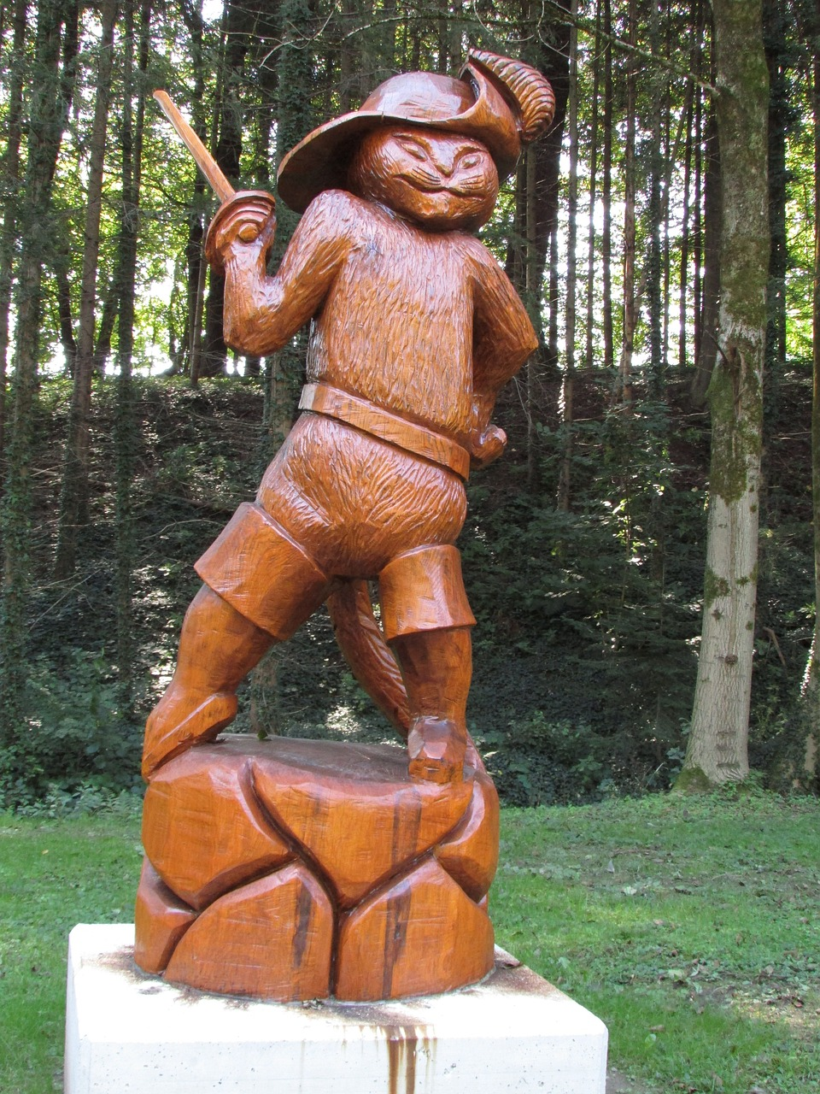
Notes:
Slide 7:
Here’s a problem [this is a tricky one!]:
The hunt is on for some magic beans but whose side is Humpty really on?…..
And the answer is…… Puss in Boots

Slide 8
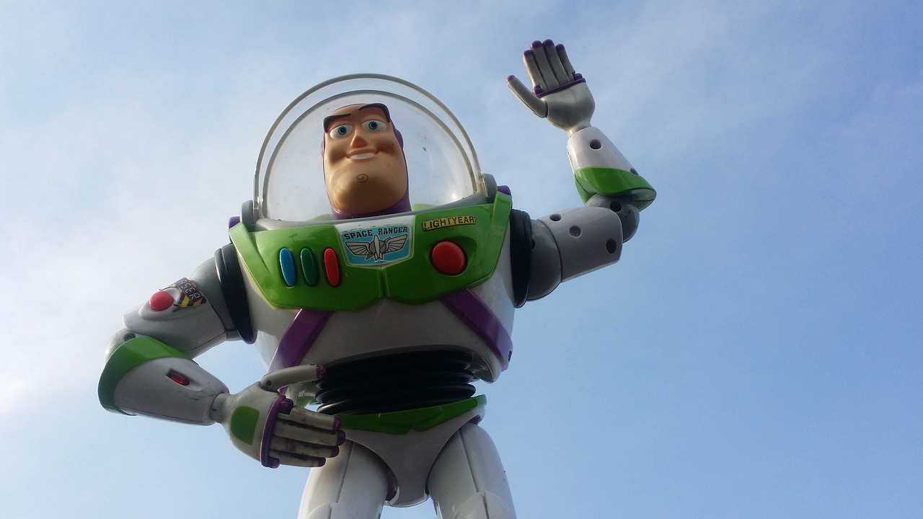
Notes:
Slide 8:
Here’s a problem:
While he’s away on summer camp, Andy’s favourite toy is ‘toynapped’ by a greedy collector and a rescue attempt begins….
And the answer is…… Toy Story 2

Slide 9
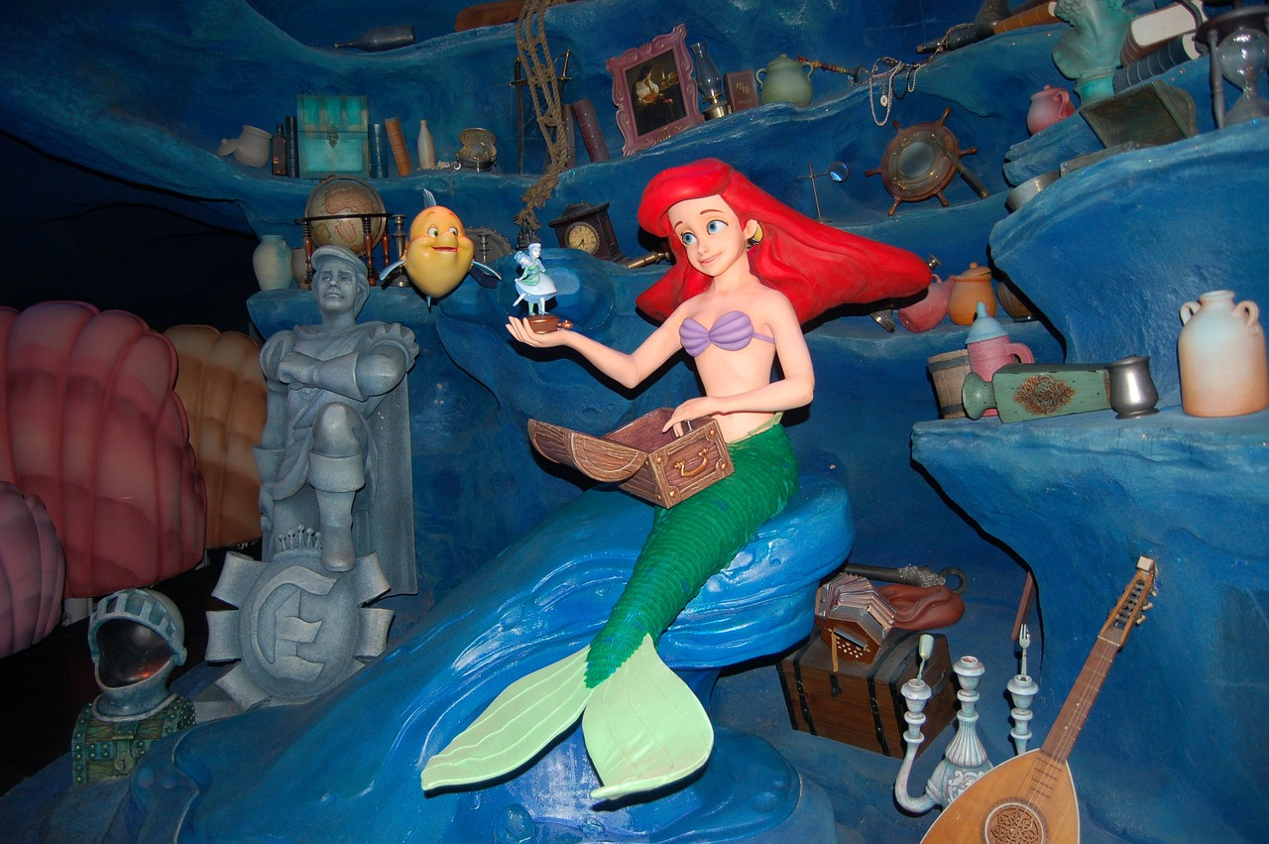
Notes:
Slide 9:
Here’s a problem:
Ariel wants more than anything to be able to live with humans, but her father forbids her from having anything to do with them…..
And the answer is…… Little Mermaid

Slide 10

Notes:
Slide 10:
Here's a problem:
The earth is heating up and Sid, Manny and Diego need to escape a flood that’s heading their way…..
And the answer is…… Ice Age 2

Slide 11
Notes:
Slide 11: I wonder how it feels to be faced with a problem – and then to find a solution, especially when we are supported by our friends? [talk together for a few moments]
The reason that we love so many of these stories – in books as well as in films – is that we love to hear how many different characters have solved problems that they faced. In A Bug’s Life, the ants learned to work together to stand up against the bullying grasshoppers….. A fairy godmother helped Cinderella around the problem of not being able to go to the ball….. Marlin (Nemo’s dad) learned how to take risks and trust others to help him find his son Nemo, lost in the Pacific Ocean…… King Triton learned that loving someone sometimes means being willing to let them go….. and Humpty Dumpty learned that ultimately friendship is worth more than the promise of golden eggs. [add your own versions of these if preferred]
Every day we face problems – most of them not as big as those we’ve heard about this morning – but the way in which we tackle little problems helps us to learn how to deal with bigger ones later in life. As human beings, we are designed for solving problems – quite simply, our brains are wired that way. Your teachers will tell you that we all learn and remember things better when we’ve had to figure out a solution to a problem than when we’ve been told how to do it.

Slide 12

The Olympics
Respect
Friendship
Excellence
Determination
Equality
Courage
Inspiration
Olympic rings © Pixabay
Notes:
Slide 12: Over the past few weeks, we’ve been thinking about stories from the Olympics and important shared values that lie at the heart of them – and today, we’re going to hear a story about someone who showed great courage in overcoming some very big problems.

Slide 13
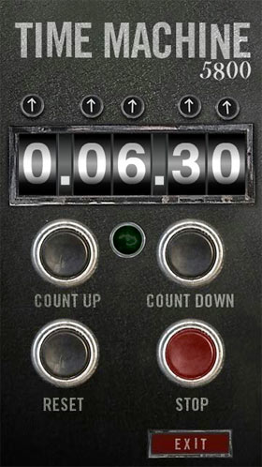
2024
CE
1940
CE
Notes:
Slide 13: We’re going to jump into our Olympic time machine again, and go back in time once more, to 1940, but not to the Olympics – not yet!
The 1940 Olympics was supposed to take place in Tokyo, Japan, but in 1939 just as all the athletes were training hard, war broke out….World War II….. and the Olympics was cancelled.

Slide 14
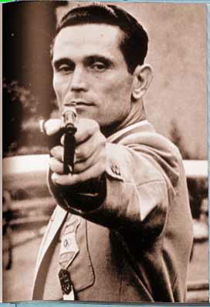
Karoly Takacs (1910-1976)
Notes:
Slide 14: This is Karoly Takacs – a Hungarian rapid-fire pistol shooter who was expected to win gold medal in the 1940 Olympics. He was the best in the world. He was also part of the Hungarian army and one day, whilst training with his army squad, a hand grenade exploded in Takacs’ right hand…..his pistol-shooting hand. His He spent a month in hospital nursing his wounds and his broken Olympic dreams.
At this point most of us would’ve given up, but not Takacs. He knew that he could face – and overcome – this enormous problem, because giving up was not an option! He might not be able to use his right hand any more, but he still had a left hand that worked, and so he decided to teach himself to shoot with his left hand instead. For months, he practised in secret – no-one knew what he was doing. When he showed up at the Hungarian National Pistol Shooting Championships, everyone said how brave he was coming to watch a competition that he could no longer take part in. ‘I didn’t come to watch, I came to compete!’ he announced……and won!
His determination to overcome a very big problem had paid off. So, let’s fast-forward now…..

Slide 15
1940
CE
1948
CE
Notes:
Slide 15: ….to the 1948 Olympics…..

Slide 16
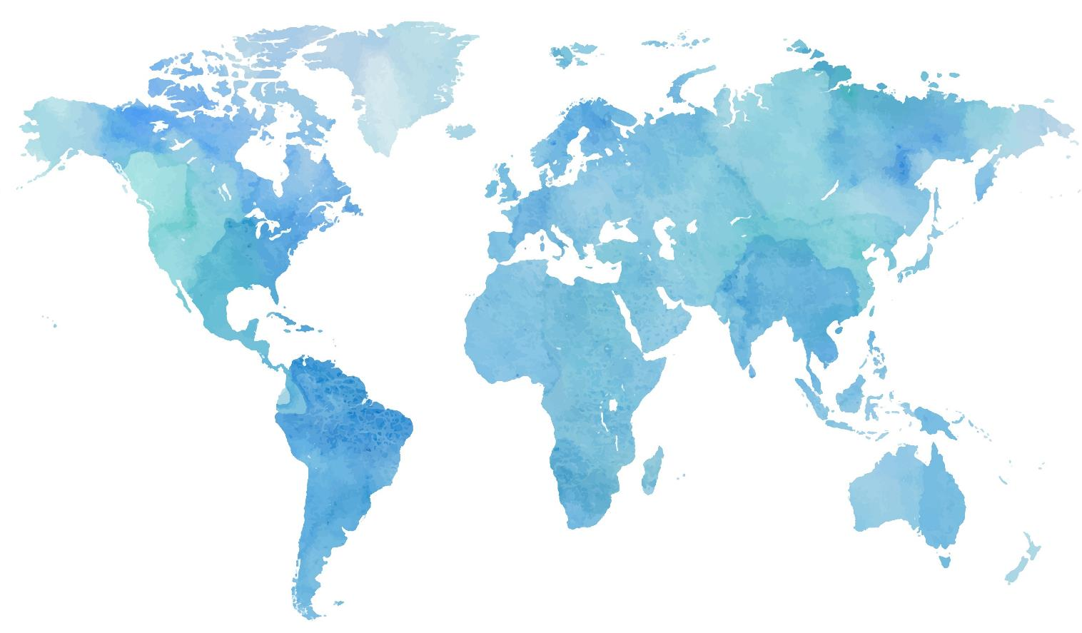

Notes:
Slide 16: which were here in Britain…..in London in fact.

Slide 17

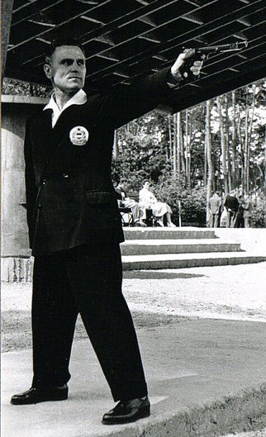
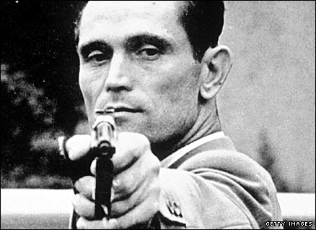
1948: Gold medal winner
1952: Gold medal winner
1956: 8th, aged 46
Notes:
Slide 17: In 1948, Takacs was 38, which is old for an Olympic athlete, but once again, his attitude helped him overcome this problem too. If he could teach himself to shoot left-handed, then being 38 wasn’t going to stop him either! And so he trained harder than ever, determined that this time, his Olympic hopes would be realised. And they were…..Takacs didn’t just compete, he won gold and broke the Olympic record with a total of 540 points. He went on to compete in the next two Olympic Games….winning a second gold in 1952 and coming 8th in the 1956 Olympic Games, aged 46.
I wonder what lessons we might learn from his courageous example?.... Just think quietly to yourself for a few moments.

Slide 18

Have a go!
Think positively
Keep on trying
Work together
Notes:
Slide 18: We’re going to think together now, about overcoming problems, in some very practical ways, using lessons we might have learned from the courage shown by Karoly Takacs – and our very own on-screen target!:
Think positively: Someone once said ‘How you think about a problem is more important than the problem itself - so always think positively.’ Karoly Takacs shows us that the way we see a problem makes all the difference. He saw his injury not as a problem, but as a challenge.
Have a go: sometimes we can spend too much time looking at a problem figuring out the best way to deal with it. Looking at it won’t solve it – at some point, you have to do something! So, have a go – what have you got to lose?
Keep on trying: we need to remember that we don’t always find the solution to a problem straight away. Solving problems can be very hard work, and so sometimes we give up too easily. Thomas Edison, the man who invented the light bulb, said that he found a thousand ways how not to make a light bulb before he found the right way! So….keep on trying!
Work together: there’s an old saying that says ‘A problem shared is a problem halved’. Everyone views a problem differently, because we’re all different, so when we ask for help & work with others to solve a problem, we learn how to listen to the ideas of others and see how another way of thinking can help. We’re going to sing about this in a few moments….

Slide 19
….I wonder if you’re facing a problem today?……
….I wonder what – or who – might help you to overcome that problem?....
….I wonder how the example of Karoly Takacs might help us this week?.....
Notes:
Slide 19: Responding and words for worship
Let’s be quiet and still with our own thoughts now…..
……I wonder if you’re facing a problem today?……
….if you are, have that problem in your mind as you think…..
…..I wonder what – or who – might help you to overcome that problem?....
.....we’ve thought of some practical ways to overcome the problems we might face….
…..thinking positively……
….having a go…..
…..sharing our problems & working with others……
…..not giving up too easily…..
…I wonder how the example of Karoly Takacs might help us this week?.....
Some people have another way to work out problems: to talk to God…..to pray about them. It says in the Bible, the special book for Christians:

Slide 20

‘If any of you needs wise advice, you should ask God, who loves to help.’
(James 1:5)
‘If any of you needs wise advice, you should ask God, who loves to help.’
(James 1:5)

Slide 21
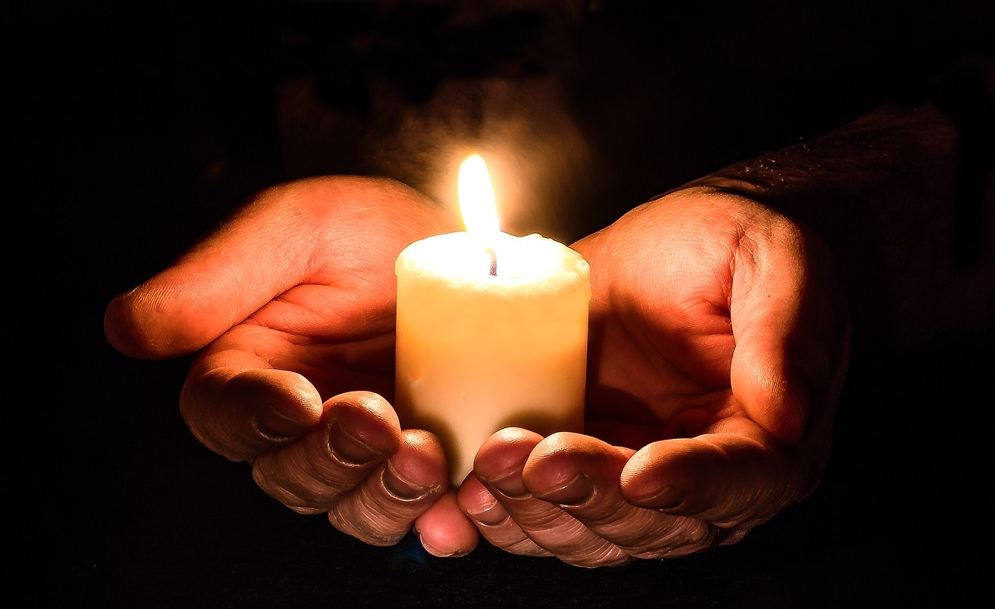
God who is wise….
Help us we pray.
Notes:
Slide 21: So, I’m going to create an opportunity for anyone who wants to pray to do just that. I will say some words, and after I say the words ‘God, who is wise’, I invite you to join me by saying ‘HELP US WE PRAY.’

Slide 22
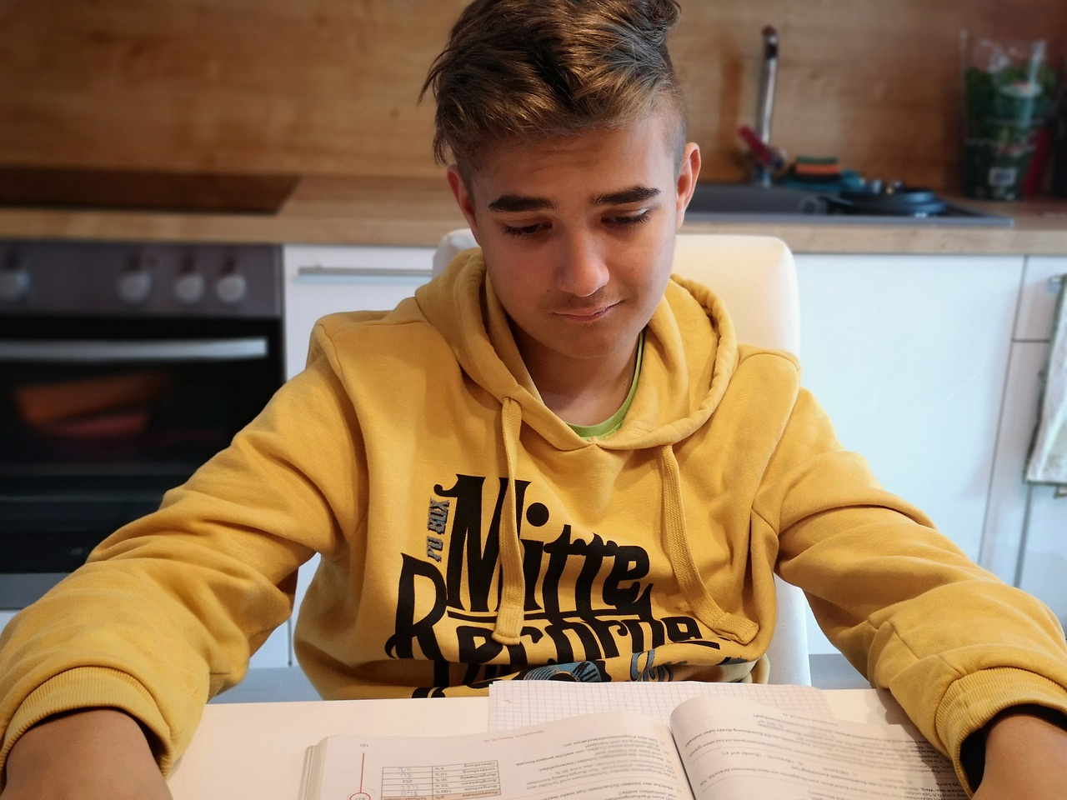
God who is wise….
Help us we pray.
Notes:
Slide 22: When we feel overwhelmed by a problem, and it’s hard to think positively,
God, who is wise, ‘HELP US WE PRAY’

Slide 23
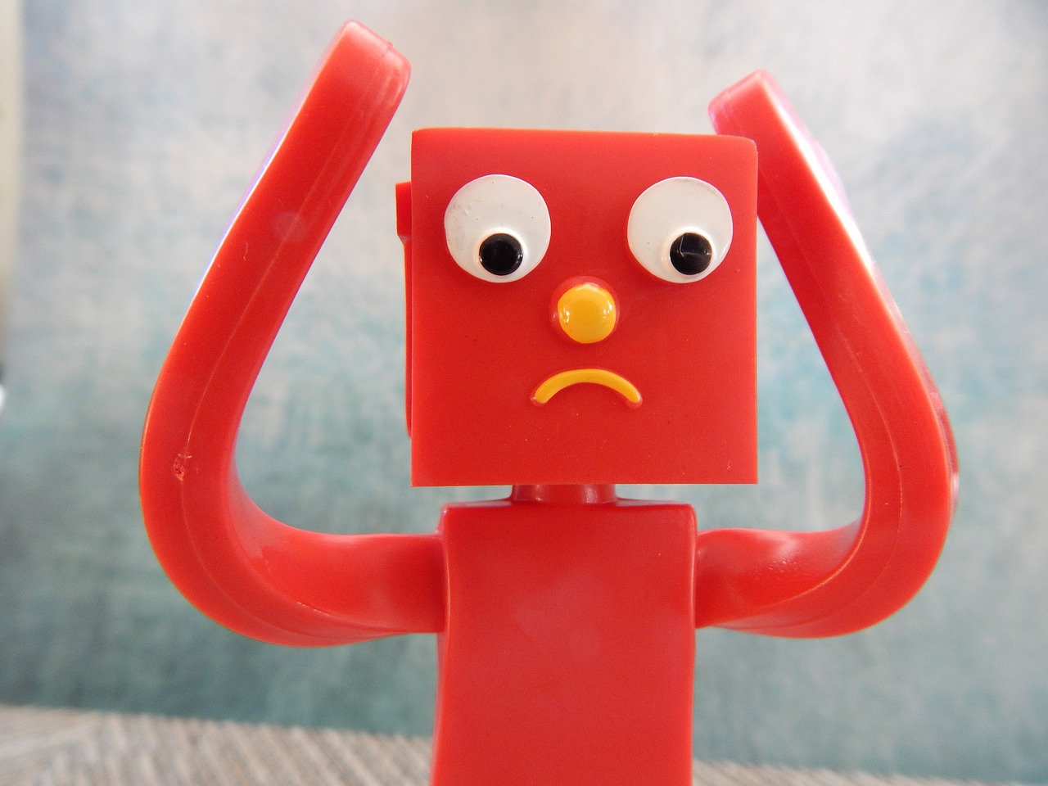
God who is wise….
Help us we pray.
Notes:
Slide 23: When if feels like there’s nothing we can do,
God, who is wise, ‘HELP US WE PRAY’

Slide 24
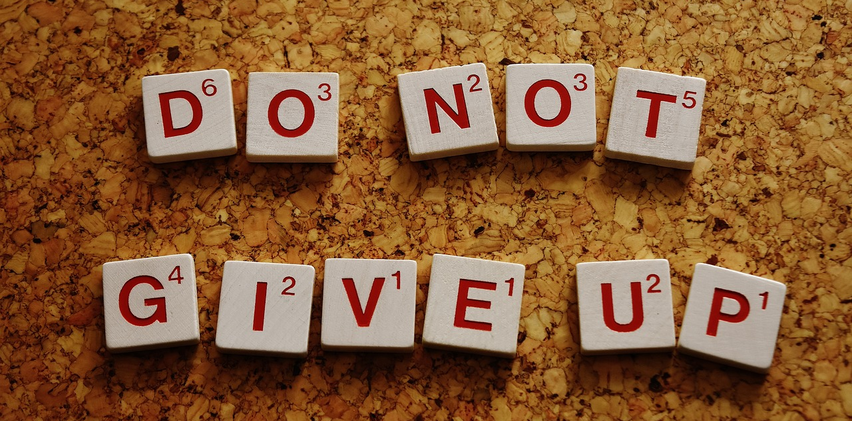
God who is wise….
Help us we pray.
Notes:
Slide 24: When we feel like giving up,
God, who is wise, ‘HELP US WE PRAY’

Slide 25
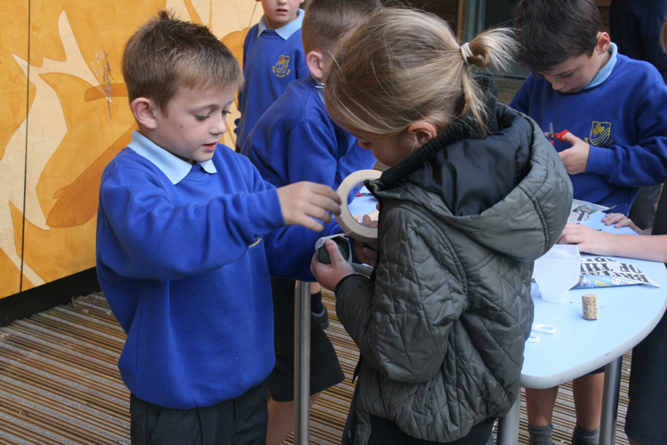
God who is wise….
Help us we pray.
Notes:
Slide 25: Rather than face a problem alone, help us to work together.
God, who is wise, ‘HELP US WE PRAY’

Slide 26


Slide 27



Leader: As we leave this place & time and go into the day ahead…
All: Let’s ‘go for gold’ in all that we do!
Notes:
Sending: Slide 15
Leader: As we leave this place & time and go into the day ahead…
All: Let’s go for gold* in all that we do!
*Again, you might need to unpick what we mean by ‘going for gold’ in the context of today’s words.

Slide 28
Notes:
Slide 28: Reflective areas: get practical!
Get practical this week and prioritise working together to help each other out. Make a class list of all the different ways in which you have done this over the week.

