Slide 1



Leader: We are here together
Children: With ears ready to hear and hands ready to serve.
ALL: May we be wise in all our actions today.
Notes:
Slide 1: Use our new gathering words. Why not invent your own actions to accompany them?
Leader: We are here together
Children: With ears ready to hear and hands ready to serve.
All: May we be wise in all our actions today.

Slide 2

Notes:
Slide 2: Let’s start today with our Wise Words

Slide 3
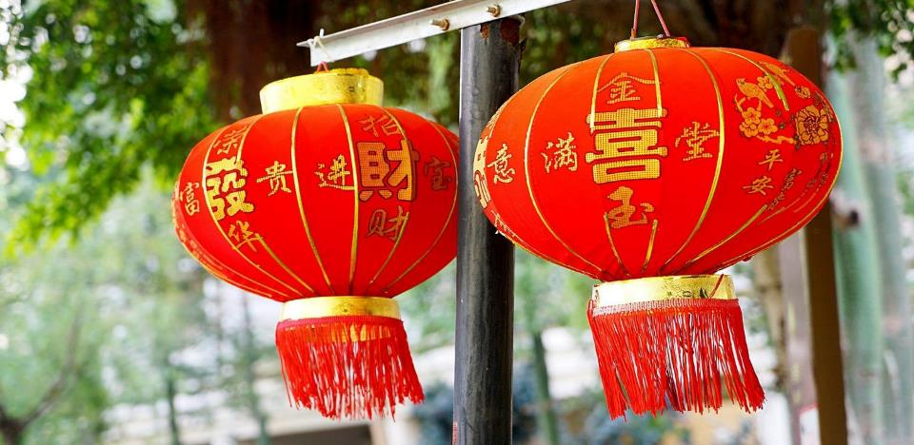
‘A generous person will themselves be blessed.’
[Proverbs 22:9]
Notes:
Slide 3: ‘A generous person will themselves be blessed.’ [Proverbs 22:9] ’What does it mean to be generous?’ [Pause and talk together] This word is going to be very important for our time together today.

Slide 4

Notes:
Slide 4: In our collective worship today, we are going to be thinking about Lunar New Year, sometimes called ‘Chinese New Year’.

Slide 5
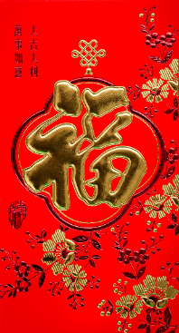
Gung Hay
Fat Choy!
Gung Hay Fat Choy!
Photo by Mae Mu on Unsplash
Notes:
Slide 5: All over the world, people will be wishing each other ‘Gung Hey Fat Choy!’, Happy New Year! There are lots of different traditions, such as hanging out lanterns, lucky red envelopes, and wearing new clothes – especially red ones!

Slide 6

Notes:
Slide 6: Each new year takes the name of a different animal – this year it’s the Year of the Dragon. There are lots of traditional stories about why this happens, but we’re not going to be thinking about these stories today…. although we ARE going to have a story about some dragons!

Slide 7
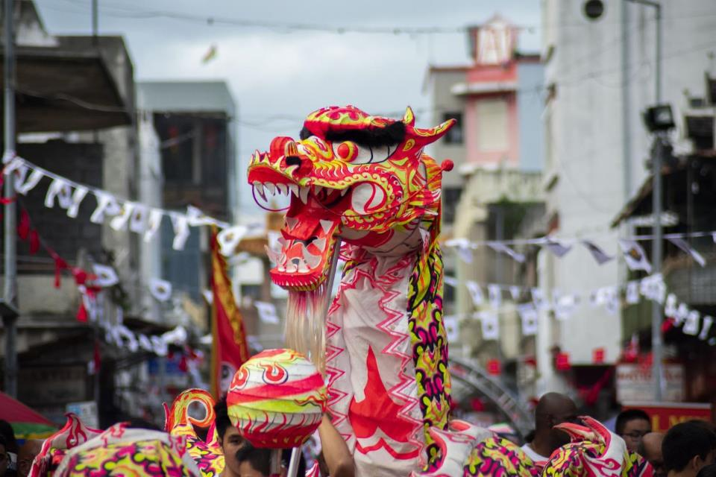
Notes:
Slide 7: Another traditional thing that you might see at Lunar New Year is a dragon dance. It’s believed that dragons are friendly and helpful creatures, associated with strength, good fortune, wisdom and long life, not scary fire-breathers as you might think! We’re going to hear a legend from China about some dragons now.

Slide 8
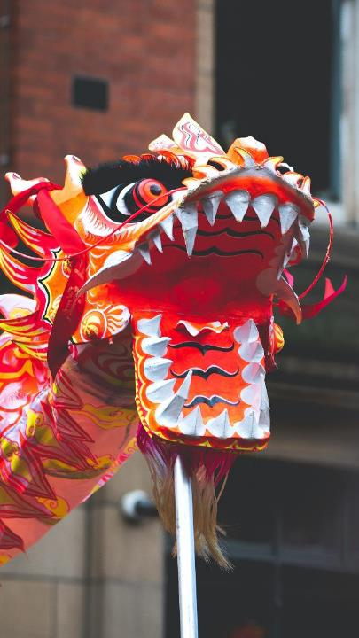
The Generous Dragons
Photo by Valentin Petkov on Unsplash
Notes:
Slide 8: It’s called ‘The Generous Dragons’ and it will help us to think and reflect together later. As you listen, think about where you see generosity in the story…. [use script and pictures slides 9-15] If time allows, come back to this question after the story for further discussion.

Slide 9

Photo by Michael Benz on Unsplash
Notes:
Slide 8: Long, long ago, there were no rivers or lakes on the earth, but only the great Eastern Sea. Four dragons lived in it – the Long Dragon, the Black Dragon, the Yellow Dragon and the Pearl Dragon. They were all wise and generous creatures and they loved to fly, high in the sky, soaring above the sea and out over the land. One day, they looked down and saw something they had never seen before.

Slide 10
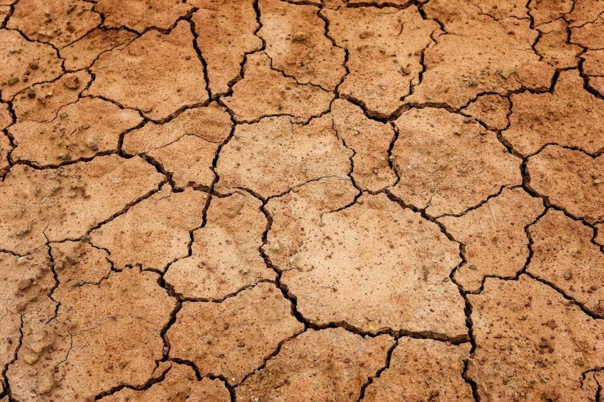
Notes:
Slide 9: The land which had once been green and fertile was now brown and parched, because there had been no rain for a long time. The people who lived on it were looking hungry and worried, and the dragons wanted to do something to help.
‘How poor the people are!’ the Yellow Dragon exclaimed. ‘If they don’t have rain soon, they will have no food to eat.’ So the dragons decided to go and see the Jade Emperor to beg him for rain and soared high into the clouds to find the Heavenly Palace.

Slide 11
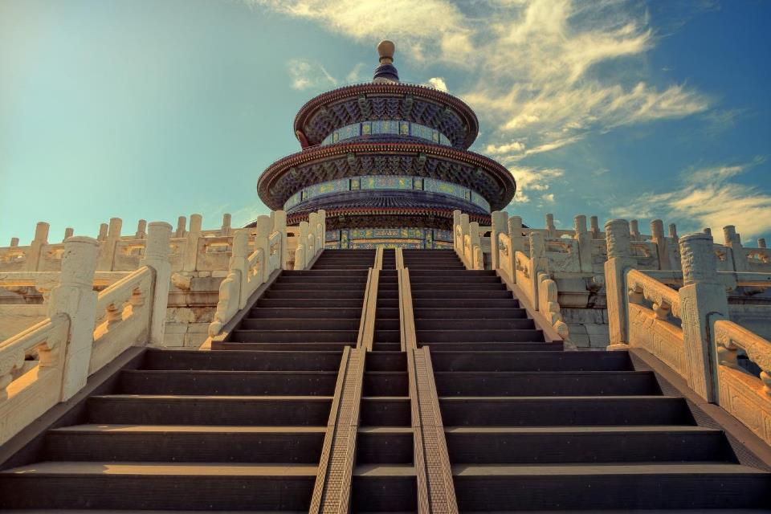
Notes:
Slide 10: They presented their case to the Jade Emperor, pleading for him to send rain to the villagers so that they might grow food to eat. Now unfortunately, the Jade Emperor wasn’t the kindest of rulers. ‘OK’ he said, ‘You go down first and I’ll send rain tomorrow.’ The dragons gratefully thanked the Emperor and flew away happy. But tomorrow came, and there was no rain, or the day after, or the day after that. Ten days passed, and the people of the village were running out of food to eat and water to drink. The four dragons saw all this, and were saddened. They knew that the Emperor had forgotten his promise, and so decided to do something about it themselves.

Slide 12

Photo by James Eade on Unsplash
Notes:
Slide 11: ‘There is plenty of water in the Eastern Sea, where we live!’ the Long Dragon. ‘Let’s scoop it up and spray it down over the village, and it will look like rain, and the people won’t die!!’
‘That’s a great idea!’ the other dragons exclaimed, but then they thought deeply for a moment. ‘If the Emperor finds out we have done this, we’ll be in trouble…’
But they decided that it was more important to save the people, and so off they flew, back to the Eastern Sea, and began to scoop up water in their mouths to spray out over the earth.

Slide 13
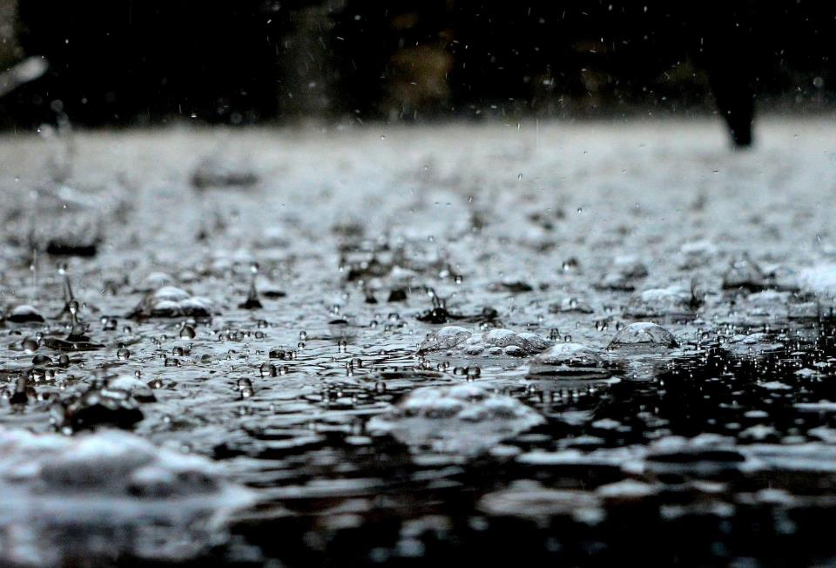
Notes:
Slide 12: They flew backwards and forwards, high up into the sky doing this until the sky became dark and the sea water became rain pouring out of the sky.
‘It’s raining! It’s raining !’ the people shouted, and knew they had been saved.
But the Jade Emperor found out about the generous deed of the four dragons and decided to punish them for interfering. He gathered his army and they brought the dragons to the Palace.

Slide 14
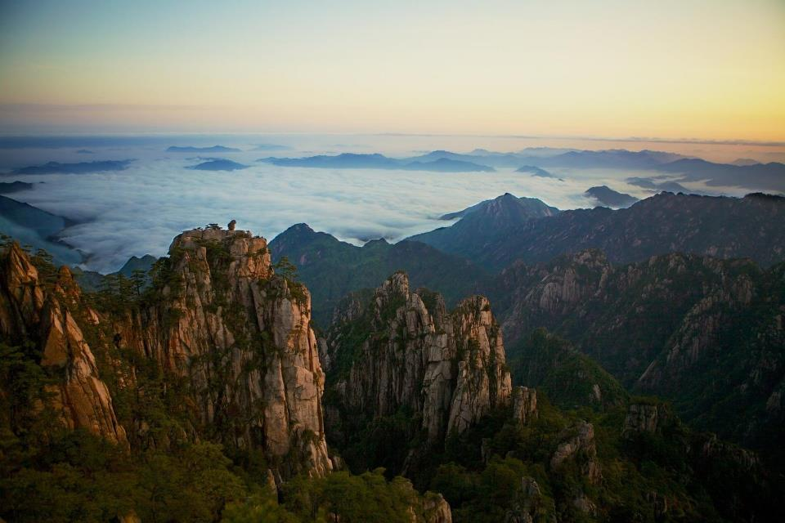
Notes:
Slide 13: ‘Go and find four mountains’ he ordered. ‘Then lay the mountains on them so that they can never escape!’
And that’s what happened, but the dragons were still glad that they had saved the villagers. Even as they were, stuck under the mountains, they decided to do one last good deed to help the people.

Slide 15
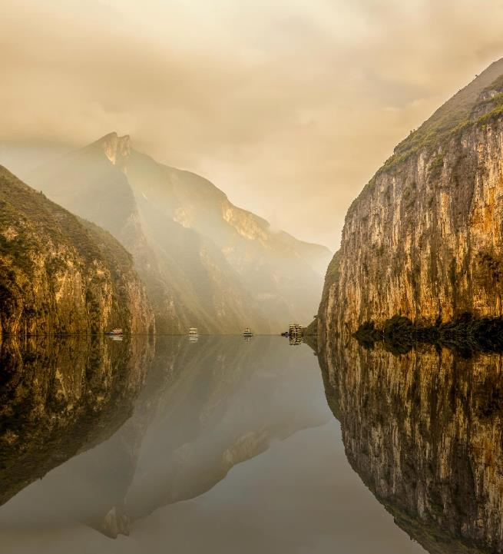
Photo by Shane Young on Unsplash
Notes:
Slide 14: They turned themselves into four rivers to give the people of China water forever. And that’s the legend of how China’s four great rivers were formed, thanks to the selfless actions of the Four Dragons.
If time allows, revisit the question about where generosity was seen in the story.

Slide 16
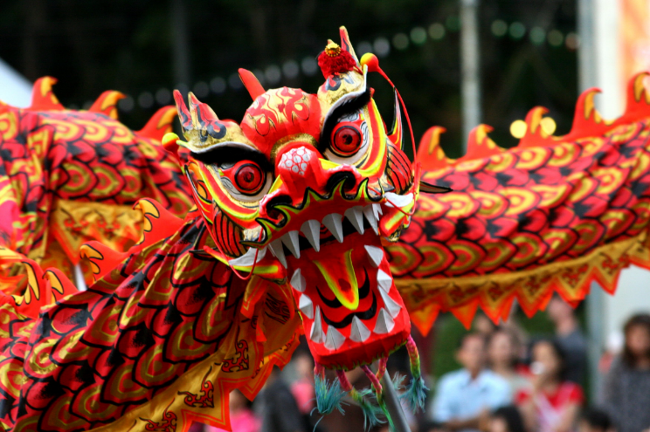
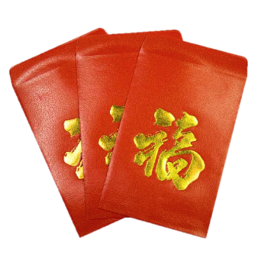
‘Lucky’ envelopes
Notes:
Slide 16: At the start of our time together, we were talking about some of the different customs of Lunar New Year. Another tradition is that the older people in the family will give red envelopes to the younger members of the family, with ‘lucky money’ inside for them to spend or save. We’re going to end our assembly with a game using ‘red envelopes’. Now these are not proper ‘red envelopes’, with real lucky money, but there’s something inside each red envelope to remind us of Lunar New Year and to help us think. In the story, we heard about the generous actions of the four dragons and these envelopes are going to help us to think more about what it means to be generous. [Use the envelopes and cards] I wonder how these ideas might help us today – and throughout half term?

Slide 17
‘A generous person will themselves be blessed.’
[Proverbs 22:9]
Notes:
Responding (and words for worship): Slide 17
Let’s be still and quiet together now….
….we’ve been thinking about generosity today….
….we shared a story about the generous actions of the dragons….
….and shared some thoughts about being a generous person….
…generosity is a really important part of Eastern cultures and traditions…
...but is also shared by many other communities across the world….
Let’s go back to the wise words we started with….
‘A generous person will themselves be blessed.’
…..I wonder why this is?.....
….I wonder if being generous might help others to be generous?.....
….and why being generous is such an important part of Lunar New Year?....

Slide 18
Generosity
‘…be generous on every occasion…’
2 Corinthians 9:11
Notes:
Slide 18: A man named Paul, who was one of the very first Christians wrote these words to the people of one of the very first churches: ‘Be generous on every occasion’….
….I wonder what this might mean for you today…and during half term?.....
[Allow plenty of time for reflection]
Being generous all the time is not always easy! I’m going to turn my thoughts into a prayer now, asking God to help us. If you’d like to, find a way to make this prayer your own – or if you’d prefer, then continue to be still with your own thoughts….

Slide 19
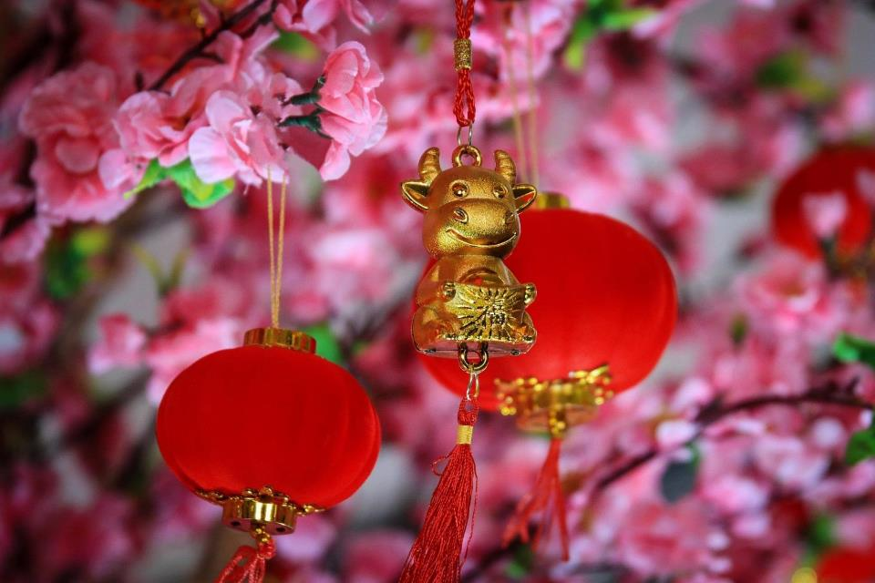
Dear God
Thank you for the time we’ve spent today thinking about what it means to be generous. We like it when people are generous towards us, but please help us to find ways to be generous to those around us, as often as possible – to our family, our friends, in our wider communities, and to anyone who needs it.
Amen
Notes:
Prayer: Slide 18
Dear God
Thank you for the time we’ve spent today thinking about what it means to be generous. We like it when people are generous towards us, but please help us to find ways to be generous to those around us, as often as possible – to our family, our friends, in our wider communities, and to anyone who needs it.
Amen

Slide 20


Leader: As we leave this place & time and go into the day ahead…
All: May today’s words help us to make wise choices.

Slide 21
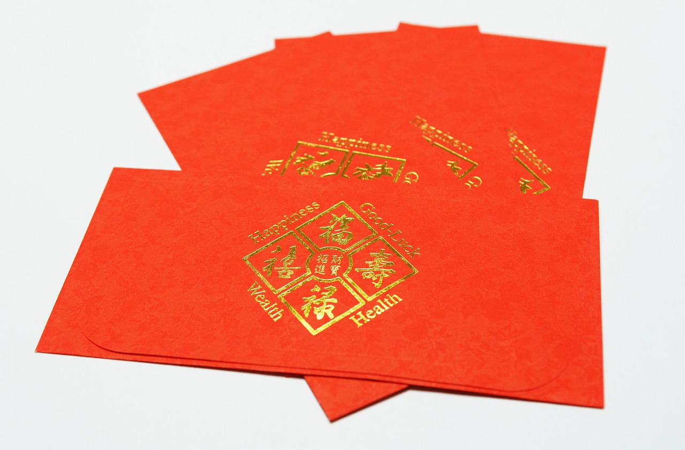
Notes:
Reflection areas:
Make lucky red envelopes using the resources on p.5-8 to print out cards to help children to think about being generous and put in your reflective area. Encourage pupils to write onto red paper some ideas they have about generous acts they could offer to do for others & fold up to make an ‘envelope’. You might want to use the words from different religious traditions on p.9-10 (which are also on slides 22-24 at the end of the PowerPoint), or just put a sentence starter: ‘A generous person…..’ to help children to suggest their own ideas.
Why not send this idea out to families to use one a day during half term – and suggest that they agree generous actions together that would make a difference to their family? Make sure it’s something you can actually do!

Slide 22
The Generous Dragons
‘Generosity brings happiness’
Siddattha Gotama (Buddha)

Slide 23
The Generous Dragons
‘Do not turn away a poor man…even if all you can give is half a date’
Prophet Muhammad (pbuh) [Islam]

Slide 24
The Generous Dragons
‘…generosity consists not in the sum given, but the manner in which it is given….’
Mahatma Gandhi [Hinduism]

