Slide 1


Follow my
lead!
Notes:
Slide 1: This term, we are thinking about leading, leaders, and followers, so let’s start as we always do….

Slide 2


Leader: As we share these stories of leaders…
ALL: May we follow their example
in thoughts
and words
and actions.
Notes:
Leader: As we share these stories of leaders…
ALL: May we follow their example in thoughts and words and actions.
Signs for greeting: click on links
Thoughts: British Sign Language BSL Video Dictionary - thought (signbsl.com)
Words (use 3rd definition): British Sign Language BSL Video Dictionary - word (signbsl.com)
Actions: British Sign Language BSL Video Dictionary - action (signbsl.com)

Slide 3
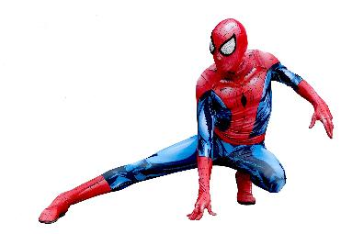
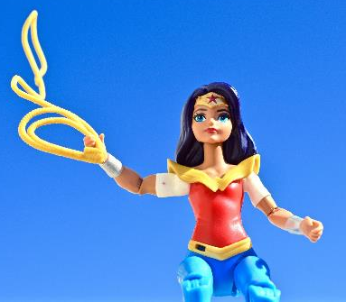
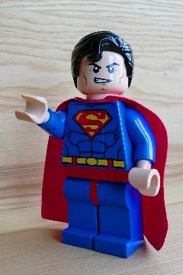
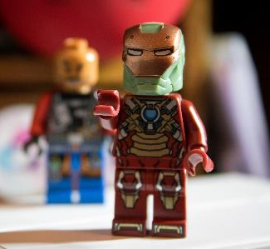

Slide 4
SUPER POWER!!
Notes:
Slide 3: We’re going to start our time together today with another quick game….about superheroes. Explain that you’re going to show them some pictures of different superheroes, and that you want them to tell you what each’s superpower is. Then show each picture in turn before continuing:

Slide 5
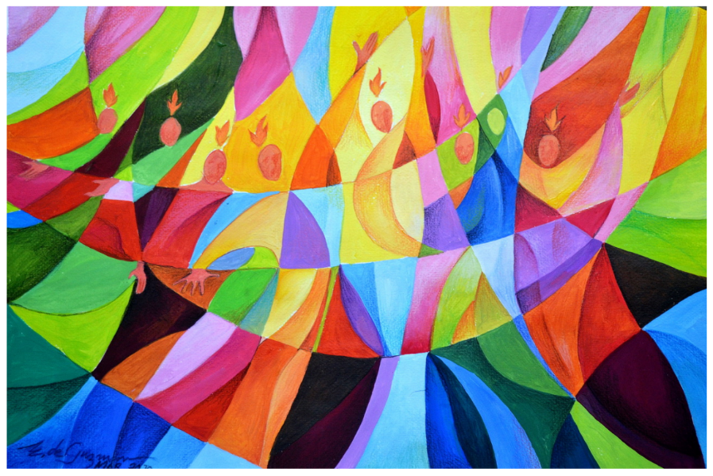
Notes:
Slide 5: This week, Christians all over the world will be celebrating something called Pentecost. Pentecost happens 50 days after Easter, and recalls the story from the Bible of how the very first Christians were given a rather different kind of ‘super power’. There’s something I need your help with in the story. Every time I say the word ‘power’, I need you to put on your best ‘superhero’ voice, put your arm out front (like Superman!) and say ‘SUPER POWER!’ Can you do that for me now?...... There’ll be lots of opportunities for you to join in, so pay attention and I’ll try not to catch you out! [use script on p.3]

Slide 6
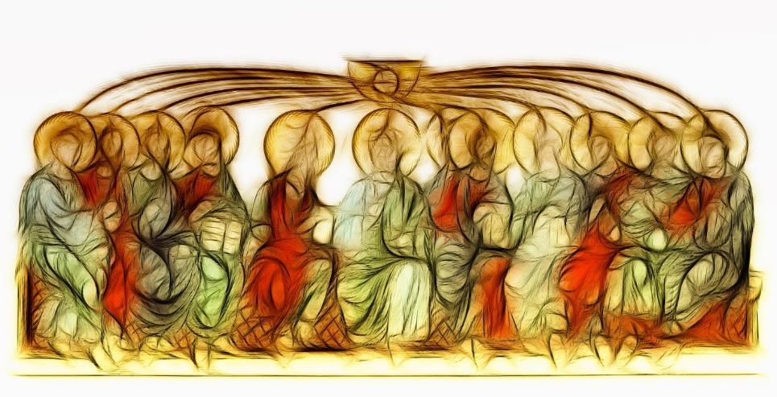
Picture copyright-free from pixabay
…to be continued...
Notes:
Slide 6: That’s the story of the very first Pentecost, and all around the world, as it’s being celebrated, Christians will also be remembering that the story hasn’t finished yet! They believe that it carries on in their lives because as followers of Jesus, they now carry God’s power ‘SUPER POWER!’ wherever they go. As you heard, this is not like Superman’s super powers, but the power to be brave and to love others. As Christians live their lives, God’s Holy Spirit can work in, and through, them to change and save our world too. Christians believe that when they ask God to give them more of his Holy Spirit power (‘SUPER POWER!’) it changes them first, to make them more like Jesus – and then helps them to love others, as God does.

Slide 7
Picture copyright-free from pixabay
….I wonder what might happen if each of us looked for the chance to demonstrate the kind of love that comes from God for someone else today?….
….I wonder what difference it might make?….
….I wonder if it might literally change the world?.....

Slide 8
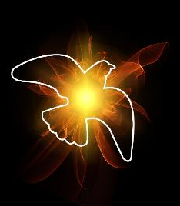
God be in my head and in my understanding

Slide 9
God be in my eyes and in my looking

Slide 10
God be in my mouth and in my speaking

Slide 11
God be in my heart and in my loving

Slide 12
God be in my hands and in my caring

Slide 13
God be in my life and in my living

Slide 14
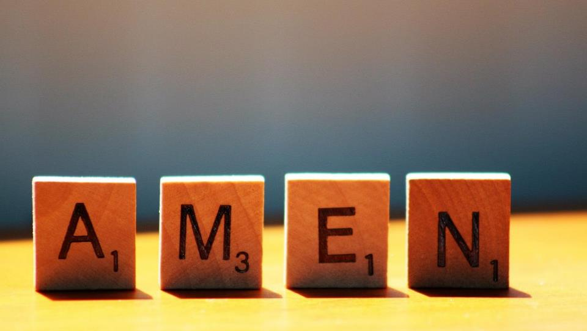

Slide 15



Leader: As we leave this place & time and go into the day ahead…
All: …may our hearts be filled with love.

Slide 16


Do some mindful colouring and think about the difference that love makes.

