Slide 1





We are here together in our school family. May God be with us…
...and watch over us.
Notes:
Slide 1: Use these new gathering words for this term, or your usual greeting if you prefer.

Slide 2
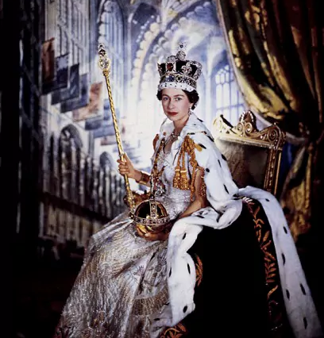
Notes:
Slide 2: This is our Queen on her coronation day, June 2nd 1953, although she became Queen when her father died quite suddenly the year before, in 1952….

Slide 3

Notes:
Slide 3: …so we celebrate her Platinum Jubilee this year, 2022 - 70 years later. She is the longest reigning monarch in British history – which is something worth celebrating!!

Slide 4
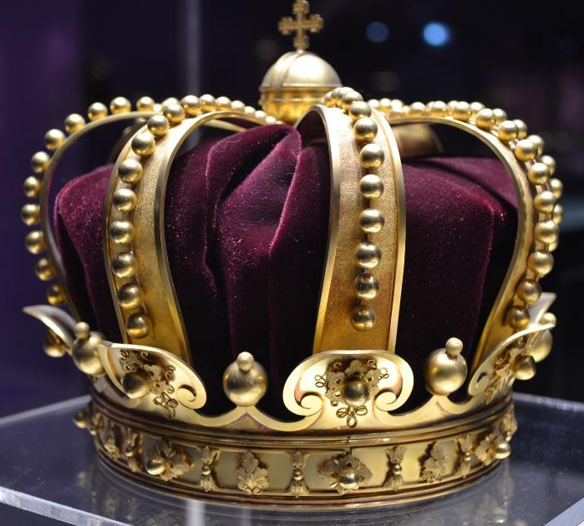
If you were Queen (or King!) for the day, what rule would you make?
Notes:
Slide 4: Ask the question you’ve prepared, and allow pupils a few moments to think whilst the teachers share their ideas. Then ask as many children as you have time for, or invite one child to dress up as the monarch for the day and give some ‘decrees’

Slide 5

The Lord’s Prayer
Notes:
Slide 5: This term, we’re thinking about the words in the prayer that Jesus taught to his friends – the prayer that Christians call the ‘Lord’s Prayer’.

Slide 6
Our Father in heaven,
Hallowed be your name
Your kingdom come, Your will be done on earth, as it is in Heaven.
Give us today our daily bread.
Forgive us our sins,
As we forgive those who sin against us.
Lead us not into temptation,
But deliver us from evil.
For the Kingdom, the power and the glory are yours, now and forever.
Amen
Notes:
Slide 6: This week, we come to this line: ‘Your kingdom come, your will be done on earth as it is in heaven’. Christians believe that God is King, not just for a day – as we’ve pretended to be – or even for nearly 70 years like our Queen, but FOREVER.

Slide 7
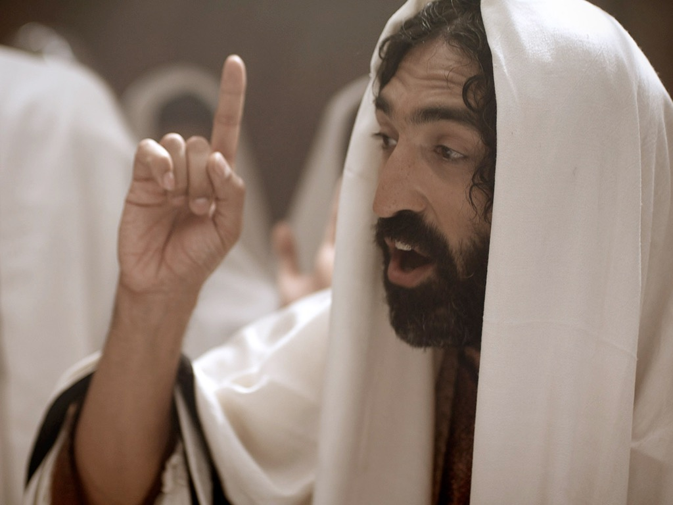
In God’s kingdom….
Notes:
Slide 7: When Jesus walked this earth, people often asked him about the kingdom of God, in fact, someone once asked him what the most important rule in God’s kingdom was: I wonder if you can have a guess at what Jesus replied [ask some children]

Slide 8

Jesus said ‘Love God and love other people’
love God
love others
Notes:
Slide 8: In fact, Jesus answered very simply: to love and serve God, and to love and serve others. In the life he lived, Jesus showed people what God’s kingdom should look like – especially in how he treated those whom he met. He spent time with people that no-one else cared about, valuing them, loving them, serving them: loving God, his father, and loving others. Jesus said that living life this way shows that you are part of God’s kingdom, here on earth.
When Christians pray ‘Your kingdom come, your will be done’, they are asking God to help them to live this way, loving God and loving others.

Slide 9
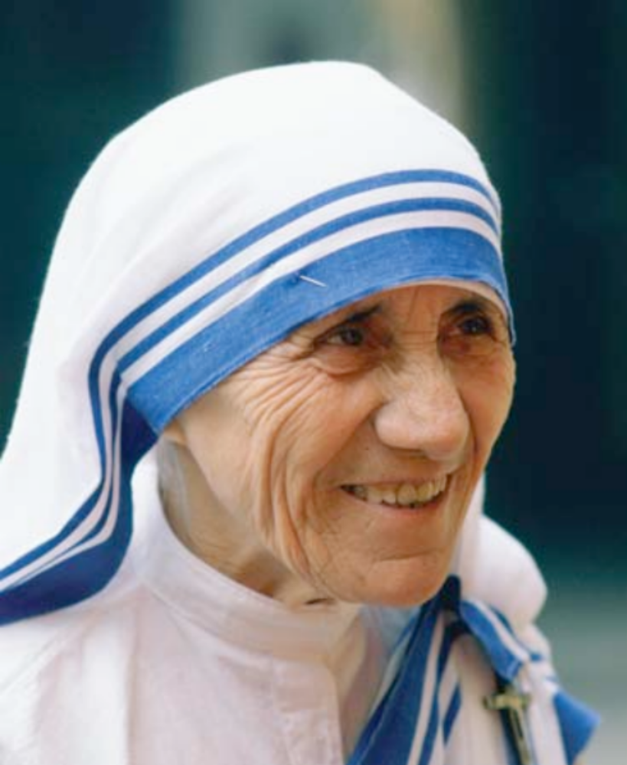
Notes:
Slide 9: One famous lady who prayed this prayer for herself, and lived her life trying to love God and love others was a Christian lady called Mother Teresa.

Slide 10
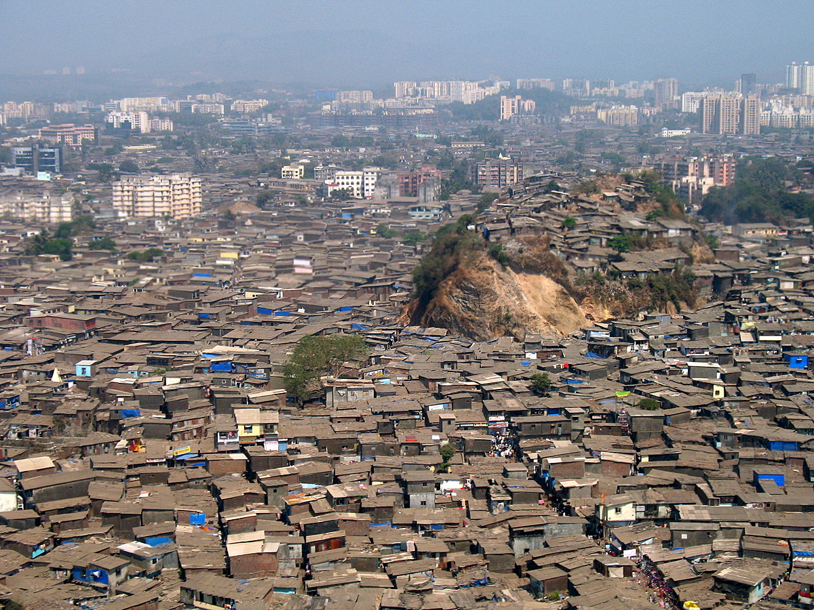
Notes:
Slide 10: She lived with the some of the poorest people on earth, just as Jesus had done, but in a large city called Colcatta, in India.

Slide 11
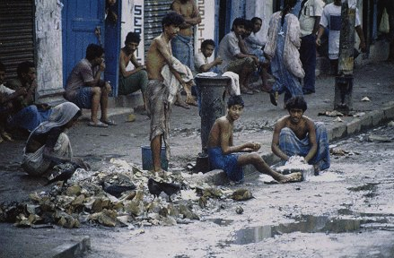
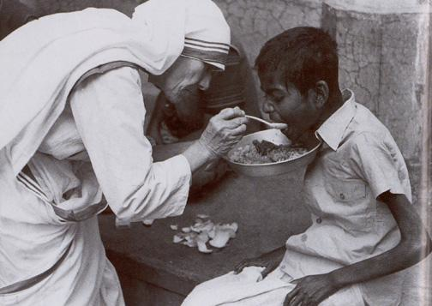
We cannot do great things, but we can do small things with great love.
Notes:
Slide 11: Every day, she showed God’s love to them by showing them that they truly mattered to her. She fed those who were hungry, nursed those who were sick, and sat by those who were dying. To her, these were such small things – but she is famous now for her great love, as she followed the example of Jesus. She said these words: ‘In our lives, we can do no great things – just small things with great love.’ As we approach Valentine’s Day next week, on February 14th, there will be much talk about love: you may not be able to do great things, but we can all do small things for the people around us, with great love in our hearts.

Slide 12
…. I wonder what it’s like to be a part of God’s kingdom?....
….I wonder what it means for Christians to ‘love God’ and ‘love others’?....
….I wonder how Mother Teresa’s actions helped to bring God’s kingdom to earth?....
….I wonder how our world might be changed if everyone lived like this?....
love God
love others
Notes:
Slide 12: Let’s wonder together…
…. I wonder what it’s like to be a part of God’s kingdom?....
…I wonder what it means for Christians to ‘love God’ and ‘love others’?....
….I wonder how Mother Teresa’s actions helped to bring God’s kingdom to earth?....
….I wonder how our world might be changed if everyone lived like this?....

Slide 13
Jesus said ‘Love God and love other people’
love God
love others
Notes:
Slide 13: Responding (words for worship):
Let’s be still and quiet together now….
…in the stillness, think about the things that you’ve heard today, about loving God, and loving others….
…and about showing God’s kingdom here on earth…
…we’ve heard how Jesus did this, and how Mother Teresa did it….
….what might it mean to ‘love God’?.....
....and ‘love others’?.....
I’m going to turn my thoughts into a prayer now, using the words of a song, (from Out of the Ark) [which you could sing as you go out.] Make the prayer your own if you’d like to…or if you’d prefer not to pray, then just sit quietly with your own thoughts.

Slide 14
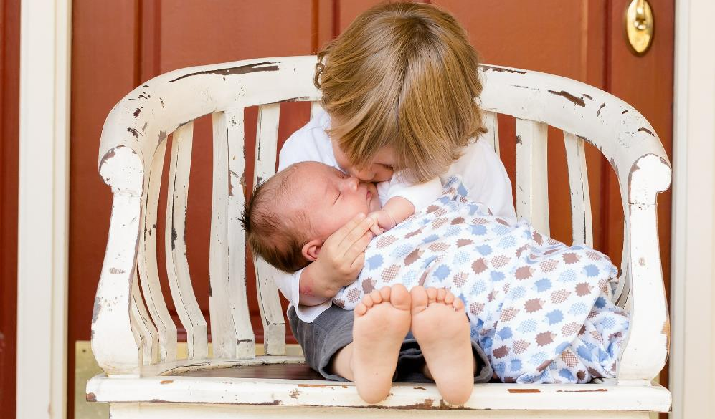
Today is the day we’ve been given
To care for everyone,
In all we do, in all we say,
May this day be filled with kindness and love.
© Out of the Ark

Slide 15


Slide 16


love God
love others
Leader: As we leave this place & time and go into the day ahead…
All: May this day be filled with kindness and love.

