Slide 1
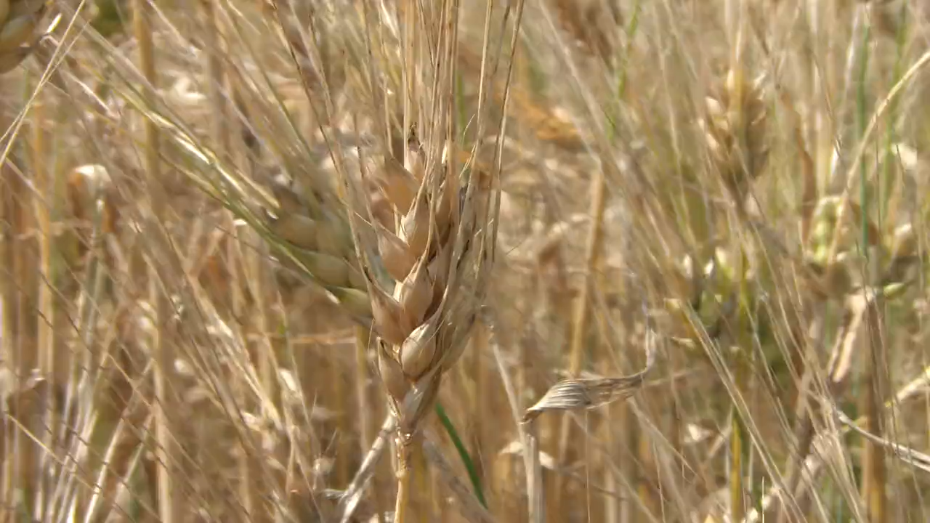
All images copyright-free from pixabay, unless otherwise identified
Notes:
Slide 1: Welcome stilling exercise – field of grain
Use the stilling slide if desired: the suggested words should be spoken slowly, leaving pauses inbetween to create a sense of stillness.
As you sit quietly here, watch the movement of the grain in the field…..and bring your mind into a peaceful place [PAUSE]
Now practise slower breathing…..in…..and out…..in……and out…..keep this going as you continue to watch….[PAUSE]
You maybe notice that you are feeling calmer and more relaxed….[PAUSE]
As you breathe, think about yourself and what you bring into this time today…..and think about how peace has come upon us…. [PAUSE]
We come into this special / sacred space and time to be still….to think deeply…..to be together as a school community…..
In our time together today, we are thinking about Harvest, and we will….. talk about Harvest…..tell each other a HARVEST story….. and think together about Harvest means for our school community – and the wider world.
But first, let’s welcome one another as we begin….

Slide 2
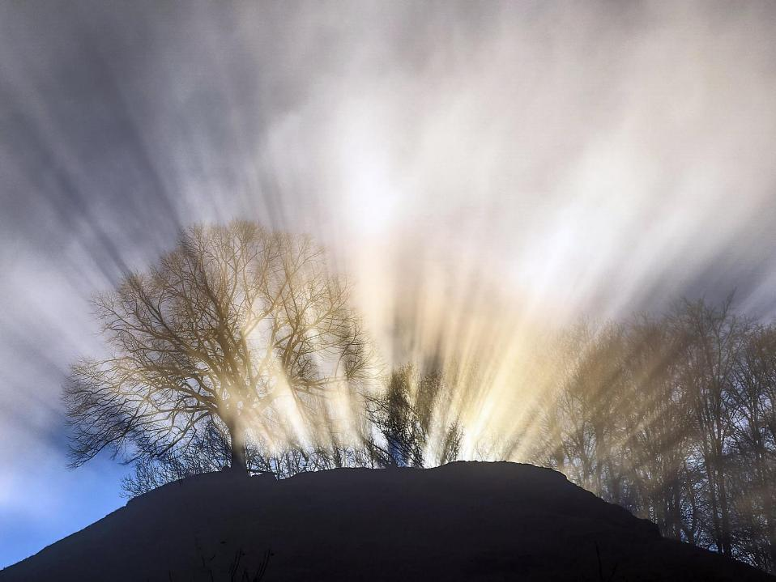
Leader: This is a day that God has made.
ALL: We will rejoice and be glad in it!
Notes:
Slides 2/3: Teach this new greeting to your school community – there are two slightly different versions from the point of view of the leader; choose which best fits your school’s context. One uses words adapted from Psalm 118:24
Leader: This is a day that God has made!
ALL: We will rejoice* and be glad* in it!
OR:
Leader: Today is a brand new day…..
ALL: May we be a blessing to each other!
*There are different BSL signs for rejoicing and joy/gladness. View them here: https://www.signbsl.com/sign/rejoice
Blessing: https://www.signbsl.com/sign/blessing (1st video)

Slide 3
Leader: Today is a brand new day!
ALL: May we be a blessing to each other!
Notes:
Slides 2/3: Teach this new greeting to your school community – there are two slightly different versions from the point of view of the leader; choose which best fits your school’s context. One uses words adapted from Psalm 118:24
Leader: This is a day that God has made!
ALL: We will rejoice* and be glad* in it!
OR:
Leader: Today is a brand new day…..
ALL: May we be a blessing to each other!
*There are different BSL signs for rejoicing and joy/gladness. View them here: https://www.signbsl.com/sign/rejoice
Blessing: https://www.signbsl.com/sign/blessing (1st video)

Slide 4

Count your blessings
Notes:
Slide 2: This term, we are thinking about our blessings – all the good things in our lives.

Slide 5
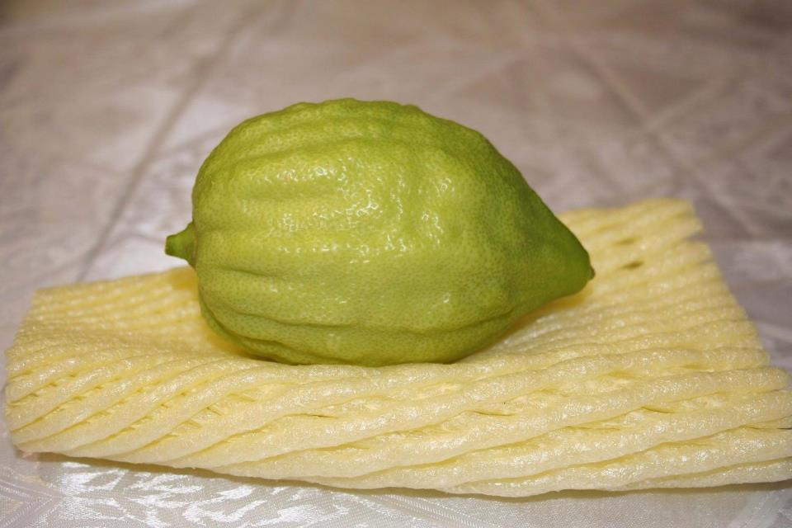
“God will provide!”
Sukkot
Notes:
Slide 5: Last week, we heard of a special, thank-ful, Harvest celebration for Jewish people, called Sukkot – a festival that is still being celebrated today all over the world, reminding people that ‘God will provide!’ Today, we are going to continue that theme… by being thankful, ourselves, for the food that our earth (and farmers!) produce.

Slide 6

The big Harvest shout-out!
Notes:
Slide 6: We are going to do a great big, grateful, HARVEST shout-out now, which is NOT something that we very often allow in collective worship (shouting out)! After 3, everyone can shout out their favourite food… so have a quick think now about what you’ll say…... 3-2-1…. [HARVEST shout-out!]
We are lucky to live where we do, with all the many different types of food that we like, but it’s not the same for everyone. I have some big letters here to help us with a very special HARVEST story, and I need 7 helpers to hold them. [gather your helpers and give them each one letter to hold so that the word HARVEST is spelt]

Slide 7
H A R V E S T
Notes:
Slide 7: H A R V E S T……and I need 7 helpers to hold them. [gather your helpers and give them each one letter to hold so that the word HARVEST is spelt]

Slide 8
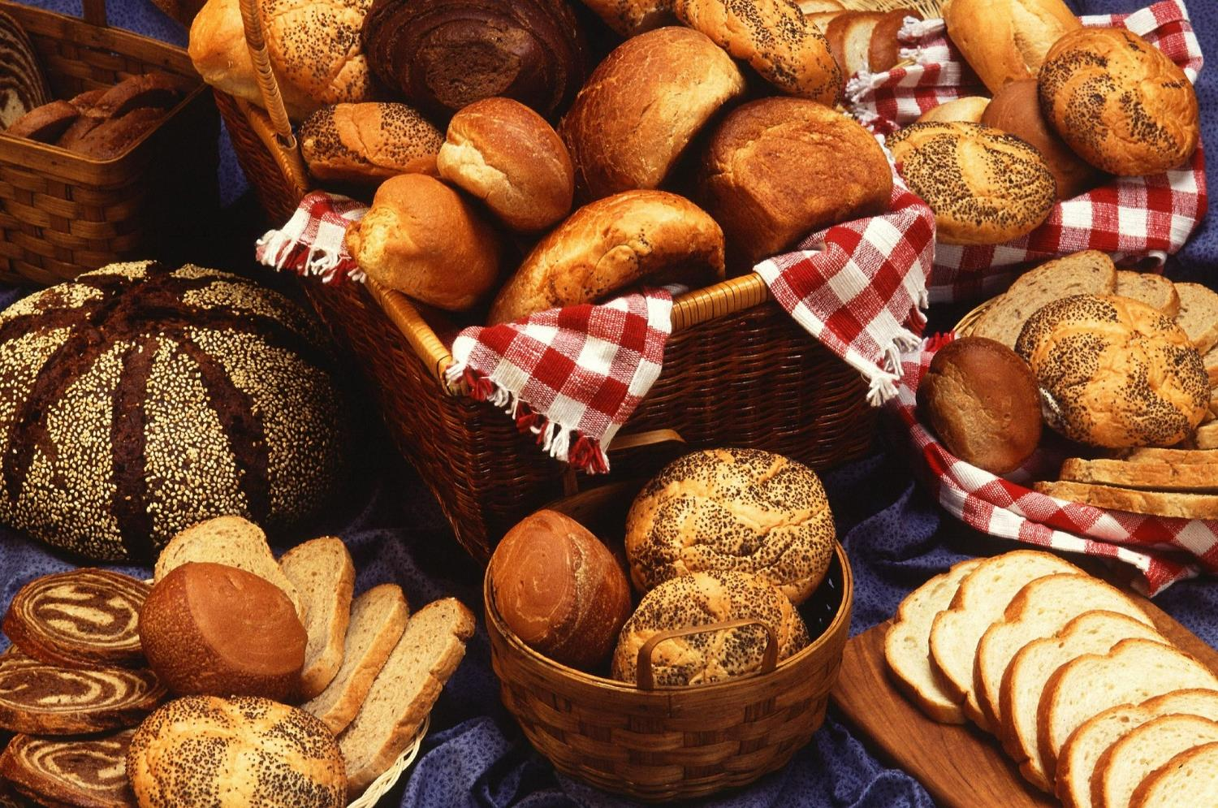
Notes:
Slide 8 / bread: At this time of year, we often think about HARVEST-time. People sometimes make special shaped bread to celebrate the HARVEST. But we don’t just harvest wheat: HARVESTing happens all over our world, to bring our food from where it is grown to our tables.

Slide 9
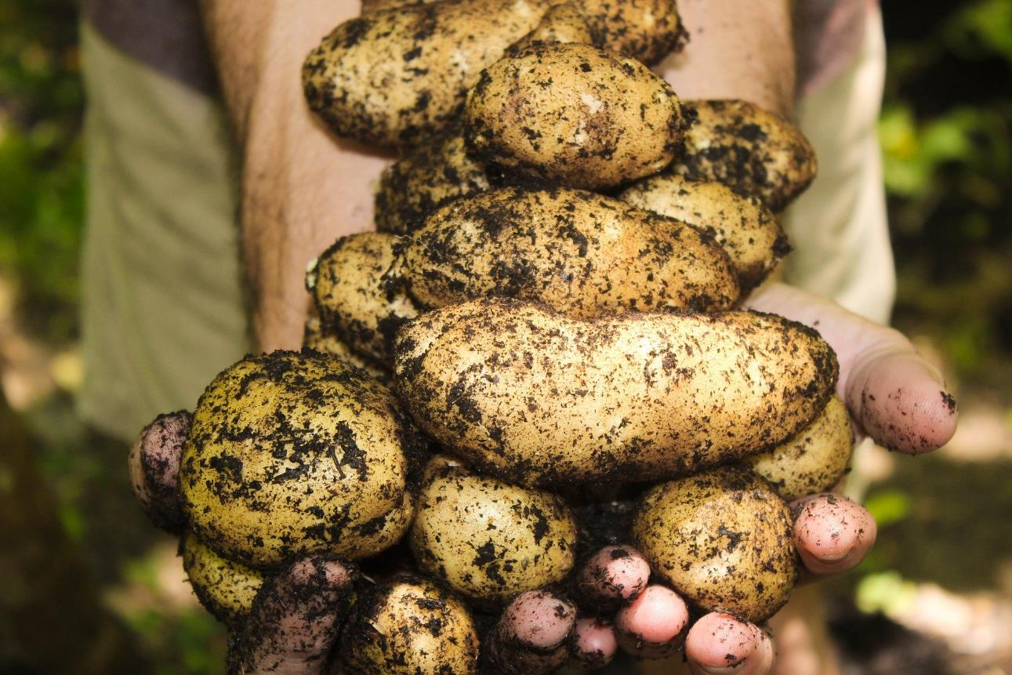
Notes:
Slide 9: Some of you may even have grown things in your garden, that you are now HARVESTing!

Slide 10
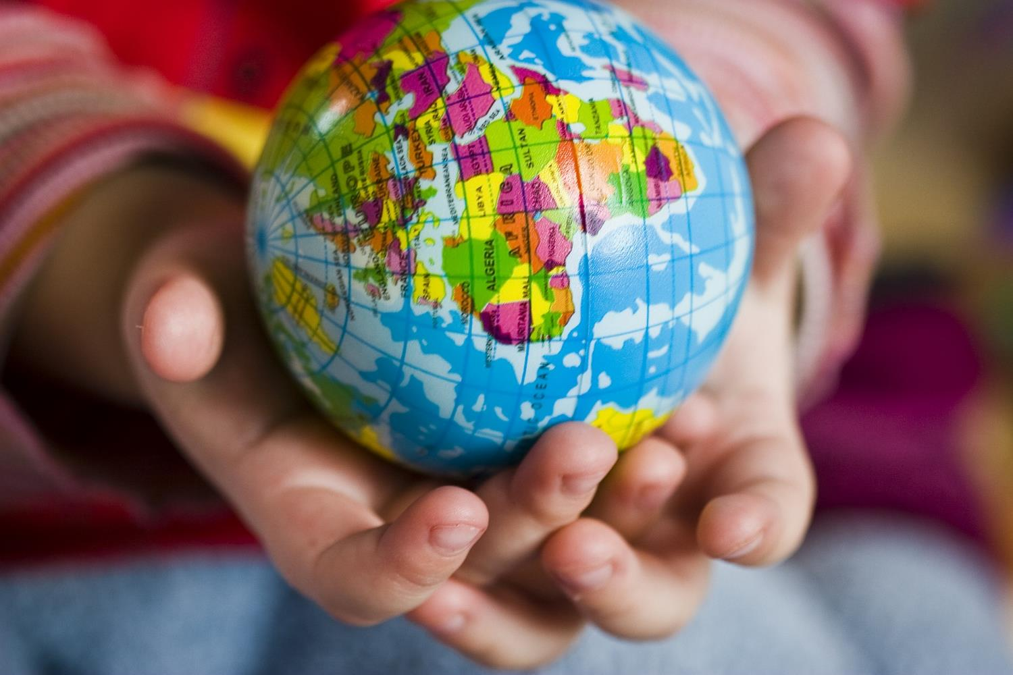
Notes:
Slide 10 / globe: Let’s have letters 5,2,3,7&1: EARTH. Our earth works very hard for us, because all our food comes from it. We’ve already given a great big shout-out for all our favourite foods, those we really like to EAT (5,2&7 - reshuffle if you want to!) We are completely dependant on our planet for the food that we EAT.

Slide 11
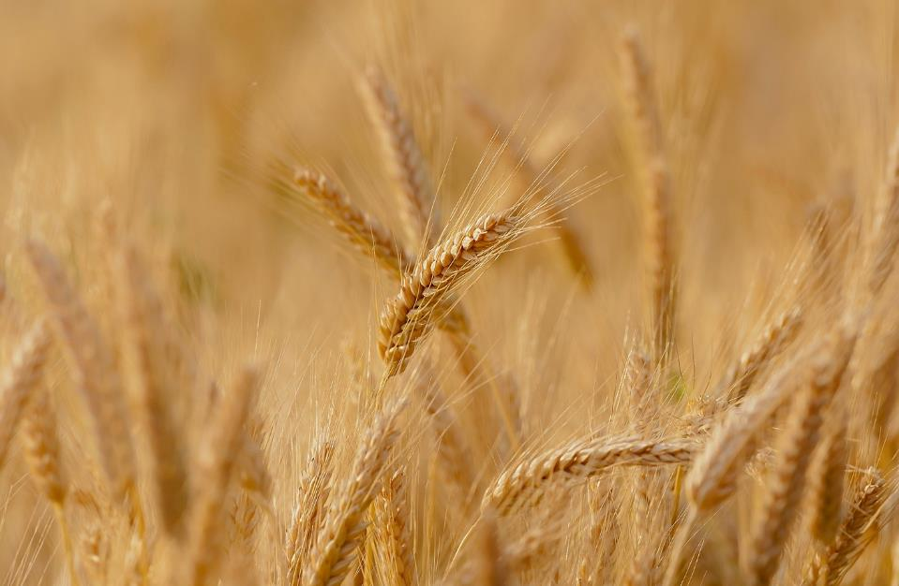
Notes:
Slide 11: Just as an example, the wheat that is made into the bread or cereal that many of you will have eaten for breakfast has come from farms all over Britain, and the banana that you might have at break time will have been harvested in other places of our world where it’s hotter.

Slide 12
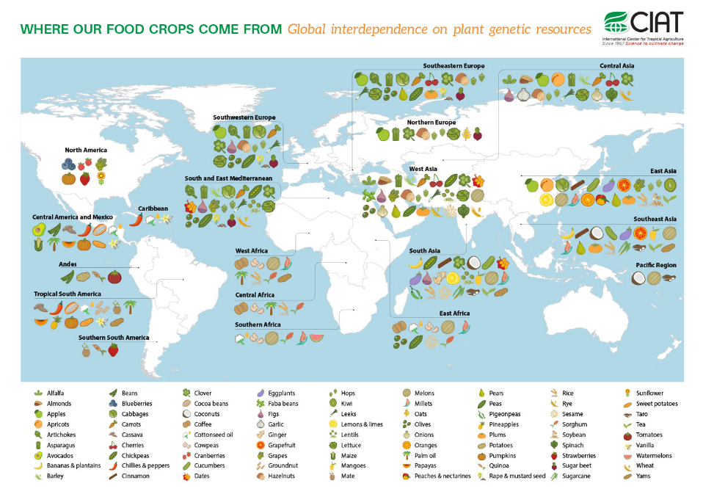
Notes:
Slide 12: Talk about this slide if you have time! This is just an example – there are many others to be found on the internet!

Slide 13
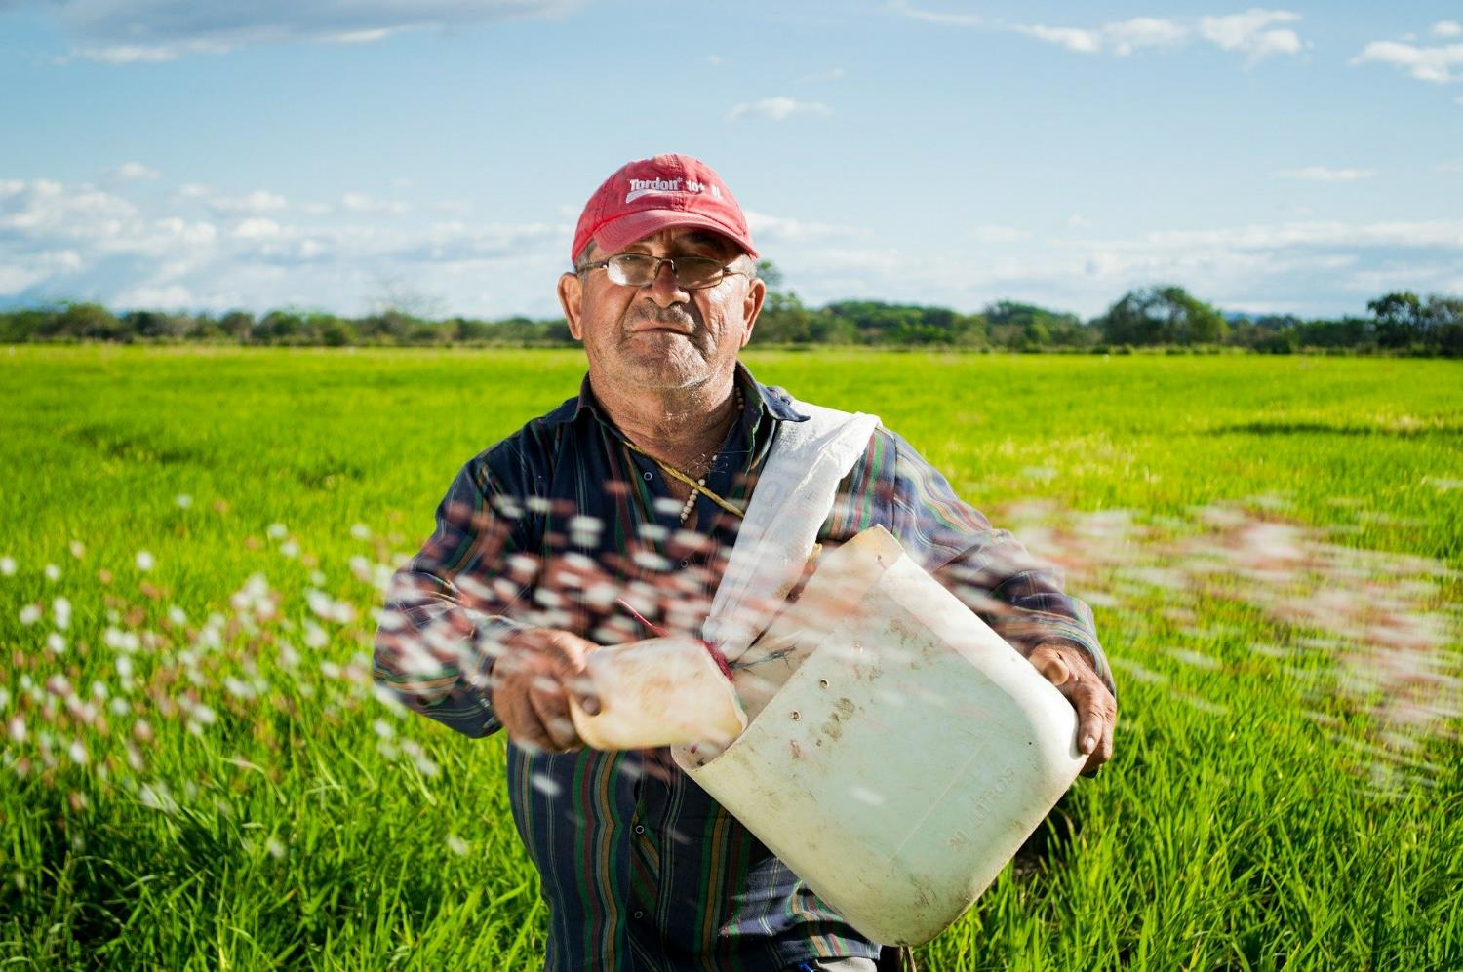
Notes:
Slide 13 / tractor: Let’s have letters 7&2 ‘TA!’ – that’s short for ‘thankyou’!! At Harvest time, we say thank you for our food: to the farmers who’ve grown it and taken care of it, those who’ve harvested it, those who’ve stored it and sold it…and (as a church school family) to God for the rain and sunshine that has helped it to grow.

Slide 14
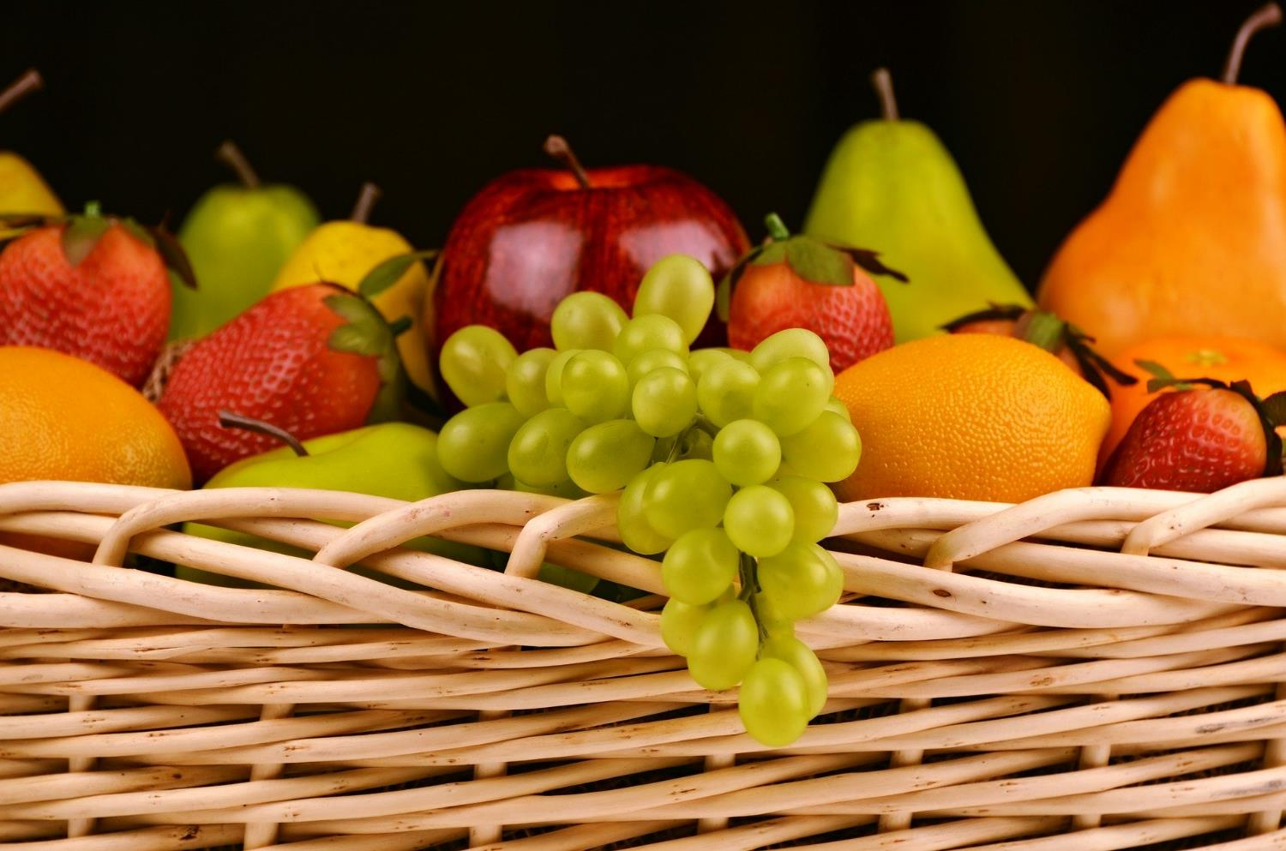
Notes:
Slide 14 / plate of role play food: Let’s have 1,2,4&5 HAVE: most of us HAVE plenty of food in our country…

Slide 15
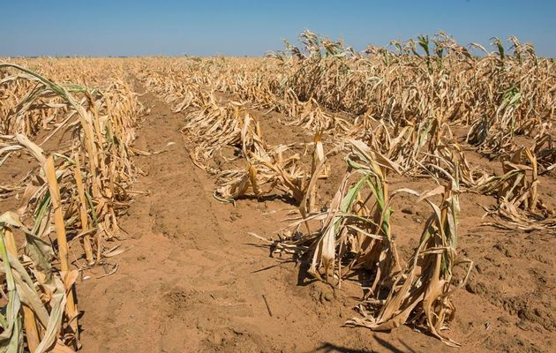
Notes:
Slide 15 / empty bowl: but we need to remember that in other places, there is not enough food to eat because their harvest has not been good – too hot, too cold, too wet, too dry – or people don’t have enough money to buy food, and so people might (6,7,2,3,4&5) STARVE.

Slide 16
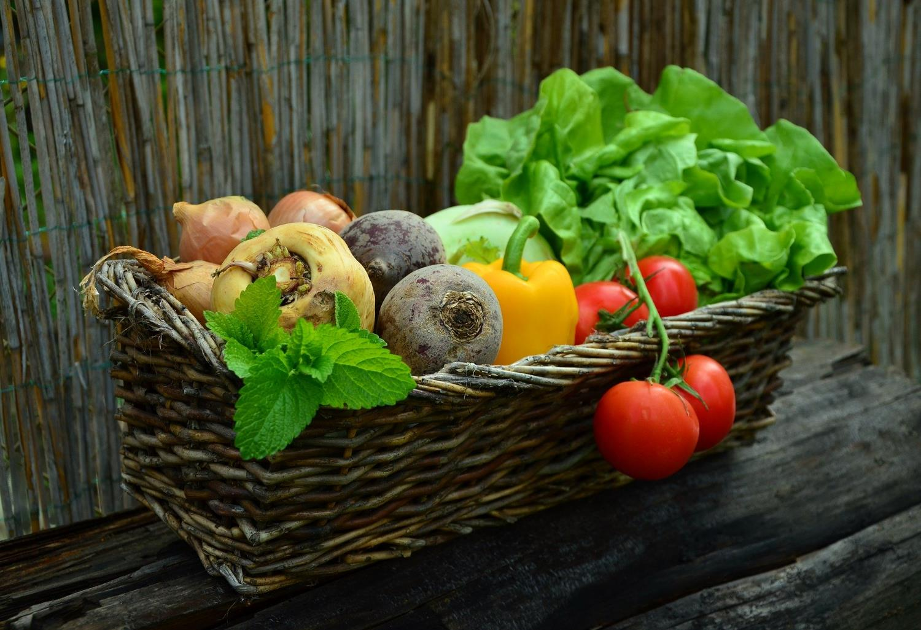
Notes:
Slide 16 / bread: Let’s have letters 6,1,2,3&5 SHARE: And so, at Harvest time, it’s good to find ways to SHARE what we have with others [break up bread into pieces] (Explain how you will be doing this as a school this year – or together think of ways e.g. giving to the local food bank, donating money to charity etc.) In the Bible, on many occasions, there are encouragements to remind people to SHARE.

Slide 17
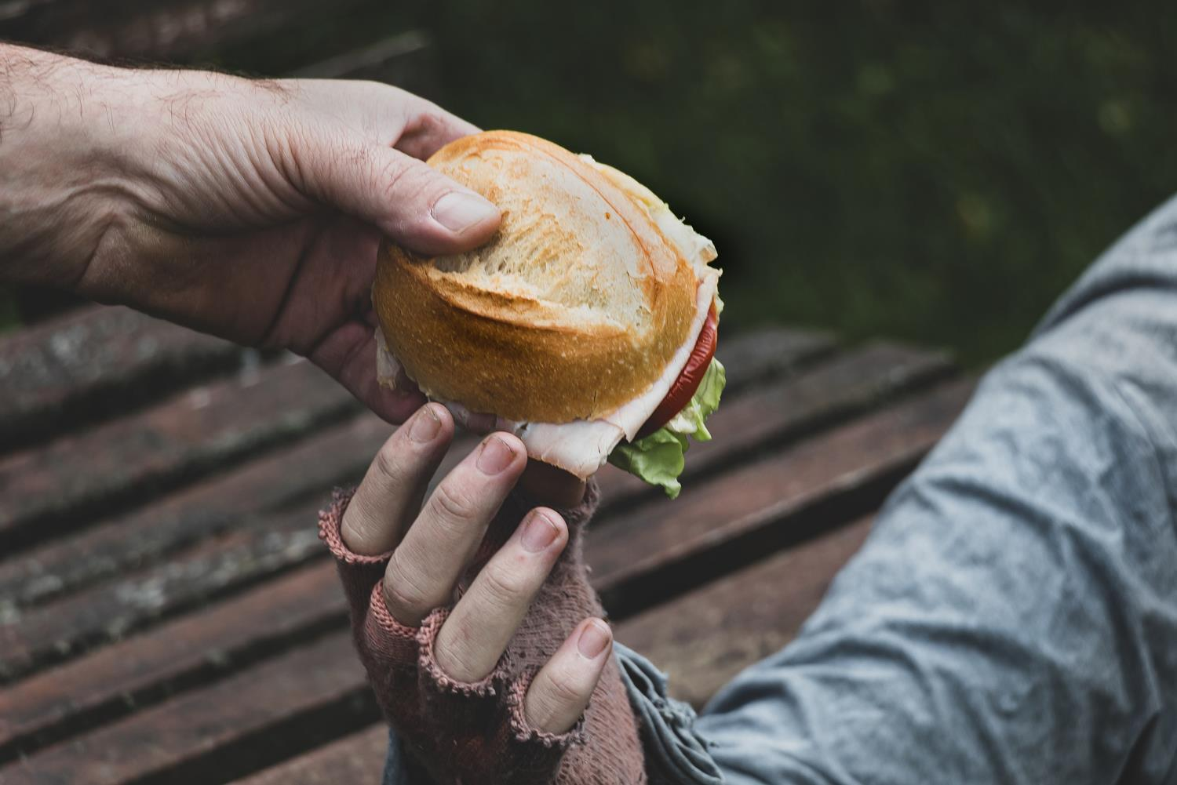
‘They shared everything.’
(Acts 2:44)
‘Be generous and willing to share.’
(1 Timothy 6:18)
Notes:
Slide 17: Let’s read these words together as we draw near to the end of our time together, both from the New Testament. We are told that the first Christians shared all that they had: ‘They shared everything.’ Those who had more gave to those who were in need – just like we are doing here today.
St. Paul, writing to these early Christians in other places, wrote: ‘Be generous and willing to share.’
I wonder what these words might mean for us today….?

Slide 18
E A T
T A
H A V E
S H A R E
S H A R E
Notes:
Slide 18: Responding and words for worship
……We’ve been thinking today about HARVEST time….
…We’ve thought of lots of words….EAT….TA (thankyou)….HAVE and SHARE….
…I wonder which word might be most important?.....or which word made you think the most?..…
….HARVEST is an important time of the year…a time to remember and celebrate…. and say ‘TA!’….
…..but above all, to SHARE
I’m going to do that right now, in a thankyou prayer. Make it yours if you’d like to…or if you’d prefer not to pray, then just sit quietly with your own thoughts. You’ll see some of our HARVEST words again!

Slide 19
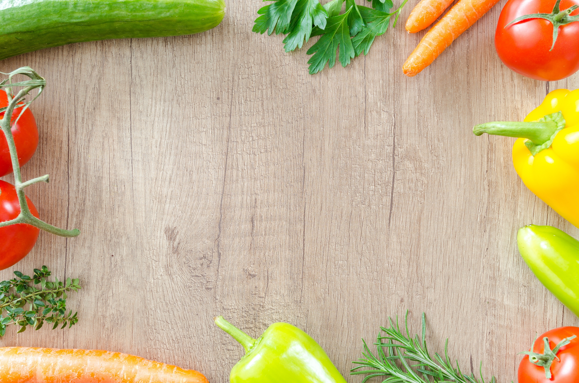
Dear God, giver of the HARVEST
Thank you for this time of year, HARVEST time, and for the food that we HAVE on our tables. It is good to be grateful for the things we EAT – and good to find ways to SHARE. Help us to find ways to do this, we pray.
Notes:
Slide 19: Dear God, giver of the Harvest
Thank you for this time of year, Harvest time, and for the food that we HAVE on our tables. It is good to be grateful for the things we EAT – and good to find ways to SHARE. Help us to find ways to do this in these challenging times, we pray.

Slide 20
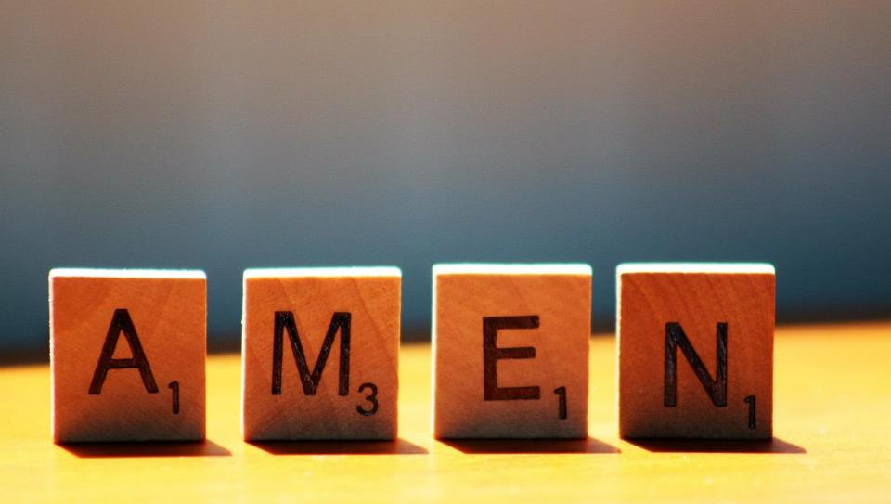

Slide 21
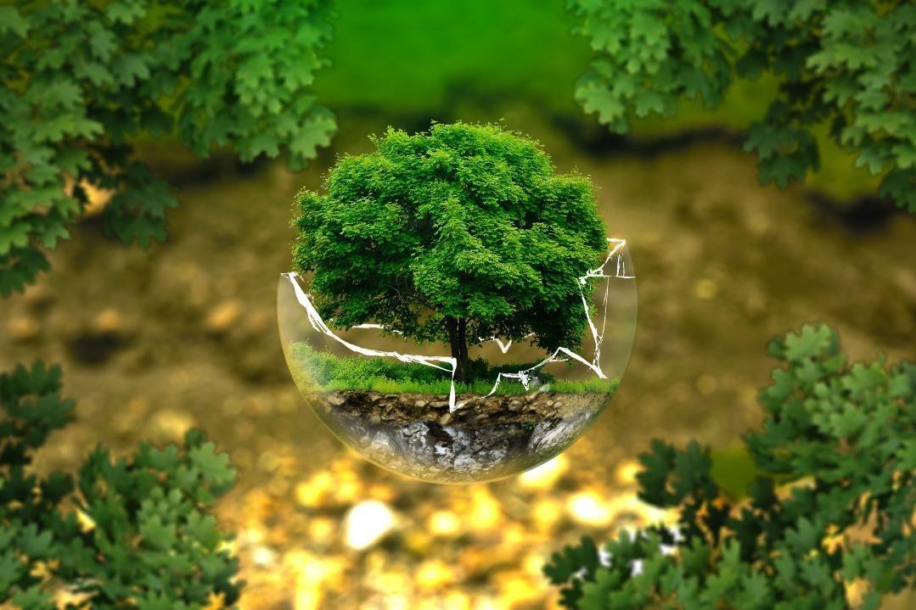
The earth is fruitful; may we be generous.
The earth is fragile; may we be gentle.
The earth is fractured; may we be just.
Notes:
Slide 21: ALTERNATIVE: a blessing, ©Christian Aid, 2024
The earth is fruitful; may we be generous.
The earth is fragile; may we be gentle.
The earth is fractured; may we be just.

Slide 23
Leader: As we leave this place & time, and go into the day ahead…
All: May we be generous and willing to SHARE.
Notes:
Sending: Slide 23
Leader: As we leave this place and time and go into the day ahead….
All: May we be generous and willing to share.

Slide 24
Notes:
Slide 24: Reflection areas
Use the big word sheets from p.11-17 enlarged to A3 to give children space to doodle and draw.
Think: Look at the big words. What ideas do you think of when you look at them?
Do: Doodle or draw your idea on one or more big sheets.
Talk: At the end of the week, talk about the ideas you’ve thought of. You could also display them with your Harvest goods for any Harvest celebration that you are holding.

