Slide 1





All pictures copyright-free from pixabay
Notes:
Slide 1: Starry sky stilling exercise
Use the stilling slide if desired: the suggested words should be spoken slowly, leaving pauses inbetween to create a sense of stillness.
As you sit quietly, watch the stars twinkling….[PAUSE]
Now practise slower breathing…..in…..and out…..in……and out…..keep this going as you continue to look at the stars….[PAUSE]
You maybe notice that you are feeling calmer and more relaxed….[PAUSE]
We come into this special / sacred space and time to be still….to think deeply…..to be together as a school community…..
In our time together today, we will find out some facts about lions together, share the final part of our story and then use it to help us to think.
But first, let’s welcome one another as we begin….

Slide 2

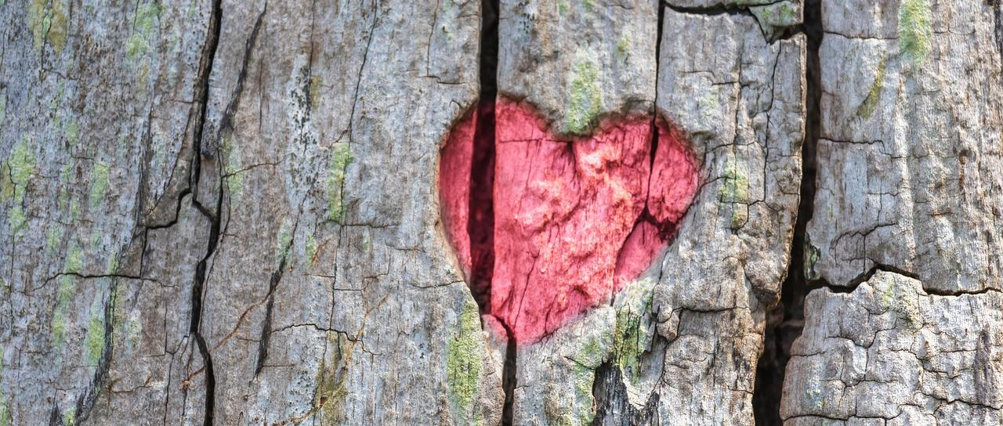
Leader: As we gather together today…
ALL: …we bring our thoughts and our hearts into this sacred space.
Notes:
Slide 2: Gathering
Leader: As we gather together today….
ALL: ….we bring our thoughts and our hearts into this sacred space.
Here are BSL actions for some of the words:
Leader’s words:
Gather: https://www.signbsl.com/sign/gather (1st video)
Today: https://www.signbsl.com/sign/today (1st video)
Pupils’ response:
Thoughts: https://www.signbsl.com/sign/thoughts (1st video)
Hearts: https://www.signbsl.com/sign/heart (1st video)

Slide 3
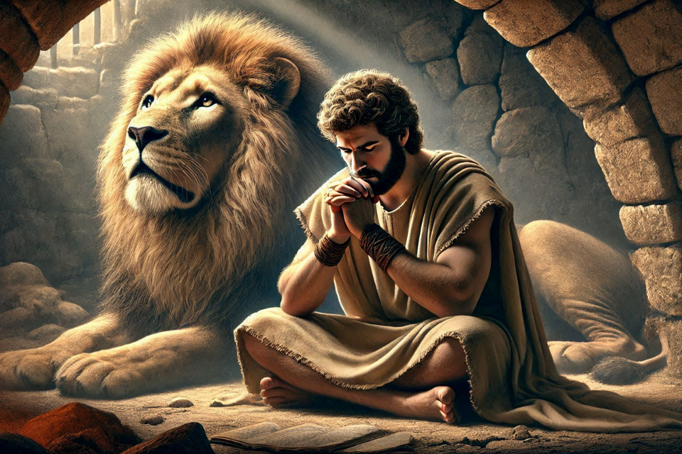
Shine like stars!
Notes:
Slide 3: All through this term so far, we have seen this image of Daniel with lions – so you’ll be very pleased to know that we have finally reached this part of the story….and there will be lions!

Slide 4
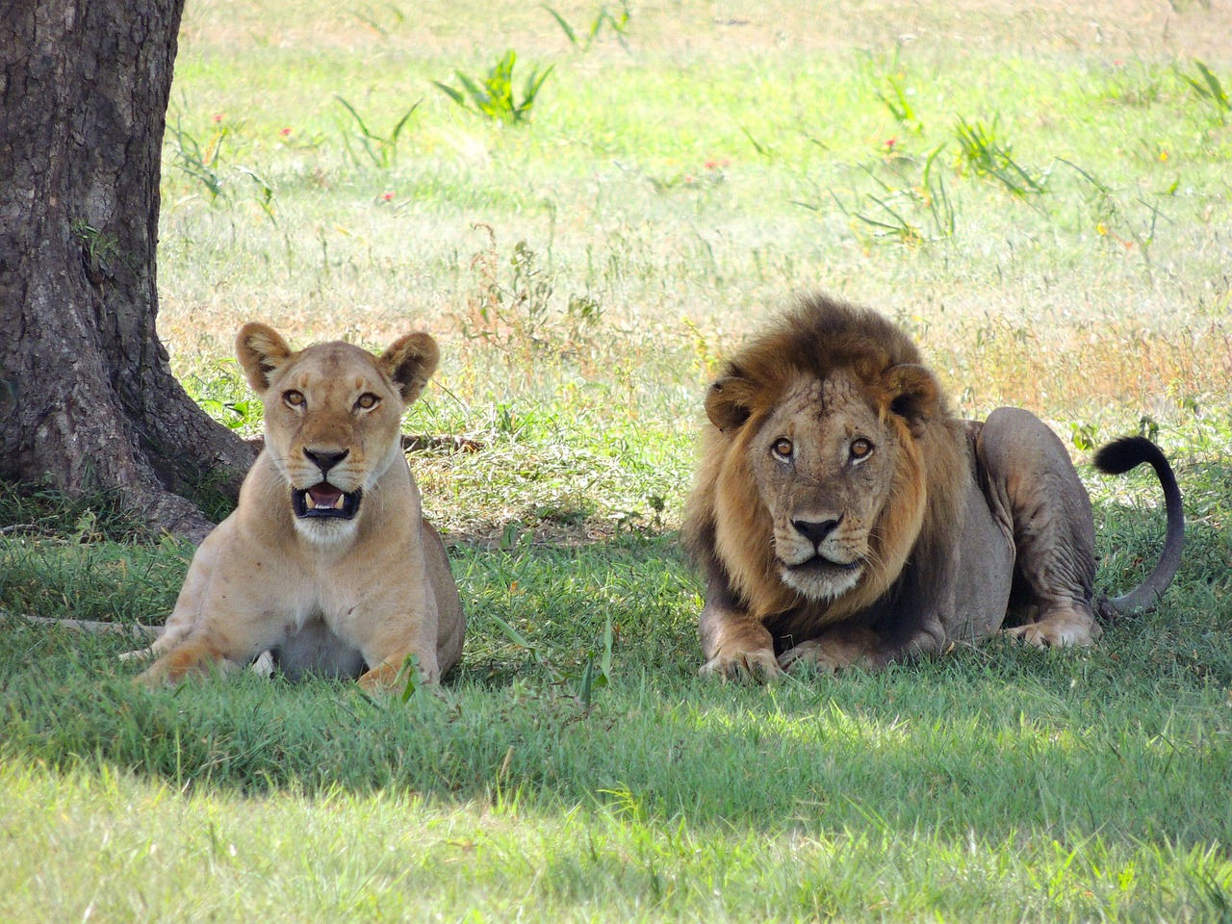
A ‘roarsome’ quiz!
Notes:
Slide 4: Lion Quiz
But first, in honour of the lions in our story, we are going to have a quiz about lions! There will be two answers – you need decide which one is correct! [You can decide how you ask children to vote – with hands, or maybe by roaring, if you’re feeling brave!]

Slide 5
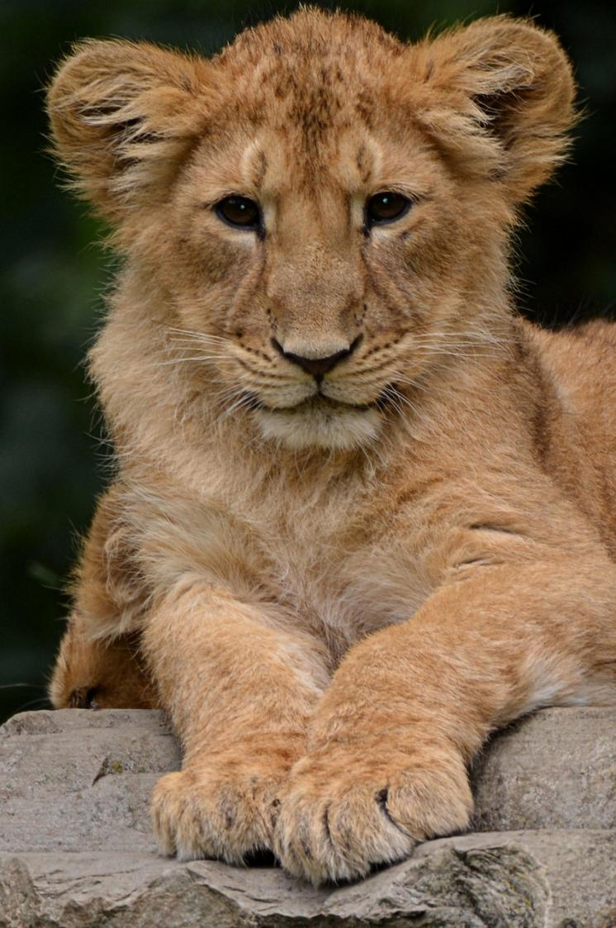
A baby lion is called…..
A kitten
A cub
Notes:
Slide 5: A baby lion is called…..
A kitten
A cub

Slide 6
A baby lion is called…..
A kitten
A cub
Notes:
Slide 6: A cub

Slide 7
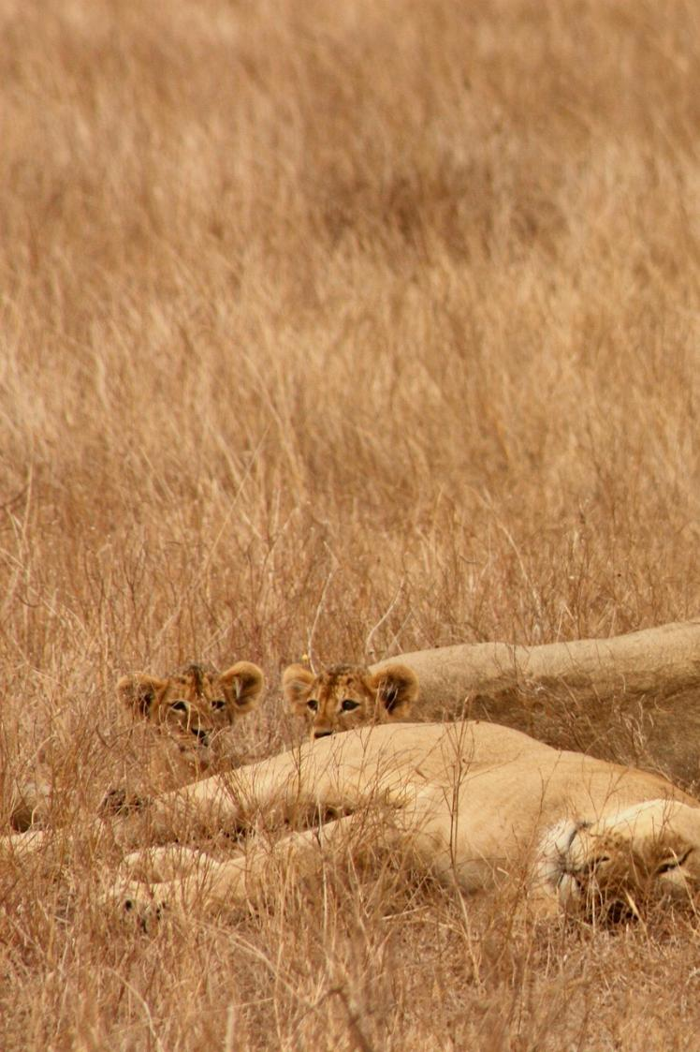
Lion cubs are born spotty.
True
False
Notes:
Slide 7: Lion cubs are born spotty.
True
False

Slide 8
Lion cubs are born spotty.
True
False
Notes:
Slide 8: True – it helps them to be camouflaged against possible predators.

Slide 9
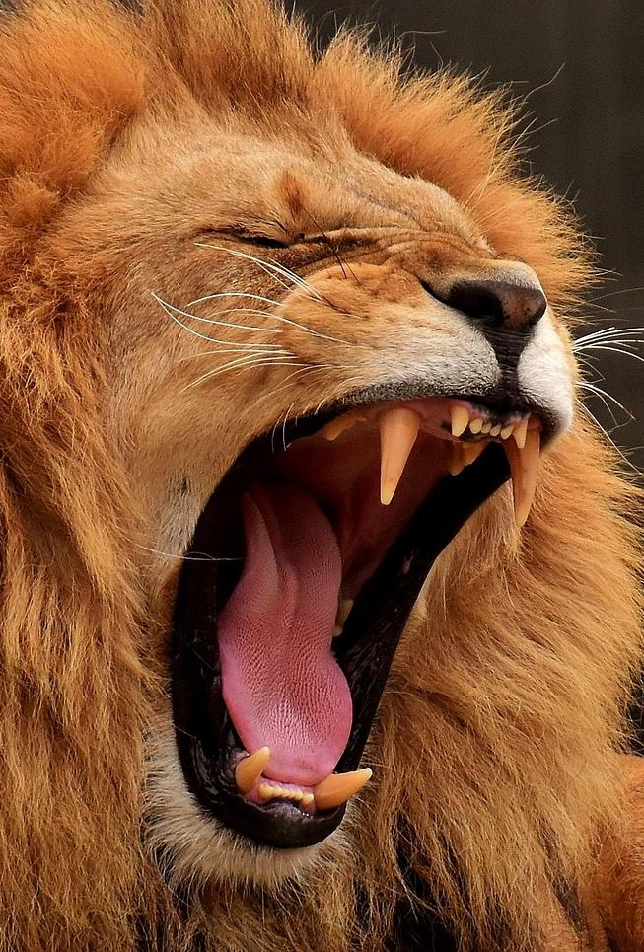
How far away can a lion’s roar be heard?
2km
8km
Notes:
Slide 9: How far away can a lion’s roar be heard?
2km
8km

Slide 10
How far away can a lion’s roar be heard?
2km
8km
Notes:
Slide 10: 8 km (that’s 5 miles). And lions are the only big cat who practise roaring in groups – cubs start when they are 2-3 months old!

Slide 11
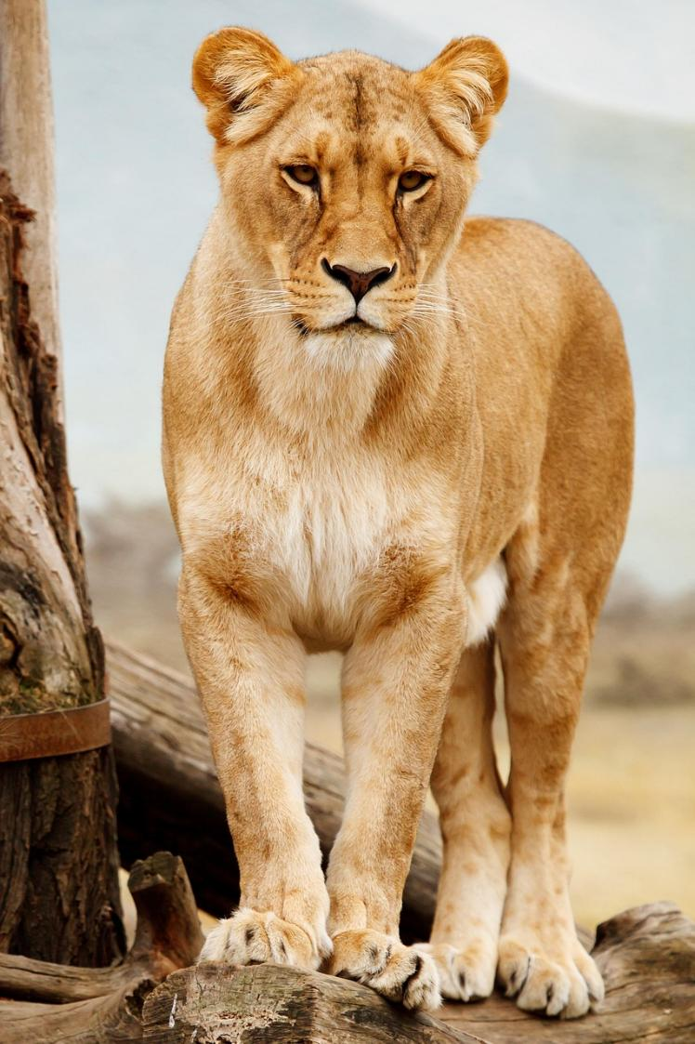
The Swahili word for lion is ‘nala’.
True
False
Notes:
Slide 11: The Swahili word for lion is ‘nala’. (Swahili is one of the languages spoken across the continent of Africa)
True
False

Slide 12
The Swahili word for lion is ‘nala’.
True
False
Notes:
Slide 12: False – it’s actually ‘simba’. You might recognise this from the Lion King!

Slide 13
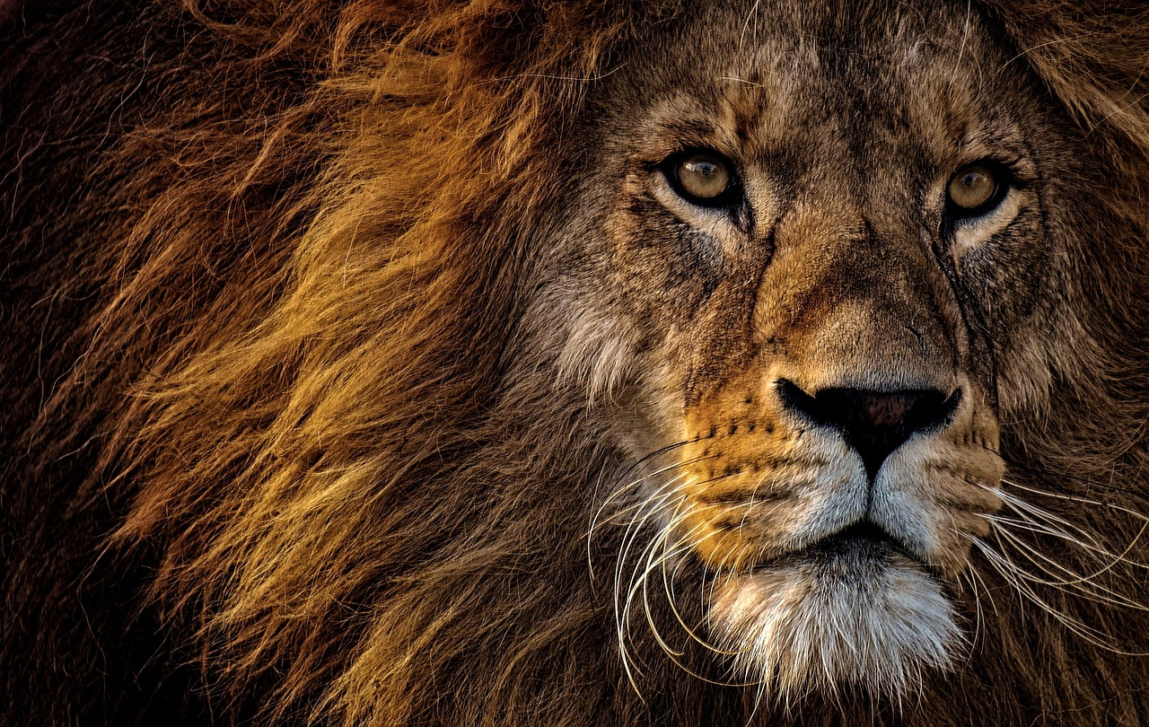
Where do lions live?
Africa
Asia
Notes:
Slide 13: Where do lions live?
Africa
Asia

Slide 14
Where do lions live?
Africa
Asia
Notes:
Slide 14: Actually both are true – most lions live in Africa, but there are also Asiatic Lions who live in parts of India.

Slide 15
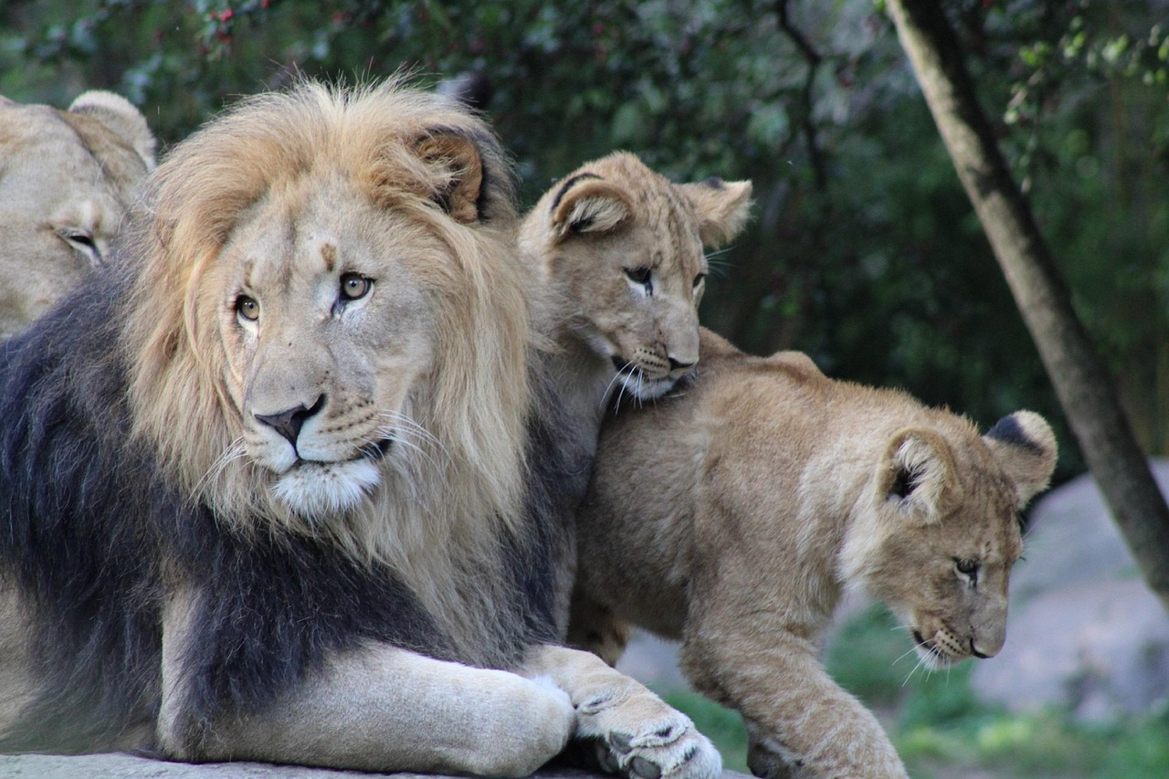
Notes:
Slide 15: Despite how cuddly they may look, how similar their behaviours might be to our pet cats, or how cute they are as cubs, lions are apex predators and they would see most of us as a little snack if we came across their path when they were hungry!!

Slide 16
Daniel and the lions
Notes:
Slide 16: Now it’s finally time to find out what happens when Daniel actually meets some lions. It’s a story that everyone can join in with, and here’s how. [explain actions, and then use story script on p.4-5. with images on slides 17-24]

Slide 17
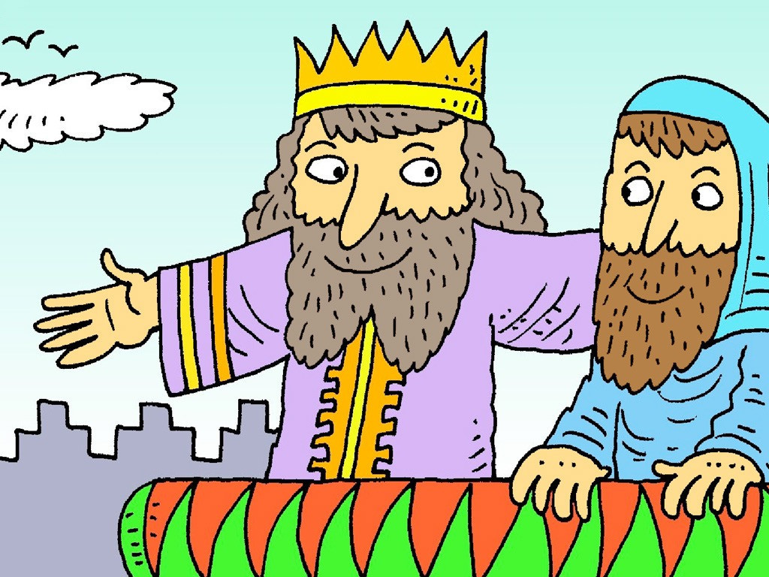
Notes:
Slide 17: King [place crown on head] Darius was the new King [place crown on head] of Babylon – and in Jerusalem. ‘Long live the King [place crown on head]!’
He gathered all of the wisest men to help govern his new King [place crown on head]-dom and chose Daniel to be one of them. Daniel loved God [point upwards] and prayed [hands together] to him every day. Some of the other advisers were very jealous [BSL action, across heart] of Daniel’s new role, so they went to the King [place crown on head] with a plan to get him in trouble.

Slide 18
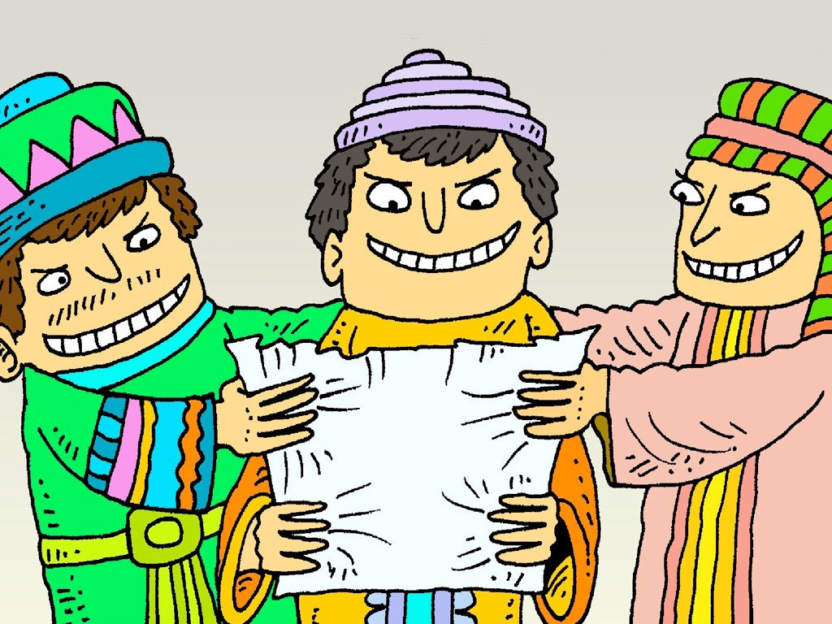
Notes:
Slide 18: ‘King [place crown on head] Darius, live forever!’ they greeted him. ‘We think that the King [place crown on head] should make this law that everyone would have to obey: no one should pray [put hands together] to anyone or anything except to you, our King [place crown on head]. Anyone who doesn’t obey this law should be thrown into a den of lions [create a lion pose with hands, and let out a ‘ROAR!!!’]. Write it down so that it cannot be changed.’ The King [place crown on head] thought this was a great idea and so sent out a decree declaring his new law across the king-[place crown on head]-dom.

Slide 19
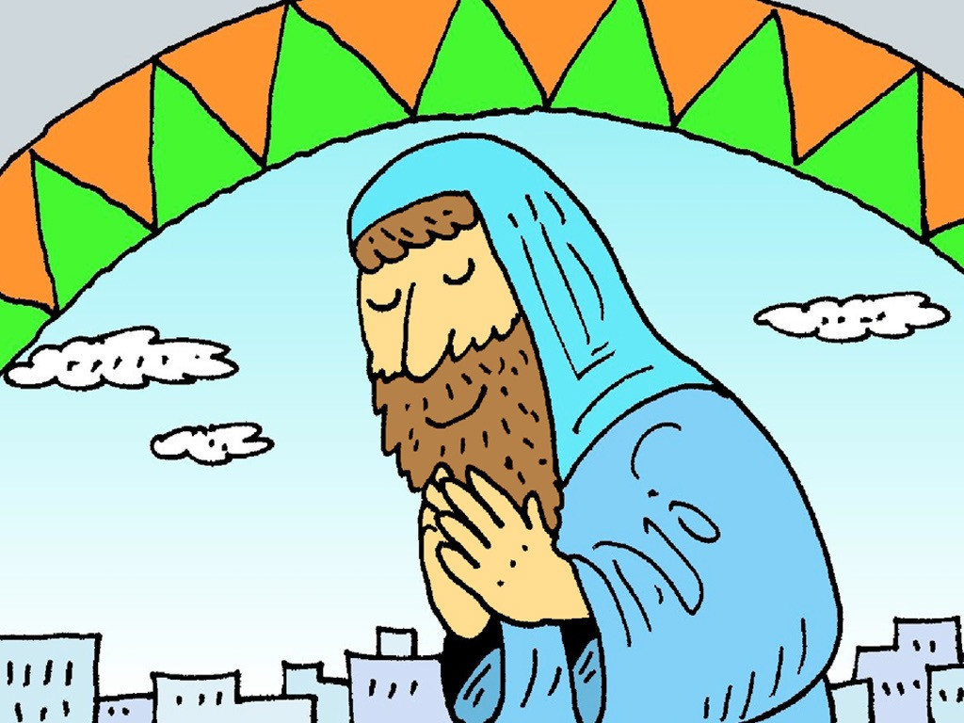
Notes:
Slide 19: When Daniel heard about the new law, he went back to his house, got down onto his knees and prayed [put hands together] to God [point upwards], just as he would normally do, which was exactly what the jealous [BSL action, across heart] advisers wanted.

Slide 20
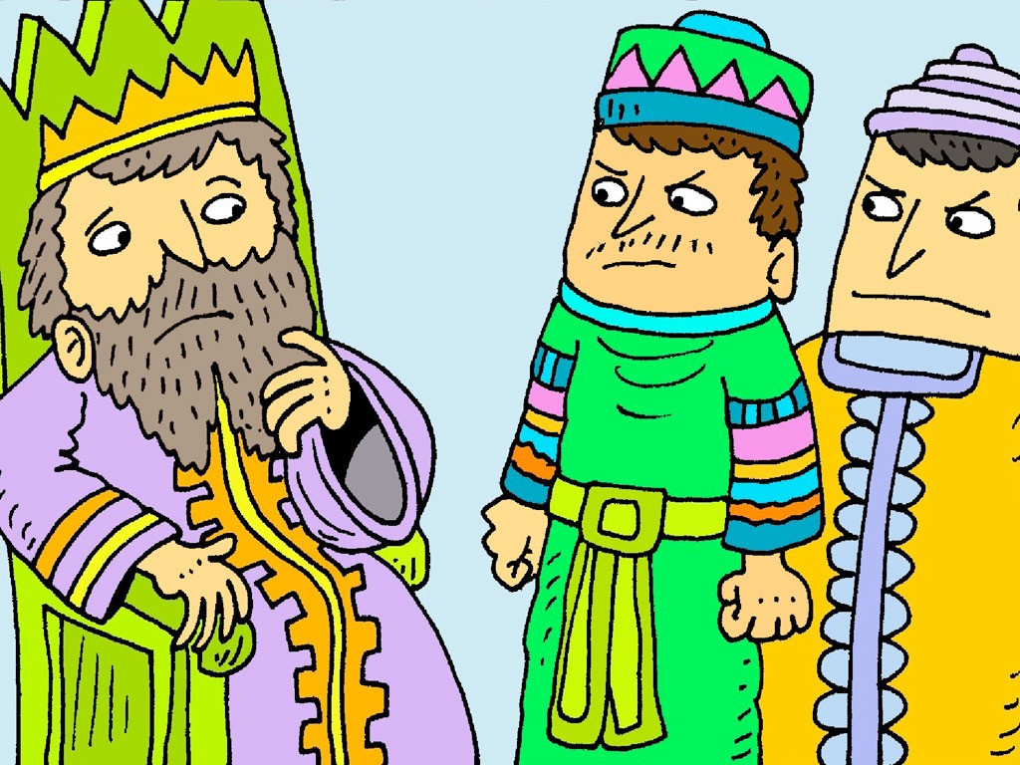
Notes:
Slide 20: So they went to the King [place crown on head] and told him what they had seen: that Daniel was breaking his new law. King [place crown on head] Darius was heart-broken, but knew that he had no choice: according to his new law, Daniel must be thrown into the lions’ [create a lion pose with hands, and let out a ‘ROAR!!!’] den, for praying [put hands together] to God [point upwards] rather than to him.

Slide 21
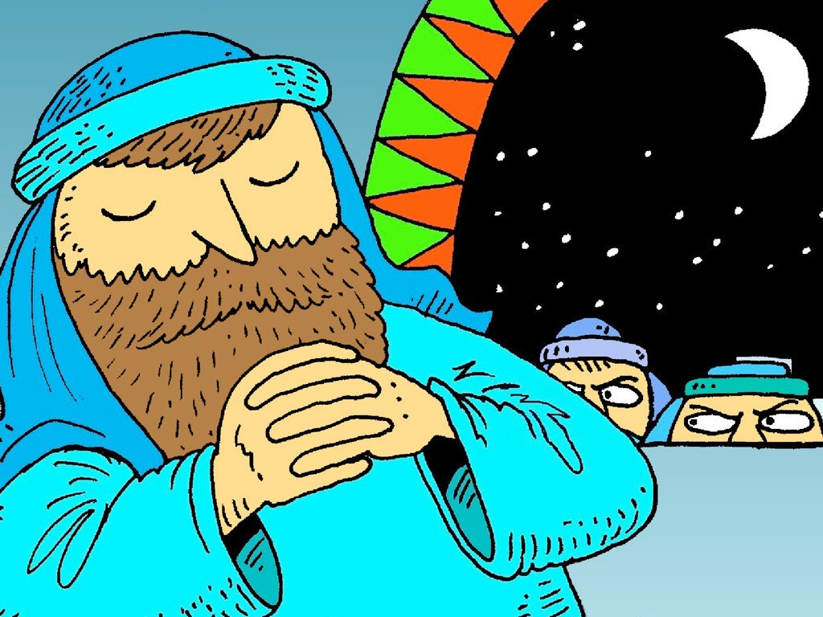
Notes:
Slide 21: King [place crown on head] Darius summoned his soldiers [salute and say ‘Sir! YES SIR!!!’] and they went to Daniel’s house, where they found him on his knees, praying [put hands together] to God [point upwards].

Slide 22
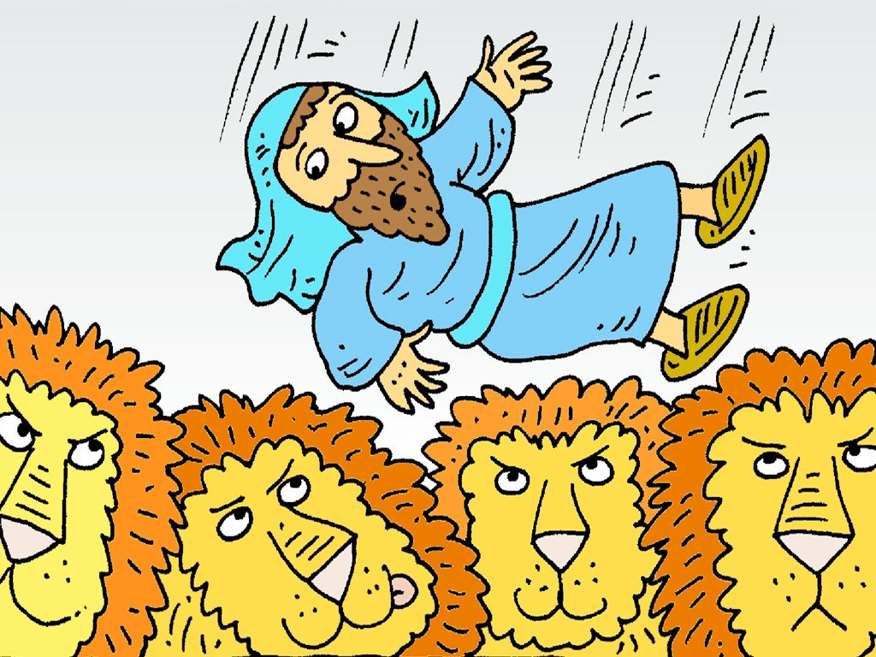
Notes:
Slide 22: The soldiers [salute and say ‘Sir! YES SIR!!!’] threw Daniel into the lions’ [create a lion pose with hands, and let out a ‘ROAR!!!’] den. ‘May the God [point upwards] that you serve all the time save you!’ the King [place crown on head] said as he sealed the den with a huge stone.
The King [place crown on head] went back to his palace and did not eat [mime eating] or sleep [rest head on hands and snore gently] for the whole night. The next morning, he went to the lions’ [create a lion pose with hands, and let out a ‘ROAR!!!’] den very early, worried at what he might find.
Daniel, servant of the living God [point upwards]! Has your God [point upwards] that you always worship been able to save you from the lions [create a lion pose with hands, and let out a ‘ROAR!!!’]?”

Slide 23
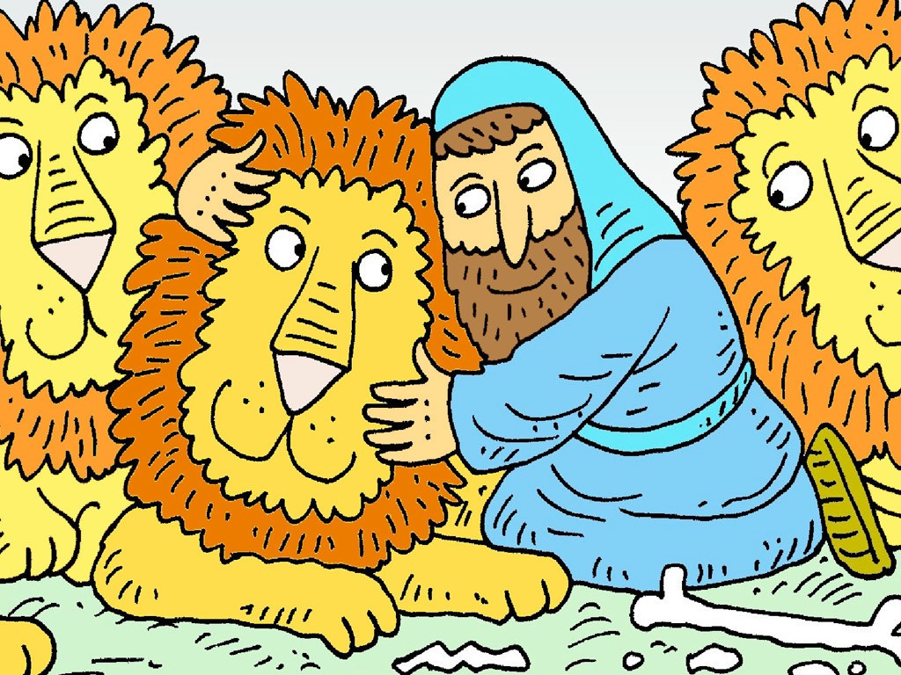
Notes:
Slide 23: ‘My King [place crown on head], live forever! Please don’t worry!’ Daniel called out from within the den. ‘God [point upwards] sent his angel to close the lions’ [create a lion pose with hands, and let out a ‘ROAR!!!’] mouths. They have not hurt me at all!’

Slide 24
Notes:
Slide 24: And so, Daniel was brought out of the lions’ [create a lion pose with hands, and let out a ‘ROAR!!!’] den and the King [place crown on head], wrote another decree that he sent out to all the land.
This is what he wrote: ‘Daniel’s God [point upwards] is the living God [point upwards]. He lives forever. His King [place crown on head]-dom will never be destroyed. God [point upwards] rescues and saves people. God [point upwards] does mighty miracles in heaven and on earth. God [point upwards] saved Daniel from the power of the lions. Worship him!’

Slide 25

…wise people will shine like the brightness of the sky. Those who teach others to live right will shine like stars forever and ever.
Daniel 12:3
Notes:
Slide 25: Responding and words for worship
At the very start of this term, and a brand new year, we read these words together, from the book of Daniel in the Bible: let’s read them again:
…wise people will shine like the brightness of the sky. Those who teach others to live right will shine like stars forever and ever.

Slide 26
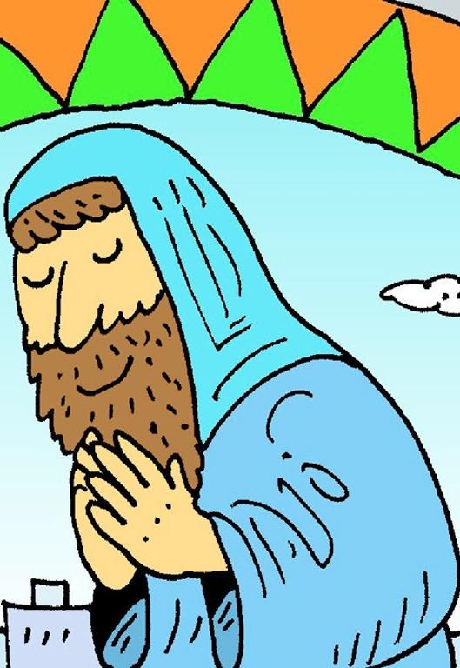
‘Shine like stars’
….I wonder what we might have learned from Daniel’s actions about how to live, or about being wise?....
….I wonder what you think most helped Daniel to stand out?....
….I wonder how our school’s vision and values might help us to be more like Daniel?....
Notes:
Slide 26: Responding and words for worship
We’ve heard this term so far about the actions of Daniel, the hero of our story – and how his actions helped him to ‘shine’, to stand out in a world where other leaders were often proud and cruel. As we come to the end of Daniel’s saga, we’re going to pause and think together…..
….I wonder what we might have learned from Daniel’s actions about how to live, or about being wise?....
….I wonder what you think most helped Daniel to stand out?....
….I wonder how our school’s vision and values might help us to be more like Daniel?....

Slide 27

Help us to shine!
Notes:
Slide 27: Opportunity for reflection/prayer
We’re going to return to a prayer that we used at the very start of term, with some words to join in: if this is something that you would like to do, then you will see these words ‘Help us to shine!’ throughout the prayer – do join in with them if you would like to.

Slide 28
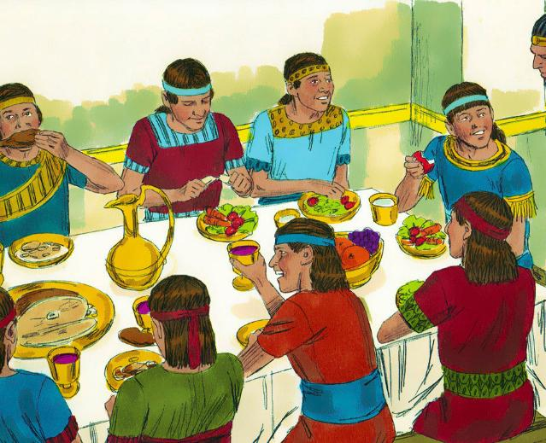
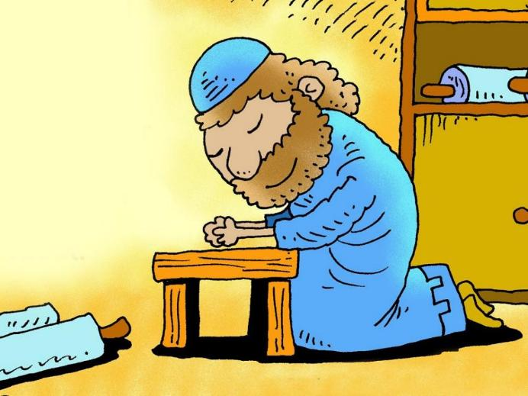
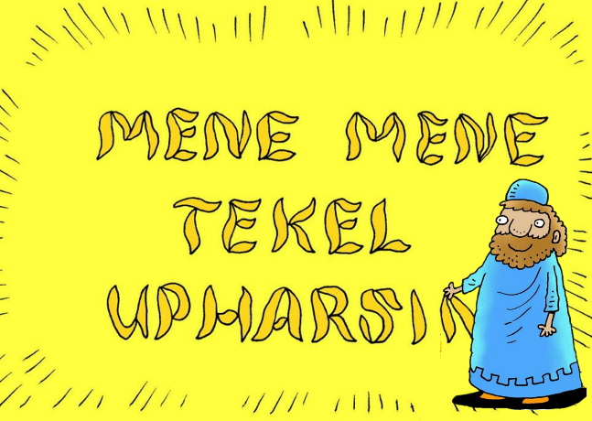
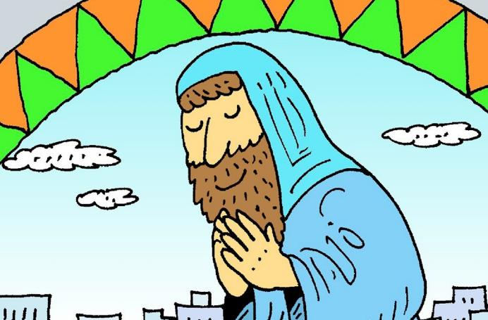
Notes:
Slide 28: As we think about how Daniel’s actions might inspire us, please

Slide 29
Help us to shine!
Notes:
Slide 29: ‘Help us to shine!’

Slide 30
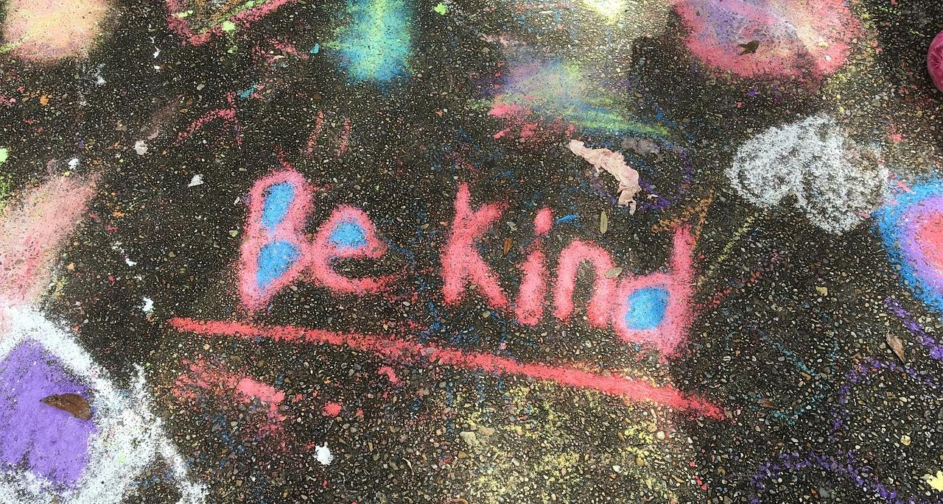
Notes:
Slide 30: As we live out our school’s vision and values….

Slide 31
Help us to shine!
Notes:
Slide 31: ‘Help us to shine!’

Slide 32
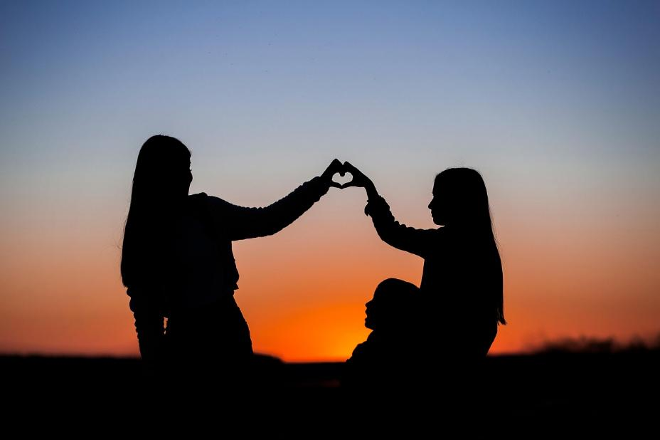
Notes:
Slide 32: In our friendships and families….

Slide 33
Help us to shine!
Notes:
Slide 33: ‘Help us to shine!’

Slide 34

Notes:
Slide 34: In our desire to make our world a better place….

Slide 35
Help us to shine!
Notes:
Slide 36: ‘Help us to shine!’

Slide 36
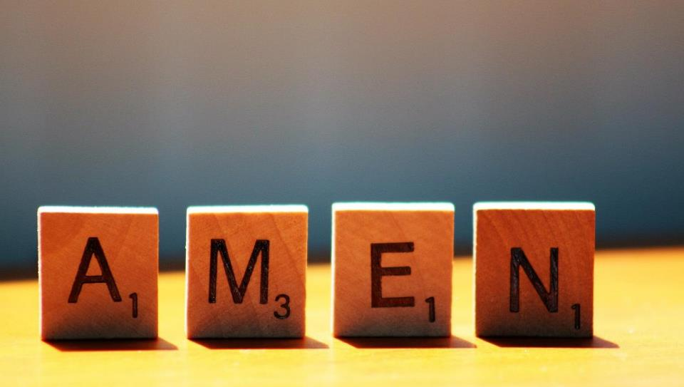

Slide 37



Leader: As we leave this place & time and go into the day ahead…
All: May we shine like stars!
Notes:
Sending: Slide 37
Leader: As we leave this place & time and go into the day ahead…
All: May we shine like stars!

Slide 38
Notes:
Slide 38: Reflective areas
Print off some more stars on coloured paper for this week – add to your ongoing class display to keep the reflection going!
Think: Think about the stories of Daniel that we have explored so far this term. What have you learned from them?
Talk: Talk about what has helped us to ‘shine like stars’.
Do: Write or draw your thoughts onto a star and add it to your class display.

