Slide 1
We are here together….
May our attitudes make our school community a happy place today.
Notes:
Slide 1: Use the new gathering words for this term
Leader: We are here together
ALL: May our attitudes make our school community a happy place today.

Slide 2
Beatitudes
Beati
‘How-to-be-attitudes’
Notes:
Slide 2: We are thinking this term about our ‘How-to-be-attitudes’ – ways of behaving together as part of our school community, ways that will make us happy, based on the lesson Jesus taught on the mountainside. We’ll come to today’s words in a moment, but we’re going to start our time together today with a story.

Slide 3
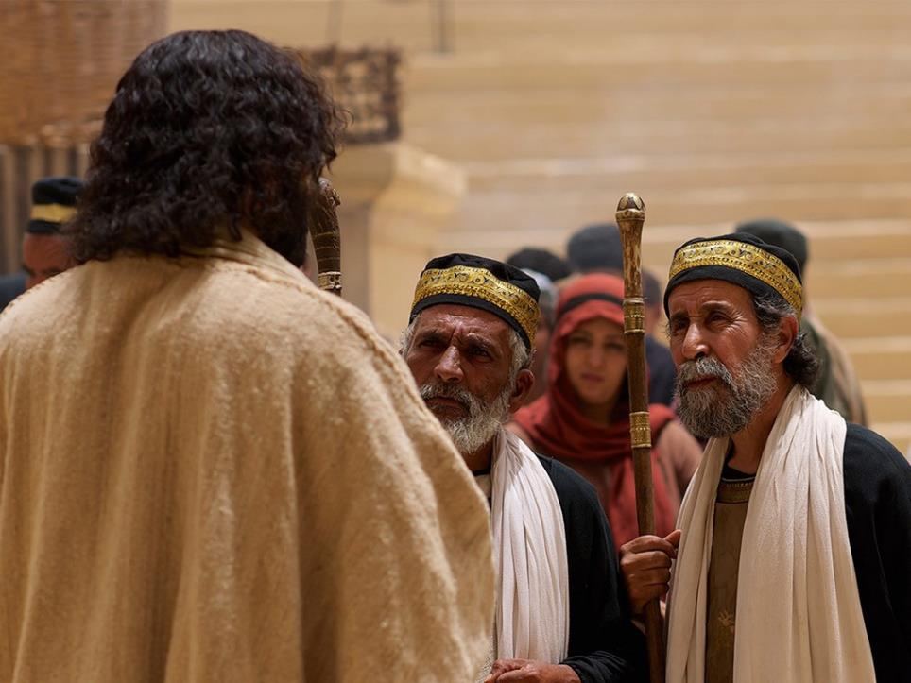
Notes:
Slide 3: Jesus loved to meet people wherever he went. He often told them stories called parables to help them to understand big ideas about God and what’s important to him. One day, he met some men who were very sure of themselves, and looked down on everyone else, so he told them this parable…..

Slide 4
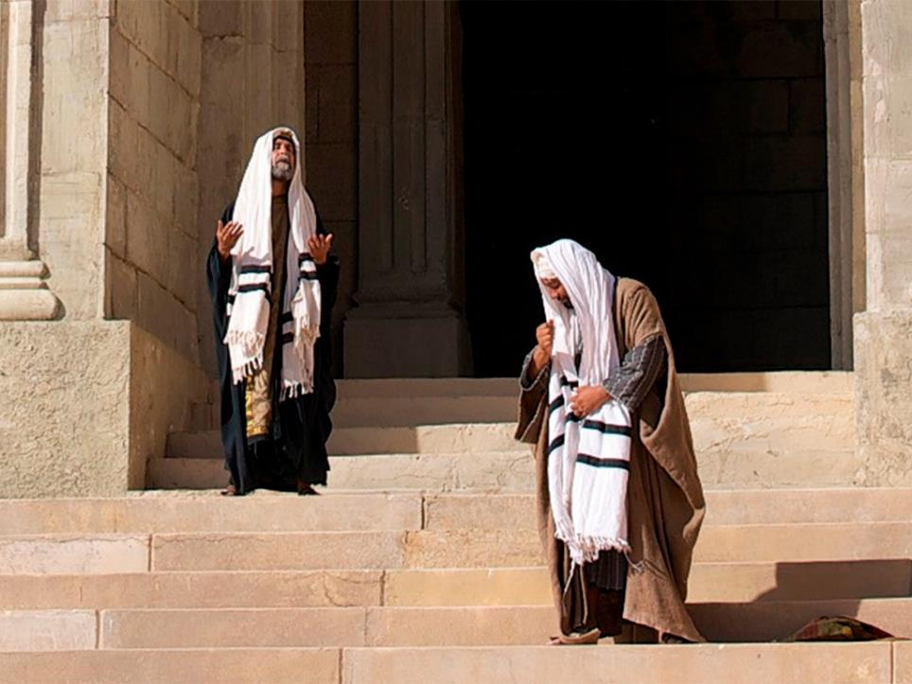
The Pharisee and the Tax Collector
Notes:
Slide 4: The Pharisee and the Tax Collector
Two men went up to the temple to pray, one a Pharisee, a very religious man, and the other a tax collector.

Slide 5
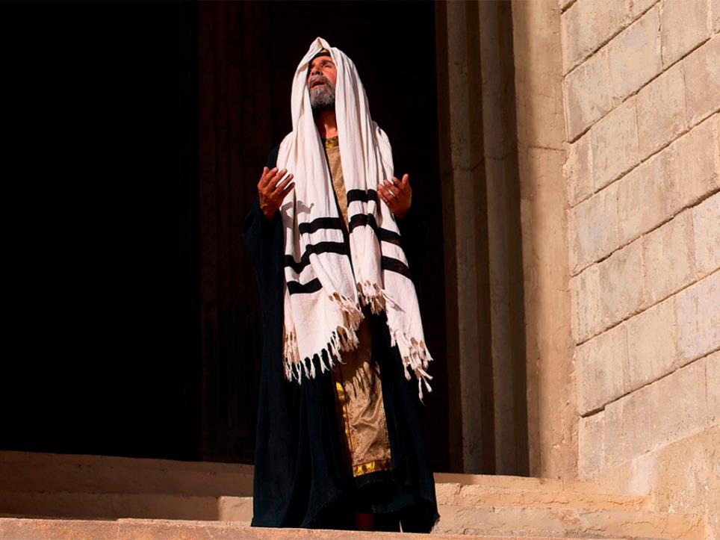
Notes:
Slide 5: The Pharisee stood by himself and prayed. He looked around him to make sure that everyone was listening, then this is what he said: ‘Father God, I am so glad that I am not like other people – robbers and thieves, but especially not like this man, a tax collector and a sinner.’ As he said this, he pointed towards the other man who was standing in the shadows, with his head bowed. ‘I am a very good person: I go without food twice a week as a holy fast, and give away a tenth of all that I earn.’

Slide 6
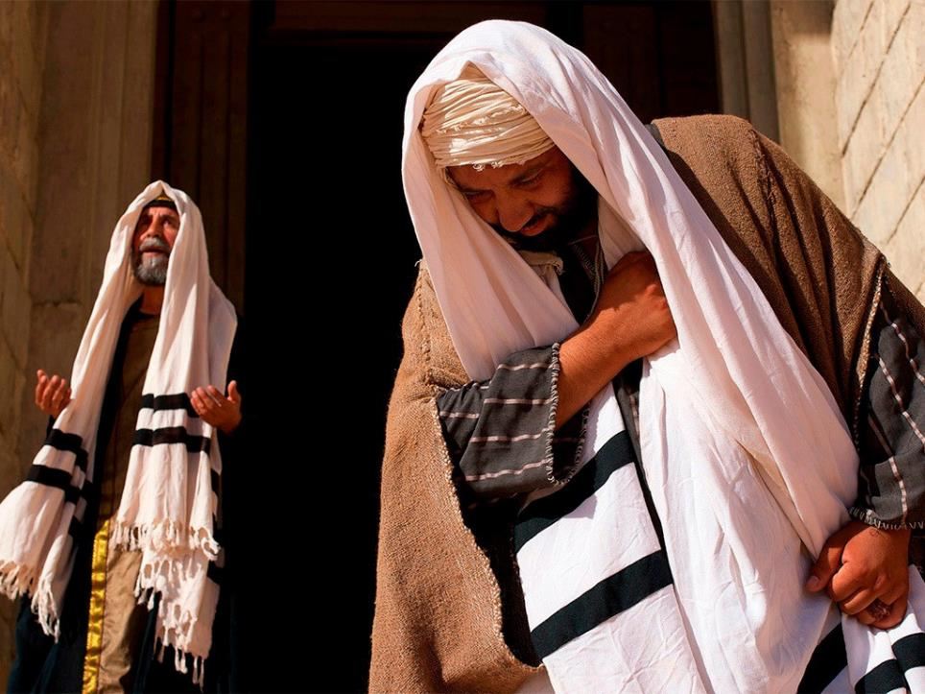
Notes:
Slide 6: The other man could hardly lift his head up, he felt so alone and so ashamed. He was indeed a tax collector, and he had cheated people out of their money, but he was sorry, so sorry for the things he had done and so he prayed ‘I am such a sinner. I’m no good. God, please forgive me.’

Slide 7
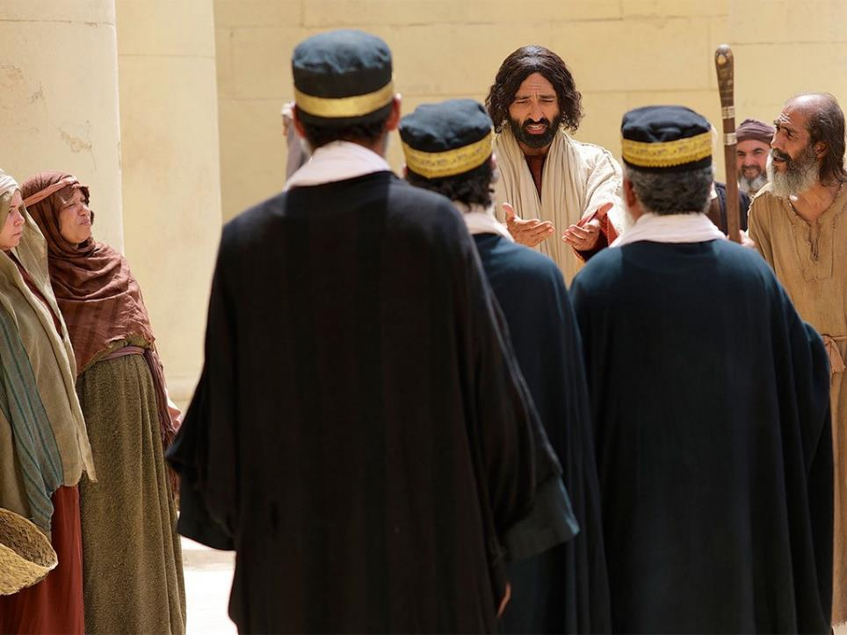
Notes:
Slide 7: At the end of the story, Jesus told his listeners which man’s prayer had pleased God.
Before we answer that question, let’s just have a look at our ‘How-to-be-attitudes’ words for today….

Slide 8
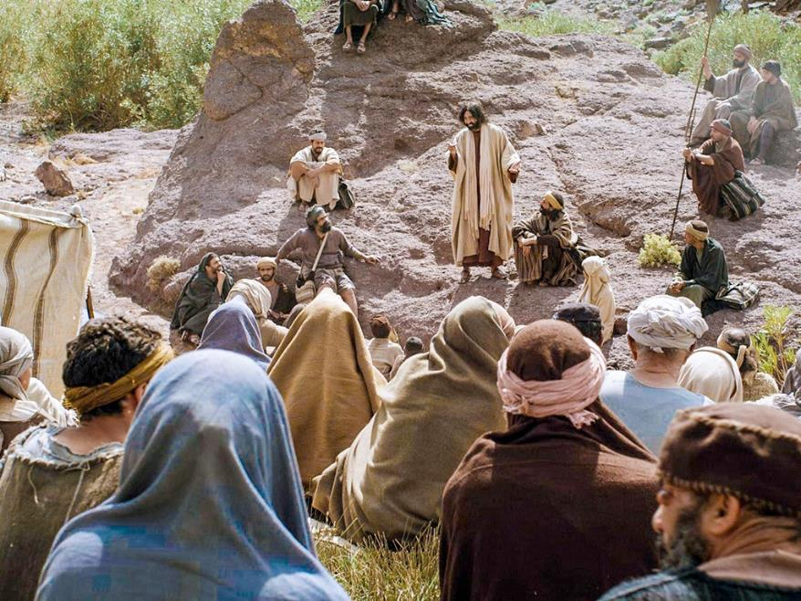
Those who are humble will be truly happy. The earth will belong to them.
Notes:
Slide 10: In the Lesson on the Mountain, Jesus said: ‘Those who are humble will be truly happy. The earth will belong to them.’
[Talk for a few moments about the word ‘humble’ – and what it means. Children may be able to work this out from the context of the story, so give them time to do so. You could also talk about the adjectives that you might choose to describe the Pharisee, especially the words ‘proud’ (in the wrong sense) or arrogant. You might also want to tease out the difference between being rightly proud of something that we have done well and arrogant, where our pride gets out of hand and makes others feel small.]

Slide 9
….I wonder which of the prayers in our story pleased God more?.....
….I wonder which man was ‘humble’?....
….I wonder what being ‘humble’ might look like in our school?....
Notes:
Slide 9: Responding and words for worship
So now let’s bring our thoughts together and reflect on what we might have learned from this parable of Jesus – and how it might help us to understand Jesus’ words about being ‘humble’ – our ‘How-to-be-attitude’ for this week…..
….I wonder which of the prayers in our story pleased God more?.....
….I wonder which man was ‘humble’?....
….I wonder what being ‘humble’ might look like in our school?....

Slide 10
God of the humble
Thank you that you encourage us to be like you, to be humble and not arrogant. We want to be pleased with the good things that we do, but not in a way that makes other people feel small. Please help us, we pray.
Notes:
Slide 10: Prayer
God of the humble
Thank you that you encourage us to be like you, to be humble and not arrogant. We want to be pleased with the good things that we do, but not in a way that makes other people feel small. Please help us, we pray.

Slide 11
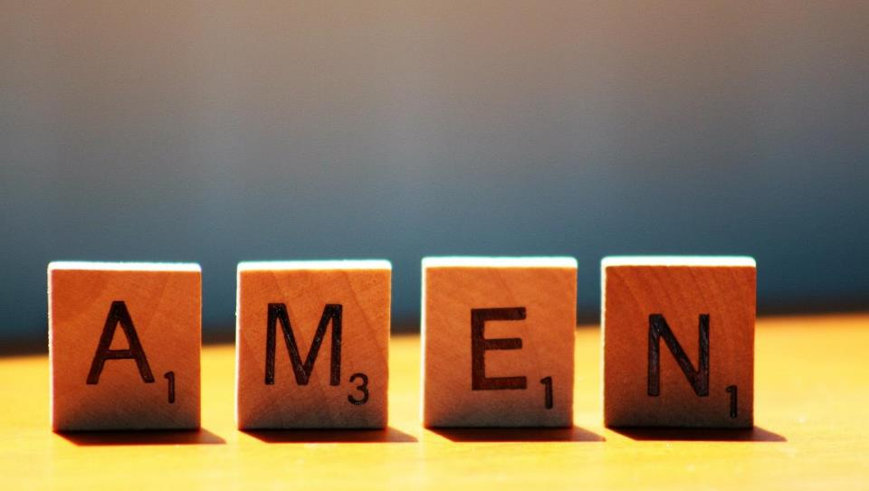

Slide 12
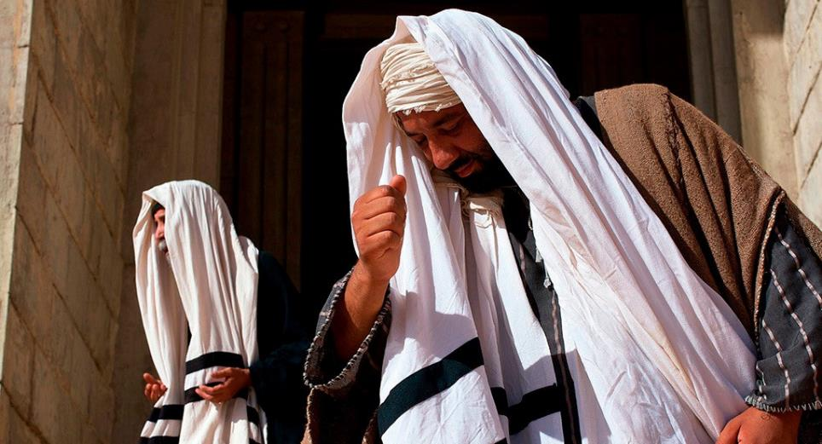
Leader: As we leave this place & time and go into the day ahead…
All: May we live humbly today.
Notes:
‘The tax collector prayed, “God, have mercy on me, a sinner.”’

Slide 13
Notes:
Slide 13: Reflective areas
Create a display of cleaning tools e.g. washing up bowl, washing up brush, car washing sponge, duster etc. A toilet brush (brand new) elicits quite a response! NB These need to be new or very clean with no cleaning products included
You could also include a display of pictures of people doing unpleasant jobs and helping others.
Print out the action cards on p.4 – you could cut them up for pupils to take away as a reminder.

