Slide 1

All images copyright-free from pixabay, unless otherwise identified
Notes:
Gathering:
Slide 1: Bouncing balls stilling exercise
Use the stilling slide if desired: the suggested words should be spoken slowly, leaving pauses inbetween to create a sense of stillness.
As you sit quietly, look at the tennis balls as they bounce….. [PAUSE]
Now practise slower breathing…..in…..and out…..in……and out…..as you watch the movement of balls up and down….[PAUSE]
You maybe notice that you are feeling calmer and more relaxed….[PAUSE]
As you breathe, think about yourself and what you bring into this time today….. [PAUSE]
We come into this special / sacred space and time to be still….to think deeply…..to be together as a school community…..
In our time together today, we will do some more science together, share a story, and then think together.

Slide 2

Leader: As we gather to share our story today….
All: May we grow in our understanding of ourselves and others.
Notes:
Slide 2: Use our new gathering words for this term, or your usual greeting if you prefer. These greetings may change slightly each week to reflect the spiritual elements that we will be exploring in each week’s materials.
Leader: As we gather to share our story today….
All: May we grow in our understanding of ourselves and others.

Slide 3

Another Mad Science Moment!
Notes:
Slide 3: We’re taking a little break today from parables to hear another story about Jesus, but first…..some more science! As you watched the tennis balls bouncing earlier, I wonder if you noticed that some balls were going up and some were coming down? I wonder if you can explain why this was happening? [allow a few responses, demonstrating with the real tennis ball if needed – it’s possible that some children will talk in simple ways about the force of gravity, or about the balls bouncing. Don’t worry about children getting this right, because your experiment will help!]

Slide 4
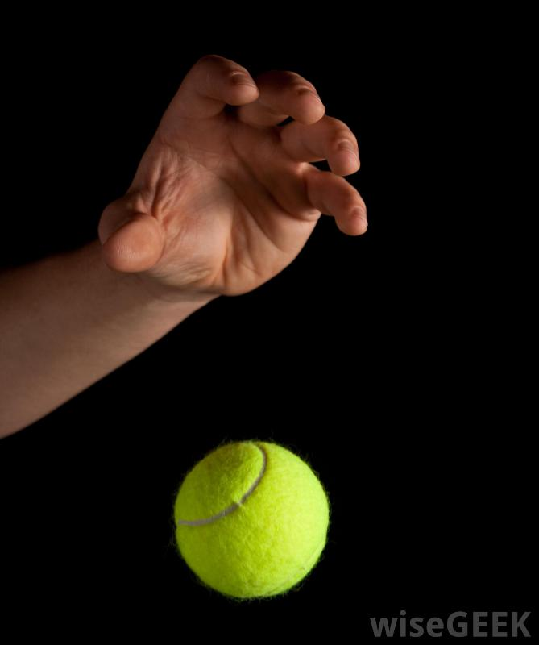
What goes up must come down!
Notes:
Slide 4: We’re going to do some more simple science together, and conduct our own experiment about going up and coming down. Let’s see what you think will happen if I throw some other things into the air… [repeat experiment with the other objects] We’ve found out that “What goes up, must come down.” Our theory still works, but a bit more slowly with very light objects like the feather…. We call this idea gravity: the force that ensures that what goes up must come down again….and it was discovered by this man…

Slide 5
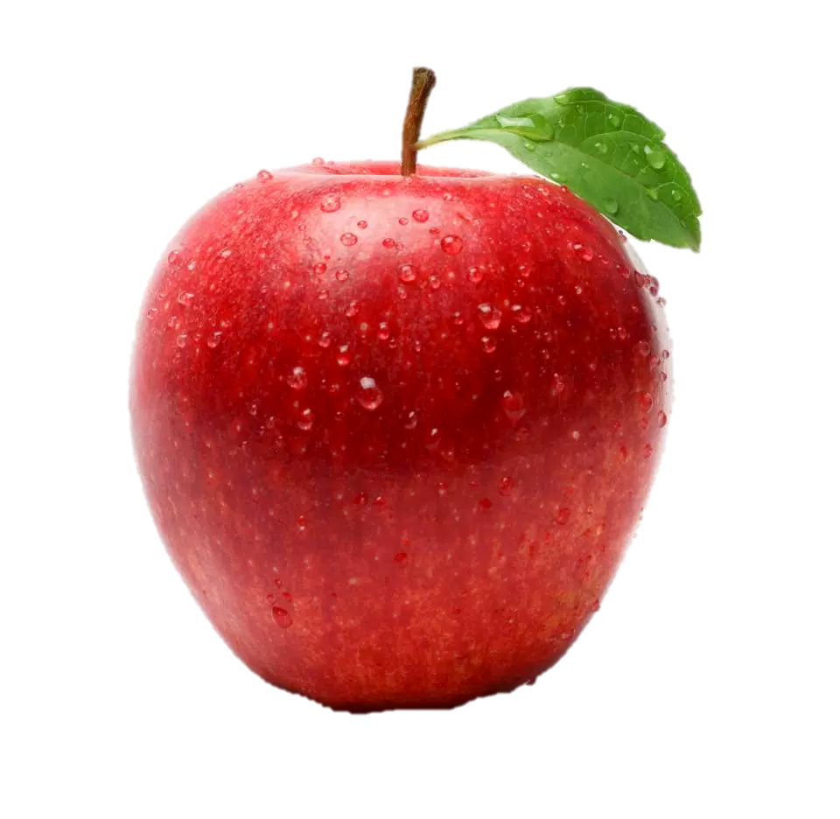
Sir Isaac Newton
(1643-1727)
Notes:
Slide 5: …Isaac Newton, in 1666, when he’d wondered why apples always fell to the ground. That big question led to him describing the law of gravity for the very first time! So, keep asking big questions yourselves!!

Slide 6
What goes up….?
…and what comes
down?
(based on the accounts in Matthew 28, Mark 16 and Luke 24)
Notes:
Slide 6: Our story today is about going up and coming down…and how the disciples were told to wait for something special….As you listen, think about what goes up and what comes down….[use script on p3. There are some pictures to go with it.]

Slide 7
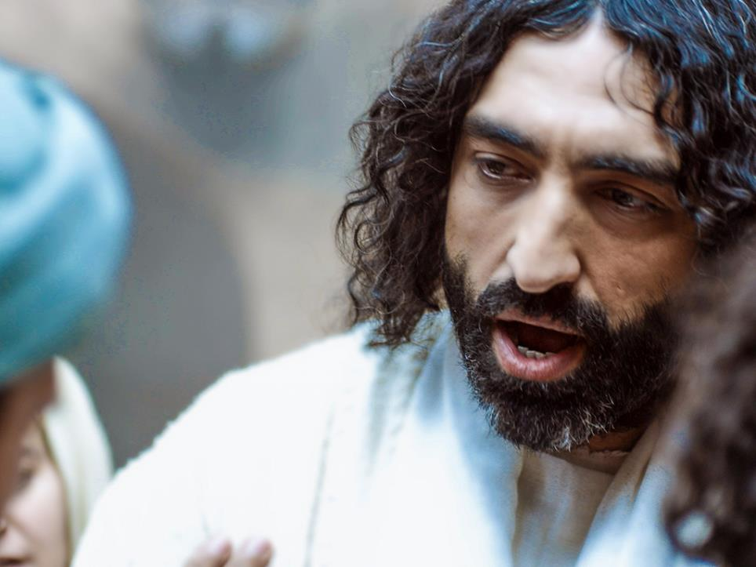
Notes:
Slide 7: Jesus had always told his friends the disciples that he had come down from heaven to show them what God, his Father, was like, and that one day he would return to his home, up in heaven. Some days after his resurrection, the disciples were all gathered together in Jerusalem. Suddenly Jesus appeared among them, as if out of nowhere.

Slide 8
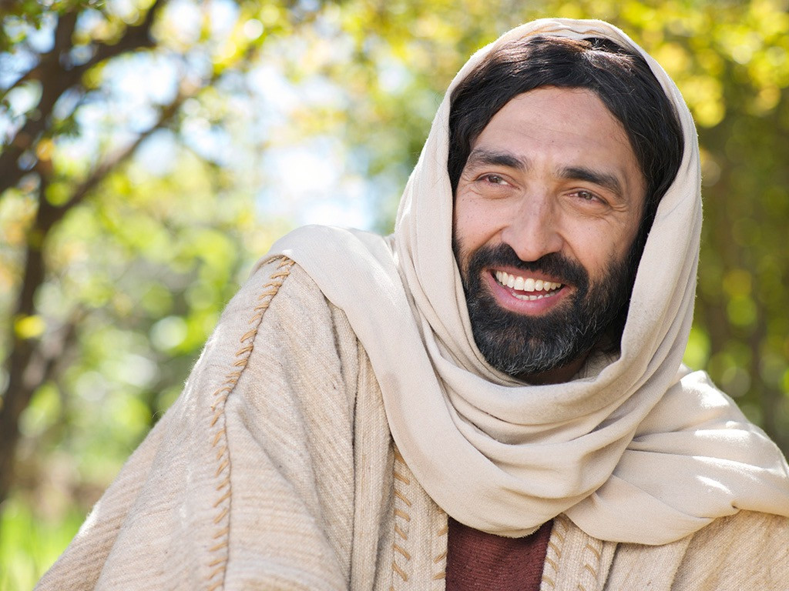
Notes:
Slide 8: ‘Stay here in Jerusalem’, Jesus told them. ‘I am going home, up to heaven, to be with my Father. But don’t worry: my Father will send down what he has promised: the Holy Spirit. It’s a special gift for you to be your helper, just like me…And don’t forget!’ he added ‘Even though I am going up to heaven, I will never leave you: never! I will be with you….always and forever!’

Slide 9
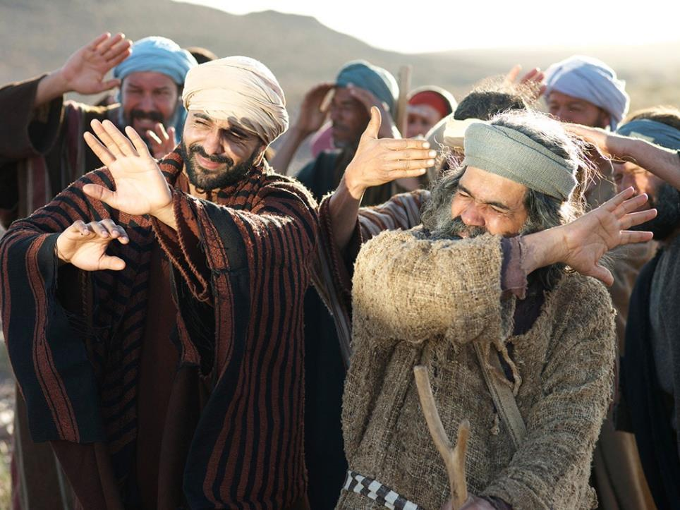
Notes:
Slide 9: And then, in a blaze of bright light, the friends watched as Jesus left them for the last time and went up into heaven.

Slide 10
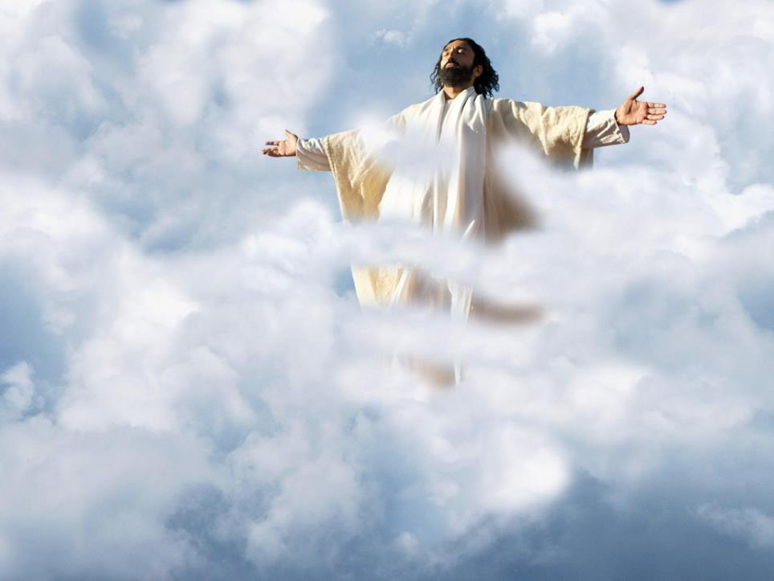
Notes:
Slide 10: They watched until he was hidden by the clouds….and then stood, staring at the sky, hardly knowing what to do next.

Slide 11
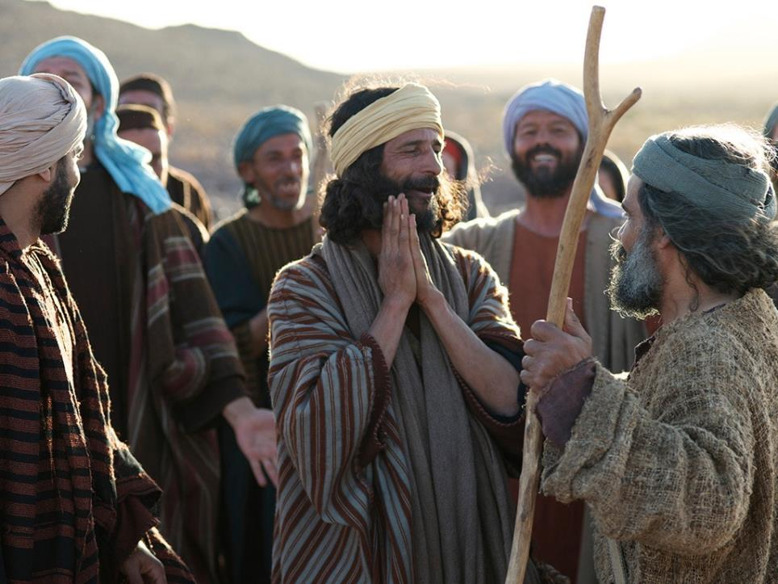
Notes:
Slide 11: The friends returned to Jerusalem with a strange sort of happiness in their hearts, as they remembered what Jesus had said about the gift that God would send down from heaven – and that he would be with them always.

Slide 12
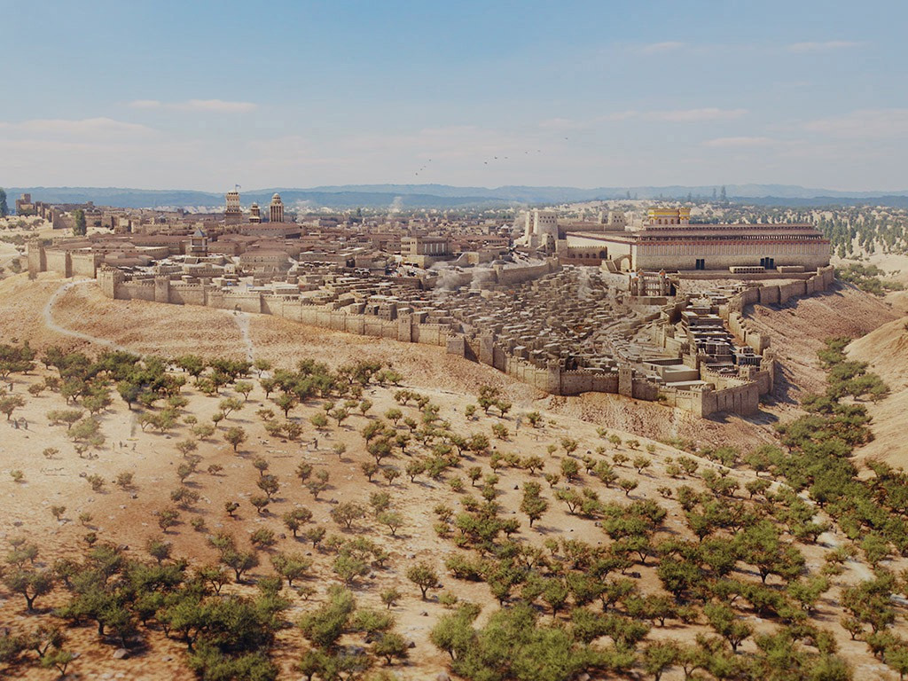
Notes:
Slide 12: 10 days later, the friends were again gathered together in Jerusalem, waiting.

Slide 13
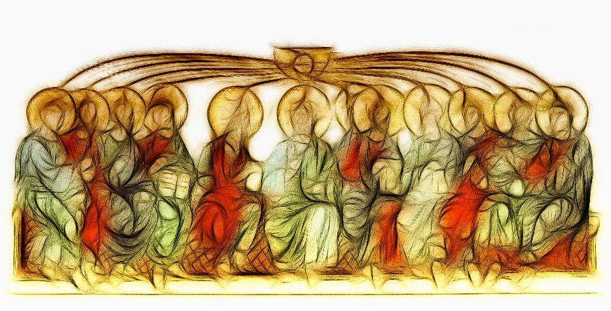
Notes:
Slide 13: Suddenly, they heard the sound of a rushing wind, all around them, and the Holy Spirit, the gift Jesus had promised, came down from heaven. It rested on their heads, and filled their hearts. It gave them love, and joy, and courage. It was just as Jesus had promised: a little piece of heaven that came down to live in their hearts, and helped them to tell the whole world what God had done.

Slide 14
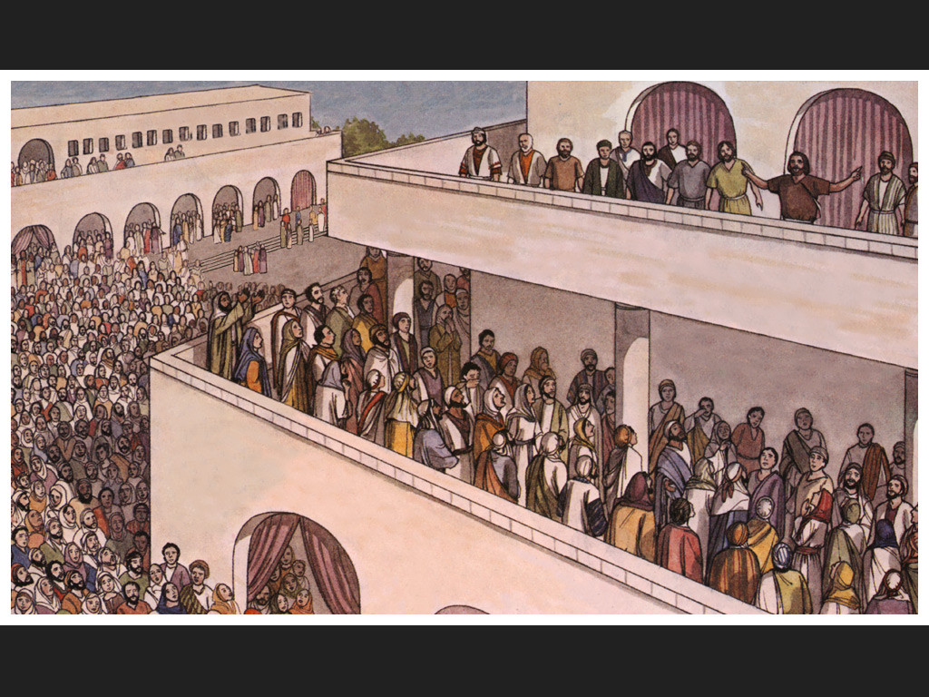
Notes:
Slide 14: And three thousand people who heard this good news on the day of Pentecost became the very first church.

Slide 15
What went up….?
…and what came
down?
Happy
Birthday
Church!
Notes:
Slide 15: So, what went up, and what came down? [ask children]
Because Jesus went back up to heaven, he could send down the Holy Spirit to be the special helper not just for the disciples, but for anyone who is a Christian, so that they can follow the ways of God’s Kingdom.
God’s gift of the Holy Spirit is something that Christians will be celebrating during the first weekend of half term, at Pentecost. Pentecost is known as the birthday of the Church, because three thousand people became followers of Jesus on that day – the very first church community.

Slide 16
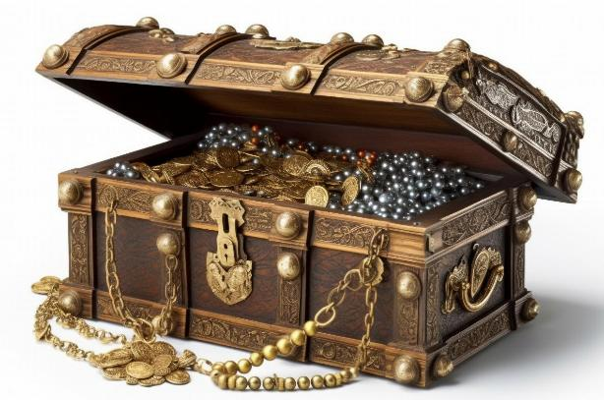
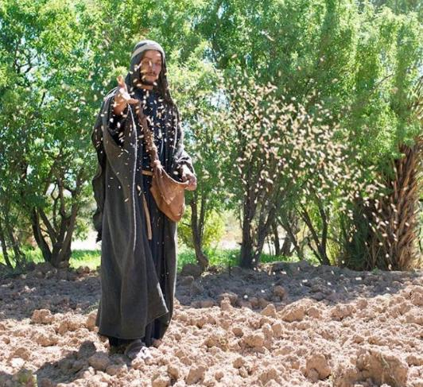

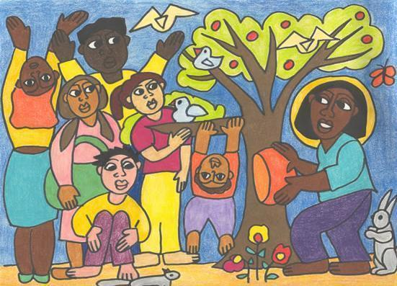
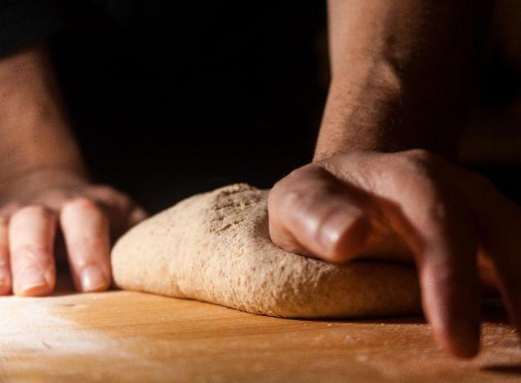
…listening to wisdom, old and new…
…sowing good ‘seeds’ in their hearts…
…making good choices…
…being a place of welcome for all…
…doing ‘small things with great love’…
Notes:
Slide 16: But what did this actually look like? The Bible says that these first Christians lived as part of God’s Kingdom here on earth, just as Jesus had shown them, so what we’ve seen in our parables might help us here…..[words animate on one click, one after the other] …listening to wisdom, old and new….…sowing good ‘seeds’ in their hearts……being a place of welcome for all……doing ‘small things with great love’……making good choices… so that God’s Kingdom on earth would grow. [you might want to talk together about how all these things might have an impact on the life of the Early Church or on actions/behaviour towards others]

Slide 17
...I wonder how the gift of God’s Holy Spirit helped them to do this?...
…or how different our world might be if everyone shared with others?...
…I wonder what we might share as part of this community?...
...and how this might change our world?...
Notes:
Slide 17: Responding (and words for worship)
The Bible also says that the whole community shared everything that they had, so that there was no-one in need. Just think about this for a moment [say it slowly…]…..everyone shared everything…..no-one needed anything! [pause for a few moments] This is a challenging idea, but what it meant was that those people who had lots shared with those who had nothing, so that everyone had what they needed.
…in the stillness, let’s take some time to think about this…..
…we’ve heard about the gift of the Holy Spirit that God sent at Pentecost….
…a little piece of heaven that helped the Early Church to live as part of God’s Kingdom here on earth….
….we’ve heard how the very first Christians shared everything that they had….
….so that no-one needed anything….
….I wonder how the gift of God’s Holy Spirit helped them to do this?...
...or how different our world might be if everyone shared with others?...
...I wonder what we might share as part of this community?...
...and how this might change our world?...
I’m going to turn my thoughts into a prayer now, as I ask God to help us to put some of these ideas into practice. There’s a part that you can join in with if you would like to …or if you’d prefer not to pray, then you can continue to sit quietly with your own thoughts. If you want to join me, then the words are very simply ‘Help us to share’….

Slide 18
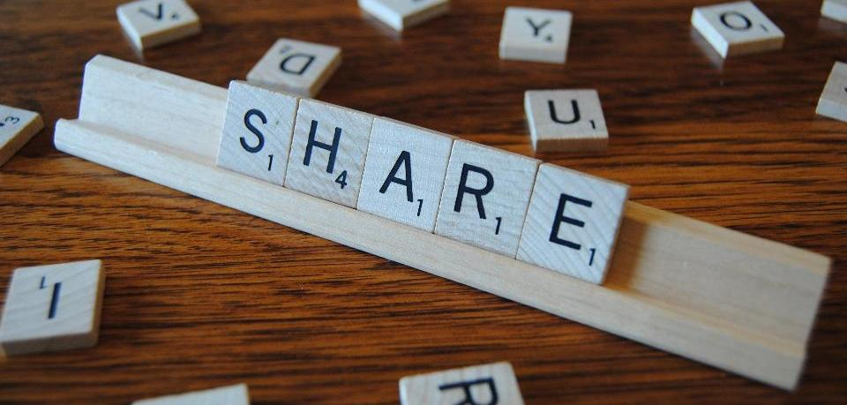
….help us to share.
Notes:
Slide 18: ‘Help us to share’….

Slide 19
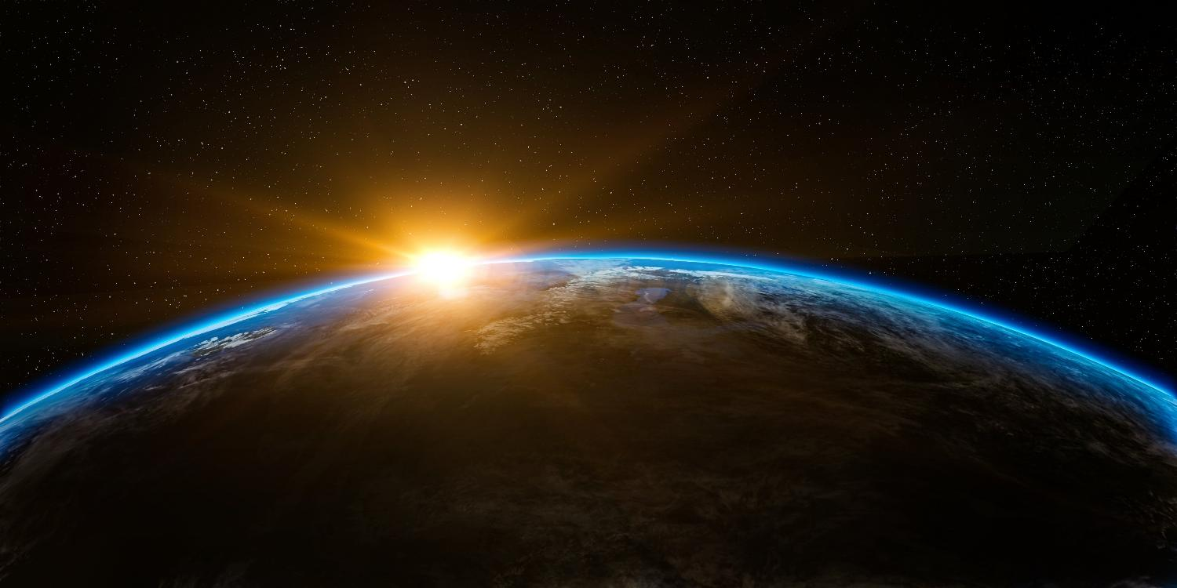
God, who has shared everything with us,
Notes:
Slide 19: God, who has shared everything with us,

Slide 20
….help us to share.
Notes:
Slide 20: ‘…help us to share.’

Slide 21
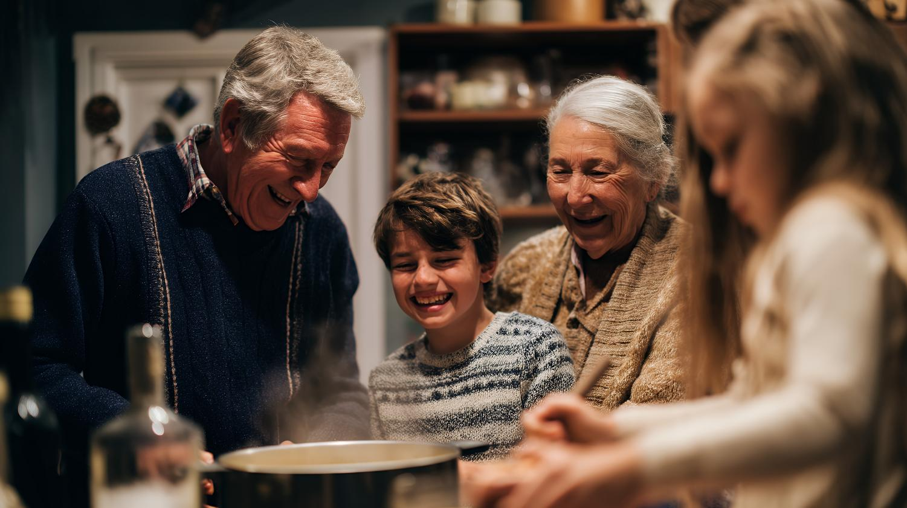
With our friends and in our families,
Notes:
Slide 21: With our friends and in our families,

Slide 22
….help us to share.
Notes:
Slide 22: ‘…help us to share.’

Slide 23
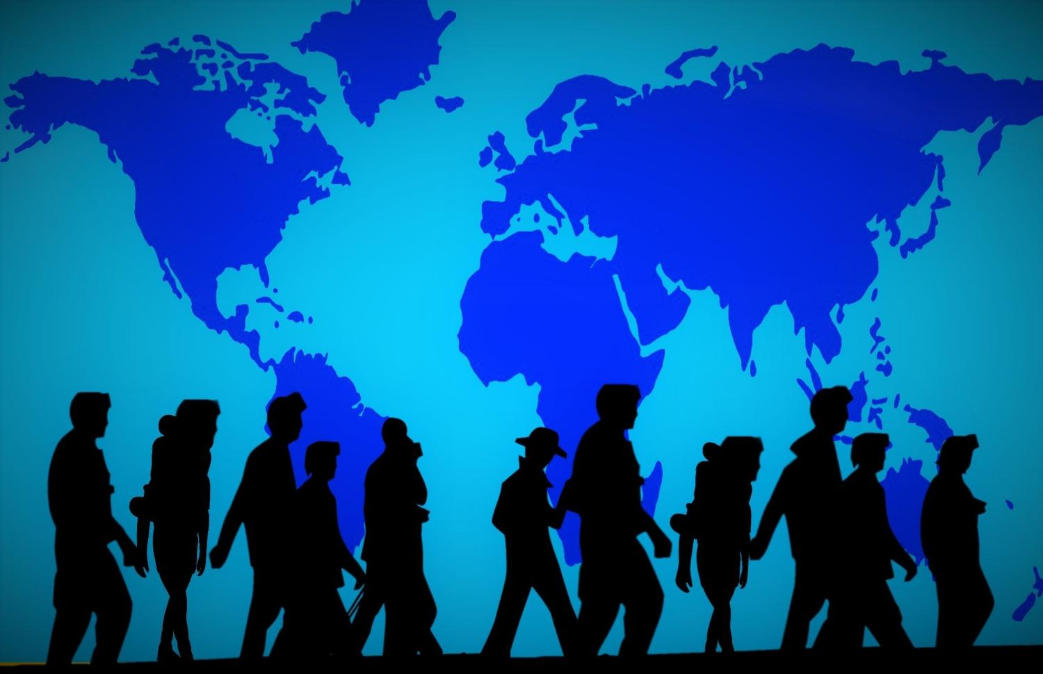
When we see someone in need,
Notes:
Slide 23: When we see someone in need,

Slide 24
….help us to share.
Notes:
Slide 24: ‘…help us to share.’

Slide 25
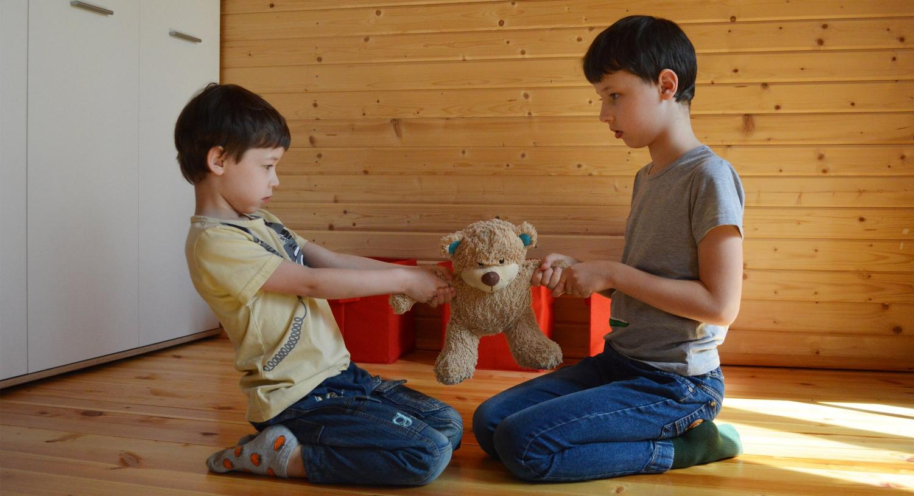
Even when it’s difficult,
Notes:
Slide 25: Even when it’s difficult,

Slide 26
….help us to share.
Notes:
Slide 26: ‘…help us to share.’

Slide 27


Slide 28




Leader: As we leave this place & time and go into the day ahead…
All: May we be willing to share!
Notes:
Sending: Slide 27
Leader: As we leave this place and time and go into the day ahead…
All: May we be willing to share!

Slide 29

Notes:
Slide 28: Reflective areas
You will need a gift box and some small gift tags.
Think: Think of something that you might share with others.
Talk: Talk about how it feels to share. Is it easy or difficult? Are some things easier to share than other things?
Do: Write or draw on a small gift label then put it inside the box …..you might like to ask God to help you to share.

Slide 30
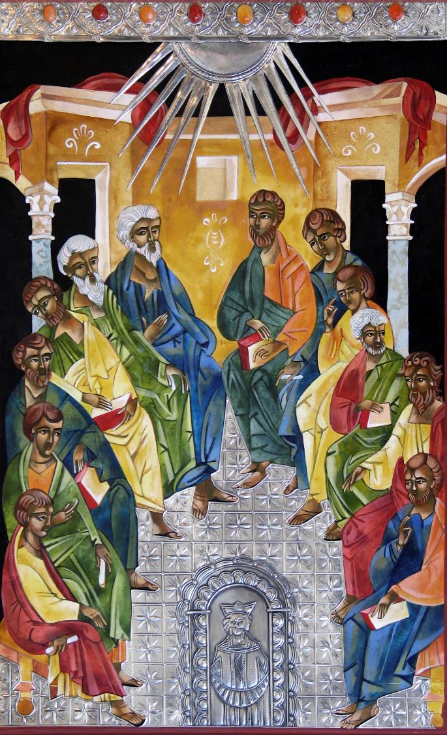
Notes:
Pentecost from Mexico, 2008
Mary Jane Miller is a self-taught Byzantine style iconographer with over 28 years of experience, born in New York and living in Mexico full time. Her collections of sacred art are contemporary, with a proficient command of egg tempera (which is how iconography was originally created). Her work is extraordinarily rich in style and has been exhibited in museums and churches in both the United States and Mexico.
Pentecost was the Jewish holiday of Shavuot, or Festival of Weeks, a holiday in honour of the first fruits of the harvest. The annual celebration commemorates receiving the laws - the Torah - on Mount Sinai - fifty days after the first day of Passover and the Exodus from Egypt. According to the book of Acts, the disciples are gathered in one place. The disciples hold books while others hold scrolls. Biblical accounts describe the Holy Spirit as rushing wind and individual tongues of fire descending upon the disciples’ heads. In this icon, the rays of silver are the Holy Spirit descending from a heavenly mandorla. The half-circle shaped mandorla is the source of divine wisdom that radiates toward the disciples’ heads.

