Slide 1
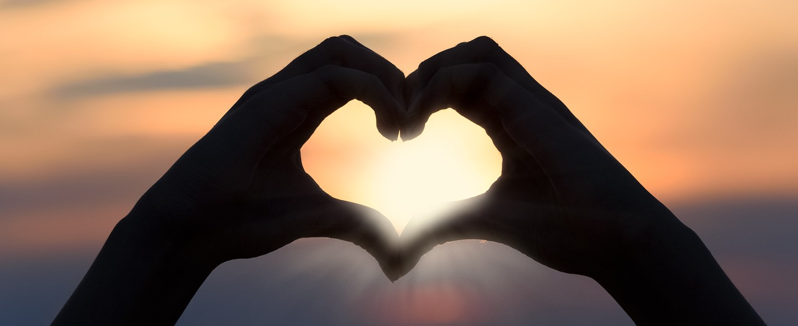
Leader: As we gather together
ALL: …we bring our hearts.
Notes:
Slide 1: Use these new gathering words for this term, or your usual greeting if you prefer. The greeting comes with BSL signing; you can view the demos using links under the slide.
Leader: As we gather together,
ALL: …we bring our hearts
Signs for greeting: click on links
Hearts: British Sign Language BSL Video Dictionary - heart

Slide 2

Leader: As we gather together
ALL: …we share our thoughts.
Notes:
Slide 2: Use these new gathering words for this term, or your usual greeting if you prefer. The greeting comes with BSL signing; you can view the demos using links under the slide.
Leader: As we gather together,
ALL: …we share our thoughts.
Signs for greeting: click on links
Thoughts: British Sign Language BSL Video Dictionary - thought

Slide 3





Leader: As community together
ALL: …we serve one another.
Notes:
Slide 3: Use these new gathering words for this term, or your usual greeting if you prefer. The greeting comes with BSL signing; you can view the demos using links under the slide.
Leader: As community together,
ALL: …we serve one another.

Slide 4
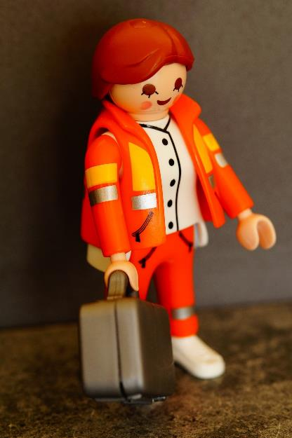
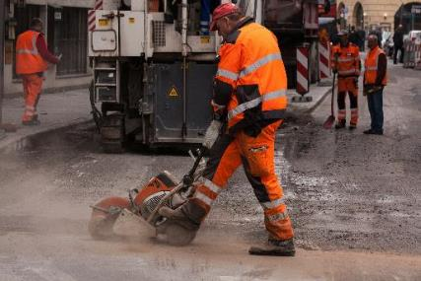
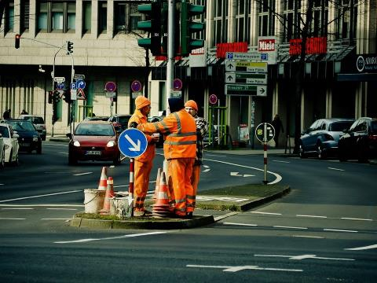
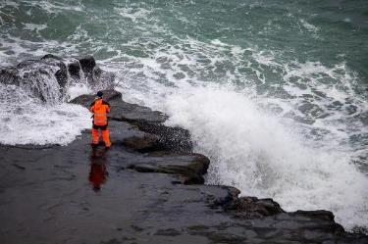
Notes:
Slide 4: What have all these pictures got in common? [they are all wearing high vis jackets that help them to be seen.

Slide 5
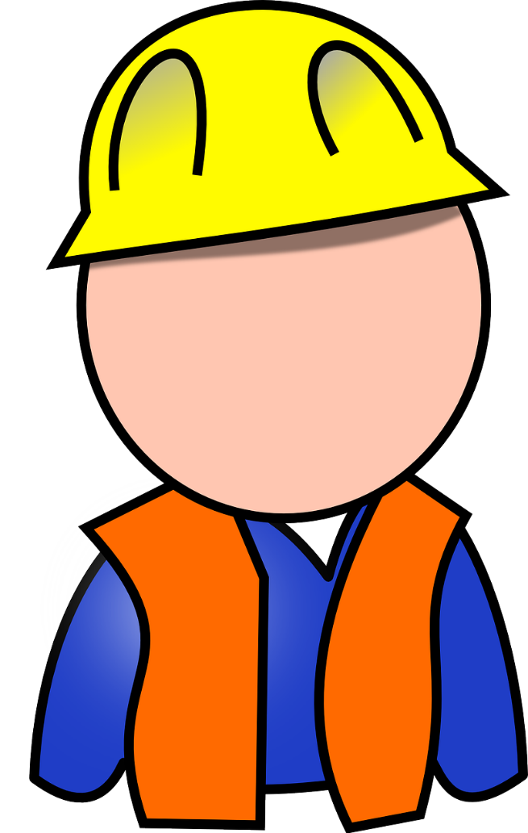
?
Notes:
Slide 5: Talk together about why someone might wear clothes like this – and why it’s so important that they are seen, that they stand out.

Slide 6





Songs from
the heart
Notes:
Slide 6: Songs from the heart
This term, as you know, we are looking at some of the songs of King David in the Psalms and finding out from his life what might’ve caused him to write them. Today’s words come from Psalm 103.

Slide 7
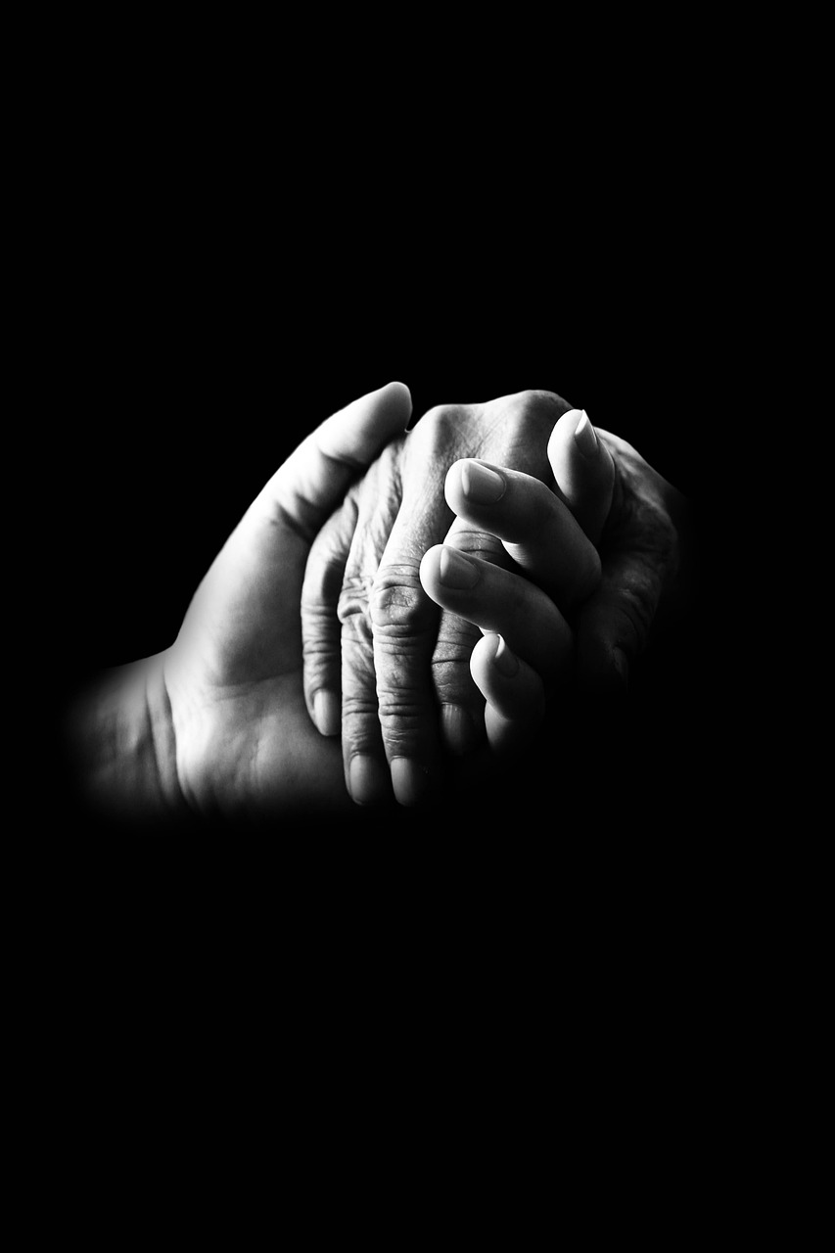
The Lord shows mercy and is kind. He does not become angry quickly, and he has great love. Psalm 103:8
Notes:
Slide 7: The Lord [that’s what David calls God] shows mercy and is kind. He does not become angry quickly, and he has great love.
[explain any words here that you think children may need clarification on]
Keep these words in your mind now, as we dip into another story from David’s life. You might recall that David had a very best friend, King Saul’s son Jonathan, who died in battle. The story that we are going to share together in a moment is about Jonathan’s son – who has a very long name!....

Slide 8

Mephibosheth
Notes:
Slide 8: Mephibosheth [Meh-fib-oh-sheth] who is just a young boy
This story works a little differently than usual! [Explain how it works if you’re doing it live, or use the video linked above. Ask children to see if they can spot any links between this story and the words from Psalm 103]
So, how do David’s actions link with the words that he wrote in Psalm 103?
David was modelling in his actions what he saw in God’s character. He said that God was kind and shows mercy, and so David chose to reach out to a poor, crippled boy, and show him the most generous kindness by bringing him to live in his palace.
David said ‘I want to show God’s kindness to Mephibosheth.’
We’re going to spend some time now thinking about what this might mean for us….

Slide 9



….I wonder what stands out for you in this story?.....
David chose to show God’s kindness to Mephibosheth.
….I wonder what it means to show God’s kindness to someone?
….I wonder how your kindness might stand out today ?
Notes:
Slide 9: Responding (words for worship & wondering questions): Let’s be still and quiet together now….
….I wonder what stands out for you in this story?.....
David chose to show God’s kindness to Mephibosheth
….I wonder what it means to show God’s kindness to someone?
….I wonder how your kindness might stand out today?
As we’ve heard today, David’s kindness towards Mephibosheth, and the promise he made, really stand out in this story….
…Mephibosheth did not expect to be treated this way….
….

Slide 10
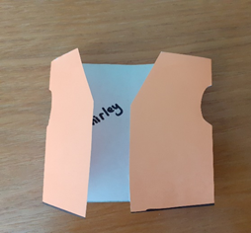
Notes:
Slide 10: Prayer
Do you remember how at the start of our time together today, we saw some pictures of people wearing high vis vests, to help them to stand out? We’ve been thinking about how we want our kind actions to stand out in our school community. So, to help us to pray today, I’m going to use a paper high vis vest. You might want to turn your own thoughts into a prayer as we go along….
Model each of the actions listed as you talk
….as I open up one side of the jacket, think about someone you are close to, who needs to know some kindness today….
[leave some space]
….as I open up the other side, think about someone you perhaps don’t get on with, who you might show kindness to this week….
[leave some space]
….as I close up the jacket, spend a few moments now thinking or praying about these people…
….and about your actions, that your kindness will stand out this week….

Slide 11
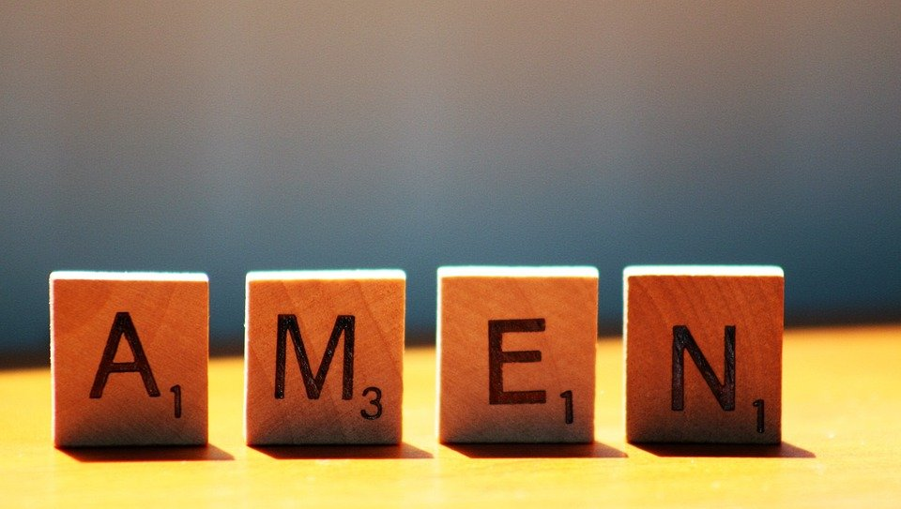
Notes:
Slide 11: And as we close our time, you may want to join in with ‘Amen’

Slide 12


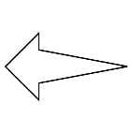
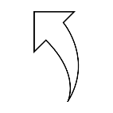
Leader: As we leave this place & time and go into the day ahead…
All: …may we serve one another in our kind thoughts and words and actions.
Notes:
Sending: Slide 12
Leader: As we leave this place and time and go into the day ahead,
All: ….may we serve one another in our kind thoughts and words and actions.
Signs for response: click on links
Thoughts: British Sign Language BSL Video Dictionary - thought (signbsl.com)
Words (use 3rd definition): British Sign Language BSL Video Dictionary - word (signbsl.com)
Actions: British Sign Language BSL Video Dictionary - action (signbsl.com)

Slide 13
Notes:
Reflective / prayer idea for this week, which you have just modelled.
There are further ideas in the script.

