Slide 1
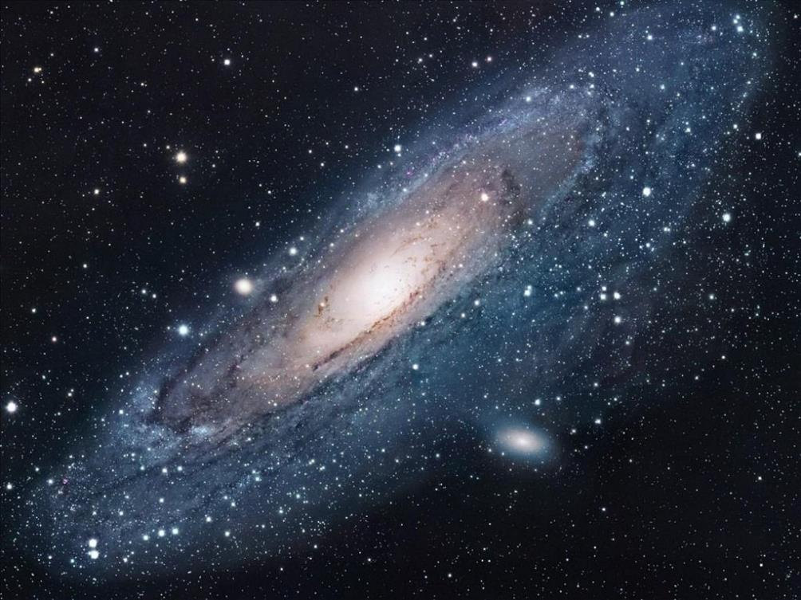
God is so big, so strong and so mighty
Notes:
This PowerPoint includes the words of the song ‘God is so big, so strong & so mighty’ [slides 1-18] and is referred to during the script [slides 21-22], as it’s a good way to identify some Christian beliefs about (& adjectives that describe!) God. Remove these if it’s not a familiar song.

Slide 2
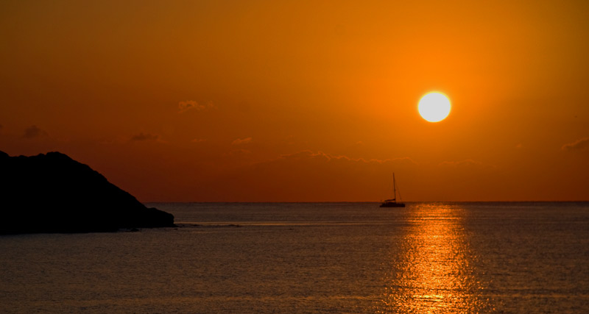
There’s nothing that he cannot do
Kum ba Yah, my Lord,
Kum ba Yah
Kum ba Yah, my Lord,
Kum ba Yah

Slide 3
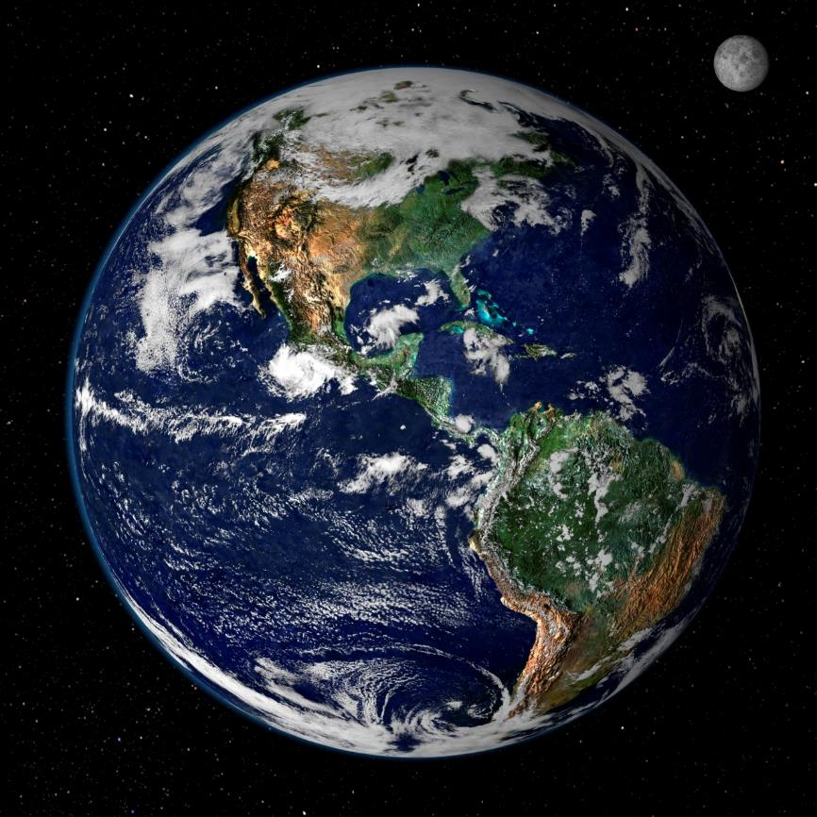
God is so big, so strong and so mighty

Slide 4
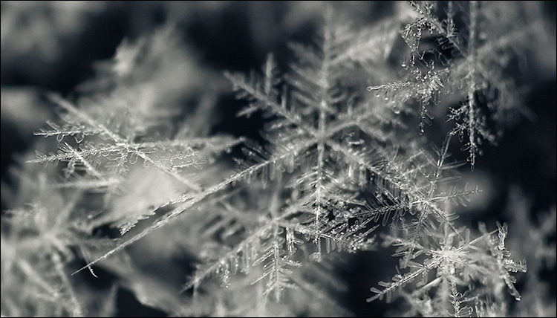
There’s nothing that he cannot do
Kum ba Yah, my Lord,
Kum ba Yah
Kum ba Yah, my Lord,
Kum ba Yah

Slide 5
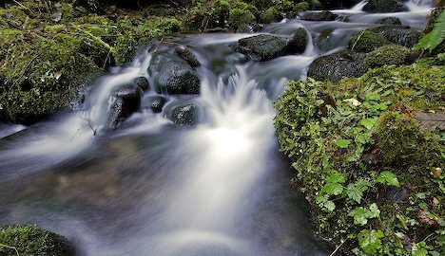
The rivers are his

Slide 6
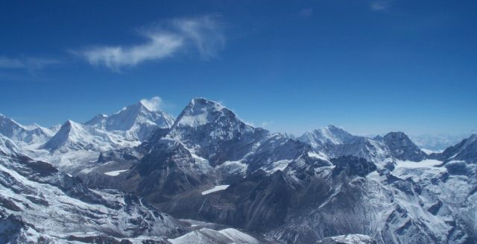
The mountains are his

Slide 7
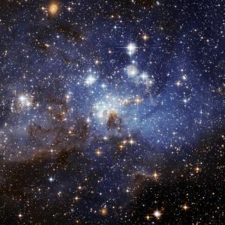
The stars are his handiwork too

Slide 8
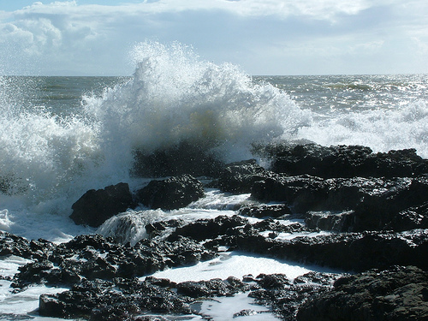
God is so big, so strong and so mighty

Slide 9
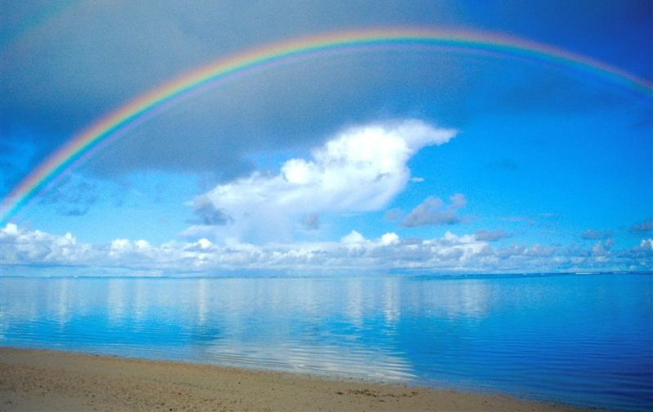
There’s nothing that he cannot do

Slide 10
God is so big, so strong and so mighty

Slide 11
There’s nothing that he cannot do
Kum ba Yah, my Lord,
Kum ba Yah
Kum ba Yah, my Lord,
Kum ba Yah

Slide 12
God is so big, so strong and so mighty

Slide 13
There’s nothing that he cannot do
Kum ba Yah, my Lord,
Kum ba Yah
Kum ba Yah, my Lord,
Kum ba Yah

Slide 14
The rivers are his

Slide 15
The mountains are his

Slide 16
The stars are his handiwork too

Slide 17
God is so big, so strong and so mighty

Slide 18
There’s nothing that he cannot do

Slide 19





We are here together in our school family. May God be with us…
...and watch over us.
Notes:
Slide 1: Use these new gathering words for this term, or your usual greeting if you prefer.

Slide 20
What’s your
name?
Notes:
Slide 20: What’s your name? Does it mean something? Is there a story behind your name?
Explain that people sometimes choose names for their children because of the meaning that the name has, and that each of the names they can see has a different meaning. Look at the selection you have chosen together, or explore meanings that children know.

Slide 21
God is so big, so strong and so mighty
Notes:
Slides 21-22: As we were coming in, we listened to / sang the song: ‘God is so big, so strong and so mighty, there’s nothing that he cannot do’. I wonder which words tell us what God might be like? [explore together]

Slide 22
God is so big, so strong and so mighty

Slide 23
God, you are…..
Notes:
Slide 23: I wonder what other words we might think of?.....[explore more together]

Slide 24

The Lord’s Prayer
Notes:
Slide 24: This term, we’re thinking about the words in the prayer that Jesus taught to his friends – the prayer that Christians call the ‘Lord’s Prayer’.

Slide 25
Our Father in heaven,
Hallowed be your name
Your kingdom come, Your will be done on earth, as it is in Heaven.
Give us today our daily bread.
Forgive us our sins,
As we forgive those who sin against us.
Lead us not into temptation,
But deliver us from evil.
For the Kingdom, the power and the glory are yours, now and forever.
Amen
Notes:
Slide 25: Today we’re thinking about the line: ‘Hallowed be your name’. When people pray this line of the prayer, they are saying that God’s name is ‘holy’ [hallowed is an old word for ‘holy’]. But what does this word ‘holy’ mean? [share ideas together] Here’s a story about this….with one of the very first leaders of God’s people, Moses.

Slide 26
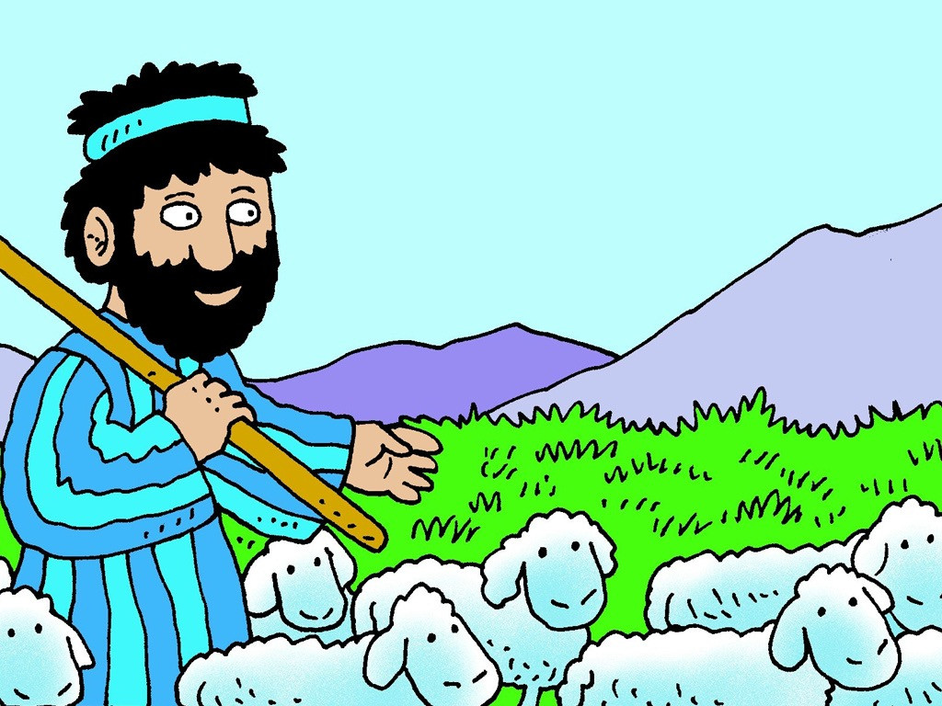
Notes:
Slide 26: Before he led the people through the desert, and wrote down God’s Ten Commandments, Moses was a shepherd. One day when he was caring for his sheep, he saw a very strange sight…

Slide 27
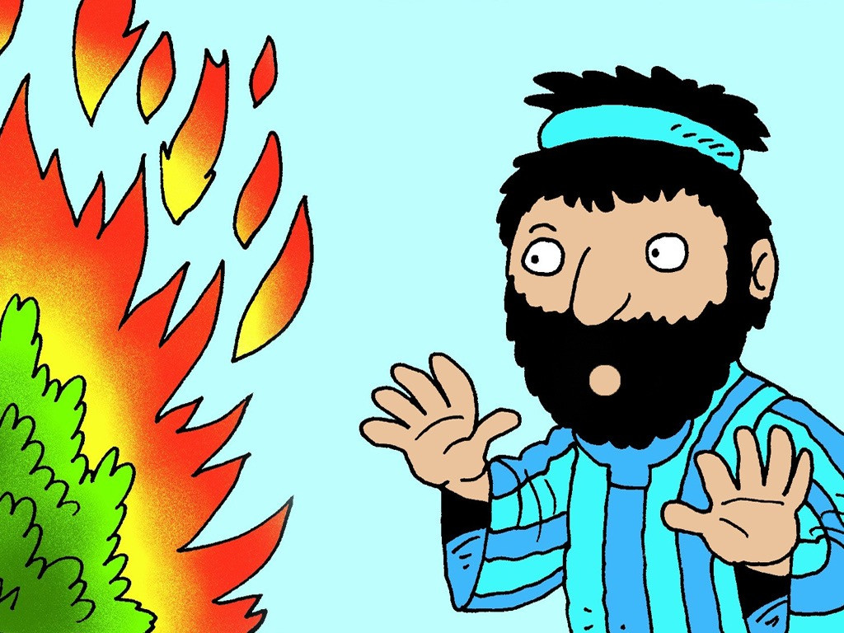
Notes:
Slide 27: A bush was on fire, all by itself…but it wasn’t burning up…Curious, Moses went to get a closer look and as he did so, he heard a voice:

Slide 28
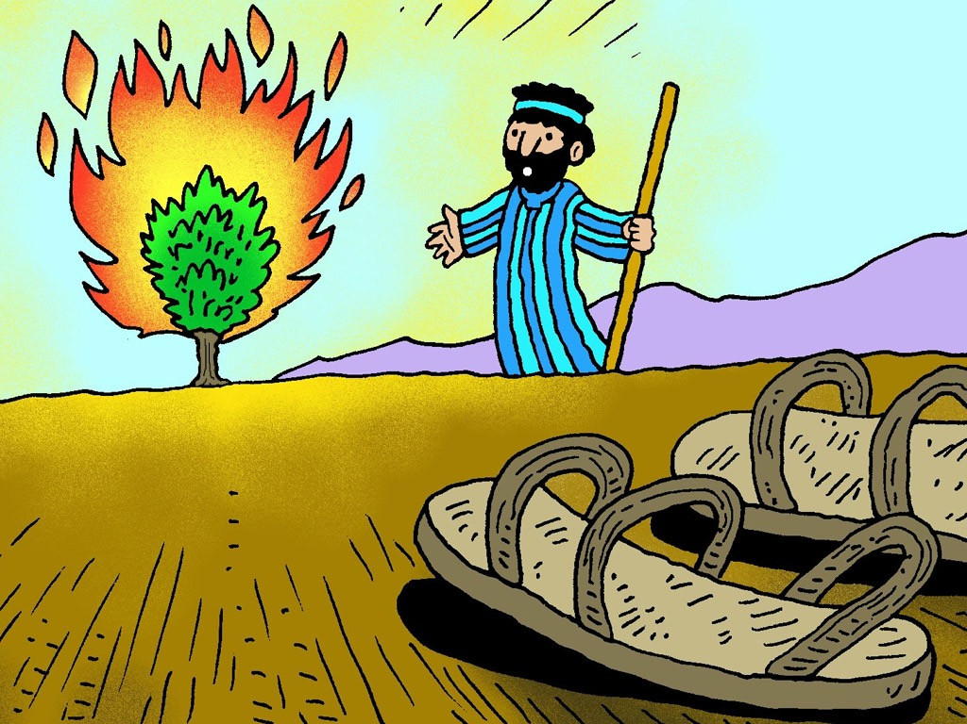
Notes:
Slide 28: ‘Take your sandals off, Moses, because this ground is holy ground. I AM the Lord God, the God of your people from long ago – and I am sending you to rescue my people from Egypt and bring them to a new land where they will be safe and happy.’
Moses was terrified, but eventually, he found words to speak… ‘But who shall I say you are, when they ask for your name?' Moses asked. And the voice replied, 'This is my name. I am Yahweh, which means 'I am who I am' and 'I will be who I will be'. Tell them that Yahweh, the 'I AM', has sent you. This is my name forever and by this name I will be remembered for all generations.’

Slide 29
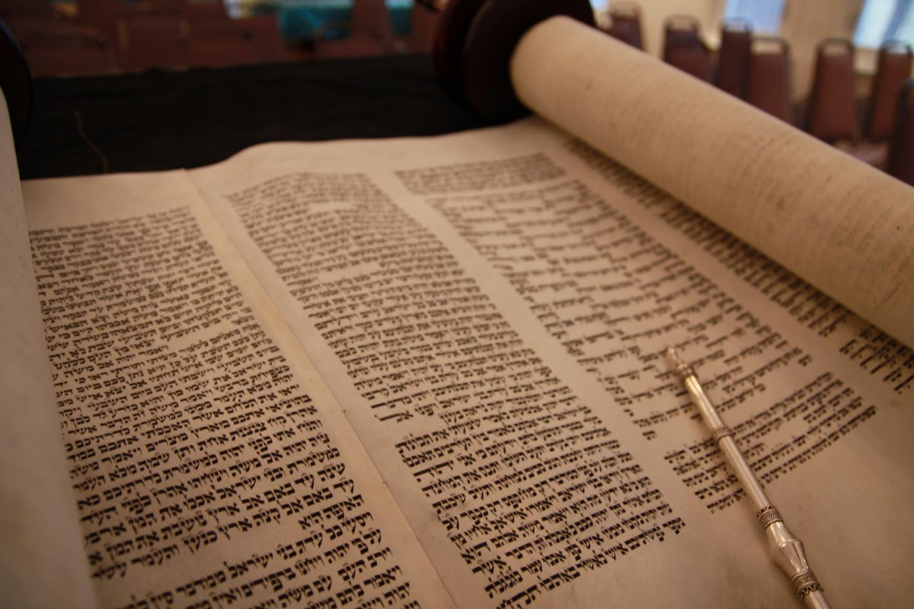
Notes:
Slide 29: This puzzling name ‘Yahweh’ (meaning ‘I Am Who I Am’ and ‘I will be who I will be’) was so important and precious to the Jewish people that they wouldn’t even write it down in full, in case the paper got damaged afterwards. It was so holy, so precious, that they would only speak it out loud on one day in the year. For them, the name JHWH was infinitely precious….it was a name that would last for infinity, forever and ever…..and a name that is greater than any other name or any other thing
It’s also a name that Christians use carefully and respectfully [you might like to talk more about what this means]

Slide 30
…. I wonder what difference it makes for Christians to believe that God is ‘Holy’?....or to pray ‘Holy is your name?’….
….and why it’s important to them to use God’s name carefully & respectfully?....
….I wonder what you think about these ideas?....
Notes:
Slide 30: Let’s wonder together…
…. I wonder what difference it makes for Christians to believe that God is ‘Holy’?....or to pray ‘Holy is your name?’….
….and why it’s important to them to use God’s name carefully & respectfully?....
….I wonder what you think about these ideas?....

Slide 31
Notes:
Slide 31: Responding (words for worship):
Let’s be still and quiet together now….
We’ve been thinking today about how Christians pray ‘Holy is your name’…
…and that they use God’s name carefully and respectfully…..
…….
….I wonder what’s so precious to you that you would be upset if someone treated it with disrespect?.....
….when Christians pray ‘Holy is your name’, they are reminding themselves how amazing God is…
….that God’s name is the best name ever….
I’m going to give you a chance to just reflect on these things, or use the stillness as an opportunity for you to pray if this is something that you are comfortable with. You might want to use the words ‘Holy is your name’…. Or any of the other words we chose to describe God earlier…..

Slide 32


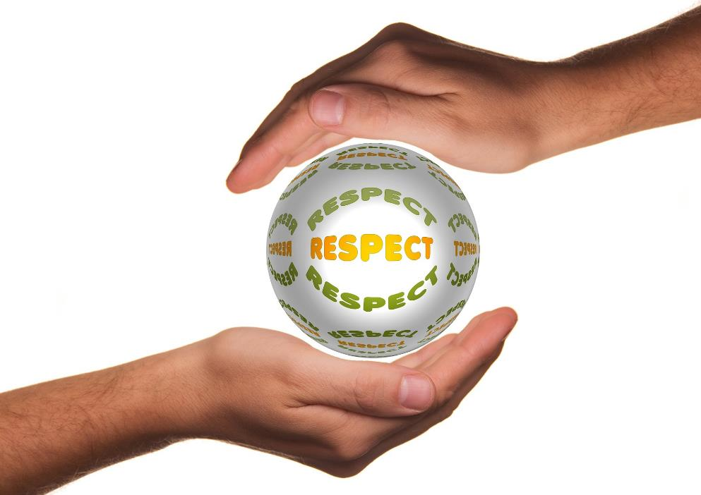
Leader: As we leave this place & time and go into the day ahead…
All: Let’s remember to treat each other’s beliefs with respect.
Notes:
Sending: Slide 20
Leader: As we leave this place and time and go into the day ahead…
All: Let’s remember to treat each others’ beliefs with respect.

