Slide 1
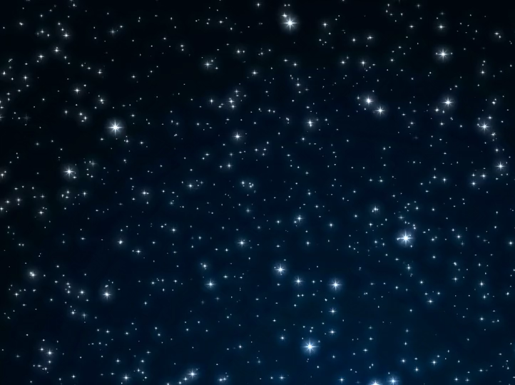




All pictures copyright-free from pixabay
Notes:
Slide 1: Starry sky stilling exercise
Use the stilling slide if desired: the suggested words should be spoken slowly, leaving pauses inbetween to create a sense of stillness.
As you sit quietly, watch the stars twinkling….[PAUSE]
Now practise slower breathing…..in…..and out…..in……and out…..keep this going as you continue to look at the stars….[PAUSE]
You maybe notice that you are feeling calmer and more relaxed….[PAUSE]
We come into this special / sacred space and time to be still….to think deeply…..to be together as a school community…..
In our time together today, we will do a quiz together, share the next part of our story, talk together and then think together.
But first, let’s welcome one another as we begin….

Slide 2
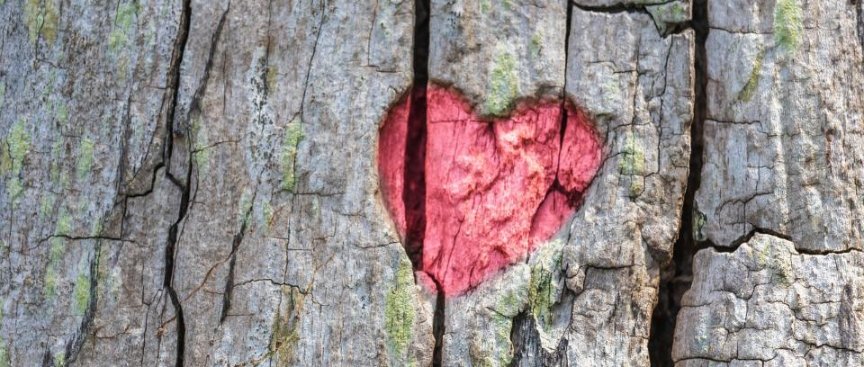
Leader: As we gather together today…
ALL: …we bring our thoughts and our hearts into this sacred space.
Notes:
Slide 2: Gathering
Leader: As we gather together today….
ALL: ….we bring our thoughts and our hearts into this sacred space.
Here are BSL actions for some of the words:
Leader’s words:
Gather: https://www.signbsl.com/sign/gather (1st video)
Today: https://www.signbsl.com/sign/today (1st video)
Pupils’ response:
Thoughts: https://www.signbsl.com/sign/thoughts (1st video)
Hearts: https://www.signbsl.com/sign/heart (1st video)

Slide 3
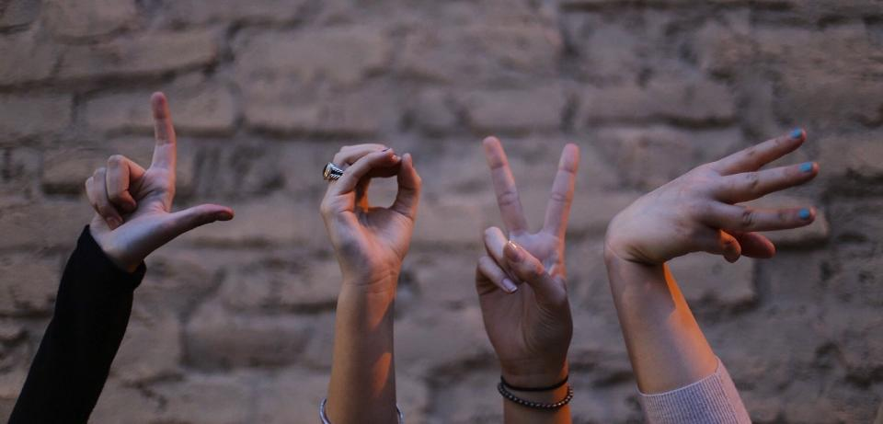
What’s the message?
Notes:
Slide 3: First, we’re going to have a quiz about messages.
On the screen, you will see some messages – you need to work out what they are and how they might help the person receiving the message. [Many are deliberately open-ended, to aid discussion]
Let’s start with what we can see here….you may have to look really carefully at the shapes of each hand to work out the message! (It’s LOVE by the way)….What might this message remind someone about?

Slide 4

Notes:
Slide 4: Back to school time

Slide 5
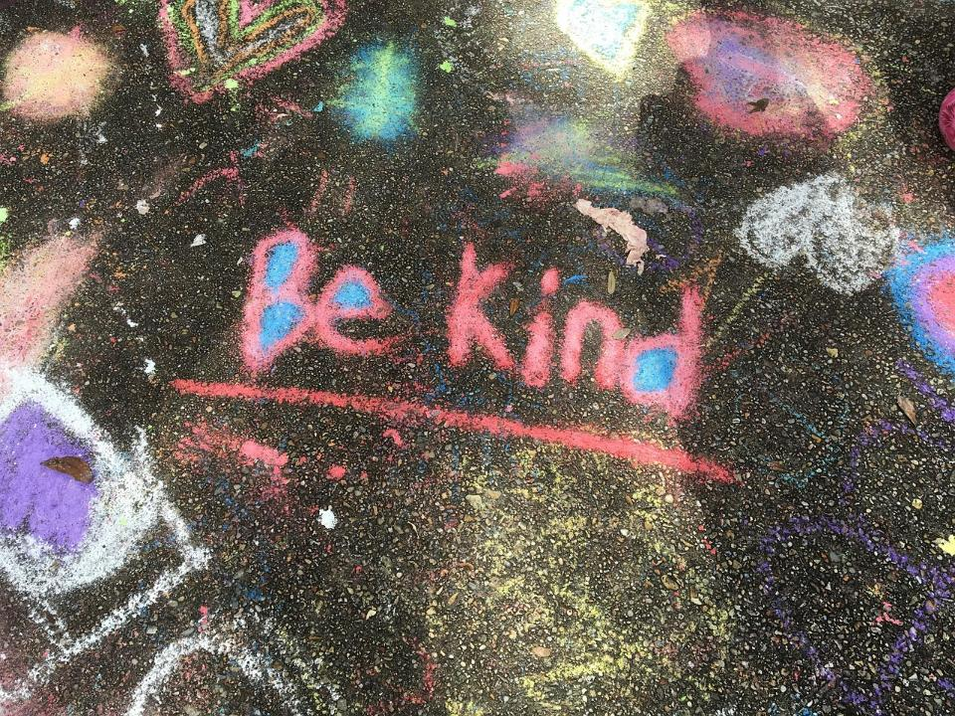
Notes:
Slide 5: be kind to one another

Slide 6
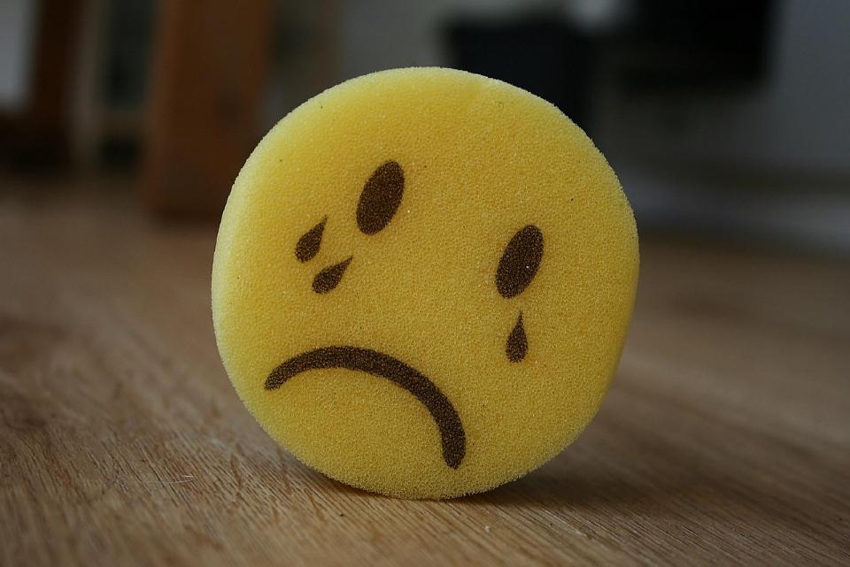
Notes:
Slide 6: I’m feeling sad today

Slide 7

Notes:
Slide 7: Reduce, reuse and recycle to save our planet

Slide 8
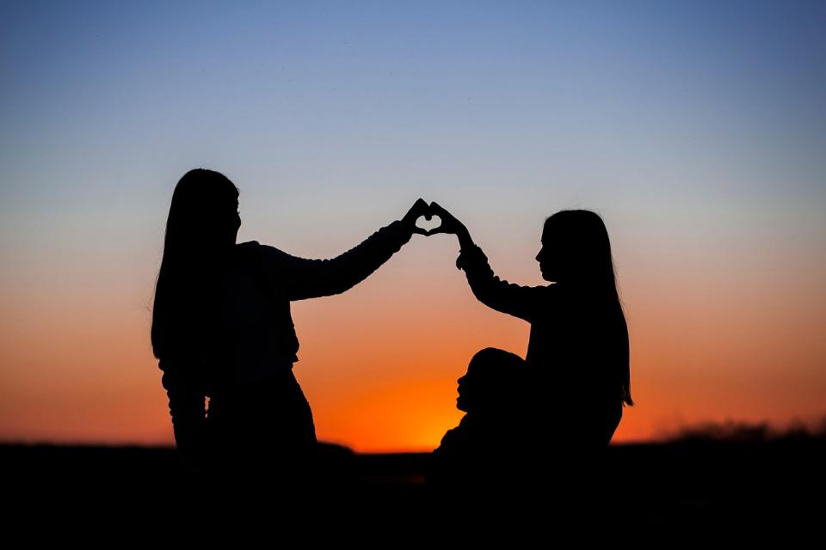
Notes:
Slide 8: share the love

Slide 9
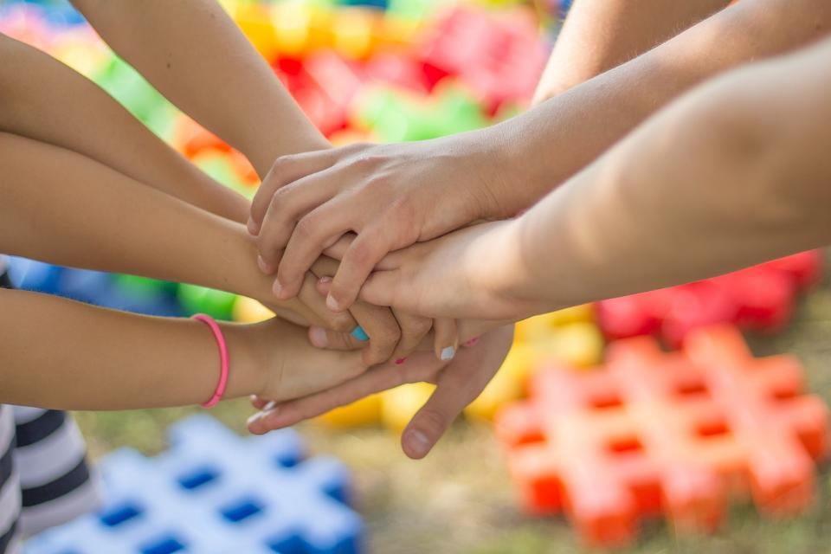
Notes:
Slide 9: teamwork / friendship

Slide 10
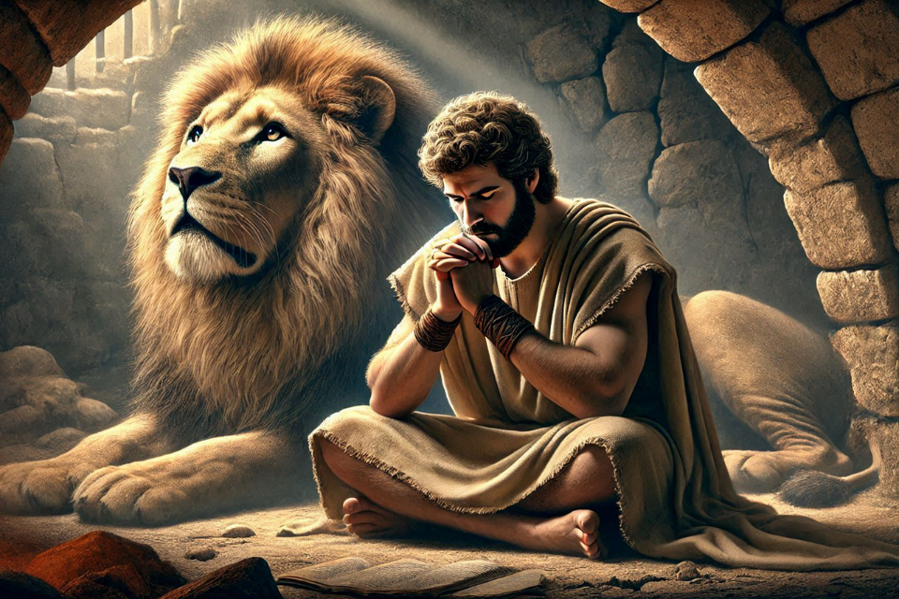
Shine like stars!
Notes:
Slide 10: We’re going to continue now with Daniel’s story…..There is a message for the new King of the Babylonians in today’s instalment.

Slide 11
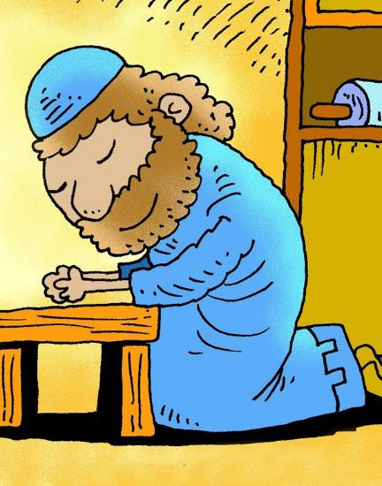
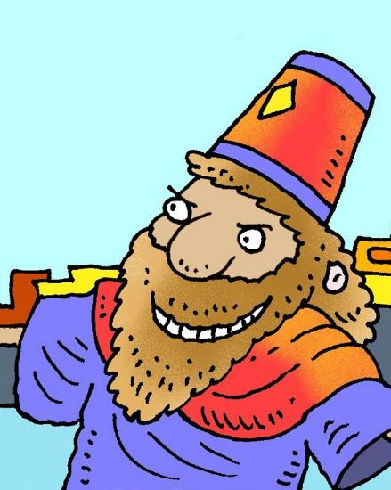
‘Pride comes before a fall.’
Notes:
Slide 11: Last week, we heard how King Nebuchadnezzar learned that ‘pride comes before a fall’ – and thought about how different he was to Daniel.
So, let’s find out if the new king will be an improvement…..

Slide 12
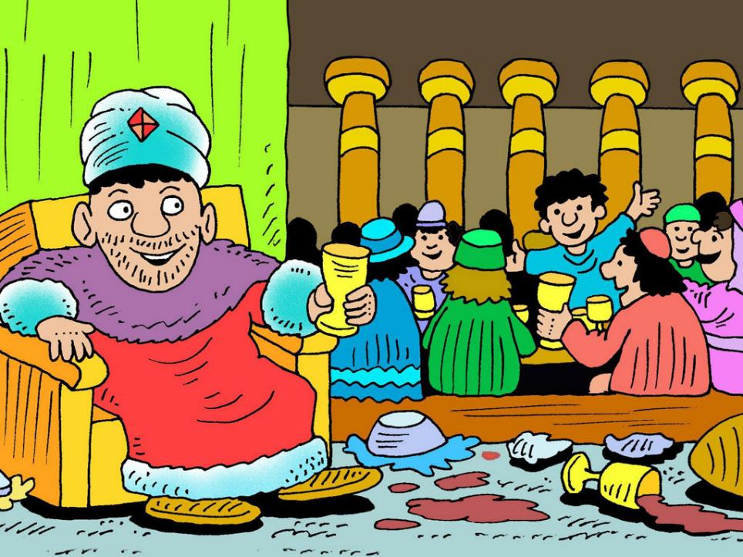
Belshazzar’s Feast
Notes:
Slide 12: Belshazzar’s Feast [use numbered slides, or interactive reflective story on p4)
This is the story of King Belshazzar, who took over the reign of the Babylonian Empire after King Nebuchadnezzar. [Read on in the script, or use props and the script on p.4]

Slide 13
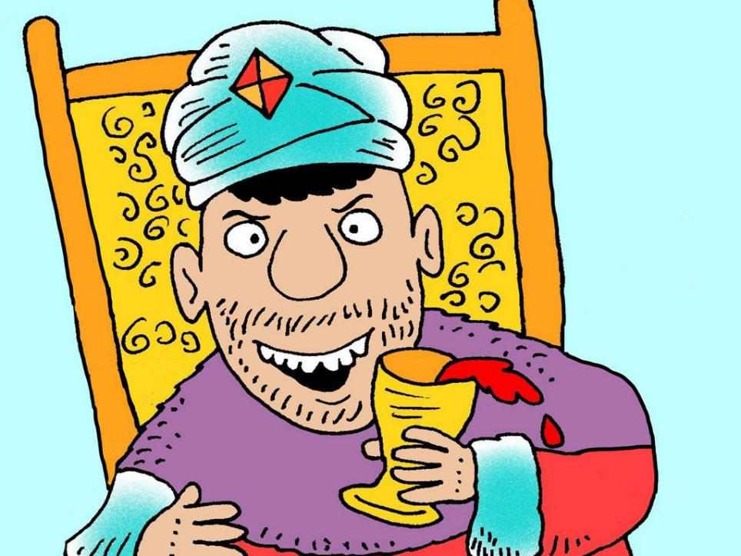
Notes:
Slide 13: King Belshazzar thought his kingdom would last for ever. He believed he was so powerful that no-one could defeat him, that he was unbeatable. And he wanted to celebrate how great he was.

Slide 14
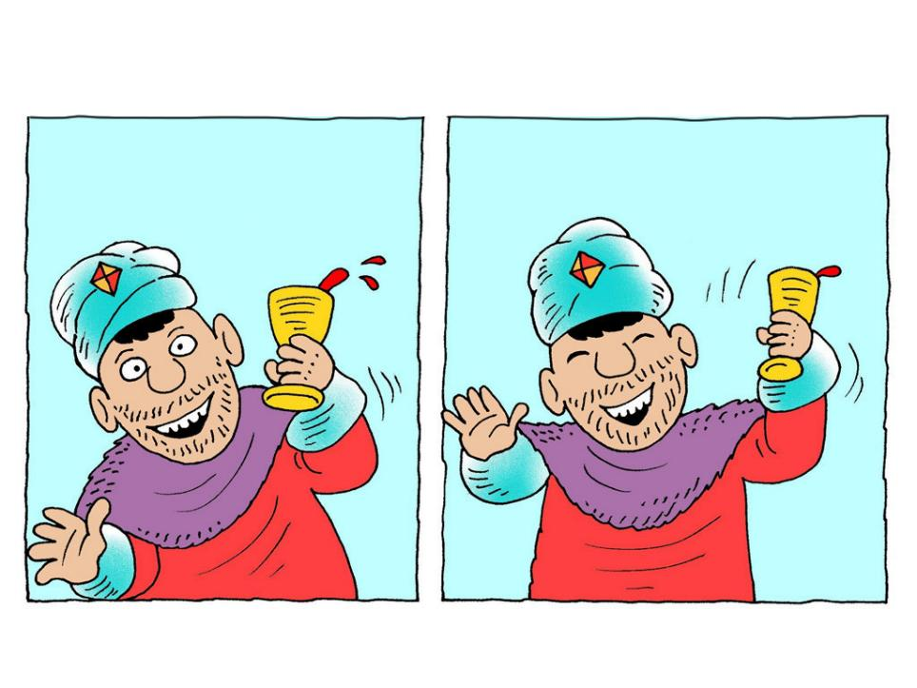
Notes:
Slide 14: So, he decided to throw the biggest party anyone had ever seen to celebrate his success and invited a thousand very important guests! Money would be no object – he was determined to show off how important, how rich and how great a King he was.

Slide 15
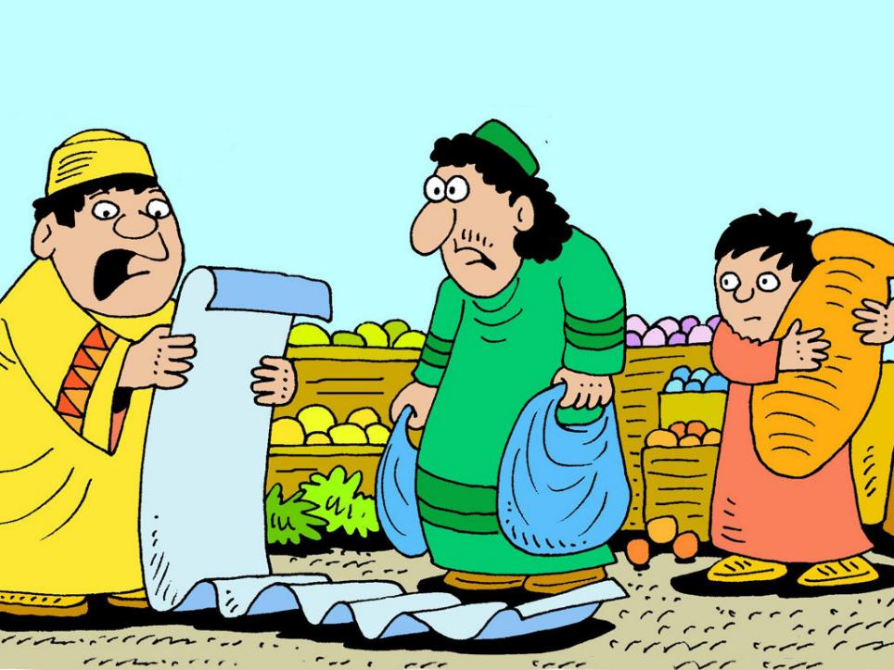
Notes:
Slide 15: But, of course, it was his servants who were left with all the preparation – at least one thousand of everything!

Slide 16
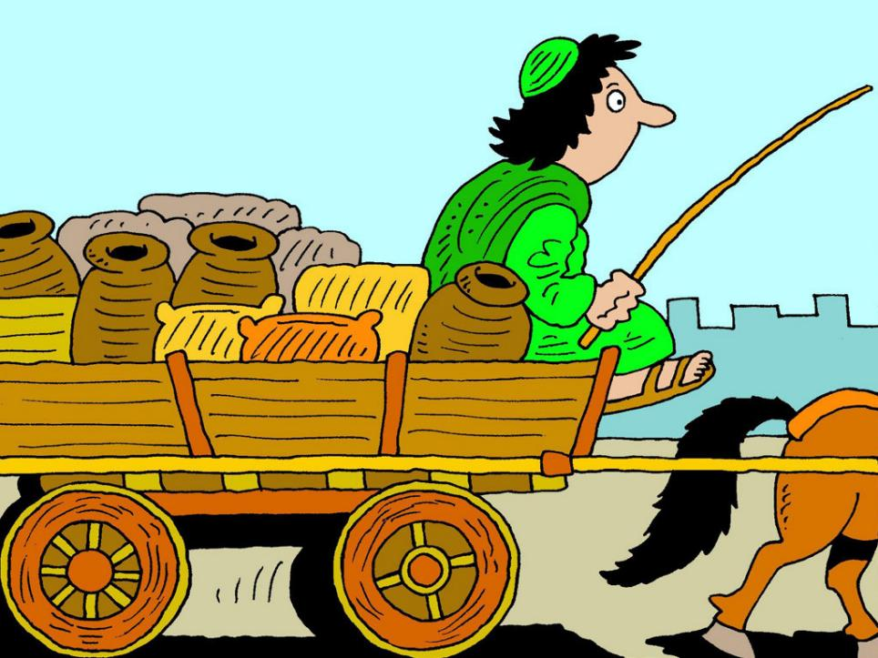
Notes:
Slide 16: Vast amounts of food and wine soon began arriving at the palace.

Slide 17
Notes:
Slide 17: The day of the party came and all the guests arrived. They were very excited to see this new king, who was treating them to such a lavish and extravagant party. He had promised them the best of everything – and they were not disappointed!

Slide 18
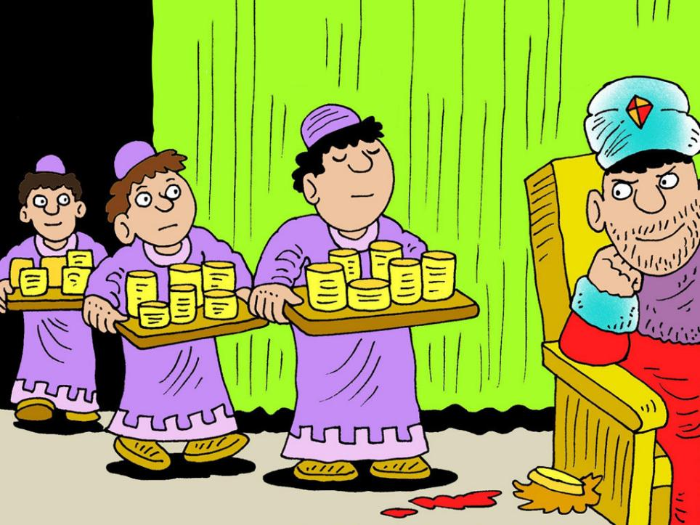
Notes:
Slide 18: As he watched his guests enjoying themselves, King Belshazzar had a very wicked idea. He remembered that they had taken all the sacred gold and silver cups out of God’s holy temple when the Babylonians had captured Jerusalem. The cups were beautiful and had been made to use during worship in the Temple. They would be perfect for his party, King Belshazzar thought, and so he sent for them to be brought up from the treasure store.

Slide 19
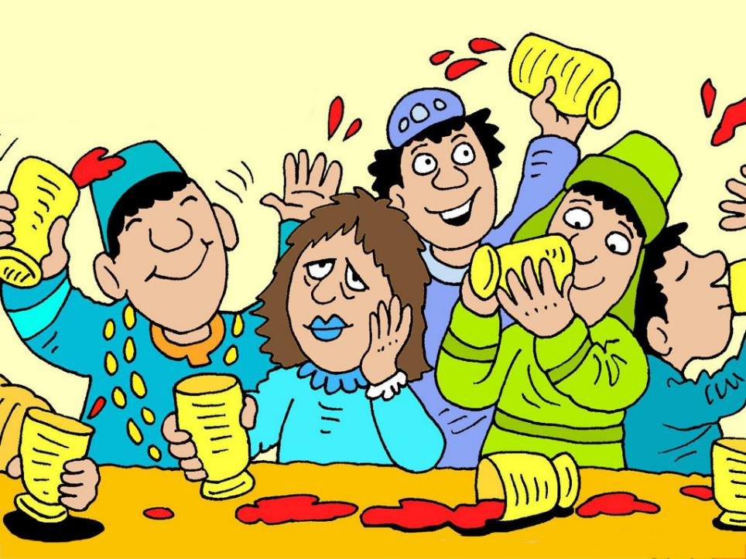
Notes:
Slide 19: The guests filled up all the cups with wine and partied late into the night. This party, like Belshazzar’s reign, would go down in history!

Slide 20
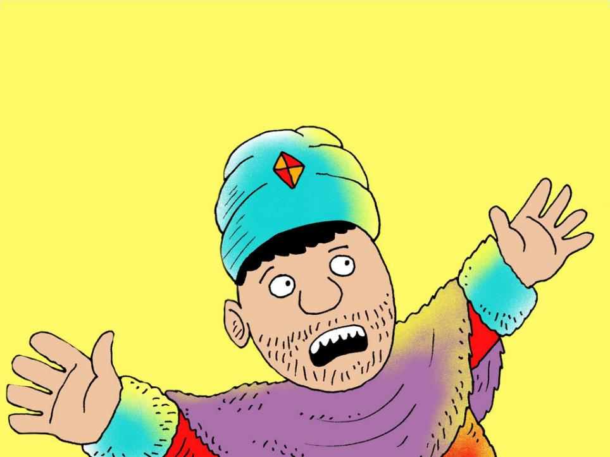
Notes:
Slide 20: Suddenly there was a dazzlingly bright light – and out of nowhere…..

Slide 21
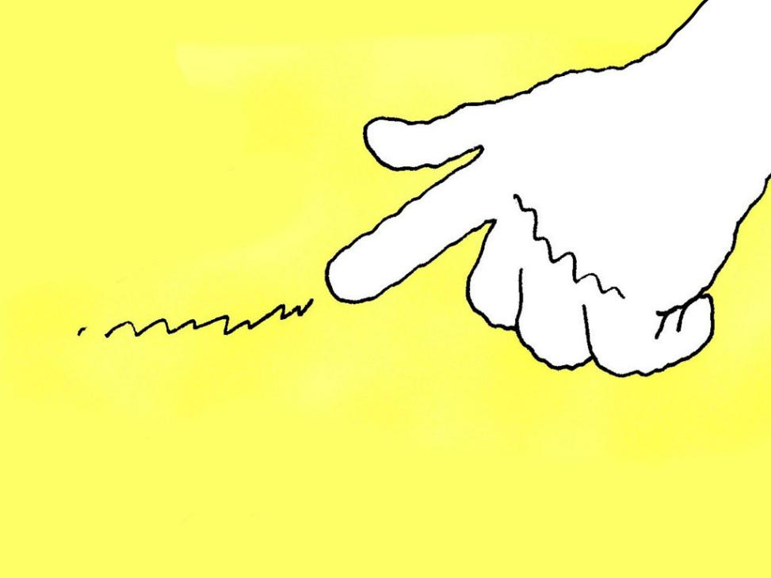
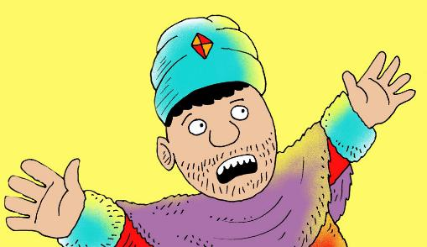
Notes:
Slide 21: a hand appeared, as if from heaven.

Slide 22

Notes:
Slide 22: The finger wrote some very strange words: ‘Mene Mene, Tekel, Upharsin.’ [menay menay tekel you-parsin] No-one at the party had any idea what they had meant or who had written them. Belshazzar sent for all his wise men, but none of them could tell him either.

Slide 23
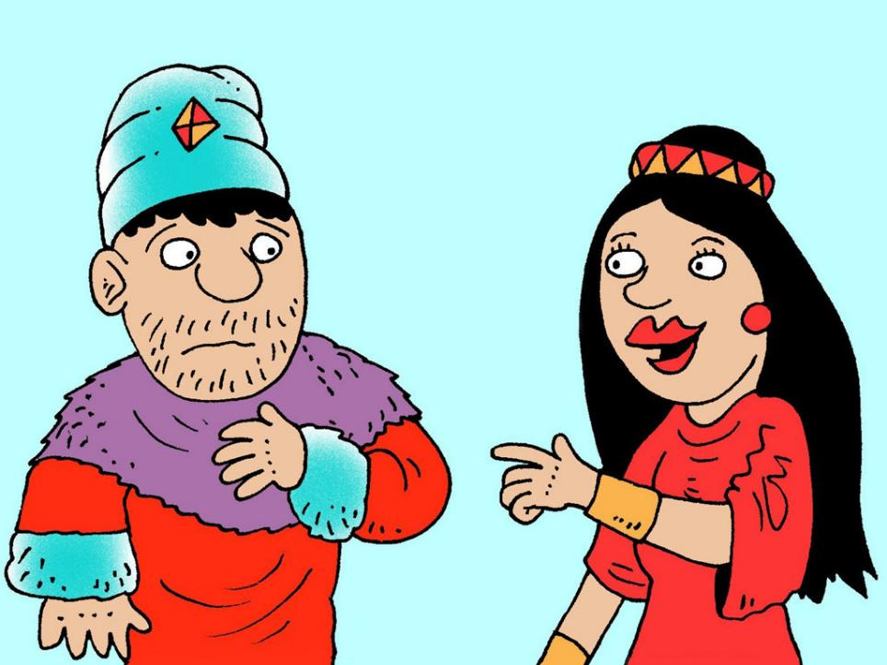
Notes:
Slide 23: But then the Queen remembered Daniel and told Belshazzar to send for him.

Slide 24
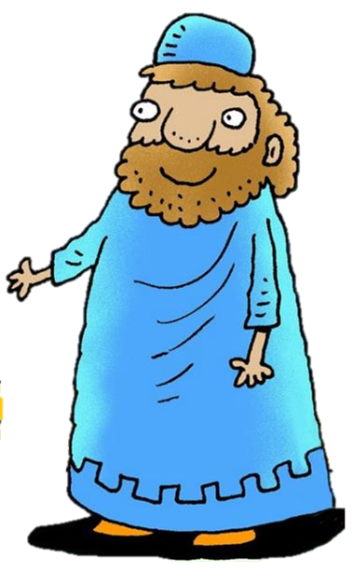
Notes:
Slide 24: ‘God can help me tell you the meaning of these words, which are a warning to you.’ Daniel replied. ‘Mene means “numbered”,. Tekel means “weighed” and “upharsin” means divided.’ God has weighed your actions and because of your wickedness and cruelty, your days as king are coming to an end, and your great kingdom will be divided.

Slide 25
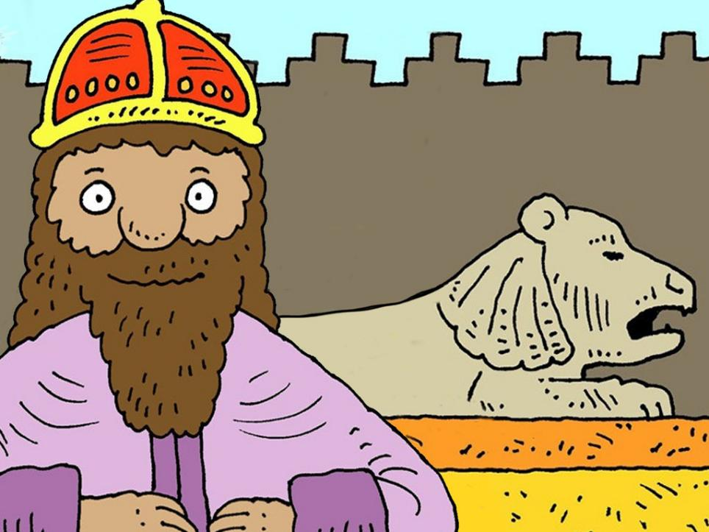
Notes:
Slide 25: And that very night, it happened just as God had said it would: King Belshazzar was removed as king and the kingdom fell to King Cyrus of Persia. I wonder what kind of a leader he will be?……

Slide 26

….I wonder what we might learn from today’s story?….
….I wonder what messages of encouragement might remind us to live well together?....
….I wonder how our school’s vision and values might help us too?....
….I wonder how God might view our actions?....
Notes:
Slide 26: Responding and words for worship
We’ve heard today about the strange writing on the wall; the warning to the King about his actions – and a reminder to us that it matters how we treat other people…..
Warnings are sometimes still needed in certain circumstances, but we often prefer to be encouraged! So today, this is where we will begin our time of reflection together….
….I wonder what we might learn from today’s story?….
….I wonder what messages of encouragement might remind us to live well together?....
….I wonder how our school’s vision and values might help us too?....
….I wonder how God might view our actions?....
[We recommend that you talk together about this before moving on to the prayer, as it will help to set the scene for your class-based reflection spaces this week.]
As a way of turning our thoughts into prayers now, I’m going to collect some words from you about ways you think we should treat each other. I’ll collect them onto our message board here – which you will also be able to do in your classrooms this week….
[Gather children’s ideas for some positive messages that they might ‘leave’ to encourage others – and explain how this will work for your setting e.g. on whiteboards / walls (and how!) or in playground chalks]

Slide 27

Interactive prayer
Notes:
Slide 27: Prayer
Rephrase some of the words of encouragement that you have just collected into a prayer, or read some out and invite children to turn the ideas into their own silent prayer….

Slide 28
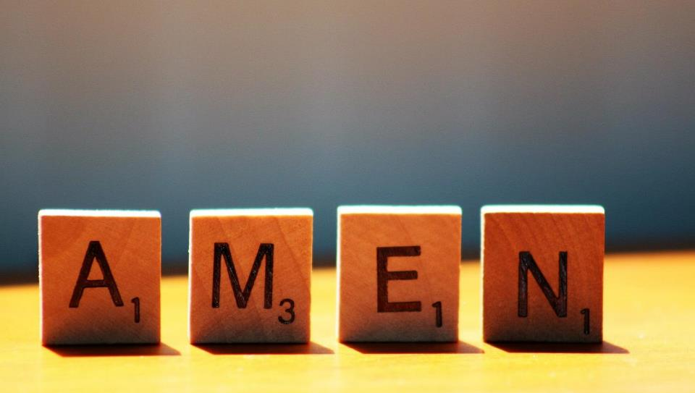

Slide 29
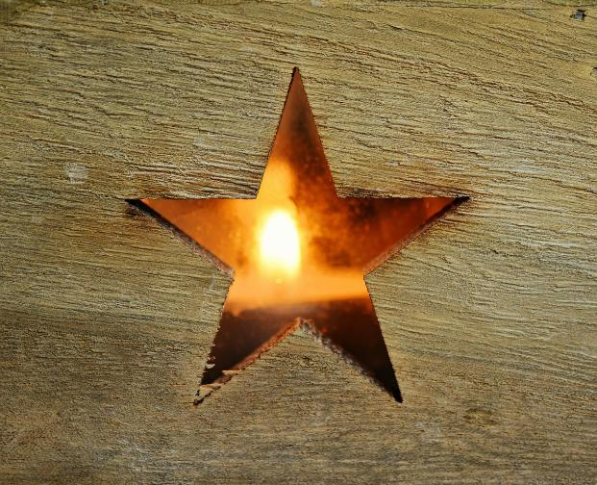


Leader: As we leave this place & time and go into the day ahead…
All: May we shine like stars!
Notes:
Sending: Slide 29
Leader: As we leave this place & time and go into the day ahead…
All: May we shine like stars!

Slide 30

Notes:
Slide 30: Reflective areas
Think: What message might encourage someone to ‘live out’ your school’s vision or values this week?
Do: Write or draw this message onto the class message wall* this week.
Talk: At the end of the week, talk together about the difference that these messages might have made to your school community.
*You will need to edit this to suit your instructions e.g. ‘on the playground in chalk.’

