Slide 1
Follow my
lead!
Notes:
Slide 1: This term, we are thinking about leading, leaders, and followers – and today, we are ending our mini-series about the Coronation. But let’s start as we always do….

Slide 2
Leader: As we share these stories of leaders…
ALL: May we follow their example
in thoughts
and words
and actions.
Notes:
Leader: As we share these stories of leaders…
ALL: May we follow their example in thoughts and words and actions.
Signs for greeting: click on links
Thoughts: British Sign Language BSL Video Dictionary - thought (signbsl.com)
Words (use 3rd definition): British Sign Language BSL Video Dictionary - word (signbsl.com)
Actions: British Sign Language BSL Video Dictionary - action (signbsl.com)

Slide 3
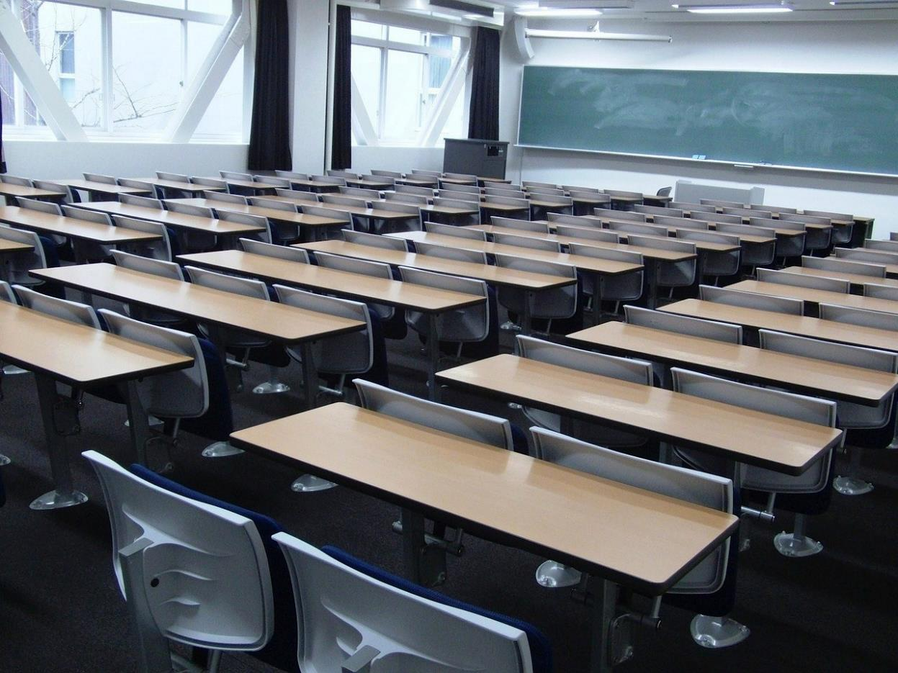
Chairs!
Notes:
Slide 3: We’re going to start our time together today with a game….all about chairs!! I’m going to show you a series of pictures – and all you need to do is decide who might sit in a chair like this….let’s start with this picture! ‘When might you sit in a chair like this?’ [at school]

Slide 4
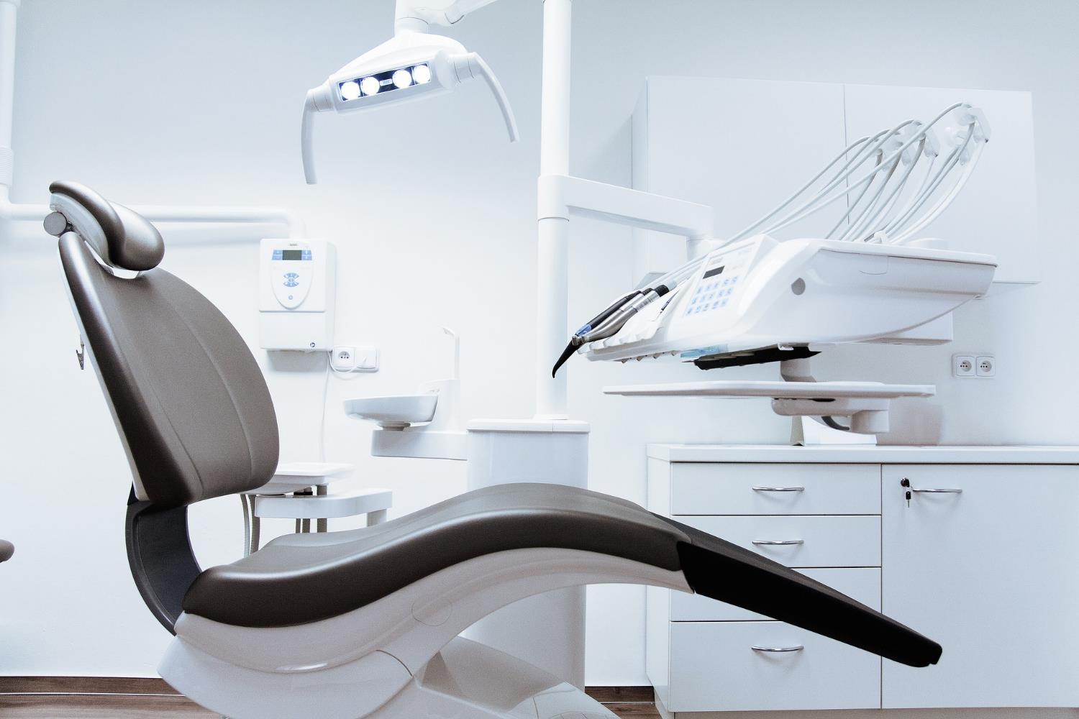
Notes:
Slide 4: ‘When might you sit in a chair like this?’ [at the dentist]

Slide 5
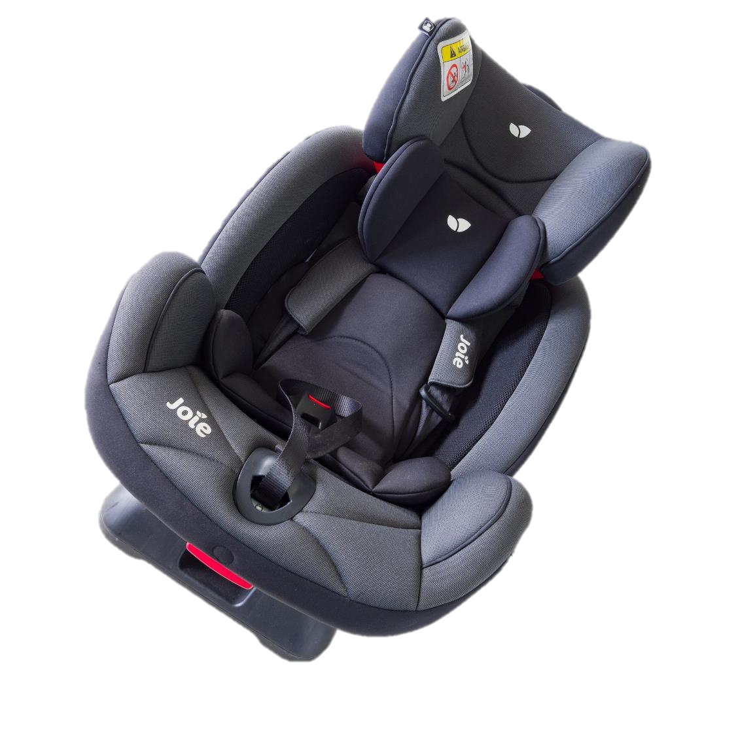
Notes:
Slide 5: ‘When might you sit in a chair like this?’ [in the car]

Slide 6
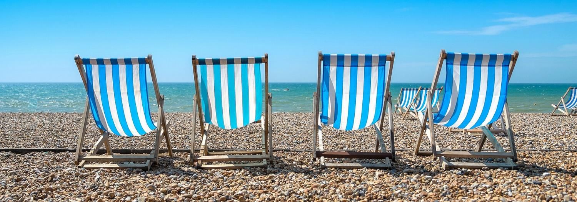
Notes:
Slide 6: ‘When might you sit in a chair like this?’ [at the seaside]

Slide 7
Notes:
Slide 7: ‘When might you sit in a chair like this?’ [to watch a movie/go to a show]

Slide 8
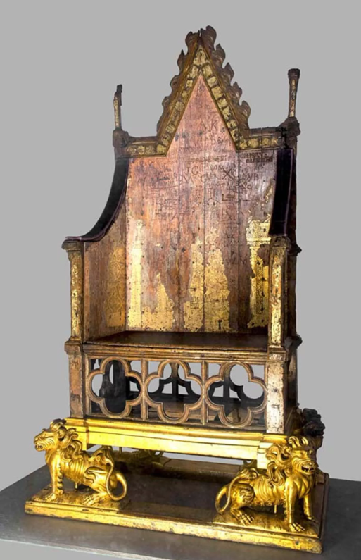
Notes:
Picture from Westminster Abbey.
Slide 8: ‘When might you sit in a chair like this?’ [to be crowned] You might have seen this in the Coronation – and it’s another very old artefact, dating back to 1301 (that’s 722 years ago!) Although it probably doesn’t look as grand as you might think a throne should be, it’s where many of England’s Kings and Queens have sat to be crowned. You will remember that, in the Coronation, there were special words for the King to say as he made promises to the people and to God.
We’re going to use a throne as a symbol for us now, to help us as we begin on our journey through the rest of the term, looking at and learning from the lives of leaders across the world and across history. Our throne isn’t very grand, but for this week, we’re going to use it to help us to think about and pray for the people who are leaders for us.

Slide 9
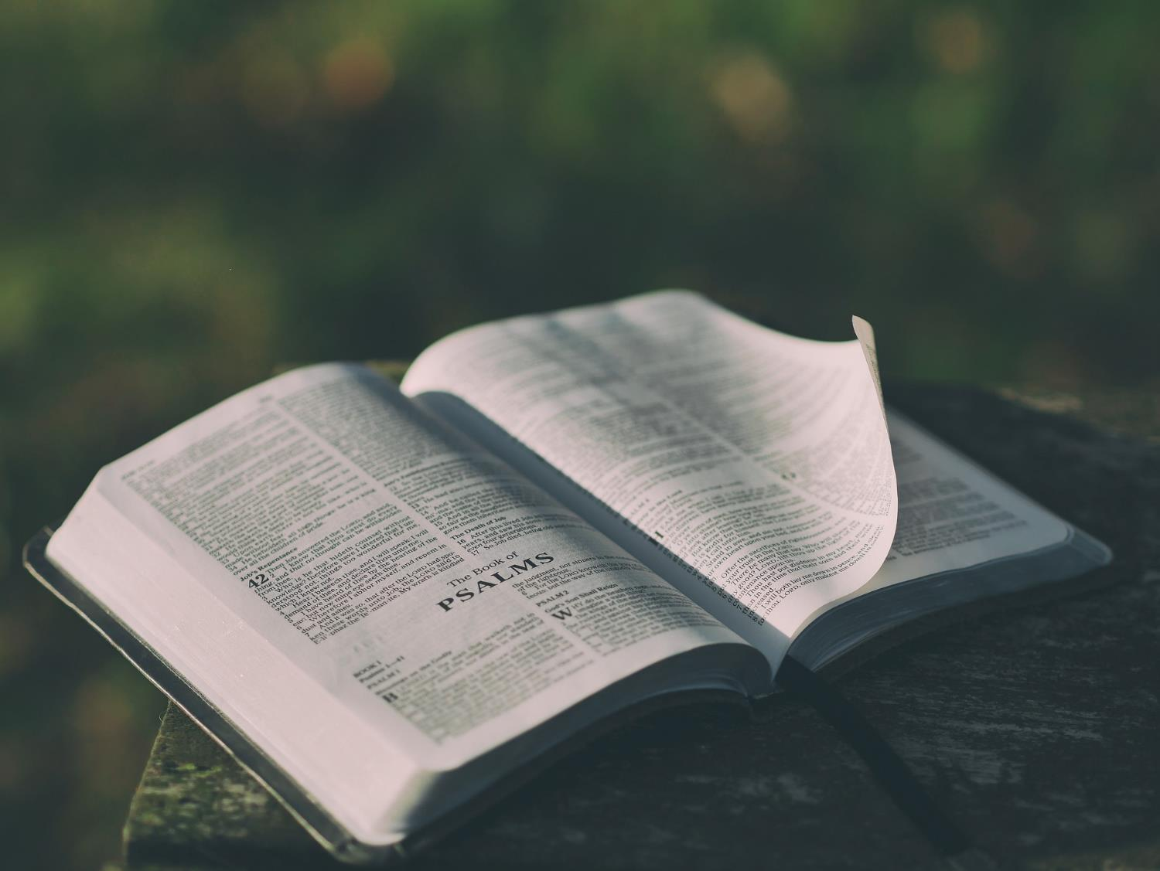
‘You should pray for kings and for all who have authority. Pray for leaders so that we can have quiet and peaceful lives — lives full of worship and respect for God’.
(I Timothy 2:2)
Here is wisdom….
Notes:
Slide 9: At her Coronation in 1953, our late Queen was given a Bible, with the words ‘Here is wisdom’. The Bible was a book which she treasured for the whole of her long life, a place where she said she found the wisdom to help her to lead well. In the Bible, one of the very first Christian leaders wrote these wise words of advice to one of the very first churches. He said:
You should pray for kings and for all who have authority. Pray for leaders so that we can have quiet and peaceful lives — lives full of worship and respect for God.
We have many leaders in our lives – here in school, in our wider community and in our nation, like our King. I’m going to invite you to join me to pray in a moment, but first, we are going to have a special time to recognise the leaders in our school. Like there were words at the Coronation, we’re going to use some words together, to commit to each other as leaders and followers in our school community. One of the words I will use is ‘affirm’: this just means that we recognise them as leaders and want to tell them they are good at it. [teach/explain the words first, then insert the appropriate names / roles where you see …. ; everyone to join in the words in bold. Invite as many leaders as you have time for to be seated on the throne, while you use the words for each person, or who they represent. You could include your headteacher, SLT, class teachers, and especially pupil leaders. Depending on the age of the pupils, you may need to talk about how we could help to be good followers, encouraging and supporting your leaders.]

Slide 10
Leader: We are grateful for…..
ALL: We are glad that you lead us.
Leader: We affirm you in your role…..
ALL: May you be given wisdom as a leader.
Leader: And for those of us who follow…..
ALL: We will support and encourage you.
Notes:
Insert your school logo on this slide.

Slide 11
….I wonder how we can best support and encourage the leaders in our school community?….
….I wonder where in school you might be a leader….or a follower?....
….I wonder how we all might help others this week, wherever we are?.....
Notes:
Slide 11: Responding (words for worship):
….in the stillness of this moment, let’s be quiet and think…..
….we’ve been thinking about leaders in our school community today, and about our responsibilities to support and encourage them….
…we’ve committed ourselves and them to the roles they’ve been given….
…so now let’s wonder together….
....I wonder how we can best support and encourage the leaders in our school community?....
…I wonder where in school you might be a leader, or a follower?.....
….I wonder how we all might help others this week, wherever we are?....
…we’ve also heard some words from the Bible, about praying for our leaders, so that’s what we are going to do now….
….you might like to think about someone who is a leader for you as I use these words…. and you’d like to pray too, then join in with the Amen at the end.
I’m going to turn my thoughts into a prayer now. If you’d like to pray too, then find a way to make it your own….

Slide 12
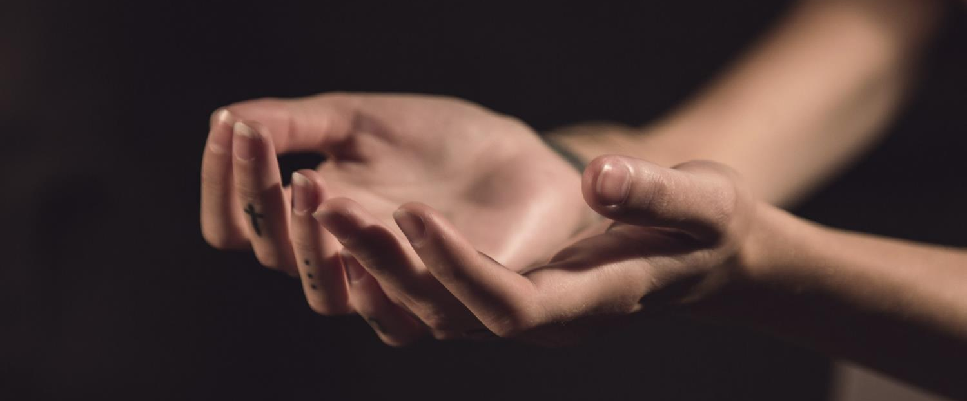
O God, who gives wisdom to all who ask,
We are grateful for all those who lead us…. in our families….our schools….our community….and our wider world, and especially for our new King.
Give our leaders wisdom to help them to lead, and us wisdom to help us to follow.
Notes:
Slide 12: Prayer
O God, who gives wisdom to all who ask,
We are grateful for all those who lead us…. in our families….our schools….our community….and our wider world, and especially for our new King.
Give our leaders wisdom to help them to lead, and us wisdom to help us to follow.

Slide 14
Leader: As we leave this place & time and go into the day ahead…
All: …may we be good leaders and good followers.

Slide 15
Hold the crown and think about and/or pray for the people who lead you. You might want to write these thoughts down and leave them on the ‘throne’.

