Slide 1
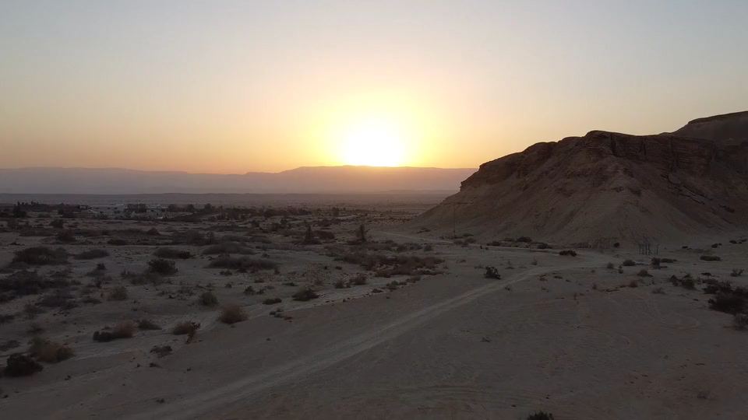
All images copyright-free from pixabay, unless otherwise identified
Notes:
Slide 1: Welcome stilling exercise – desert landscape
Use the stilling slide if desired: the suggested words should be spoken slowly, leaving pauses inbetween to create a sense of stillness.
As you sit quietly here, look at this very different landscape…..and bring your mind into a peaceful place [PAUSE]
As you watch, think about what makes it different from the landscape of our school environment……..[PAUSE]
Now practise slower breathing…..in…..and out…..in……and out…..keep this going as you continue to watch….[PAUSE]
You maybe notice that you are feeling calmer and more relaxed….[PAUSE]
As you breathe, think about yourself and what you bring into this time today…..and think about how peace has come upon us…. [PAUSE]
We come into this special / sacred space and time to be still….to think deeply…..to be together as a school community…..
In our time together today, we are thinking about an ancient journey through a landscape like this, and we will…..talk about deserts…..tell a story together….. and think together about what this story might mean for our school community – and the wider world.
But first, let’s welcome one another as we begin….

Slide 2
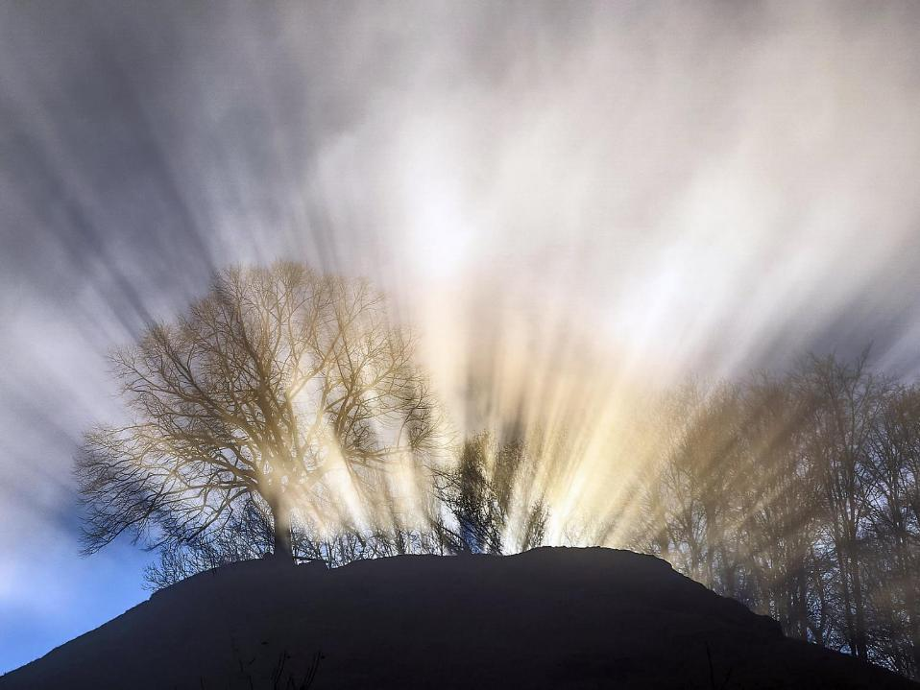
Leader: This is a day that God has made.
ALL: We will rejoice and be glad in it!
Notes:
Slides 2/3: Teach this new greeting to your school community – there are two slightly different versions from the point of view of the leader; choose which best fits your school’s context. One uses words adapted from Psalm 118:24
Leader: This is a day that God has made!
ALL: We will rejoice* and be glad* in it!
OR:
Leader: Today is a brand new day…..
ALL: May we be a blessing to each other!
*There are different BSL signs for rejoicing and joy/gladness. View them here: https://www.signbsl.com/sign/rejoice
Blessing: https://www.signbsl.com/sign/blessing (1st video)

Slide 3
Leader: Today is a brand new day!
ALL: May we be a blessing to each other!
Notes:
Slides 2/3: Teach this new greeting to your school community – there are two slightly different versions from the point of view of the leader; choose which best fits your school’s context. One uses words adapted from Psalm 118:24
Leader: This is a day that God has made!
ALL: We will rejoice* and be glad* in it!
OR:
Leader: Today is a brand new day…..
ALL: May we be a blessing to each other!
*There are different BSL signs for rejoicing and joy/gladness. View them here: https://www.signbsl.com/sign/rejoice
Blessing: https://www.signbsl.com/sign/blessing (1st video)

Slide 4
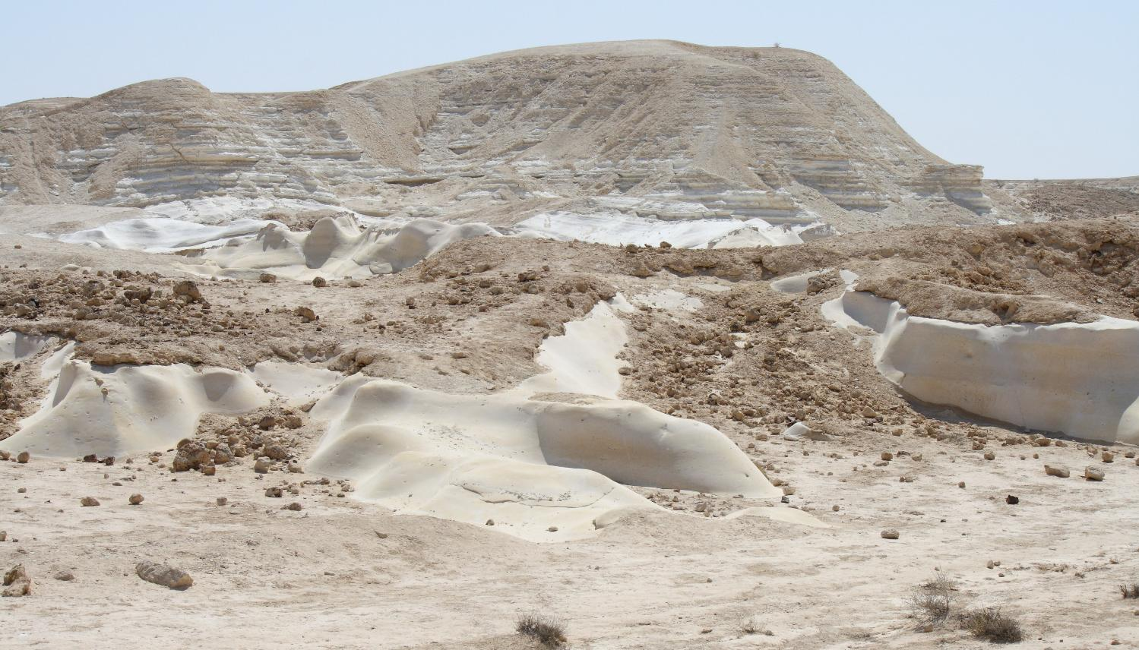
Notes:
Slide 4: What’s it like here?
Talk together about this landscape – and how different it is (we hope!) from the view from your classroom window!

Slide 5

Count your blessings
Notes:
Slide 5: This term, we are thinking about our blessings – all the good things in our lives. This week, we are going to find out about a very special time for gratitude in Jewish homes and communities – a time that has a very special story which we are all going to share in.

Slide 6
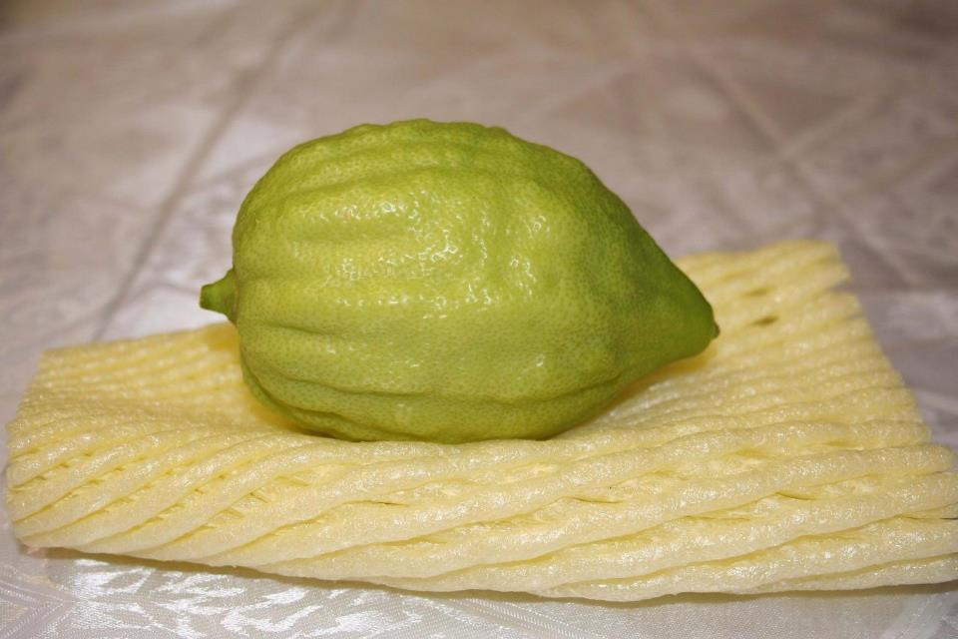
Sukkot
Notes:
Slide 6: The festival of Sukkot runs this year between dusk on 25th September and dusk on 2nd October. During Sukkot, Jewish families will eat outdoors in shelters that they build out of tree branches, and they’ll hang up fruit, like this rather strange-looking lemon, called an ‘etrog’, to decorate their shelters as a reminder to be thankful and remember…which is a very good message to us as well!

Slide 7
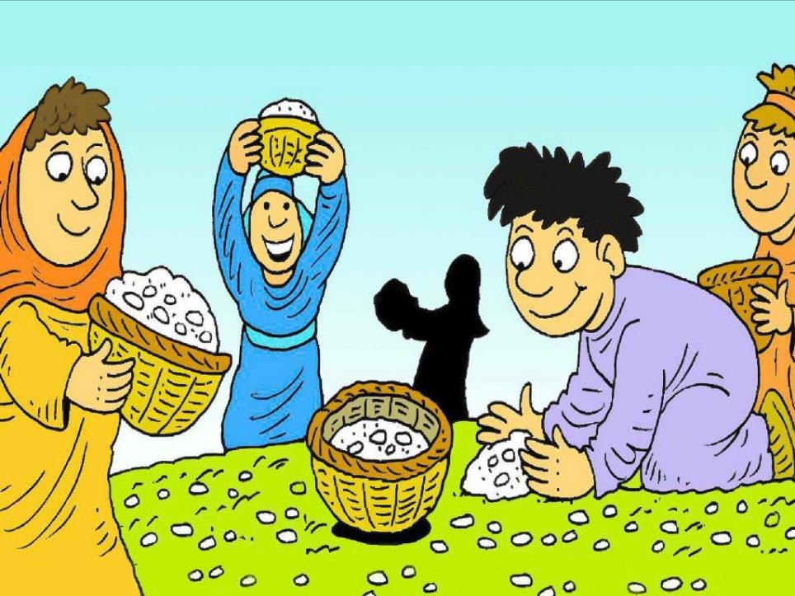

Notes:
Slide 7: We’re going to share together the story families retell at Sukkot, which helps them to remember the time that God’s people spent in the desert, on their epic journey to a new home. There are places where you can join in [use the script, rehearsing the actions together briefly first.]

Slide 8
“God will provide!”
Notes:
Slide 8: I wonder which part of the story you think was the most important to remember? For Jewish people, it’s the fact that God provided – in amazing ways – and that they were told to always remember this. That’s why we used the words ‘God will provide!’

Slide 9
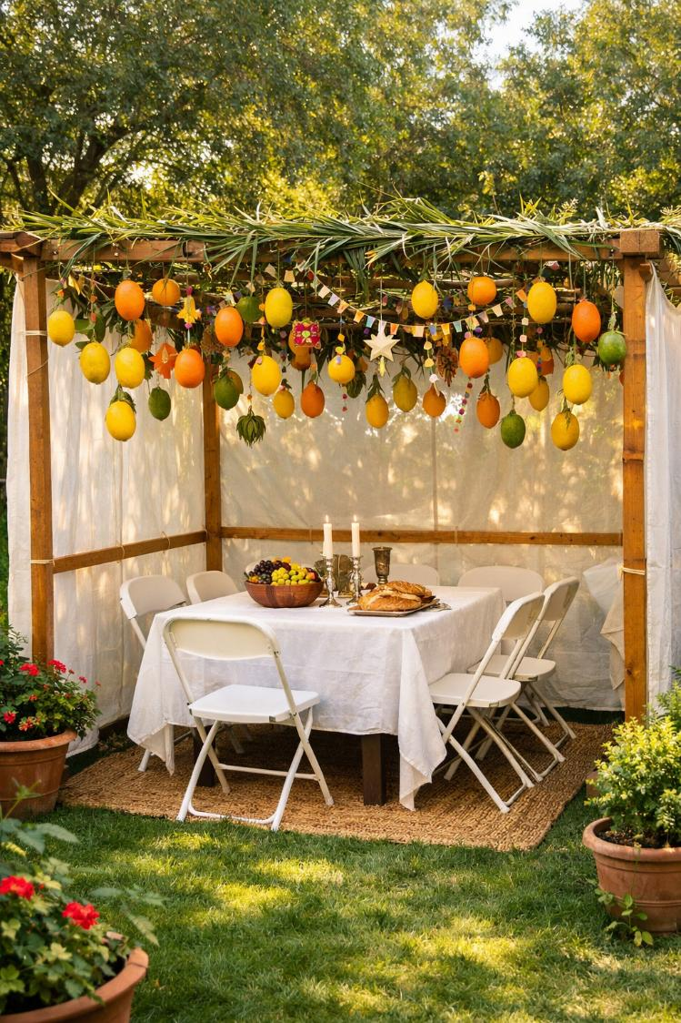
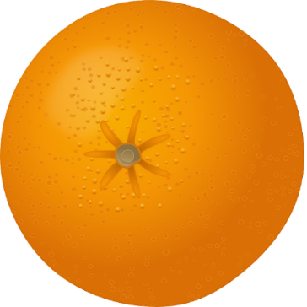
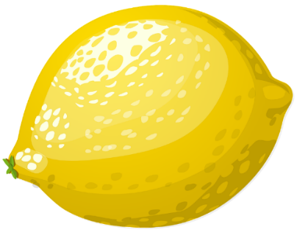
a sukkah
AI image generated by MS Co-Pilot
Notes:
Slide 9: At this time of year, eating in a sukkah, and being thankful is a really important way in which Jewish families remember. We’re going to collect OUR ideas about things we’re thankful for now – on these oranges & lemons and hang them up as a reminder for us....[collect their ideas on the orange/lemon shapes and speak them out loud as you hang the fruit up]
Responding (and words for worship)
We’re going to have some space and time to think now…..
….the story we heard today started with God’s people complaining….
…I wonder if you’ve ever done this?!…..(of course we have!)
….but this story is a reminder that despite the complaining, God still saw what the people needed and provided for them….
In the stillness now…let’s think back to some of the things we talked about that we are grateful for.....
[name some that you wrote on the oranges/lemons]
....many people believe that God still provides, in many different ways.....and that it’s good to be grateful…..
.....family.......friends.......school......love.......health….our blessings
I’m going to do that right now, in a thankyou prayer. Make it yours if you’d like to by joining with me to say the words ‘we are grateful’ after I say the word ‘God’…or if you’d prefer not to pray, then just sit quietly with your own thoughts.

Slide 10
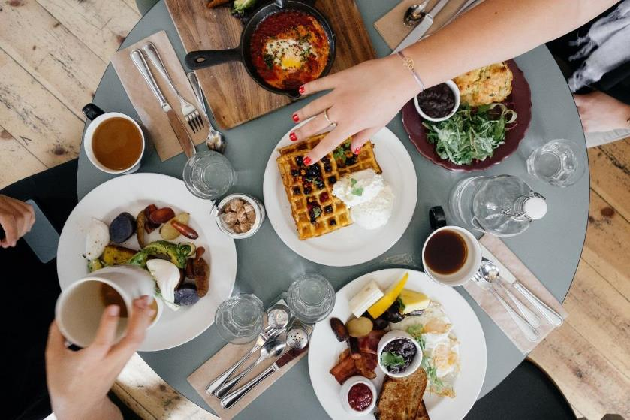
….we are grateful!
Notes:
Dear God,
Slide 10: For food on our tables – God, we are grateful!

Slide 11

….we are grateful!
Notes:
Slide 11: For love in our hearts – God, we are grateful!

Slide 12


….we are grateful!
Notes:
Slide 12: For a chance to be grateful – God we are grateful!

Slide 13
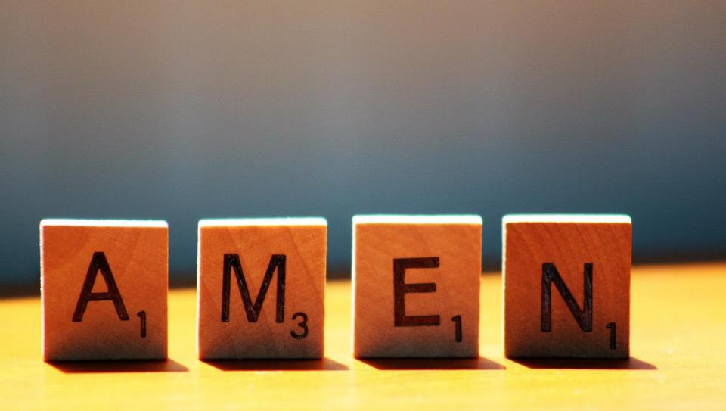

Slide 14




Leader: As we leave this place & time and go into the day ahead…
All: May we remember that ‘God will provide’!

Slide 15
Notes:
Slide 15: Reflection areas
Create a sukkah in your reflective area, or even better, create an outdoor reflection area for the duration of Sukkot: hang fairy lights, assemble artificial plants / branches and hang up the oranges and lemons from the reflection included in the collective worship.
Talk: About the Sukkot story and the lessons that God’s people learned in the desert.
Think: What are you grateful for?
Do: Draw or write your idea onto an orange or lemon shape and hang up in your ‘sukkah’

