Slide 1

Leader: As we gather together
ALL: …we bring our hearts.
Notes:
Slide 1: Use these new gathering words for this term, or your usual greeting if you prefer. The greeting comes with BSL signing; you can view the demos using links under the slide.
Leader: As we gather together,
ALL: …we bring our hearts
Signs for greeting: click on links
Hearts: British Sign Language BSL Video Dictionary - heart

Slide 2

Leader: As we gather together
ALL: …we share our thoughts.
Notes:
Slide 2: Use these new gathering words for this term, or your usual greeting if you prefer. The greeting comes with BSL signing; you can view the demos using links under the slide.
Leader: As we gather together,
ALL: …we share our thoughts.
Signs for greeting: click on links
Thoughts: British Sign Language BSL Video Dictionary - thought

Slide 3





Leader: As community together
ALL: …we serve one another.
Notes:
Slide 3: Use these new gathering words for this term, or your usual greeting if you prefer. The greeting comes with BSL signing; you can view the demos using links under the slide.
Leader: As community together,
ALL: …we serve one another.

Slide 4

“Simon says…”
Pictures in this presentation are copyright-free from pixabay
Notes:
Slide 4: ‘Simon says….’ Play ‘Simon says….’ [you could change the name on the slide to your name…] You need to ensure that all of the ‘Simon says…’ instructions relate to somewhere to look e.g. ‘Simon says look out of the window.’ ‘Simon says ‘Look up at the ceiling.’ You will obviously need to tailor these to suit your specific environment! Ask children / adults if they noticed anything about the ‘Simon says…’ instructions.

Slide 5

looking
Notes:
Slide 5: Hopefully someone will realise that they were all instructions about looking! ‘We’re going to think today about how the things we look at can help keep our hearts happy and our thoughts positive – and about something that David the Psalmist (Song-writer) wrote about where he looked in times of trouble.

Slide 6

Notes:
Slide 6: We’ve talked a lot at school about keeping our minds happy and positive: it’s more difficult to do this if we’re worried or maybe life is difficult.

Slide 7





Songs from
the heart
Notes:
Slide 7: Songs from the heart
As we know from stories of his life, David the Psalmist often found himself in difficult circumstances. A lot of his songs and poems tell us about how he felt, and what he did about those feelings.

Slide 8

I lift my eyes to the mountains.
Where does my help come from?
It comes from God, who made heaven and earth….He will watch over you now and forever. Psalm 121:1-2
Notes:
Slide 8: David wrote: I lift my eyes to the mountains. But where does my help come from? It comes from God, who made heaven and earth….He will watch over your coming and going, now and forever. Psalm 121:1-2 & 8 Looking up from his problems at the majesty of the mountains gave David a different perspective. It reminded him that God was bigger than any problem he might be facing and that lifting his eyes up helped him also to lift his heart. (If you want to read the whole Psalm, then do: it is very child-friendly and accessible.) In this song from David’s heart, we hear that he recognised that the God who made the world would look after him – as he says later on, that God watched over him all the time, day and night. This gave David great confidence and comfort when things were hard.
I wonder if there are things around us at the moment that might also help to lift our own hearts? Here are a few of my favourites, some of them especially Spring-y!

Slide 9
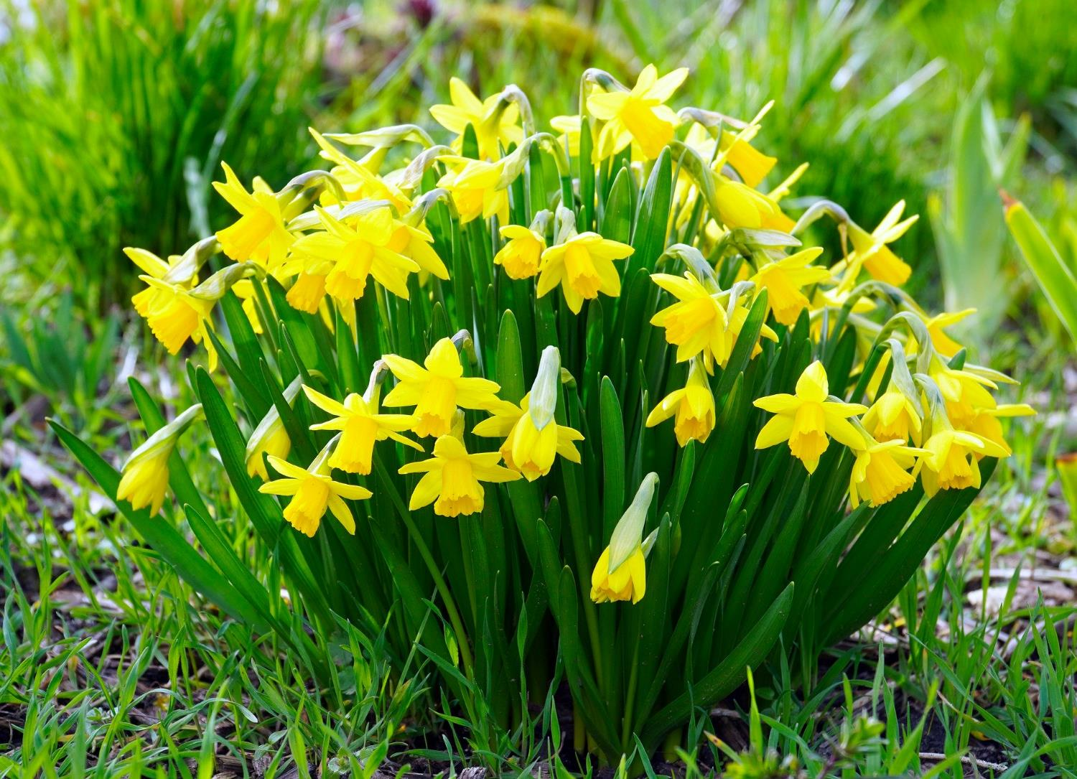
Notes:
Slide 9: Daffodils

Slide 10
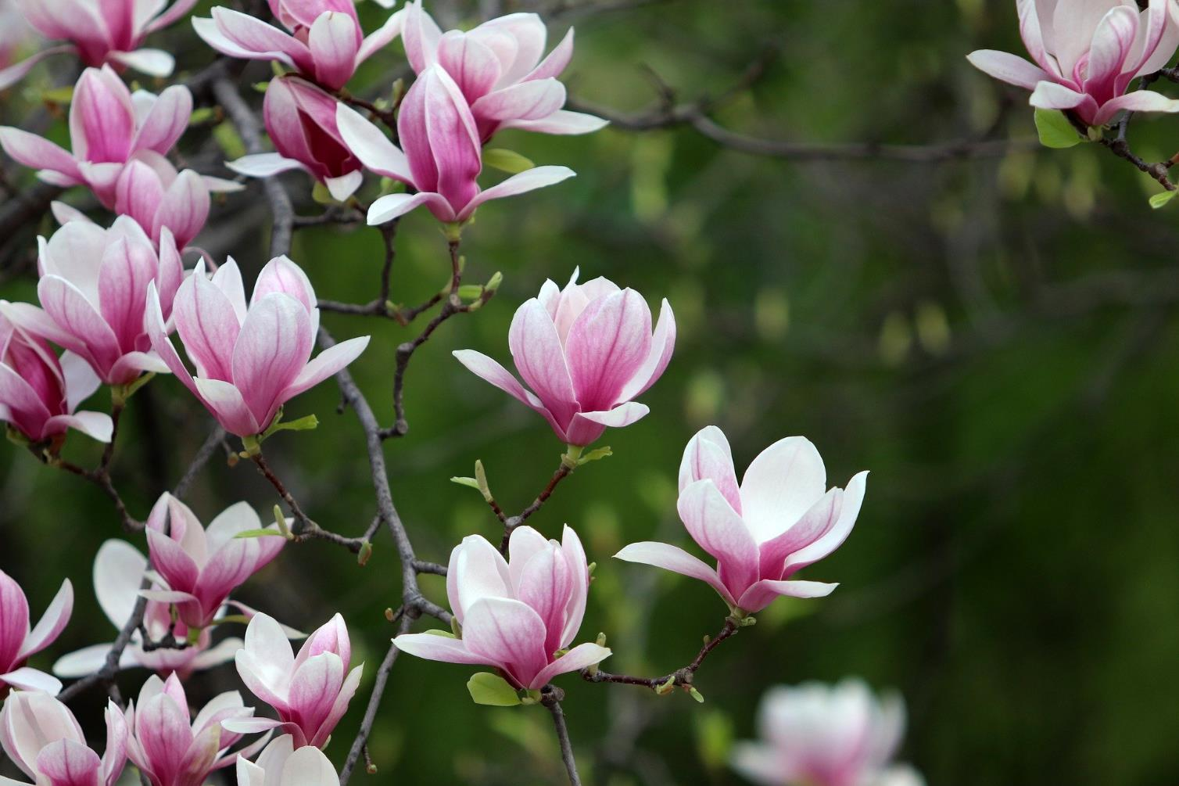
Notes:
Slide 10: Magnolia blossom

Slide 11
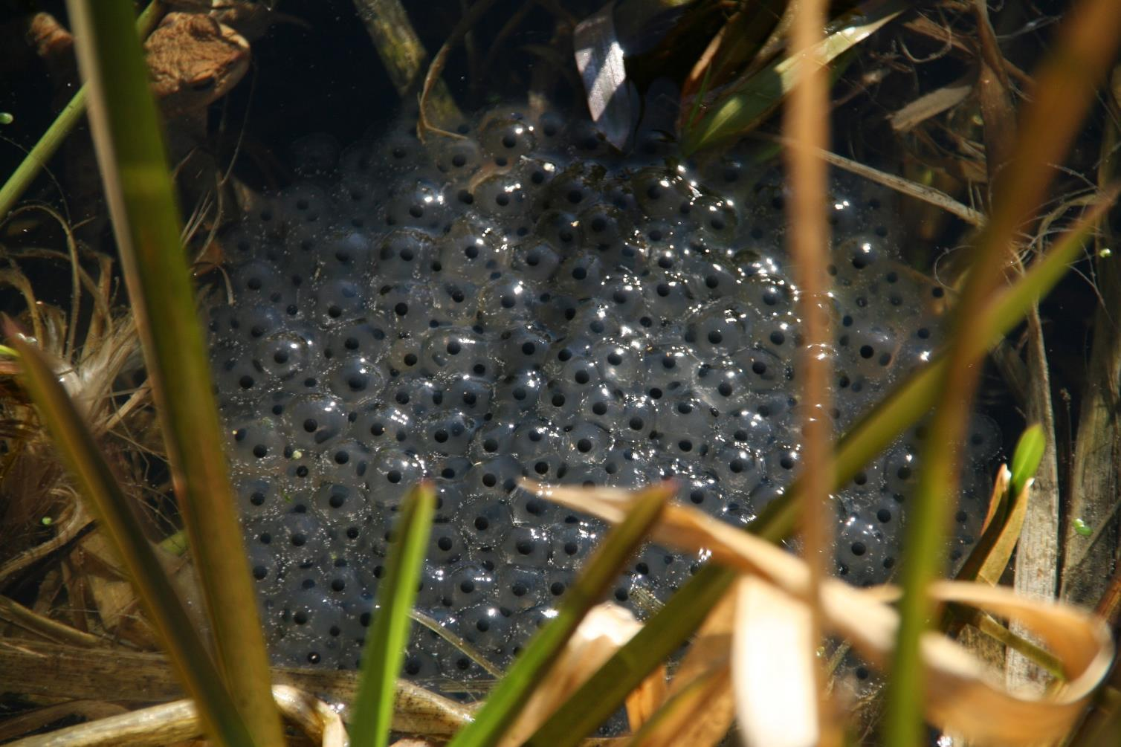
Notes:
Slide 11: Frogspawn

Slide 12
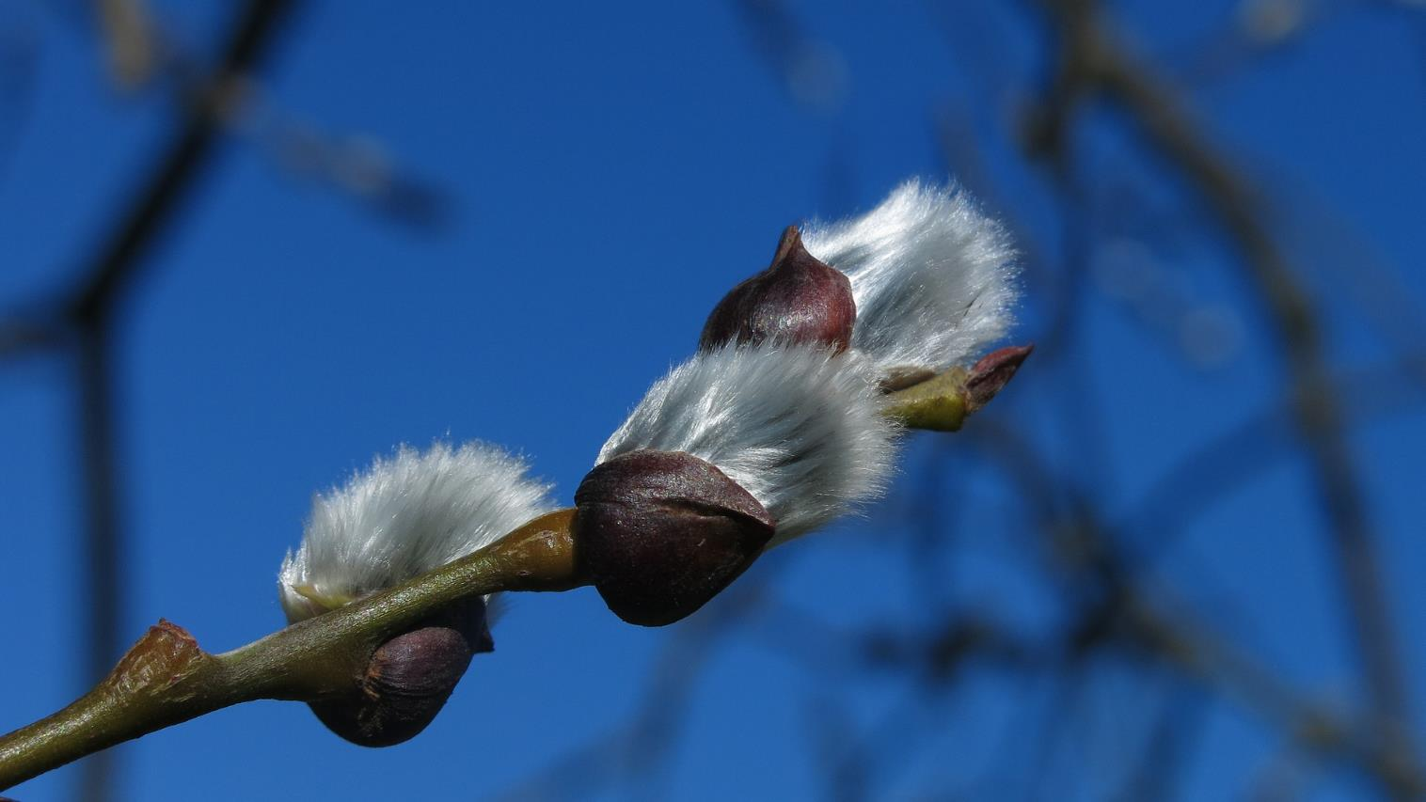
Notes:
Slide 12: ‘Pussy’ Willow buds

Slide 13
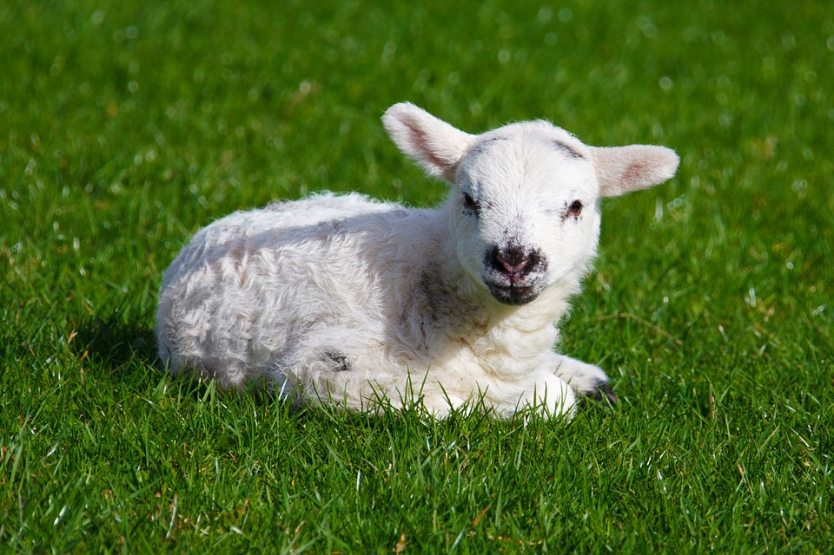
Notes:
Slide 13: Lambs

Slide 14

Notes:
Slide 14: Cherry blossom

Slide 15
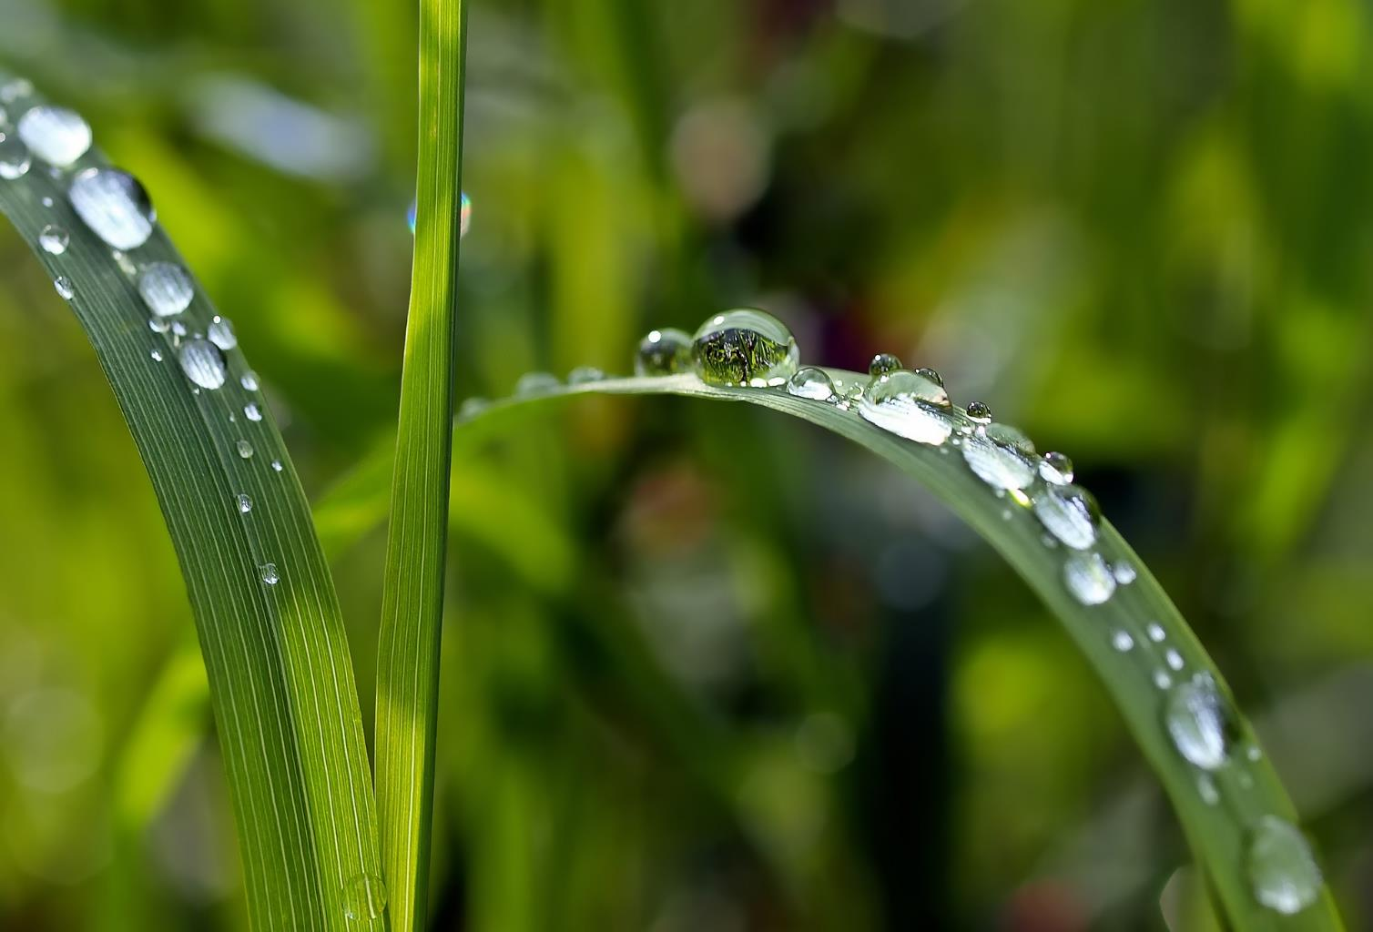
Notes:
Slide 15: Raindrops

Slide 16
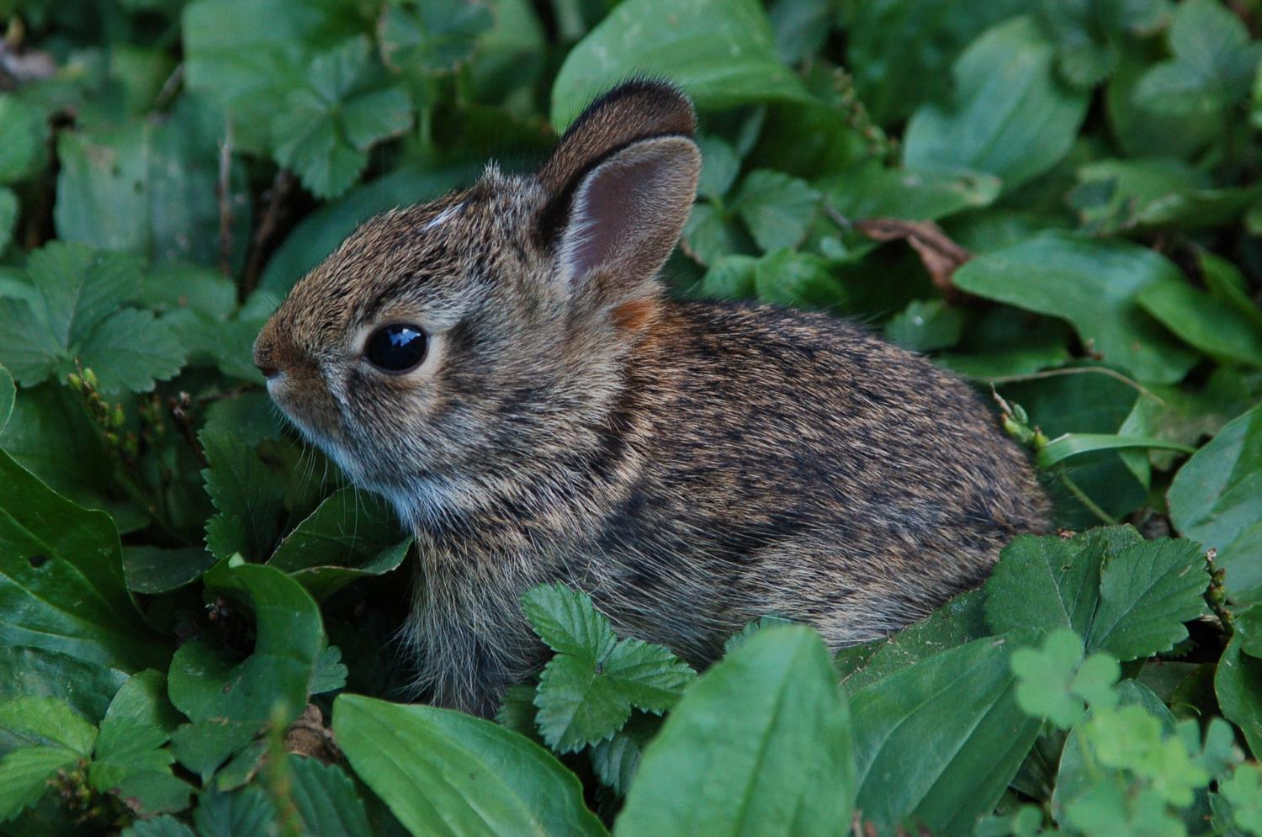
Notes:
Slide 16: Baby rabbits – they’re called ‘kittens’!

Slide 17
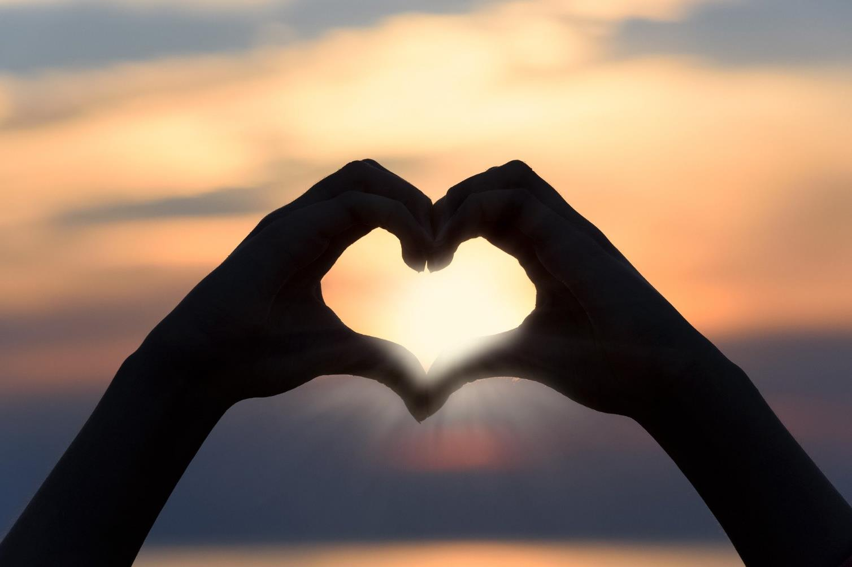
Notes:
Slide 17: I wonder how looking at all these things made you feel? [if possible, give children time to chat to the person next to them] In these days where there are lots of difficult things happening in our world, it’s good to find other things to look at – things that gladden our hearts and remind us to be grateful. Even just going outside can make all the difference…. Maybe you could find some time in your week to go and do some outdoor learning and take photos of something that makes your heart glad?

Slide 18
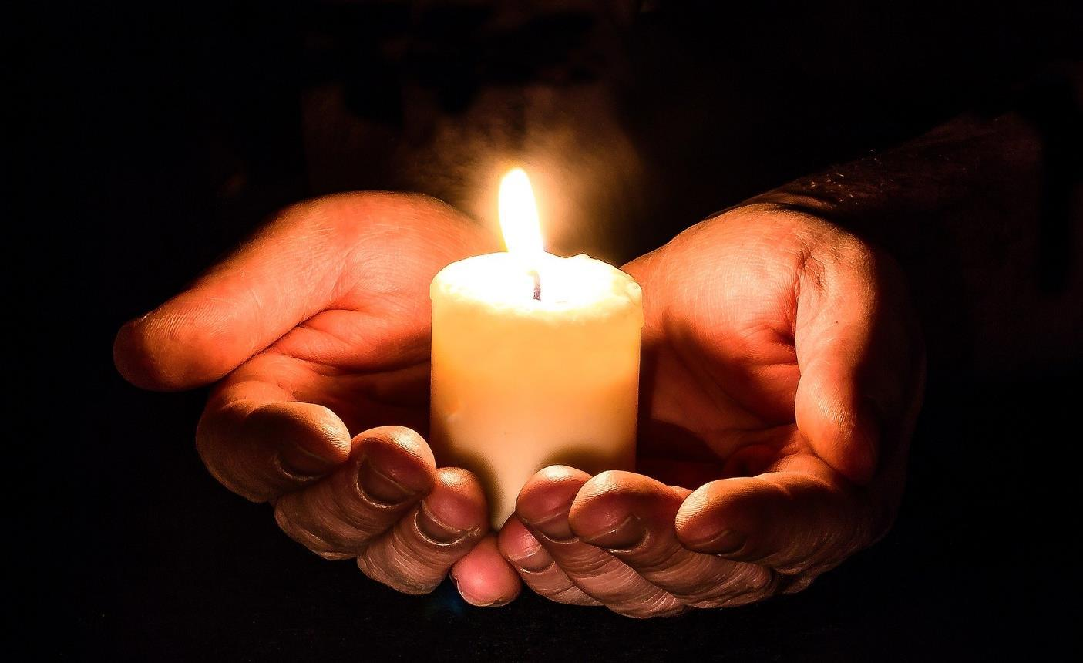
Let’s be still and quiet
Notes:
Slide 18: Responding (and words for worship):
…so let’s take a few moments now to do that, to be still and quiet, and think about our own responses to what we’ve heard today….
….We’ve been thinking today about looking….
…I wonder if the things we look at can change how we think and how we feel….
….I wonder how looking at Springtime might help us to feel more positive?.....
…we’ve also heard some words that David the Psalmist wrote….
….about looking up to the mountains, and finding God….
…..take some time in the quietness to think to yourself now…..
I’m going to turn my thoughts into a prayer now, as I ask God to help us. There’s a part you can join in with if you’d like to make the prayer your own: the words are the same each time –

Slide 19
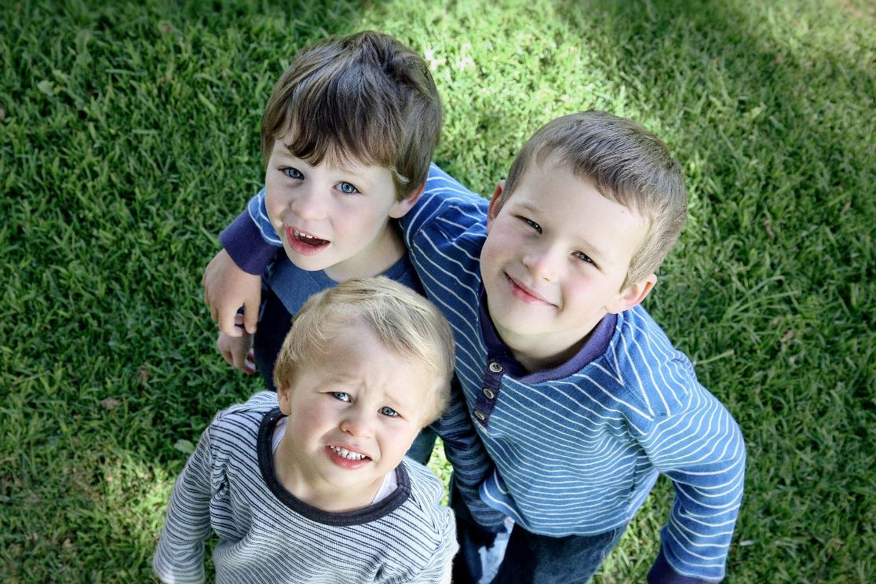
“Help us to look up”
Notes:
Slide 19: ‘Help us to look up’ – but if you’d prefer not to pray, then just sit quietly with your own thoughts.
Dear God
When we’re worried or concerned
‘Help us to look up’ and find help from those around us
When our hearts feel heavy or sad
‘Help us to look up’ and find small things to be grateful for
As David looked to the mountains,
‘Help us to look up’ and find you

Slide 20

Notes:
Slide 20: Amen

Slide 21
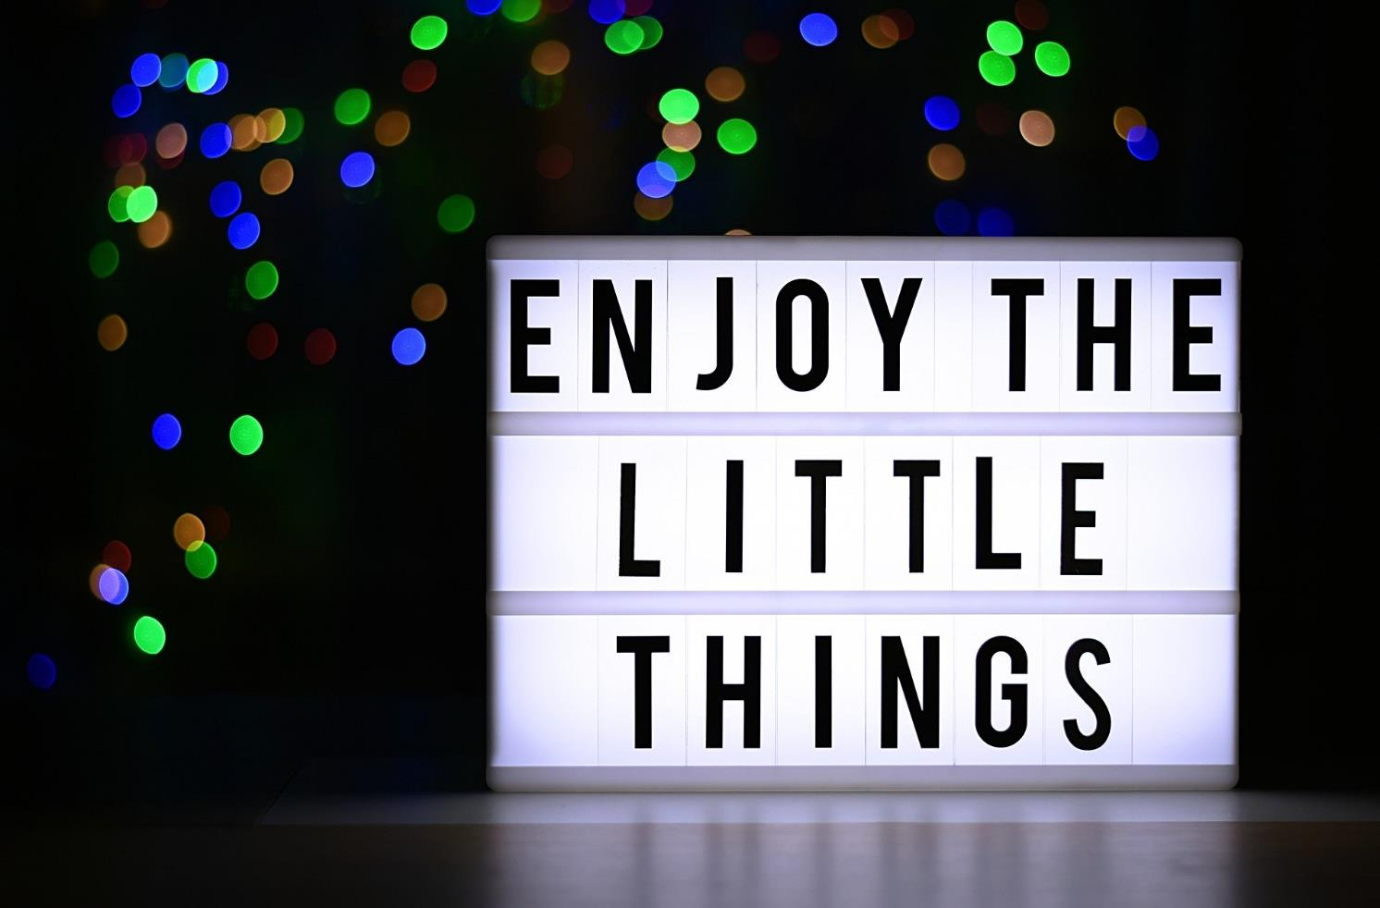
Notes:
Slide 21: And so a challenge: I wonder whether we could find one small thing each day to be grateful for? Maybe it might help us to get through any difficult days?

Slide 22
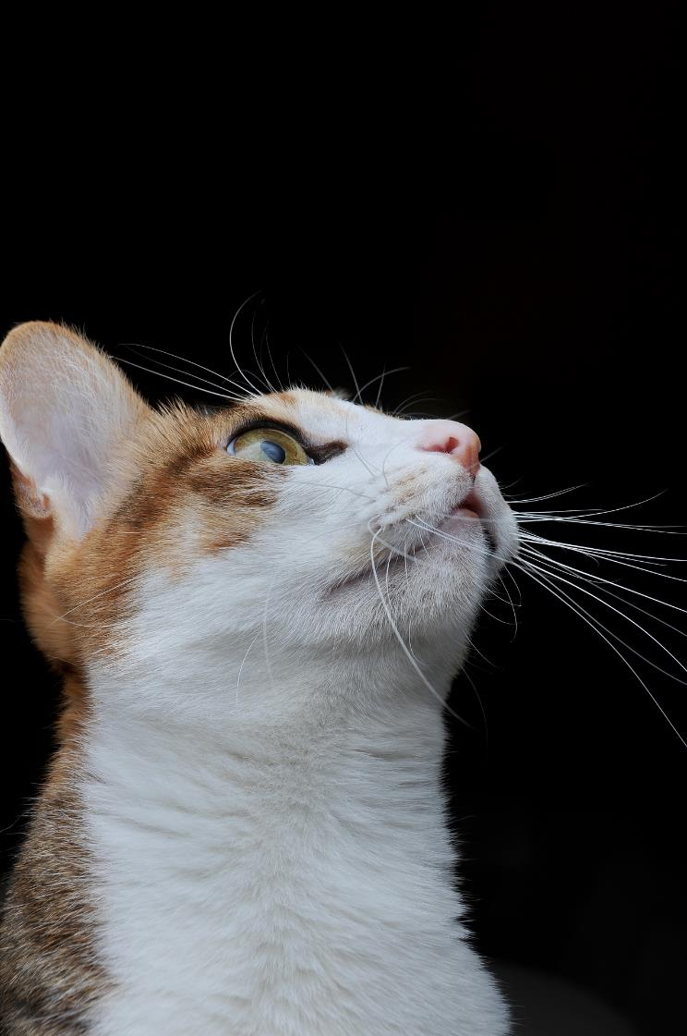
Look up…
Look out…
Notes:
Slide 22: And who doesn’t need a cute cat picture as a reminder, to Look up….and look out!

Slide 23




Leader: As we leave this place & time and go into the day ahead…
All: …may we serve one another in our thoughts and words and actions.
Notes:
Sending: Slide 20
Leader: As we leave this place and time and go into the day ahead,
All: ….may we serve one another in our thoughts and words and actions.
Signs for response: click on links
Thoughts: British Sign Language BSL Video Dictionary - thought (signbsl.com)
Words (use 3rd definition): British Sign Language BSL Video Dictionary - word (signbsl.com)
Actions: British Sign Language BSL Video Dictionary - action (signbsl.com)

Slide 24


Notes:
Ideas for classroom reflection: there are a few ideas to choose from this week
People shapes: draw/write who helps you when you are feeling down, OR….
Write your own version of David’s words about where your help comes from or what reminds you to look to God, OR….
Go outside and ‘Look up!’ – take some photos that make your heart glad or help you to ‘look to God.’

