Slide 1





We are here together….
May our attitudes make our school community a happy place today.
Notes:
Slide 1: Use the new gathering words for this term
Leader: We are here together
ALL: May our attitudes make our school community a happy place today.

Slide 2


Beatitudes
Beati
‘How-to-be-attitudes’
Notes:
Slide 2: Over the last 2 weeks, we have properly introduced our theme for this term as the ‘How-to-be-attitudes’, Jesus’ words from the Lesson on the Mountain. These were words spoken to large crowds of people, which have provided guidance for millions of Christians all over the world in how to live as part of God’s Kingdom on earth.

Slide 3
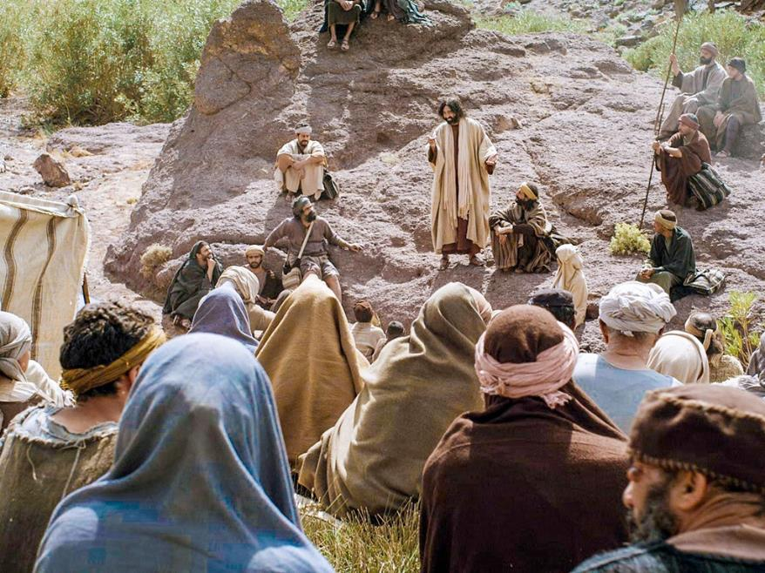

You will be truly happy if you recognise your need of God and will ask him for help in times of need.
Notes:
Slide 3: In his Lesson on the Mountain, Jesus said: ‘You will be truly happy if you recognise your need of God and will ask him for help in times of need.’
These are the words from the ‘How-to-be-attitudes’ that we are going to be thinking about today, and we will be coming back to these words at the end of our time together today. But first, I need some help with some big letters [choose 7 children to help you to spell out H A R V E S T.

Slide 4
H A R V E S T
Notes:
Slide 4: At this time of year, we often think about HARVEST-time.

Slide 5
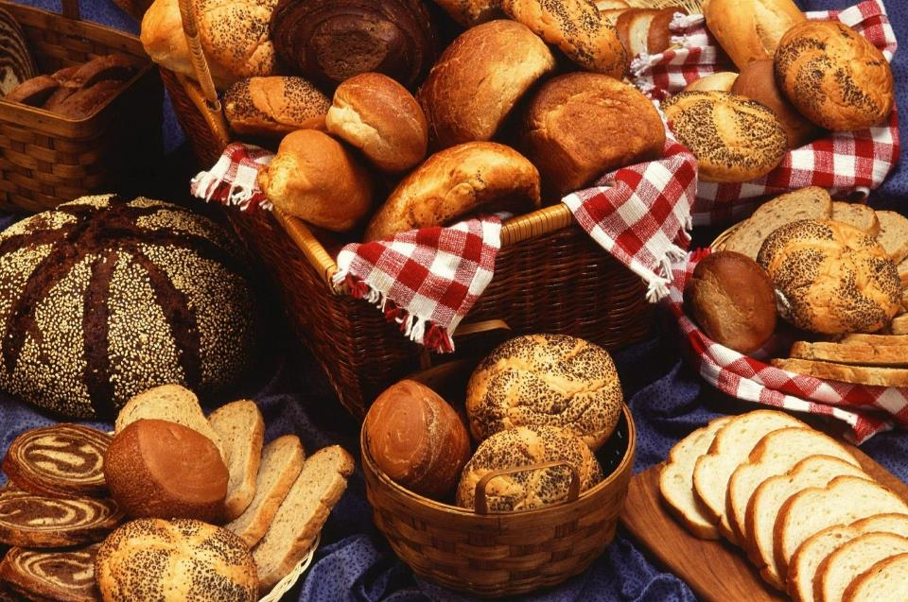
Notes:
Slide 5: People sometimes make special shaped bread to celebrate the HARVEST. But we don’t just harvest wheat: HARVESTing happens all over our world, to bring our food from where it is grown to our tables.

Slide 6
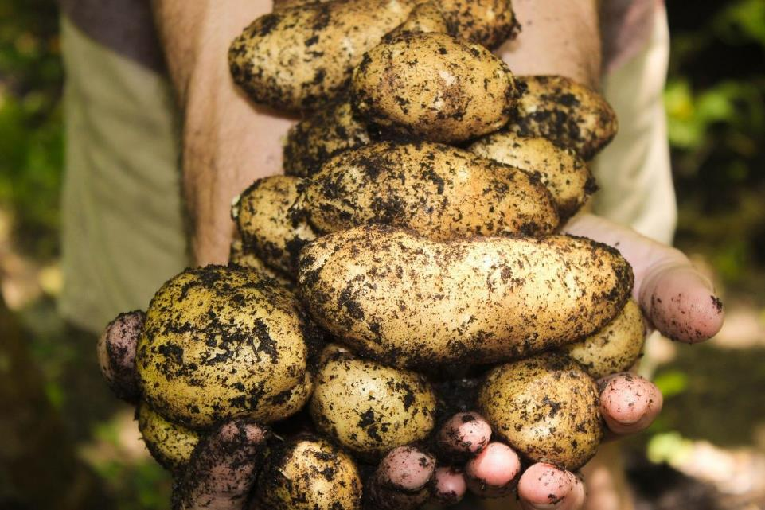
Notes:
Slide 6: Some of you may even have grown things in your garden over the summer, that you are now HARVESTing!
Now, let’s have letters 5,2,3,7&1, which spell……

Slide 7
E A R T H
Notes:
Slide 7: EARTH.

Slide 8

Notes:
Slide 8: Our earth works very hard for us, because all our food comes from it. At the end of our time today, we’re going to give a great big shout-out for all our favourite foods, those we really like to…… let’s have letters 5,2&7…….

Slide 9
E A T
Notes:
Slide 9: ….EAT: We are completely dependent on our planet for the food that we EAT.

Slide 10
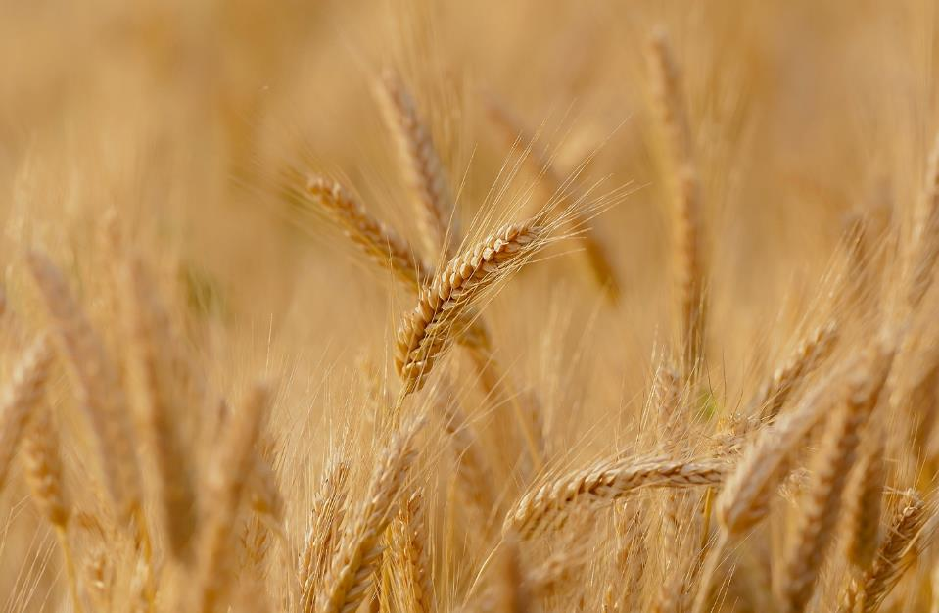
Notes:
Slide 10: Just as an example, the wheat that is made into the bread or cereal that many of you will have eaten for breakfast has come from farms all over Britain, and the banana or orange that you might have at break time will have been harvested in other places of our world where it’s hotter.

Slide 11
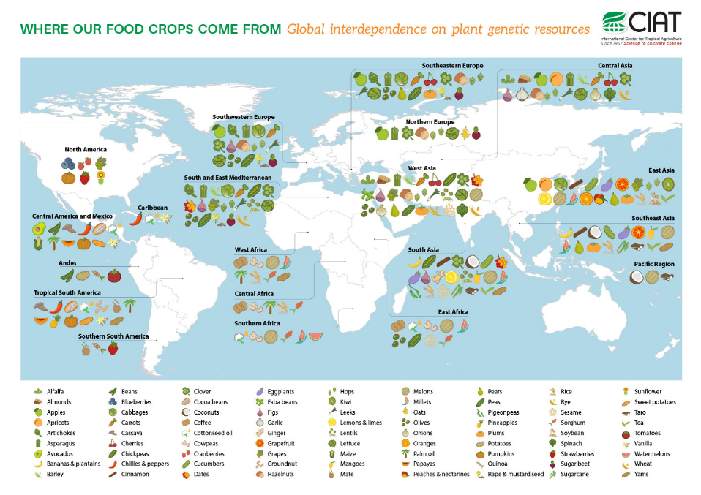
Notes:
Slide 11: such as here…. Talk about this slide if you have time!
Let’s have letters 7&2…..which spell…..

Slide 12
T A
Notes:
Slide 12: ‘TA!’ – that’s short for ‘thankyou’!!

Slide 13
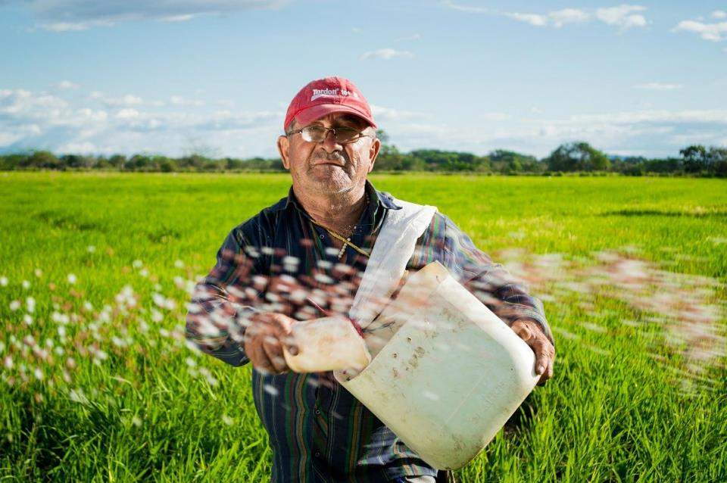
Notes:
Slide 13: At Harvest time, we say thank you for our food: to the farmers who’ve grown it and taken care of it, those who’ve harvested it, those who’ve stored it and sold it…and (as a church school family) to God for the rain and sunshine that has helped it to grow.
Let’s take letters 1,2,4&5….

Slide 14
H A V E
Notes:
Slides 14&15: Most of us have HAVE plenty of food…

Slide 15
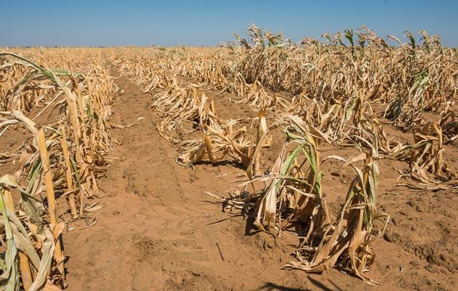
Notes:
Slide 16: but we need to remember that in other places, there is not enough food to eat because the harvest has not been good – too hot, too cold, too wet, too dry – and so people might…… let’s take letters 6,7,2,3,4&5….

Slide 16
S T A R V E
Notes:
Slide 16: STARVE.
There might also be people here in our community who struggle to feed their families, people we can also help this Harvest time. Finally, let’s have letters 6,1,2,3&5, which spell…..

Slide 17
S H A R E
Notes:
Slide 17: SHARE….

Slide 18
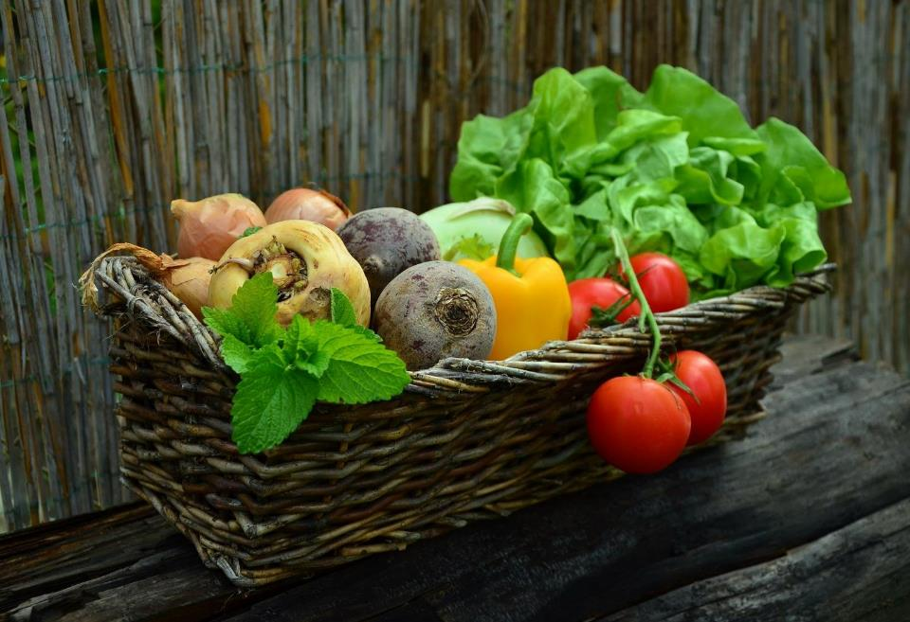
Notes:
Slide 18: And so, at Harvest time, it’s good to find ways to SHARE what we have with others. Explain how you will be doing this as a school this year – or together think of ways e.g. giving to the local food bank, donating money to charity etc., or using the idea on slides 19-23 to support The Garden Route Children’s Trust. You could also use them after the reflection slide.)

Slide 19
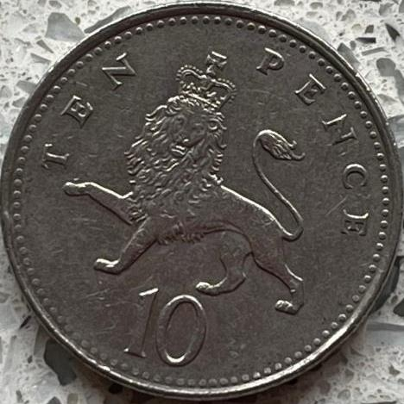
What can you buy for 10p?
Notes:
Slide 19: Optional slides, relating to The Garden Route Children’s Trust
Here’s a question for us to ponder as we think about Harvest time this year…
What can you buy for 10p?..... [ask children to suggest a few ideas]
The answer is, not much! But what if you could use just 10p to help give breakfast to a child in poor communities in South Africa? Let’s find out how…..

Slide 20
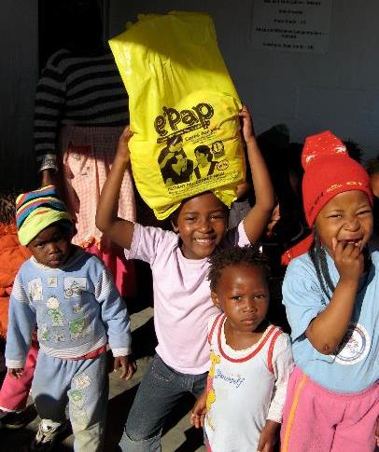


The Garden Route Children’s Trust is a Christian charity
As Christians, they believe that God loves them and that they can love others in all sorts of ways that make a difference.
Notes:
Slide 20: The Garden Route Children’s Trust is a Christian charity, started in 2016 by a lady who lives in Oxshott called Penny Fleming to support the work of Sister Ethel (who founded the Missionvale Care Centre) and others.
As Christians, the Garden Route Children’s Trust believe that God loves them and that they can love others in all sorts of ways that make a difference.

Slide 21
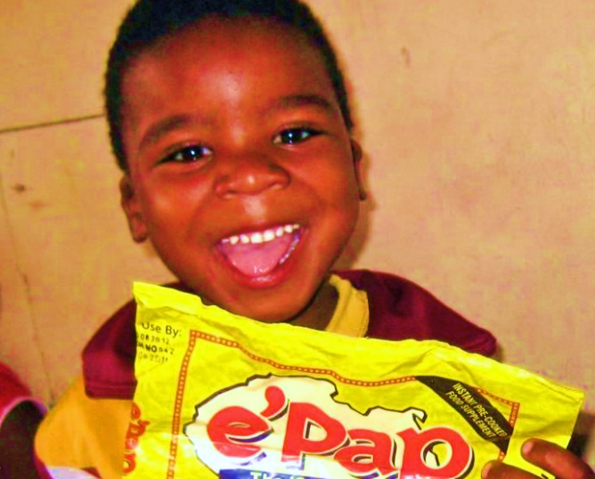
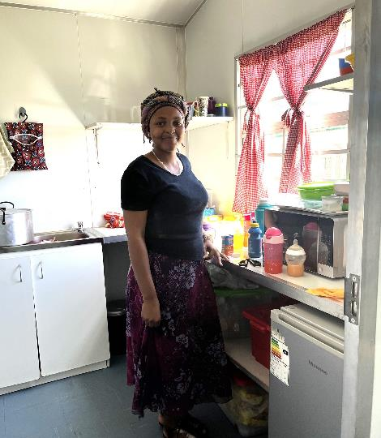

This is Nora. She works in a creche in Addo in South Africa.
If you look closely, you can see the box of packets of e’Pap at her feet.
Each packet costs about £1.50 and has about 20 servings depending on the age of the child.
So, it only costs about 10p for a nutritious breakfast which will help children to concentrate in school.
The charity raises money to fund a type of porridge called e’Pap for breakfast at Missionvale School and other schools in South Africa.
Notes:
Slide 21: read words on screen

Slide 22

One of their fun fundraising ideas is….
So, anyone, anywhere can help to support their work.
You can find out more at
www.grct.org.uk
Notes:
Slide 22: This is one of their fundraising ideas….but you could create your own using the 10p challenge e.g. make a 10p chain in your school hall / playground.

Slide 23
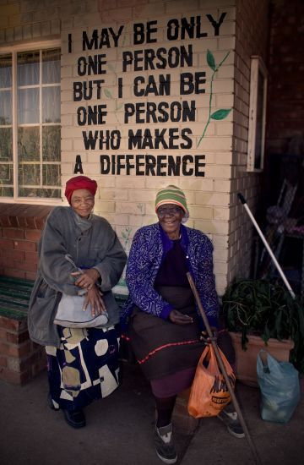
With these ideas, anyone can be a person who makes a difference.

Slide 24
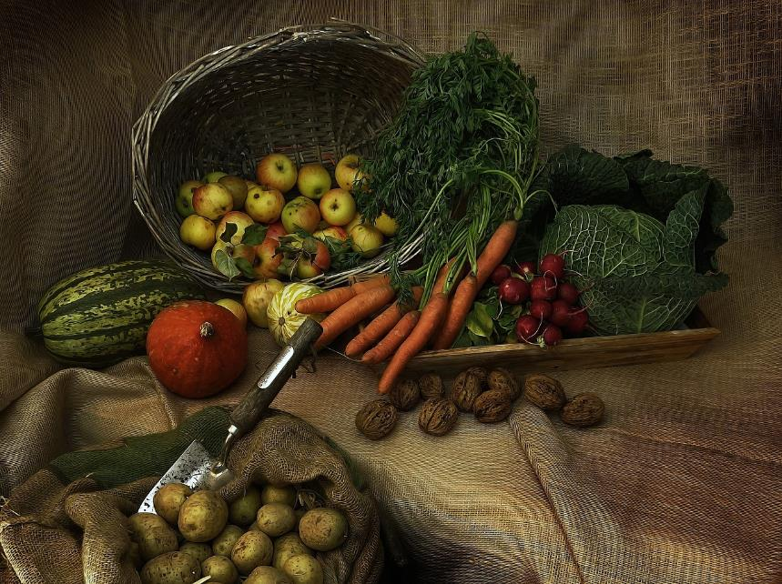
You will be truly happy if you recognise your need of God and will ask him for help in times of need.
….I wonder how Harvest might give some people an opportunity to do this?....
….I wonder what help some people might need…..and how God might help?....
….I wonder how we might help too?....
Notes:
Slide 24: Reflection and words for worship
Let’s stop and think for a few moments now….
……We’ve been thinking today about HARVEST time….
…We’ve thought of lots of words….EAT….TA (thankyou)….HAVE and SHARE….
…I wonder which word might be most important?.....or which word made you think…
HARVEST is an important time of the year…a time to remember and celebrate…. and say ‘TA!’
Now let’s go back to the words we started with.
In his Lesson on the Mountain, Jesus said: ‘You will be truly happy if you recognise your need of God and will ask him for help in times of need.’
….I wonder how Harvest might give some people an opportunity to do this?....
….I wonder what help some people might need…..and how God might help?....
….I wonder how we might help too?....

Slide 25

….I wonder what you might be thankful for this Harvest time?....
Notes:
Slide 25: ….I wonder what you might be thankful for this Harvest time?....
This is NOT something that I very often allow in assembly (shouting out), but as a one-off, we’re going to have a big grateful shout-out –which you can use as a prayer if you want to! After 3, everyone can shout out something that you are most grateful for… so have a quick think now about what you’ll say…… 3-2-1….
[Pause for a few moments before ending]

Slide 26


Leader: As we leave this place & time…
All: May we be thankful for what we have and be generous in helping others.
Notes:
Sending: Slide 26
Leader: As we leave this place and time….
All: May we be thankful for what we have, and be generous in helping others.

Slide 27

Notes:
Slide 27: Reflective areas
Do something practical this week, to help others who are in need.
Use a Bible chat-mat focussed on Harvest, here: bible-chat-mat-its-harvest.pdf

