Slide 1

Pictures copyright-free from pixabay
Leader: We are a creative community. As we gather together today…
ALL: May our thinking, talking and wondering help us to grow.
Notes:
Slide 1: Gathering
Use the new greeting, with BSL actions if desired.
Leader: We are a creative community. As we gather together today….
ALL: May our thinking, talking and wondering help us to grow.
Here are BSL actions for some of the words:
Leader’s words:
Creative: https://www.signdictionary.co.uk/view/creative?q=creative#title
Community: (we use the word ‘gathering’ as it’s a simpler sign!) https://www.signbsl.com/sign/gathering
Gather together: https://www.signbsl.com/sign/gather (1st video)
Pupils’ response:
Think: https://www.brightbsl.co.uk/signs/think
Talk: https://www.signbsl.com/sign/talk (1st video)
Wonder: https://www.signbsl.com/sign/wonder (1st video)
Grow: https://www.signbsl.com/sign/grow (2nd video)

Slide 2
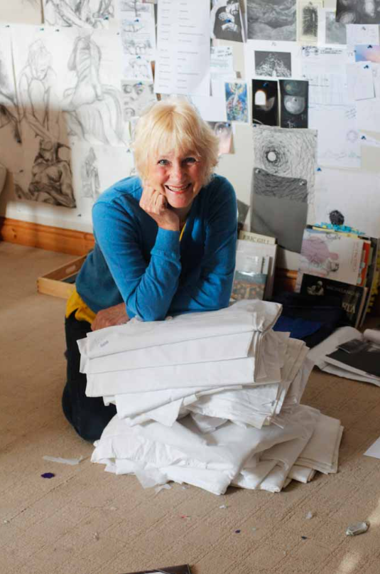
Threads Through the Cross
Notes:
Slide 2: Threads Through the Cross
Shortly, we will be looking at more of Jacqui’s panels. But first, something to think and talk about together.

Slide 3




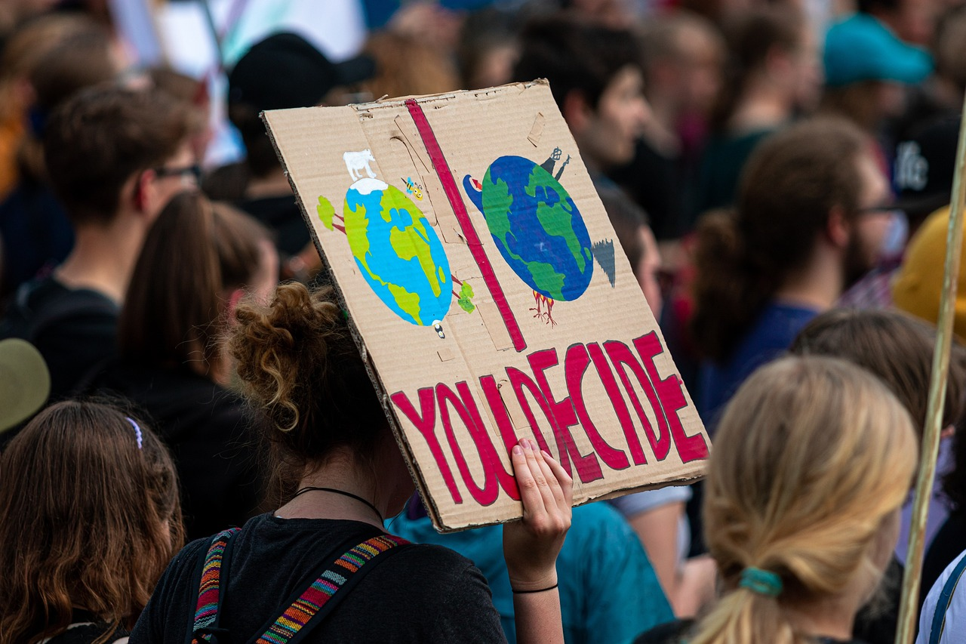
GOOD NEWS!
Notes:
Slide 3: Good news!!
We don’t often see headlines that are good news, but today, we’re going to be thinking about ‘good news’ as an idea.
What might be some ‘good news’ headlines?.... ….for our world?......for our environment?....for our community/families?.... [talk together & share ideas]
We’ll come back to the theme of ‘good news’ in a short while, but now let’s look at Jacqui’s artwork for this week.

Slide 4
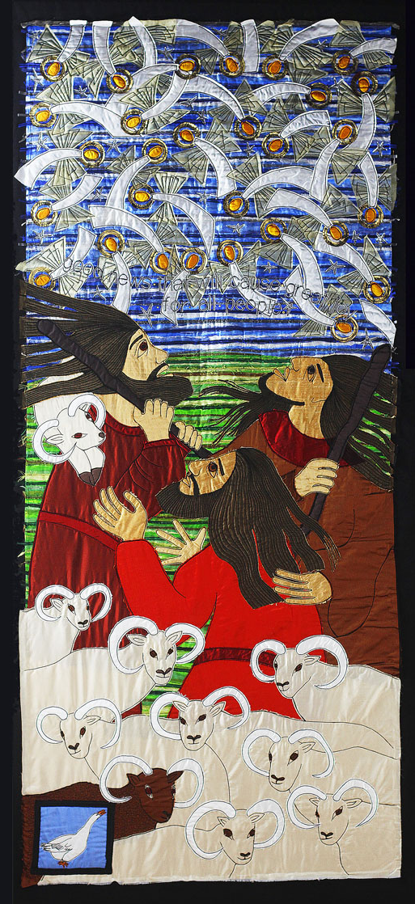
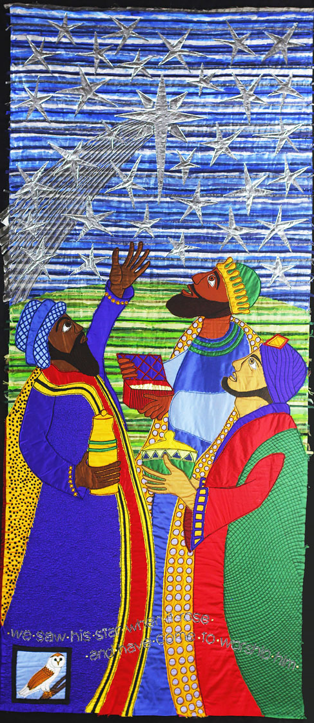
Glory to God in the heavenly heights; peace to all men and women on earth who please him.
We saw his star when it rose and have come to worship him.
Notes:
Slide 4: This week’s panel
Spend a while just gazing at the panel. Relax, and focus on calm breathing.
Let your eyes take in (look at) every detail……. [leave silence for a short while]
Now I’m going to use some questions to help us…for now, we’re not going to tell each other our answers. [select from the questions below, or use all, depending on the time / pupils you have]
….Which parts do you especially like?
….Which story do you think this is?
….Who are the people in this panel?
….What do you think they are looking at?
….How are the people feeling?
….Are there any words to read?
Now spend a few minutes talking about the things you were thinking about….and pick out the words ‘Glory to God in the heavenly heights; peace to all men and women on earth who please him.’ and ‘We saw his star when it rose and have come to worship him.’ to confirm what children might already have said.
….Can you find the birds? …..I wonder why you think Jacqui chose an owl to appear on the wise men panel?.... [for time purposes, we choose to focus on the owl in the wise men panel, but if children ask about the goose, this is what Jacqui said about it: ‘The white goose represents light – there’s lots of light on this dark night. And geese can be noisy when alarmed – imagine how they would have reacted to a host of angels!’]

Slide 5

Do not be afraid!
Follow the star
‘Gospels’ = ‘good news’
Notes:
Slide 5: This week’s panels – Do not be afraid and Follow the star
This is what Jacqui called these panels, and they represent some of the very unusual visitors that Jesus received, whose stories we often celebrate at Christmas time: shepherds and wise men.
In Bible times, these visitors were literally worlds apart – not just because of where they had each started their journeys, but also because of the communities they had come from.
Shepherds were considered to be the lowest of the low. They lived and worked on the hills just outside of Bethlehem. They were ordinary men doing an ordinary job.
Can you imagine the story the shepherds would tell to their families and neighbours, of the good news for all people that the angels spoke about?
The wise men, on the other hand, were rich and sophisticated and had followed the new star all the way from lands in the East. They had been studying their astronomical books that told them that a new star would show the way to a new king, so they travelled expecting to find an extraordinary new king, in a fine palace. I wonder if you can imagine what they thought when the star led them to the child, Jesus, in such a humble home? As the story tells us, they bowed and worshipped him, and gave him their treasures of….? [gold, frankincense and myrrh]
Even though the shepherds and the wise men were so different from each other, the birth of Jesus, God’s Son, was good news for them both, and indeed for everyone – it meant peace on earth for all people, and a new type of King, with a new type of Kingdom, as we’ll hear in weeks to come. In fact, this good news was so important that the four books in the Bible that contain these stories are called ‘Gospels’- which means ‘good news’!

Slide 6
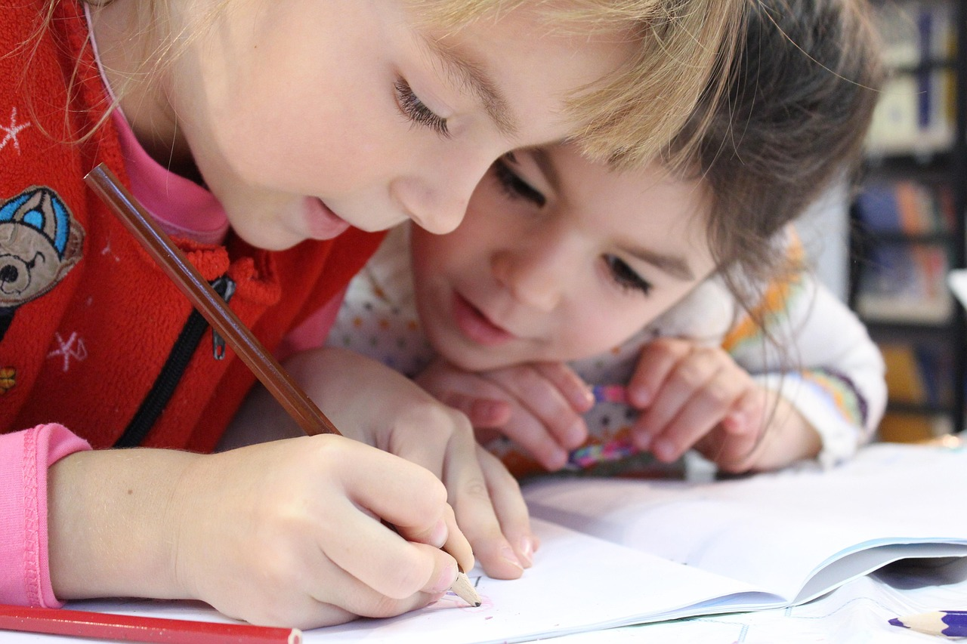
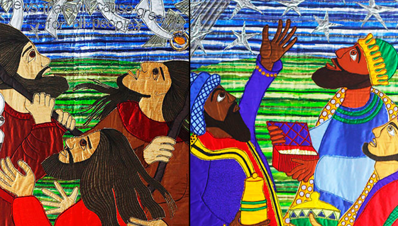
GOOD NEWS!
Notes:
Slide 6: Good news!!
But what might good news look like here, for us in our school? And how might our school be good news for those who come here? [refer to how you make a difference e.g. as learners, making friends etc.]
We can all be part of the good news story that is our school, by being….. [reference school values]

Slide 7
….I wonder what sort of good news might be most important for us here today?....
….or for our world? Maybe ‘peace on earth’, as the shepherds heard?
….I wonder how we might be good news for others this week?....
Notes:
Slide 7: Responding and words for worship
We started today with thinking about good news – the good news that we would like to see in our world, and the good news that the shepherds and the wise men found in Jesus. And we’ve just thought about good news in our own school community. So let’s be quiet and still with our own thoughts now…..
….I wonder what sort of good news might be most important for us here today?....
….or for our world? Maybe ‘peace on earth’, as the shepherds heard?
….I wonder how we might be good news for others this week?....
Opportunity for reflection / prayer
I’m going to pray now. If this is something that you feel comfortable doing, then find a way to make these words your own and join in with ‘Amen’ at the end.

Slide 8
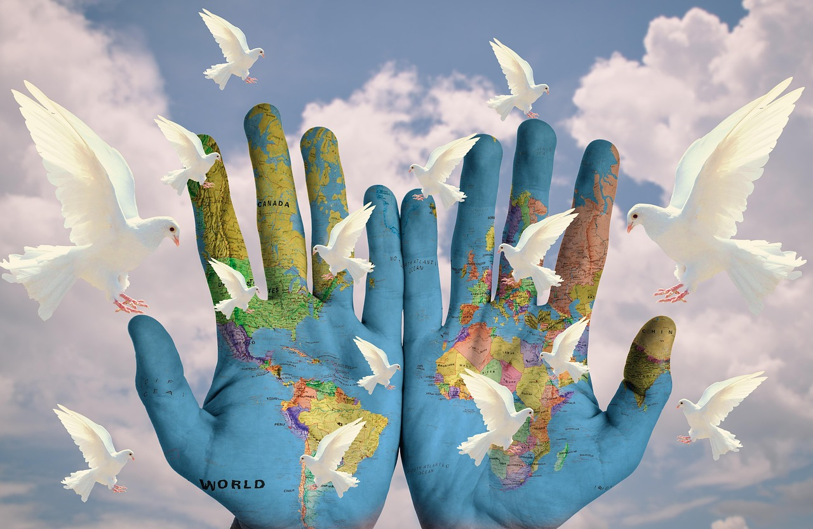
God of peace
As the angels spoke to the shepherds ‘Peace on earth for all people’, so we pray this for our troubled world.
May our actions bring peace and good news to others this week.
Notes:
Slide 8: A prayer for peace
God of peace
As the angels spoke to the shepherds ‘Peace on earth for all people’, so we pray this for our troubled world.
May our actions bring peace and good news to others this week.

Slide 9
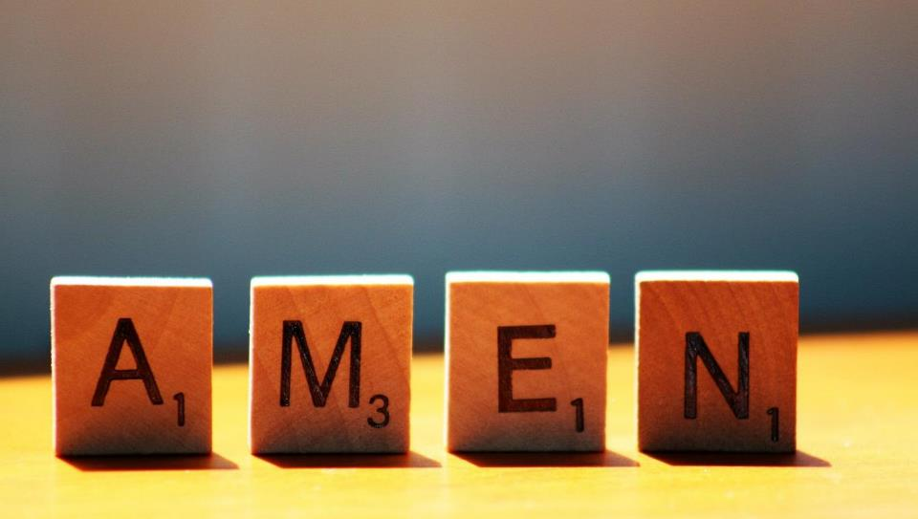

Slide 10


GOOD NEWS!
Leader: As we leave this place & time and go into the day ahead…
All: Together, we create a peaceful community!
Notes:
Sending: Slide 10 (NB note different word from last week!)
Leader: As we leave this place & time and go into the day ahead…
All: Together, we create a peaceful community!
BSL Together: https://www.signbsl.com/sign/together (1st video); Peaceful: https://www.signbsl.com/sign/peace
You already have signs for ‘community’

Slide 11

Notes:
Slide 11: Reflective areas
Think: How might being a friend to someone be good news this week?
Do: Take up the friendship challenge – invite someone different to play with you or join in your game today!!
Talk: How did this change our class/ school community this week?

Slide 12
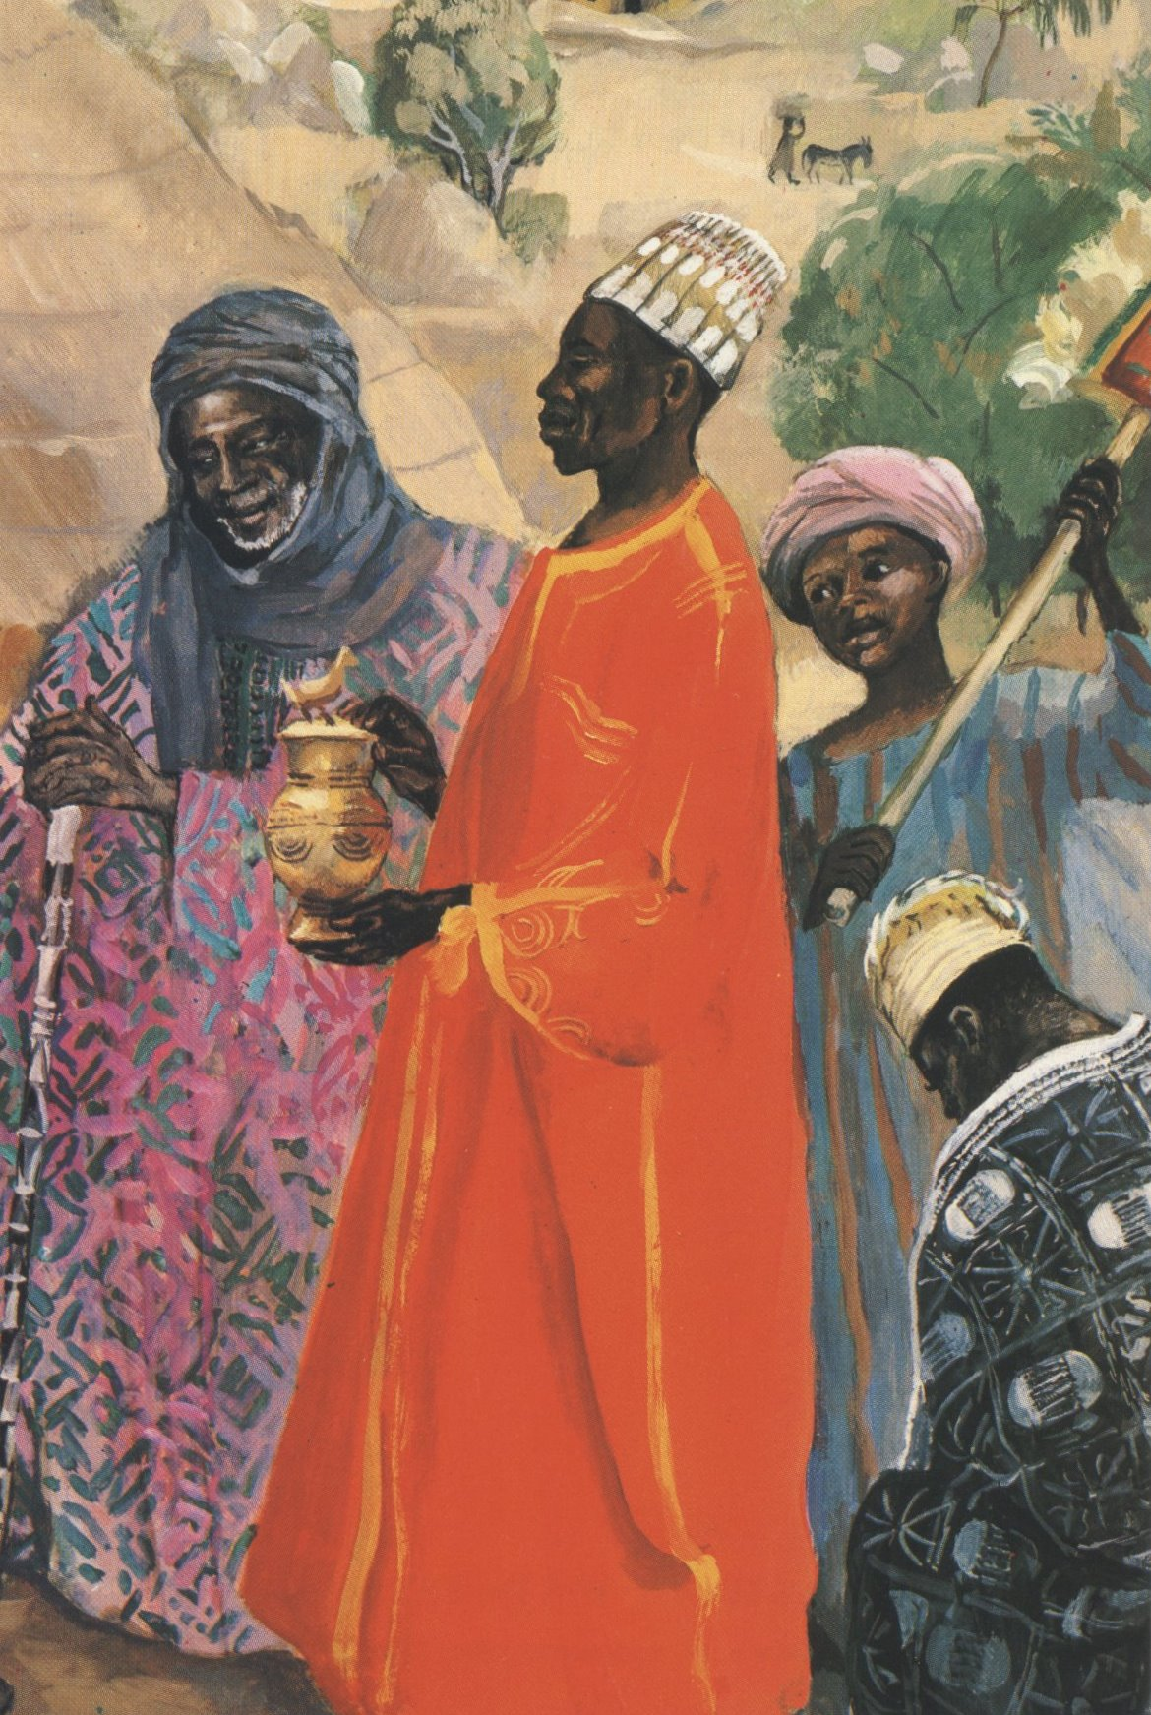
JESUS MAFA. The Three Wise Men, from Art in the Christian Tradition
Notes:
Slide 12: Showing the wise men (Magi) from different cultural perspectives
Link to original artwork: https://diglib.library.vanderbilt.edu/act-imagelink.pl?RC=48399, which includes some key information.
Looking at these two creative interpretations of this part of the story may be something that links with your RE curriculum, reflecting the fact that Christianity is a global religion, encouraging pupils to appreciate the diversity that exists across cultures, traditions and geographical areas. It’s important for pupils’ wider understanding that they are given opportunities to think about how Christians show Jesus as being ‘like them’, and that this important story for Christians is imagined in different ways across the world. It also creates an inclusive classroom environment, giving all pupils opportunity to see themselves in the art that they view.
You may wish to consider these questions:
What is the same? What is different?
Which culture / tradition does the 2nd piece come from?
Why do we think this?
What questions might we want to / need to ask?

