Slide 1
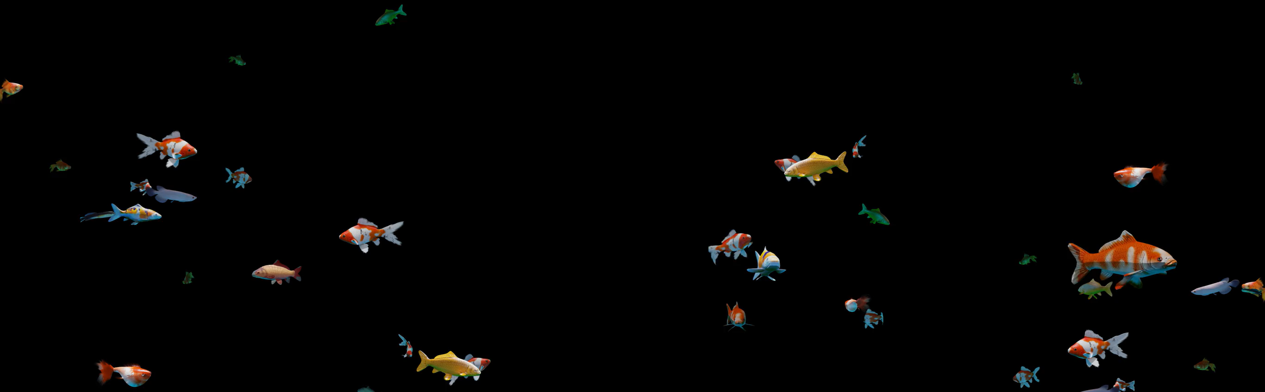
All images copyright-free from pixabay, unless otherwise identified
Notes:
Gathering:
Slide 1: Swimming fish stilling exercise
Use the stilling slide if desired: the suggested words should be spoken slowly, leaving pauses inbetween to create a sense of stillness.
As you sit quietly, look at the fish swimming ….. [PAUSE]
Now practise slower breathing…..in…..and out…..in……and out…..as you watch the movement of the fish….[PAUSE]
You maybe notice that you are feeling calmer and more relaxed….[PAUSE]
As you breathe, think about yourself and what you bring into this time today….. [PAUSE]
We come into this special / sacred space and time to be still….to think deeply…..to be together as a school community…..
In our time together today, we will talk about a question together, share not one, but two stories (!), play a game, and then think together.
But first, let’s welcome one another as we begin….

Slide 2

As we gather to share today's story.
As we gather to share today's story.
Leader: As we gather to share our story today….
All: May we grow in our understanding of ourselves and our choices.
Notes:
Slide 2: Use our new gathering words for this term, or your usual greeting if you prefer. These greetings may change slightly each week to reflect the spiritual elements that we will be exploring in each week’s materials.
Leader: As we gather to share our story today….
All: May we grow in our understanding of ourselves and our choices.

Slide 3
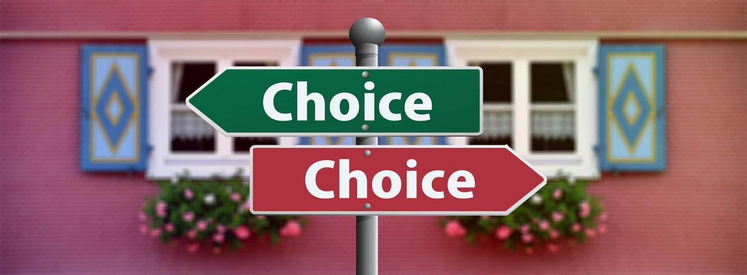
Why is it sometimes hard to make good choices?
Notes:
Slide 3: A question to ponder as we begin: why is it sometimes hard to make good choices? [Talk together for a while]

Slide 4
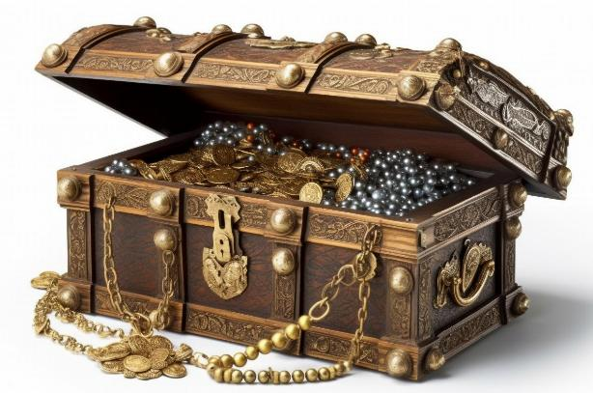
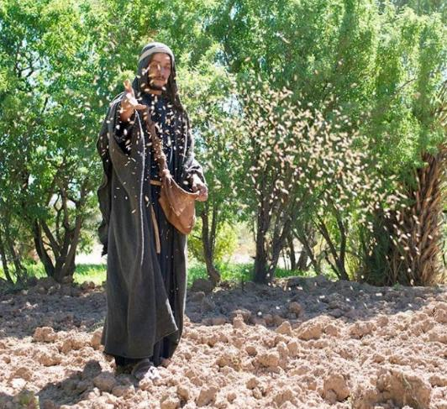
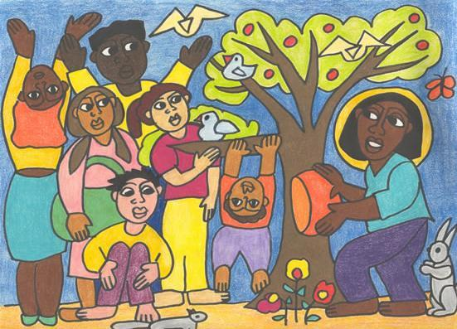
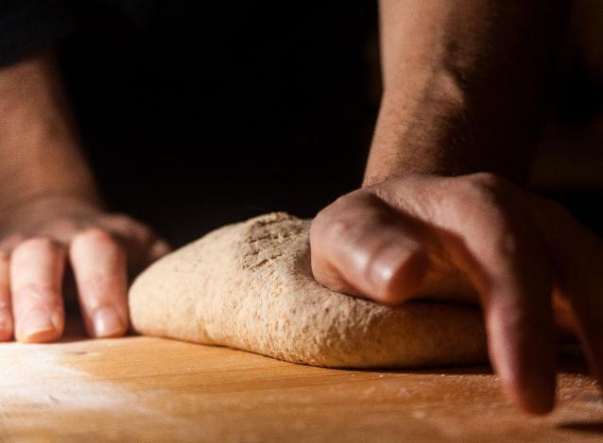
Notes:
Slide 4: So far this term, we have heard some parables told by Jesus to make his listeners think and explain to them how to live as part of God’s kingdom. These ancient stories have helped us in turn to think about ourselves, how we live, and how we behave towards others – and to explore some of Jesus’ ideas for ourselves.

Slide 5
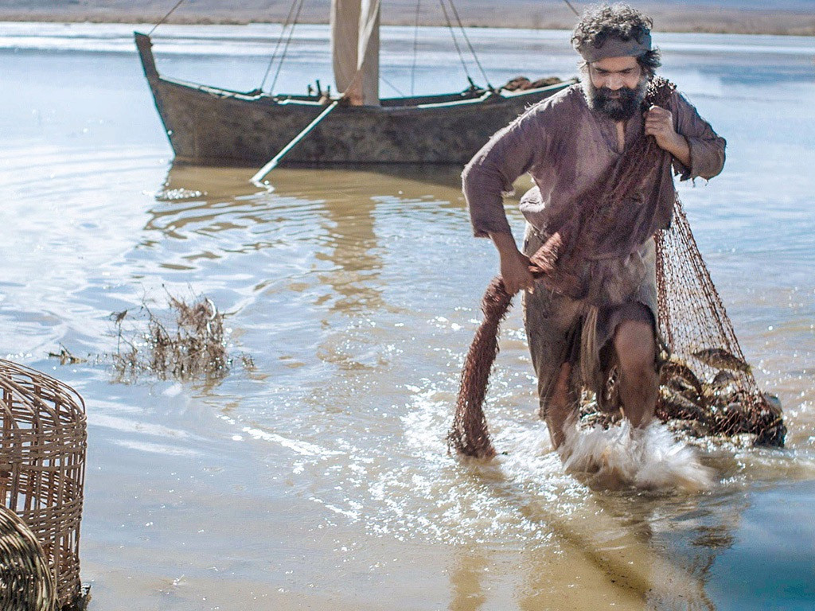
‘The kingdom of heaven is like a net that was put into the lake. The net caught many different kinds of fish. When it was full, the fishermen pulled the net to the shore. They sat down and put all the good fish in baskets. Then they threw away the bad fish….’
[Matthew 13:47-48]
Notes:
Slide 5: Today’s parable is about fishing, which was something that many of his disciples knew a LOT about!! This is what Jesus said (and these are the words from an actual Bible today!): ‘The kingdom of heaven is like a net that was put into the lake. The net caught many different kinds of fish. When it was full, the fishermen pulled the net to the shore. They sat down and put all the good fish in baskets. Then they threw away the bad fish….’ [Matthew 13: 47&48]

Slide 6
…I wonder what you think Jesus was meaning in this parable?...
…I wonder how the fishermen might choose what’s good and what’s bad?...
…I wonder what you think the fish might represent?...
Notes:
Slide 6: …I wonder what you think Jesus was meaning in this parable?...…I wonder how the fishermen might choose what’s good and what’s bad?...…I wonder what you think the fish might represent?...[talk together again]
People often accused Jesus of teaching them hard things: the message in this parable for those who wanted to belong to God’s Kingdom was a hard one, about making Kingdom choices – and about the consequences of making bad choices.

Slide 7
Good Fish, Bad Fish!
Notes:
Slide 7: To help us think some more about choices I have a fishing game for us to play – a game called Good Fish, Bad Fish. In my net / bag here I have some fish: help me decide whether they are a good fish with a good choice, or a bad fish, with a bad choice [play the game together. You can make your own version using the blank fish on p.8 Also talk together about what to do when we make bad choices: the importance of saying sorry, being forgiven and accepting forgiveness.]
Although it doesn’t sound very hard, we all know that there are times when making good choices isn’t easy. Jesus knew this too, which is why he told so many parables about people with choices!

Slide 8

Choices
Notes:
Slide 8: We’re going to share our second story about choices now to help to unpack what Jesus might have been meaning in his parable of the fish and the net. Watch out for some reminders of other parables as well! [use script on p9)

Slide 9
...I wonder what choices we might face today?...
…I wonder what might help us to make good choices…or how we might put things right if we make a bad choice?...
…I wonder what impact our choices have on other people?...
Notes:
Slide 9: Responding (and words for worship)
Let’s be still and quiet together now….
...I wonder what choices we might face today?...
…I wonder what might help us to make good choices…or how we might put things right if we make a bad choice?...
…I wonder what impact our choices have on other people?...
…..you might want to spend some time in quietness now, thinking or praying…..
[leave a time of quiet]

Slide 10


May the words of our mouths,
The thoughts in our hearts
And the choices we make
Be pleasing to you, O God.
May the words of our mouths [touch lips]
The thoughts of our hearts [touch heart]
🤷
May the words of our mouths
Notes:
Slide 10: Prayer
I’m going to pray now, using some words written by King David the Psalmist. We used some of these words in an earlier week, but I’ve added an extra line that fits with today’s theme. There are some actions that you can join in with as well as the words if you would like to, [teach them here] but if you’d prefer not to pray, then just continue to be quiet with your own thoughts.
May the words of our mouths [touch lips]
The thoughts of our hearts [touch heart]
And the choices we make [hands at shoulders, open palms – like the ‘What?!’ emoji] 🤷
Be pleasing [thumbs up] to you, O God.

Slide 11


Slide 12



Leader: As we leave this place & time and go into the day ahead…
All: May we make good choices!

Slide 14
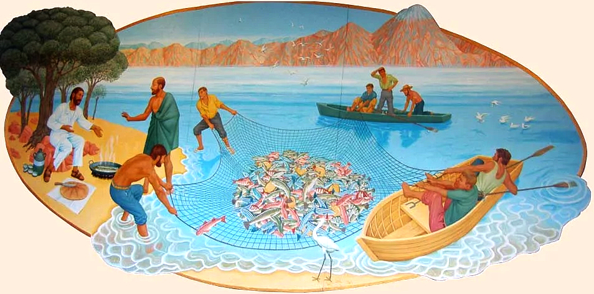
Notes:
Breakfast on the beach
By Peter Koenig, sited in the Church of St Edward, Kettering
This art comes from the story of Breakfast on the beach, but shows fishermen (the disciples) hauling in a net of fish.
Source for this image: https://diglib.library.vanderbilt.edu/act-imagelink.pl?RC=58541

