Slide 1
Leader: We are here together
Children: With ears ready to hear and hands ready to serve.
ALL: May we be wise in all our actions today.
Notes:
Slide 1: Use our new gathering words. Why not invent your own actions to accompany them?
Leader: We are here together
Children: With ears ready to hear and hands ready to serve.
All: May we be wise in all our actions today.

Slide 2
Notes:
Slide 2: As you know by now, we are thinking about Wise Words this term – and what we can learn from them about how to live well in our own school community – and lives! So, let’s get right to our words from Solomon’s book of Proverbs at the start of our time together today.

Slide 3
‘The lives of good people are like lights in the darkness.’ (Proverbs 13:9)
Notes:
Slide 3: ‘The lives of good people are like lights in the darkness.’
I wonder what you think these words mean? [talk together briefly, as you will come back to them at the end.]
We’ll come back to these words towards the end of our time together today, but now…..

Slide 4
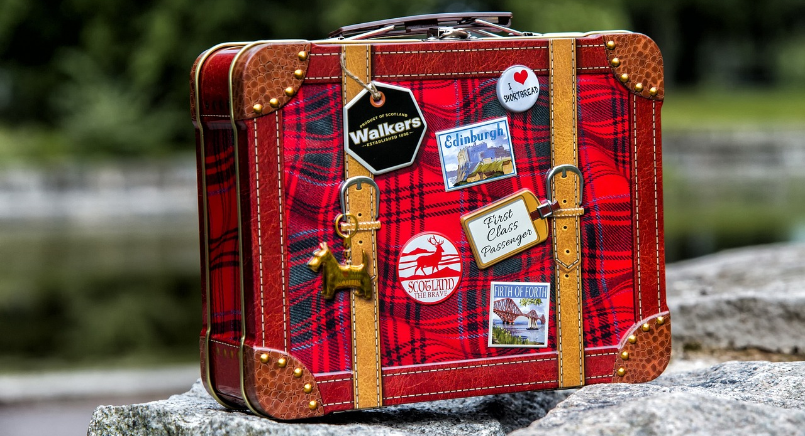
The Packing Challenge!
Notes:
Slide 4: …another challenge!
[set your own packing challenge in the way that you have decided]
This picture of trying to get more into a container is going to be an important image for our story today…..

Slide 5
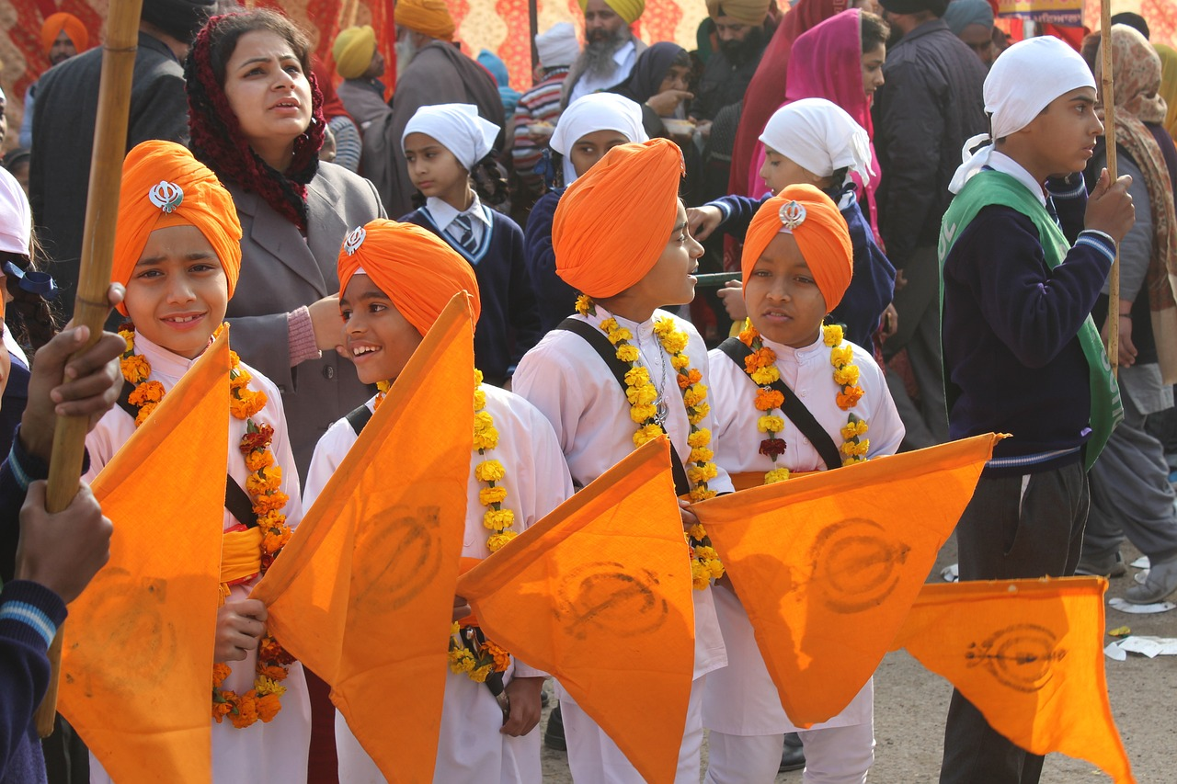
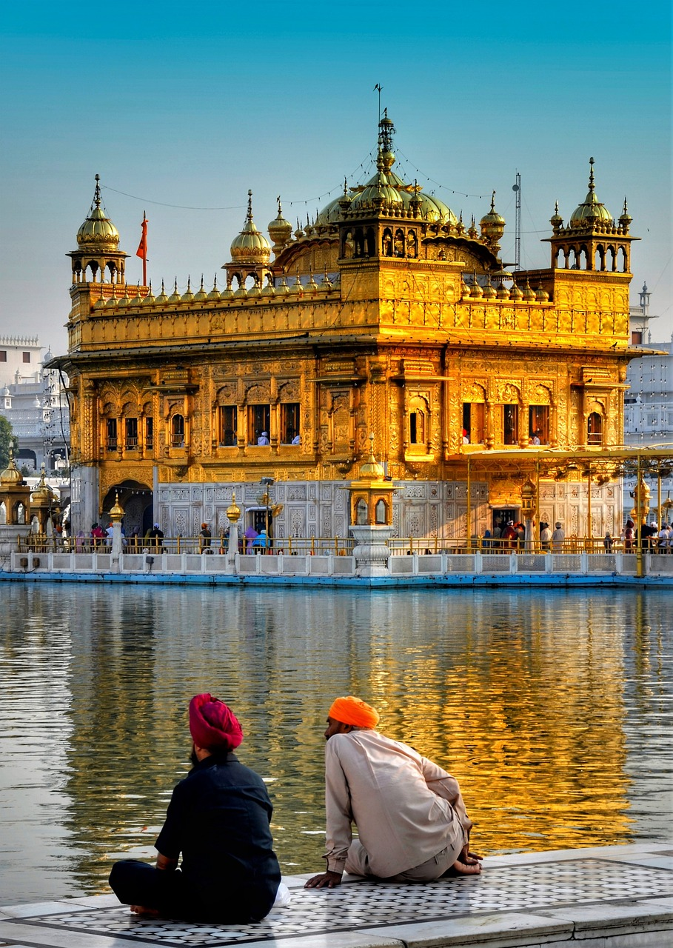
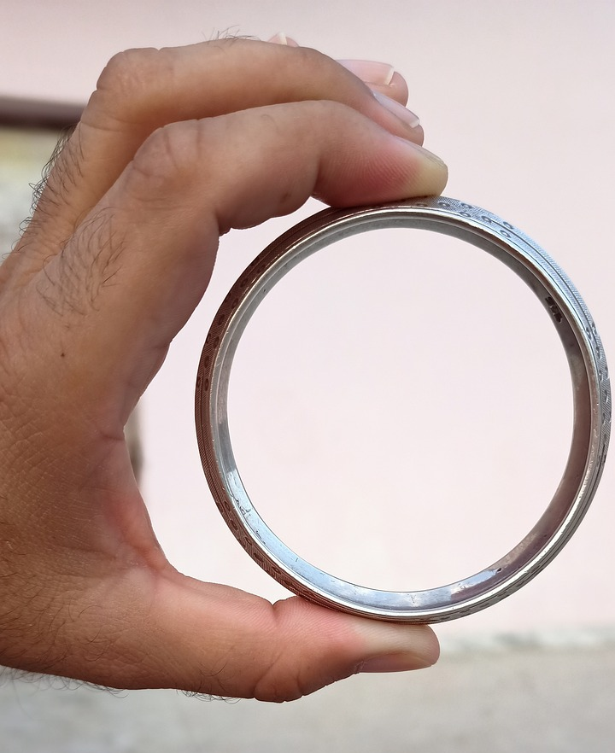
Notes:
Slide 5: …which comes from the Sikhi religion (also known as ‘Sikhism’). This religion began in northern India with a very wise teacher called Guru Nanak, who was the first guru – or teacher – of the religion. Like we heard last week about the importance of the words of Prophet Muhammad (may peace and blessings be upon him) to Muslims in our story about the cosy kittens, the words of the gurus are very important to Sikhs, and it’s some words of Guru Nanak which are going to help us today as we think about our wise words.

Slide 6
Guru Nanak, the milk & the jasmine flower
Notes:
Slide 6: This is a very famous story about Guru Nanak, the milk and the jasmine flower – and some words that have inspired Sikhs all over the world since….

Slide 7
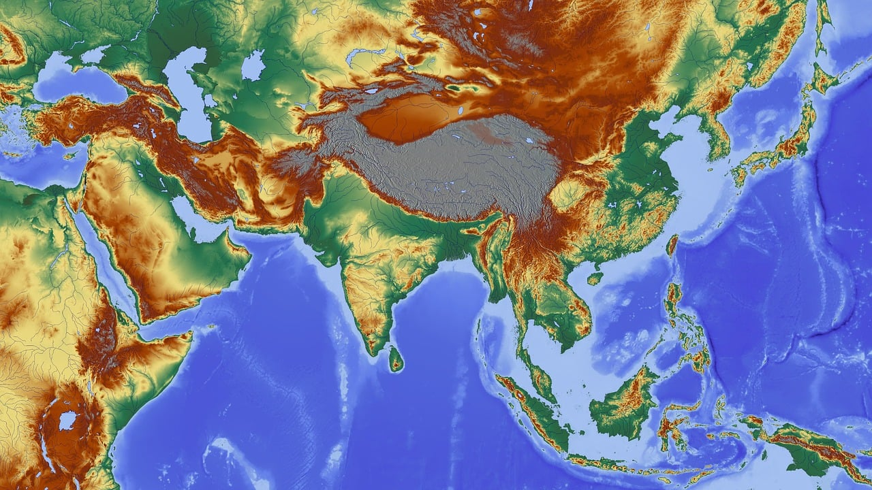
Notes:
Slide 7: Guru Nanak travelled all over India with his best friend Mardana, sharing messages of kindness and peace.

Slide 8
Notes:
Slide 8: Some towns would welcome them, but others would not! Some people liked their old ways and were afraid of change.
As Guru Nanak and Mardana entered a town one day, they were met by the leaders of that town. Nanak had heard that they had been greedy and unkind to the townspeople and wanted to show them that they could change. But the leaders were frightened by Guru Nanak’s kindness.

Slide 9
‘There is always room
for more holiness
in the world.’
Notes:
Slide 9: So they sent a messenger carrying a bowl full of milk – and a message. [use your own bowl illustration here if you’re doing it live]
‘Our city is full, like this bowl of milk. There is no room for you or your friend here!’
You might think that this was very rude, but Guru Nanak was very gentle, and did a very strange thing. He picked a jasmine flower from a nearby plant and floated it on the surface of the milk.
‘There is always room for more holiness in the world.’ he told them.

Slide 10
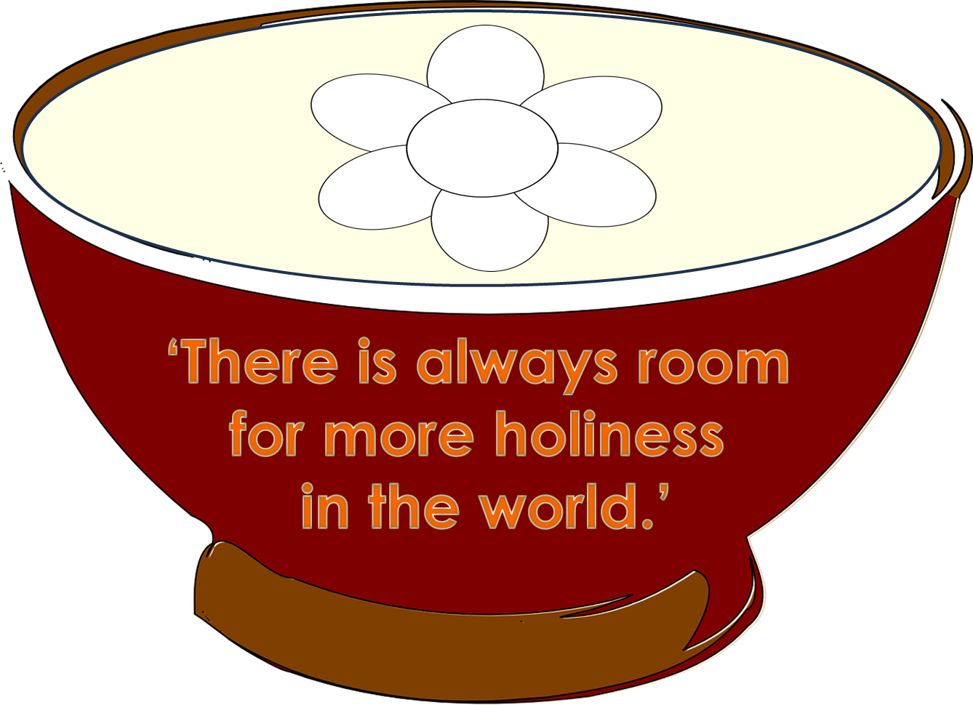
…..I wonder what the leaders felt when they heard Guru Nanak’s words?....
….I wonder what it means to have ‘more holiness’ in the world?....
….I wonder how these words help Sikhs today?....
Notes:
Slide 10: Let’s just pause and wonder about this story, and Guru Nanak’s words.
….I wonder what the leaders felt when they heard Guru Nanak’s words?....
…..I wonder what it means to have ‘more holiness’ in the world?....
….I wonder how these words help Sikhs today?....
[talk together for a short while]

Slide 11
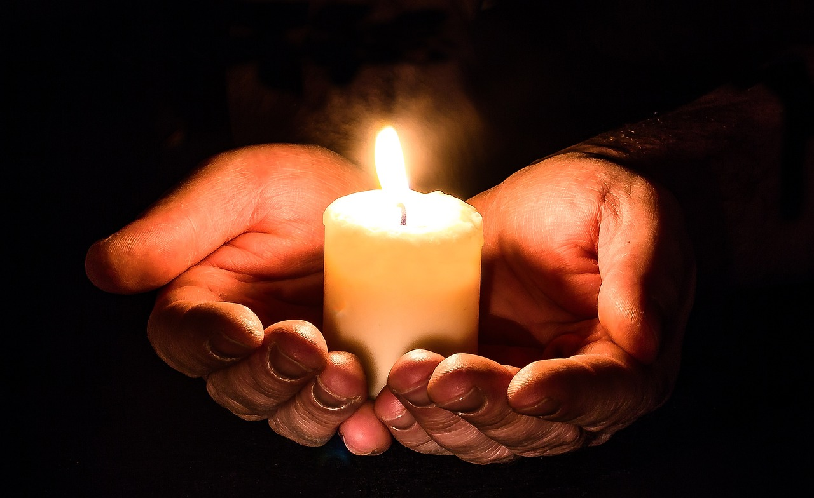
Reflection Time

Slide 12
…..I wonder what in our lives might shine like ‘lights in the darkness’?.....
….I wonder what our world might need more of?..... ….and whether we might be just the people to do something about it?....
….I wonder how we might be able to bring more goodness – and light – into our school today?.....
‘The lives of good people are like lights in the darkness.’ (Proverbs 13:9)
Notes:
Slide 12: ‘The lives of good people are like lights in the darkness.’
We started our time together today with these words. I wonder what you think these words mean? [talk together again]
[For older pupils…] – and what connection they might have with Guru Nanak’s words?
Let’s wonder together again…..
…..I wonder what in our lives might shine like ‘lights in the darkness’?.....
….I wonder what our world might need more of?.....
….and whether we might be just the people to do something about it?....
….I wonder how we might be able to bring more goodness – and light – into our school today?.....

Slide 13
God, who is the light in the darkness, help us as we try to be like you – to shine our light of goodness and holiness in this dark world. Help us we pray.
Notes:
Slide 13: God, who is the light in the darkness, help us as we try to be like you – to shine our light of goodness and holiness in this dark world. Help us we pray.

Slide 14
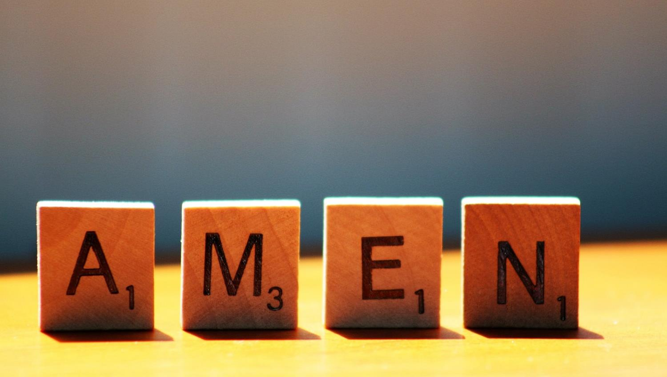

Slide 15
Leader: As we leave this place & time and go into the day ahead…
All: May today’s words help us to make wise choices.

Slide 16
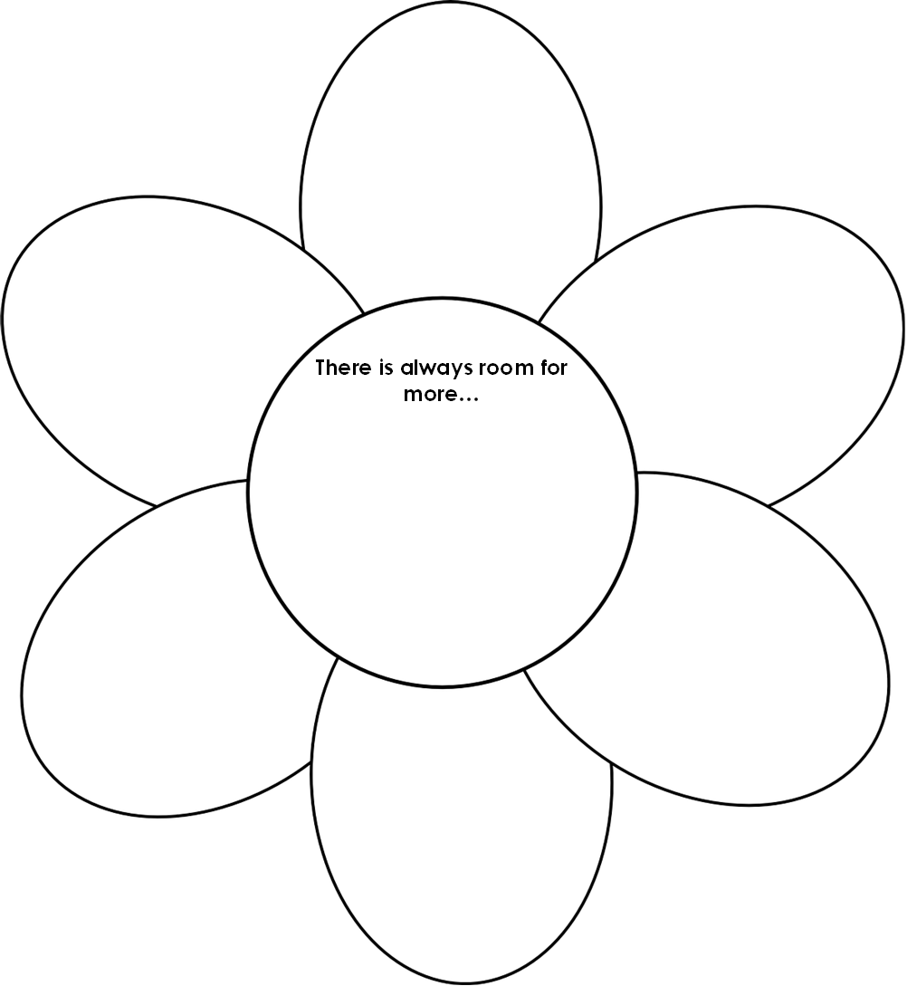
Notes:
Slide 16: Reflective areas
Make flower shapes out of paper and write on them the finished sentence: ‘There’s always room for more….’ It’s best to use pencils rather than felt pens so that the words don’t run when in contact with the water!
Fold in the petals of your flower then float the flowers in a large bowl of water and watch them open up to reveal your ideas.

