Slide 1


Leader: As we share these stories of leaders…
ALL: May we follow their example
in thoughts
and words
and actions.
Notes:
Slide 1: Use these new gathering words for this term, or your usual greeting if you prefer. The greeting comes with BSL signing, you can view the demos using links under the slide.
Leader: As we share these stories of leaders…
ALL: May we follow their example in thoughts and words and actions.
Signs for greeting: click on links
Thoughts: British Sign Language BSL Video Dictionary - thought (signbsl.com)
Words (use 3rd definition): British Sign Language BSL Video Dictionary - word (signbsl.com)
Actions: British Sign Language BSL Video Dictionary - action (signbsl.com)

Slide 2

Notes:
Slide 2: Last week, we found out about some of the Coronation regalia and their meaning as part of the ancient traditions, so to get us started today, we’re going to see what we spotted in some pictures from the weekend.

Slide 3

Notes:
Slide 3: [use your photos and spot the various items that were significant as part of the Coronation.] We’ll come back to the Coronation and King Charles III later on, but for a few moments, we’re going to return to the story of Samuel anointing David that we heard last week.

Slide 4
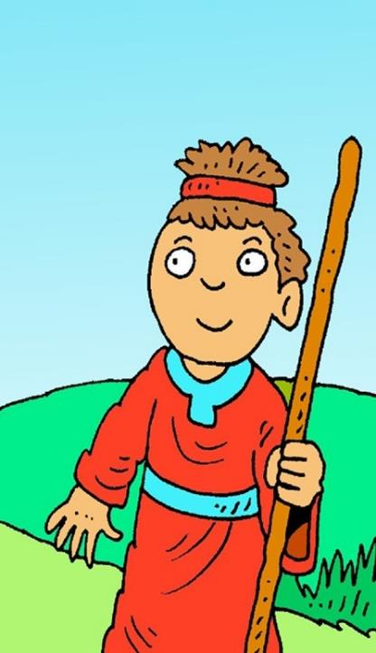

‘I don’t see the same way people see. People look at the outside of a person, but I look at their heart.’
(I Samuel 16: 7)
Notes:
Slide 4: In the story, we heard how Samuel thought that God would choose the strongest son and was surprised that God chose the smallest and youngest of Jesse’s sons. Here’s what God said to Samuel: ‘I don’t see the same way people see. People look at the outside of a person, but I look at their heart.’[you may need to discuss together what this means i.e. it’s not about the physical biology of the heart, but about the character of a person]
Do you remember in the Guess Who?® game we played last week, that we decided it was very hard to tell what someone is like as a person by how they look. But this is not how God sees people. Even though David was just a young boy, God could see what sort of a person he was inside – and this was more important to him than anything else.

Slide 5
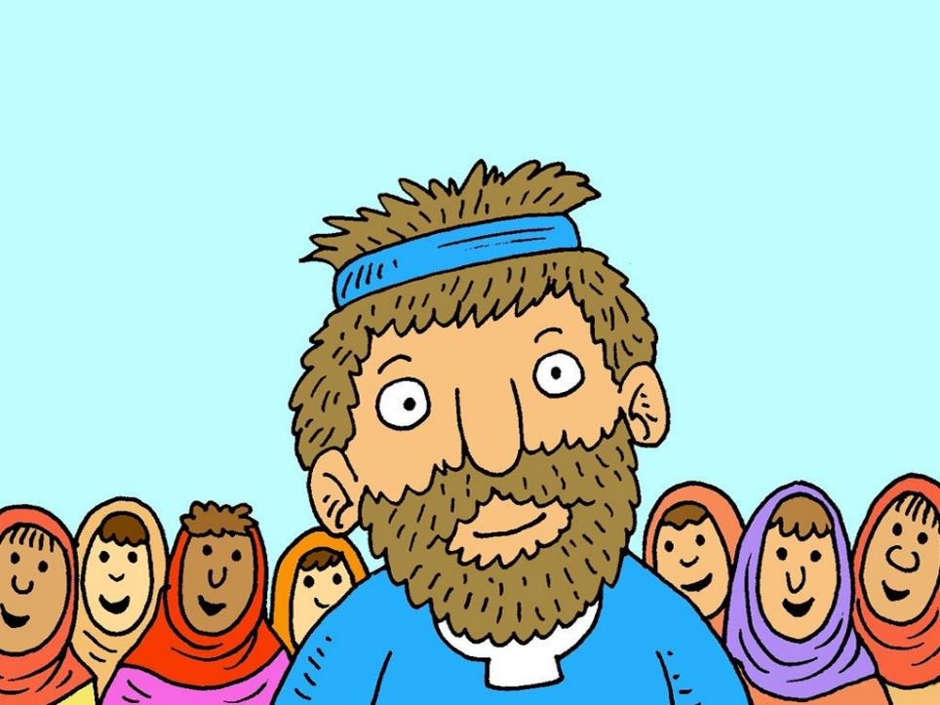
Notes:
Slide 5: David is described in the Bible as someone who followed God – ‘a man after God’s heart’. Throughout his life, even when he made dreadful mistakes, he always came back to God and tried to live better. This is what God saw in King David’s heart. I wonder what God might see in our new King’s heart? What do we know is important to him? Here are a few ideas for us to think about….

Slide 6
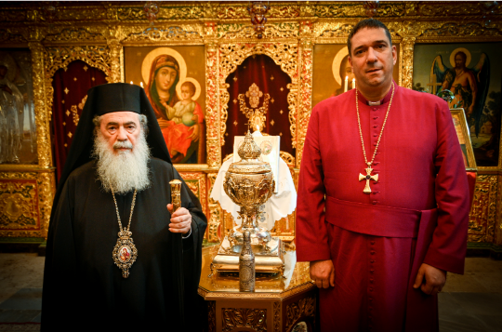
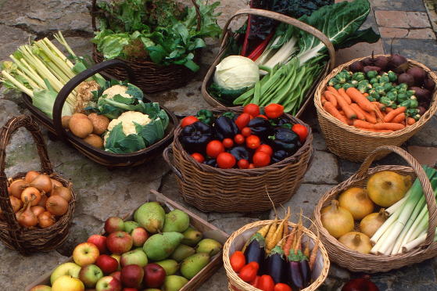
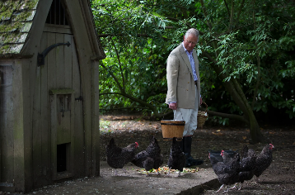
I wonder what these things show about what’s important to our new King, and what’s ‘in his heart’?
Notes:
All photos from Royal UK & Highgrove House
Slide 6: [talk about each, and what they show about our new King’s priorities. Which things do we think might help King Charles to be a good leader? What kind of a leader do we think he might be?] Last week we talked about the anointing oil that was used in the Coronation: King Charles insisted that it should completely vegetarian: King's Coronation: Anointing oil to be animal-free - BBC Newsround; at Highgrove, the King’s former residence, the gardens are managed in a way that is environmentally friendly, so that all that’s grown there is organic, and used in the kitchens to prepare food for the household. I wonder what these things show about what’s important to our new King, and what’s in his heart? [talk together]

Slide 7
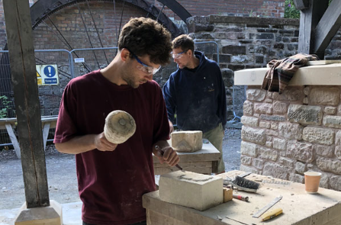
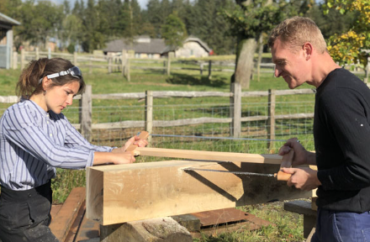
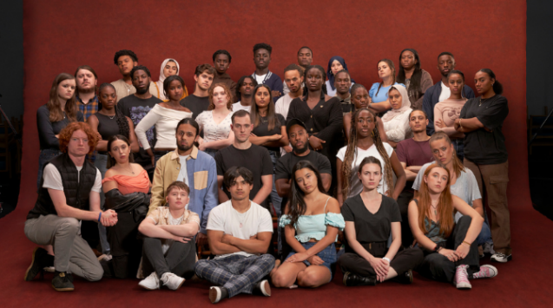
I wonder what these things show about what’s important to our new King, and what’s ‘in his heart’?
Notes:
All photos from Highgrove House & Prince’s Trust.
Slide 7: The sale of produce from Highgrove’s gardens and tours of the house and gardens provide money to support one of the King’s charities, the Prince’s Foundation, which ensures that craftspeople like this can continue to use their skills to restore old buildings [video here, for later: The Prince's Foundation at Highgrove - YouTube]; another of the King’s favourite charities is called the Prince’s Trust, which has helped thousands of young people get a good start in life through providing education or jobs: here are just a few of them, who have been helped to get work after the pandemic disrupted their education. I wonder what these things show about what’s important to our new King, and what’s in his heart? [talk together]

Slide 8
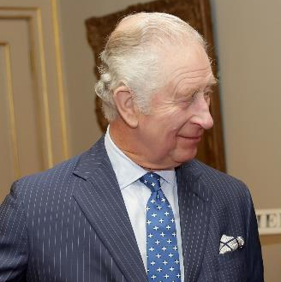

I particularly want to pay tribute to all those wonderfully kind people who so generously give food or donations, or that most precious commodity of all – their time – to support those around them in greatest need…they do such extraordinary work in the most difficult circumstances.
I wonder what this might show about what’s important to our new King, and what’s ‘in his heart’….AND ours? I wonder what a difference we might make in our local community?
Notes:
Slide 8: In his first Christmas speech, last Christmas, King Charles spoke these words:
‘I particularly want to pay tribute to all those wonderfully kind people who so generously give food or donations, or that most precious commodity of all – their time - to support those around them in greatest need…they do such extraordinary work in the most difficult circumstances.’ We sometimes call this ‘volunteering’ – giving up your free time to help others. As part of the Coronation celebrations, many volunteers alongside this, many charities supported by the Royal Family are working together in The Big Help Out. They want everyone to take part and make a difference all across the country through volunteering.…. I wonder how this might show what’s important to our new King, and what’s in his heart…..AND ours?! I wonder what a difference we might make in our local community?....

Slide 9
….I wonder what qualities are most important to God?….
….I wonder how we help other people to see what’s in our hearts….and how our school values might help us?....
I wonder what God sees when he looks at our school community?.....
Notes:
Slide 8: Responding (words for worship):
….in the stillness of this moment, let’s be quiet and think…..
….we’ve heard today about some of the things that are important to King Charles, and thought about what they might show about what’s in his heart…and the sort of leader that he might be…..
….we’ve heard how God saw David’s heart and knew he’d be a good king…..
….even when he made mistakes…..
….and now we’re going to think about ourselves….
….I wonder what qualities are most important to God?….
…I wonder how we help other people to see what’s in our hearts?....
….and how our school values might help us?....
….I wonder what God sees when he looks at our school community?.....
…..spend a few moments now thinking or praying about this now….
I’m going to turn my thoughts into a prayer now. If you’d like to pray too, then find a way to make it your own….

Slide 10

Dear God
Thank you for the story of David and what it shows about what’s important – not what we look like on the outside, but for what we are like inside, as a person. Please help our new King as he leads the way for us and for others. May he look to you to lead us, just like David did.

Slide 11
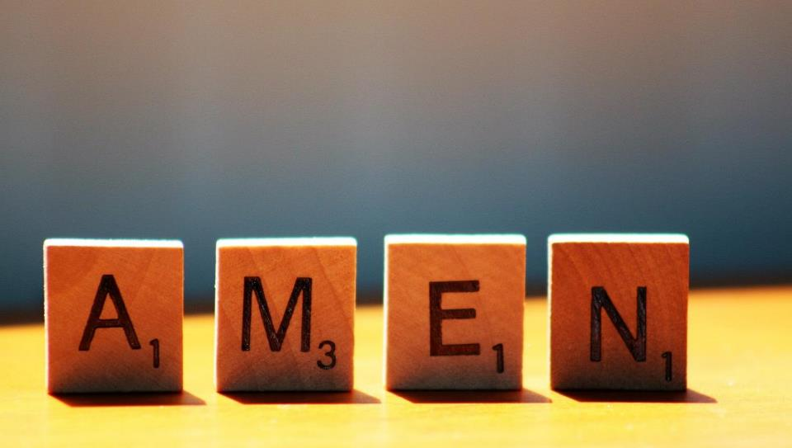

Slide 12


Leader: As we leave this place & time and go into the day ahead…
All: Let’s remember that it’s what’s in our hearts that matters most.

Slide 13



Reflecting on what’s in our hearts and how this might make a difference to how we treat each other.

