Slide 1
Leader: We are here together
Children: With ears ready to hear and hands ready to serve.
ALL: May we be wise in all our actions today.
Notes:
Slide 1: Use our new gathering words. Why not invent your own actions to accompany them?
Leader: We are here together
Children: With ears ready to hear and hands ready to serve.
All: May we be wise in all our actions today.

Slide 2
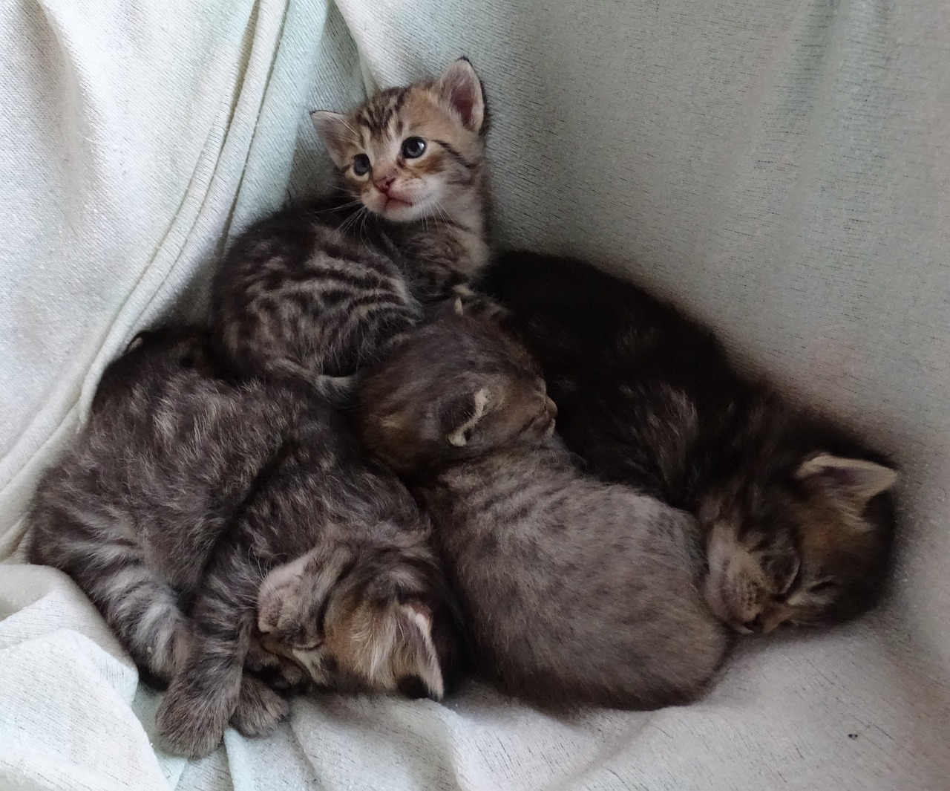
Cats sleep anywhere
by Eleanor Farjeon
Notes:
Slide 2: We’re going to start our time together today with a poem – and a story! If some of you have pet cats at home, you will understand the truth of these words!! [if time allows, do share some stories together from your own experiences!]
Cats sleep anywhere, by Eleanor Farjeon
Cats sleep, anywhere, Any table, any chair Top of piano, window-ledge, In the middle, on the edge, Open drawer, empty shoe, Anybody's lap will do, Fitted in a cardboard box, In the cupboard, with your frocks- Anywhere! They don't care! Cats sleep anywhere.
Before we hear from wise King Solomon today, we are going to share another story from across the world – and across time! It’s not a story written by Aesop, but a story about the life of the Prophet Muhammad (may peace and blessings be upon him). There are some wise words in this story too – listen out for them…... [Tell / read / watch the story]

Slide 3
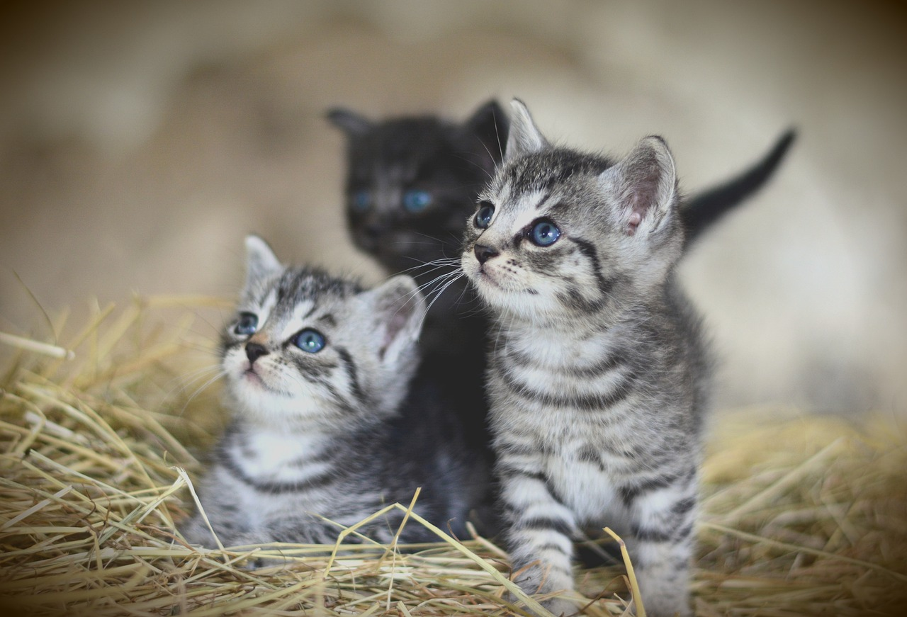
Notes:
Long ago in the time of the Prophet (may peace and blessings be upon him), a small cat gave birth to some beautiful little kittens…. …Aaahh!

Slide 4
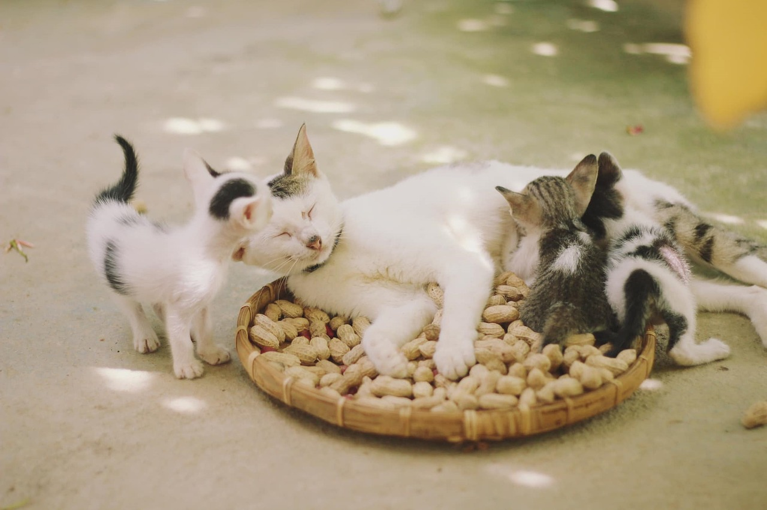
Notes:
…..people in the town noticed that the mother cat was very good at finding comfy spots to nurse her growing family…..
….I wonder what places you think she might have found?....

Slide 5
Notes:
One warm day, the Prophet Muhammad came to town, wearing his travelling cloak to keep the dust off his clothes and carrying his sword, as was the custom in those days. As usual, people gathered to hear his wisdom….
….as the hottest part of the day began to approach, Muhammad found that he was feeling quite warm, and so he took off his sword and his cloak, lay them on the ground and sat down on one corner of the cloak while he continued to teach…..

Slide 6
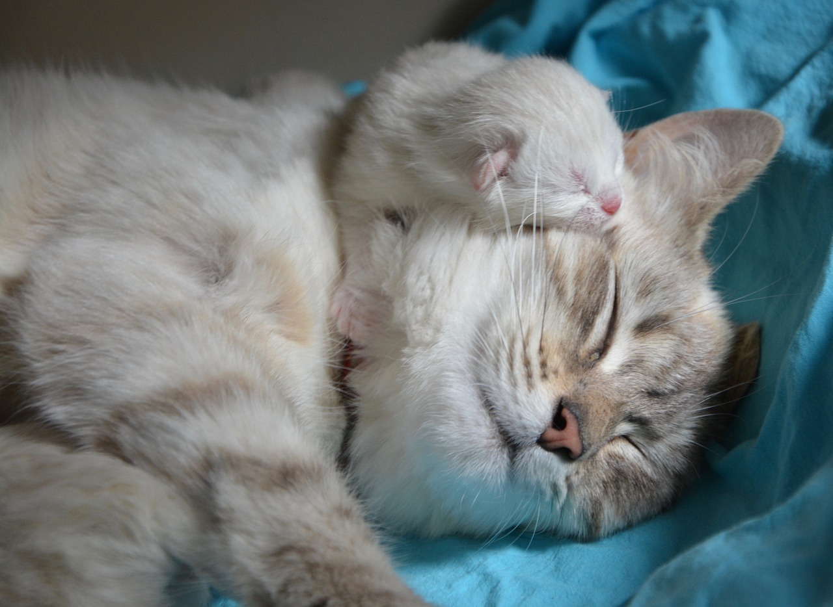
Notes:
….as he talked, the mother cat came with her little kittens and saw the cosy, soft cloak…..’an ideal place to sleep!’, she thought....and so that’s what she did!
….when the Prophet had finished speaking, he got up and went to put on his cloak, seeing the little cat just in time….

Slide 7
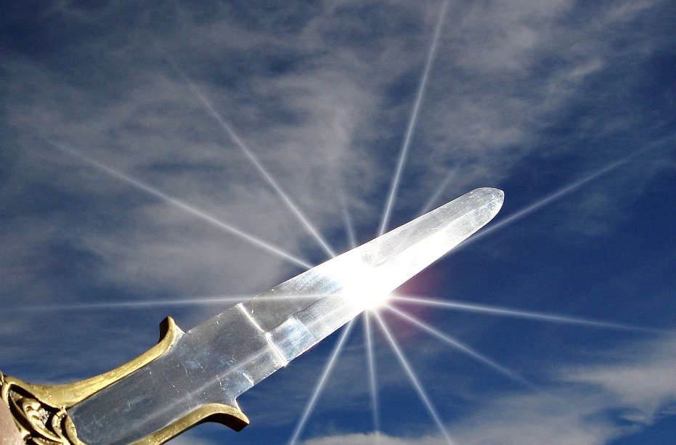
Notes:
…quick as a flash, he got out his sword. The crowd gasped with horror…..
….but they needn’t have worried. The wise Prophet simply cut off the section of the cloak next to where the cat was sleeping and went on his way, leaving the mother cat and her kittens peacefully sleeping…..SHHHH!

Slide 8
Notes:
….but they needn’t have worried. The wise Prophet simply cut off the section of the cloak next to where the cat was sleeping and went on his way, leaving the mother cat and her kittens peacefully sleeping…..SHHHH!

Slide 9
….I wonder what the people thought when they saw what the Prophet (pbuh), did?.....
….I wonder what Muhammad was trying to show them?.....
….I wonder what Muslims still learn from this story, all these years later?....and what we might learn too?....
Notes:
….I wonder what the people thought when they saw what the Prophet (may peace and blessings be upon him), did?.....
….I wonder what Muhammad was trying to show them?.....
….I wonder what Muslims still learn from this story, all these years later?.... and what we might learn too?....

Slide 10
Notes:
Slide 10: Having heard the words of Prophet Muhammad (may peace and blessings be upon him), we are going to hear Solomon’s wise words now.

Slide 11
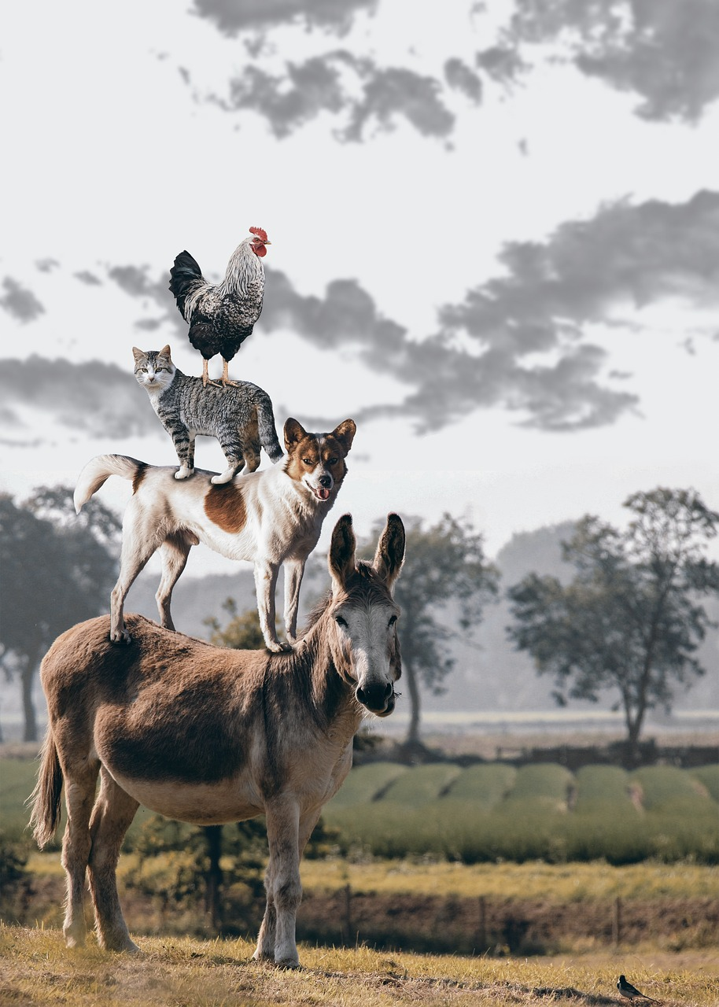
Pets!
‘Good people take care of their animals.’ (Proverbs 12:18)
Notes:
Slide 11: read the words together
I wonder what connections you can see between the words of these two wise men? [allow children to talk together]
Let’s make this very practical now, and think about our own lives. I wonder if you have pets at home that need caring for?
It would have been very easy for the Prophet Muhammad (pbuh) to take his cloak back from the sleeping cats in our story, but he ruined his cloak so that they could carry on sleeping. Muhammad used to take great care of his own camels when he was travelling and would make sure that their needs were taken care of even before he knelt to pray – which as some of you may know, is VERY important to a Muslim. He said that ‘Caring for animals is a kind of worship’, teaching his followers that looking after animals is a way of worshipping Allah [which is the Muslim name for God] who created them. He would have agreed that ‘Good people take care of their animals’.
[use animal ‘props’ for younger pupils, with the extra words below, or lead a discussion about caring for pets and being responsible owners:
In this special case I have some more of ‘Allah’s living creatures', some cuddly friends of mine – would you like to see them?.....[Get each ‘pet’ out one at a time and introduce them to the children, making as appropriate a fuss of them as you feel able!, then placing them on a table at the front of the hall]
‘Some of you may have pets just like these at home, and will be our experts to help us decide which of the things in my bag belong with each different pet. Each of the objects in my bag will help us to think about how we should care for these animals….]

Slide 12
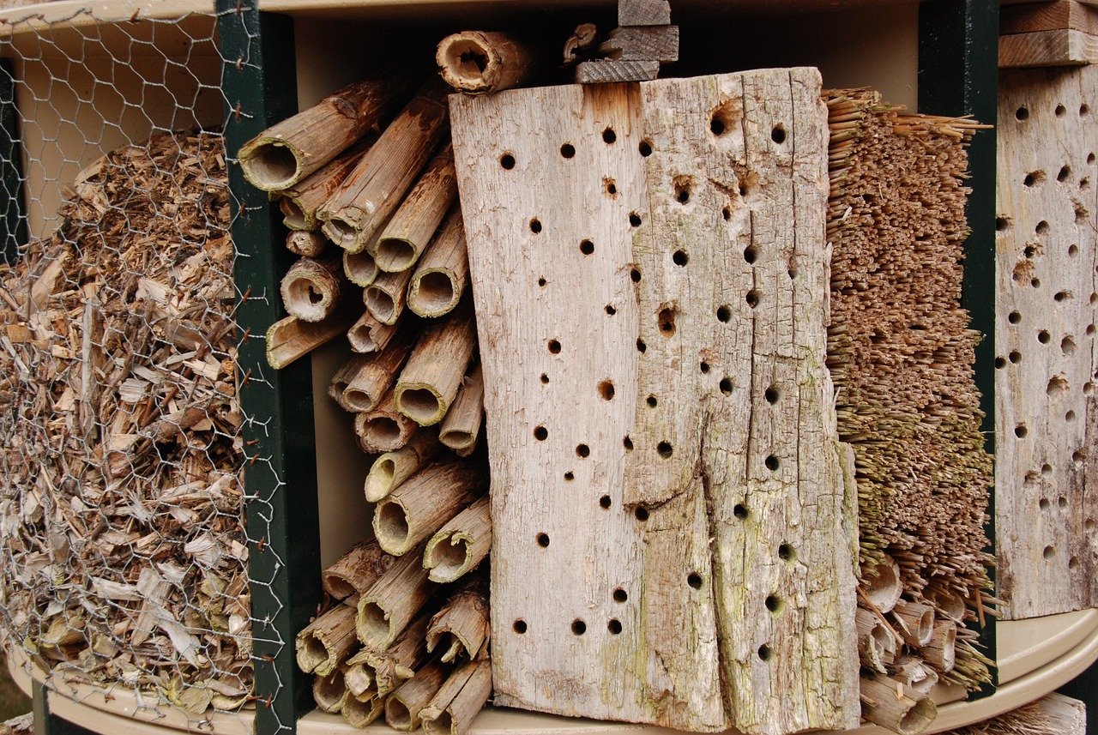
Notes:
Slide 12: Responding and words for worship
Some of you are probably thinking that you don’t have a pet, so how can you help to care for the living creatures that many people believe God created for us to enjoy? Well, there are lots more creatures in the world besides pets – and we need to be just as concerned about them! What about all the birds who visit our school, and your gardens at home? They need food and water, especially in winter time, and really appreciate water to splash in in the summer months as well! There are lots of different wild animals who are endangered species who would really appreciate you finding out about them and doing whatever you can to help them survive – maybe even sponsoring one… And everywhere you look if you just take the time, there are even the tiniest creatures going about their business!

Slide 13
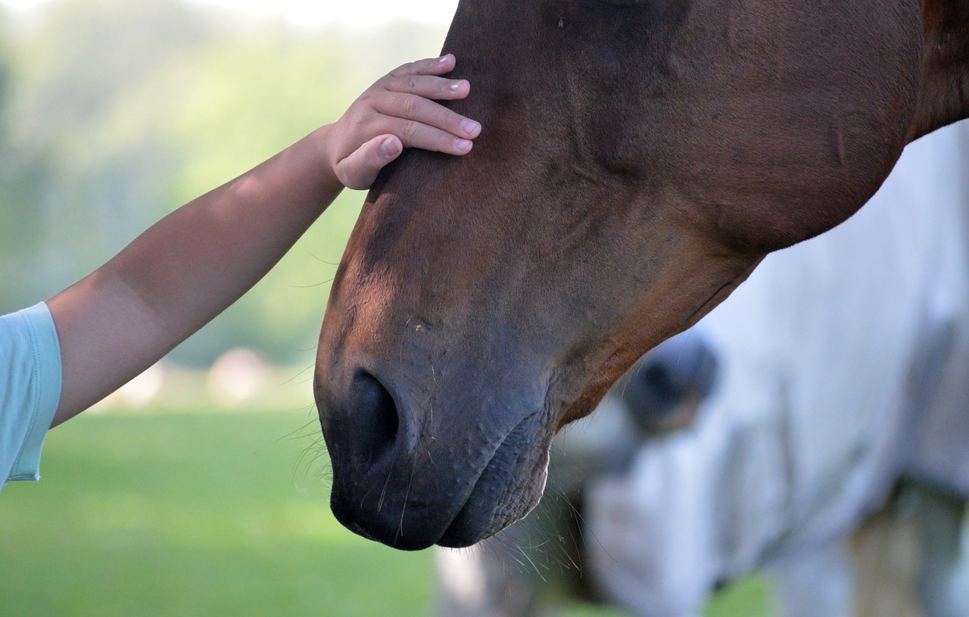
…..I wonder how we might show that we are looking after all living creatures?....
…..I wonder if we could do more to care for the animals we are responsible for?.....
….even when it might be a bit inconvenient, or we might feel we have better things to do?.....
Notes:
Slide 13: Words for worship
We’ve done a lot of talking today, so now a few thoughts for us to take away with us into our day.
…..I wonder how we might show that we are looking after all living creatures?....
…..I wonder if we could do more to care for the animals we are responsible for?.....
….even when it might be a bit inconvenient, or we might feel we have better things to do?.....

Slide 14
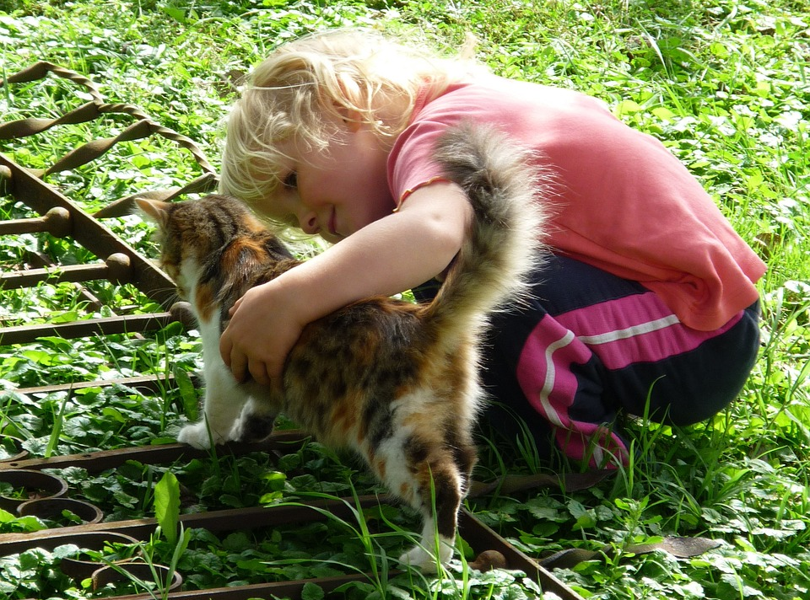
‘We will care for all you’ve made.’
Reflection Time
Notes:
Slide 14: As we come to pray now, let’s bring to our mind some animals that we could care for……
I am going to say some words first, and I encourage you to join in with the parts that come on the screen ‘We will care for all you’ve made.’

Slide 15
‘We will care for all you’ve made.’
Notes:
Slide 15:
We are grateful for the wonder of all living things.
‘We will care for all you’ve made.’

Slide 16
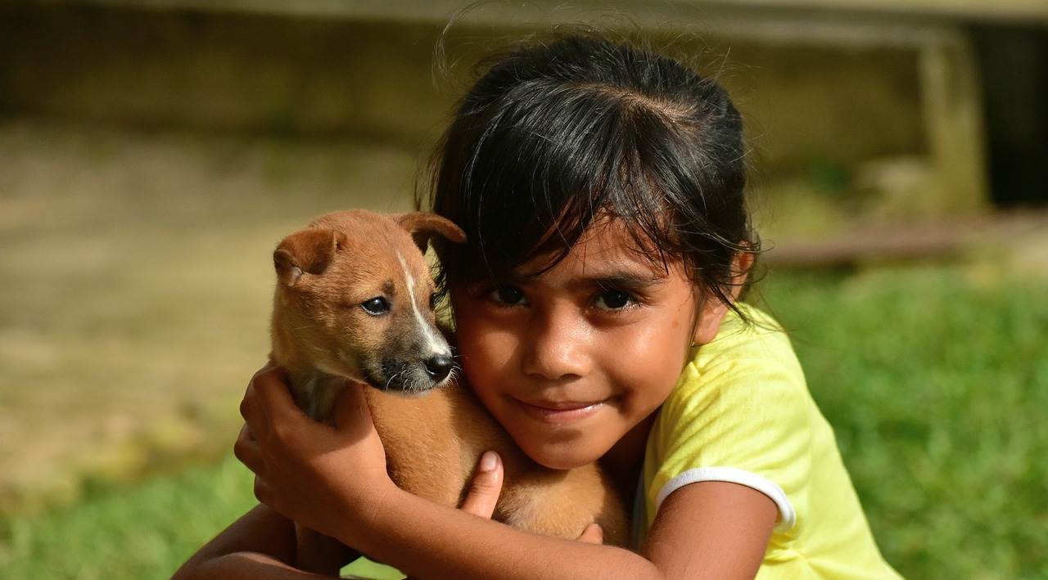
‘We will care for all you’ve made.’
Notes:
Slide 16:
We thank you for the animals that share our lives.
‘We will care for all you’ve made.’

Slide 17
‘We will care for all you’ve made.’
Notes:
Slide 17:
Even when we’d rather be playing,
‘We will care for all you’ve made.’

Slide 19
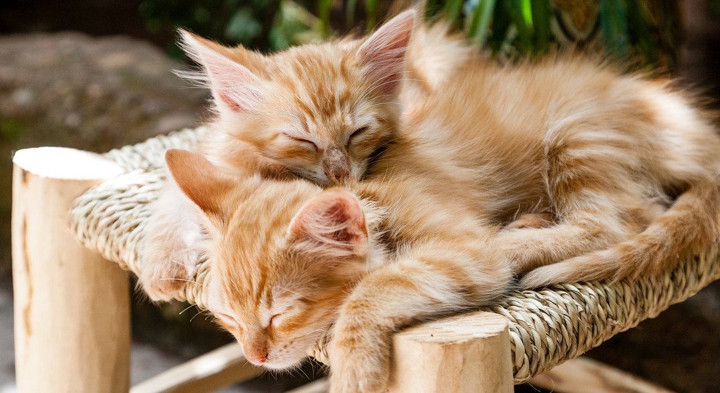
Leader: As we leave this place & time and go into the day ahead…
All: May today’s words help us to make wise choices.

Slide 20
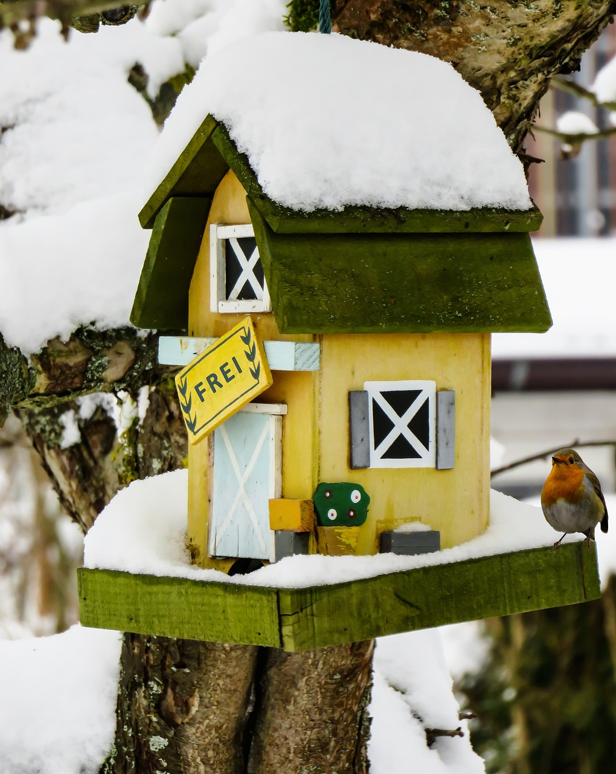
Notes:
Slide 11: Reflective areas
Make sticking plaster shapes & write healing words on them

