Slide 1
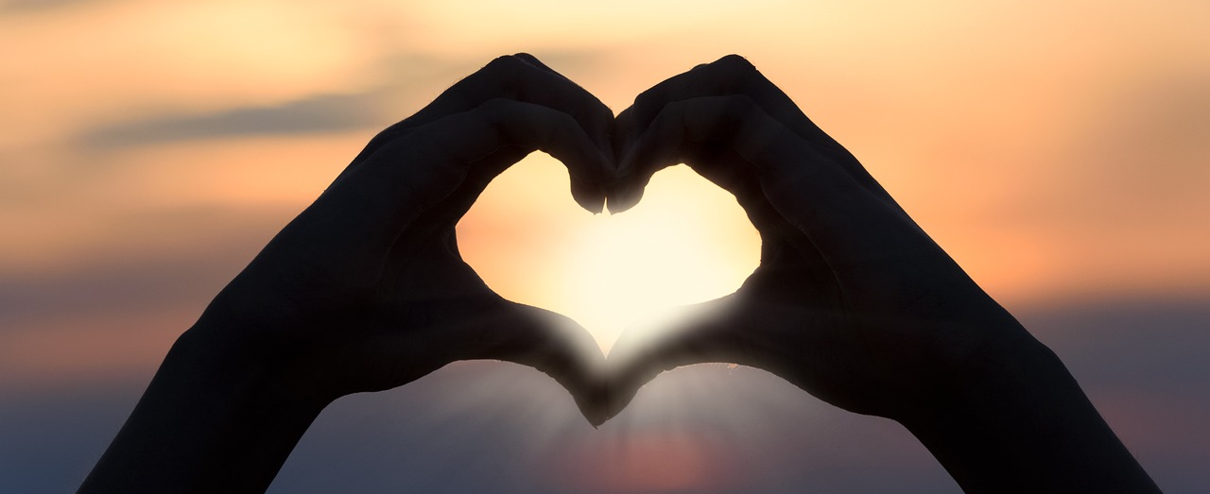
Leader: As we gather together
ALL: …we bring our hearts.
Notes:
Slide 1: Use these new gathering words for this term, or your usual greeting if you prefer. The greeting comes with BSL signing; you can view the demos using links under the slide.
Leader: As we gather together,
ALL: …we bring our hearts
Signs for greeting: click on links
Hearts: British Sign Language BSL Video Dictionary - heart

Slide 2

Leader: As we gather together
ALL: …we share our thoughts.
Notes:
Slide 2: Use these new gathering words for this term, or your usual greeting if you prefer. The greeting comes with BSL signing; you can view the demos using links under the slide.
Leader: As we gather together,
ALL: …we share our thoughts.
Signs for greeting: click on links
Thoughts: British Sign Language BSL Video Dictionary - thought

Slide 3





Leader: As community together
ALL: …we serve one another.
Notes:
Slide 3: Use these new gathering words for this term, or your usual greeting if you prefer. The greeting comes with BSL signing; you can view the demos using links under the slide.
Leader: As community together,
ALL: …we serve one another.

Slide 4
Who wins?
Notes:
Slide 4: Who wins? We’re going to start our time together today, as we often do, with a quiz. I wonder if you’ve ever noticed how many stories and films that we all love have some sort of ‘goodie versus baddie’ situation in them? So let’s look at some together – and you tell me who wins! [use images you have chosen, on slides 5-9. The answers are: Kung Fu Panda, Po; Luke Skywalker; the ants; Buzz Lightyear; the Three Little Pigs]

Slide 5
Po-vs-Tai-Lung-po-and-master-shifu-32877186-600-450.png (600×450)
Notes:
Slide 5: Kung Fu Panda or Tai Lung?

Slide 6
Darth Vader Vs Luke Skywalker (Poster) by DryBowJP on DeviantArt
Notes:
Slide 6: Darth Vader or Luke Skywalker?

Slide 7
Movies: A Bug's Life (1998)
Notes:
Slide 7: Ants or Grasshopper (A Bug’s Life)

Slide 8
1679049401_Is-Zurg-Really-Buzzs-Father-Lightyear-Hints-At-Toy-Story-1024x512.jpg (1024×512)
Notes:
Slide 8: Buzz Lightyear or Zurg?

Slide 9
Setting Of The Three Little Pigs
Notes:
Slide 9: The big bad wolf or the three little pigs?

Slide 10
The Big Bully
Notes:
Slide 10: The big bully
There’s always a point in all these stories where we think that there’s no way the ‘goodie’ is going to win but somehow they always do. And the smaller they are, and the bigger the baddie, the more we love it – because it’s what we hope will happen in real life, that good wins over evil.
We’re all going to have a part to play in another story about good v. bad now – another story that comes from the life of David. In the story, David, who is just a young boy, takes a very brave stand against a mean and unfair baddie. Every time we say certain words, there’s something to do – actions that I’m going to teach you now [go through the list, using your class to help teach the actions]
Now, we’re ready to tell our story – don’t forget your part, and watch out for a few extra actions to do as we go along! [use script on p.3-4. There are pictures if you want to use them.]

Slide 11
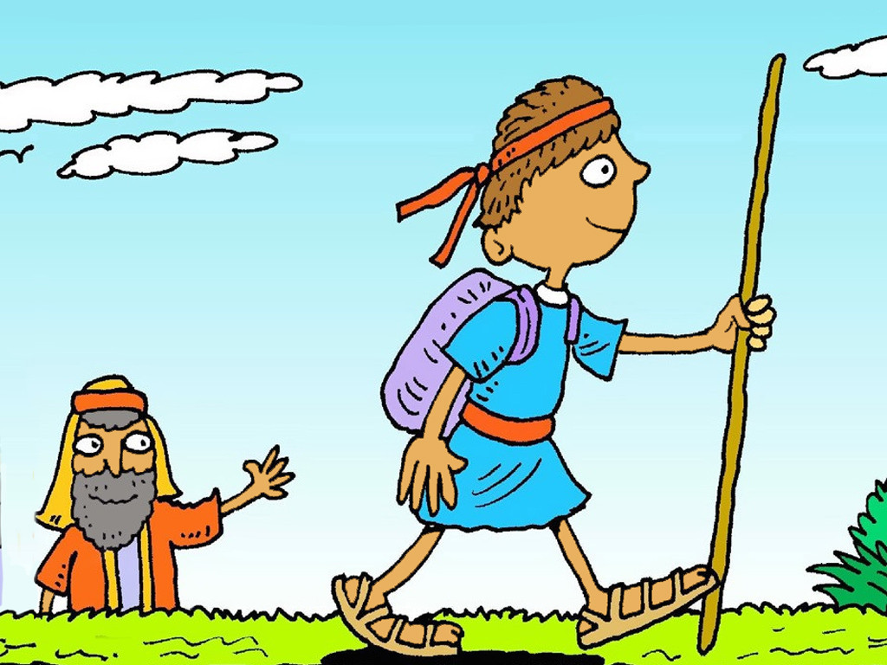
Notes:
Slide 11: David was a young boy, a boy who looked after sheep [baa!] but a boy who listened to God and knew that God was going to use him in very special ways. His brothers were all big and strong, and were soldiers in King Saul’s army. King Saul’s soldiers were powerful and strong, but the enemy army was enormous and wherever they went, everyone was afraid of them.

Slide 12
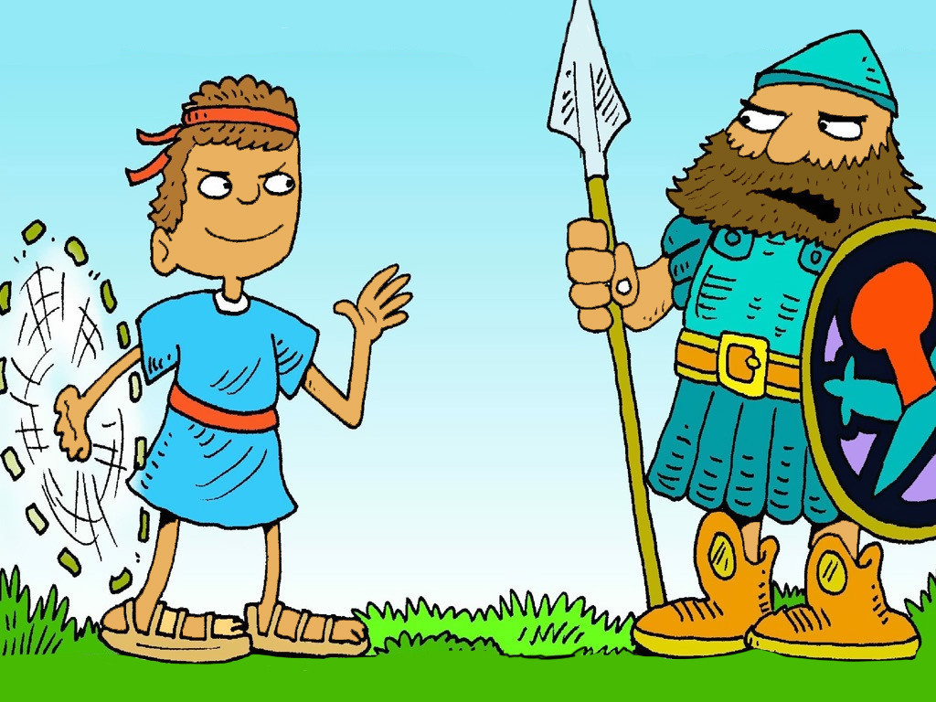
Notes:
Slide 12: The Philistines’ champion was a giant named Goliath who each day stood on top of the hillside and made fun of King Saul’s soldiers. ‘You think you’re stronger than me?! You puny little Israelites!’ Goliath jeered. ‘Send your mightiest soldier out to face me and you’ll see who’s the champion! And when we win, you will all be our slaves!!!!’

Slide 13
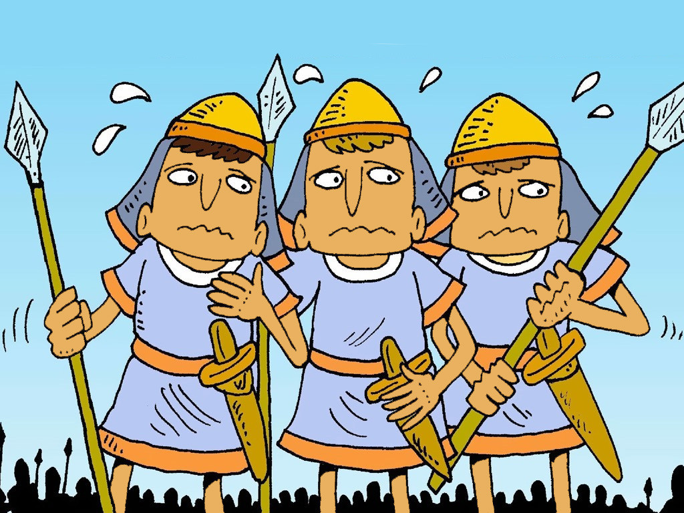
Notes:
Slide 13: Before long, the entire army of King Saul was cowering in their tents, worn down by the taunts of Goliath, and believing that he was indeed unbeatable.
One day, the young boy David was sent out to the battlefield with food for his brothers and he saw Goliath standing on the hilltop, jeering and laughing at the frightened army of King Saul. David couldn’t believe what he saw and said to King Saul – ‘Don’t you know who we are? We are the army of the mighty God, who fights on our side. Goliath is no match for our God! Can’t you see he’s just a big bully?! So I, David, will fight him. The God who has helped me protect my sheep [baa!] against the bear [ggrr!] and the lion [roar!] will fight with me against this bully.’

Slide 14
Notes:
Slide 14: He took his slingshot from his small shepherd’s bag and went to the bubbling brook to select five small stones. Then David walked right up to Goliath with only his sling and five small stones as his weapon.
When Goliath saw him, he laughed out loud at how small and ridiculous David looked: ‘What use are those stones going to be against my mighty sword?!’ he jeered. But David took no notice and put one of his five small stones into his sling. As Goliath laughed on, David swung the sling around his head and let the small stone fly. It flew across the battlefield towards Goliath and struck him right between the eyes [donk!].

Slide 15
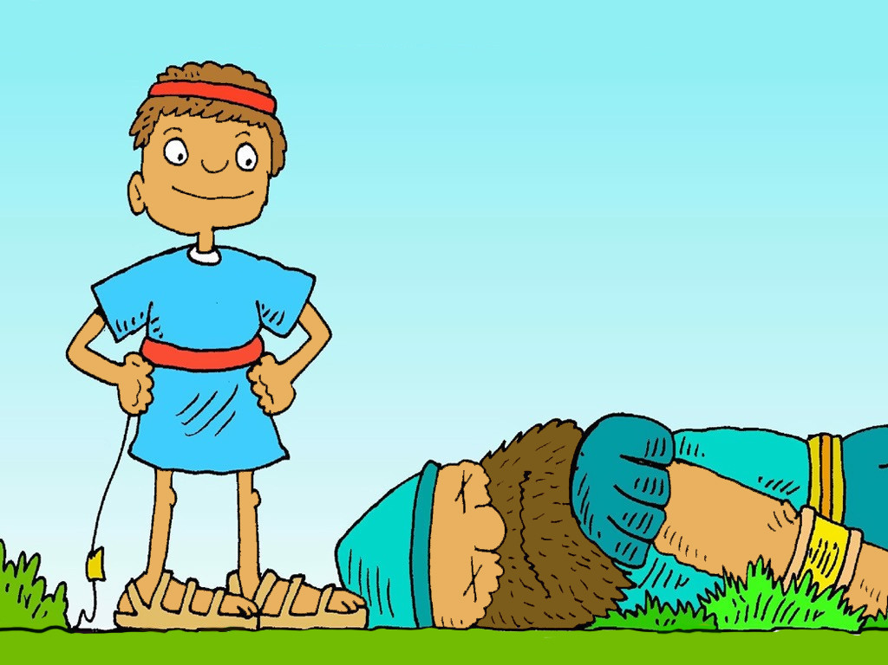
Notes:
Slide 15: Then Goliath fell to the ground, dead. King Saul’s army was victorious – and all because a young boy, whose name was David, knew that God helps those who stand against injustice.

Slide 16
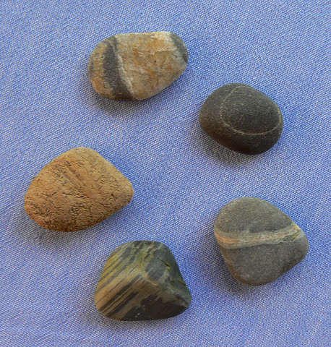
Notes:
Slide 16: We said earlier that we love stories where good wins over evil – but we love it even more when the goodie has stood up for people who are being treated unfairly, like David did. David knew that God loves fairness – the Bible calls it ‘justice’ – and he also knew that God would help him to fight against those who treated others unfairly. That same boy David one day became King – and continued to stand up for justice – fairness – for much of his reign. David’s stones didn’t seem to be much of a weapon when compared to Goliath’s mighty sword, but David knew he needed only one, well-placed stone to be victorious. It takes great courage to stand up against unfairness, and we might feel we don’t what to say, or who to say it to, but many people believe that God can help too – just as he helped the shepherd boy David.
We have many chances to act as David did every day – maybe not to defeat a big bad baddie like Goliath, but to make sure that we do something about unfairness if we see it happening. Things like…….not sharing……or someone else always being in charge of the game…..or someone being unkind……or someone not doing their bit when it’s time to tidy up. Our school rules exist to make sure that everyone is our school community is treated fairly, and treats others fairly – so let’s do all that we can to help each other to keep them.

Slide 17
‘Hear the sound of my prayer, when I cry out to you for help…..
….Praise the Lord! He heard my prayer for help.
The Lord is my strength and shield.
I trust him, and he helps me.’
Psalm 28: 2,6&7
….I wonder what you think this shows about David’s beliefs about God?....
….and what difference this might have made in this story about Goliath, or throughout David’s life?....
….I wonder how these words might help us to stand up for what’s right and fair, even when we feel small like David did against Goliath?....
Notes:
Slide 17: Responding (and words for worship):
Now let’s stop and think……Last week we heard about how David often expressed his deepest feelings in the psalms that he wrote. Listen to these words from Psalm 28:
‘Hear the sound of my prayer, when I cry out to you for help…..
….Praise the Lord! He heard my prayer for help.
The Lord is my strength and shield.
I trust him, and he helps me.’
Psalm 28: 2, 6&7
….I wonder what you think this shows about David’s beliefs about God?....
….and what difference this might have made in this story about Goliath, and throughout his life?....
….I wonder how these words might help us to stand up for what’s right and fair, even when we feel small like David did against Goliath?....

Slide 18
Dear God
Thank you that you love it when things are fair, and that you heard David the shepherd boy’s prayer for help to be brave and defeat Goliath. Thank you that you promise to help us too when we ask. Please help us to know what to do if we come across unfairness of any sort but above all, to do all we can to treat others as we would want to be treated – with fairness.
Notes:
Slide 18: Prayer
Dear God
Thank you that you love it when things are fair, and that you heard David the shepherd boy’s prayer for help to be brave and defeat Goliath. Thank you that you promise to help us too when we ask. Please help us to know what to do if we come across unfairness of any sort but above all, to do all we can to treat others as we would want to be treated – with fairness.

Slide 19
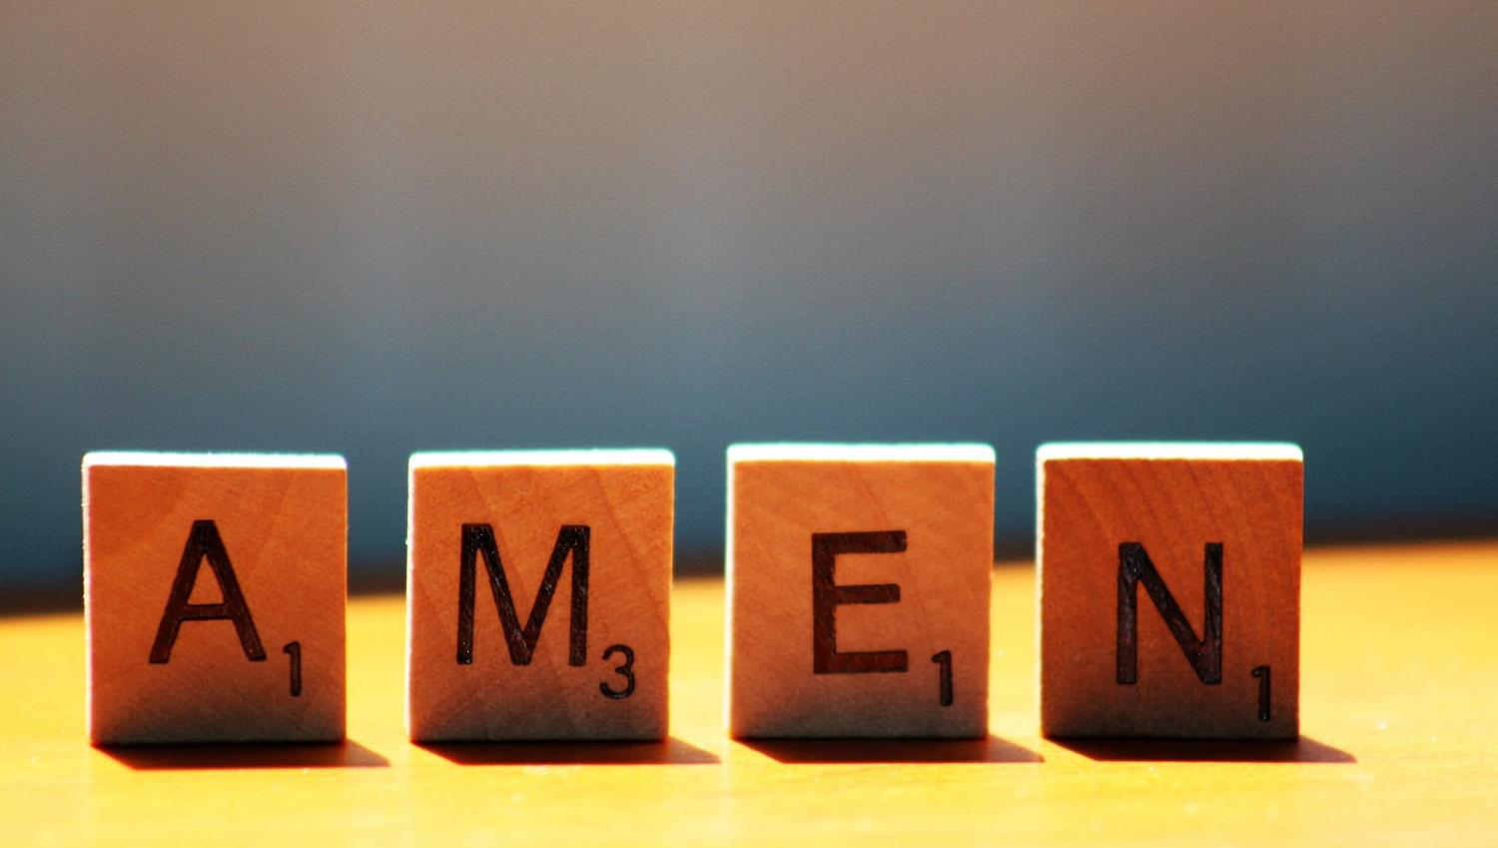

Slide 20




Leader: As we leave this place & time and go into the day ahead…
All: …may we serve one another in our thoughts and words and actions.
Notes:
Sending: Slide 20
Leader: As we leave this place and time and go into the day ahead,
All: ….may we serve one another in our thoughts and words and actions.
Signs for response: click on links
Thoughts: British Sign Language BSL Video Dictionary - thought (signbsl.com)
Words (use 3rd definition): British Sign Language BSL Video Dictionary - word (signbsl.com)
Actions: British Sign Language BSL Video Dictionary - action (signbsl.com)

Slide 21

Notes:
Ideas for classroom reflection: Pebble for your thoughts
David used a pebble to defeat Goliath.
Take a pebble in your hand and think about a situation that seems unfair to you. This might be something personal to you, or something in our world.
Place the pebble back in the bowl and as you do, you might want to ask God to bring justice, like he did for David and King Saul’s army.

