Slide 1
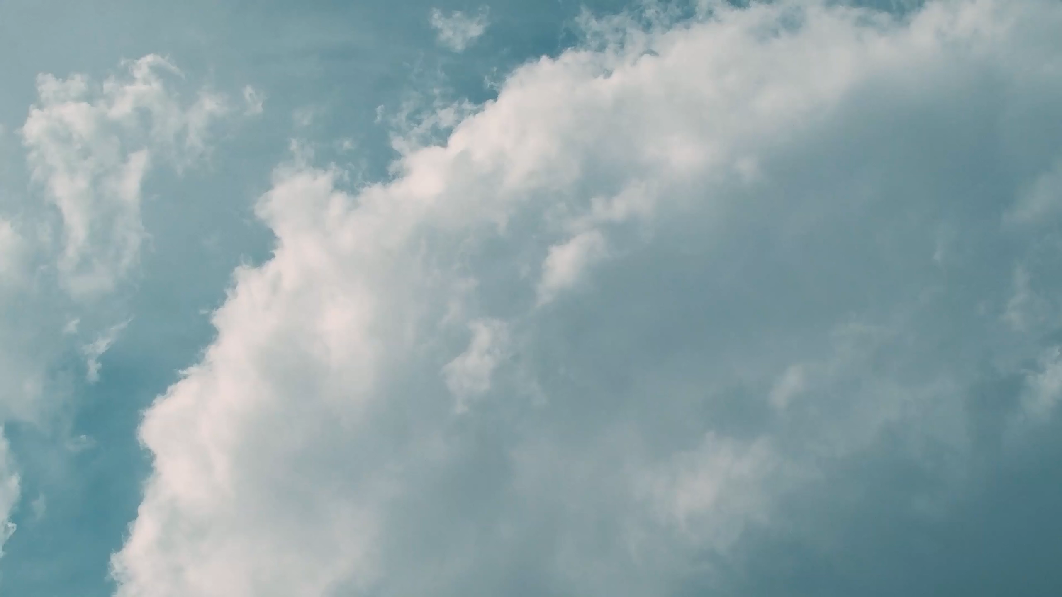
All images copyright-free from pixabay, unless otherwise identified
Notes:
Slide 1: Welcome stilling exercise – cloud formations
Use the stilling slide if desired: the suggested words should be spoken slowly, leaving pauses inbetween to create a sense of stillness.
I wonder if you’ve ever just lain on the grass to watch the clouds – and maybe tried to spot different shapes?!....
As you sit quietly here, watch these clouds…..and bring your mind into a peaceful place [PAUSE]
Now practise slower breathing…..in…..and out…..in……and out…..keep this going as you continue to watch….[PAUSE]
You maybe notice that you are feeling calmer and more relaxed….[PAUSE]
As you breathe, think about yourself and what you bring into this time today…..and think about how peace has come upon us…. [PAUSE]
We come into this special / sacred space and time to be still….to think deeply…..to be together as a school community…..
In our time together today, we will …..talk together…..TWICE!....tell each other a story….. and think think together about what it might mean for our school community.
But first, let’s welcome one another as we begin….

Slide 2
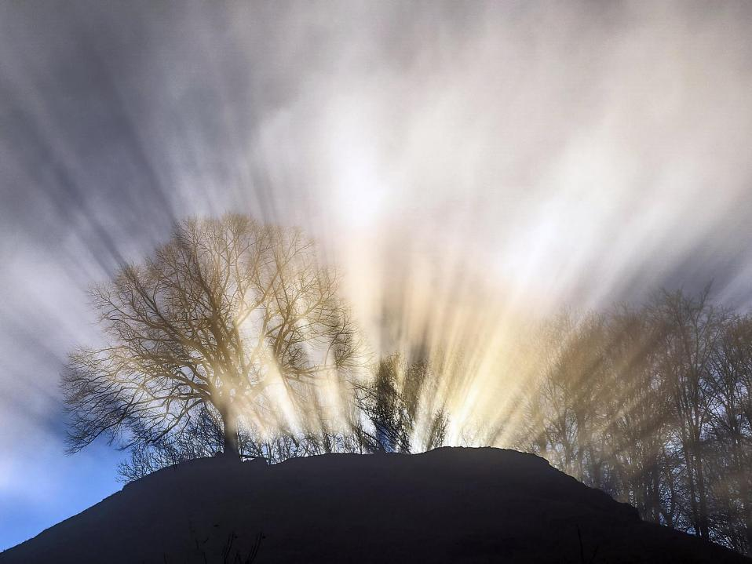
Leader: This is a day that God has made.
ALL: We will rejoice and be glad in it!
Notes:
Slides 2/3: Teach this new greeting to your school community – there are two slightly different versions from the point of view of the leader; choose which best fits your school’s context. One uses words adapted from Psalm 118:24
Leader: This is a day that God has made!
ALL: We will rejoice* and be glad* in it!
OR:
Leader: Today is a brand new day…..
ALL: May we be a blessing to each other!
*There are different BSL signs for rejoicing and joy/gladness. View them here: https://www.signbsl.com/sign/rejoice
Blessing: https://www.signbsl.com/sign/blessing (1st video)

Slide 3
Leader: Today is a brand new day!
ALL: May we be a blessing to each other!
Notes:
Slides 2/3: Teach this new greeting to your school community – there are two slightly different versions from the point of view of the leader; choose which best fits your school’s context. One uses words adapted from Psalm 118:24
Leader: This is a day that God has made!
ALL: We will rejoice* and be glad* in it!
OR:
Leader: Today is a brand new day…..
ALL: May we be a blessing to each other!
*There are different BSL signs for rejoicing and joy/gladness. View them here: https://www.signbsl.com/sign/rejoice
Blessing: https://www.signbsl.com/sign/blessing (1st video)

Slide 4

Count your blessings
Notes:
Slide 4: This term, we are thinking about our blessings – all the good things in our lives.

Slide 5

Peace is not just made at conference tables, but in classrooms, neighbourhoods, and everywhere people meet with open minds and open hearts. Together, day by day, we can build a more just world, with compassion, equality and dignity for all.
International Day of Peace
Notes:
Slide 5: Today [or September 21st] is a special day across the world, as people think about the blessing of Peace – and how to make more of it! Lots of people across the world are focused on how to do this in our troubled world through the work of an organisation called the United Nations – and International Peace Day is a way of helping us all to play our part. This year’s theme is ‘Invest in Peace – for everyone, everywhere, every day’ – and so today, we will be thinking and talking about peace. The Secretary-General of the United Nations, António Guterres, says this: Peace is not just made at conference tables, but in classrooms, neighbourhoods, and everywhere people meet with open minds and open hearts. Together, day by day, we can build a more just world, with compassion, equality and dignity for all.

Slide 6
What is peace?

Slide 7
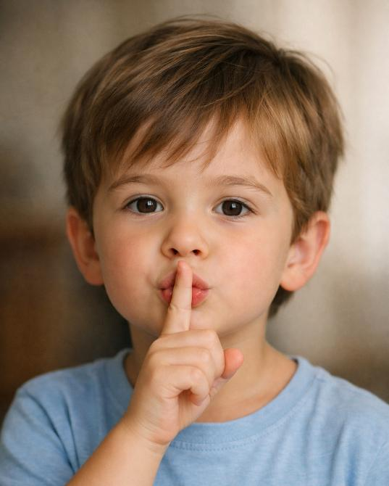
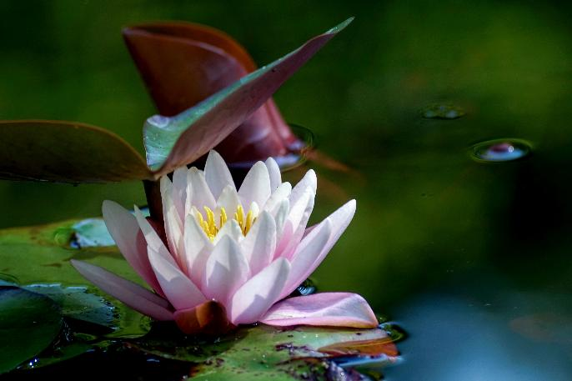
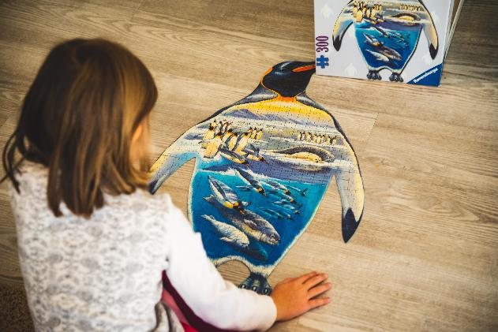
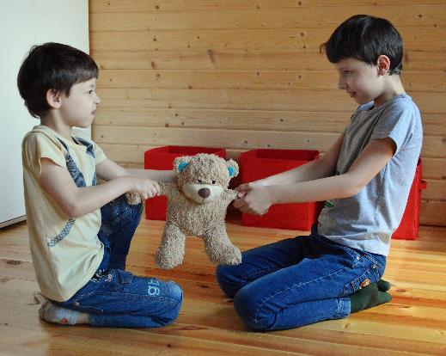
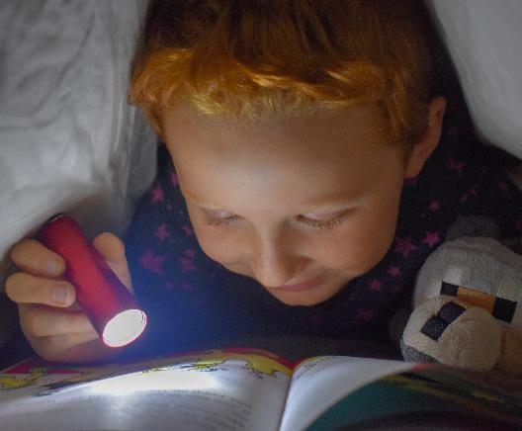
AI image generated by MS-Copilot
Notes:
Slide 7: We sometimes talk about ‘peace and quiet’, where’s there’s not a lot of noise….We live in a very noisy world! Or maybe a peaceful place….where you can get that peace and quiet, or a place that helps you to feel peaceful inside! Or perhaps you thought of some peaceful activities, such as doing a puzzle, or reading a book….or maybe you talked about bringing peace when someone’s had an argument…. There are many different meanings for the idea of peace – and there are places in our world today that are far from peaceful, places that we might want to pray for or think about later on.

Slide 8

Image © Quakers UK/ Society of Friends
Notes:
Slide 8: Our story today is a little bit different from usual, because it’s a story in a picture. I wonder if you can tell the story of what’s happening here?.... [leave some space for children to think, then allow them to share their versions – or they could tell a partner. The arrows move to help focus on each part of the story. Afterwards, talk about how co-operating / working together brought peace in this situation for the mules.] The mules had to work hard to find a solution – and it could only be achieved together. This is a picture of peace for us today.

Slide 9

MUSLIM
As-Salamu-Alaikum
Peace be upon you!
ISLAM
SALAAM
Notes:
Slide 9: Peace is important in different religions as well. For people who are Muslims, the very name that they give to their religion – Islam – comes from the Arabic word for peace Salaam, and is also one of God – Allah’s – beautiful names: As-Salam, bringer of peace. You’ll also hear it when they greet one another with this peaceful greeting – As-Salamu-Alaikum, Peace be upon you!, which in Arabic* looks like this…. [it’s read from R-L]
[*Arabic Calligraphy By Hadysylmy - This file was derived from: Assalamu-aleykum.svg, CC BY-SA 4.0, https://commons.wikimedia.org/w/index.php?curid=161196036]

Slide 10
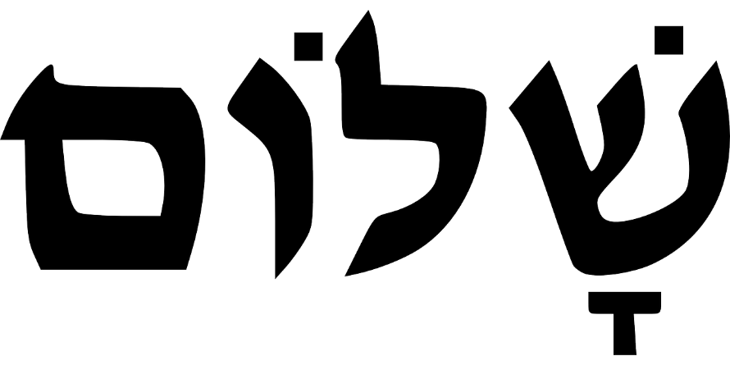
‘Do your best to live in peace with everyone.’
‘Shalom’
Notes:
Slide 10: This is the Hebrew word for peace – ‘Shalom’ (it also reads from right to left) It’s one of the most beautiful words in the Bible and refers to a sense of wholeness – a completeness – of wellbeing. It’s not just the absence of conflict, but the presence of something better – this sense of complete wellbeing. It is this kind of peace that many people throughout history have worked hard to bring; a peace that Christians believe Jesus brings, making right all wrongs, putting things right. Jesus talked about people who followed him needing to be ‘peace-makers’ and it’s an idea that the very first Christians took very seriously – to act peacefully wherever and whenever they could. St Paul, who wrote a lot of letters in the New Testament part of the Bible, wrote these words to encourage the Church: ‘Do your best to live in peace with everyone.’

Slide 11
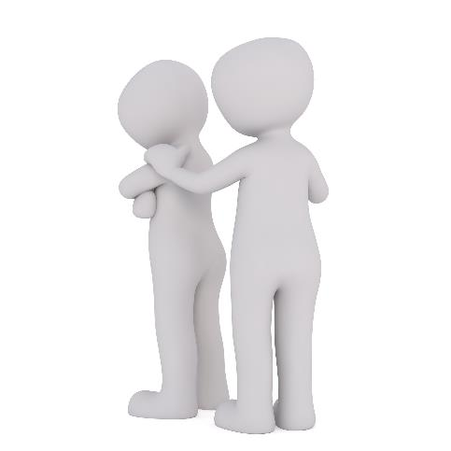
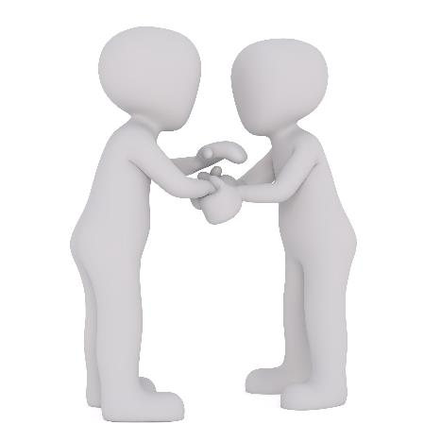
‘Blessed are the peacemakers’
Notes:
Slide 11: Peace-making is an active word, a doing word – Jesus wanted his followers to be peacemakers, to copy him, working for peace, putting things right, bringing wholeness, ‘shalom’ wherever they went. This sounds like an enormous job, and although it’s often hard work, it’s not as difficult as it might seem. Here are 2 examples…. [Talk about the two pictures on the slide – ask children to try to imagine what might have happened just before each one. They could talk together first.] Peace starts in the small things that we do for others…..

Slide 12
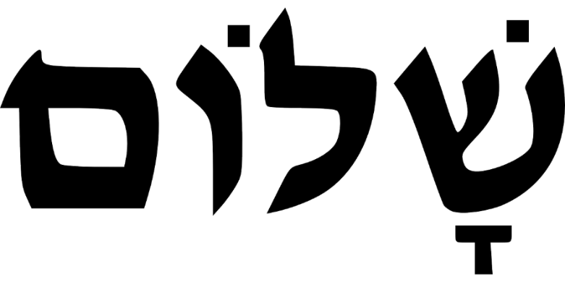
Notes:
Slide 12: Responding (and words for worship)
Let’s be still and quiet together now….
…We’ve been thinking today about the blessing of peace – whatever that word means for each of us….
….and on this day especially, on the importance of us trying to make peace wherever we go….
[Arabic Calligraphy By Hadysylmy - This file was derived from: Assalamu-aleykum.svg, CC BY-SA 4.0, https://commons.wikimedia.org/w/index.php?curid=161196036]

Slide 13
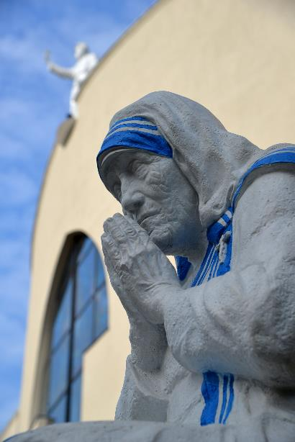
Peace begins with a smile.
What can you do to promote world peace? Go home & love your family.
Mother Teresa (1910-1997)
Notes:
Slide 13: ….Mother Teresa was a follower of Jesus who lived her life quite simply, bringing peace wherever she went: she had these two simple things to say about peace….[you might want to explore these words again later in the week]
Peace begins with a smile*.
What can you do to promote world peace? Go home & love your family*.
I wonder how these ideas might help us today, or tomorrow, or this week, to be a peace-maker?...
I’m going to turn my thoughts into a prayer now, as I ask God to help us to put some of these ideas into practice, or you might also want to use the time to think about parts of the world where we would want to see peace today.
The words come from a very famous prayer about peace. Make the prayer your own if you’d like to…or if you’d prefer not to pray, then just sit quietly with your own thoughts…

Slide 14
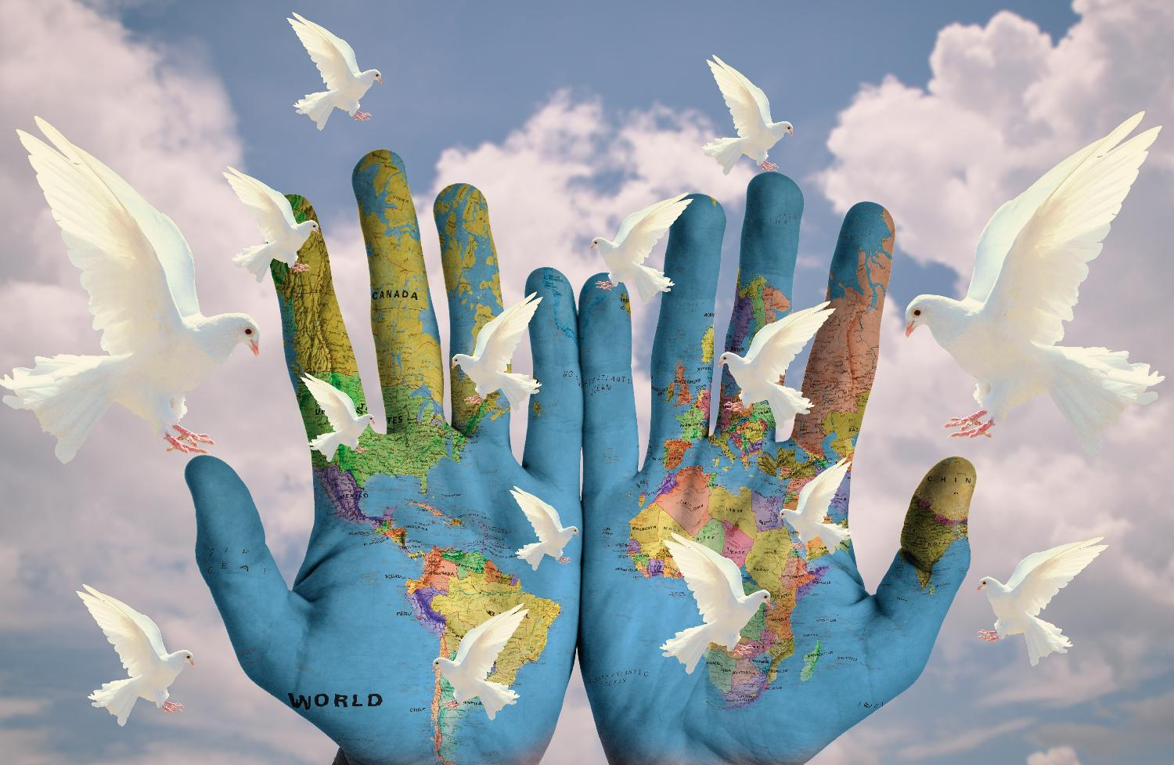
God of peace,
May we bring your peace to other people.
Where people have given up, may we bring hope.
Where peoples’ lives feel dark, may we bring light.
And where there's sadness, may we bring joy.
Notes:
Slide 14: God of peace,
May we bring your peace to other people.
Where people have given up, may we bring hope.
Where peoples’ lives feel dark, may we bring light.
And where there's sadness, may we bring joy. (based on St. Francis’ Prayer, ‘Make me a channel of your peace’)

Slide 15
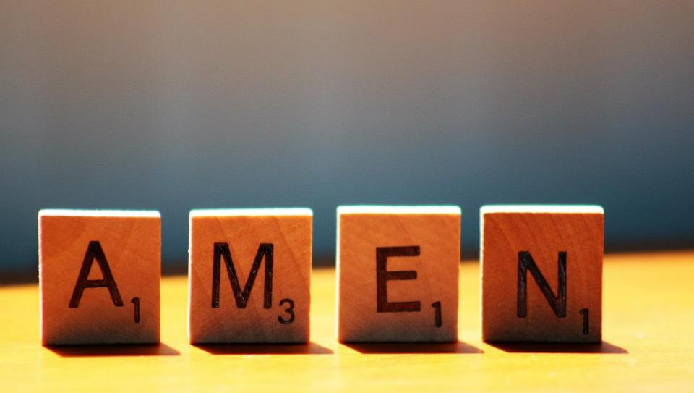

Slide 16
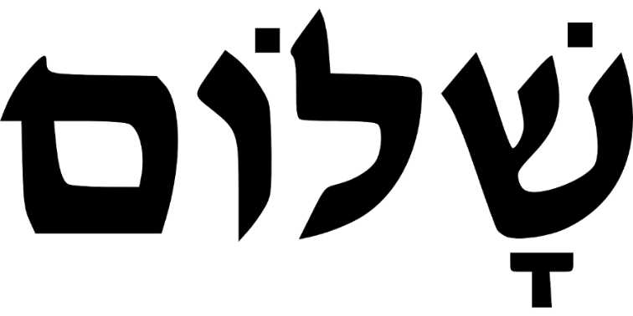
Leader: As we leave this place & time and go into the day ahead…
All: May we make peace, ‘Shalom’, wherever we go.
Notes:
Slide 16
Leader: As we leave this place & time and go into the day ahead…
All: May we make peace, ‘Shalom’, wherever we go.

Slide 17
Notes:
Slide 17: Reflection areas
Make a Peace Garden in your reflective area. ‘Plant’ flowers made on lolly sticks, with children’s thoughts & ideas relating to ‘making peace’ written on them. You can see an example here.
Think: How might we ‘make peace’?
Do: Write or draw your thought on a lolly stick and make it into a flower for our Peace Garden.
Talk: How can we help one another and work together to make peace?

