Slide 1




We are here together in our school family. May God be with us…
...and watch over us.
Notes:
Slide 1: Use these gathering words for this term, or your usual greeting if you prefer.

Slide 2
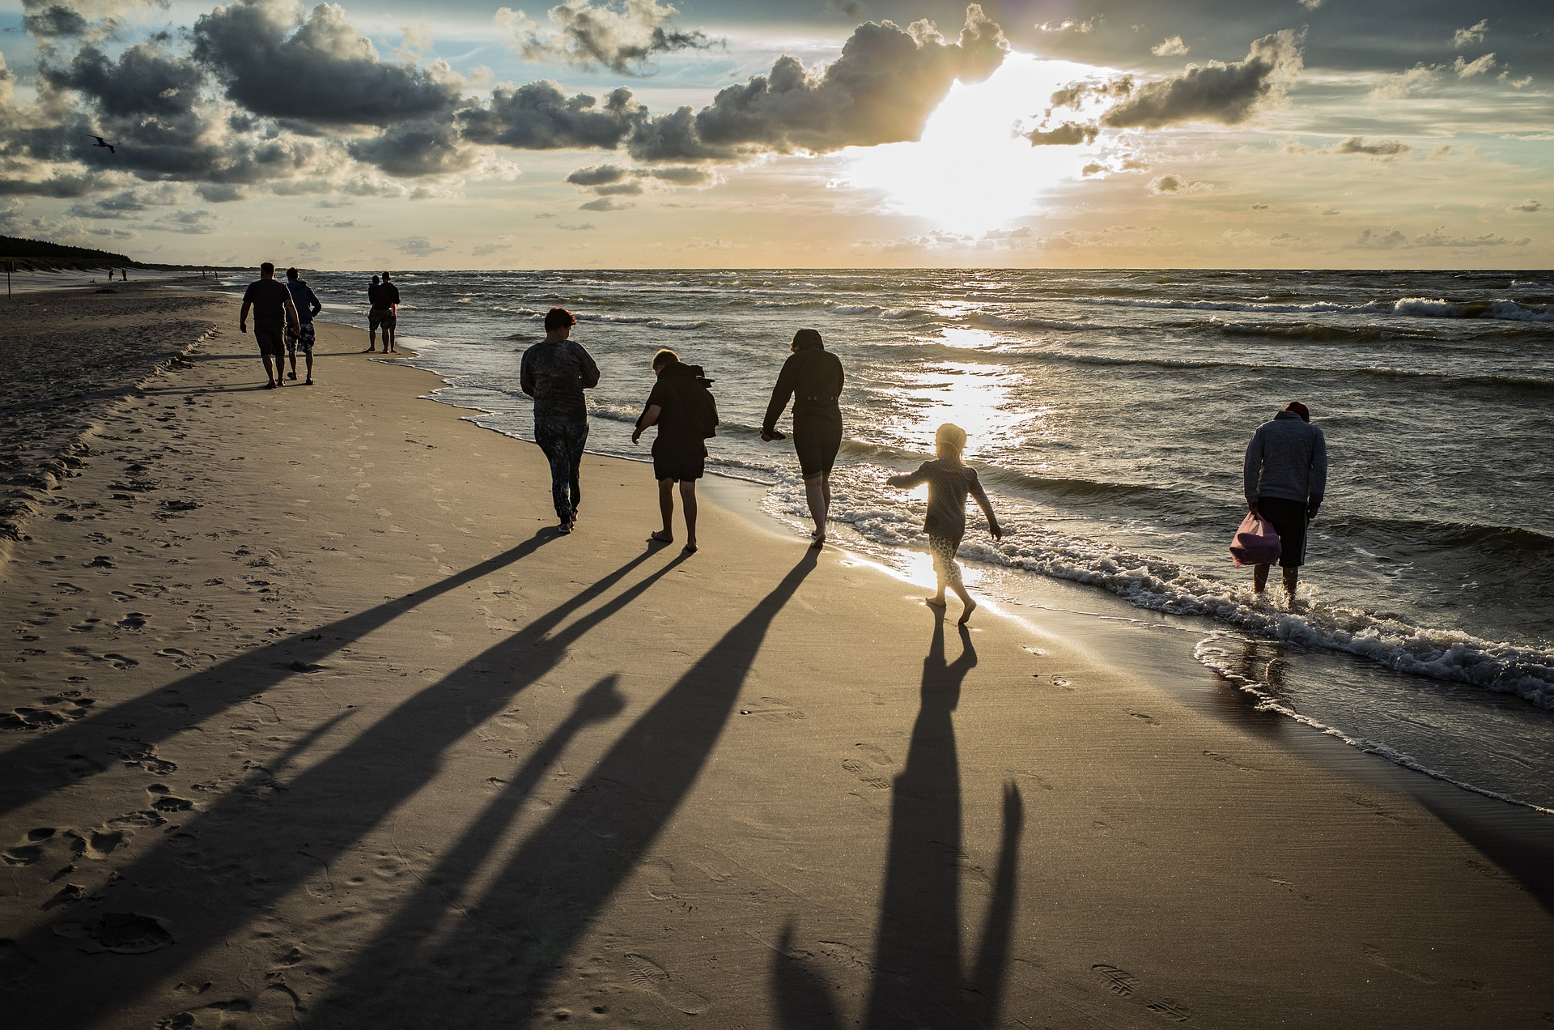
Families
Notes:
Slide 2: Put together a short quiz about family relationships, based on characters in books e.g. show Charlie & Grandad Bucket (grandparent & grandson); Harry Potter & Dudley (cousins); Biff, Chip, Kipper, Mum & Dad from Oxford Reading Tree; Bart & Lisa Simpson (brother-sister) etc. to get children talking about different family connections. Finish with your school badge or logo, as an expression of belonging to your school family. Talk about how spending time together as ‘family’ is important.

Slide 3
Notes:
Grandpa Joe & Charlie Bucket from Charlie and the Chocolate Factory

Slide 4
Notes:
Harry Potter & Dudley Dursley (cousins) and his aunt and uncle (Vernon & Petunia)

Slide 5
Notes:
Bart & Lisa Simpson – brother & sister

Slide 6
Notes:
Mum & Dad, Biff, Chip (twins) and Kipper – from Oxford Reading Tree reading scheme

Slide 7
Notes:
Slide 7: Insert your own school logo here

Slide 8
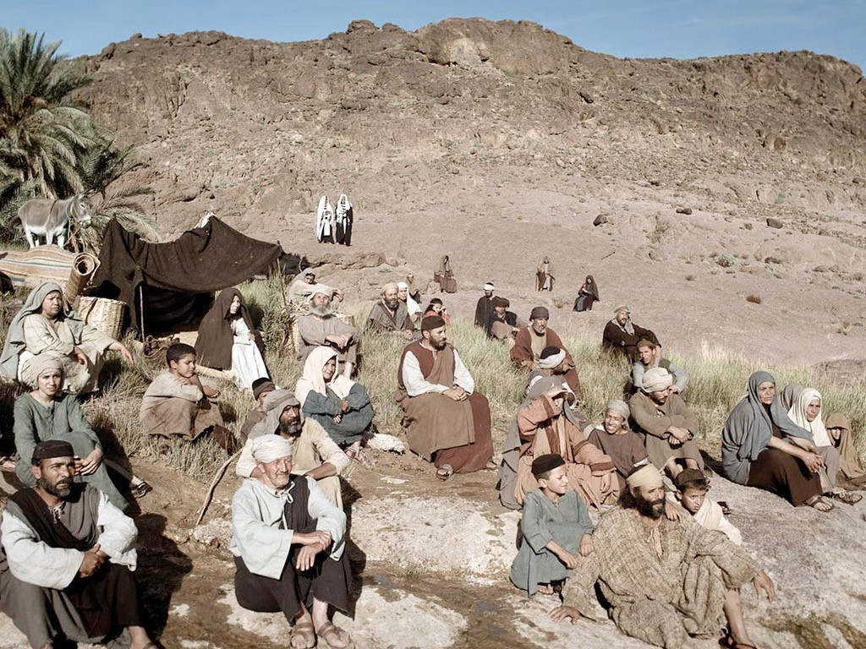
Notes:
Slide 8: Jesus often chose to find a place away from the crowds of people to spend time with his Father, the same Father that he taught his disciples to pray to using this prayer model. He was trying to explain that they should pray to God in the same way he did.

Slide 9
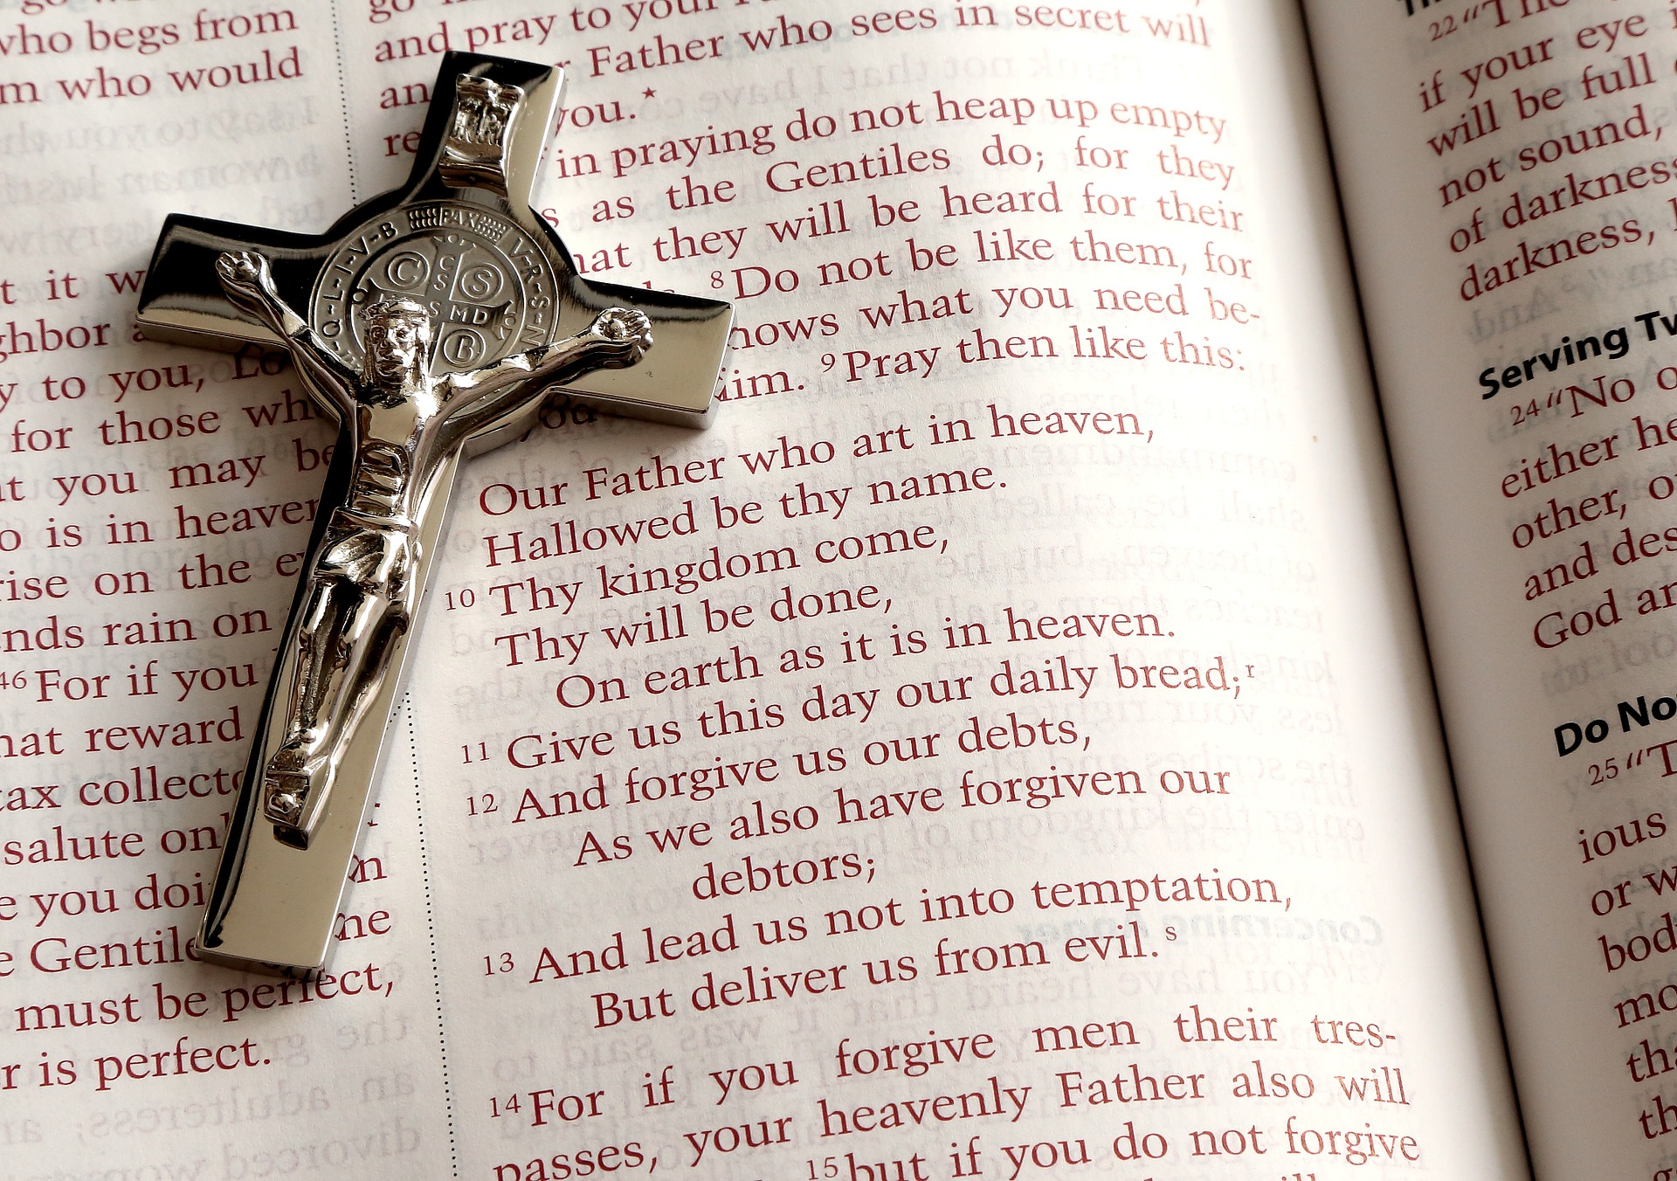
‘Our Father’
‘Our Father’
The Lord’s Prayer
‘Our Father’
Notes:
Slide 9: We begin this week by looking at the opening words of this prayer…. ‘Our Father’
When Christians pray these words, they pray ‘our’ Father: they are reminding each other that they are all God’s children – brothers and sisters – part of the same family.
They are also reminding themselves that God is like the very best parent: ‘Our FATHER’

Slide 10




‘Father’
‘Pére’
‘Padre’
‘Baba’
Notes:
Slide 10: We heard last week that Father translates as…
‘Pere’, in French
‘Padre’, in Spanish
‘Baba’, in Swahili
‘Father’ sounds a very formal word – I’m not sure that many of you might use that word to address your dad (unless you’re a Victorian maybe?!)! However, the word that Jesus actually used is not quite this word ‘Father’: he used the word ‘Abba’ – which means ‘daddy’.

Slide 11
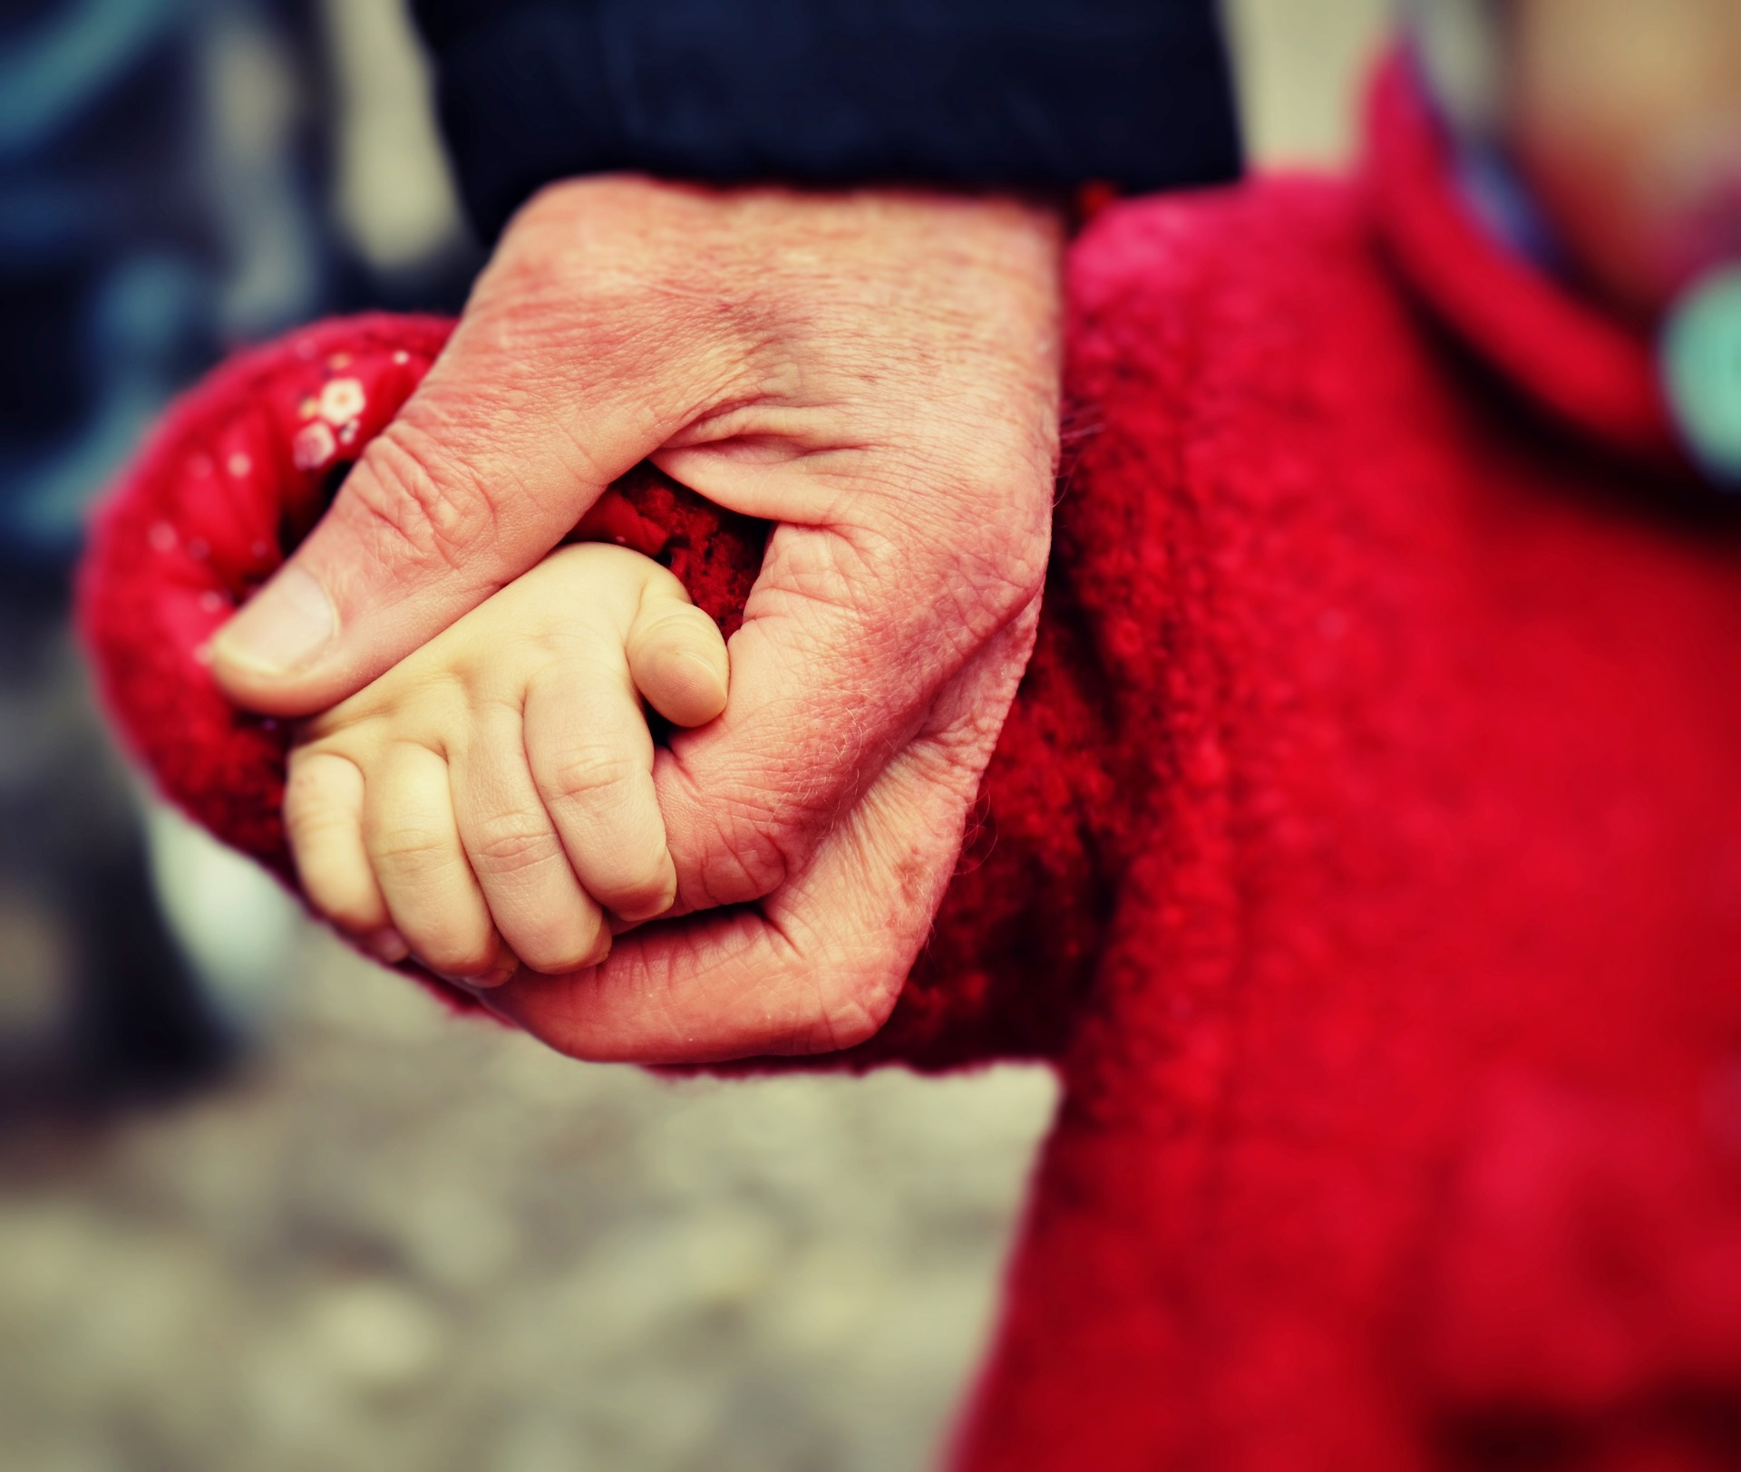
‘Daddy’
Notes:
Slide 11: This word, ‘Abba’, ‘Daddy’, creates a very different image to ‘Father’, because ‘Abba’ is a word that’s used to express a very close relationship, of great love, like a small child choosing to snuggle up close to their parent. I wonder what you think about this idea? [you might want to take some time to talk together, bearing in mind that not all children will have positive family experiences]
For Christians, it’s a reminder that God is not far away, but really close, like a loving parent – and that he knows and cares about each of his children as individuals. You might remember that Jesus once told a story about a shepherd who knew each of his sheep by name and went searching for the lost one. It’s this kind of love that Christians are talking about when they use the word ‘Father’, ‘Daddy’.

Slide 12
…. I wonder how praying ‘Our Father’ helps Christians to feel a part of God’s family?....or closer to God?....
….I wonder what difference it makes for Christians to be brothers & sisters?....
….I wonder how our school community feels like a family too?....

Slide 13
Families
Notes:
Slide 13: Responding (words for worship)
Let’s be still and quiet together now….
We’ve heard today that the prayer that Jesus taught his disciples to pray, the Lord’s Prayer, starts with the words ‘Our Father’ – ‘Abba’, ‘Daddy’…..
….it’s an image of a close relationship….
….it’s how Christians view their relationship with God – as a child with their parent….
…think about the people who are like this for you….
…maybe the people in your family…..
….bring their faces and names into your mind now…..
….we are grateful for these people in our lives….
….
…this prayer reminds Christians that they are family together, like brothers and sisters….
….I wonder what difference it might make to the way they treat each other?....
…we have a chance to do this in our school, to live together as family….
….to care for each other and look out for each other….
….think now about how you might do this today: in a moment we will have a chance to pray about this as well…
…..I wonder what difference it would make in our world if we all lived like this?…..
……..
Now I’m going to pray, using the words of a song that you might know (although I’m not going to sing it!) make it your own in some way if you’d like to, or you can pray your own prayer, or you can just sit quietly with your own thoughts….it’s your choice.

Slide 14
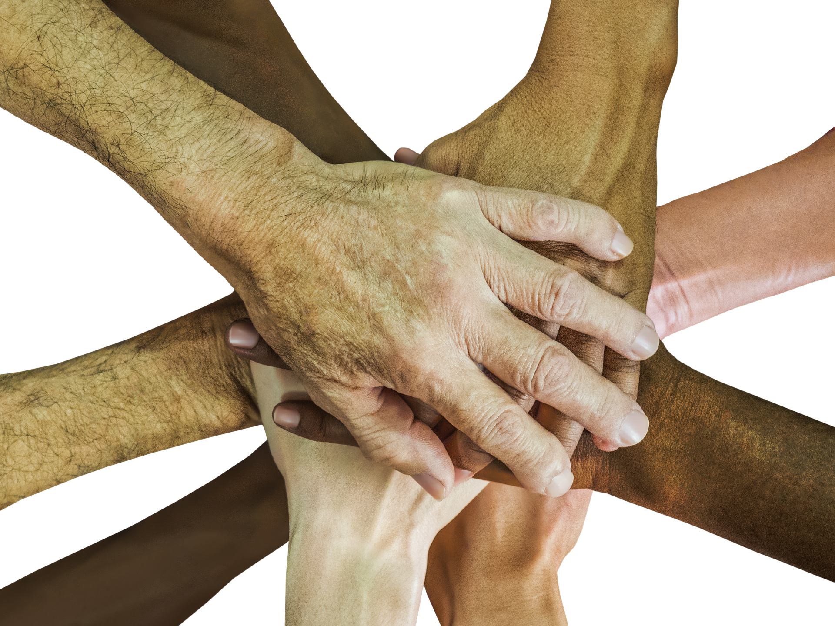
Dear God
We will grow and share with each other,
We will show that we care for one another,
‘Cos we know we are sisters and brothers in the eyes of God above:
We are growing together in love.

Slide 15


Slide 16


Leader: As we leave this place & time and go into the day ahead…
All: Let’s live together as family in our school community.

