Slide 1
We are here together….
May our attitudes make our school community a happy place today.
Notes:
Slide 1: Teach the new gathering words for this term
Leader: We are here together
ALL: May our attitudes make our school community a happy place today.

Slide 2
Emoji Charades
Notes:
Slide 2: We are very used to these little pictures (we call them emoji) which sometimes help us to communicate how we might be feeling, our emotions. Today we’re going to be finding out a bit more about Jesus’ Lesson on the Mountain, and what he said about one emotion in particular.
But before we do, let’s see if you can guess the emoji…
I’ve got some emojis on some cards here, and I’m going to ask a few children / adults to show the expression on their faces, for us to guess – a bit like the game Charades – with no sounds.
Slides 3-8: Emoji Charades Use these ideas (print on cards), or create your own….

Slide 3
What’s that emoji?
Notes:
Happy

Slide 4
What’s that emoji?
Notes:
Angry

Slide 5
What’s that emoji?
Notes:
Sad

Slide 6
What’s that emoji?
Notes:
Loving / in love

Slide 7
What’s that emoji?
Notes:
Sleepy

Slide 8
What’s that emoji?
Notes:
Worried

Slide 9
Beatitudes
Beati
‘How-to-be-attitudes’
Notes:
Slide 9: Last week, we heard how Jesus taught the people on the mountain, the lesson known as the ‘Beatitudes’ – and that these words are going to help us to think this term about our ‘How-to-be-attitudes’ – ways of behaving together as part of our school community, ways that will make us happy.
As you might remember, in the ‘Beatitudes’ Jesus explained to the people how to be truly happy and some of the attitudes that are important in God’s Kingdom.
Let’s carry on a little further into this lesson today….and find out what Jesus’ words have to do with being worried….

Slide 10
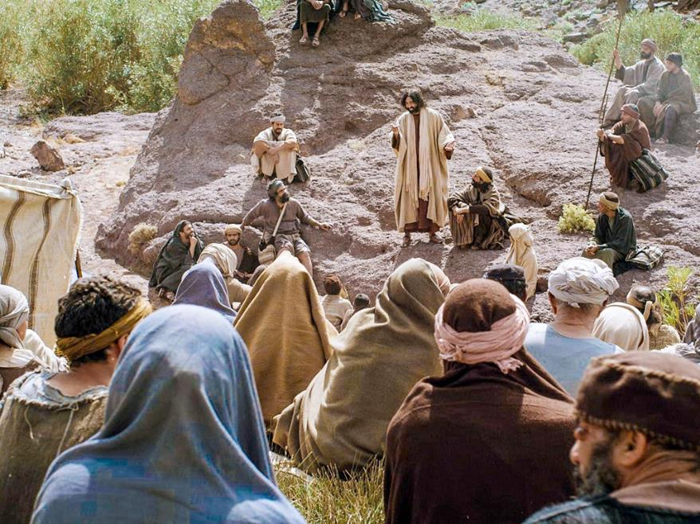
….I wonder what the people might have been worried about?.....
….I wonder what we might worry about?.....
Notes:
Slide 10: After he’d spoken all these words about being happy, Jesus saw that the people were still worried about many things. [Pause here for a moment to ask a couple of wondering questions, allowing children some time to think / chat together]
….I wonder what the people might have been worried about?.....
….I wonder what we might worry about?.....

Slide 11
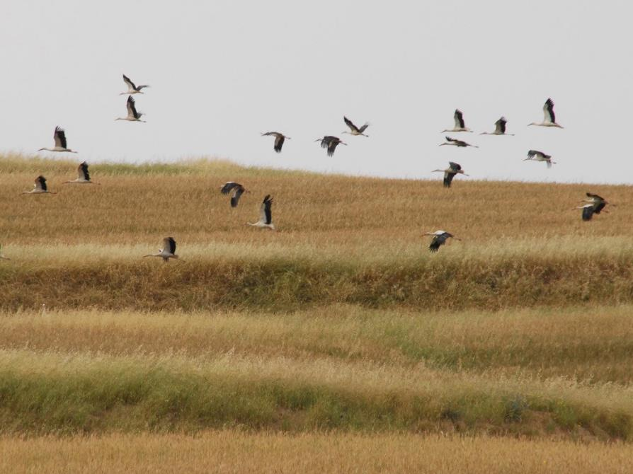
Notes:
Slide 11: So now let’s continue with our story.
Jesus spotted some birds, gathering food from the hillsides near where the people were sitting. ‘Don’t worry’ he said…..‘Look at the birds of the air …

Slide 12
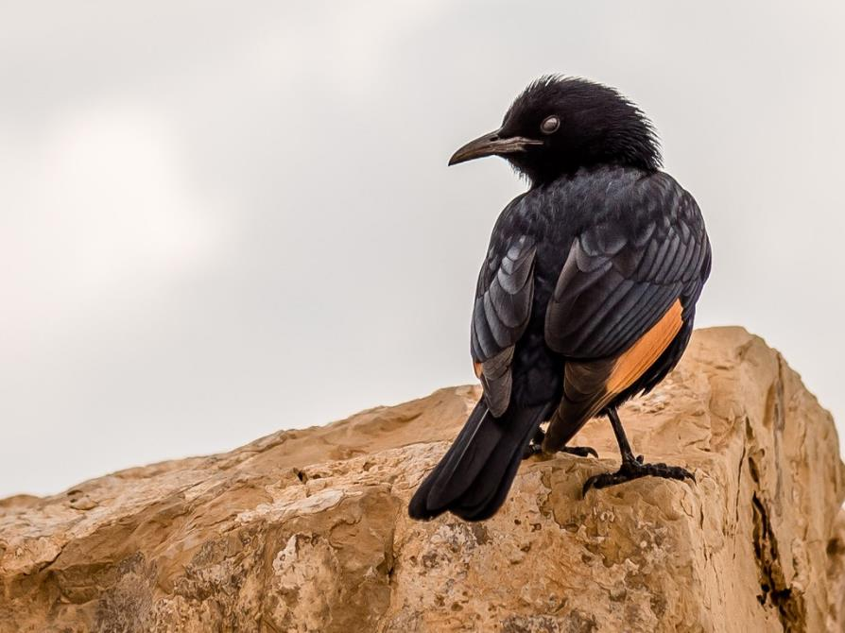
Notes:
Slide 12: ‘… they do not sow or reap corn …… or store their food up in barns.’

Slide 13
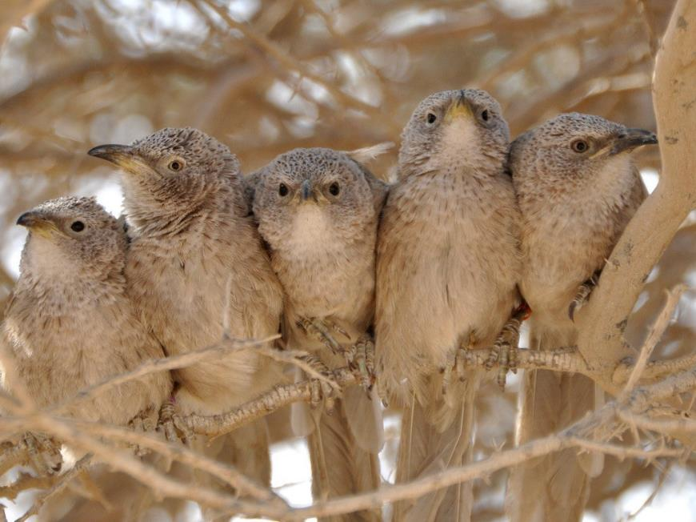
Notes:
Slide 13: ‘… and yet your Father in Heaven, who made the birds, takes care of them. Are you not worth so much more than they are?’

Slide 14
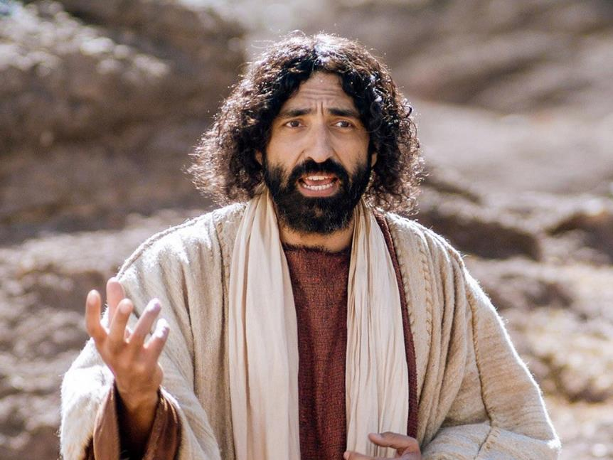
Notes:
Slide 14: Then he spotted some wild flowers, growing amongst the grass on the mountainside.

Slide 15
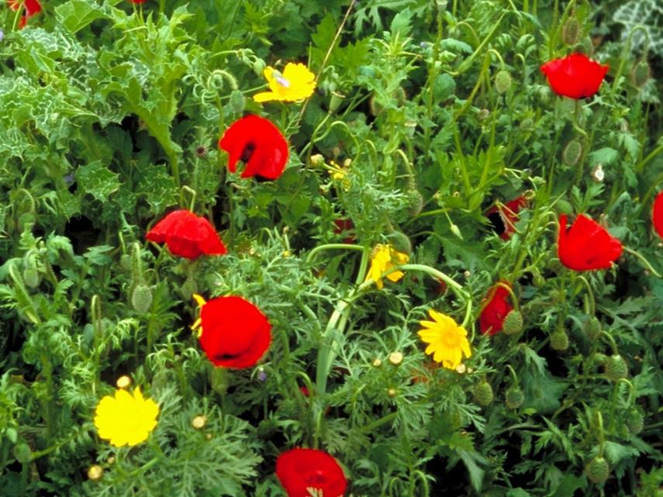
Notes:
Slide 15: ‘Look at the flowers of the field and how they grow. They do not need to work hard or spin wool to make fine clothes.’

Slide 16
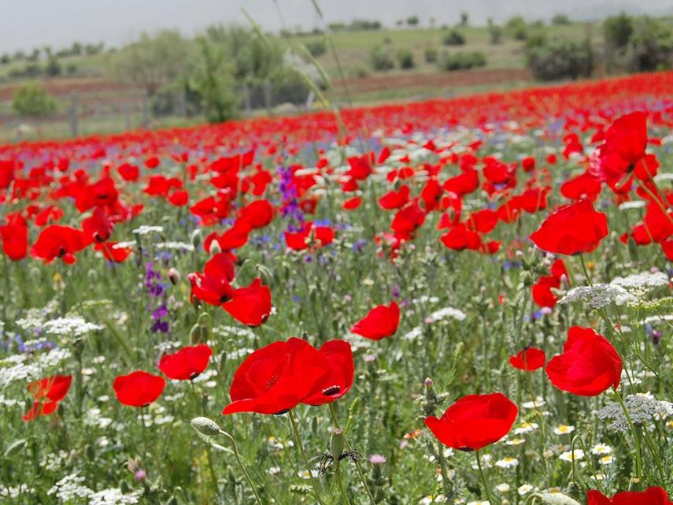
Notes:
Slide 16: ’Yet even King Solomon in all his finest kingly robes is not dressed as beautifully as these flowers. If that is how God clothes the flowers in the fields, which are here today and gone tomorrow, how much more will he care for you?!’

Slide 17
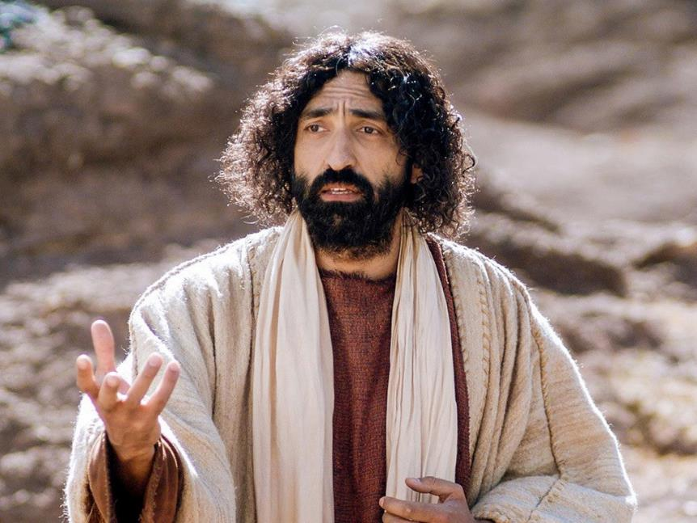
Notes:
Slide 17: ‘So do not worry. Trust God, your Heavenly Father, who takes care of you.’

Slide 18
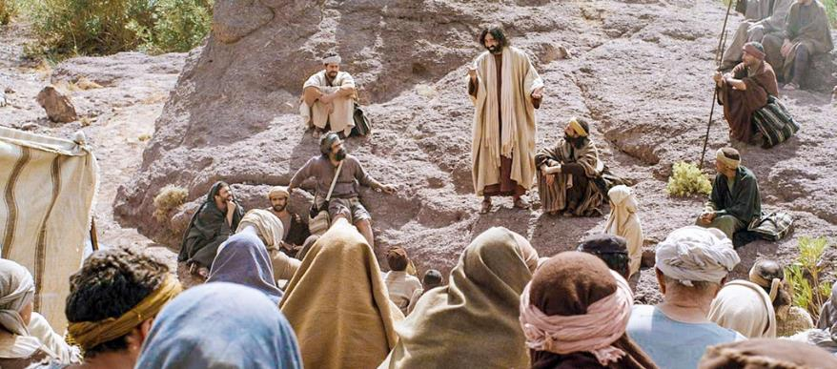
Do not worry….
….I wonder what the people thought when they heard what Jesus said?.....
….I wonder how Jesus’ words might have helped them?....
….I wonder what this taught the people about being truly happy?....
….I wonder what helps you when you are worried?....
Notes:
Slide 18: Responding and words for worship
In his Lesson on the Mountain, Jesus said ‘Do not worry….’
Jesus wanted the people to think about how the birds of the air and the flowers in the fields didn’t worry about life, but trusted God (who Jesus said made them).
Worrying is a very human emotion – and what Jesus most certainly didn’t mean was that worrying is wrong, or not to share our worries when we have them. Of course we must do this – because caring for each other is important, and sharing our worries can really help. We’ll talk a little more about this in a moment…..
What Jesus was saying to the people was about remembering that God, their Father in heaven, cares so much for them – more than birds and flowers – and to trust him.
People who are Christians still find Jesus’ words about worrying very powerful – and good words to remember.
Let’s now be still and quiet and wonder together about what we’ve heard…..
….I wonder what the people thought when they heard what Jesus said?.....
….I wonder how Jesus’ words might have helped them?....
….I wonder what this taught the people about being truly happy?....
….I wonder what helps you when you are worried?....

Slide 19
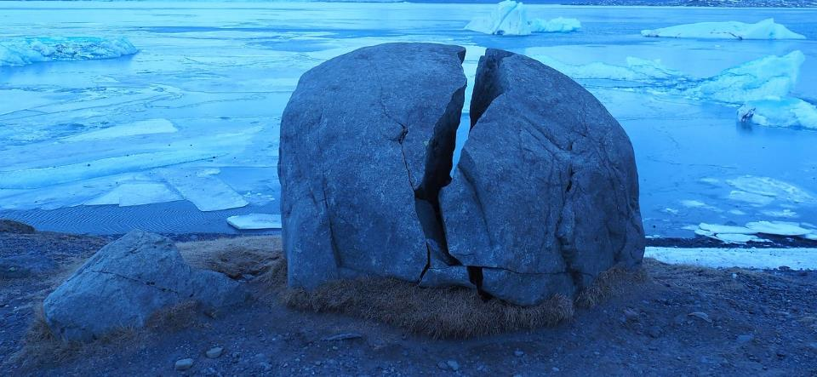
‘a worry shared is a worry halved’
Notes:
Slide 19: Sometime worries can make us feel as if we are carrying around a big, heavy weight, maybe like this enormous rock.
Someone one once said that ‘a worry shared is a worry halved.’
This means that one of the best ways to deal with a worry is to talk to others about it, to get it out in the open rather than it staying stuck inside us and weighing us down. I wonder if you’ve every found this to be true for you?
[You might like to invite children to talk to each other about times when this might have helped them]
Some people like to talk to God when they are worried, maybe remembering the words that Jesus said about God caring for them.
Prayer
I’m going to use some words to help us pray now – if you want to pray too, you might want to join in with the words….

Slide 20
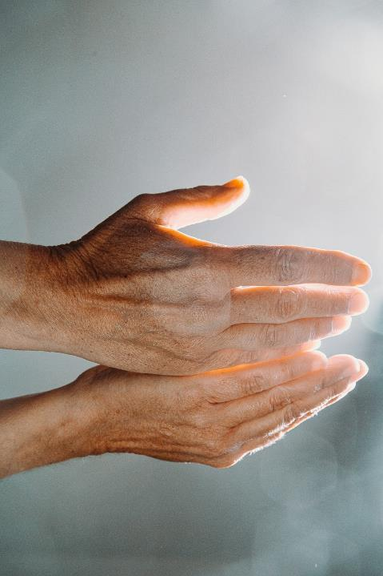
We share our worries with you, God.
Notes:
Slide 20: We shar our worries with you, God.
If you don’t want to pray, then you might find it helpful to be still and quiet and think about the things we’ve talked about today.
So now I invite you to join with me if you’d like to….

Slide 21
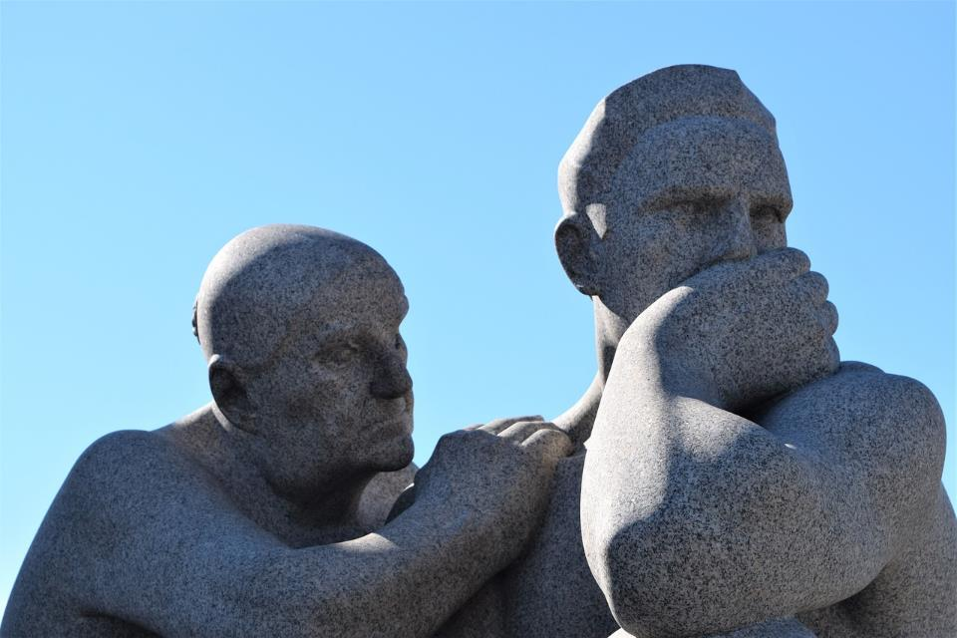
Notes:
Slide 21: When worries lie heavy in our hearts

Slide 22
We share our worries with you, God.
Notes:
Slide 22: We share our worries with you, God.

Slide 23
Notes:
Slide 23: Whether worries are big or small, one or many…..

Slide 24
We share our worries with you, God.
Notes:
Slide 24: We share our worries with you, God.
.

Slide 25
Notes:
Slide 25: We remember that a worry shared is a worry halved, so….

Slide 26
We share our worries with you, God.
Notes:
Slide 26: We share our worries with you, God.
Thank you that you care for us.

Slide 28
Leader: As we leave this place & time and go into the day ahead…
All: May we remember that a worry shared is a worry halved.

Slide 29
Notes:
Slide 29: Reflective areas
Stone ‘prayers’: hold a pebble in your hand, and think about something that might be worrying you. Give your worry away (maybe if it helps you, to God) by putting the stone down (you could put a small standing cross in your reflective area, or just make a pile)

