Slide 1
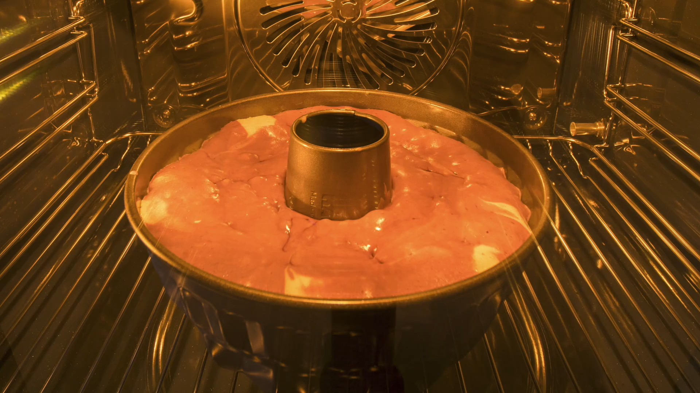
All images copyright-free from pixabay, unless otherwise identified
Notes:
Gathering:
Slide 1: Rising cake stilling exercise
Use the stilling slide if desired: the suggested words should be spoken slowly, leaving pauses inbetween to create a sense of stillness.
As you sit quietly, look at the cake rising in the oven….. [PAUSE]
Now practise slower breathing…..in…..and out…..in……and out…..maybe matching the rising of the cake….[PAUSE]
You maybe notice that you are feeling calmer and more relaxed….[PAUSE]
As you breathe, think about yourself and what you bring into this time today….. [PAUSE]
We come into this special / sacred space and time to be still….to think deeply…..to be together as a school community…..
In our time together today, we will conduct a science experiment, share a quiz, tell a story and then use it to help us to think.
But first, let’s welcome one another as we begin….

Slide 2

As we gather to share today's story.
As we gather to share today's story.
Leader: As we gather to share our story today….
All: May we grow in our understanding of ourselves and our actions towards others.
Notes:
Slide 2: Use our new gathering words for this term, or your usual greeting if you prefer. These greetings may change slightly each week to reflect the spiritual elements that we will be exploring in each week’s materials.
Leader: As we gather to share our story today….
All: May we grow in our understanding of ourselves and our actions towards others.

Slide 3
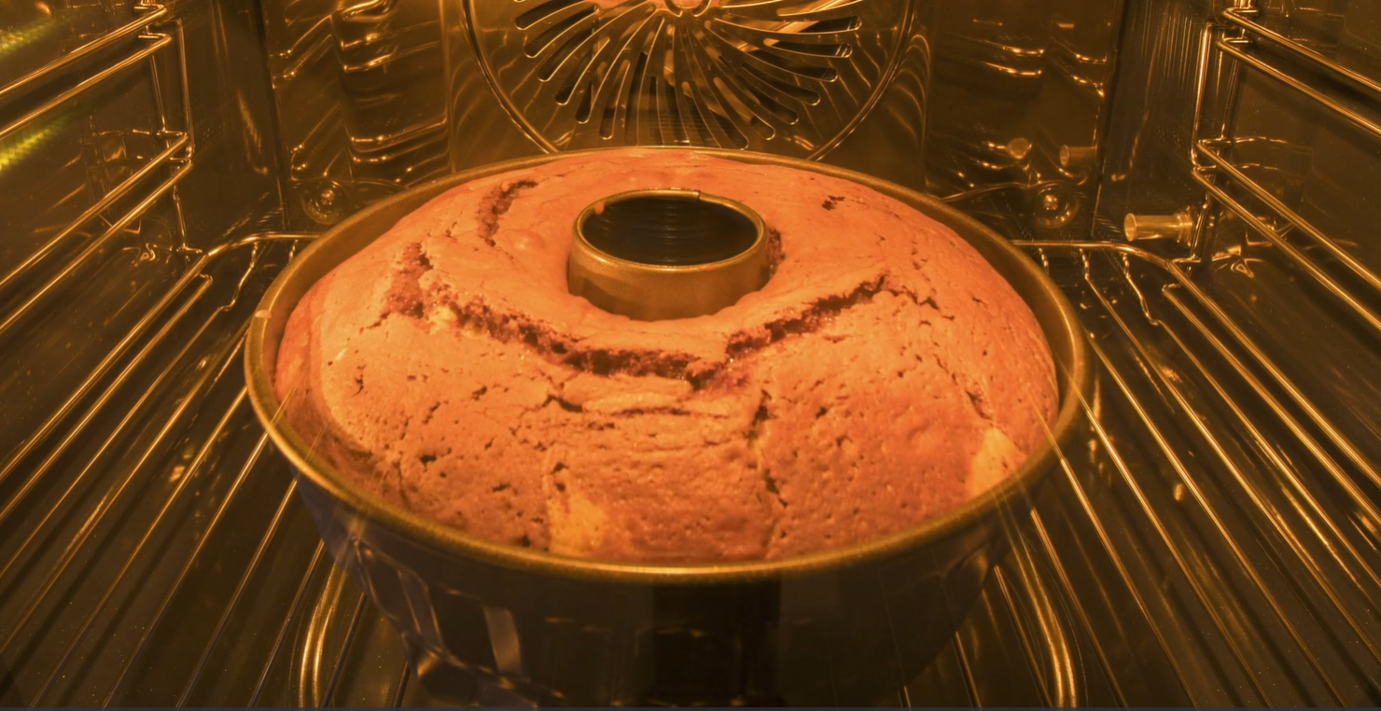
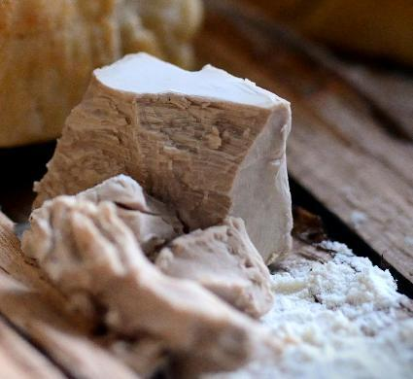
Notes:
Slide 3: As you watched the cake rise at the very start of our time together, I wonder if you thought about what was happening in the oven, or if you’ve ever watched this happen for yourselves? [talk together about the ‘science’ of cake-baking and the presence of a raising agent to make the cake puff up.] Today, we’re going to share another of Jesus’ stories, about this very strange substance [show it if you have a piece– it’s worth a smell too! – or view on screen], which is the ‘magic ingredient’ in bread to make it rise. It’s called yeast.

Slide 4
Mad Science Moment
Notes:
Slide 4: Mad science moment
To show you how it works, we’re going to conduct an experiment with yeast and leave it to work for a while. We’ll look at it again before you go back to class… [do the experiment, or watch the video, talking to children about the process as you go]

Slide 5
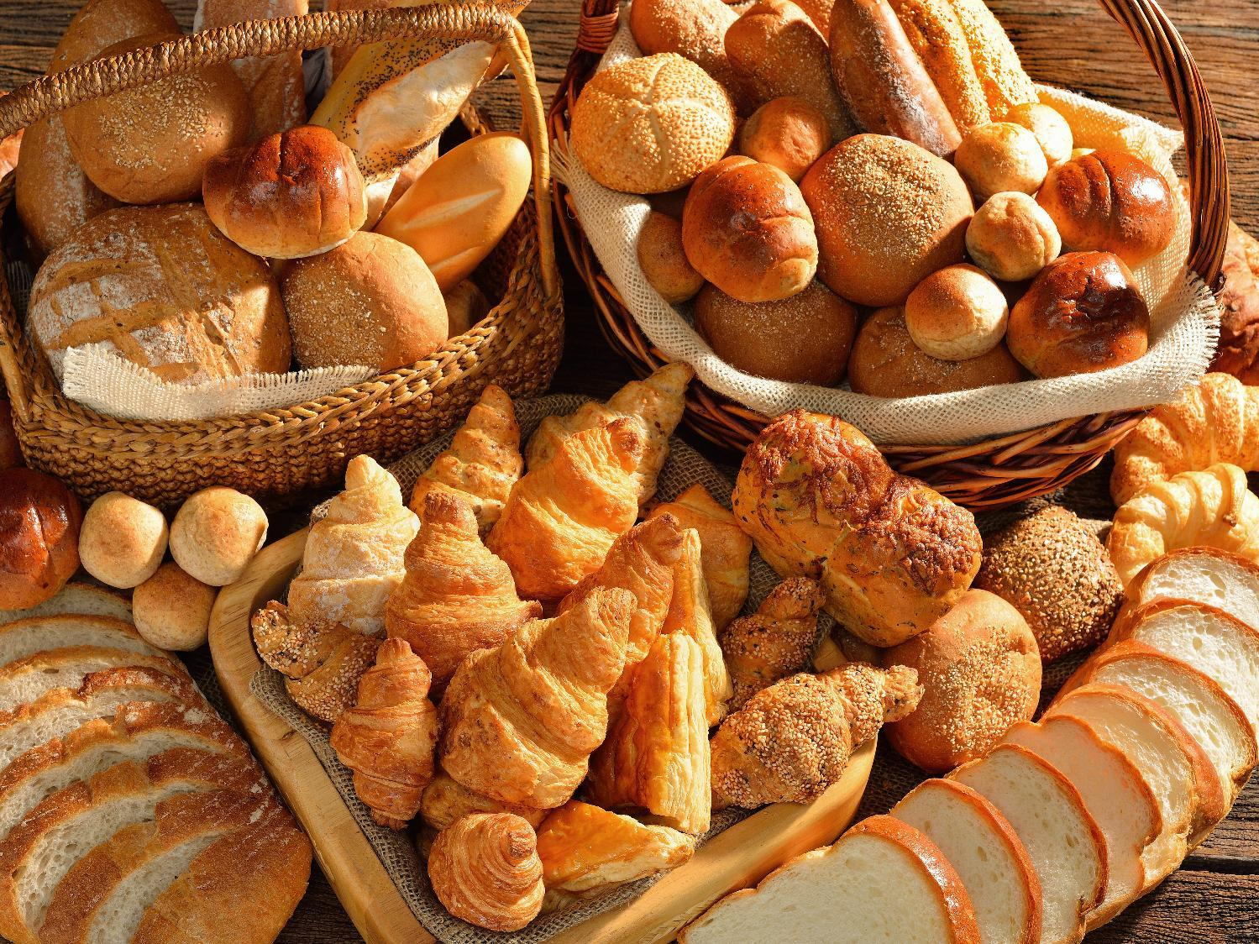
Taste Test
Notes:
Slide 5: Now, while that’s getting going, we’re going to conduct another experiment: a taste-test! Who likes bread?! On this table, I have several different types of bread to be tasted. [go through each, making sure each is named to help children to identify them, or learn new vocabulary. Then choose your volunteers and explain the process. Make sure you choose children / adults who don’t mind being blindfolded – and don’t have any food allergies! Congratulate them for their participation.]
As you’re aware, our parable today is about yeast, which, as we’ve seen, is the ingredient in bread that makes it rise like this [show an example from your table] not stay flat like this [show a flatbread] Just like most of us, people in Jesus’ day would’ve eaten bread every day, in fact, maybe with every meal! So they would really know their bread!

Slide 6
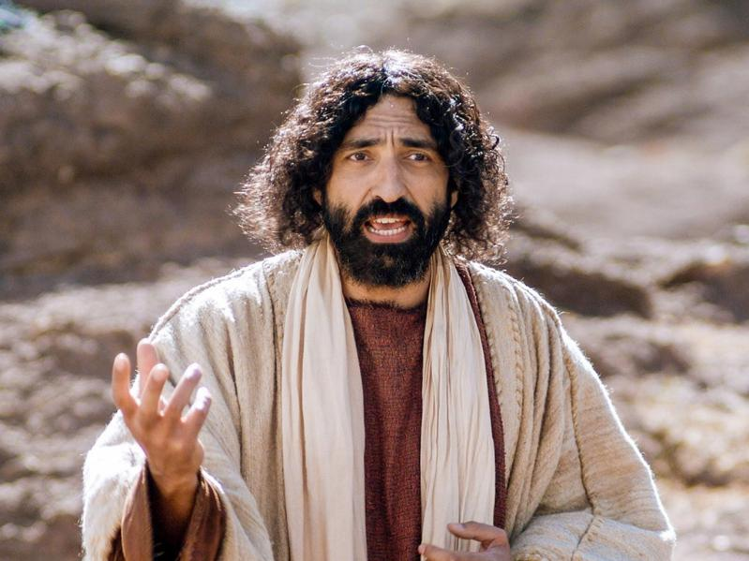

Notes:
Slide 6: So, let’s hear Jesus’ story. This version of Jesus’ parable isn’t quite how Jesus told it, but as you listen, think about what the story might mean….and then we’ll look to see if our experiment has worked!

Slide 7
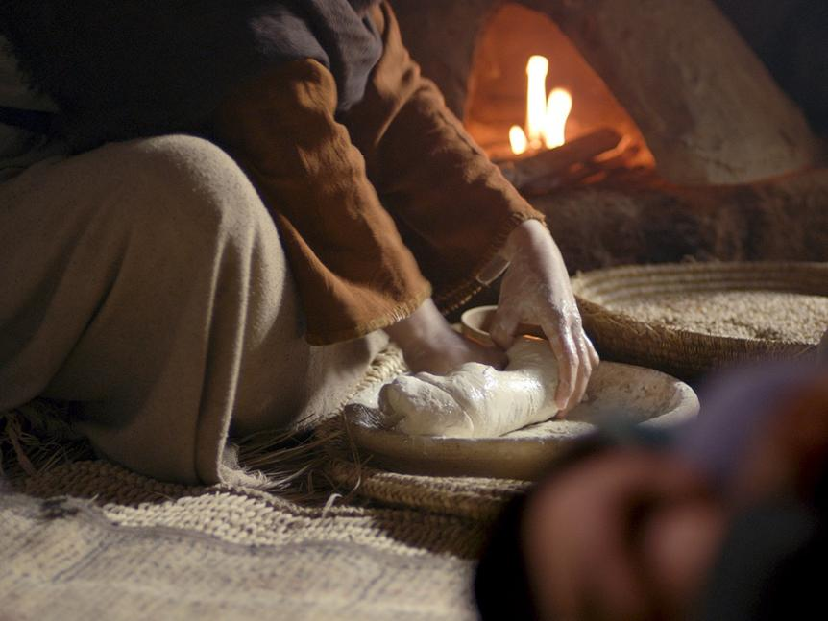
An agent of change
Notes:
Slide 7: An agent of change [use script on p4]

Slide 8
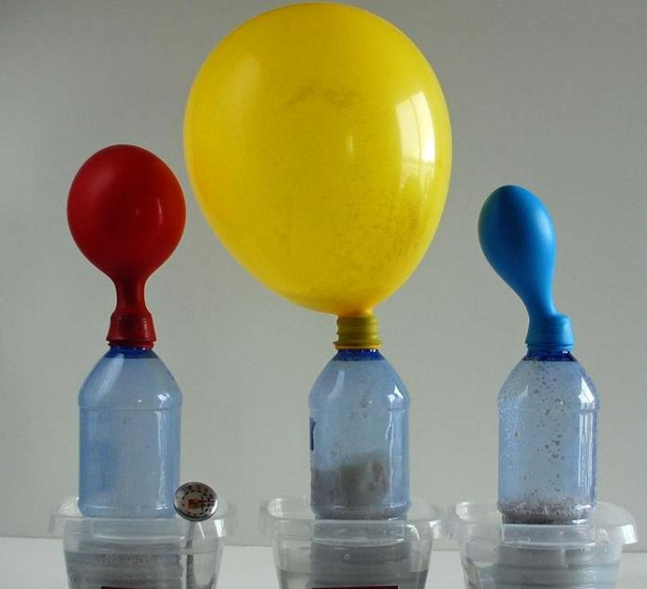
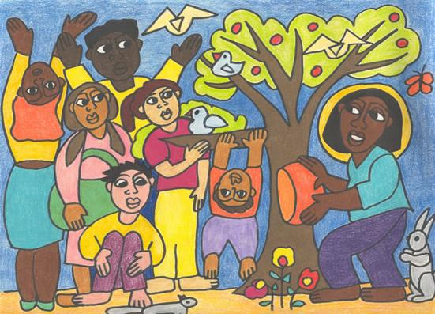
Notes:
Slide 8: Now let’s see if our yeast has done its work! [Bring back your experiment, and talk about what’s happened, explaining the chemical reaction that’s taken place if time allows] A small amount of yeast can have a big effect! In his parable, Jesus was giving another message about God and his kingdom to everyone who was listening. I wonder if you can see any connections with the mustard seed parable that we heard last week? [ask for some responses if you have time, or leave the question open to be pondered…Answers may draw out the idea of something small having a big impact]

Slide 9
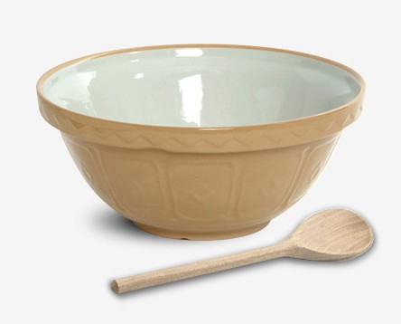
Notes:
Slide 9: Over the time in the Christian calendar called Lent, the 40 days just before Easter, you may have been thinking about small, good deeds to do to bless others. In the same way that you only need a little bit of yeast to make a whole loaf of bread rise, you don't have to do a big thing to make a difference – and you don’t have to save it for Lent! I have some ideas here in my mixing bowl: as I read, think about the difference that it might make to someone else today [use a few cards from the mixing bowl] ….by doing these things, Jesus said, other people get a glimpse of what God’s kingdom might be like, but right here on earth.

Slide 10
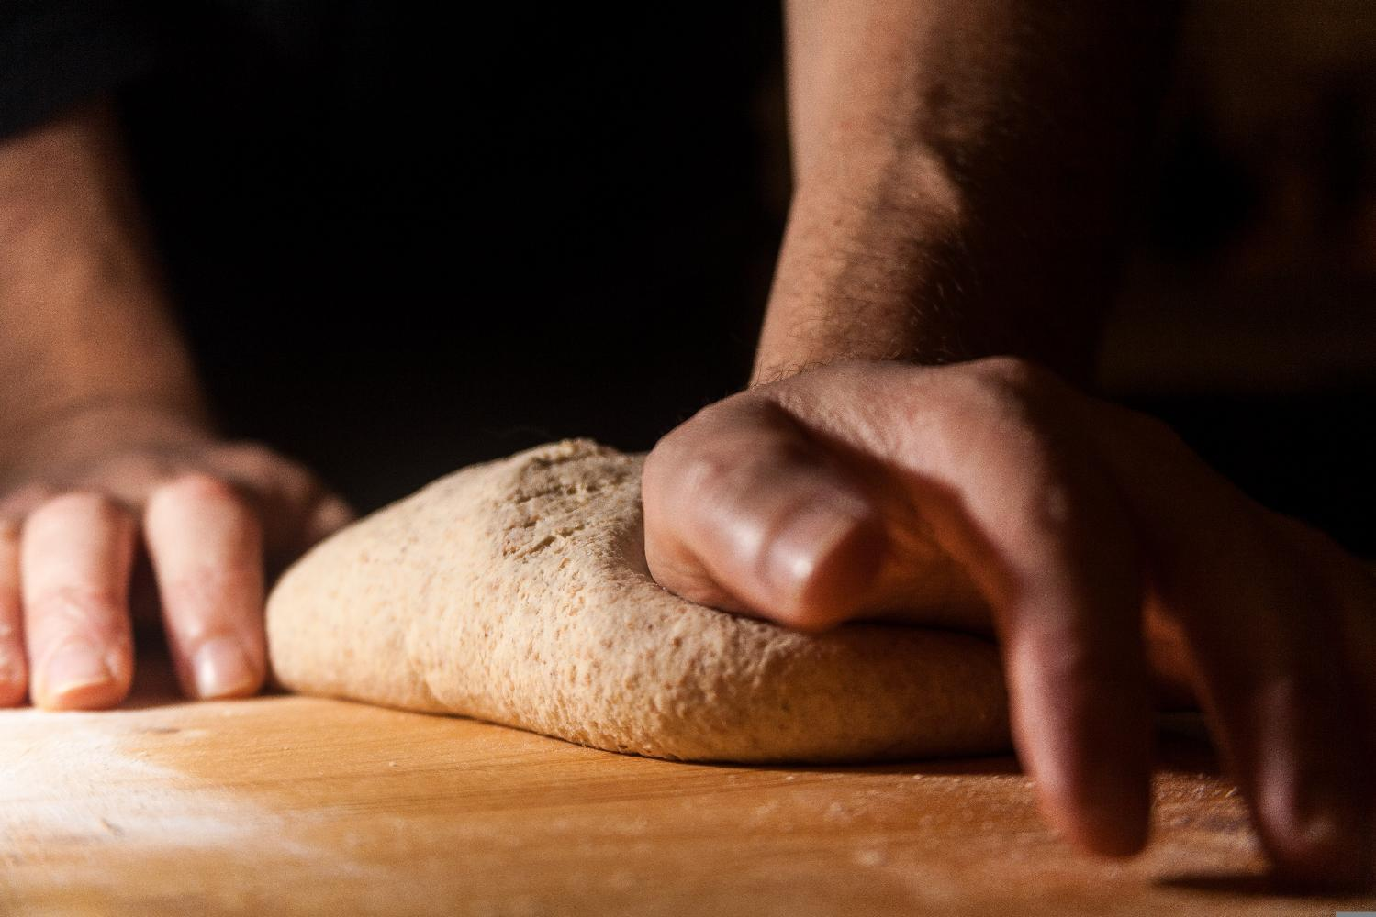
….I wonder how our actions, even very small ones, might make a whole lot of difference?....
“Do small things with great love.”
Notes:
Slide 10: Responding (and words for worship)
Let’s be still and quiet together now….
…in the stillness, think about the things that you’ve heard today….
…about how a little bit of yeast makes a whole loaf of bread rise….
…..we’ve also thought about how one small deed can make a whole lot of difference….
…[repeat some of the cards you looked at]…..
…I wonder how our actions, even very small ones, might make a whole lot of difference?....
Mother Teresa once said that we should ‘do small things with great love’…
…these small things, done out of a heart of love, can change the world….
….and maybe show others what God’s kingdom is like….
I’m going to turn my thoughts into a prayer now, as I ask God to help us to put some of these ideas into practice. Make the prayer your own if you’d like to…or if you’d prefer not to pray, then just sit quietly with your own thoughts.

Slide 11
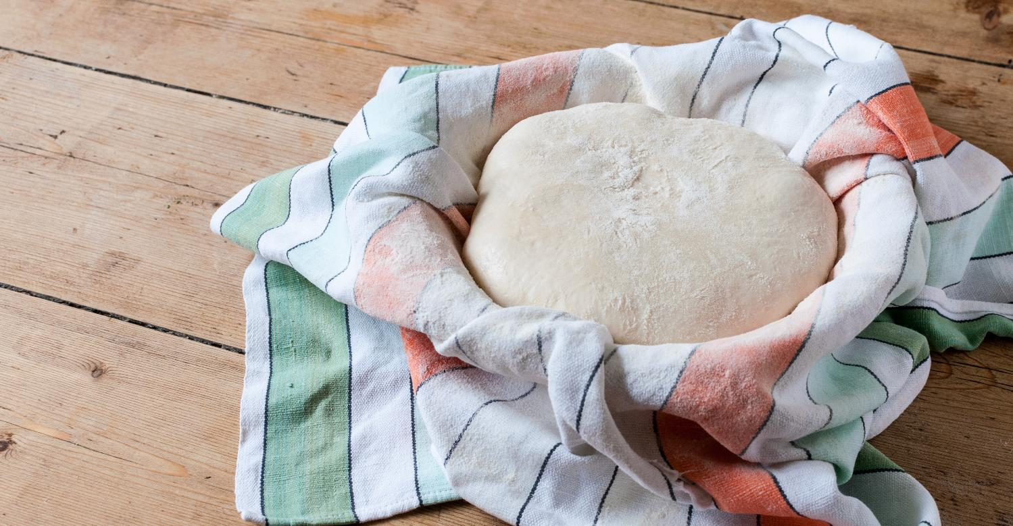
Dear God
Thank you for this reminder that we can all make a difference, by doing ‘small things with great love’. Today, help us to bless others in our school, our homes and our world.
Notes:
Slide 11:
Dear God
Thank you for this reminder that we can all make a difference, by doing ‘small things with great love’. Today, help us to bless others in our school, our homes and our world.

Slide 12
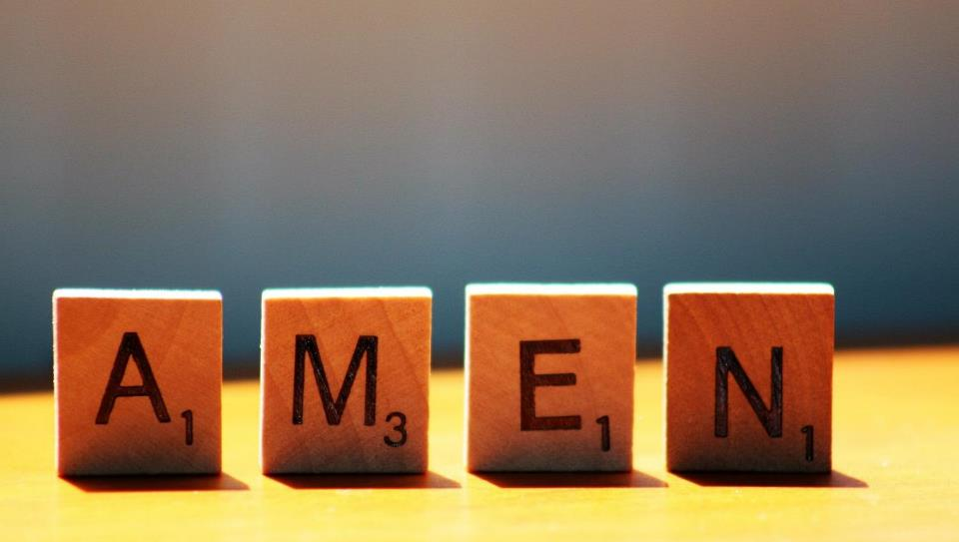

Slide 13
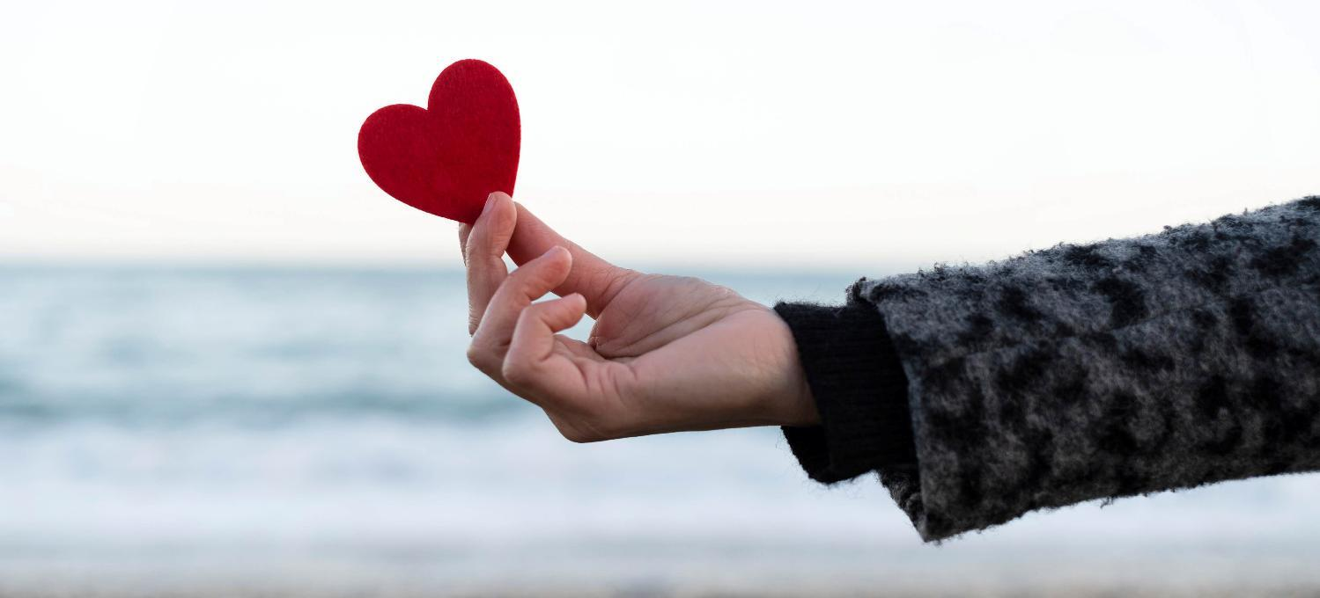
Leader: As we leave this place & time and go into the day ahead…
All: May we do small things for others, with great love.

Slide 15
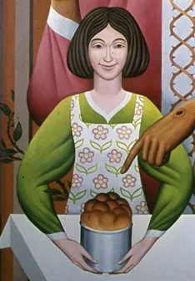
Notes:
Parable of the Yeast, detail from a larger image
By British Catholic artist Peter Koenig, 1975
You can view the entire painting on the artist’s website here: https://diglib.library.vanderbilt.edu/act-imagelink.pl?RC=58557
This image source: https://www.pwkoenig.co.uk/Portfolio/parable-of-the-yeast

