Slide 1
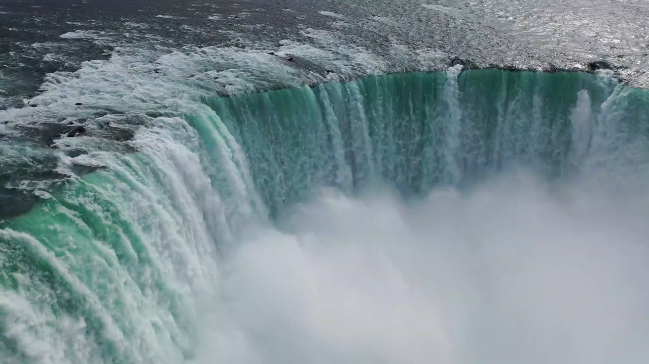
All images copyright-free from pixabay, unless otherwise identified
Notes:
Slide 1: Welcome stilling exercise – waterfall
Use the stilling slide if desired: the suggested words should be spoken slowly, leaving pauses inbetween to create a sense of stillness.
As you sit quietly, watch the water falling…..[PAUSE]
Now practise slower breathing…..in…..and out…..in……and out…..keep this going as you continue to watch….[PAUSE]
You maybe notice that you are feeling calmer and more relaxed….[PAUSE]
As you breathe, think about yourself and what you bring into this time today…..and think about the beauty of the natural world around us…. [PAUSE]
We come into this special / sacred space and time to be still….to think deeply…..to be together as a school community…..
In our time together today, we will have a quiz…..watch a video…..share a short story together, and then think together about what it might mean for our school community.
But first, let’s welcome one another as we begin….

Slide 2
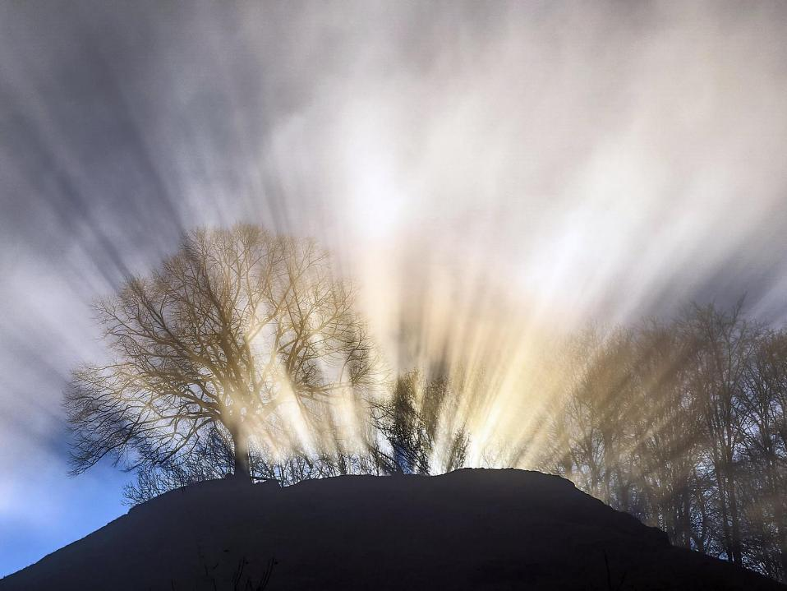
Leader: This is a day that God has made.
ALL: We will rejoice and be glad in it!
Notes:
Slides 2/3: Teach this new greeting to your school community – there are two slightly different versions from the point of view of the leader; choose which best fits your school’s context. One uses words adapted from Psalm 118:24
Leader: This is a day that God has made!
ALL: We will rejoice* and be glad* in it!
OR:
Leader: Today is a brand new day…..
ALL: May we be a blessing to each other!
*There are different BSL signs for rejoicing and joy/gladness. View them here: https://www.signbsl.com/sign/rejoice
Blessing: https://www.signbsl.com/sign/blessing (1st video)

Slide 3
Leader: Today is a brand new day!
ALL: May we be a blessing to each other!
Notes:
Slides 2/3: Teach this new greeting to your school community – there are two slightly different versions from the point of view of the leader; choose which best fits your school’s context. One uses words adapted from Psalm 118:24
Leader: This is a day that God has made!
ALL: We will rejoice* and be glad* in it!
OR:
Leader: Today is a brand new day…..
ALL: May we be a blessing to each other!
*There are different BSL signs for rejoicing and joy/gladness. View them here: https://www.signbsl.com/sign/rejoice
Blessing: https://www.signbsl.com/sign/blessing (1st video)

Slide 4
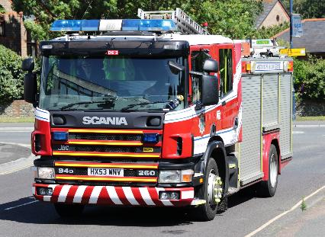
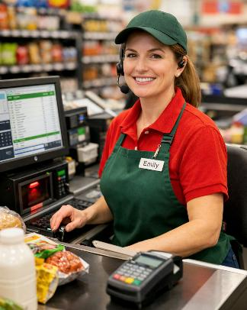
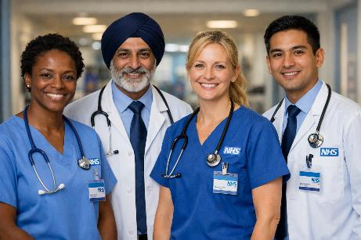
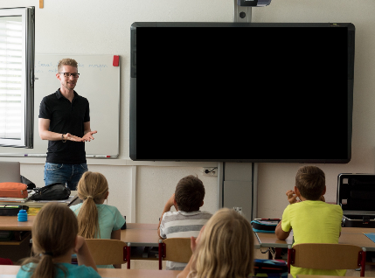
Whose job?
Notes:
Slide 4: Whose job? Show the pictures, asking children a variety of questions about the roles and responsibilities of each occupation. In this way, you can make the challenge age-appropriate.

Slide 5
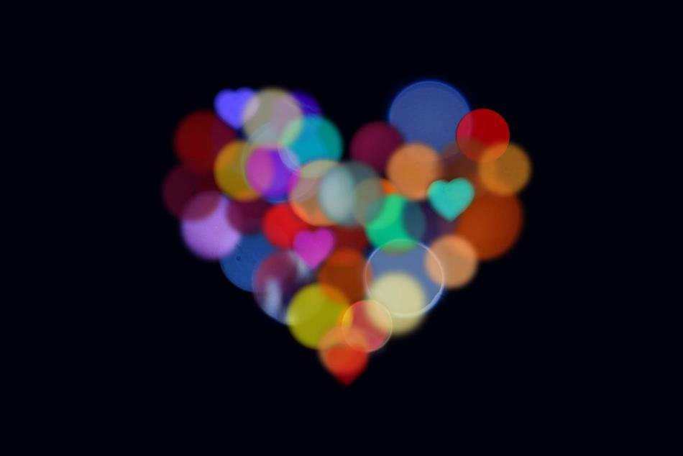
Count your blessings
Notes:
Slide 5: This term, we are thinking about our blessings – all the good things in our lives.

Slide 6
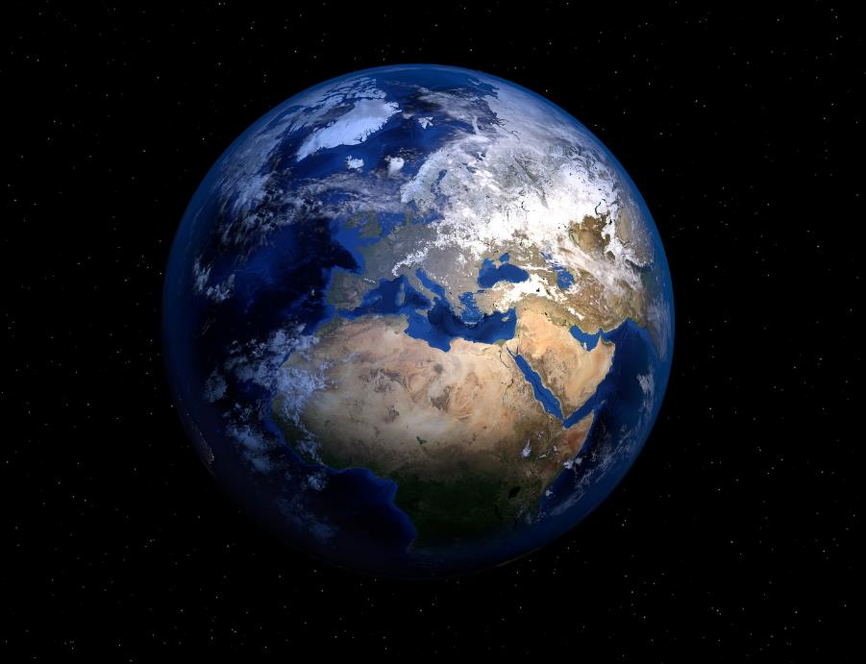
Our world
Notes:
Slide 6: You might recall that one of the things we said we were grateful for last week was our beautiful world. We’re going to watch a short video of some things we might consider ‘blessings’ in our natural world now…As you watch and listen, see if you can see something that you agree is wonderful!......[click on image and it will link to the video.]
So, what did you spot – or what wasn’t there that you’d like to have seen?.... [Use talking partners to get more discussion going – but keep it short!]

Slide 7
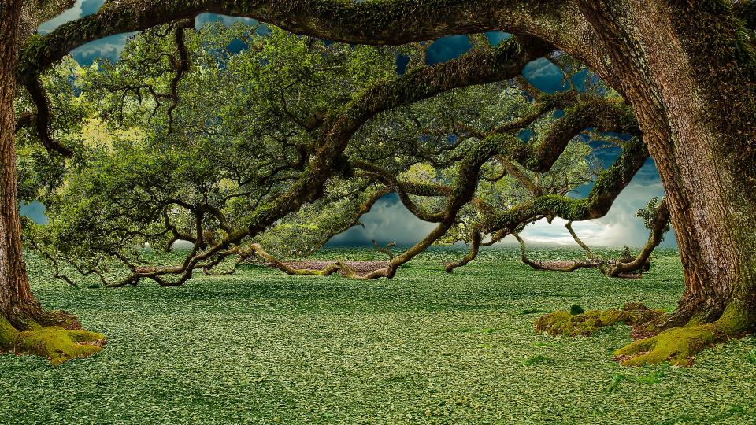

?
The new job
Notes:
Slide 7: ‘We’re going to share a story together now about someone who was given a job to do: listen carefully to see if you can spot what it was…. The story comes from the very beginning of the book that Christians call the Bible, but that is also found in the Torah and the Qur’an [use script on p4]
Question: Did you spot what the job was? (there were 2 actually! – to look after the world and care for it, plus naming the animals) The job given to Adam and Eve in the story is something that people all around the world believe we should still be doing now: caring for our world. There are many different beliefs about how the world came to be, but whatever you believe, there is no doubt that it is still very beautiful, despite the many things that humankind has done to harm it, sometimes without thinking

Slide 8
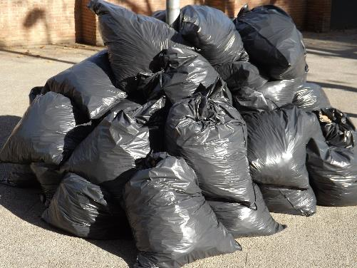
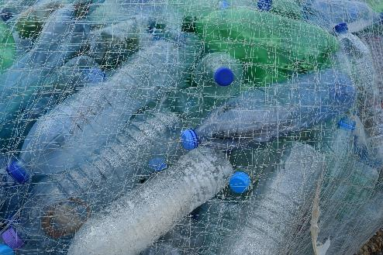
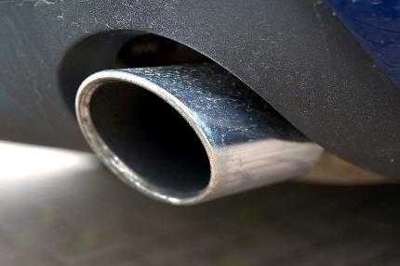
Notes:
….[Slide 8: show pictures] We know that scientists have proved that we can have a bad – or a good – impact on our environment – and we have seen pictures that show the difference we can make in quite short spaces of time, such as here….

Slide 9
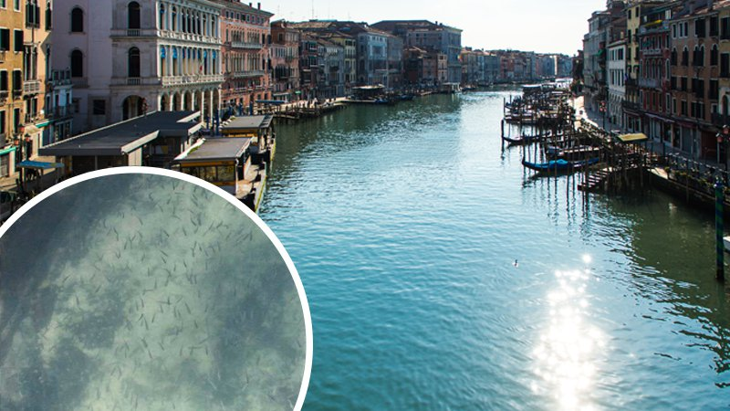
Notes:
Slide 9: Six years ago, when our world was in lockdown due to the COVID-19 pandemic, there was very little traffic, anywhere – in the air and on the waterways as well as on the roads. In Venice where water traffic had disappeared, fish miraculously reappeared in places where there had been too much pollution for fish before! So, we know that we can make a difference if we all work together.
Let’s remind each other of some things that we could do that show that we ARE caring for our world [there are some picture suggestions on Slide 10]

Slide 10


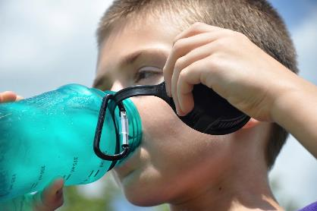
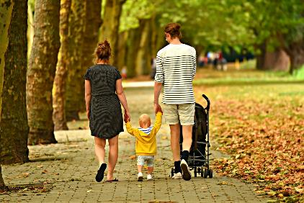
?
Notes:
Slide 10: Ways to help
recycling
turning off lights and appliances when they’re not needed
using less plastic e.g. using a refillable water bottle
using cars less
I wonder how many more we could think of in our classes this week?..... [These ideas could lead into modelling the Earth Promises Reflection area activity (p3)]

Slide 11
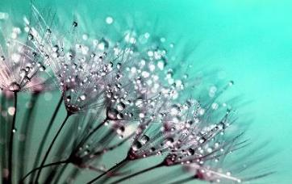
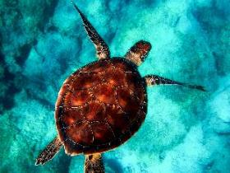
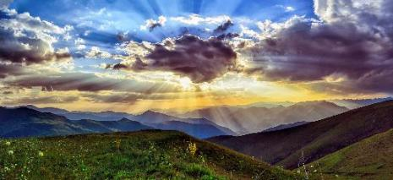
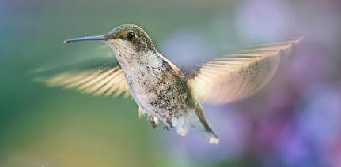
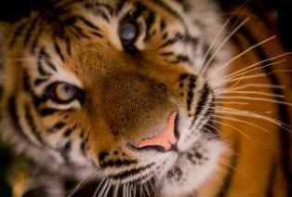
God said ‘Look after my world: it’s your job!’
Notes:
Slide 11: For Christians, these words, which we heard in our story, are one of the reasons why they might be concerned to care for our planet. And across religions and beliefs, people would agree that caring for our world is OUR job – and that we need to take this responsibility more seriously if we want to slow down climate change and ensure that our planet has a good future…. Our world is still a beautiful place, despite the many challenges it faces, and we all know that we want it to be beautiful for many generations to come.

Slide 12
…I wonder which thing in our world is your very favourite thing?....
…I wonder what you think about this important job?....
God said ‘Look after my world: it’s your job!’
Notes:
Slide 12: Responding and words for worship
Let’s be still and quiet together now….
…We’ve been thinking today about our wonderful world….
….I wonder which thing in our world is your very favourite thing?.....
…..picture that thing in you mind now, and think about how you would feel if it wasn’t there any more…
…we’ve heard the story from the Bible about how God told Adam and Eve to care for the world….
…I wonder what you think about this important job?.....
….in the quietness, think about something you might do to show you are caring for our world….
....and perhaps make a promise to yourself or to God to take action whenever you can….
I’m going to turn my thoughts into a prayer now, as I ask God to help us to put some of these ideas into practice. Make the prayer your own if you’d like to…or if you’d prefer not to pray, then just sit quietly with your own thoughts.

Slide 13
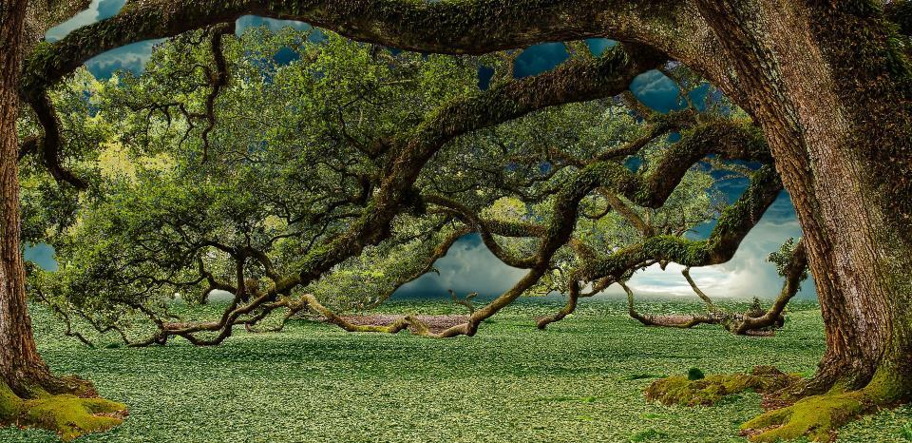
Creator God
Thank you for the world you made – and the job you gave to Adam, to Eve and to us to look after it.
Help us to do whatever we can to show that we are taking our responsibilities seriously. Help us to care for your world, as you asked us to.
Notes:
Slide 13: Creator God
Thank you for the world you made – and the job you gave to Adam, to Eve and to us to look after it.
Help us to do whatever we can to show that we are taking our responsibilities seriously. Help us to care for your world, as you asked us to.

Slide 14
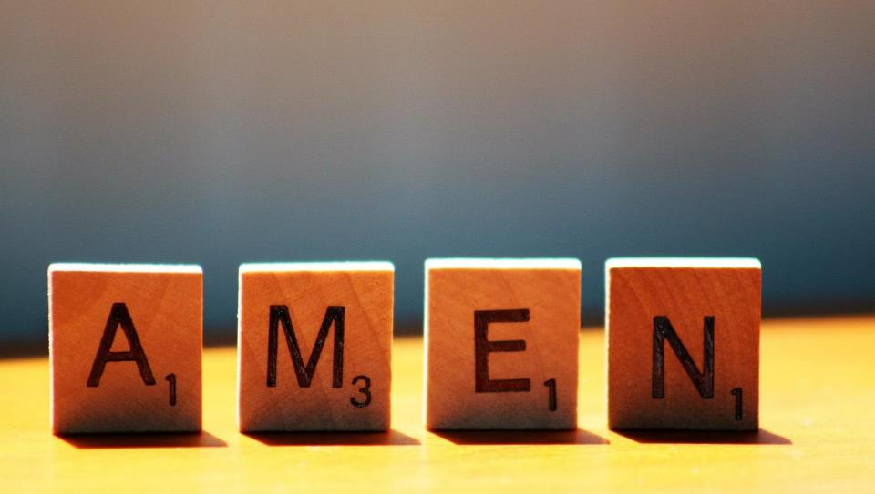

Slide 15

Leader: As we leave this place & time and go into the day ahead…
All: May we take care of our wonderful world: it’s our job!
Notes:
Slide 15: Sending
Leader: As we leave this place and time and go into the day ahead….
All: May we take care of our wonderful world: it’s our job!

Slide 16
Notes:
Slide 16: Reflection areas
Make an Earth Promises box out of recycled materials and leave slips of (recycled) paper on which children can write their own ‘Earth Promise’ to post into the box.
Think: What promise might you make to care for our planet at school or at home?
Do: Write or draw your thought on a slip of paper and post it into the box.
Talk: How can we help one another and work together?

