Slide 1




We are here together in our school family. May God be with us…
...and watch over us.
Notes:
Slide 1: Use these new gathering words for this term, or your usual greeting if you prefer.

Slide 2

Around the world….
Notes:
Slide 2: Explore some of the different languages that children in your school can speak…This may need some advance preparation and the support of children’s families.

Slide 3
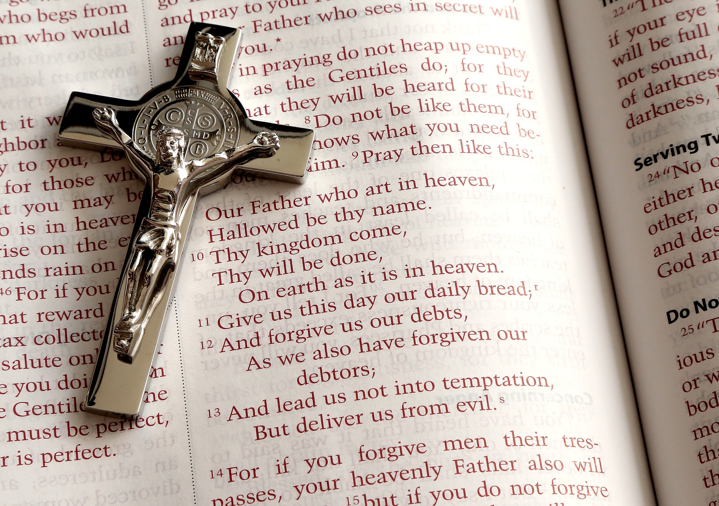
The Lord’s Prayer
Notes:
Slide 3: Last week, we heard this prayer and thought about the meaning of some of the words. It’s such an important prayer for the Christian community that it’s spoken in thousands of languages across the world: in fact, wherever there are Christians! It was one of the first things ever written down in English.

Slide 4
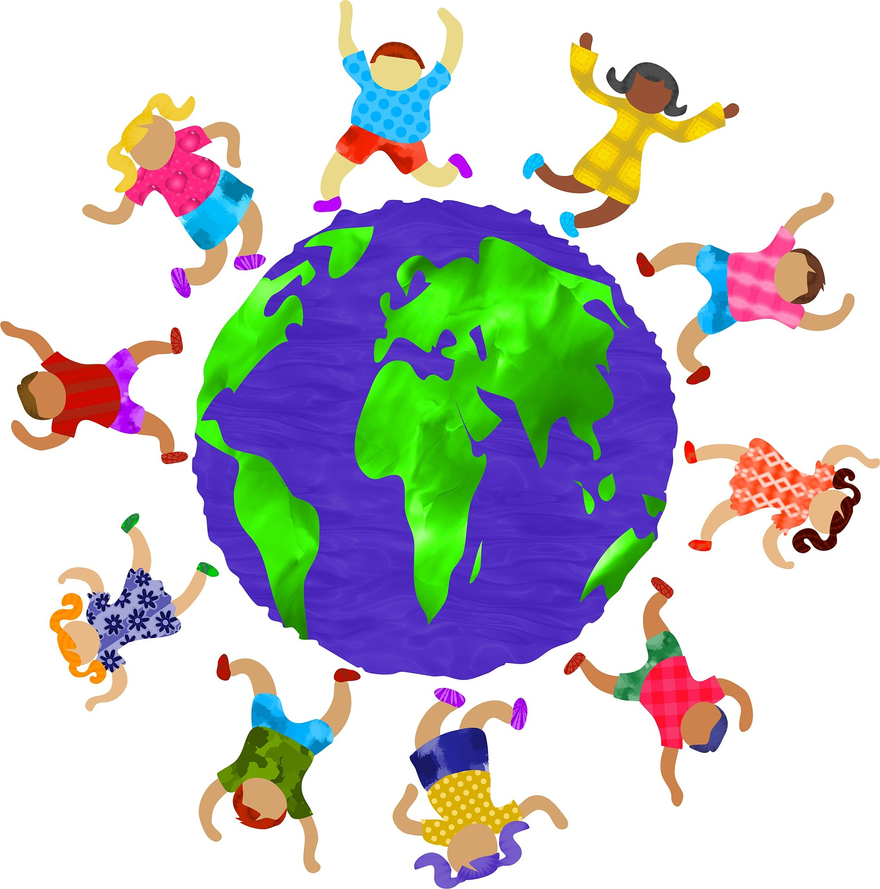
Going global: the Lord’s Prayer
Notes:
Slide 4: So let’s have a look at just a few words from the prayer, in just 4 languages (English, Spanish, French and Swahili (which is a language spoken in many African countries). I wonder if you can guess which word is in which language? – we’ll start with the English word first each time!

Slide 5


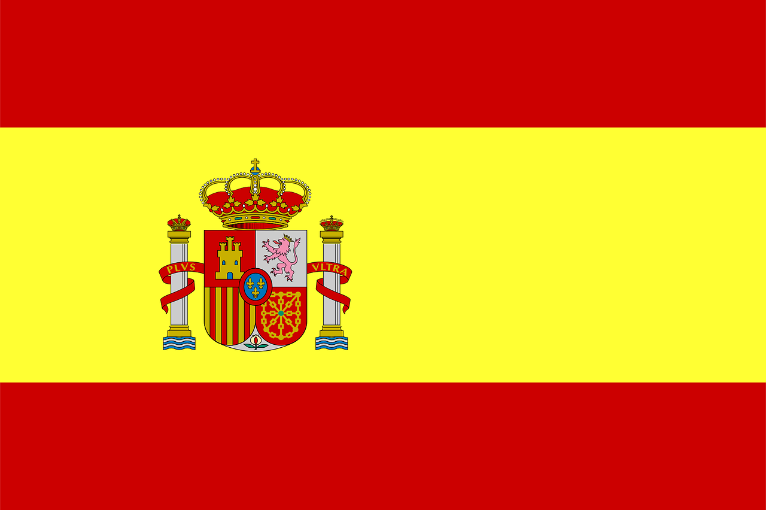
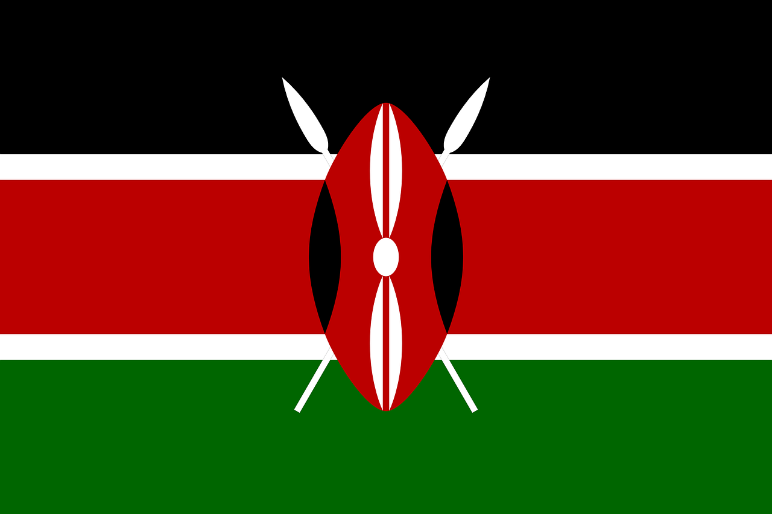
‘Father’
‘Pére’
‘Padre’
‘Baba’
Notes:
Slide 5: Father translates as…
‘Pere’, in which language? (French)
‘Padre’, in which language? (Spanish)
‘Baba’, in which language? (Swahili)

Slide 6
‘Heaven’
‘mbinguni’
‘cielo’
‘cieux’
Notes:
Slide 6: heaven translates as…
‘mbinguni’ (Swahili)
‘cielo’ (Spanish)
‘cieux’ (French)

Slide 7
‘bread’
‘pan’
‘mkate’
‘pain’
Notes:
Slide 7: bread translates as…
‘pan’ (Spanish)
‘mkate’ (Swahili)
‘pain’ (French)

Slide 8
‘Amen’
‘Amen’
‘Amina’
‘Amén’
Notes:
Slide 8: Amen translates as…
‘Amen’ (French)
‘Amina’ (Swahili)
‘Amén’ (Spanish)

Slide 9
The Global Lord’s Prayer
Notes:
Slide 9: So now, let’s listen to the Lord’s prayer being prayed in some different languages…in German, Telugu (which is an Indian language), Brazilian Portuguese, Cantonese, BSL and Yoruba, an African language spoken in Nigeria.
[Use compilation video here: Multilingual Lord's Prayer
or in individual languages from here: The Lord's Prayer in Many Different Languages | NHM Ministrants

Slide 10
…. I wonder how you felt hearing this prayer in different languages?....
….I wonder why it’s important for people to be able to pray in their own language?....
…. I wonder how praying this prayer together, all over the world, helps the Christian community to feel united?....

Slide 11
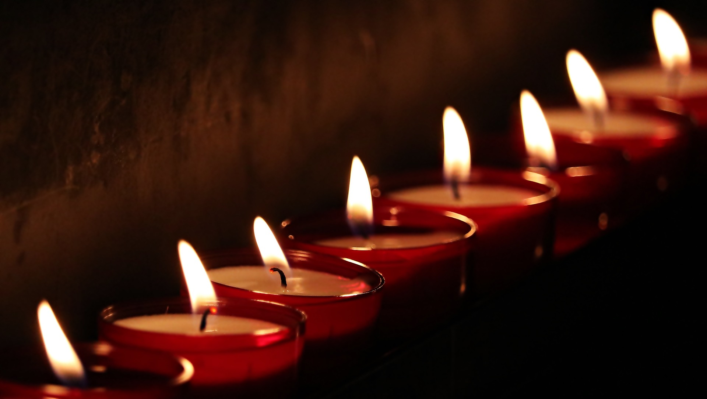
Notes:
Slide 11: Responding (words for worship)
Let’s be still and quiet together now….
We’ve heard today that the prayer that Jesus taught his disciples to pray, the Lord’s Prayer, is prayed by Christians all over the world….
….to ask God for the things that Jesus taught was important….
….in different languages, all over the world!.....
….but the words mean the same, all over the world….
….this prayer joins the Christian community together, all across the world…..
…..it unites them….
……
….I wonder what you think about the idea of a prayer that can do this?....
…..a prayer that joins people together across the world, even if they don’t speak the same language….
….I wonder what things join us together as a school community?....or help us to feel connected with each other?....
….what unites us?.....
…..spend a few moments in quietness now…..
….I’m going to turn my thoughts into a prayer now (in English!)....
…make it your own in some way if you’d like to, or you can pray your own prayer, or you can just sit quietly with your own thoughts….it’s your choice.

Slide 12
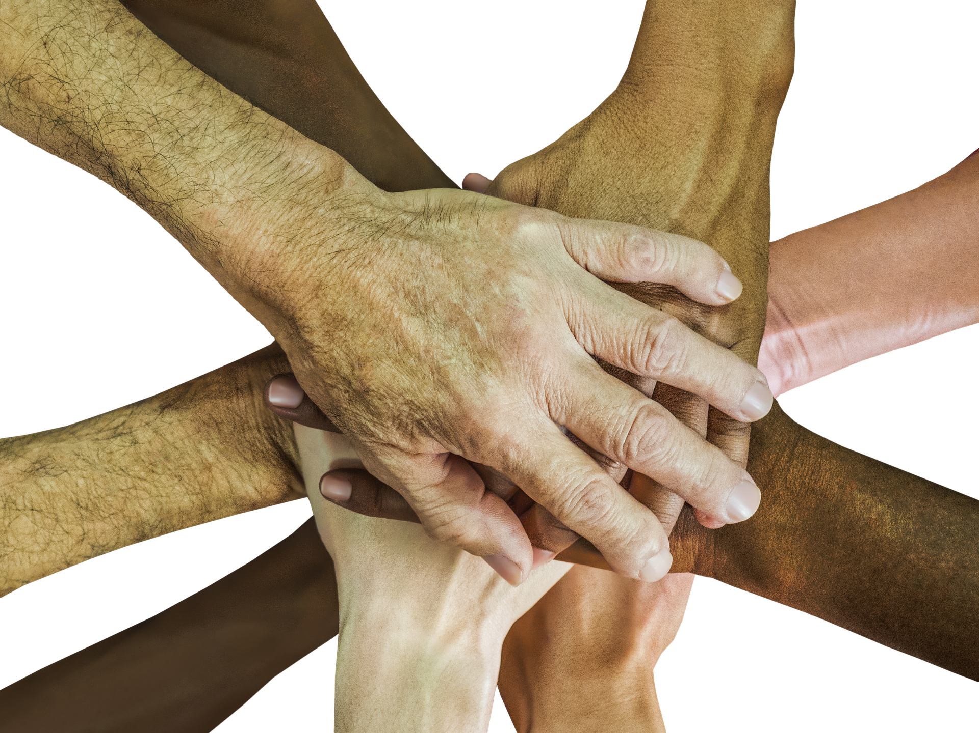
Dear God
Thank you for this prayer – the prayer that Jesus taught to his disciples. Thank you that people can pray it in their own languages and feel united by the words of this prayer. We pray that you will also unite us as a school community and help us to feel closer together.

Slide 13


Slide 14


Leader: As we leave this place & time and go into the day ahead…
All: May we be united across our school community.

