Slide 1
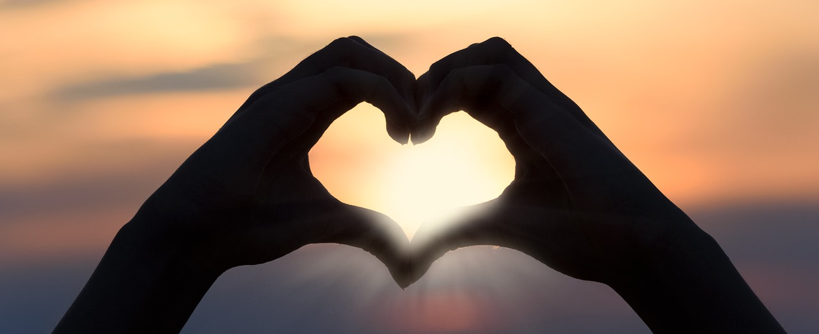
Leader: As we gather together
ALL: …we bring our hearts.
Notes:
Slide 1: Use these new gathering words for this term, or your usual greeting if you prefer. The greeting comes with BSL signing; you can view the demos using links under the slide.
Leader: As we gather together,
ALL: …we bring our hearts
Signs for greeting: click on links
Hearts: British Sign Language BSL Video Dictionary - heart

Slide 2
Leader: As we gather together
ALL: …we share our thoughts.
Notes:
Slide 2: Use these new gathering words for this term, or your usual greeting if you prefer. The greeting comes with BSL signing; you can view the demos using links under the slide.
Leader: As we gather together,
ALL: …we share our thoughts.
Signs for greeting: click on links
Thoughts: British Sign Language BSL Video Dictionary - thought

Slide 3
Leader: As community together
ALL: …we serve one another.
Notes:
Slide 3: Use these new gathering words for this term, or your usual greeting if you prefer. The greeting comes with BSL signing; you can view the demos using links under the slide.
Leader: As community together,
ALL: …we serve one another.

Slide 4
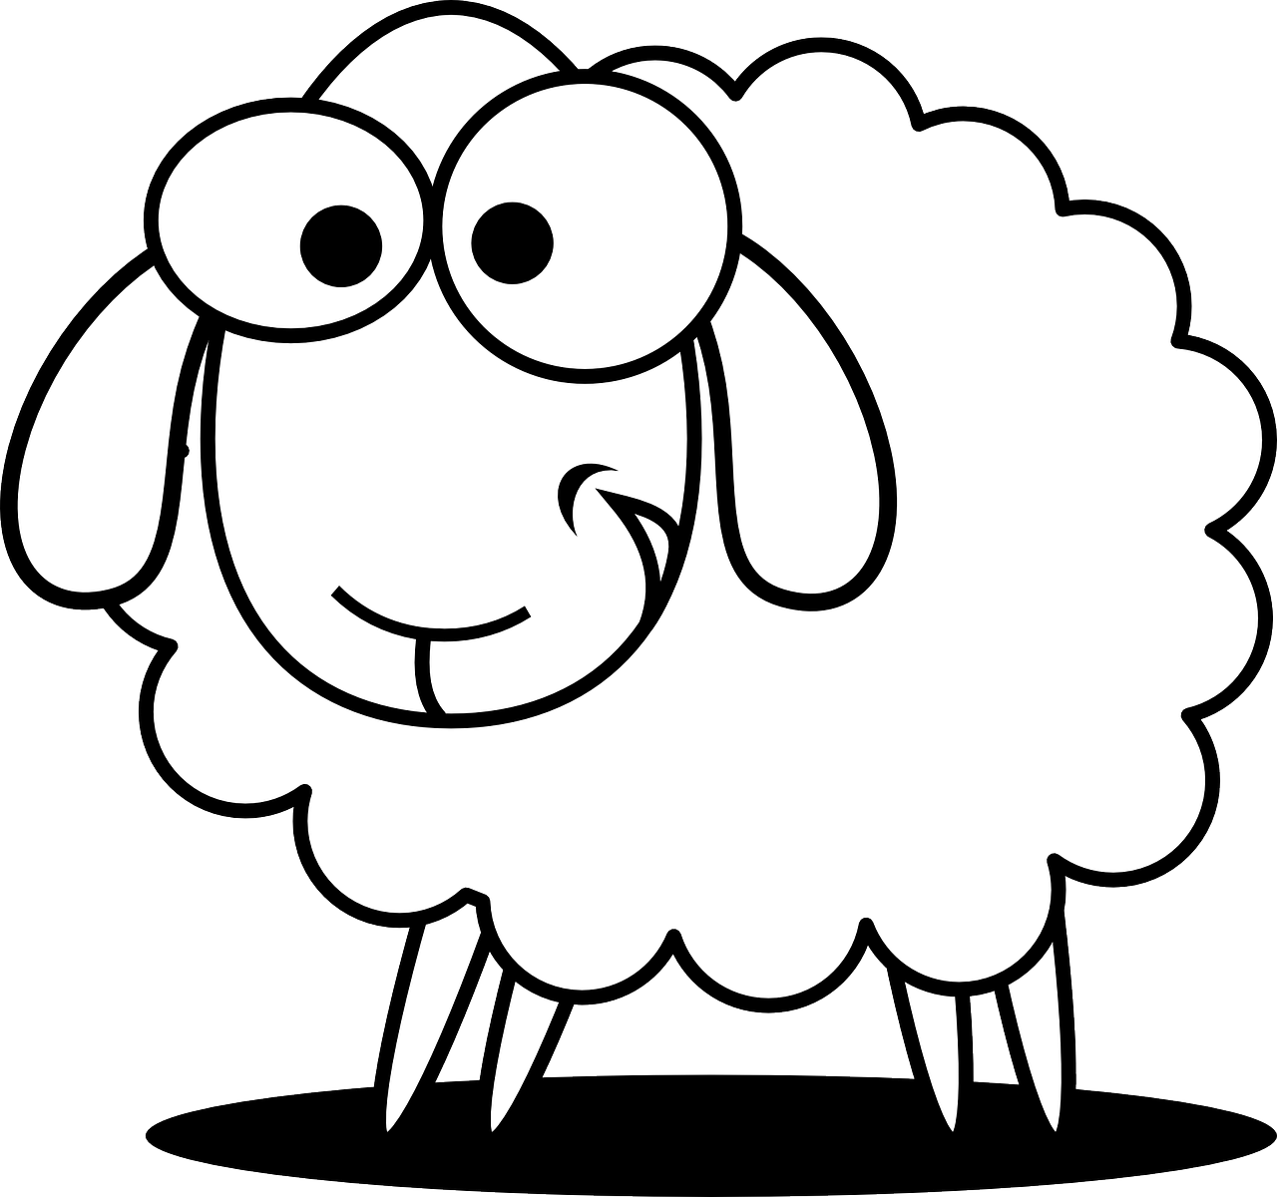
!
Sheep-ish Facts
Notes:
Slide 4: We’re going to start our time together today, as we often do, with a bit of fun. (Either appoint ‘shepherds’ to round up the sheep cards before reading what’s on the back of each, or use the slides (5-10) to reveal each fun fact.) Then continue:

Slide 5
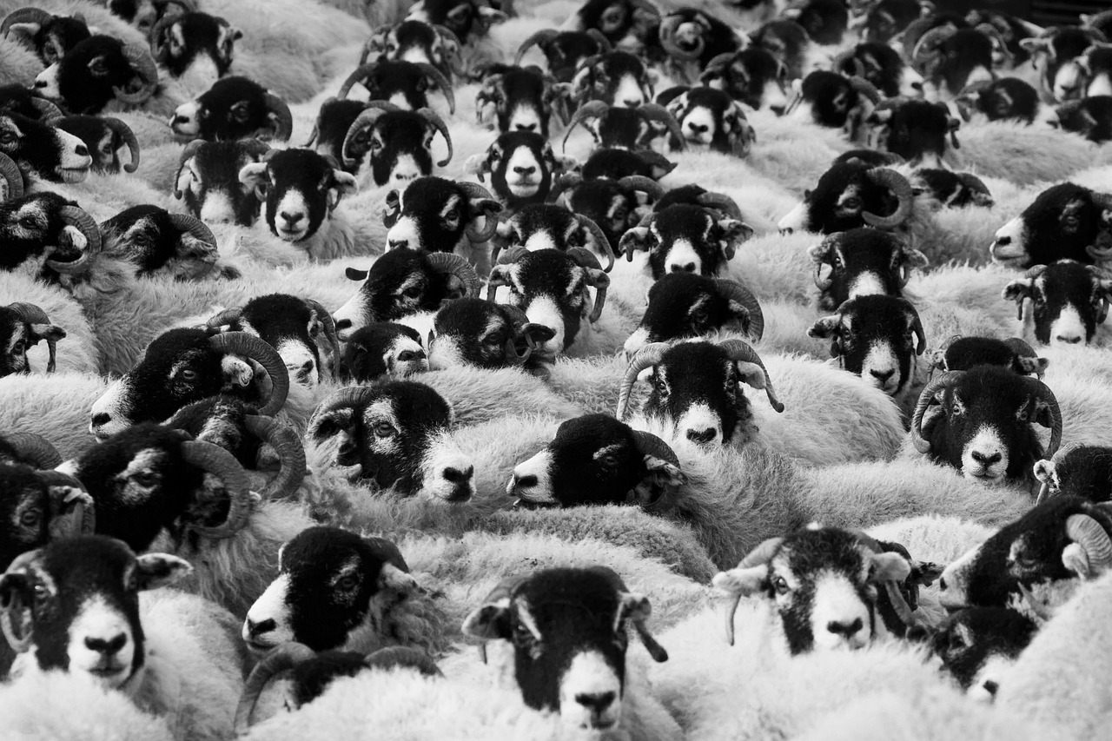
Notes:
Slide 5: A large number of sheep is called a flock, herd or mob! Sheep like to be part of a group – which is what makes them easy to move when they’re together.

Slide 6
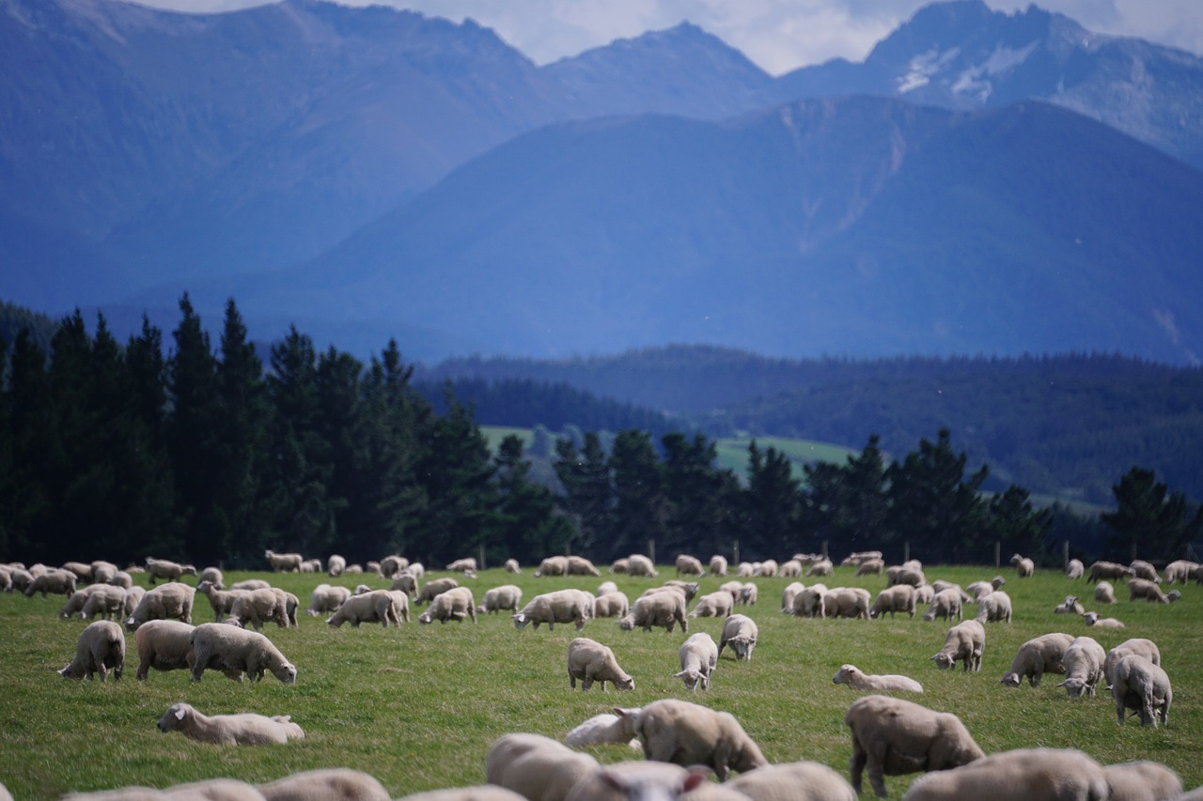
Notes:
Slide 6: There are over 1 billion sheep in the world. About 34 million of them live in New Zealand – which is about seven sheep for every person living there!

Slide 7
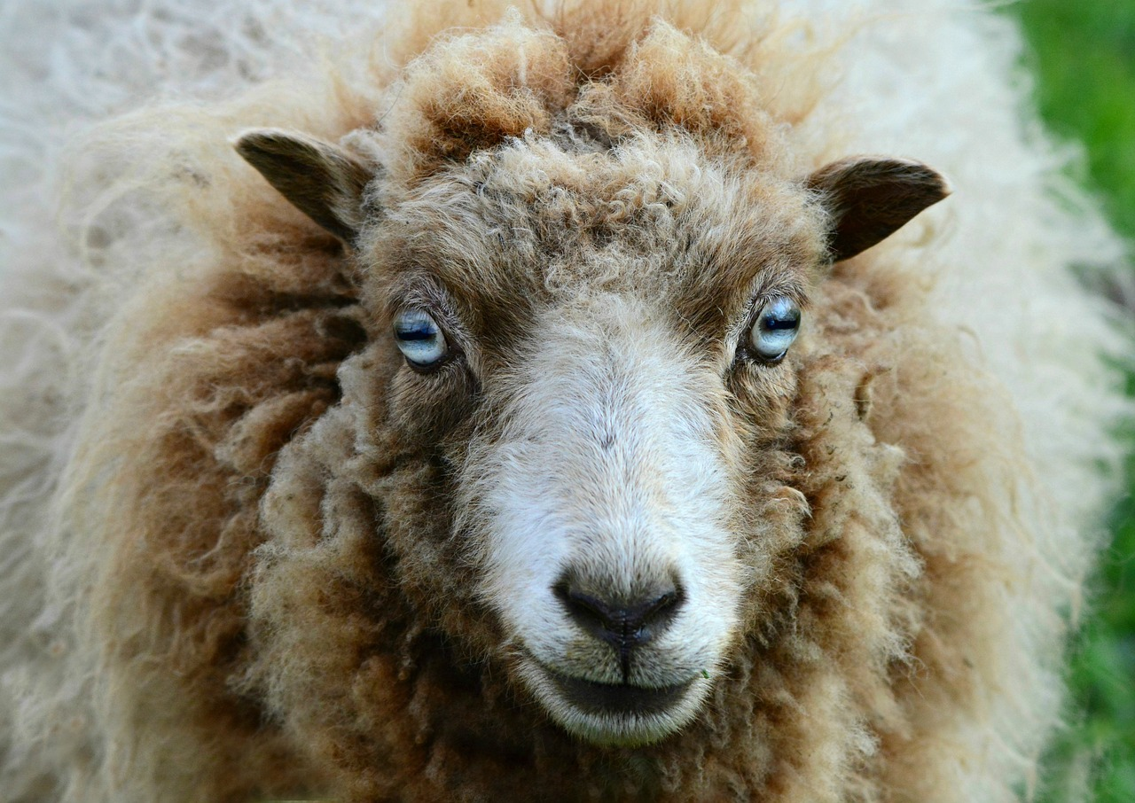
Notes:
Slide 7: Because of the position & design of their eyes, sheep can see behind themselves without turning their heads. They also have rectangular pupils, like goats.

Slide 8
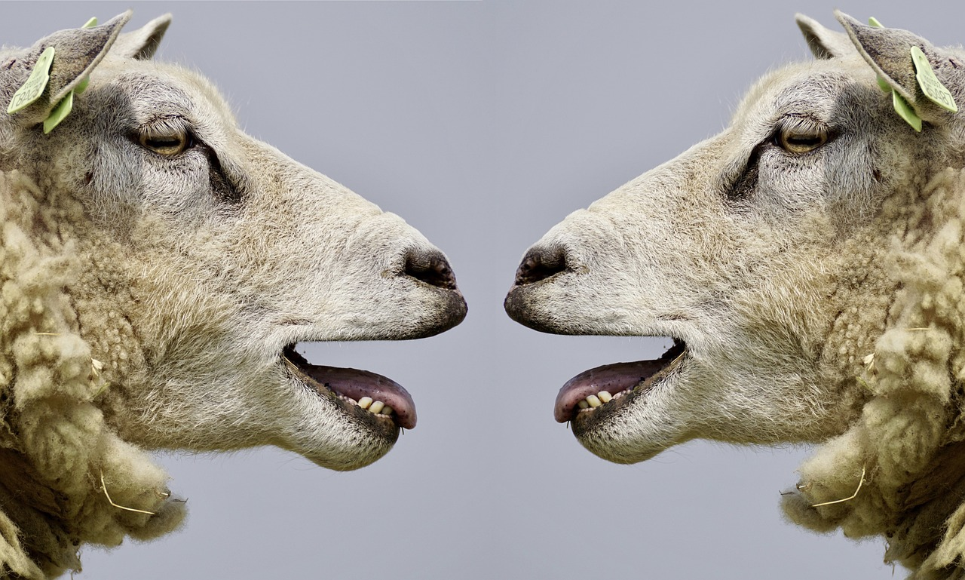
Notes:
Slide 8: Sheep can make different ‘baa-ing’ sounds to tell other sheep how they are feeling – a mother sheep can recognise their lambs by their bleating when they wander off. They get easily stressed if there is danger nearby – or if they become separated from the flock.

Slide 9
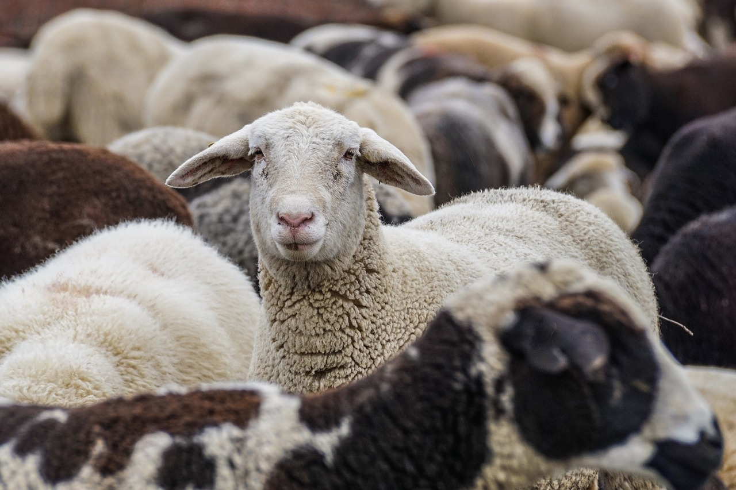
Notes:
Slide 9: Sheep have very good memories, and can recognise people they know as well as other sheep.

Slide 10
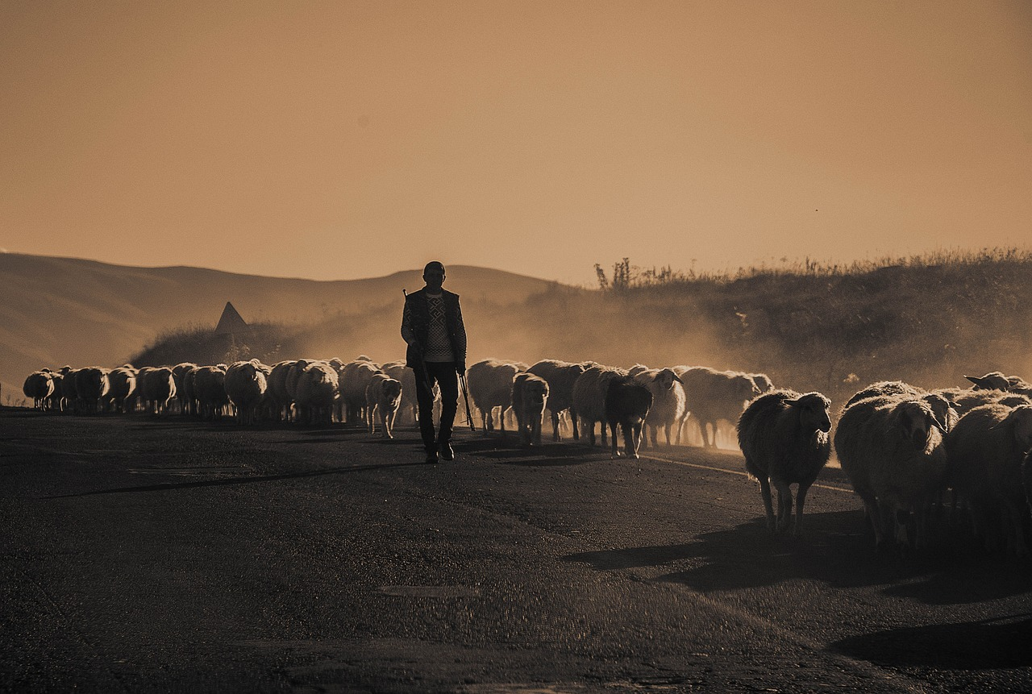
Notes:
Slide 10: A person who looks after sheep is called a shepherd – and, as you might know, sheep need an awful lot of looking after so that they stay safe!

Slide 11
Songs from
the heart
Notes:
Slide 11: Last time, we heard about the great Jewish king, King David. Before he was a king, he was a shepherd, and he knew everything there was to know about sheep. Like any shepherd, David was no stranger to danger, and as we heard last week, he’d had to rescue his sheep many a time from lions, wolves and bears….He loved his sheep, and they knew his voice. But as we also heard, David was also a great writer and he wrote many songs about God, whom he loved, songs that people now call the Psalms……
Today, I’m going to share with you what David wrote in Psalm 23, the shepherd’s psalm, which is his most famous…..

Slide 12
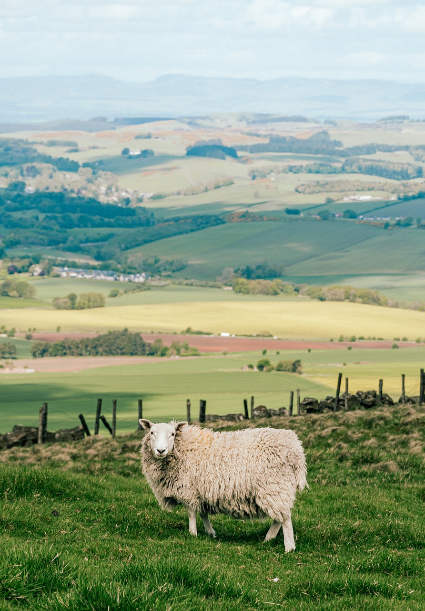
Psalm 23
Notes:
Slide 12: Psalm 23 use script on p.4-5
As you may have worked out, David wasn’t writing about sheep in Psalm 23 – he was writing about himself, and how it felt to know God’s care for him. There were times in David’s life when he wandered away from God, like a lost sheep, but David knew that because God was his shepherd, he would help him to find the right way to go. David’s Psalm is also special to people who are Jews and people who are Christians, and will help them as they trust God to lead them in their lives, whatever happens.

Slide 13
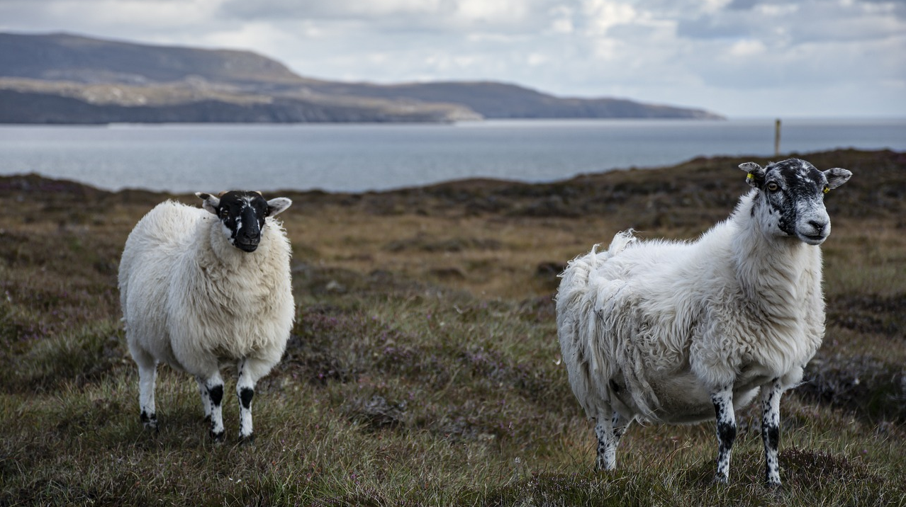
….I wonder who the people are in your life who you ‘follow’, who you feel safe with?
Notes:
Slide 13: Responding (and words for worship):
We’ve been thinking today about sheep…..and shepherds…..how sheep are kept safe when they follow where their shepherd leads them….how the shepherd knows each sheep’s voice…..and will search for them when they get lost…..
……think about your own life for a few moments now…..
….I wonder who the people are in your life who you follow?….
…..the people you feel totally safe with…..
…..the people who are like your shepherd?…..
….think about those people now…..
….that’s what David said that God is like, only even more trustworthy….
…….

Slide 14
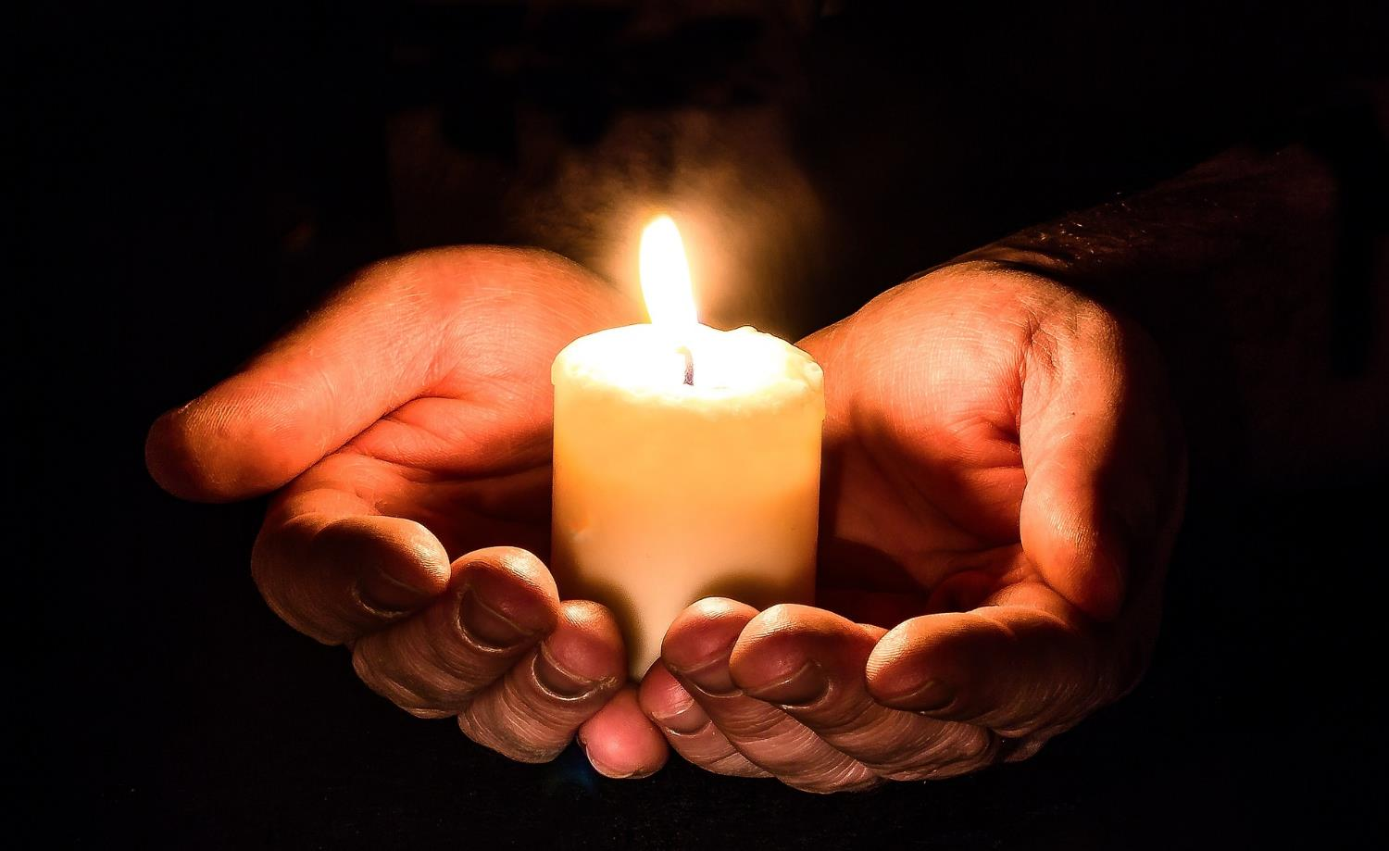
Notes:
Slide 14: Prayer
Now I’m going to pray, using some of the words from David’s psalm. If you agree with what I’m saying and would like to pray with me, then listen to the words carefully and join in with the ‘amen’ at the end.

Slide 15
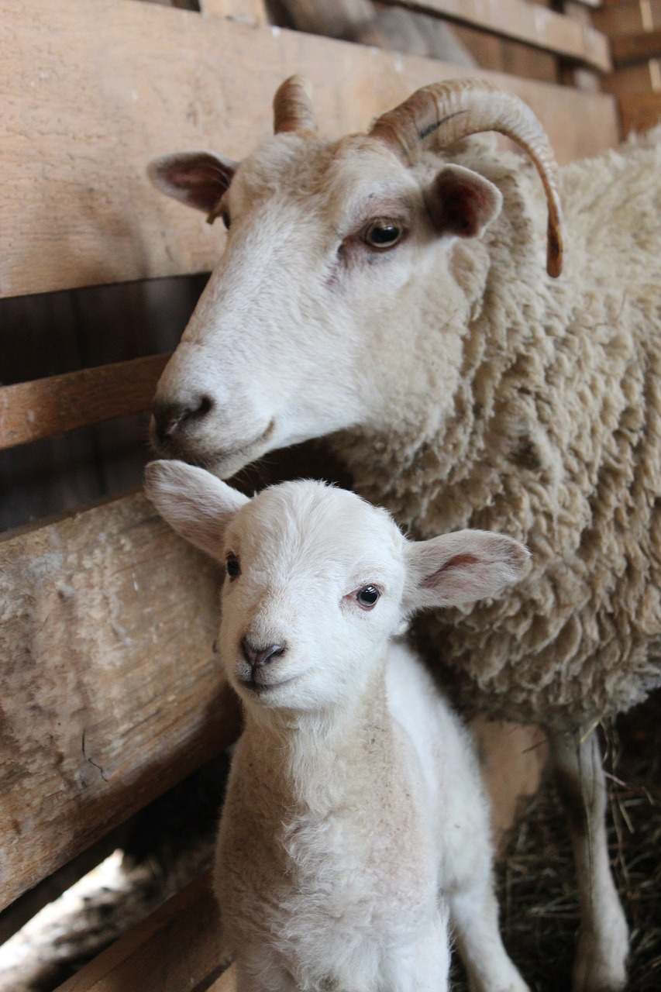
Thank you, God, that you are like the very best shepherd – you give us everything we need.
You lead us along safe paths, and we don’t need to be afraid because you are with us wherever we go.
Thank you, God, our shepherd.
Notes:
Slide 15: Prayer
Thank you, God, that you are like the very best shepherd – you give us everything we need.
You lead us along safe paths, and we don’t need to be afraid because you are with us wherever we go.
Thank you, God, our shepherd.

Slide 16
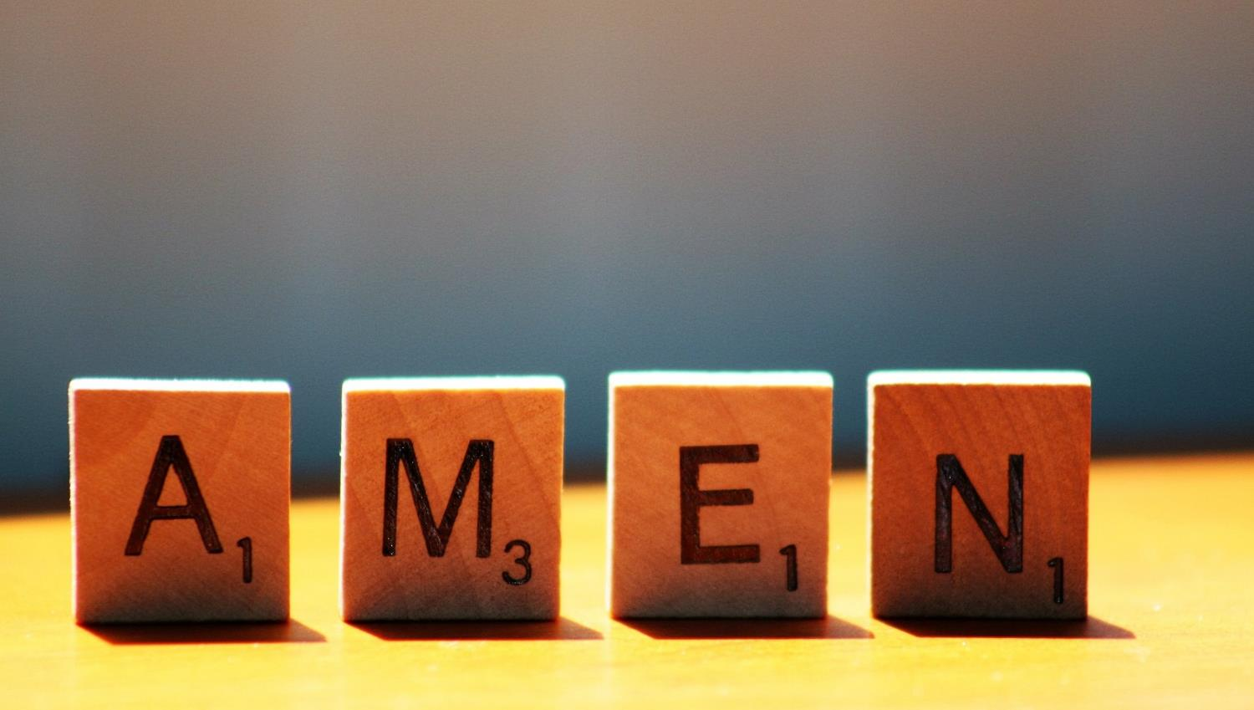

Slide 17
Leader: As we leave this place & time and go into the day ahead…
All: …may we serve one another in our thoughts and words and actions.
Notes:
Sending: Slide 21
Leader: As we leave this place and time and go into the day ahead,
All: ….may we serve one another in our thoughts and words and actions.
Signs for response: click on links
Thoughts: British Sign Language BSL Video Dictionary - thought (signbsl.com)
Words (use 3rd definition): British Sign Language BSL Video Dictionary - word (signbsl.com)
Actions: British Sign Language BSL Video Dictionary - action (signbsl.com)

Slide 18
Notes:
Ideas for classroom reflection (this week, there are a few ideas to choose from!):
‘We are grateful for these ‘goodnesses’….’: Use the present from last week, and leave slips of paper for children to write on to post into the box. When things get hard, pull one out and use them to help you to feel grateful for good things, like David did.

