Slide 1
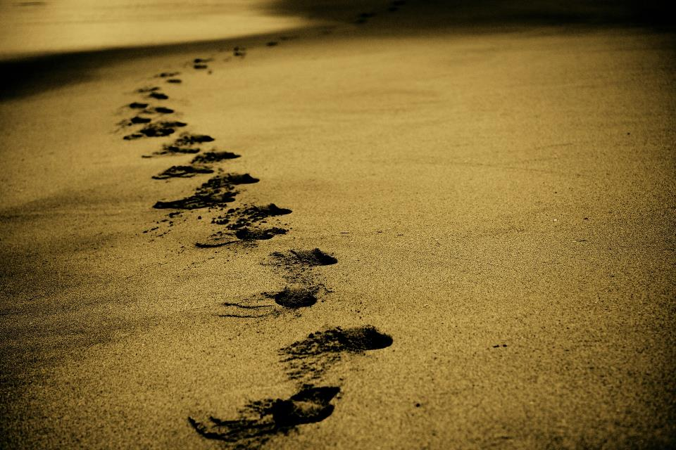
Picture copyright-free from pixabay
Leader: We are on this journey together…
Children: We are friends along the way…
ALL: May God go with us.
Notes:
Slide 1 or 2 [choose whichever image you prefer, or use them in rotation]:
Use the greeting for this term
Leader: We are on this journey together…
Children: We are friends along the way…
ALL: May God go with us.
BSL interpretation:
Sign for ‘way’ (nearest to the idea of ‘journey’): British Sign Language BSL Video Dictionary - way
Sign for ‘friends’: British Sign Language: friends
Sign for ‘God: British Sign Language BSL Video Dictionary - God
Sign for ‘go with us’ – we have invented this! After you’ve signed ‘God’, bring your finger down alongside your other finger and make them ‘journey together’ in front of you.
Engaging:
As we heard last week, in the final term of this school year, we are beginning a new theme:

Slide 2
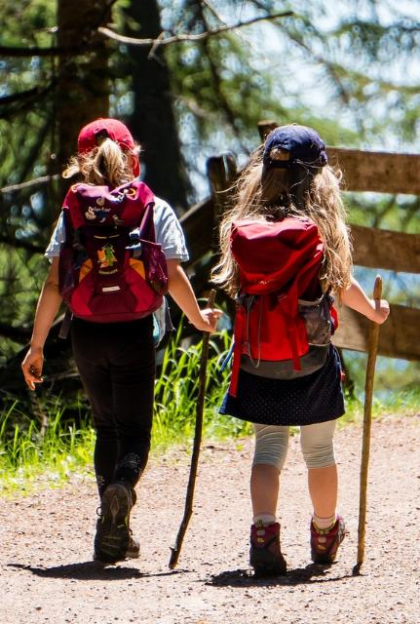
Picture copyright-free from pixabay
Leader: We are on this journey together…
Children: We are friends along the way…
ALL: May God go with us.
Notes:
Slide 1 or 2 [choose whichever image you prefer, or use them in rotation]:
Use the greeting for this term
Leader: We are on this journey together…
Children: We are friends along the way…
ALL: May God go with us.
BSL interpretation:
Sign for ‘way’ (nearest to the idea of ‘journey’): British Sign Language BSL Video Dictionary - way
Sign for ‘friends’: British Sign Language: friends
Sign for ‘God: British Sign Language BSL Video Dictionary - God
Sign for ‘go with us’ – we have invented this! After you’ve signed ‘God’, bring your finger down alongside your other finger and make them ‘journey together’ in front of you.
Engaging:
As we heard last week, in the final term of this school year, we are beginning a new theme:

Slide 3
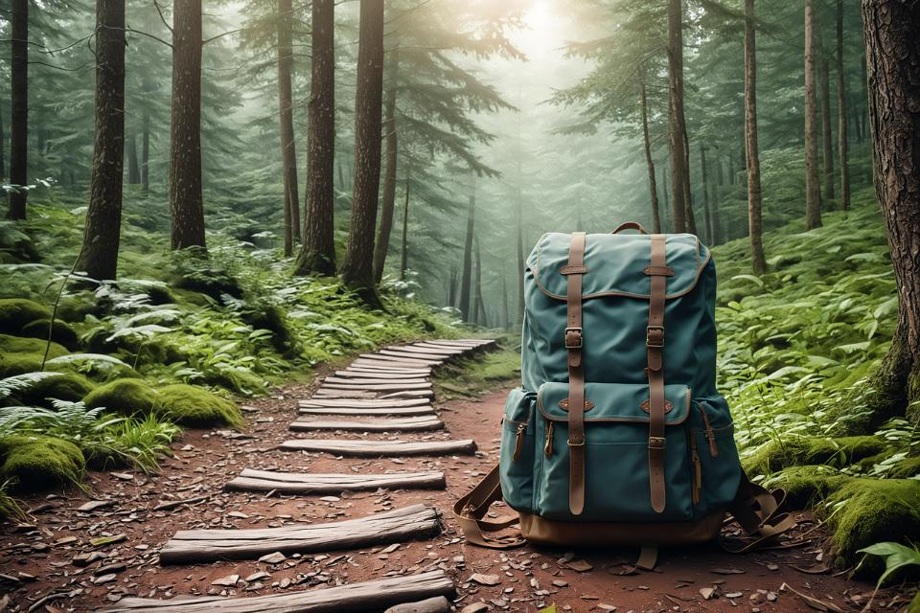
Picture copyright-free from pixabay
To boldly go….
Notes:
Slide 3: To boldly go….. As you’ll know now, our new theme is all about journeys, and today we will explore our first story together in our term of adventuring.

Slide 4
Old
or
New?
Notes:
Slide 4: Old or new? To get us thinking as we begin our time together today, I have some pictures to show you - some are of old things, some are new, and all you need to decide is which are which!

Slide 5
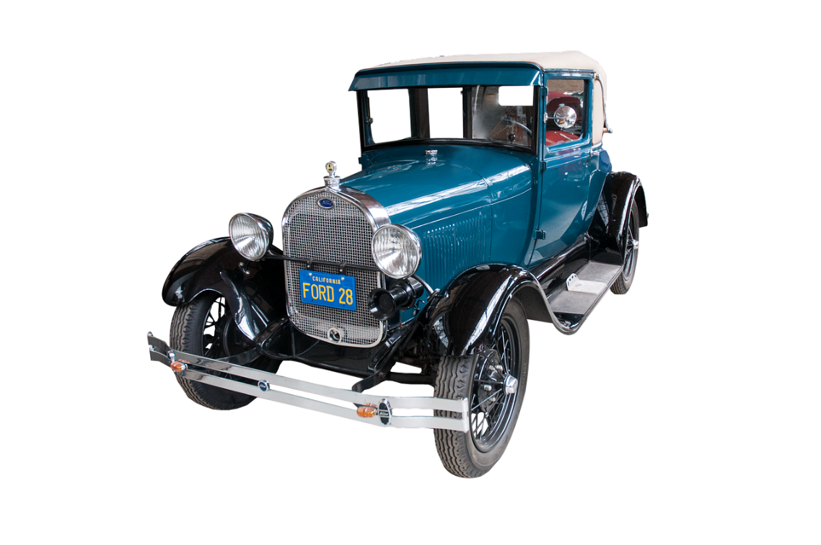
Picture copyright-free from pixabay
Old
Notes:
Slide 5: Model T Ford OLD
This was the first mass-produced motor car, launched in 1908 by American Henry Ford.

Slide 6
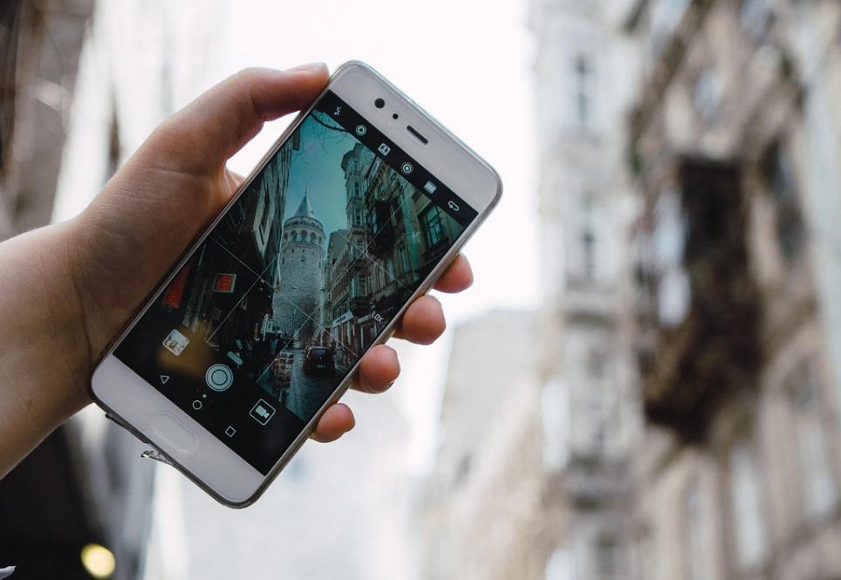
Picture copyright-free from pixabay
New
Notes:
Slide 6: Smartphone NEW
I’m sure that we’re all quite familiar with these hand-held devices: in fact many of us use these now instead of a landline phone. And they can do sooo much more than just be a phone!!

Slide 7
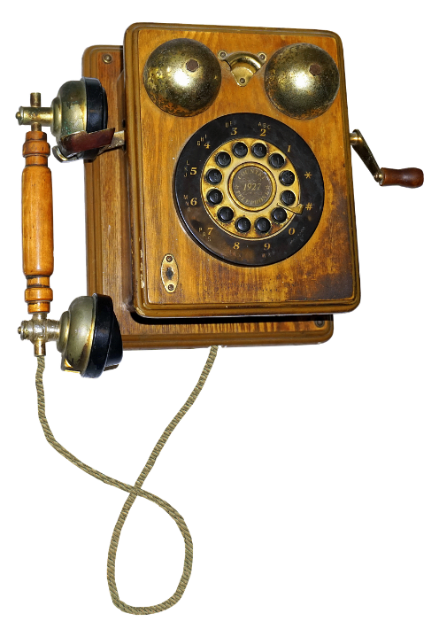
Picture copyright-free from pixabay
Old
Notes:
Slide 7: Wooden telephone OLD ….and here’s a much older version! This wouldn’t fit in your pocket!!!

Slide 8
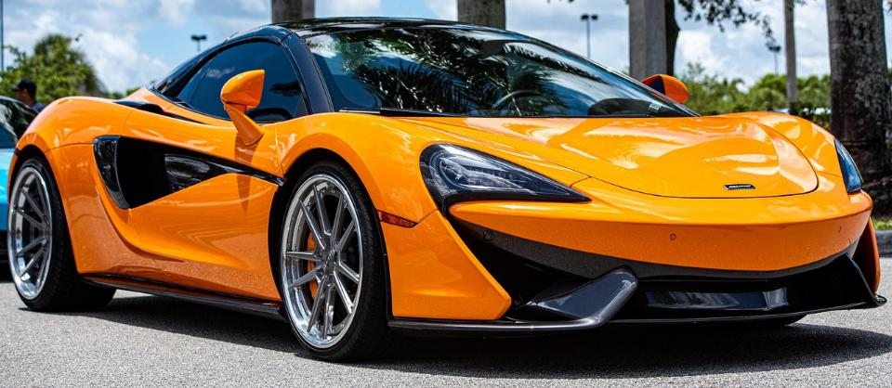
Picture copyright-free from pixabay
New
Notes:
Slide 8: McLaren Supercar NEW from the company based here in Surrey, in Woking!

Slide 9
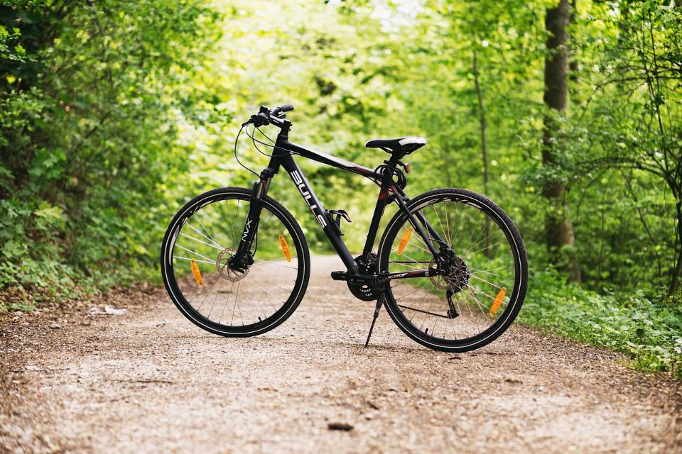
Picture copyright-free from pixabay
New
Notes:
Slide 9: Mountain bike NEW

Slide 10
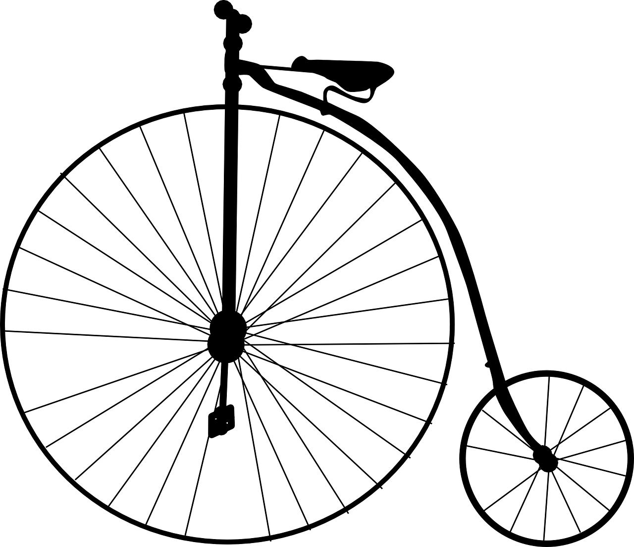
Picture copyright-free from pixabay
Old
Notes:
Slide 10: Penny Farthing OLD This is a Penny Farthing bicycle, so called because the difference in size of the wheels was similar to the difference in size of 2 very old coins, the penny and the farthing. It doesn’t look very easy, or comfortable, to ride, does it?

Slide 11
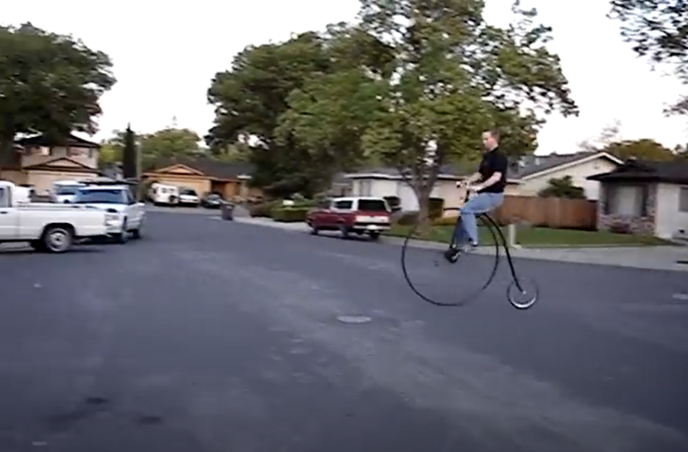
Notes:
Slide 11: Let’s watch how it’s done. This is a video of someone getting onto and riding this very old bicycle…. [click on photo to launch video; chat for a while following this to allow pupils to talk about the challenges of travelling on such a bicycle!!]
So, before we find out what a Penny Farthing has to do with today’s story, let’s open our trusty rucksack and see what’s inside…..

Slide 12
Picture copyright-free from pixabay
What’s in the rucksack?
Notes:
Slide 12: What’s in the rucksack?
Open up the rucksack and show children the mackintosh – establish how it would be used if anyone is unsure.
This was an essential piece of equipment for the gentleman in our story today…..

Slide 13
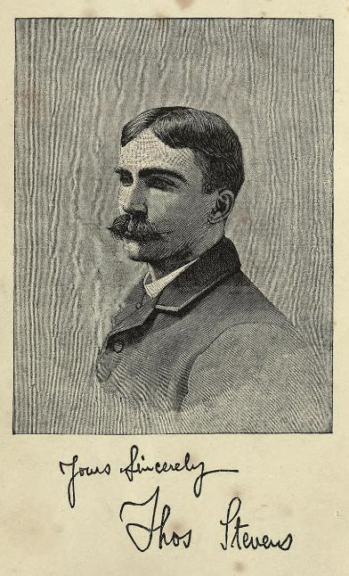
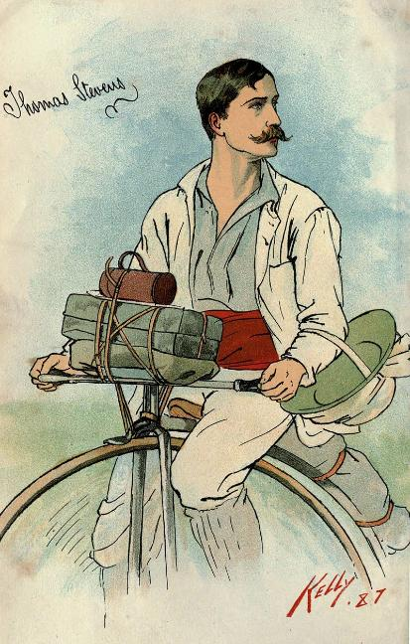
Images from Wikipedia
Notes:
Slide 13: This is Thomas Stevens, a Victorian gentleman with a very fine moustache, as you can see – and the proud owner of a Penny Farthing bicycle!
In April 1885, he began a long journey on his Penny Farthing. He’d already cycled his way across America and he wanted to set himself another challenge, so he set sail for the UK, which is where his family had come from, and where we begin our story. The only things that he packed in his handlebar bag to go with him on his journey were a spare pair of socks, a spare shirt…. and a mackintosh, which he made into a tent with his Penny Farthing, to sleep in when he needed to.
So, let’s share the story of his adventure together. We’re going to use a sort of ‘We’re going on a bear hunt!’ model of story, so do join in when you can! (And watch the red dot, because it’ll show you where Thomas cycles on his bumpy Penny Farthing!)

Slide 14
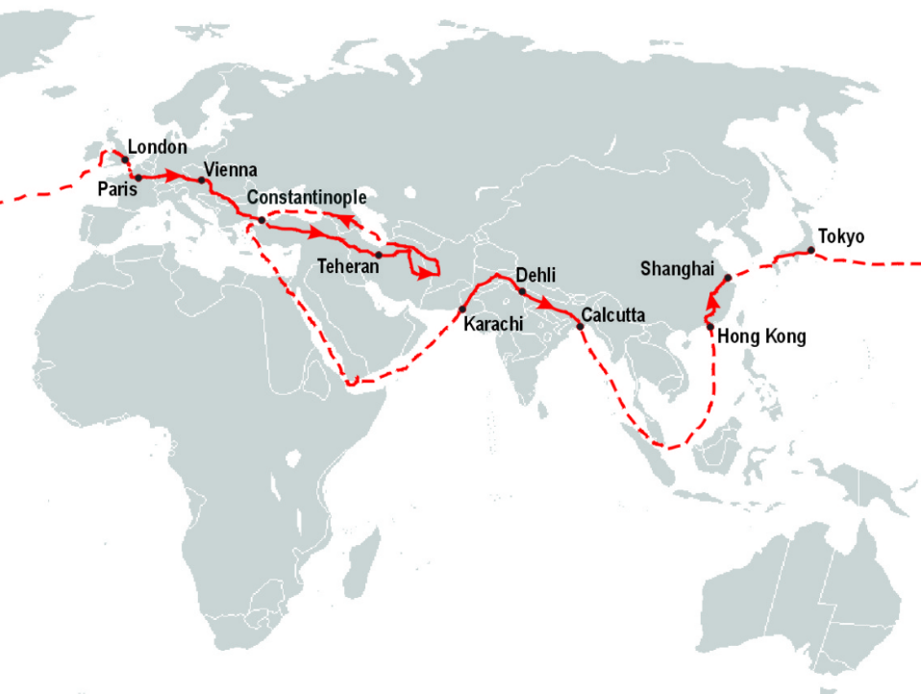
Map from Wikipedia
We’re going on a journey….
Notes:
Slide 14: We’re going on a journey…..
We’re going on a journey on a buuuuumpy Penny Farthing….
It’s a long way, we’re a bit tired…..

Slide 15
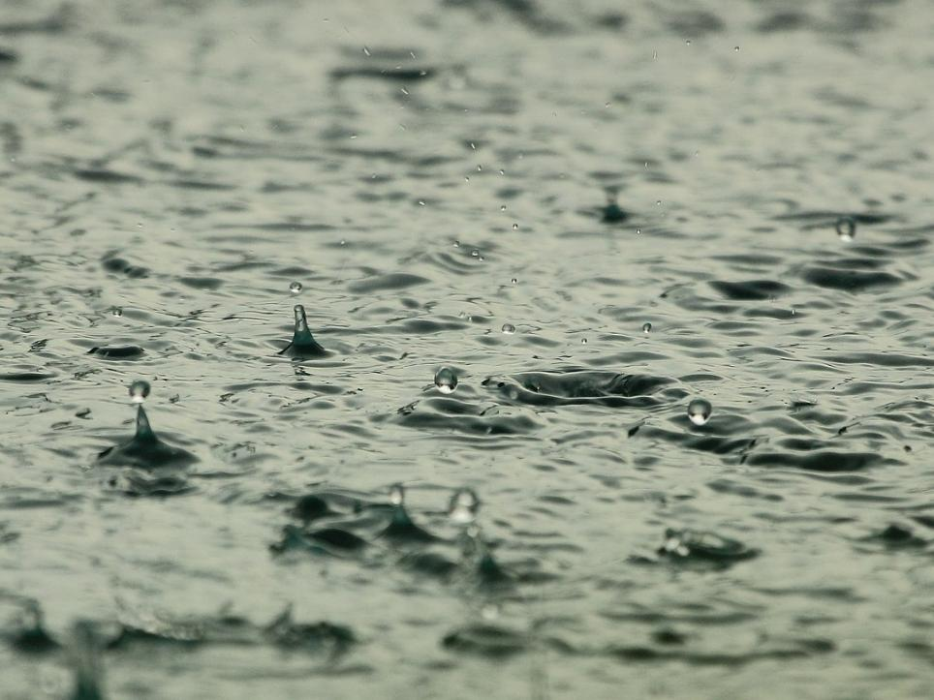
….We can’t go around it…..
….we can’t go under it….
….We’ll have to go THROUGH it!
Pedal….SPLASH! Pedal….SPLASH!
Pedal….SPLASH!
Notes:
Slide 15:
Uh-oh the rain, we’ll have to put our ‘mac’ on….
We can’t go around it, we can’t go under it
We’ll have to go through it….
Pedal SPLASH…… Pedal SPLASH…… Pedal SPLASH……

Slide 16
Map from Wikipedia
We’re going on a journey….
Notes:
Slide 16: We’re going on a journey…..
We’re going on a journey on a buuuuumpy Penny Farthing….
It’s a long way, we’re a bit tired…..

Slide 17
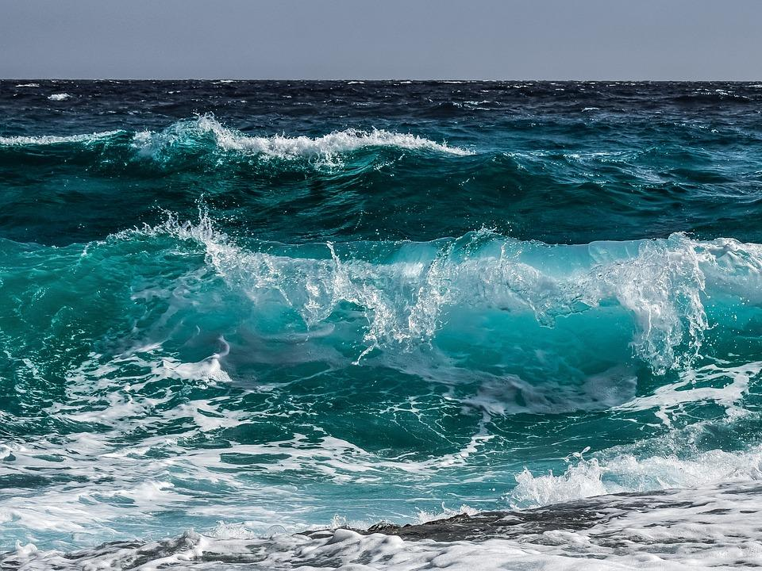
….We can’t go around it…..
….we can’t go under it….
….We’ll have to go ACROSS it!
UP…..and down…. UP…..and down….. UP….and down!
Notes:
Slide 17:
Uh-oh the Channel, the deep English Channel
We can’t go around it, we can’t go under it
We’ll have to go across it….
UP and down and UP and down and UP and down

Slide 18
Map from Wikipedia
We’re going on a journey….
Notes:
Slide 18: We’re going on a journey…..
We’re going on a journey on a buuuuumpy Penny Farthing….
It’s a long way, we’re a bit tired…..

Slide 19
….We can’t go on with this…..
….we’ll have to stop and mend it….
……….
‘Can we fix this?!’ ‘YES WE CAN!!!’
‘Can we fix this?!’ ‘YES WE CAN!!!’
Notes:
Slide 19:
Uh-oh a broken spoke in Constantinople….
We can’t go on with it, we’ll have to stop and mend it
[sing this, Bob the builder style…!]
‘Can we fix it? – yes we can!’ ‘Can we fix it? – yes we can!’

Slide 20
Map from Wikipedia
We’re going on a journey….
Notes:
Slide 20: We’re going on a journey…..
We’re going on a journey on a buuuuumpy Penny Farthing….
It’s a long way, we’re a bit tired…..

Slide 21
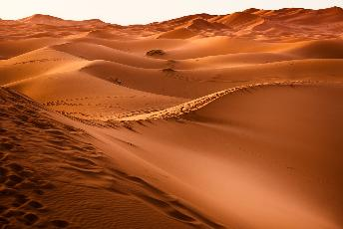
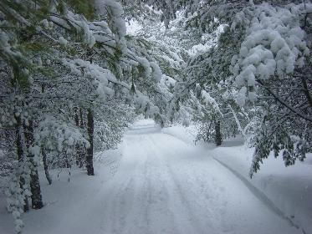
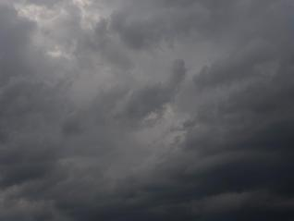
….We can’t go over it…..
….we can’t go around it….
We’ll have to take a break until Spring arrives at last…….
Notes:
Slide 21:
Through deserts and rainstorms and now snow’s begun to fall.
We can’t go over it, we can’t go around it
We’ll have to take a break until Spring arrives at last
[leave a long-ish pause]………

Slide 22
Map from Wikipedia
We’re going on a journey….
Notes:
Slide 22: We’re going on a journey…..
We’re going on a journey on a buuuuumpy Penny Farthing….
It’s a long way, we’re a bit tired…..

Slide 23
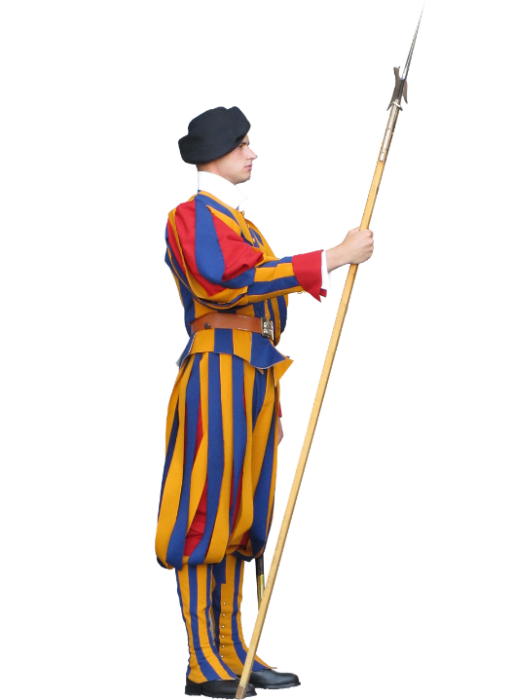
….We can’t go past them…..
….we can’t get around them….
….We’ll have to go back and get a steamer ship to India!!!
UP…..and down…. UP…..and down….. UP….and down!
Notes:
Slide 23:
Uh-oh – some guards, who won’t let us through
We can’t go past them, we can’t get around them,
We’ll have to go back and get a steamer ship to India
UP and down and UP and down…….

Slide 24
Map from Wikipedia
We’re going on a journey….
Notes:
Slide 24: Pause and look at the route, and how far back on himself Thomas had to go! [watch the red dot]
We’re going on a journey on a buuuuumpy Penny Farthing….
It’s a long way, we’re a bit HOT!!!…..

Slide 25
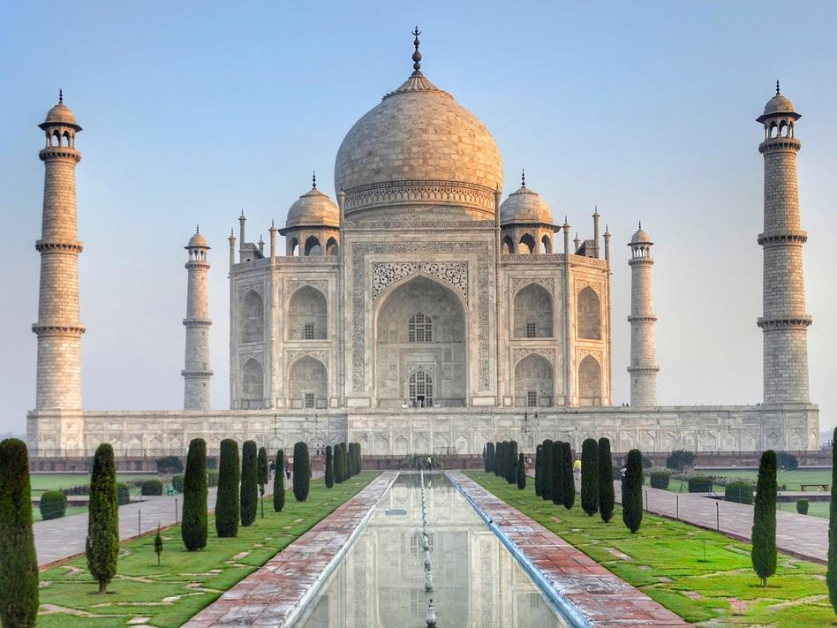
….We won’t go around it…..
….we’ll stay and have a look!….
Ooooh…..WOW!....Ooooh…..WOW!....
Ooooh…..WOW!....
Notes:
Slide 25:
Oooh look, a building – a graceful marble building
We won’t go around it, we’ll stay and have a look….
Ooooh WOW! Ooooh WOW! Ooooh WOW!

Slide 26
Map from Wikipedia
We’re going on a journey….
Notes:
Slide 26: Pause and look at the route, and how far back on himself Thomas had to go! [watch the red dot]
We’re going on a journey on a buuuuumpy Penny Farthing….
It’s a long way, we’re still a bit HOT!!!…..

Slide 27
….We can’t go around it…..
….we can’t go under it….
….We’ll have to go ACROSS it!
UP…..and down…. UP…..and down….. UP….and down!
Notes:
Slide 27:
Oh no, more sea – the wide deep sea!
We can’t go around it, we can’t go under it
We’ll have to go across it…. UP and down and UP and down

Slide 28
Map from Wikipedia
We’re going on a journey….
Notes:
Slide 28: We’re going on a journey on a buuuuumpy Penny Farthing….
It’s a long way, we’re still a bit tired!!!…..

Slide 29
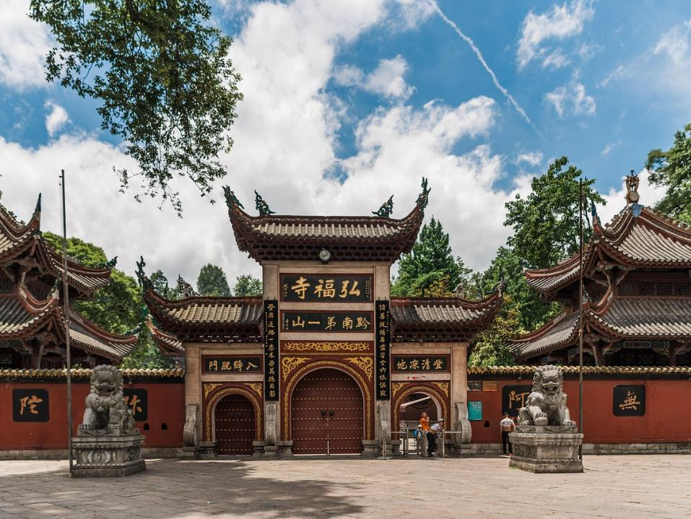
….We can’t go around it…..
….we can’t go under it!….
We’ll have to go ACROSS it!!
Hmm-oh dear! Hmm-oh dear! Hmm-oh dear!
Notes:
Slide 29:
Oh look, it’s China – with signposts we can’t read
We can’t go around it, we can’t go under it
We’ll have to go across it -
(scratching head) Hmm-oh dear! Hmm-oh dear! Hmm-oh dear!

Slide 30
Map from Wikipedia
We’re going on a journey….
Notes:
Slide 30: We’re going on a journey on a buuuuumpy Penny Farthing….
It’s a long way, we’re still a bit tired!!!…..

Slide 31
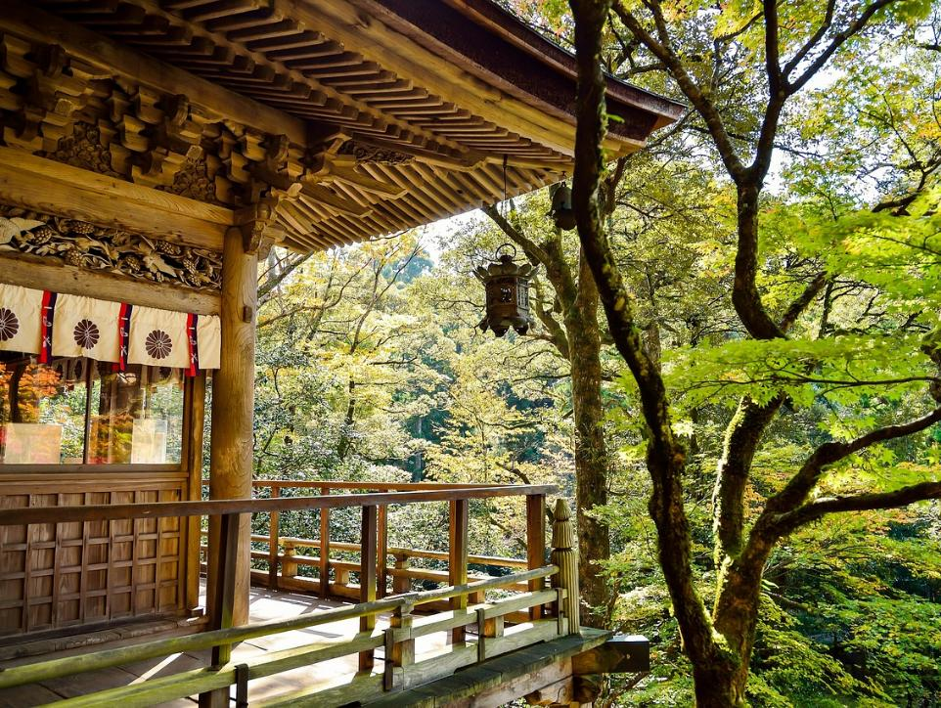
….We can’t go around it…..
….we can’t go under it!….
We’ll have to go ACROSS it!!
Pedal….AAAHHH!.... Pedal….AAAHHH!.... Pedal….AAAHHH!....
Notes:
Slide 31:
We’ve finally reached Japan, with its calm, and peaceful ways
We can’t go around it, we can’t go under it
We’ll have to go across it -
Pedal-Aaah! Pedal-Aaah! Pedal-Aaah!

Slide 32
The End!!
Map from Wikipedia
We’re going on a journey….
13,500 miles
Notes:
Slide 32: And now we’ve reached the end on our buuuuumpy Penny Farthing….
We’ve pedalled all the way….over 13 thousand miles!!!
We’ve met with many challenges across deserts and through rainstorms, but
It’s time to go back home now and tell others what we’ve done!
(The end)

Slide 33
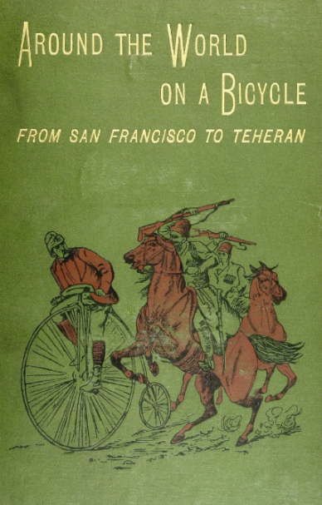
…let us keep on going with patient endurance and steady and active persistence….
(Hebrews 12:1)
Notes:
Slide 33: And this is the book that he wrote, in two parts (this is part 1), about all his adventures. His most favourite parts of the journey, it’s clear, were his visit to the Taj Mahal – and the peace that he felt in Japan (along with the excellent roads, he wrote!) What an absolutely amazing achievement at a time when travelling anywhere, let alone to other parts of the world presented all sorts of challenges – and completed in less than 2 years.
So, as we come towards the end our time together today, we’re going to hear some words from the Bible – probably to some of the first Christians in Jerusalem, who were finding life quite hard-going. Have a listen, and as you do, think about how they might connect with the story of Thomas Stevens….
…let us keep on going with patient endurance and steady and active persistence….
(Hebrews 12:1 – slightly tweaked from the Amplified Bible)
[Give pupils a few moments to share their thoughts]

Slide 34
…. I wonder how these words might help us in our own lives, on our own journey across this term?.....
….I wonder how the story of Thomas Stevens might help us to ‘keep on keeping on’?.....
…let us keep on going with patient endurance and steady and active persistence….
(Hebrews 12:1)
Notes:
Slide 34: Responding (and words for worship):
As we reflect and wonder together, let’s be still and quiet….
…we’ve heard about the epic adventure of Thomas Stevens….
….of the challenges he faced and overcame on his journey across the world…..
….we’ve also shared words from the Bible about the need for perseverance and endurance when things get difficult – we often talk about this at school!......
…. I wonder how these words might help us in our own lives, on our own journey across this term?.....
….I wonder how the story of Thomas Stevens might help us to ‘keep on keeping on’?.....
Sit quietly with your own thoughts now – you might like to use the time to pray your own prayer, or you might want to join me when I pray in a moment…..
[leave some time for individual reflection here]

Slide 35
Map from Wikipedia
We’re going on a journey….
When we are faced with challenges, may we keep on going with patient endurance and steady and active persistence.
Help us to keep on keeping on, we pray.
Notes:
Slide 35: Now I’m going to use the words from the Bible and turn them into a prayer. Make this prayer yours if you would like to….
When we are faced with challenges, may we keep on going with patient endurance and steady and active persistence.
Help us to keep on keeping on, we pray.

Slide 36
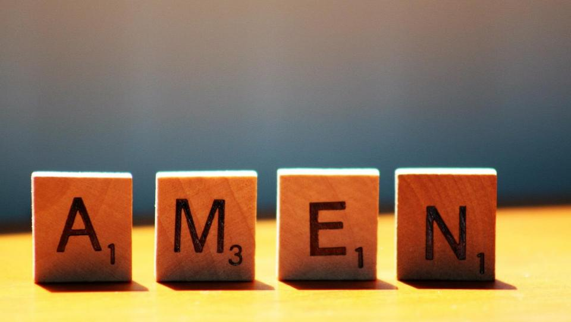

Slide 37
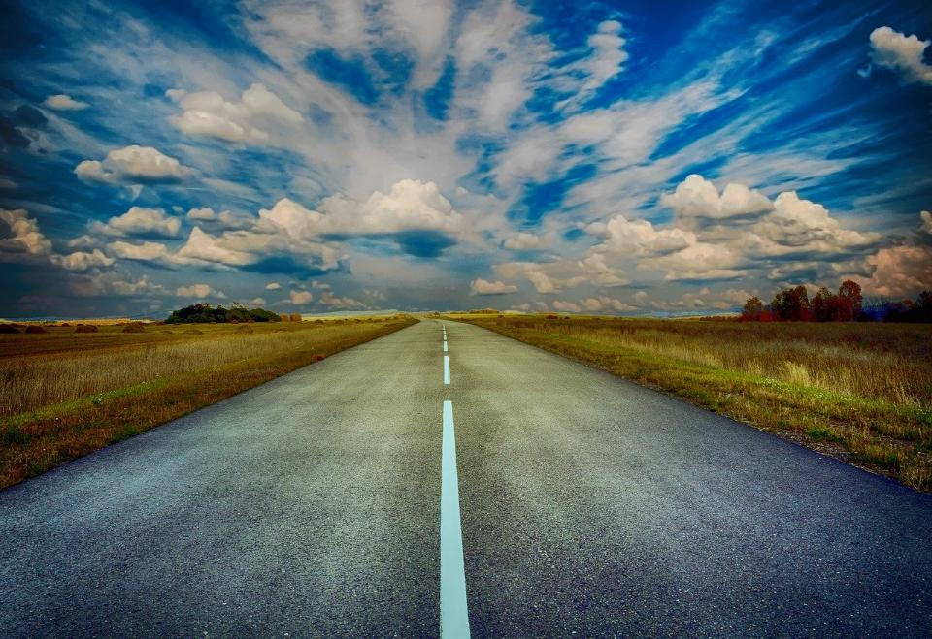
Picture copyright-free from pixabay
Leader: We have journeyed together today. As we leave this place and time and go into the day ahead…
ALL: …May God go with us.
Notes:
Slide 37: Use this term’s leaving words
Leader: We have journeyed together today. As we leave this place and time and go into the day ahead….
ALL: ….May God go with us.
Sign for ‘God: British Sign Language BSL Video Dictionary - God
Sign for ‘go with us’ – we have invented this! After you’ve signed ‘God’, bring your finger down alongside your other finger and make them ‘journey together’ in front of you.

Slide 38
Picture copyright-free from pixabay
Notes:
Ideas for classroom reflection: Personal challenge cards
Take a blank Penny Farthing card
Think about something that you are finding difficult at the moment.
This could be something at school or something outside of school.
Write or draw this onto the card. Keep this card somewhere safe to remind you to keep on going in the coming weeks.
Talk about how Thomas Stevens ‘kept on keeping on’ in his big Penny Farthing adventure.
How might his adventures inspire you to ‘keep on keeping on’?

