Slide 1





We are here together….
May our attitudes make our school community a happy place today.
Notes:
Slide 1: Teach the new gathering words for this term
Leader: We are here together
ALL: May our attitudes make our school community a happy place today.

Slide 2

Where’s this lesson?
Notes:
Slide 2: When we think of a lesson, we often think about being in school, but for today, we’re going to start by thinking about other places that lessons might take place…..
Join me to play ‘Where’s this lesson?....’

Slide 3
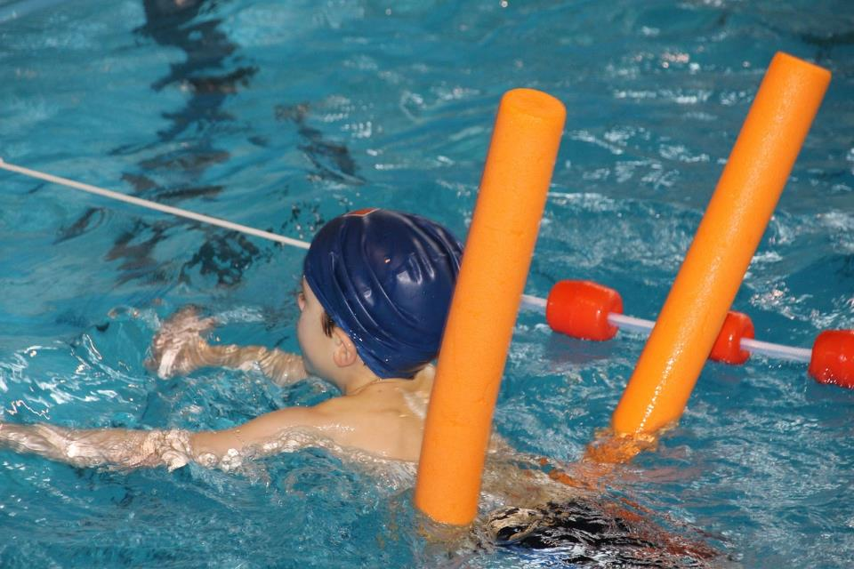
Notes:
In a swimming pool

Slide 4
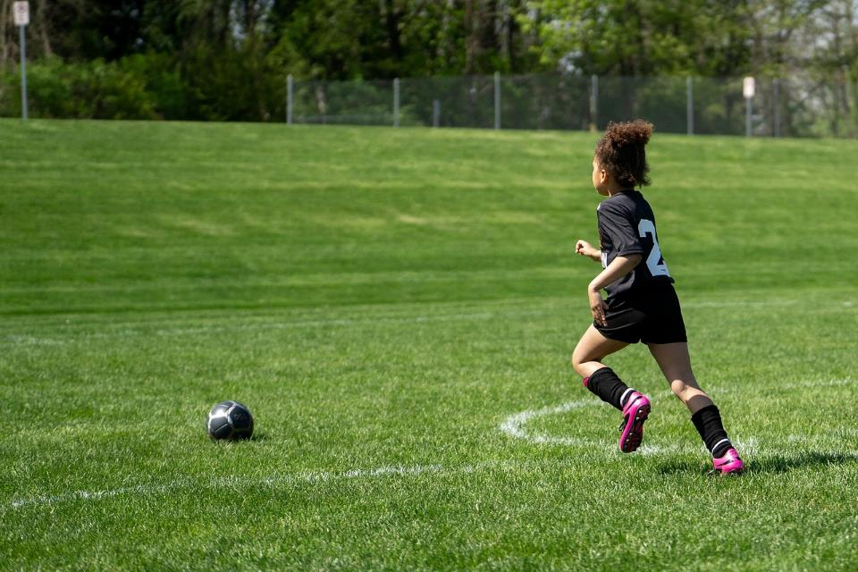
Notes:
On the field / football training

Slide 5
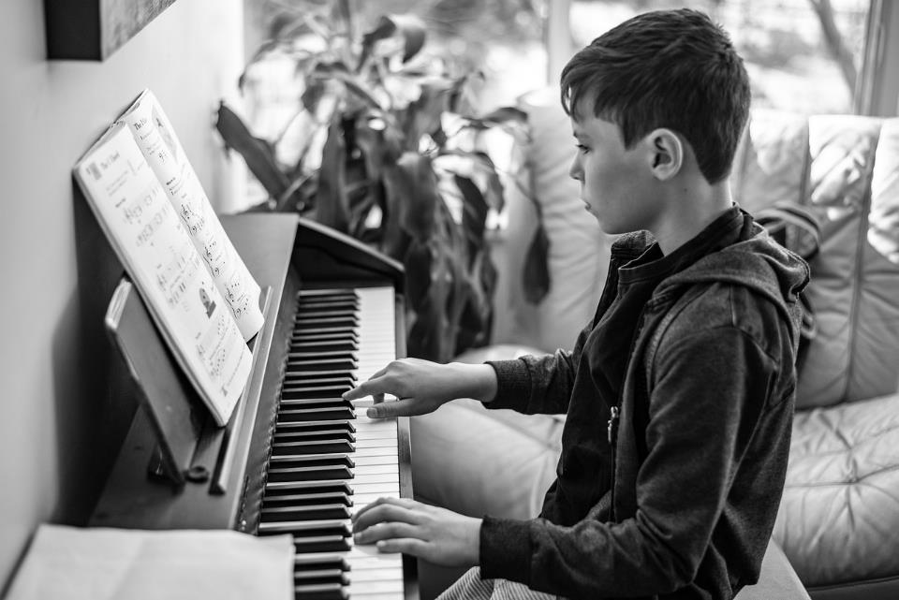
Notes:
At home

Slide 6
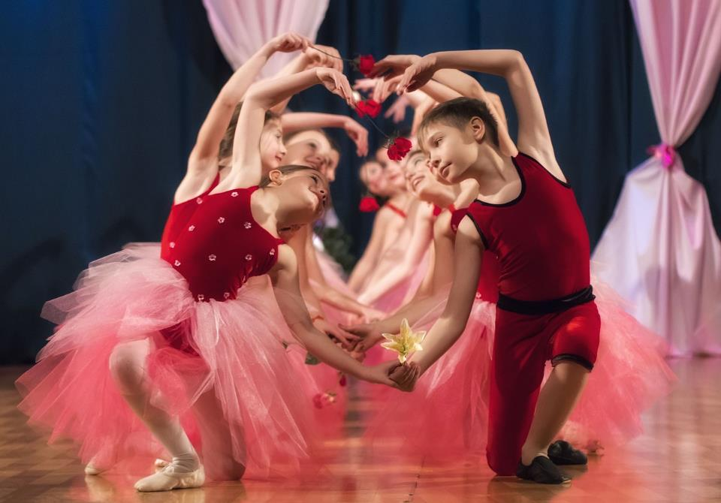
Notes:
In a dance school

Slide 7
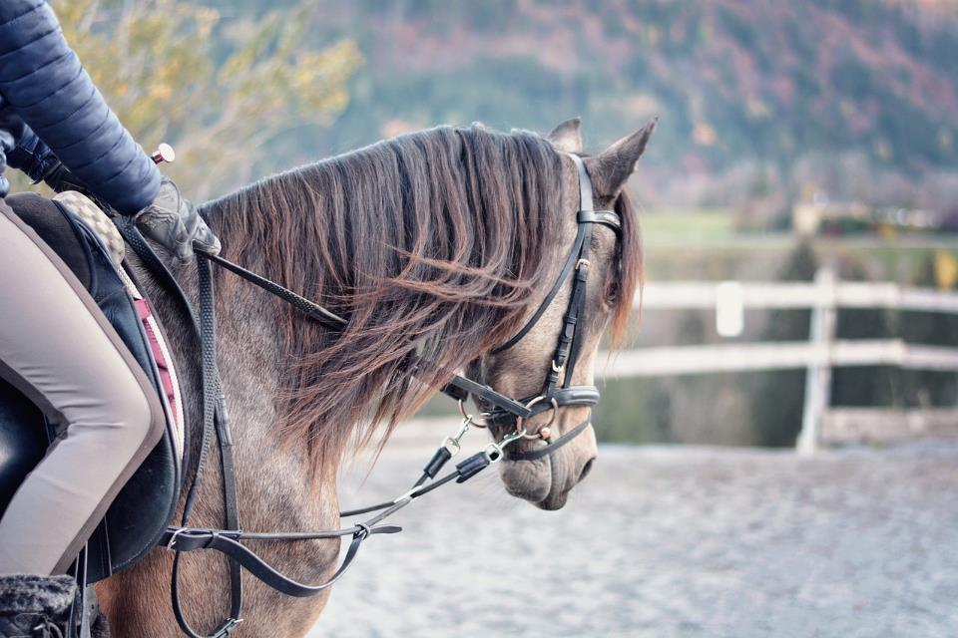
Notes:
In a riding school / on a field

Slide 8

What makes us happy?
Notes:
Slide 8: Two weeks ago, we thought about the question ‘What makes us happy?’ and we’ve been thinking more about it in our reflective areas. I wonder what different answers we have thought of? [Allow children to share some ideas.]
This really BIG question of what makes us happy has puzzled people over thousands of years, and it’s what we’re going to be thinking about over the coming weeks in our times together. We’re also going to find out what Jesus had to say about being happy, and we’re going to start with the story that I promised you last week, where Jesus teaches people, not in a classroom, but…..

Slide 9
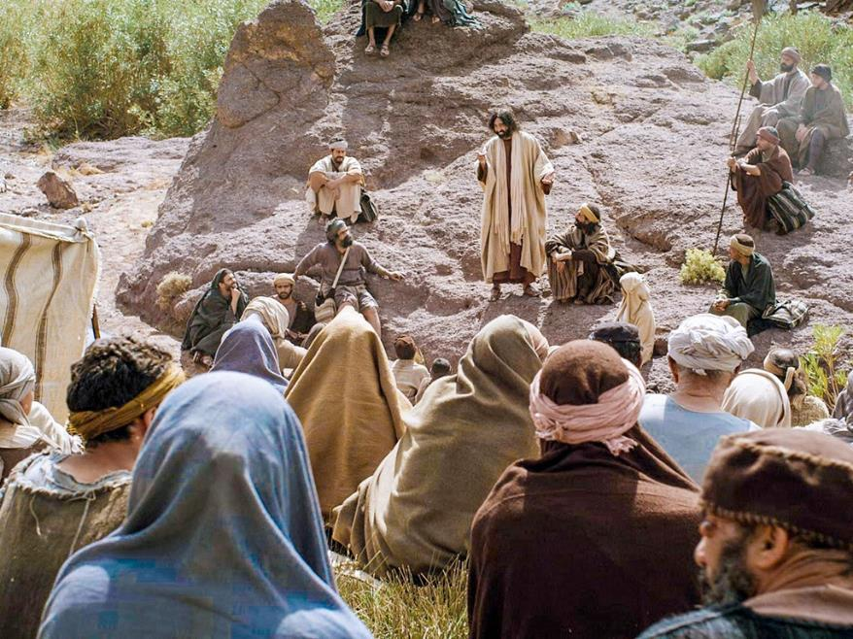

Notes:
Slide 9: ….on a mountainside! Jesus was a great teacher, and people loved to be near him. Wherever he went, crowds followed him to hear what he would say.
Don’t worry if it seems difficult to understand what Jesus was saying, because we’re going to explore more together, bit by bit over the next few weeks. [use script p. 3 and objects]

Slide 10

Picture copyright-free from pixabay
The Lesson
Notes:
Slide 10: I’m going to use some objects to help me….

Slide 11
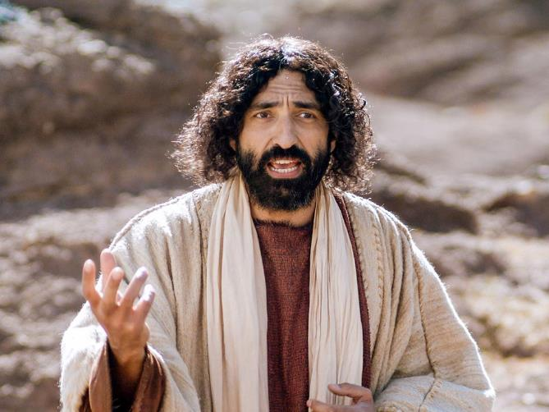
Jesus said: ‘You will be truly happy if….’
Notes:
Slide 11: We have thought together recently about the things that make us happy, and how our school values might help to do this here in our school community. Today, in the ‘lesson on the mountain’, we’ve heard how Jesus taught the crowds that there were things that would make them truly happy – things that should be a part of their everyday lives, just like food – in fact Jesus called it the ‘food’ of God’s kingdom...... I wonder if you can remember what some of them were?

Slide 12


Beatitudes
Beati
‘How-to-be-attitudes’
Notes:
Slide 12: Brilliant job! They were things like loving others and treating them with kindness.....forgiving others no matter what.....settling quarrels and being a ‘peacemaker’.
The words that we have shared in the story of Jesus’ lesson are going to be words that we will focus on during this term. In the Bible, they are called ‘The Beatitudes’ – which is a definition that comes from the Latin word ‘beati’ which means ‘blessed’, which is how Jesus started each of those important sentences, ‘Blessed are you if…..’.
To us, the word Beatitudes also sounds a lot like the word ‘attitude’, which is to do with how we behave in life, so we are doing a bit of word play and calling our theme this term the ‘How-to-be-attitudes’, as we explore Jesus’ words across the coming weeks.
We’ll be carrying on with some more of Jesus’ lesson next week, but for now, let’s draw our thoughts together.

Slide 13
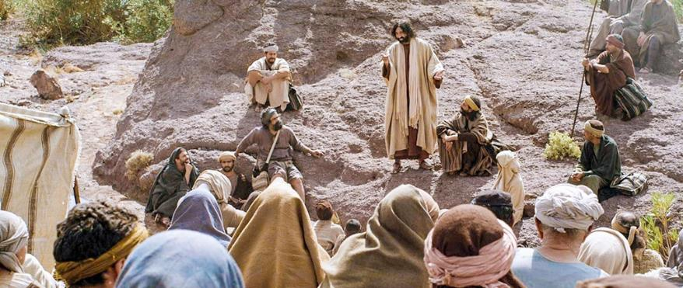
….I wonder what the people thought when they heard what Jesus said?.....
….I wonder what this shows about what’s important in God’s kingdom?.....
….I wonder what this might teach people about being truly happy?....or how to behave towards each other?....
Notes:
Slide 12: Responding and words for worship
At the end of the story, I asked some ‘wondering’ questions, which we are going to use as part of our reflection time together now….so let’s just be quiet for a few moments now…. [you may wish to allow time for children to talk to each other here, if this is your normal practice]
….I wonder what the people thought when they heard what Jesus said?.....
….I wonder what this shows about what’s important in God’s kingdom?.....
….I wonder what this might teach people about being truly happy?....
….or how to behave towards each other?....
….I wonder how we might do these things today – and how our school’s values might help us?
I’m going to turn my thoughts into a prayer now, If you agree with what I’m saying and would like to make the prayer your own, then you can join with me when I say ‘Amen’ at the end.

Slide 14
Dear God
Thank you for all the good things in our lives that make us happy. Help us to remember the things that Jesus taught about true happiness – to love others and forgive them when they hurt or upset us, to treat others with kindness and to bring peace wherever we go. Please help us as we try to live like this.
Notes:
Slide 13: Prayer
Dear God
Thank you for all the good things in our lives that make us happy. Help us to remember the things that Jesus taught about true happiness – to love others and forgive them when they hurt or upset us, to treat others with kindness and to bring peace wherever we go. Please help us as we try to live like this.

Slide 15
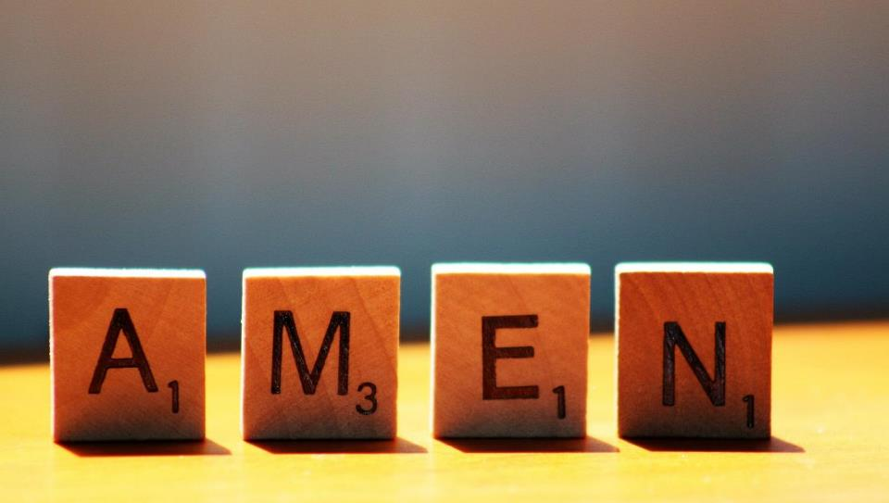

Slide 16


Leader: As we leave this place & time and go into the day ahead…
All: May we live in a way that makes us – and others – truly happy.

Slide 17
Notes:
Slide 16: Reflective areas
Leave the story objects (or a photo of them) out, to help to focus the questions on the reflection card.
OR: How can we show our school’s values in action? Maybe keep a tally chart of when you’ve noticed others ‘living out’ your values – encourage pupils to explain where they saw what happening.

