Slide 1

Leader: We are here together
ALL: May we ‘GO FOR GOLD!’ in our words and actions today!
Notes:
Slide 1: Use the new gathering words, which will be the same each week.
Leader: We are here together
ALL: May we ‘GO FOR GOLD!’ in our words and actions today!

Slide 2
The Olympics
Respect
Friendship
Excellence
Determination
Equality
Courage
Inspiration
Olympic rings © Pixabay
Notes:
Slide 2: Last week we heard about the idea that Baron de Coubertin had in setting up what we call the ‘modern’ Olympic Games event – and he established the first Olympic values of….. Respect, Excellence and Friendship.
Since then, more values have been added through the Paralympic Games…..the values of Determination, Courage, Equality and Inspiration.
These seven values are going to be the focus of our times together this term as we learn from the inspirational stories of Olympian and Paralympian athletes from across the world, and across time! Today, we will be hearing a story about a very determined athlete, but first…..

Slide 3
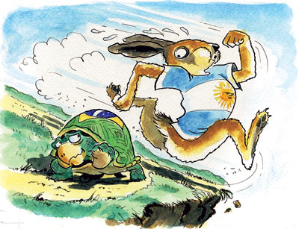
Notes:
Slide 3: …we’re going to start with a very short story, which many of you may have grown up with……the story of the hare and the tortoise, which was (by the way!) written by our good friend Aesop, in Ancient Greece, not long after the Ancient Olympic Games were founded. [use story links in resources above if you need to] In the story, who wins the race?.....we’ll come back to this shortly, so don’t forget it!

Slide 4
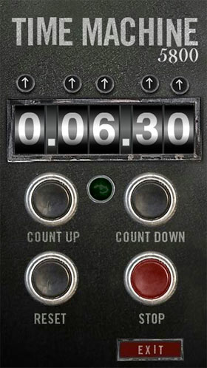
2024
CE
1896
CE
Notes:
Slide 4: We’re going to jump into our Olympic time machine again, and go back in time from 2024 to the very first modern Olympics in 1896

Slide 5


Notes:
Slide 5: ..to Greece where the Ancient Olympics had taken place……and a story from the first modern Olympic Games, in 1896, 2 years after Baron de Coubertin had had his idea.

Slide 6
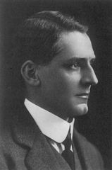

Edwin Flack
Notes:
Slide 6: Among the 17 competitors in the marathon race was an Australian runner, Edwin Flack, who had already won gold medals in the 800 and 1,500 metre races, and several other very strong contenders. But there were crowds of Greek spectators waiting on the Marathon Bridge to await the start of the race, all hoping that one of their own athletes would win a medal.

Slide 7
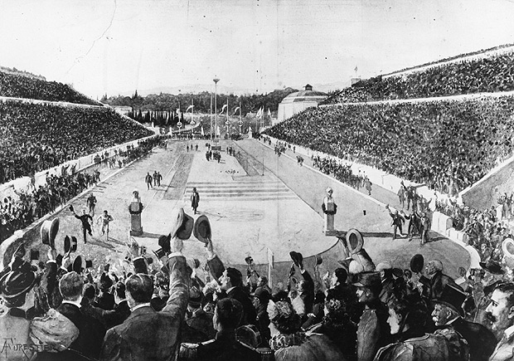
Notes:
Slide 7: After 20 miles, with six miles to go, Edwin Flack led the race and full of confidence, he sent a cyclist off to the stadium to announce his victory. Understandably, this news sent the mainly Greek crowd gathered in the stadium into a sad silence. Meanwhile, behind Flack, a Greek runner named

Slide 8
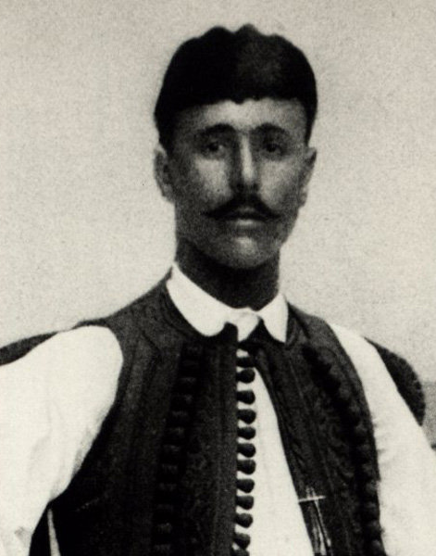
Spiridon Louis
Notes:
Slide 8: Spiridon Louis, had passed several other of the strong runners to move into second place. But Edwin Flack, just like the hare, was now exhausted, and less than a mile later, Spiridon Louis passed him and pulled into the lead. Unlike Edwin Flack, Spiridon Louis had run steadily and so had enough energy to put on a final burst of speed. Edwin Flack, unable to catch him, staggered, fell and, sadly, was carried from the course. During this battle for the lead, Greek runners had also moved into second and third place – so not only Gold, but Silver and Bronze medals were awarded to Greek marathon runners. Pheiddipides would’ve been so proud!!!
Edwin Flack may have been the better runner, but Spiridon Louis knew that he needed to run a steady race so that he would have enough energy to persevere to the very end of the marathon, just like the tortoise in the story.

Slide 9
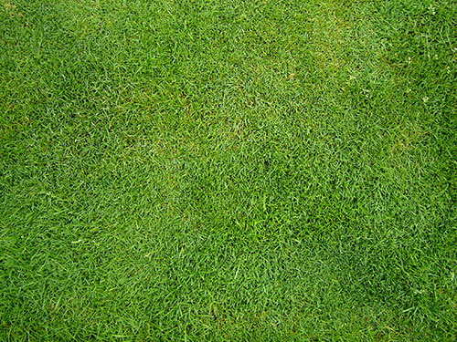

3
4
5
2
6
7
8
1
9
START
FINISH
Notes:
Slide 9: For this final part of our assembly, we’re going back to the hare and the tortoise to help us think about perseverance.
We’re going to imagine that the hare and the tortoise are having another race on this track. I’ve got some race cards here. You are going to decide whether the hare and tortoise have persevered by listening to what’s written on the card. Here they are, at the start (put hare and tortoise counters on the board)
(Pick a card and read out what’s on the card. Then ask the assembled children ‘Did the hare / tortoise persevere ?’ If the children decide ‘yes’, then follow the ‘yes’ instruction. If they decide ‘no’, then follow the ‘no’ instruction. Continue with the hare and tortoise taking turns until there is a winner. It should be the hare this time, as he has obviously learnt his lesson!)

Slide 10
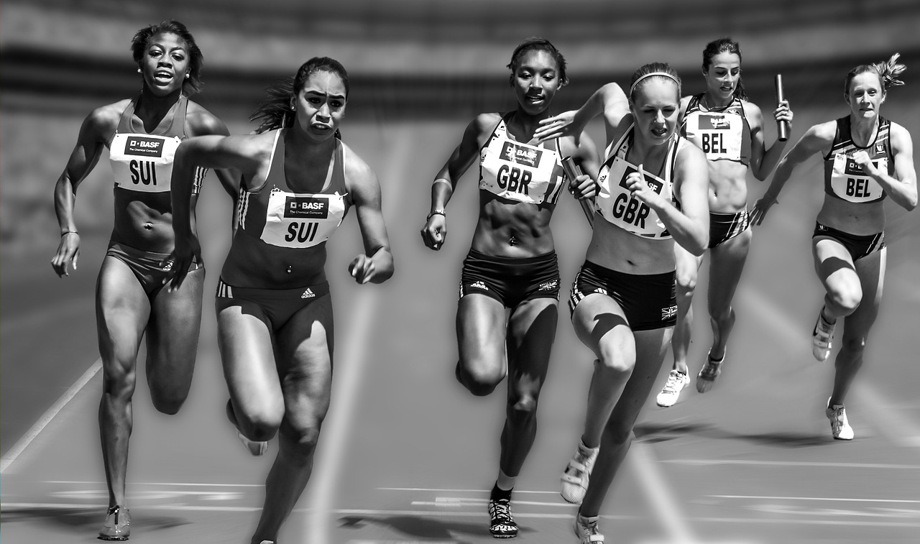
‘Run the
race with perseverance….
….keep your eyes on Jesus….’
(Hebrews 12:1-2)
Notes:
Slide 10: We talk a lot at school about keeping on trying even when things are difficult, and it’s a great feeling when we finally achieve what we’ve been aiming for.
But it’s not just at school that we need to persevere. There will be times all through our lives when things get tough and we’ll feel like giving up – you ask any adult about that!
There are some words in the Bible, advice for Christians, about what to do when life gets hard, that say this…..
‘Run the race with perseverance…. keep your eyes on Jesus….’
These words, written to one of the very first churches, talk about life being a bit like a race, and that Christians need to run that race with perseverance, which is another word for the Olympic value of determination.
People who run races often have little secrets that keep them going as they run, helping them to persevere even when the going gets tough. Some may picture themselves running across the finishing line – keeping their eyes on their goal. Others might try really hard to remember all the things that their coach – the person who’s trained them to run the race – has told them, so it’s as if their coach is running the race beside them.
I wonder what you think these words about persevering might mean for Christians – and how looking at Jesus might help them to keep going in their lives?

Slide 11
….I wonder how these words might help Christians?....
….I wonder what might help us to persevere – to keep on going when life gets tough?.....
….I wonder how the story of Spiridon Louis might inspire us to persevere in our everyday lives?.....
‘Run the
race with perseverance
….keep your eyes on Jesus….’
(Hebrews 1:12 & 12:2)
Notes:
Slide 11: Responding and words for worship
We’re going to have some quiet moments now to think….
…..we’ve been thinking today about persevering – being determined to keep on going, even when things get difficult…..
…..every day, we will find there are things that might make it hard for us to keep on going….
....think quietly to yourself about a time when you gave up…
….maybe because it didn’t go well the first time….or someone laughed when it went wrong…..or other people seem to be able to do things really easily…..
….now think to yourself about a time when you were really determined to persevere….to keep on going….
….remember how it felt when you succeeded…..
…we’ve heard some words from the Bible about persevering….
….and heard how people who are Christians will ‘keep their eyes on Jesus’….
….I wonder how these words might help Christians?....
I wonder what might help us to persevere – to keep on going when life gets tough?.....
….I wonder how the story of Spiridon Louis might inspire us in our everyday lives?.....

Slide 12
‘Help us to persevere.’
Notes:
Slide 12: Opportunity for reflection / prayer
I’m going to pray now. If this is something that you feel comfortable doing, then you can say ‘HELP US TO PERSEVERE’ at the end of each line:
Dear God
Help us when we face challenges to remember that you are with us and can help us along the way.

Slide 13
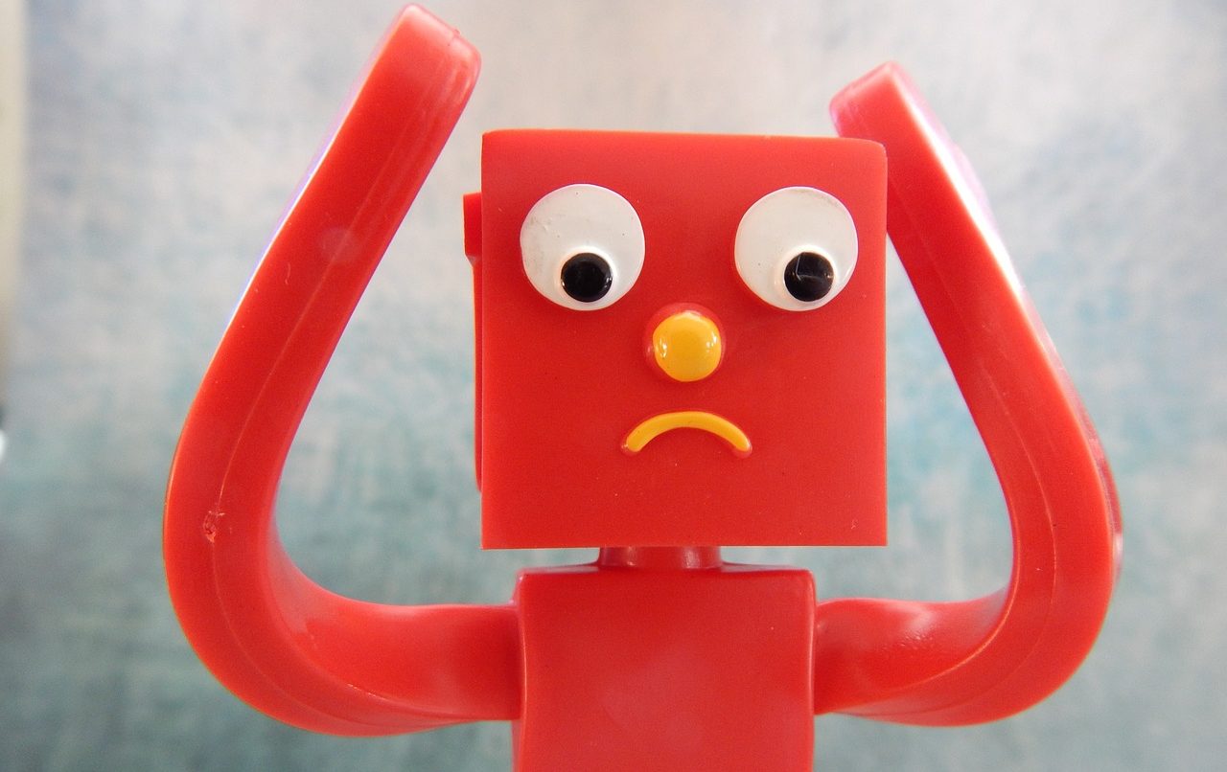
‘Help us to persevere.’
Notes:
Slide 13: When something doesn’t go right first time – HELP US TO PERSEVERE

Slide 14

‘Help us to persevere.’
Notes:
Slide 14: When we’re doing something we don’t like – HELP US TO PERSEVERE

Slide 15

‘Help us to persevere.’
Notes:
Slide 15: When other people seem to be able to do things really easily – HELP US TO PERSEVERE

Slide 16
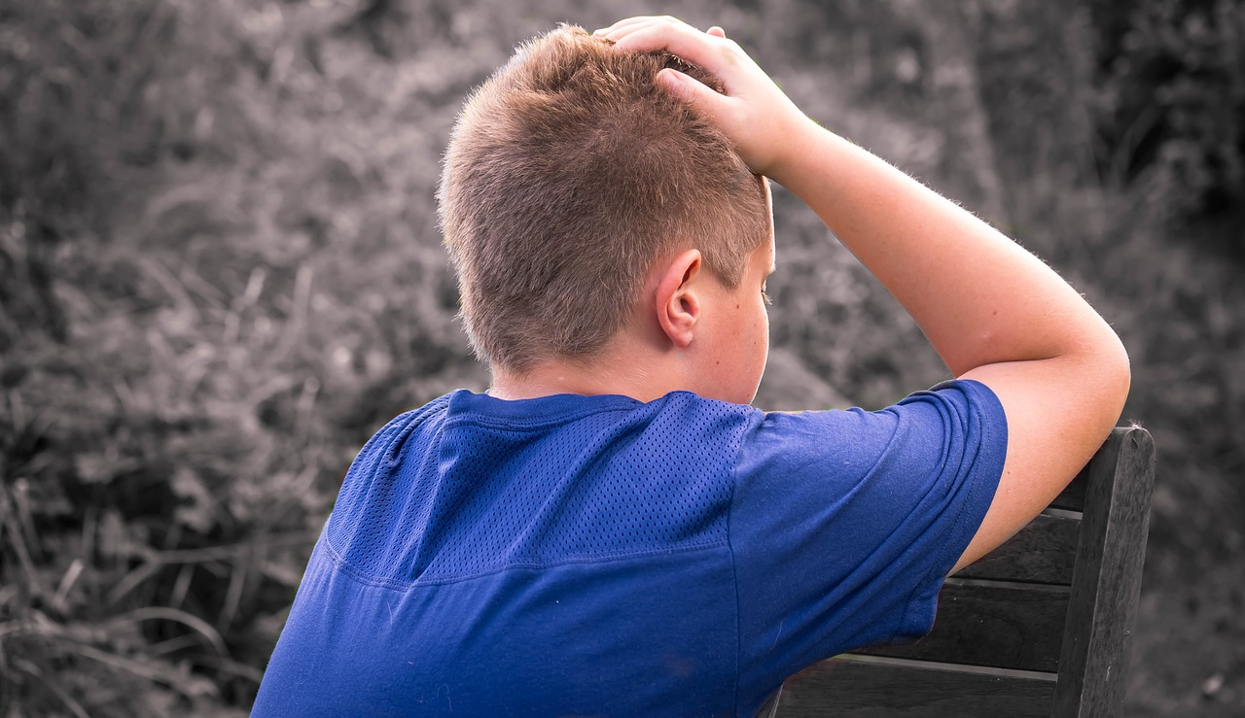
‘Help us to persevere.’
Notes:
Slide 16: When we feel we’re on our own – HELP US TO PERSEVERE

Slide 17
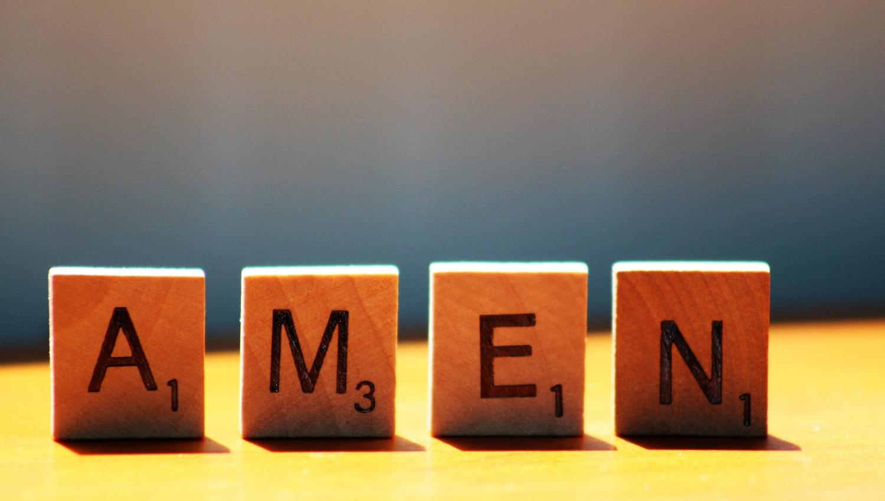

Slide 18




Leader: As we leave this place & time and go into the day ahead…
All: Let’s ‘go for gold’ in all that we do!
Notes:
Sending: Slide 18
Leader: As we leave this place & time and go into the day ahead…
All: Let’s go for gold* in all that we do!
*Again, you might need to unpick what we mean by ‘going for gold’ in the context of today’s words.

Slide 19

Notes:
Slide 19: Reflective areas
Cut out speech bubbles and ask children to write words of encouragement (like the writer to the Hebrews did) that will help others to persevere.
Use these during the week to help each other.

