Slide 1
Follow my
lead!
Notes:
Slide 1: This term, we are thinking about leading, leaders, and followers – and will find out about and learn from the lives of different leaders from across the ages.

Slide 2
Leader: As we share these stories of leaders…
ALL: May we follow their example
in thoughts
and words
and actions.
Notes:
Slide 2: Use these new gathering words for this term, or your usual greeting if you prefer. The greeting comes with BSL signing, you can view the demos using links under the slide.
Leader: As we share these stories of leaders…
ALL: May we follow their example in thoughts and words and actions.
Signs for greeting: click on links
Thoughts: British Sign Language BSL Video Dictionary - thought (signbsl.com)
Words (use 3rd definition): British Sign Language BSL Video Dictionary - word (signbsl.com)
Actions: British Sign Language BSL Video Dictionary - action (signbsl.com)

Slide 3
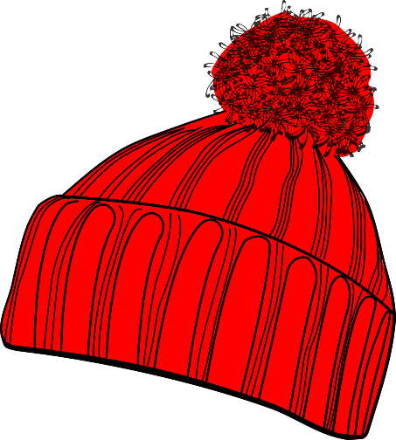
?
Guess
Who
Notes:
Slide 3: We’re going to start our time together today with a game of Guess Who?® [Explain how this will work* and play a couple of rounds: first round normally, second round must include a question from you that relates to the character of the person, which of course cannot be seen from the outside. If playing with real children, then you will need to handle this sensitively and positively affirm that of course they are e.g. kind or thoughtful on the inside, but that this is not something we can tell by looking at a person’s appearance.]
‘Guess Who?® is a game that’s all about choosing people – choosing them because of what they look like. But as we’ve said, we can’t really be certain what someone is like ‘inside’, their character, when we look at their physical appearance.

Slide 4
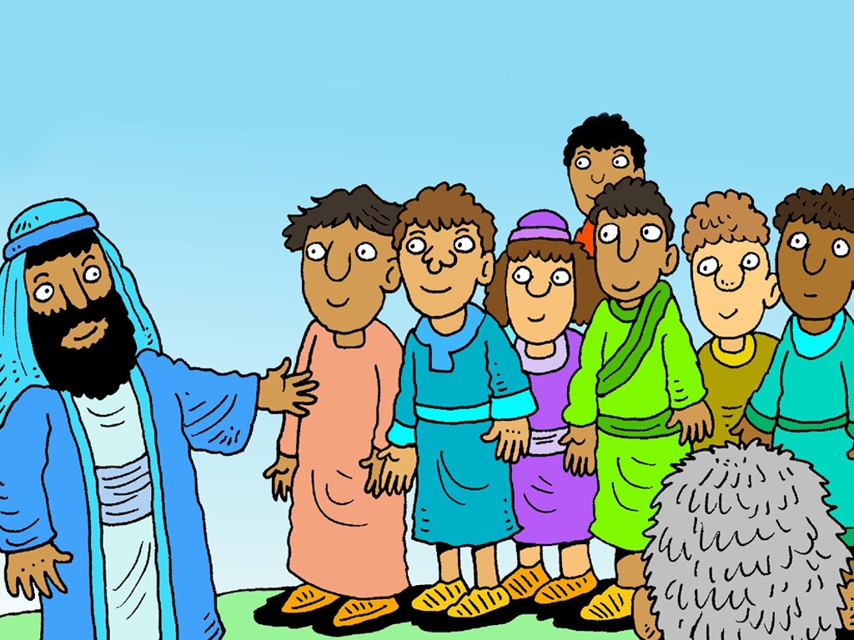
Chosen
Notes:
Slide 4: There’s a story in the Bible about someone very unexpected being chosen to be King of Israel – we’re not going to hear the whole story, but just a small part of it.

Slide 5
Notes:
Slide 5: A man called Jesse had eight sons. [Let’s count them, just to make sure!]

Slide 6
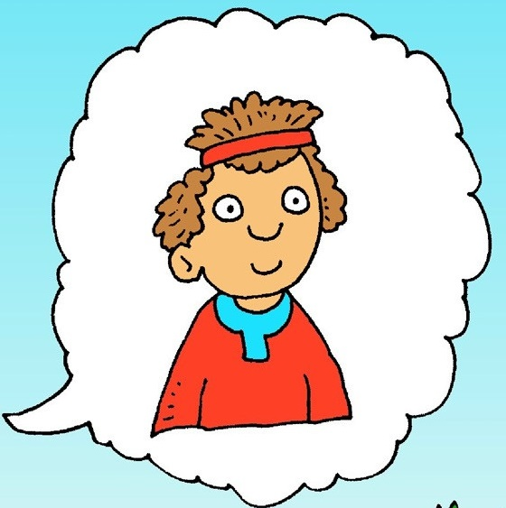
Notes:
Slide 6: David was the smallest and youngest of them all, and looked after the family’s sheep out in the fields.

Slide 7
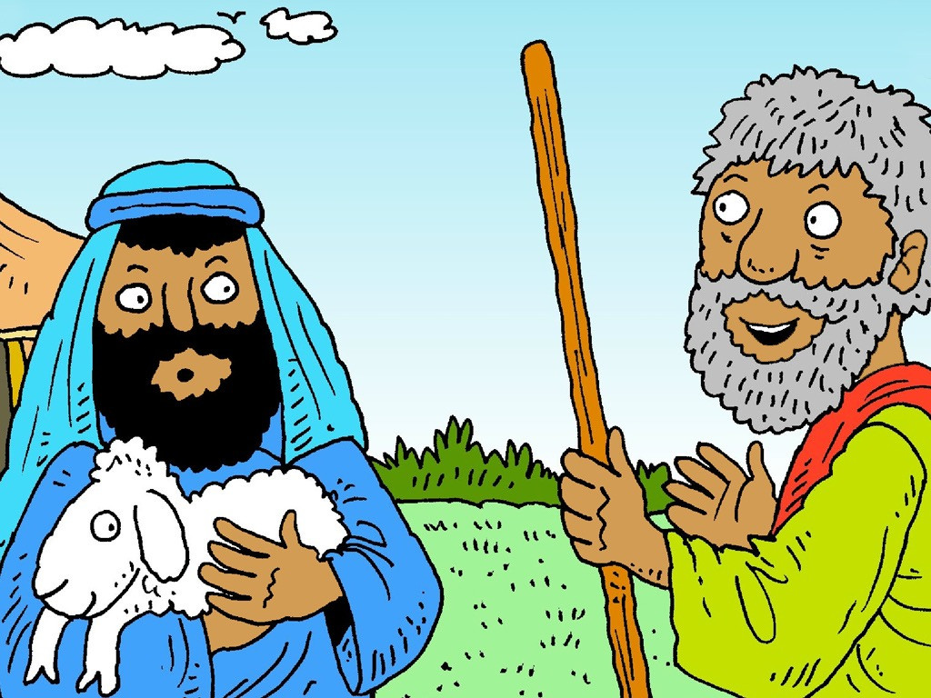
Notes:
Slide 7: One day, God’s messenger, the prophet Samuel, came to where Jesse lived in the town of Bethlehem (yes, that’s where Jesus was born, but much later on in time!), and told him that…

Slide 8
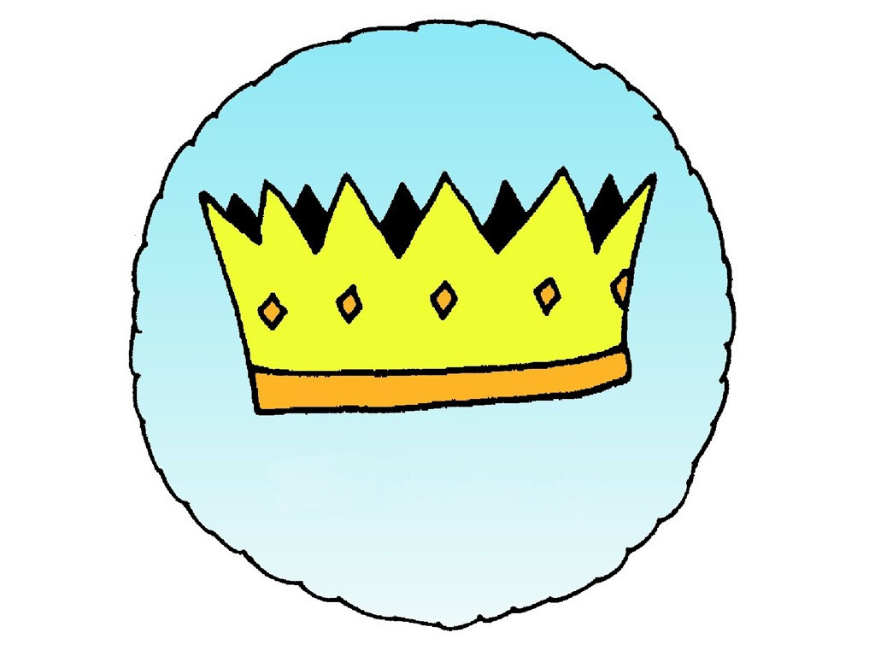
Notes:
Slide 8: God wanted one of his sons be the King of Israel.

Slide 9
Notes:
Slide 9: Samuel expected that God would choose the oldest and maybe strongest son.

Slide 10
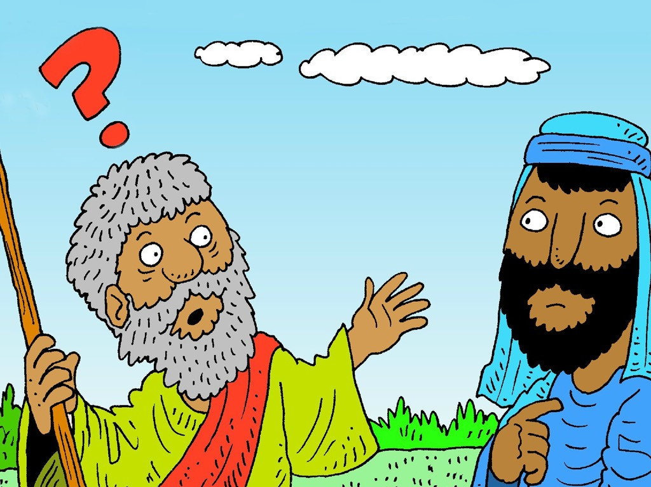
Notes:
Slide 10: But much to his surprise, God didn’t…..

Slide 11
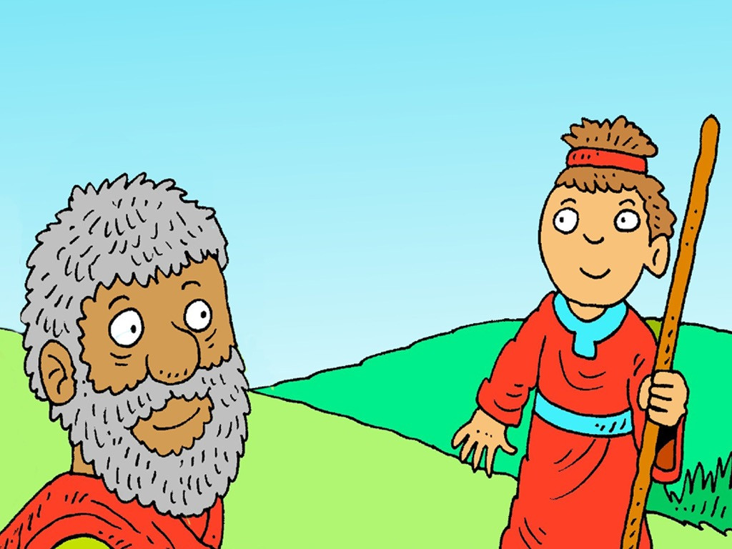
Notes:
Slide 11: Instead, God told Samuel to choose David: the youngest and the smallest….. just a little shepherd boy!

Slide 12
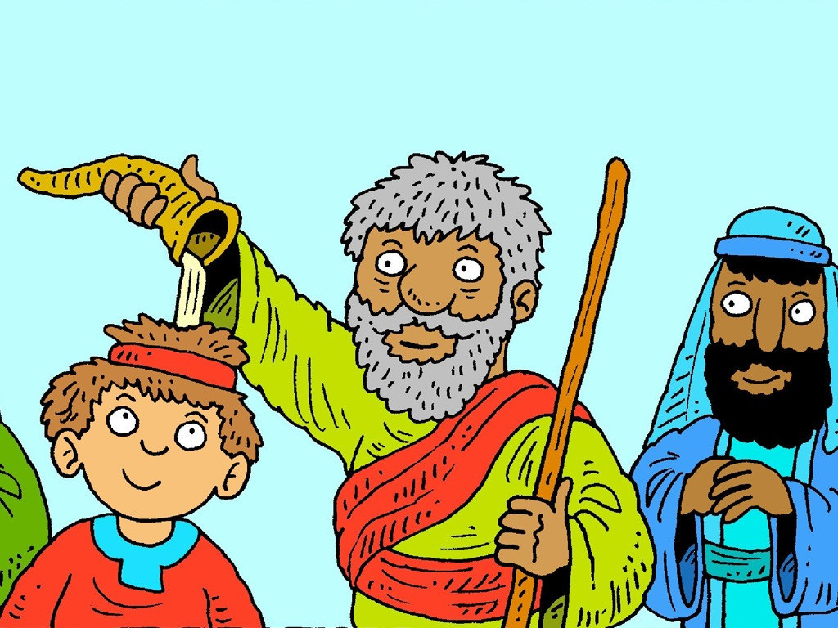
Notes:
Slide 12: And as a sign that God had chosen him, Samuel did a very strange thing: he anointed David’s head with olive oil, pressed from the trees that grew nearby. David wouldn’t be King for quite a few years, when he was older, but he knew that he had been chosen. And King David would be one of the greatest Kings that God’s people ever had.

Slide 13
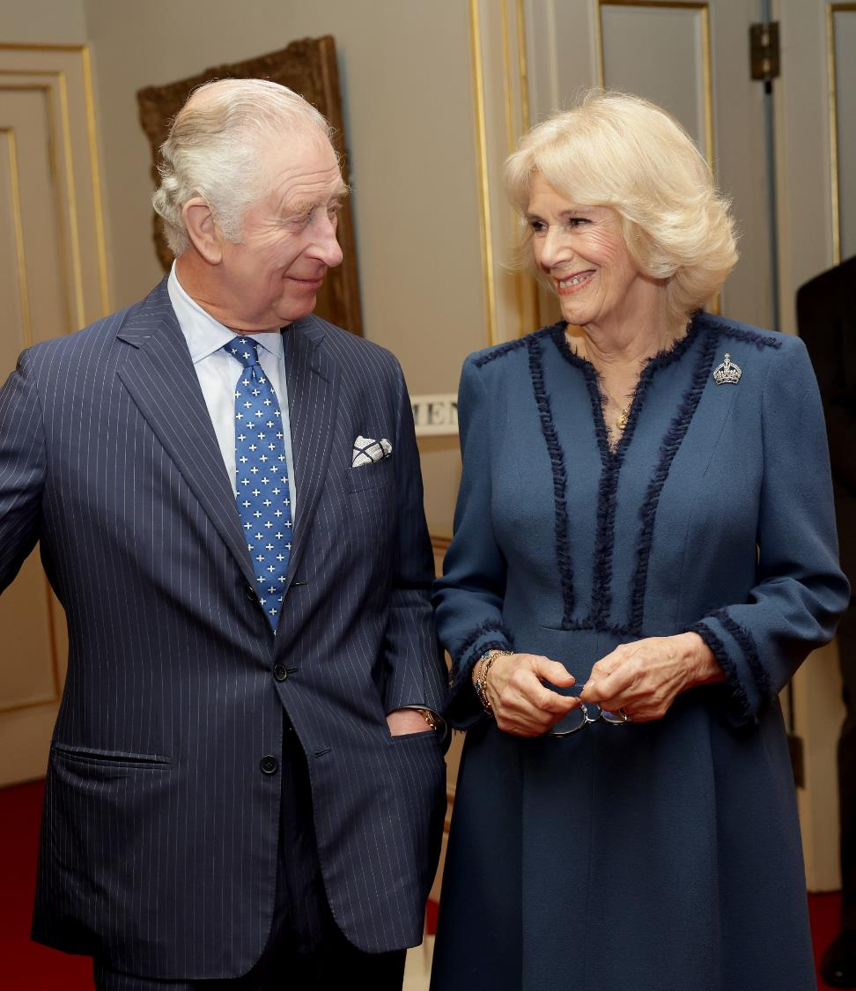
Notes:
Slide 13: This weekend, we will see our King, Charles III at his coronation. Although he has been King since our late Queen died, this special time is really important as the ceremonies that take place during a coronation are ancient traditions, some of them going back over a thousand years. They also send us messages about King Charles’ responsibilities as a leader [find out more here: What is a Coronation? - Teacher Notes - Primary (hrp.org.uk)] Here are some of the special items that you might see….and what they mean….

Slide 14
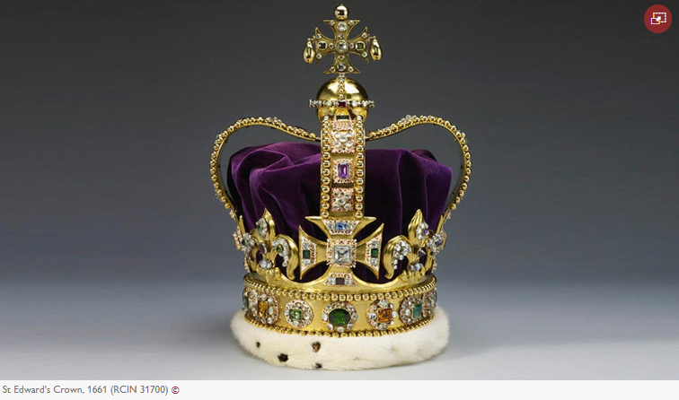
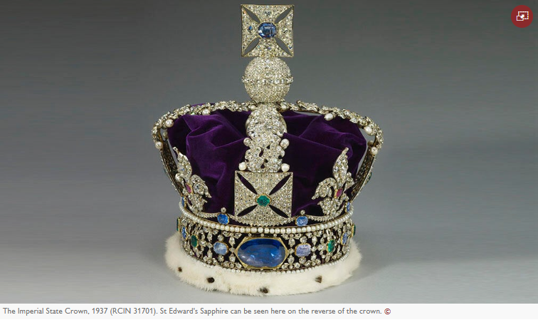
Notes:
Slide 14: a crown, representing his role as King. This crown is called St. Edwards’ crown and is only ever used in a coronation. There a few others that King Charles can choose from for special occasions, including this very heavy one that he will wear as he leaves his Coronation!

Slide 15
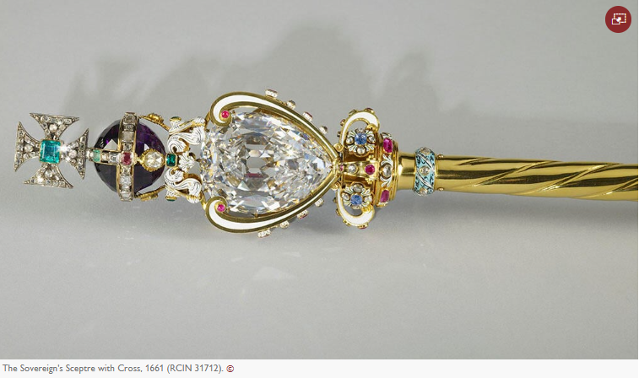
Notes:
Slide 15: a sceptre, representing the responsibility of being a leader, and a reminder that he must rule with fairness.

Slide 16
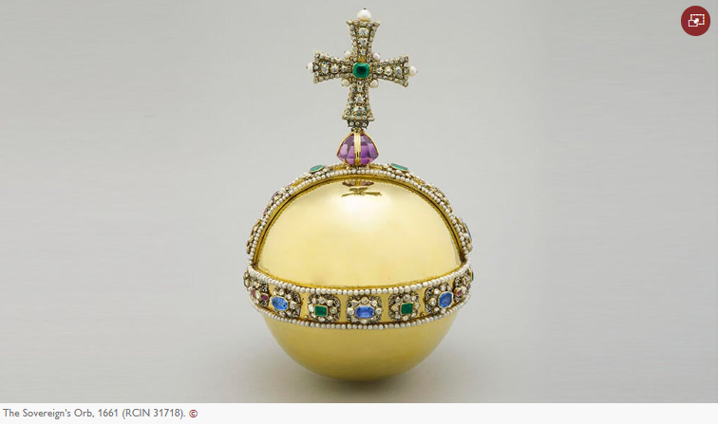
Notes:
Slide 16: an orb, reminding King Charles that it is God who rules the world, [optional: and that he has responsibilities in his role as the head of the Church of England]

Slide 17
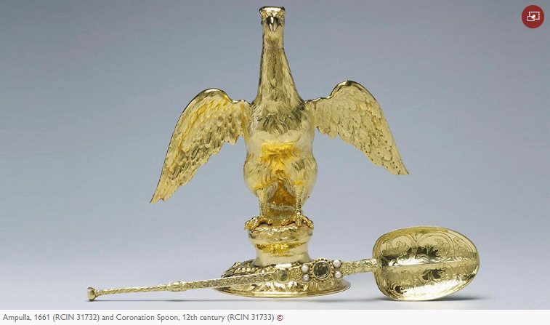
Notes:
Slide 17: But as the most sacred and holy part of his coronation, King Charles will be anointed, just like King David was. These beautiful objects, a flask and an anointing spoon are the oldest items that will be used on Coronation Day: the spoon is over a thousand years old! The oil that will be used in the anointing is a special blend that comes all the way from Israel, from olives pressed in Bethlehem, from groves near where King Charles’ grandmother is buried…

Slide 18
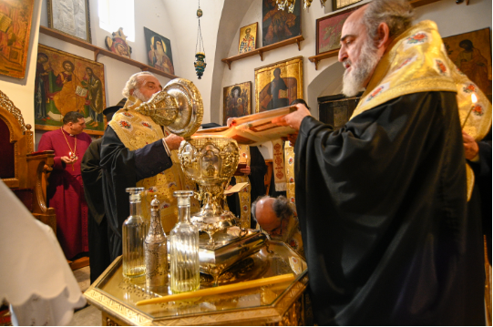
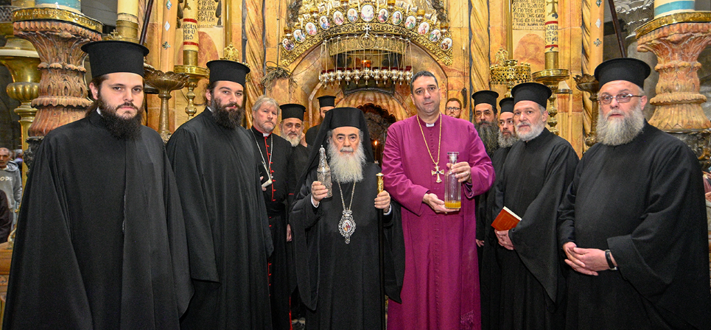
Notes:
Slide 18: The oil that will be used in the anointing is a special blend that comes all the way from Israel, from olives pressed in Bethlehem, from groves near where King Charles’ grandmother is buried……and has been blessed by church leaders there. [find out more using the links here: King's Coronation: Anointing oil to be animal-free - BBC Newsround & The consecration of the Coronation Oil | The Royal Family]

Slide 19
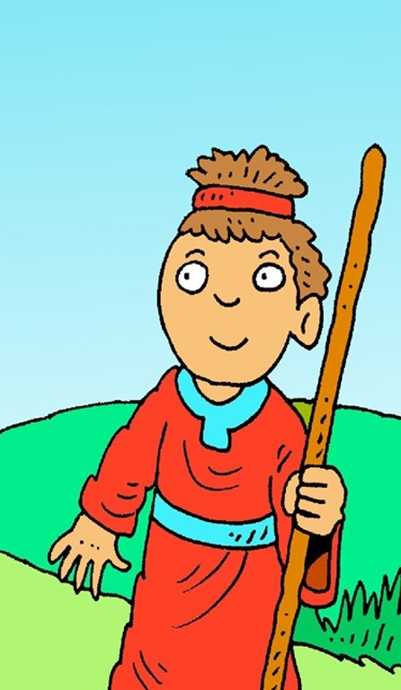
….I wonder how David felt to be chosen?....
….I wonder why God chose David, who was the youngest and the smallest?.…
….I wonder how King Charles might be feeling as Coronation Day draws near…and how we might pray for him?....
....I wonder what we might have been ‘chosen’ for?.....and what our responsibilities are?....
Notes:
Slide 19: Responding (words for worship):
….in the stillness of this moment, let’s be quiet and think…..
….we’ve heard today about how God chose David, and told Samuel to anoint him…..
….and about our own King’s Coronation, when he too will be anointed….
Let’s wonder together now…..
….I wonder how David felt to be chosen?....
….I wonder why God chose David, who was the youngest and the smallest?.…
[the David slide will fade & Coronation logo appear as you click for this next thought]
….I wonder how King Charles might be feeling as Coronation Day draws near…and how we might pray for him?....
....I wonder what we might have been ‘chosen’ for?.....and what our responsibilities are?....
[you may wish to give a few examples here, especially to help younger pupils]…..spend a few moments in quietness thinking or praying about these things now….

Slide 20
….we ask for your wisdom.
Notes:
Slide 20: Prayer
Dear God
In our school communities, God, WE ASK FOR YOUR WISDOM.

Slide 21
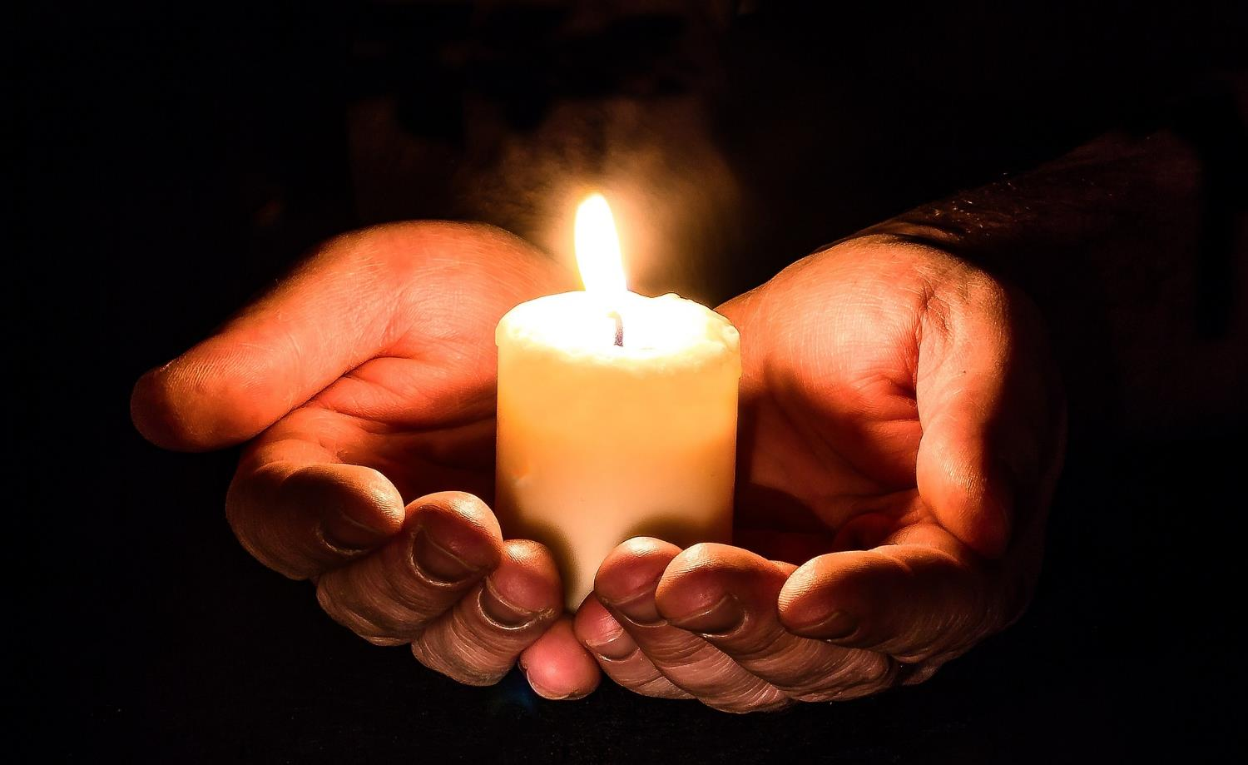
….we ask for your wisdom.
Notes:
Slide 20: Prayer
I’m going to turn my thoughts into a prayer now. It’s a prayer for us – and a prayer for our King as he nears his Coronation Day. If you’d like to pray too, then after I say the word ‘God’, join me by saying ‘we ask for your wisdom’

Slide 22
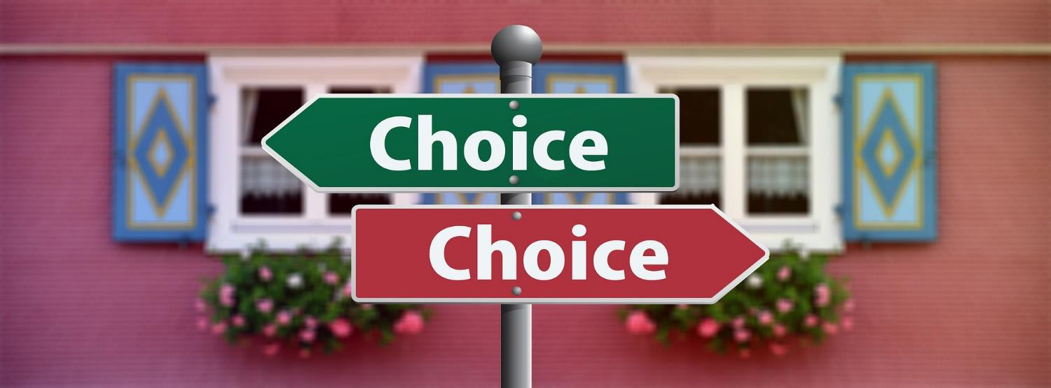
….we ask for your wisdom.
Notes:
Slide 21: For the choices we make, God WE ASK FOR YOUR WISDOM

Slide 23
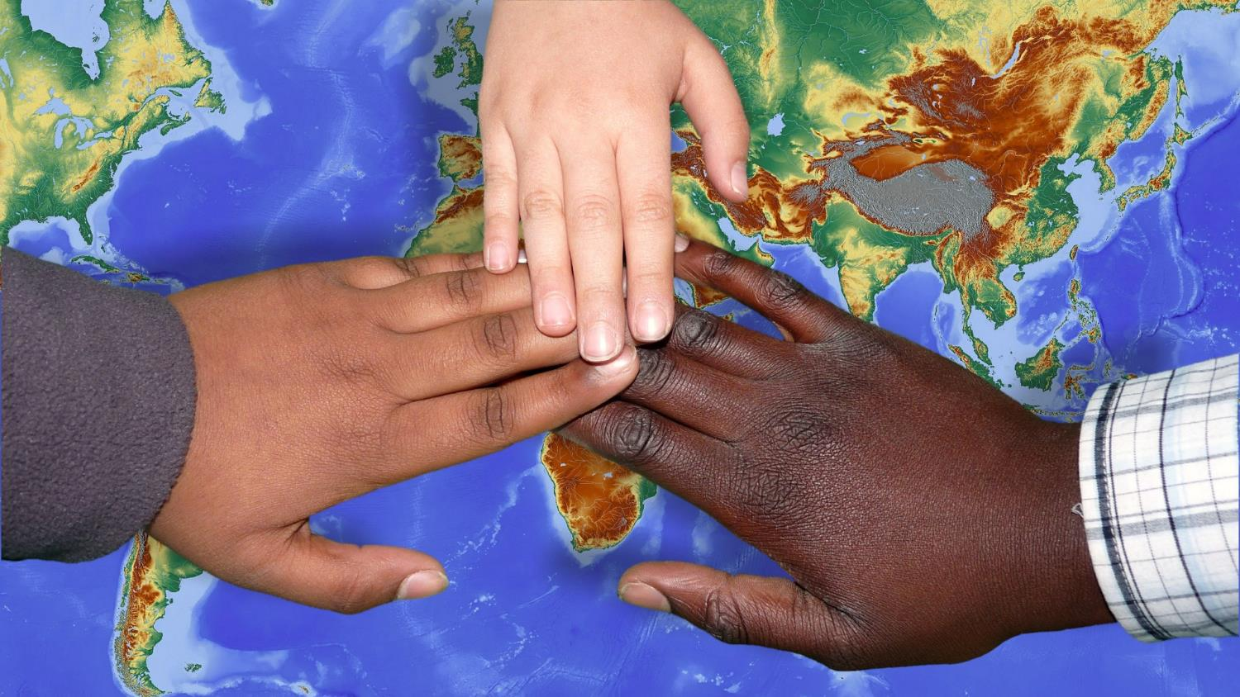
….we ask for your wisdom.
Notes:
Slide 22: For the responsibilities we carry, God, WE ASK FOR YOUR WISDOM

Slide 24
….we ask for your wisdom.
Notes:
Slide 23: For our King as he is crowned, God, WE ASK FOR YOUR WISDOM

Slide 25
….we ask for your wisdom.
Notes:
Slide 23: To help him as he reigns, God, WE ASK FOR YOUR WISDOM

Slide 26
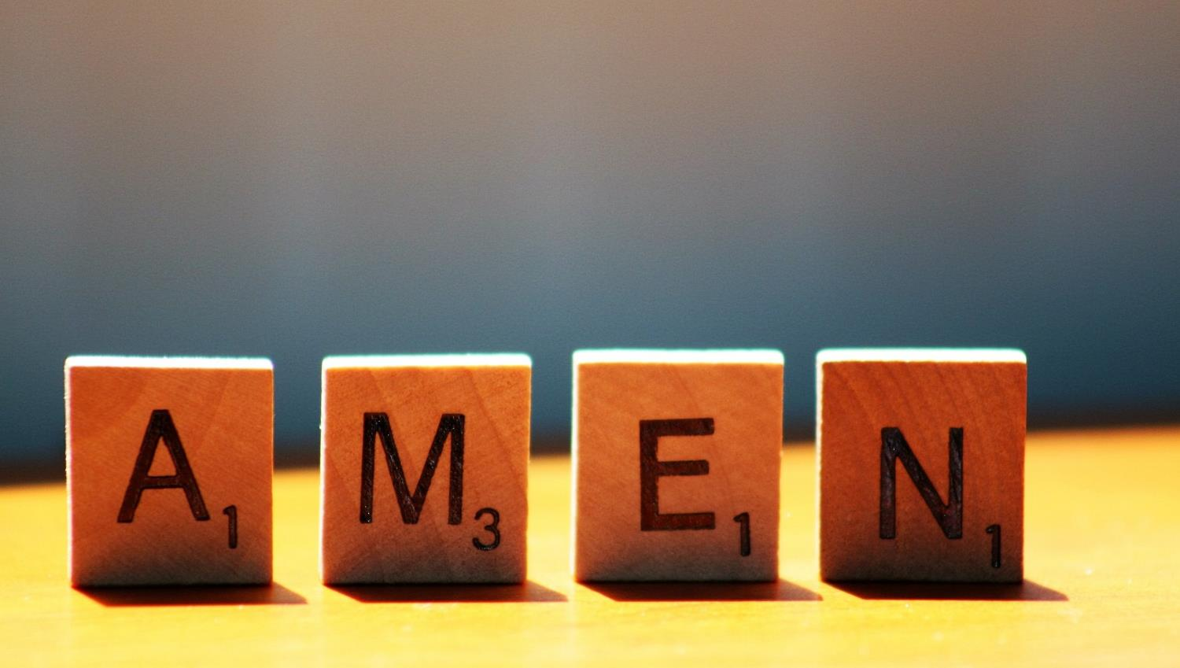

Slide 27
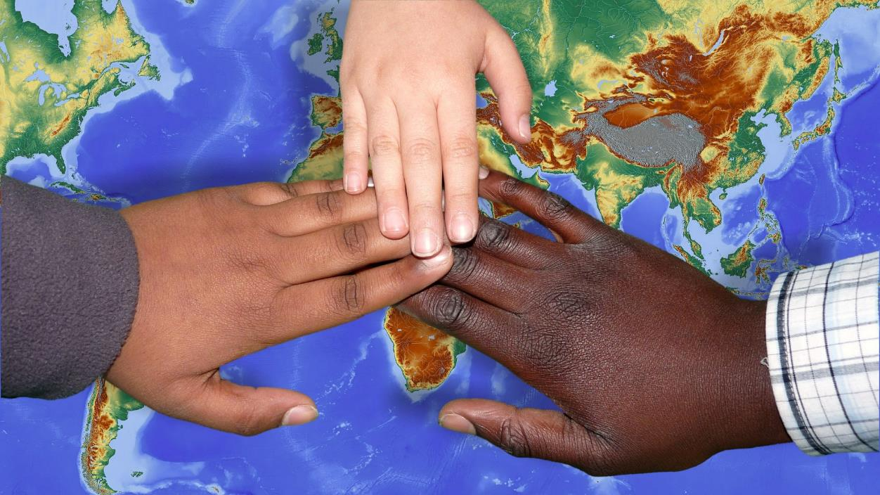
Leader: As we leave this place & time and go into the day ahead…
All: …may we be responsible members of our school community.

Slide 28
Reflecting on being chosen, our responsibilities and supporting those who have been chosen.

