Slide 1



Leader: We are here together
Children: With ears ready to hear and hands ready to serve.
ALL: May we be wise in all our actions today.
Notes:
Slide 1: Teach the new gathering words, which will be the same each week.
Leader: We are here together
Children: With ears ready to hear and hands ready to serve.
All: May we be wise in all our actions today.

Slide 2

Notes:
Slide 2: As you’ll remember from last week, our new theme for this term is Wise Words, and in a while, we will be hearing and thinking about some more of wise King Solomon’s words.

Slide 3
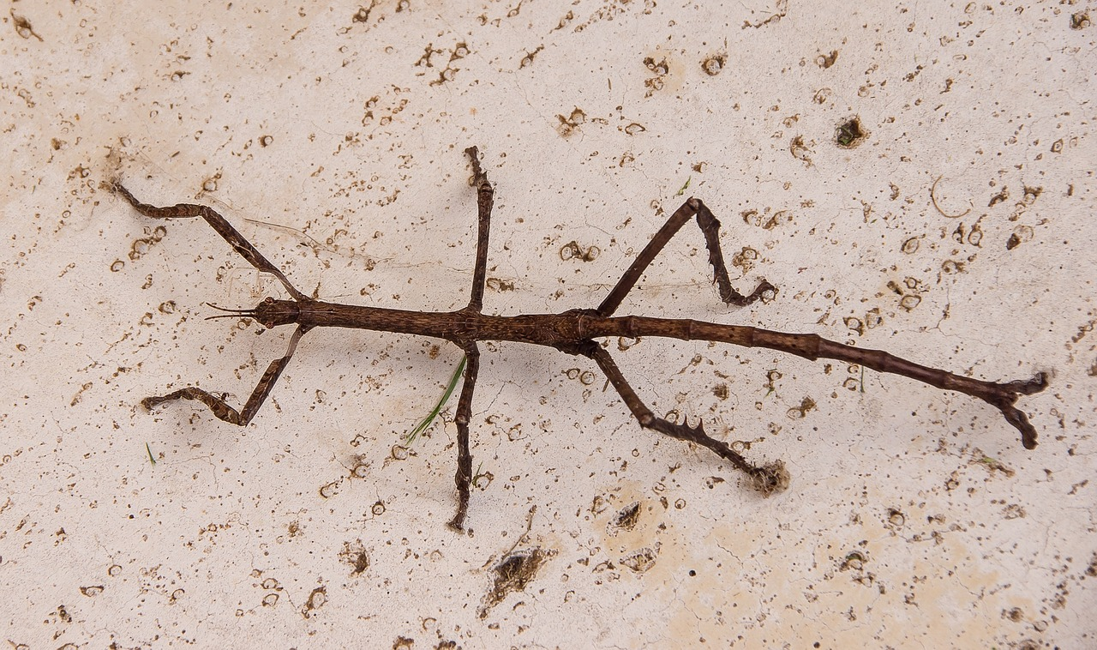
Know your bugs!
Notes:
Slide 3: We’re going to start today with a game about insects! You’ll understand why shortly….
I’ll show you a photo – all you need to do is identify the bug from its photo. Watch out for the trick question…
This insect is….. A stick insect (because that’s exactly what it looks like!)

Slide 4
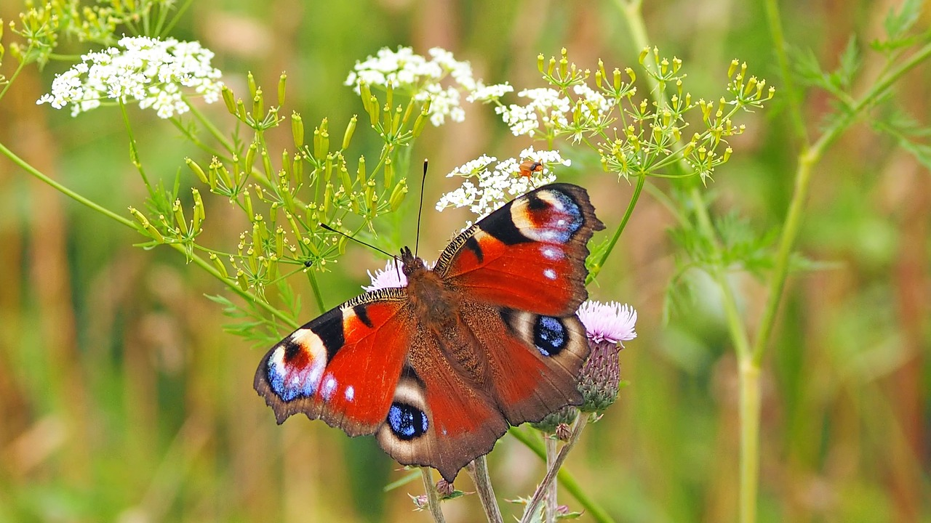
Notes:
Slide 4: Butterfly (it’s a Peacock Butterfly, to be precise!)

Slide 5
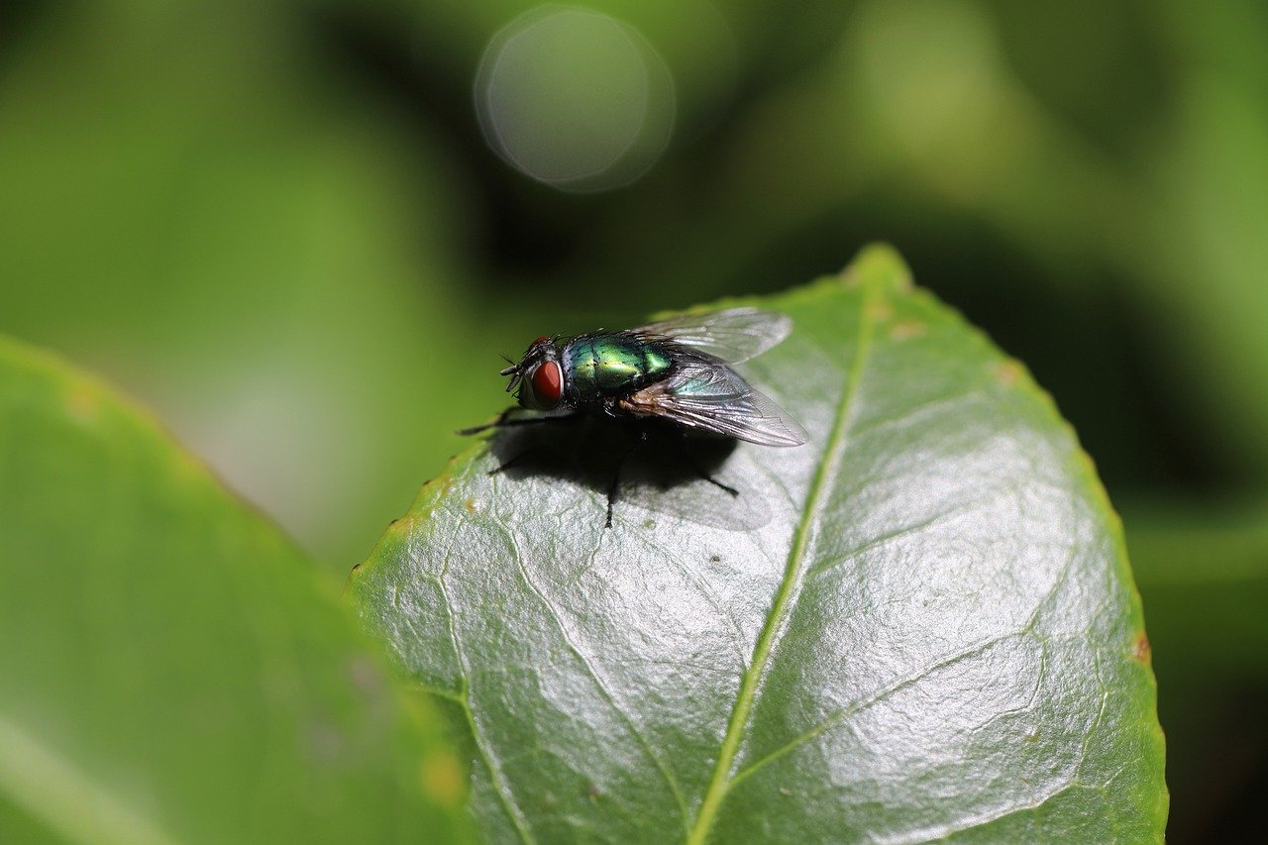
Notes:
Slide 5: A fly (bluebottle)

Slide 6
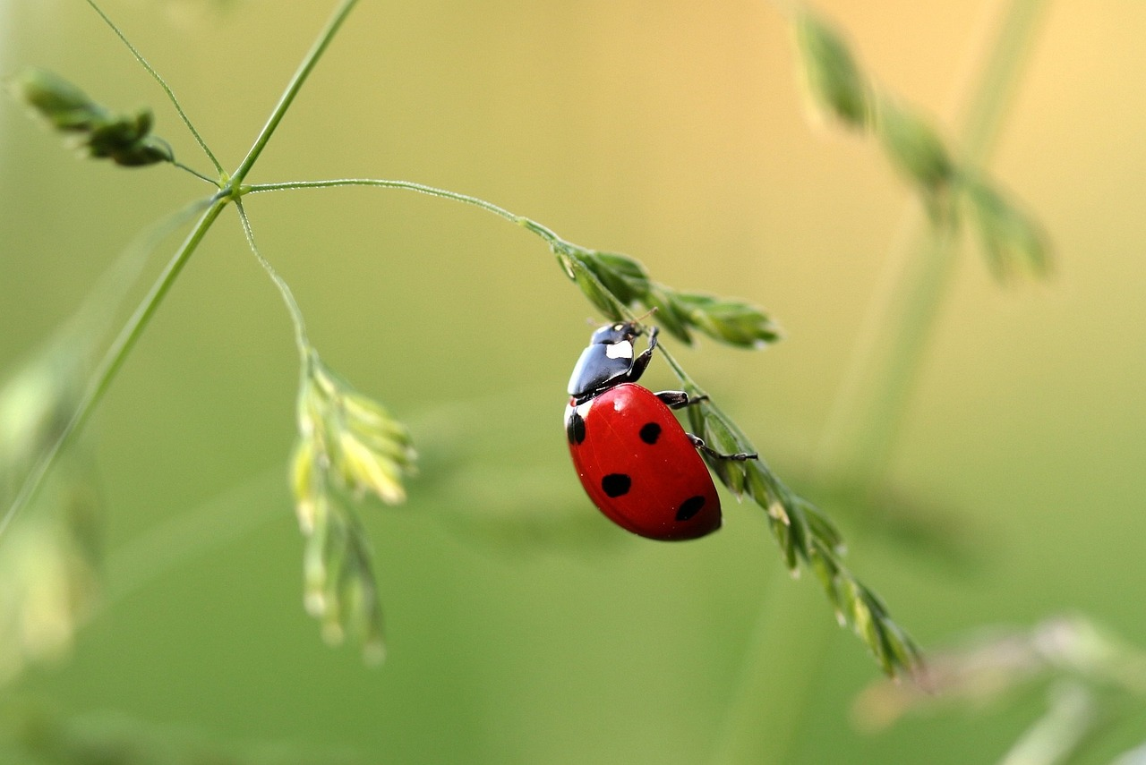
Notes:
Slide 6: Ladybird (or ladybug, if you’re in America!)

Slide 7
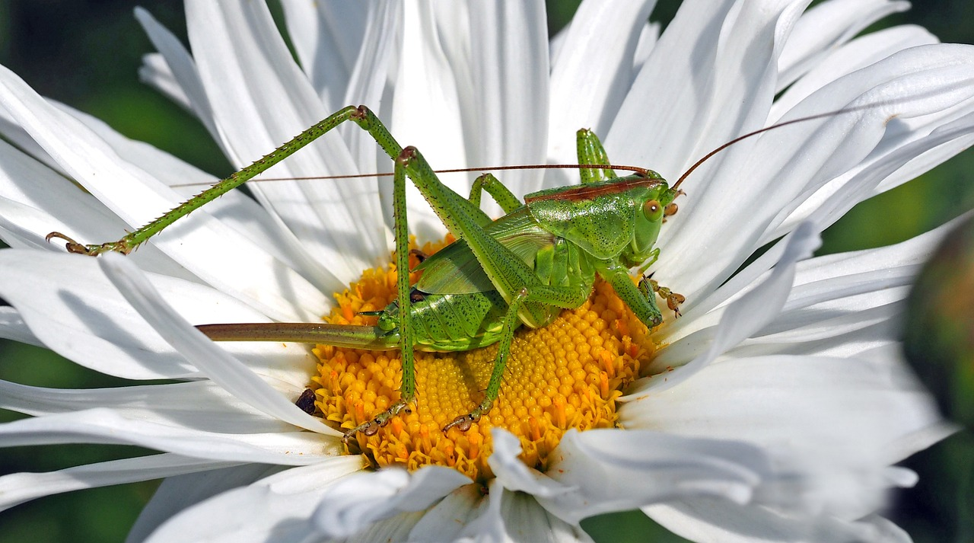
Notes:
Slide 7: Grasshopper

Slide 8
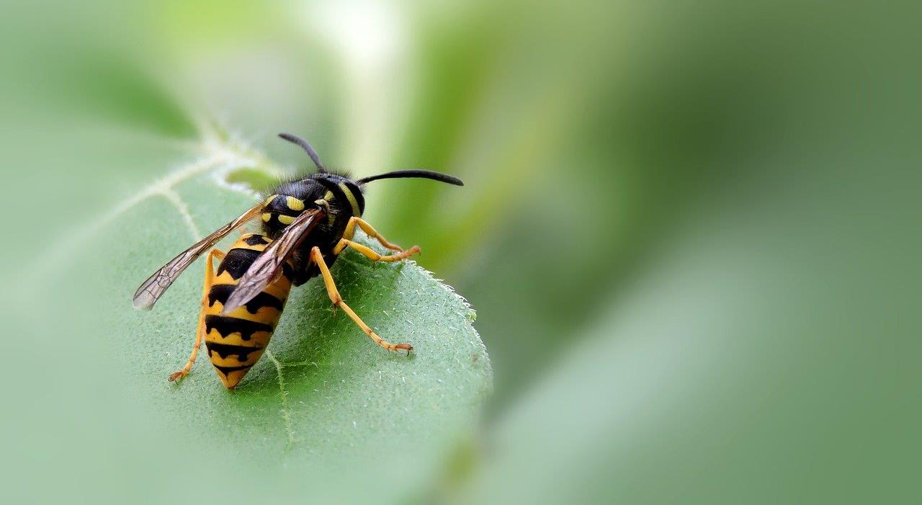
Notes:
Slide 8: Wasp….. Not to be confused with….

Slide 9
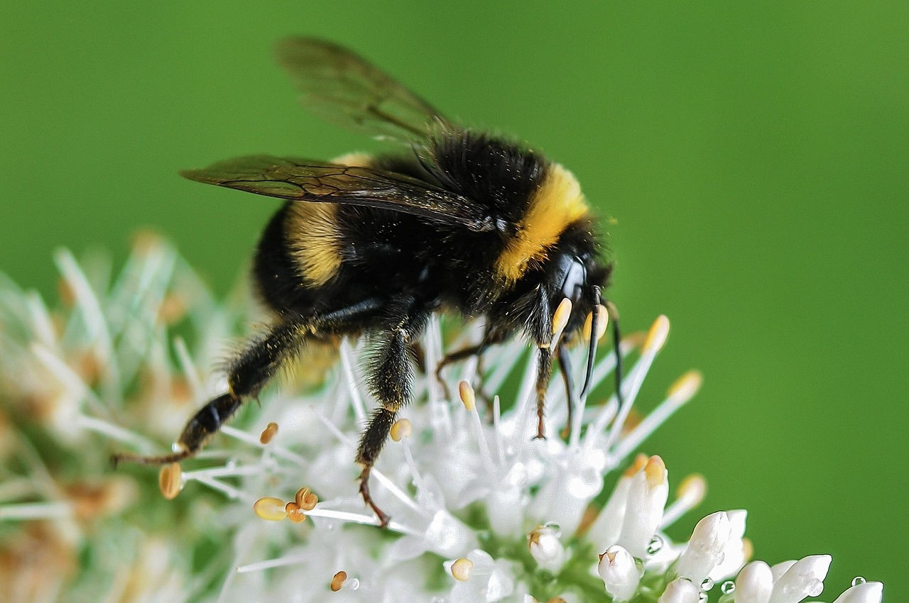
Notes:
Slide 9: …. The Bumblebee

Slide 10
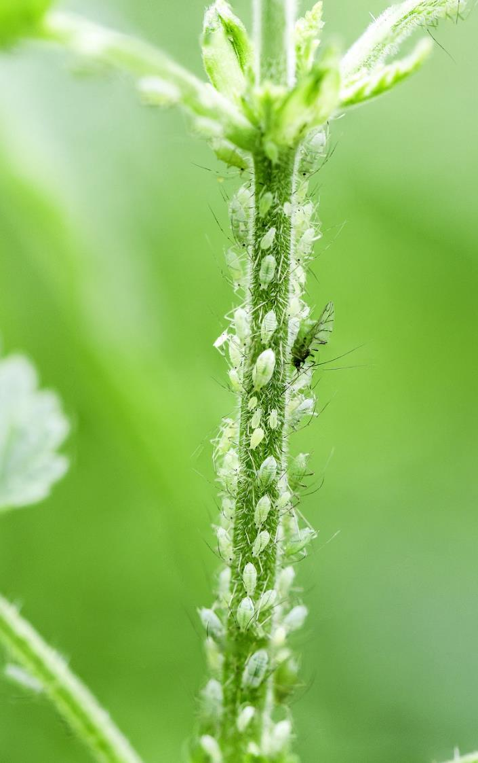
Notes:
Slide 10: Greenfly (or aphids, which is their proper name)

Slide 11
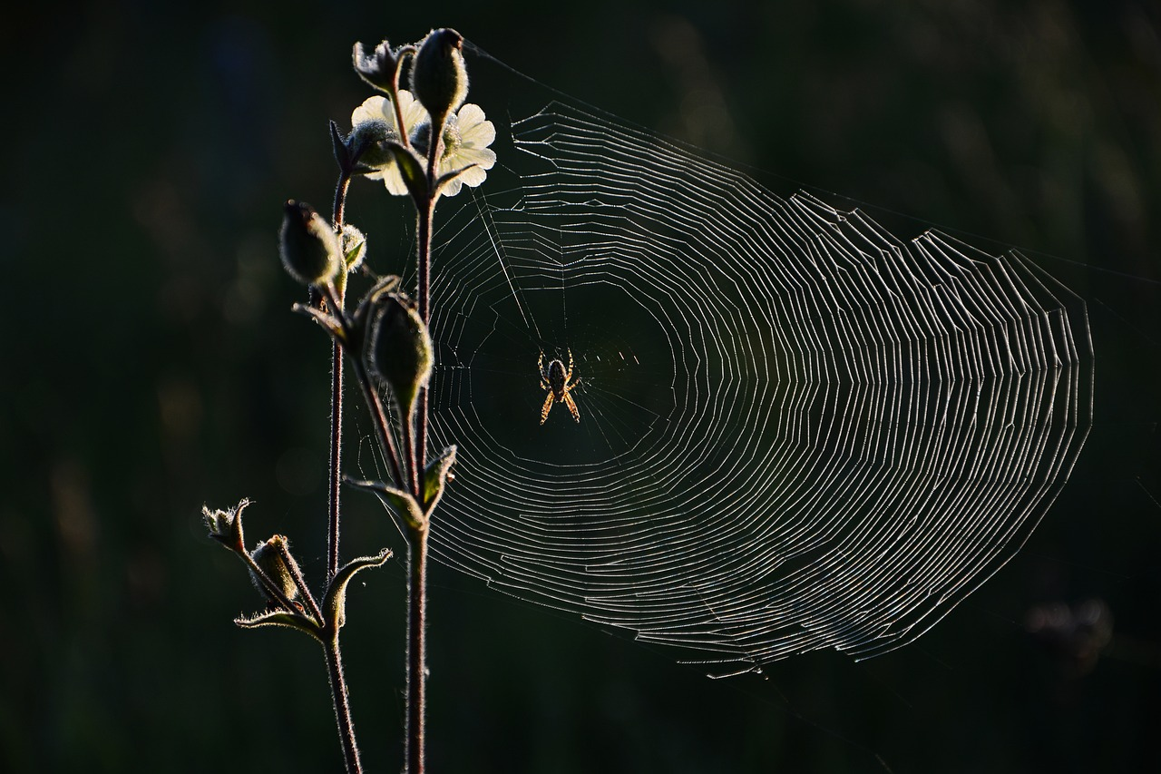
Notes:
Slide 11: Spider, my trick question, because it’s actually NOT an insect, as it has….. 8 legs, not 6!

Slide 12
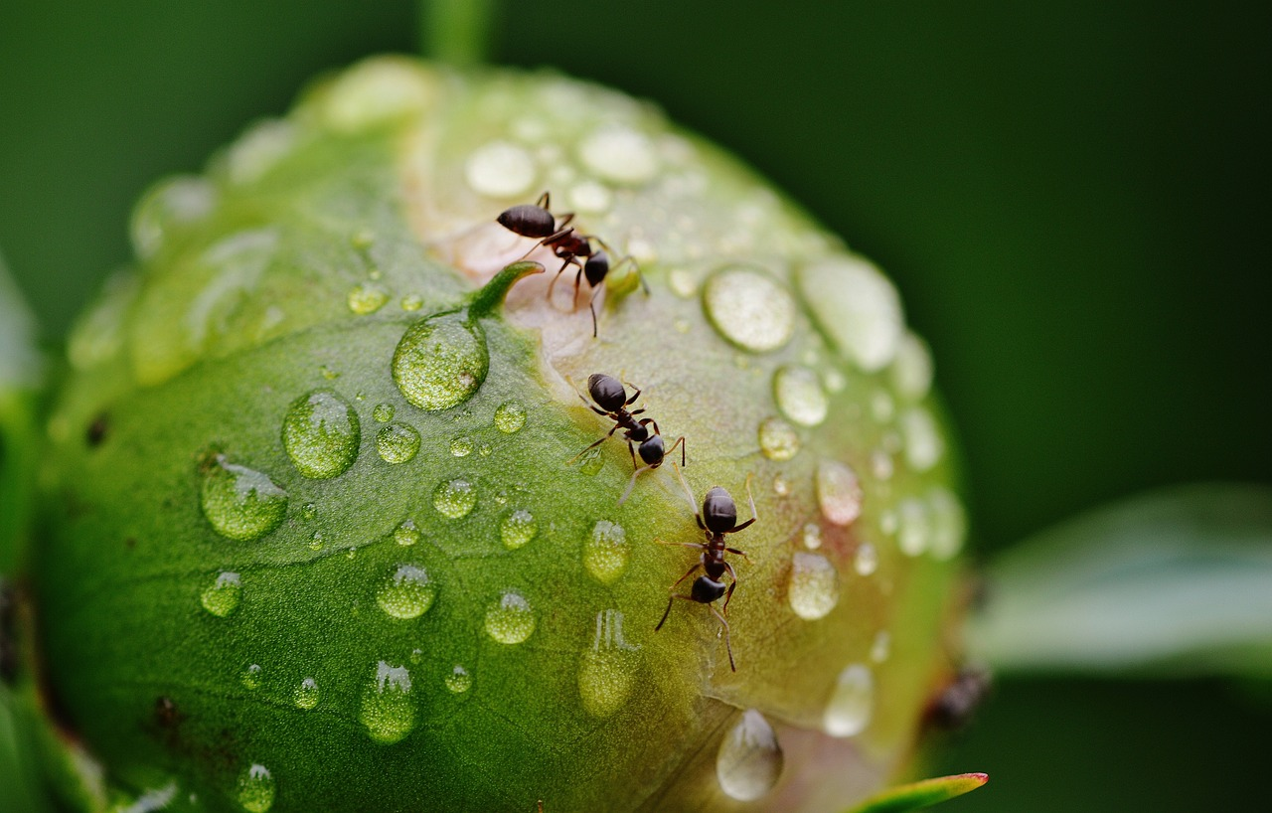
Notes:
Slide 12: Ants
Great job everyone!!

Slide 13
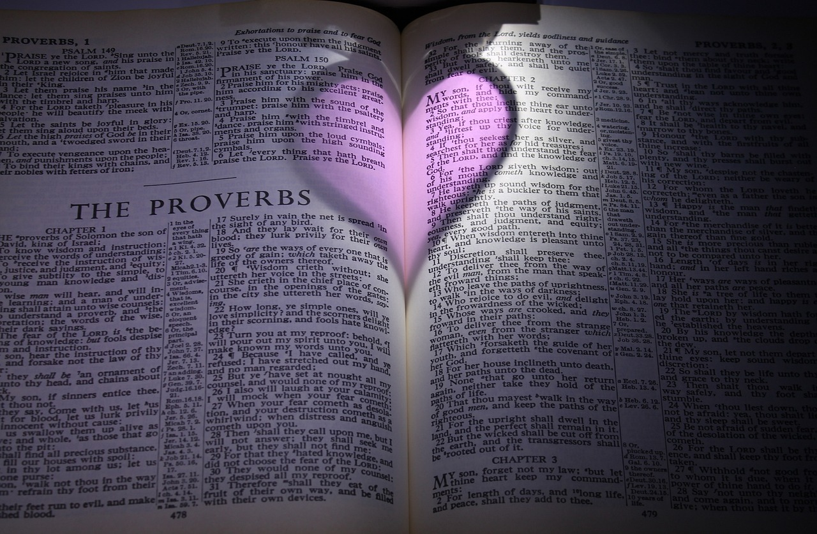
Notes:
Slide 13: As you might remember, this term we are thinking about wise words from King Solomon’s book, called ‘Proverbs’
Believe it or not, there are some wise words in his book about…..

Slide 14

‘Go and watch the ants…..
Watch what they do and be wise.’ (Proverbs 6:6)
Notes:
Slide 14: Ants!
This is perhaps a bit unexpected, but let’s read them together before we share a very short story to help us think more..
‘Go and watch the ants…..
Watch what they do and be wise.’
So now we will do exactly what King Solomon advised: watch the ants, and learn from them.

Slide 15
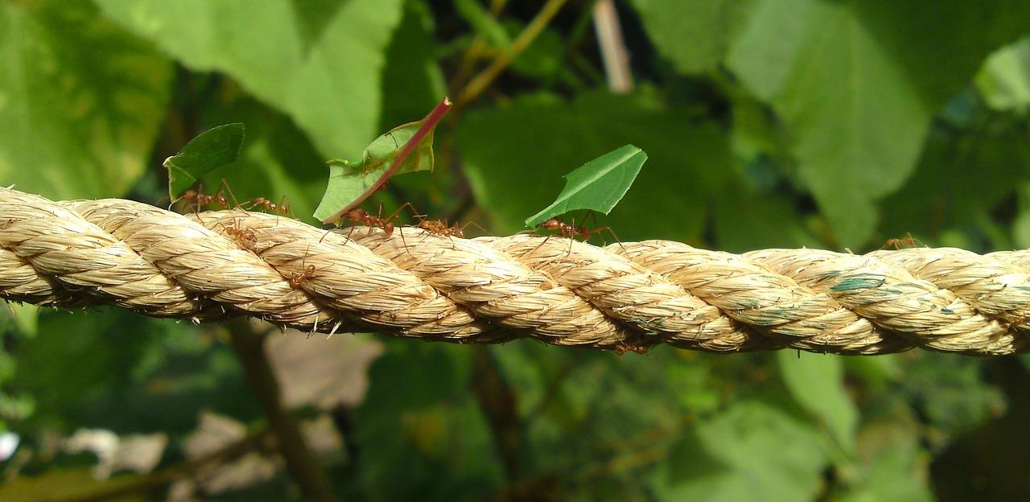
Aesop’s Ants
Notes:
Slide 15: Just a few hundred years after King Solomon’s reign, a very famous Greek storyteller, a man named Aesop, wrote a very famous story about some ants.
His stories are known as fables – they were often very short, but always included a lesson for his listeners to learn. His stories are still loved and told by people all over the world!
As you hear his story think what lesson Aesop wanted his listeners to learn from the ants.
[There is a link to a BBC retelling from the picture if you want to use a longer version]

Slide 16
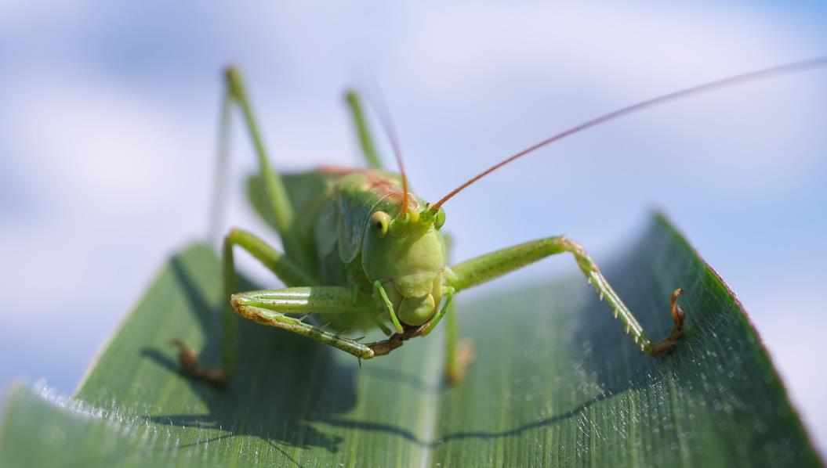

Notes:
Slide 16:
One fine summer’s day, Grasshopper sat on a blade of grass in the sunshine. From this vantage point, he could see a colony of ants busy at work down below him.
‘How ridiculous you all are!’ he exclaimed. ‘Stop work and enjoy this beautiful sunshine! There’s plenty of time for work later.’
But the ants refused, saying that winter would soon be here, and they were collecting food so they wouldn’t starve through the long months.
Summer passed, and Grasshopper was still lazing around, soaking up the last few days of Autumn sunshine.
The ants were still busily collecting food, working together to bring it safely into their nest.
And then one day, it wasn’t Autumn any more. The ground was bare and Grasshopper was cold and hungry.
I wonder what you think the message of this story is?

Slide 17
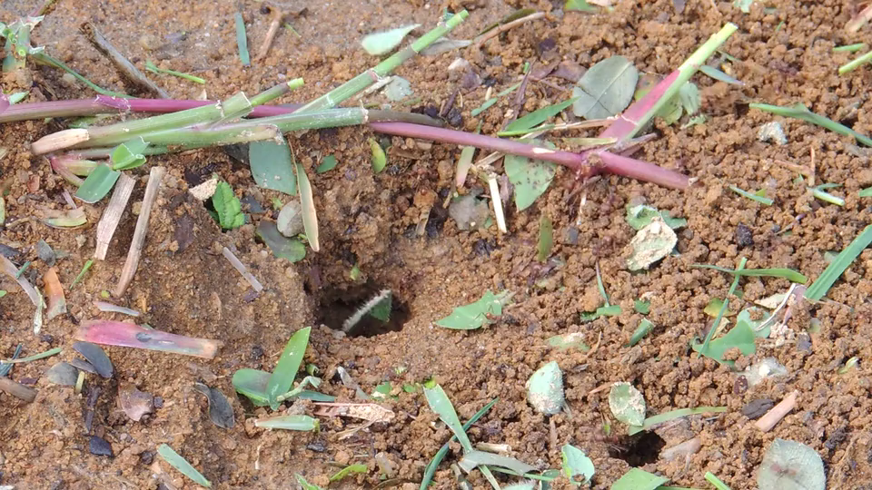
….I wonder what these ants might teach us?....
….I wonder how we might become wise by watching the ants?.....
…I wonder what we might need to work hard at today?....
Notes:
Slide 17: click on the picture and it will show a video!
Let’s do exactly what Solomon advised and watch some ants together now. Then we’ll ask some wondering questions….
….I wonder what these ants might teach us?....
….I wonder how we might become wise by watching the ants?.....
…I wonder what we might need to work hard at today?....

Slide 18
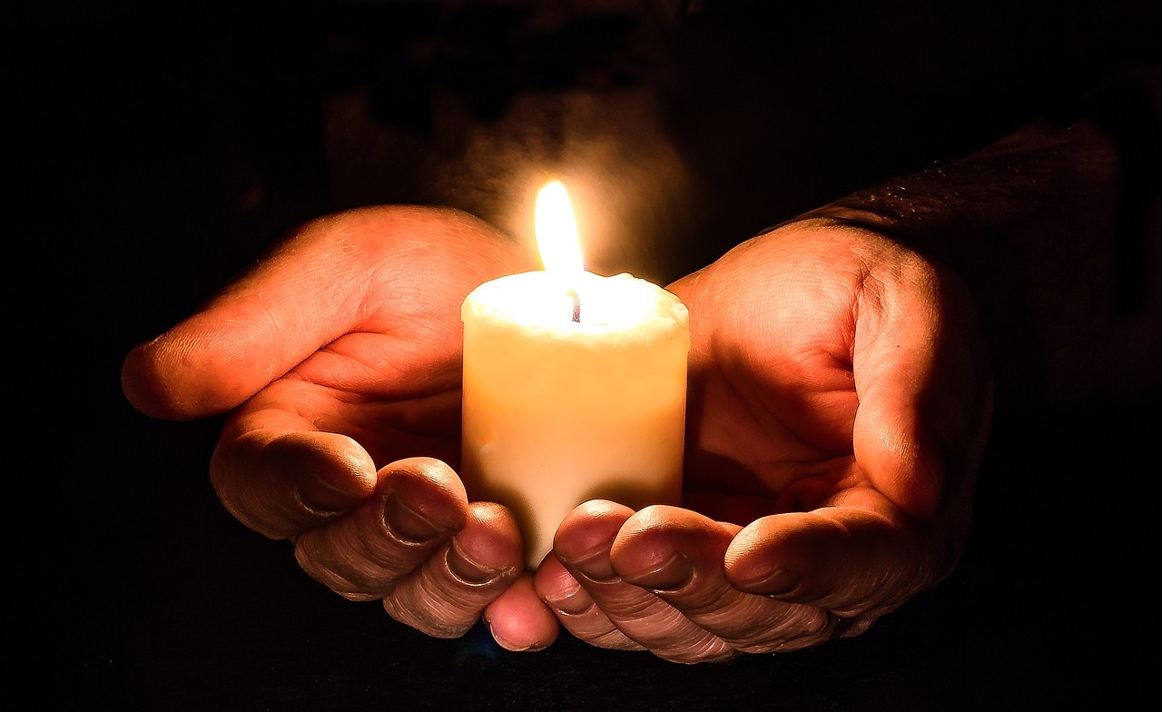
…we will give our best.
Notes:
Slide 18: I’m going to pray now, asking God to help us to give the best that we can in our work, our friendships – and in all that comes our way today, just like the Aesop’s ants did. If this is something that you feel comfortable doing, then join in with ‘We will give our best.’

Slide 19
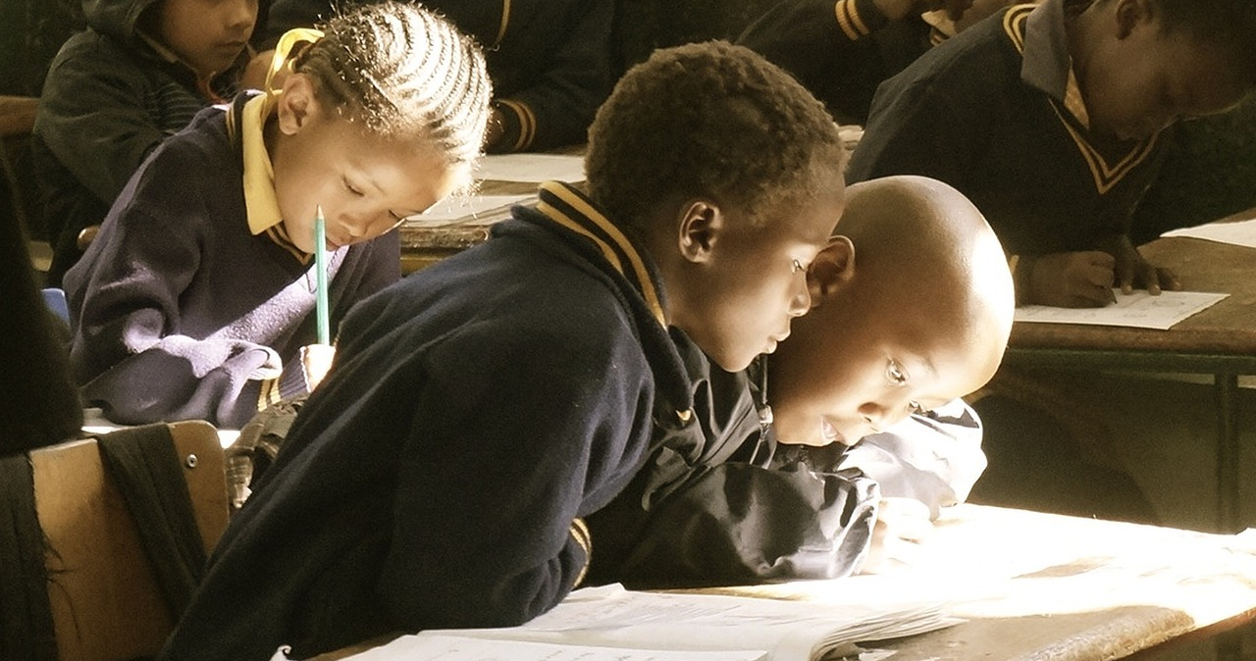
…we will give our best.
Notes:
Slide 19:
At the start of this day, we think of all that we will do today. [Pause]
In our work – we will give our best.

Slide 20
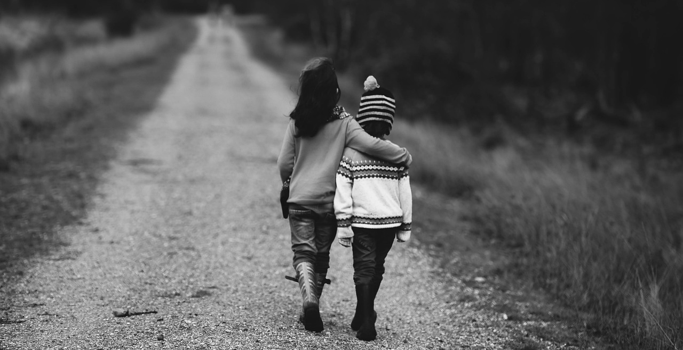
…we will give our best.
Notes:
Slide 20:
In our friendships – we will give our best

Slide 21
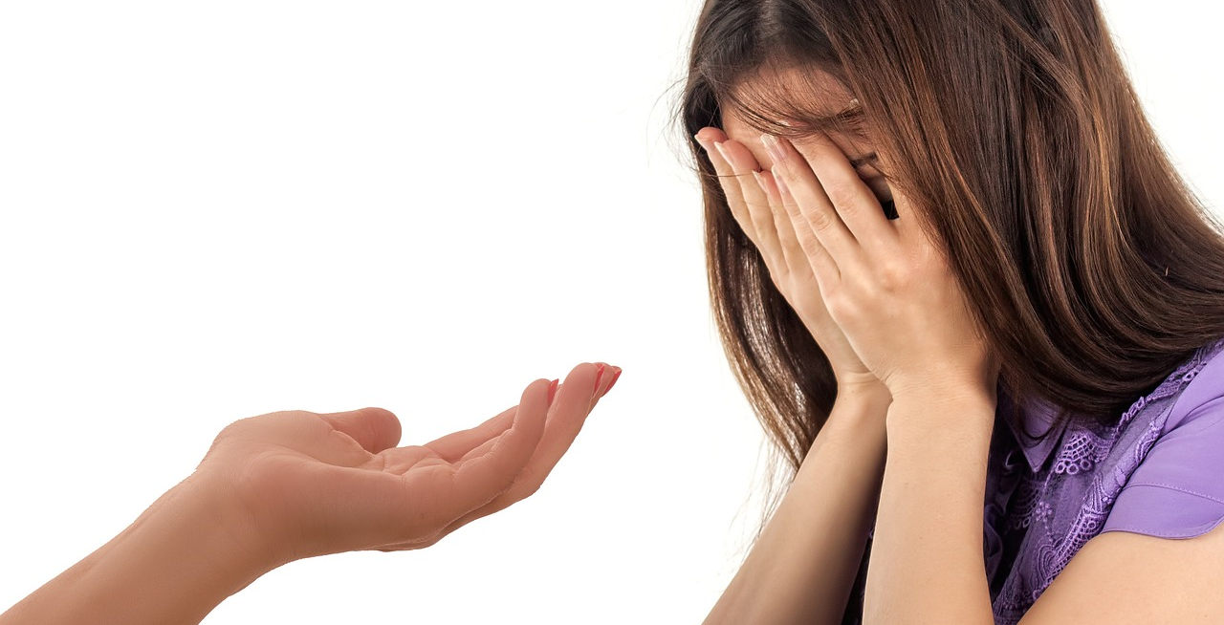
…we will give our best.
Notes:
Slide 21:
In our actions – we will give our best

Slide 22
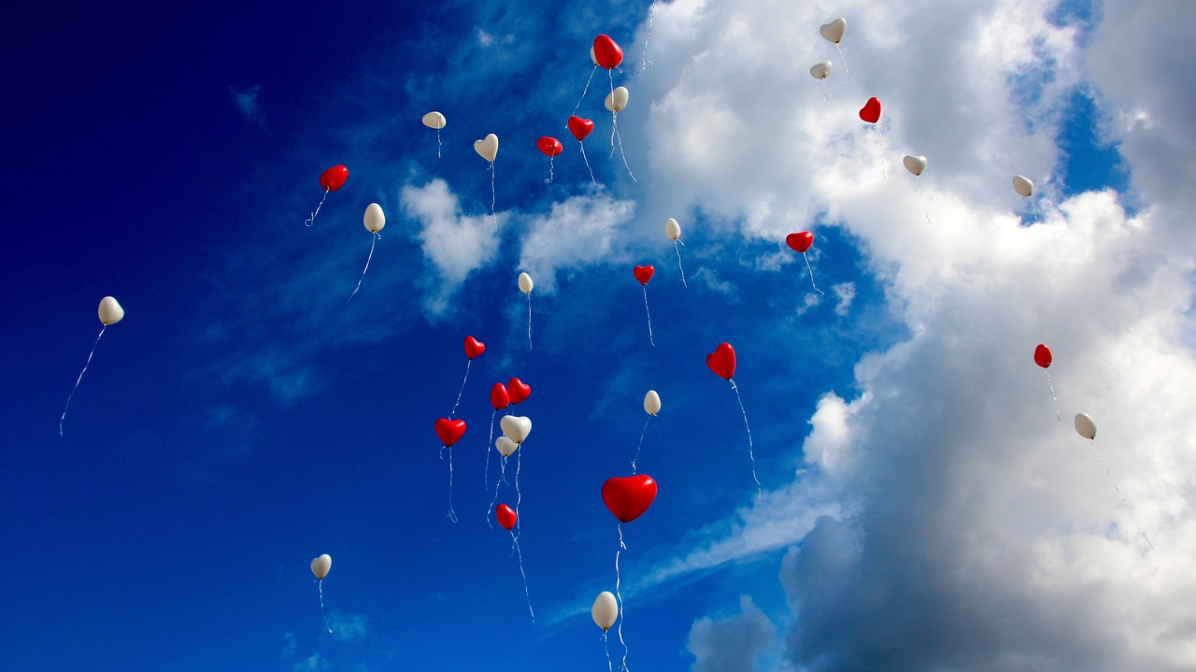
…we will give our best.
Notes:
Slide 22:
In all that this day brings – we will do our best

Slide 23


Slide 24


Leader: As we leave this place & time and go into the day ahead…
All: May today’s words help us to make wise choices.

Slide 25
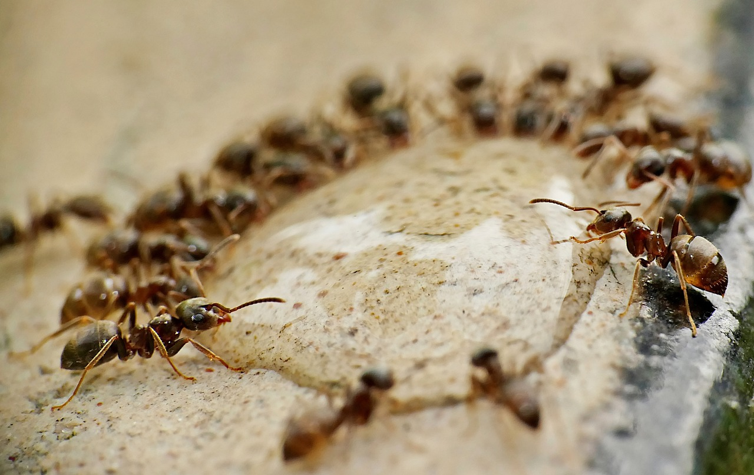
Notes:
Slide 25: Reflective areas
Watch the ants here or here, or go out and watch some of your own in your school grounds! There are also a wide range of video clips on Pixabay so you could choose a different video each day (check them first, as some are more suitable than others!): Ants Videos: Download 444+ Free 4K & HD Stock Footage Clips - Pixabay

