Slide 1

All images copyright-free from pixabay, unless otherwise identified
Notes:
Slide 1: Dandelion seeds stilling exercise
Use the stilling slide if desired: the suggested words should be spoken slowly, leaving pauses inbetween to create a sense of stillness.
You’re watching tiny dandelion seeds dropping from the sky…As you sit quietly, watch the leaves growing….[PAUSE]
Now practise slower breathing…..in…..and out…..in……and out…..keep this going as you continue to look at the seeds….[PAUSE]
You maybe notice that you are feeling calmer and more relaxed….[PAUSE]
As you breathe, think about yourself and what you bring into this time today….. [PAUSE]
We come into this special / sacred space and time to be still….to think deeply…..to be together as a school community…..
In our time together today, we will share a quiz, tell a story and then use it to help us to think.
But first, let’s welcome one another as we begin….

Slide 2

As we gather to share today's story.
As we gather to share today's story.
Leader: As we gather to share our story today….
All: May we grow in our understanding of ourselves and our actions towards others.
Notes:
Slide 2: Use our new gathering words for this term, or your usual greeting if you prefer. These greetings may change slightly each week to reflect the spiritual elements that we will be exploring in each week’s materials.
Leader: As we gather to share our story today….
All: May we grow in our understanding of ourselves and our actions towards others.

Slide 3
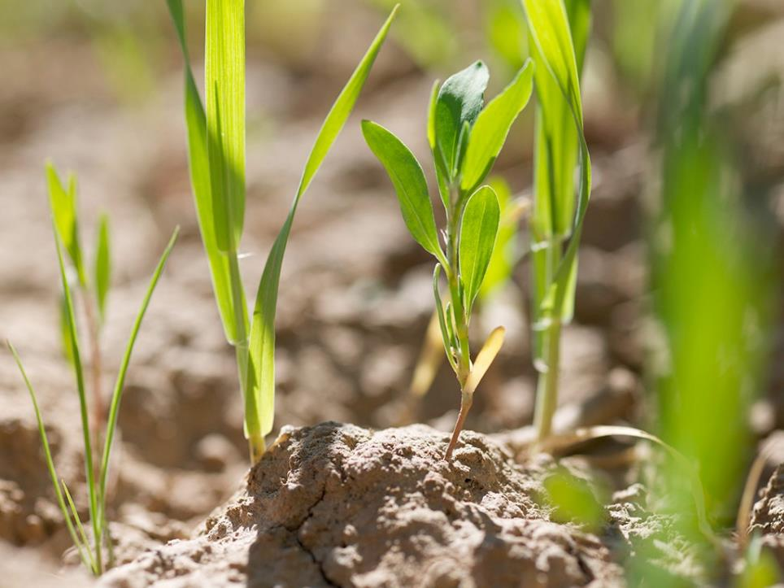
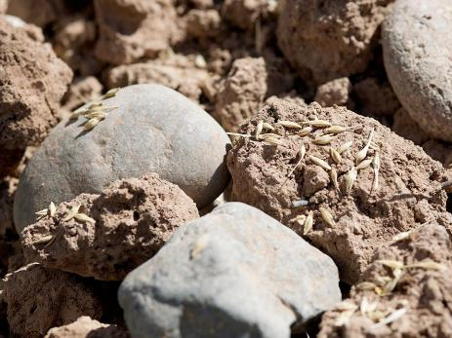
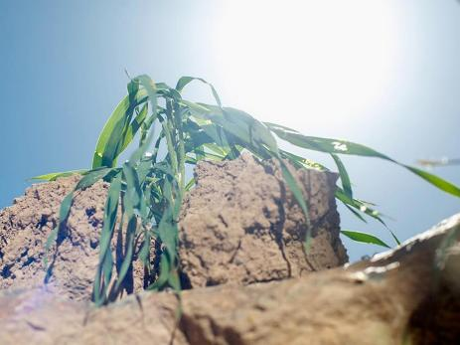
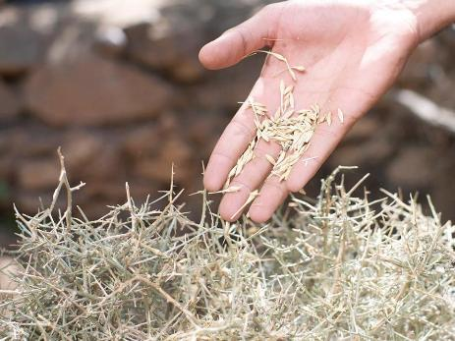
Notes:
Slide 3: Last week, we heard a parable that Jesus told, about seeds – some that grew well, and others that didn’t. In a short while, we will share another of Jesus’ most famous parables, but first…..

Slide 4

Welcome!
Notes:
Slide 3: …..a quiz that is all about welcoming each other in many different languages – some of which are spoken by families in our school community. First, you’ll see a flag, then you tell me the country (if you know it) – and then we’ll have a go at learning the word for ‘Welcome’ in that country [use the slides that you have chosen, or my selection, slides 5-11]

Slide 5

UK
Welcome!

Slide 6

France
Bienvenue!
Notes:
Pron. = biyan-ven-oo

Slide 7

Ukraine
Прошу
Pro-shu
Notes:
Pron. = pro (short o sound)-shoo

Slide 8

Germany
Wilkommen!
Notes:
Pron. = vil-com-men

Slide 9

Croeso!
Wales
Notes:
Pron. = croy-sew

Slide 10

Hong Kong
歡迎
Fun-yehng!
Notes:
Pron. = foon-yeng

Slide 11

India
नमस्ते
Namaste!
Notes:
Pron. = namas-tay

Slide 12
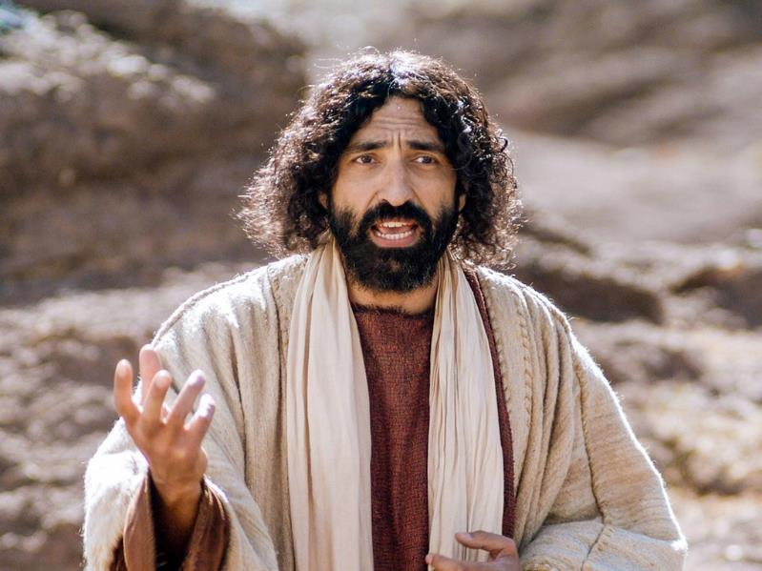

Notes:
Slide 12: Today, we are going to be sharing one of Jesus’ parables, a story that will help us to think about the idea of welcome. Jesus’ parables often started ‘The Kingdom of God is like….’ And this is no exception! It’s a parable about something that’s very small indeed –

Slide 13
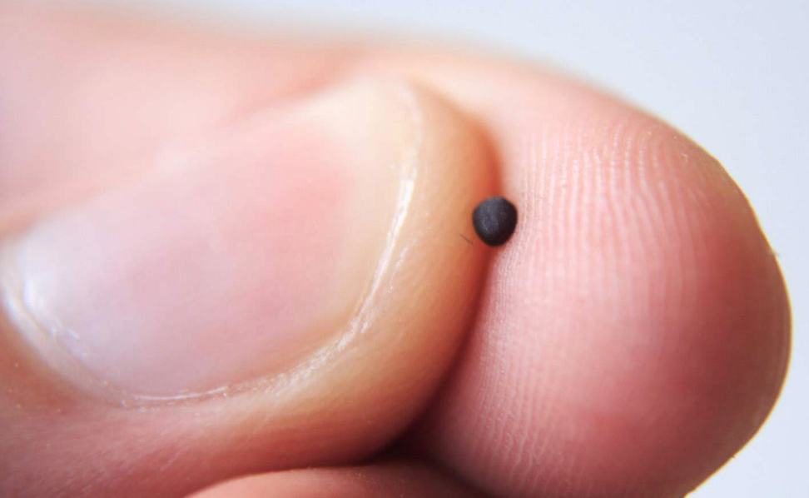
Notes:
Slide 13: …a mustard seed – and it plays a BIG part in Jesus’ story Use the script on p4, The mustard seed

Slide 14
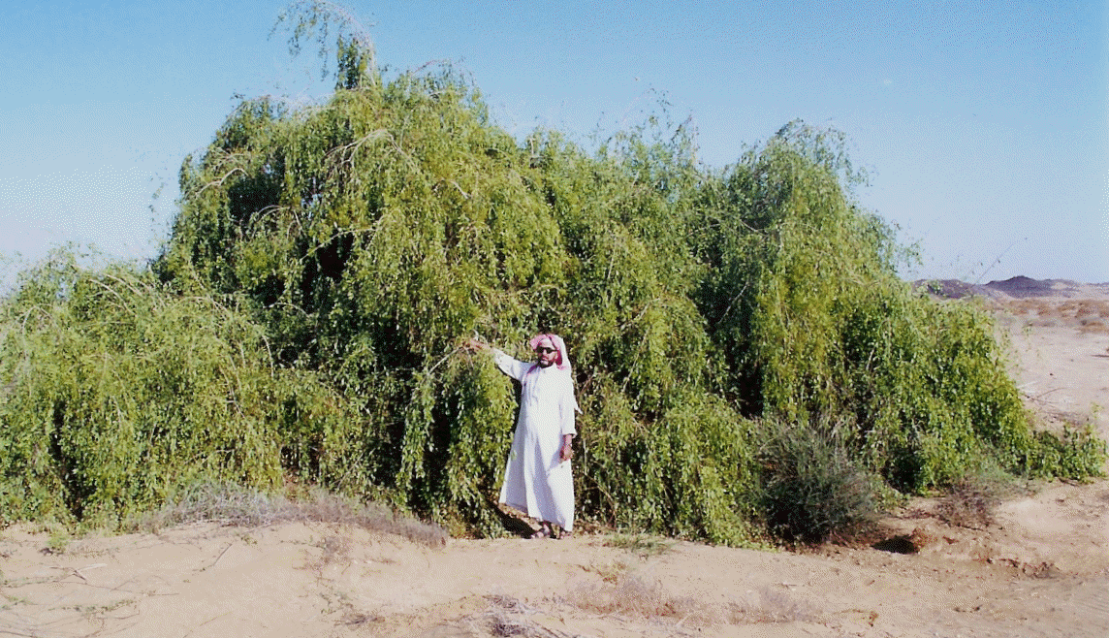
Notes:
Slide 14: [show the picture of the mustard tree] Just in case you think Jesus was joking about the size of the mustard tree, here’s what one looks like. I think you’ll agree that given how teeny-tiny a mustard seed is, that’s quite extraordinary!

Slide 15
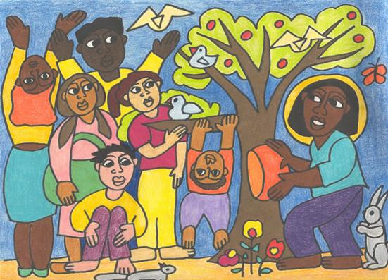
‘I tried to depict a flourishing tree and a whole community, where people work and play in harmony, supporting one another, praising God and enjoying God’s creatures and all of the wondrous creation. I wanted to suggest a world where people of all races, cultures and backgrounds share life in common, cooperate and live together.’
Notes:
Slide 15: Let’s go back to the parable. Jesus hardly ever explained to the people who were listening to his stories what he meant: he left it up to them to decide. So that means that we can all have our own ideas!
As you look at this image about the parable of the mustard seed, I wonder what you notice?....... [PAUSE – you might want to allow some children to share their ideas]
The artist, Anne Brink, who generously allowed us to use her painting based on this parable, said this about her picture: ‘I tried to depict a flourishing tree and a whole community, where people work and play in harmony, supporting one another, praising God and enjoying God’s creatures and all of the wondrous creation. I wanted to suggest a……world where people of all races, cultures and backgrounds share life in common, cooperate and live together.’
Responding (and words for worship)
Spend a few moments now, just being still and looking at Anne’s beautiful image….. [PAUSE]
….I wonder how it might help us to reflect on ourselves…..or on our relationship with others…..or our world as a wonderful place of welcome for all?.....

Slide 16
I wonder how our school community might be a bit like this mustard tree?
Notes:
Slide 16: Let’s be still and quiet together now….
…in the stillness, let’s think about the things that we’ve heard today….
…Jesus’ parable was of a teeny-tiny, eeny-weeny, itty-bitty little mustard seed….
….a seed that grew into a mighty tree where birds came to live….
….a place where many creatures found a home….
….a place of welcome and of safety….
….I wonder how our school community might be a bit like this mustard tree?....
….think for a few moments about your place in our school community….
…about how you feel at home here, in our school, as a member of our school family….
…..who else is a part of our school family, and how can we make sure that it is a place where everyone feels welcome?....
…in the quietness of this moment, use the time to think, or to pray….

Slide 17
Help us to remember….
We are all welcome here.
Notes:
Slide 17: Prayer
I’m going to do this now in a reflective prayer. If you’d prefer not to pray, then just continue to be quiet with your own thoughts.
After I say the words ‘Help us to remember,’, you might like to join with me by using the words ‘We are all welcome here’. I will also give you some space to think each time.
So, let’s pray.
God who welcomes all,
Whenever we see someone who looks left out….[leave a pause]
Help us to remember, ‘We are all welcome here’
Whenever we feel that no-one notices us…. [leave a pause]
Help us to remember, ‘We are all welcome here’
Whenever someone new or someone different joins our class….[leave a pause]
Help us to remember, ‘We are all welcome here’
God, in your Kingdom, help us to remember, ‘We are all welcome here’

Slide 18
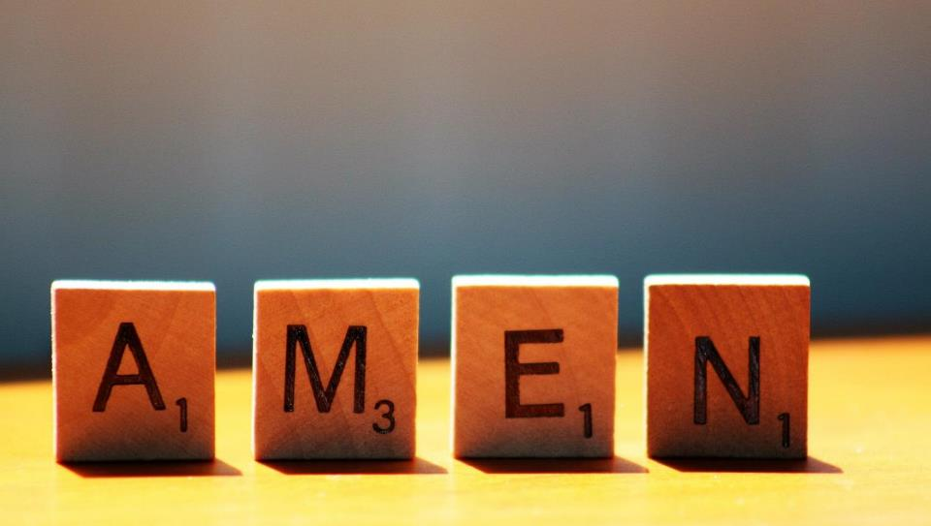

Slide 19
Leader: As we leave this place & time and go into the day ahead…
All: May we remember we are all welcome here!

Slide 20

Notes:
Slide 20: Reflective areas
Put a small bowl of mustard seeds in your reflection area.
Do: Hold a teeny-tiny mustard seed in your hand.
Think: Who is a part of our school community? Who has ‘found a home’ in our school?
Talk: How can we make sure that everyone feels welcome, and at home?
Maybe pause and pray…..

Slide 21
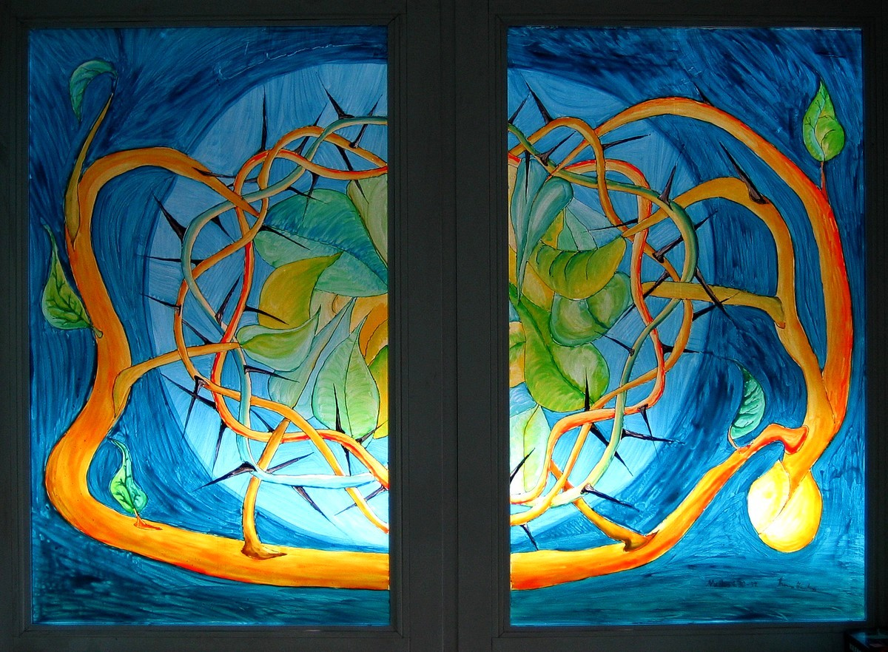
Notes:
Parable of the Mustard Seed
Painted glass window in the YMCA training centre for German leadership in Kassel.
Original source: https://diglib.library.vanderbilt.edu/act-imagelink.pl?RC=55890

