Slide 1
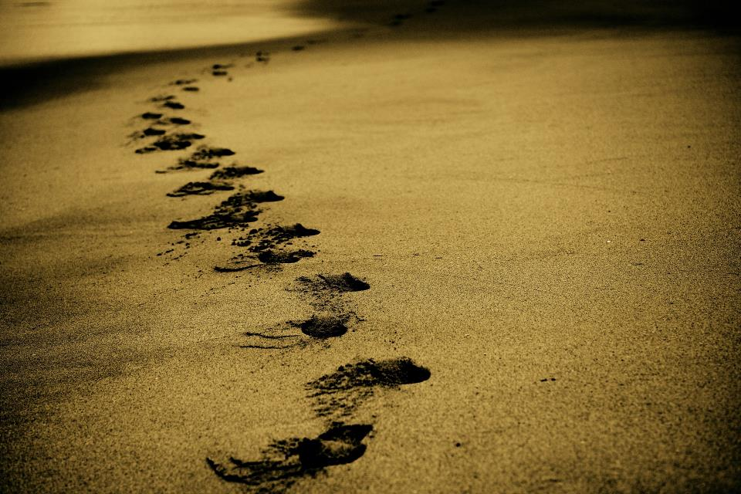
Picture copyright-free from pixabay
Leader: We are on this journey together…
Children: We are friends along the way…
ALL: May God go with us.
Notes:
Slide 1 or 2 [choose whichever image you prefer, or use them in rotation]:
Teach the new greeting for this term
Leader: We are on this journey together…
Children: We are friends along the way…
ALL: May God go with us.
BSL interpretation:
Sign for ‘way’ (nearest to the idea of ‘journey’): British Sign Language BSL Video Dictionary - way
Sign for ‘friends’: British Sign Language: friends
Sign for ‘God: British Sign Language BSL Video Dictionary - God
Sign for ‘go with us’ – we have invented this! After you’ve signed ‘God’, bring your finger down alongside your other finger and make them ‘journey together’ in front of you.
Engaging:
As we heard last week, in the final term of this school year, we are beginning a new theme:

Slide 2
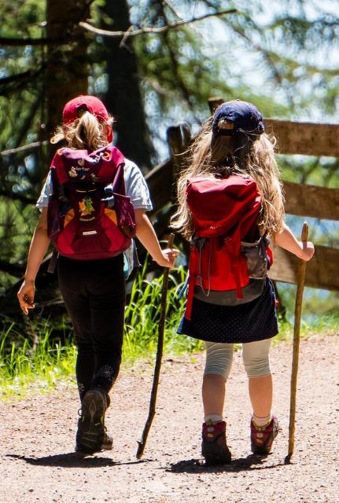
Picture copyright-free from pixabay
Leader: We are on this journey together…
Children: We are friends along the way…
ALL: May God go with us.
Notes:
Slide 1 or 2 [choose whichever image you prefer, or use them in rotation]:
Teach the new greeting for this term
Leader: We are on this journey together…
Children: We are friends along the way…
ALL: May God go with us.
BSL interpretation:
Sign for ‘way’ (nearest to the idea of ‘journey’): British Sign Language BSL Video Dictionary - way
Sign for ‘friends’: British Sign Language: friends
Sign for ‘God: British Sign Language BSL Video Dictionary - God
Sign for ‘go with us’ – we have invented this! After you’ve signed ‘God’, bring your finger down alongside your other finger and make them ‘journey together’ in front of you.
Engaging:
As we heard last week, in the final term of this school year, we are beginning a new theme:

Slide 3
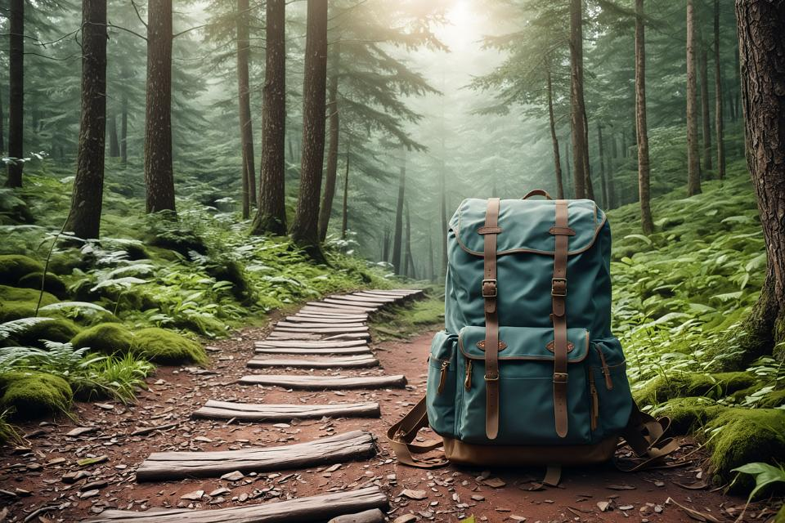
Picture copyright-free from pixabay
To boldly go….
Notes:
Slide 3: To boldly go….. when we will be exploring journeys of many different sorts. And we are going to start today with our trusty rucksack, which will accompany us on our journeys.

Slide 4
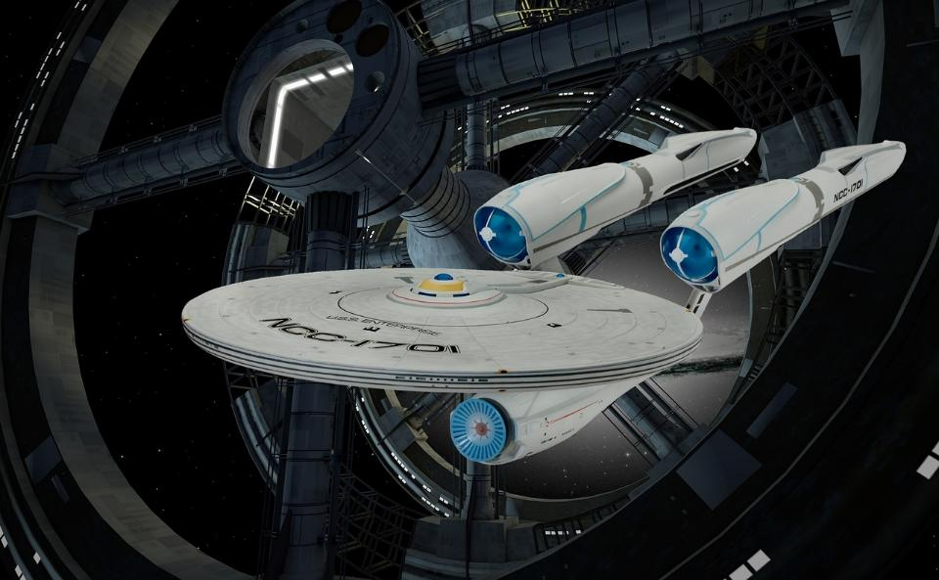
Picture copyright-free from pixabay
….to boldly go where no-one has gone before….
Notes:
Slide 4: ‘to boldly go where no-one has gone before’….. …..some of you might know these words from the adventures of the crew of the starship Enterprise. Their adventures took them into great danger and new civilisations, meeting and learning about new people and new worlds. I hope that this term, our times together will be full of this sense of adventure (but much less dangerous!)
We are going to start today, not in outer space, but with our trusty rucksack, which will accompany us on our journeys.

Slide 5

Picture copyright-free from pixabay
What’s in the rucksack?
Notes:
Slide 5: Let’s look inside and see what we have packed for our journeys this term.
[Open up the rucksack and take the objects out one at a time – they don’t need to be in order. Ask children what they think each is there for, which will be far more interesting than the ‘right’ answer, but do make sure children know what the objects are as some may never have seen e.g. a compass. You will expand on some of these during the reflective story later in the script, so don’t spend a long time on this section. Children just need to have seen the objects and know what they are.]

Slide 6
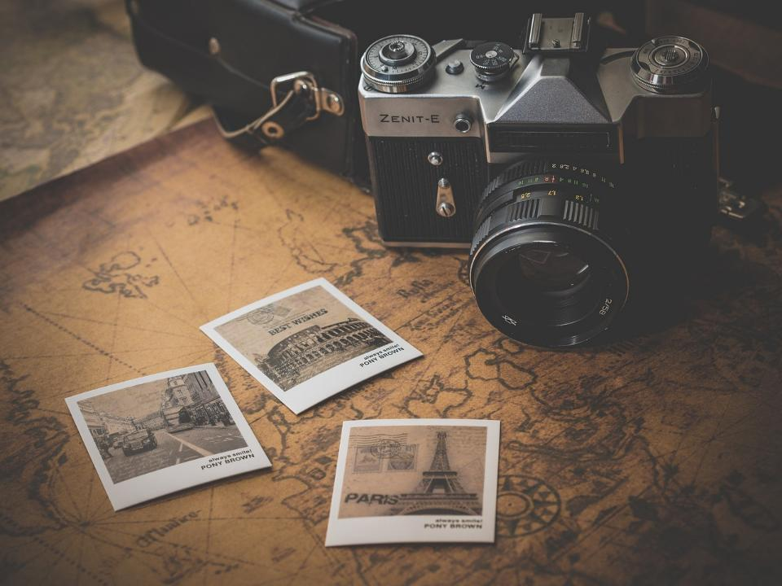
Picture copyright-free from pixabay
We’re going on a journey….
Notes:
Slide 6: We’re going on a journey…..
We’re going to use our objects now to tell a story of the very special journey that we are going to be travelling on together through this term and to the end of this school year…. [use script on p.4]

Slide 7
…. I wonder how you are feeling about the journey of this final term in the year?.....
….I wonder what bold new adventures might be waiting for you next?.....
Notes:
Slide 7: Responding (and words for worship):
As we reflect and wonder together, let’s be still and quiet….
…we’ve thought today about journeys…..
….and peeped into the future to think about our theme ‘To boldly go…..’
…..we will be hearing stories about great adventures and even greater adventurers…..
….and thinking about the journeys of our own lives….
….I wonder how you are feeling about the journey of this final term in the year?.....
….I wonder what bold new adventures might be waiting for you next?.....
….some of us like adventure and change, others do not!....
When a man named Joshua was facing a new challenge as he looked across the river into the adventure that lay ahead, God spoke these words to him, and it’s with these that we will finish today….

Slide 8
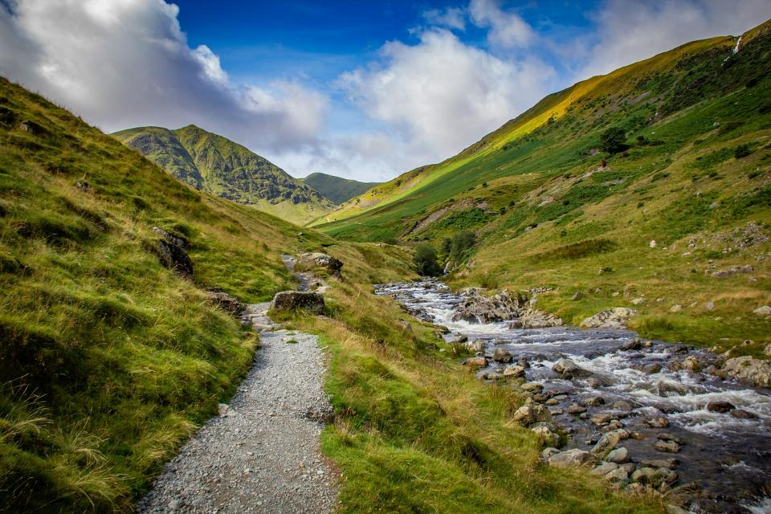
Picture copyright-free from pixabay
‘….Be strong and courageous. Do not be afraid; do not be discouraged, for the Lord your God will be with you wherever you go!’
(Joshua 1:9)
Notes:
Slide 8: ‘….Be strong and courageous. Do not be afraid; do not be discouraged, for the Lord your God will be with you wherever you go!’ (Joshua 1:9)
….I wonder how these words might help us as we travel through life?.....

Slide 9
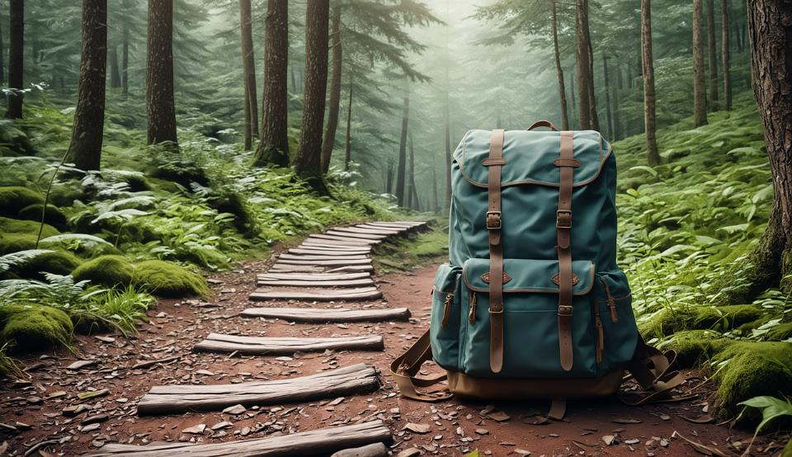
We will boldly go!
Notes:
Slide 9: Prayer:
We are going to use our theme words We will boldly go! to help us as we pray now. Join in with me if you would like to make the prayer your own.

Slide 10

Picture copyright-free from pixabay
We will boldly go!
Notes:
Slide 10: As we begin this journey together this term,
We will boldly go!

Slide 11
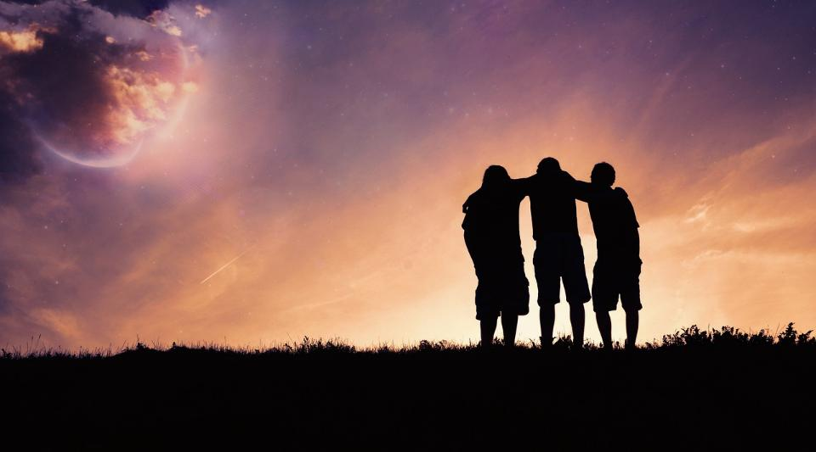
Picture copyright-free from pixabay
We will boldly go!
Notes:
Slide 11: Friends together along the way,
We will boldly go!

Slide 12
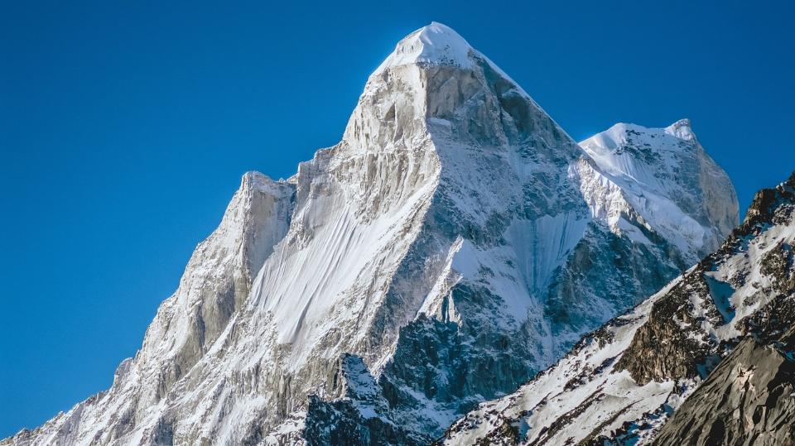
Picture copyright-free from pixabay
We will boldly go!
Notes:
Slide 12: When we face challenges or difficulties
We will boldly go!

Slide 13
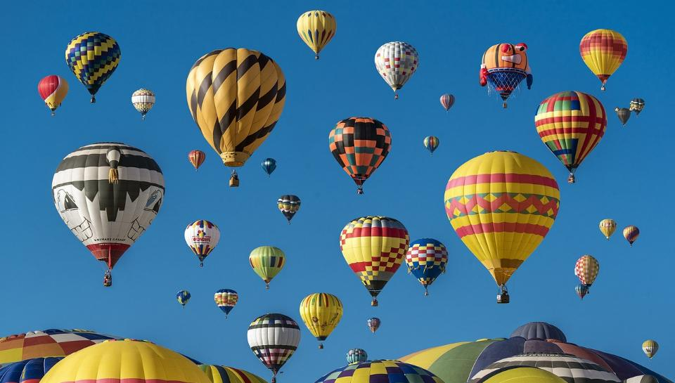
Picture copyright-free from pixabay
We will boldly go!
Notes:
Slide 13: Through all of life’s adventures
We will boldly go!

Slide 14
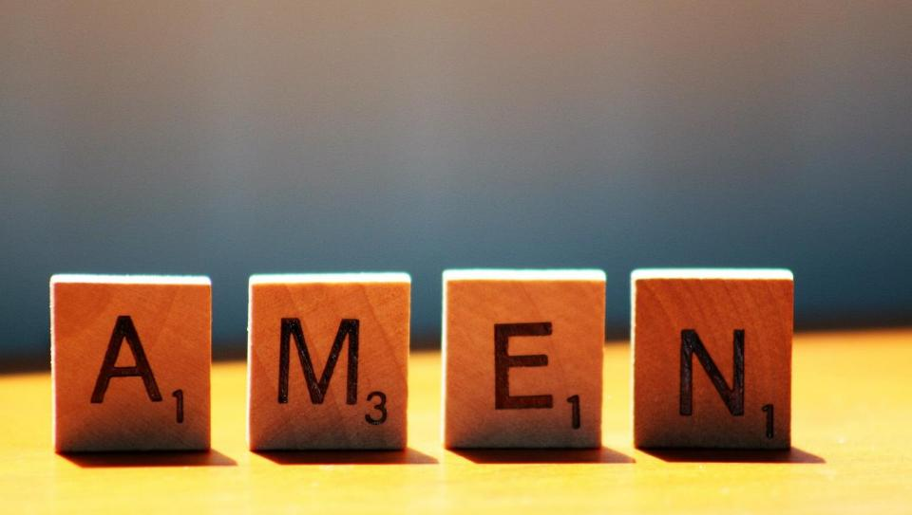

Slide 15
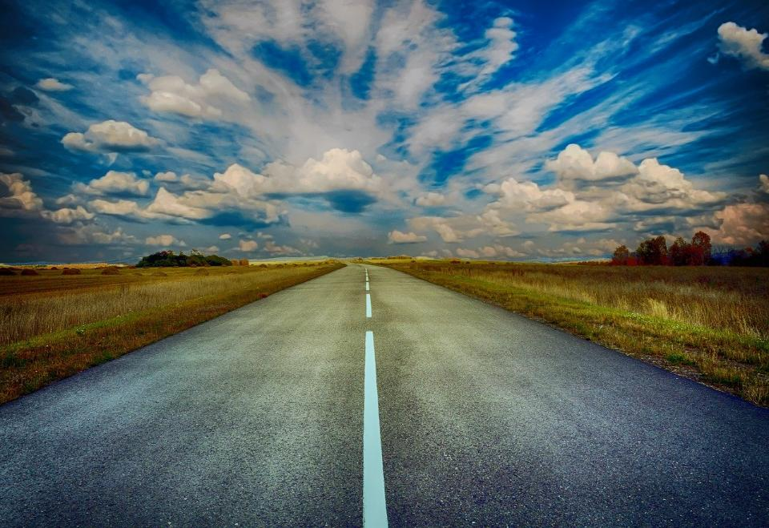
Picture copyright-free from pixabay
Leader: We have journeyed together today. As we leave this place and time and go into the day ahead…
ALL: …May God go with us.
Notes:
Slide 15: Teach the new leaving words for this term (which are very similar to the opening words you will use next week!):
As you’ve heard, we are beginning a whole new series today, as we travel together to the end of another school year. As we have a bit of a journey theme across the term, which will take us through the weeks together, it will come as no surprise that our greeting of each other during this term has a journey theme as well! Let’s learn this together…..
Leader: We have journeyed together today. As we leave this place and time and go into the day ahead….
ALL: ….May God go with us.
Sign for ‘God: British Sign Language BSL Video Dictionary - God
Sign for ‘go with us’ – we have invented this! After you’ve signed ‘God’, bring your finger down alongside your other finger and make them ‘journey together’ in front of you.

Slide 16

Picture copyright-free from pixabay
Notes:
Ideas for classroom reflection: Class passport
A passport shows that you belong in a certain country. Add your name to your class page.
Look at all the names of children and adults in your class. You all ‘belong’ in your class as well. Pray for others in your class and ask God to bless them.
Do whatever you can to ensure that others always feel that they belong.

Slide 17
Picture copyright-free from pixabay
Notes:
Example with school logo

