Slide 1




We are here together in our school family. May God be with us…
...and watch over us.
Notes:
Slide 1: Use these new gathering words for this term, or your usual greeting if you prefer.

Slide 2
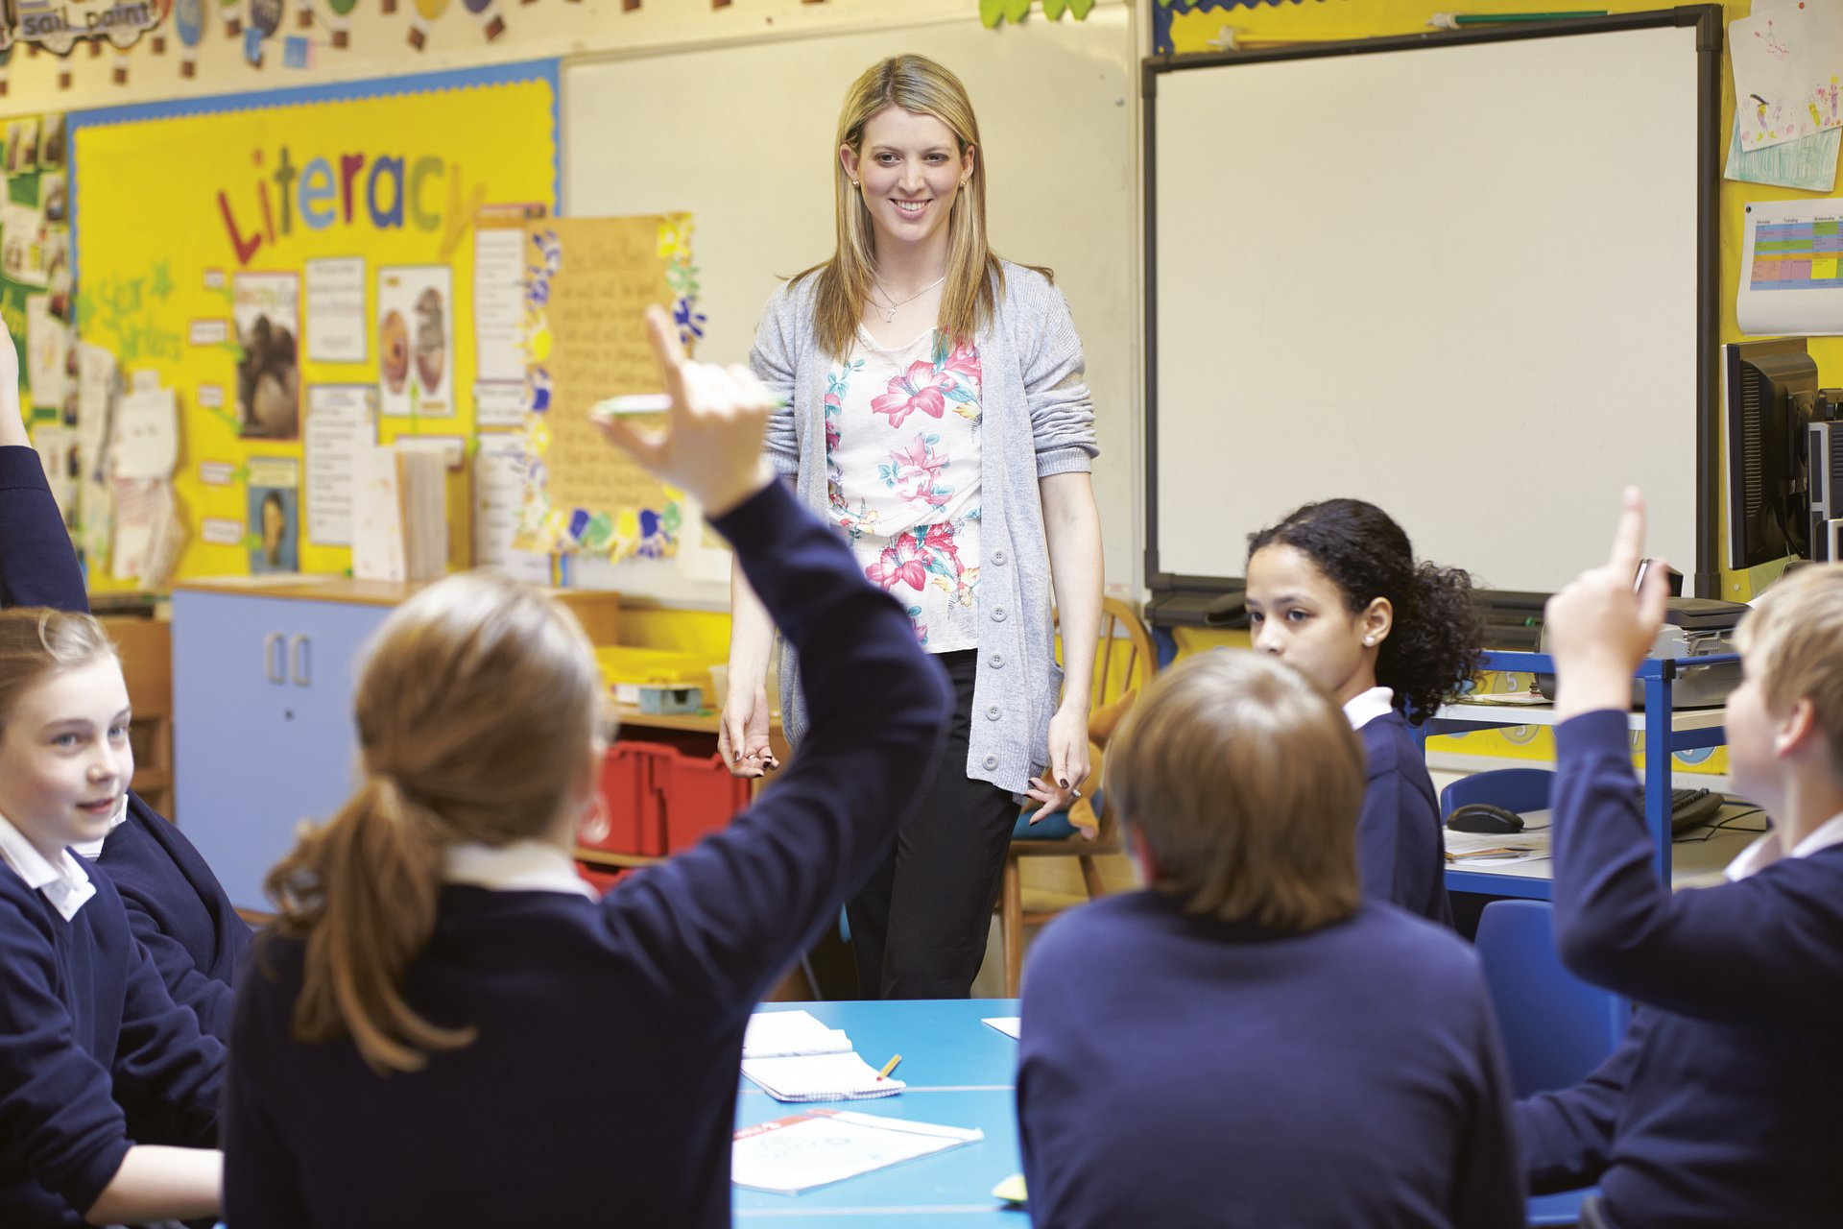
What have you learned?
Notes:
Slide 2: ‘Who can tell me something that their teacher’s taught them this term so far.....? I expect many of you have found that you learn more quickly when your teachers show you how to do something rather than just tell you.

Slide 3
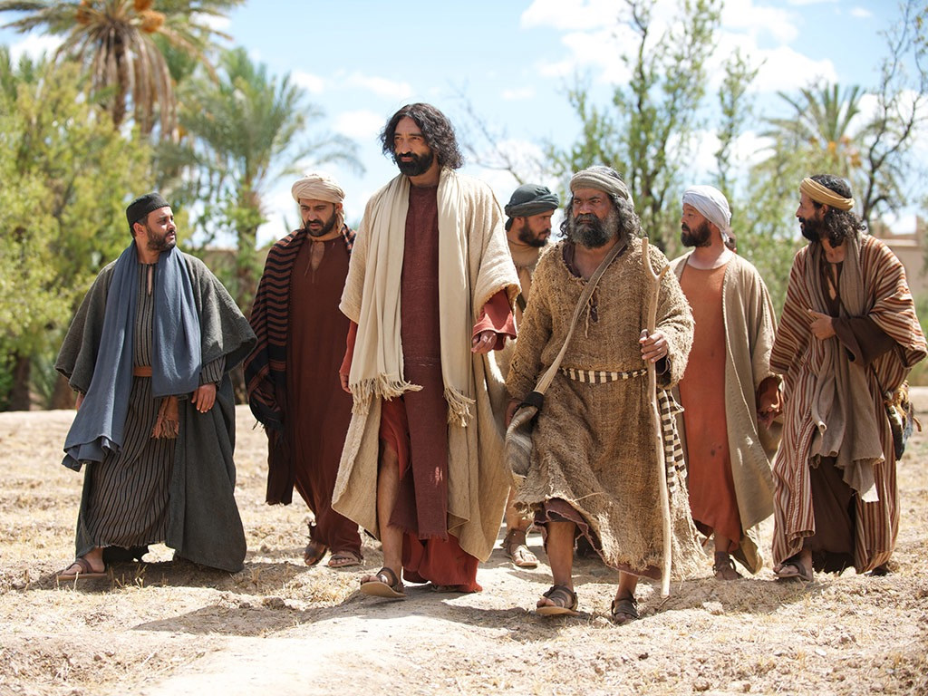
Jesus, teach us to pray!
Notes:
Slide 3: In our assembly today, we’re going to be finding out about something that Jesus’ special friends, the disciples, once asked Jesus to show them – how to pray.
Jesus explained how they were to do this using a model – not something he made out of Lego, but an example for them to copy. Some of you may have used writing models or frames during literacy. Well, this is a prayer model or frame....And it’s such a good prayer that Christians all over the world still pray it today!

Slide 4
Our Father in heaven,
Hallowed be your name
Your kingdom come, Your will be done on earth, as it is in Heaven.
Give us today our daily bread.
Forgive us our sins,
As we forgive those who sin against us.
Lead us not into temptation,
But deliver us from evil.
For the Kingdom, the power and the glory are yours, now and forever.
Amen
Notes:
Slide 4: Here’s the model he showed to them:
Our Father in heaven,
Hallowed be your name
Your kingdom come, Your will be done on earth, as it is in Heaven.
Give us today our daily bread.
Forgive us our sins,
As we forgive those who sin against us.
Lead us not into temptation
But deliver us from evil
For the Kingdom, the power and the glory are yours, now and forever.
Amen
This prayer, often called the Lord’s Prayer, is used by Christians all over the world. The words are a little tricky in places, because they’re written in Bible language, and we’ll think about what they mean in a little while. It’s a good prayer to pray using the words that Jesus gave, but Jesus was also teaching his disciples some important things about what to pray – a bit like a toolkit to help them to talk to God [put toolbox on the table]

Slide 5
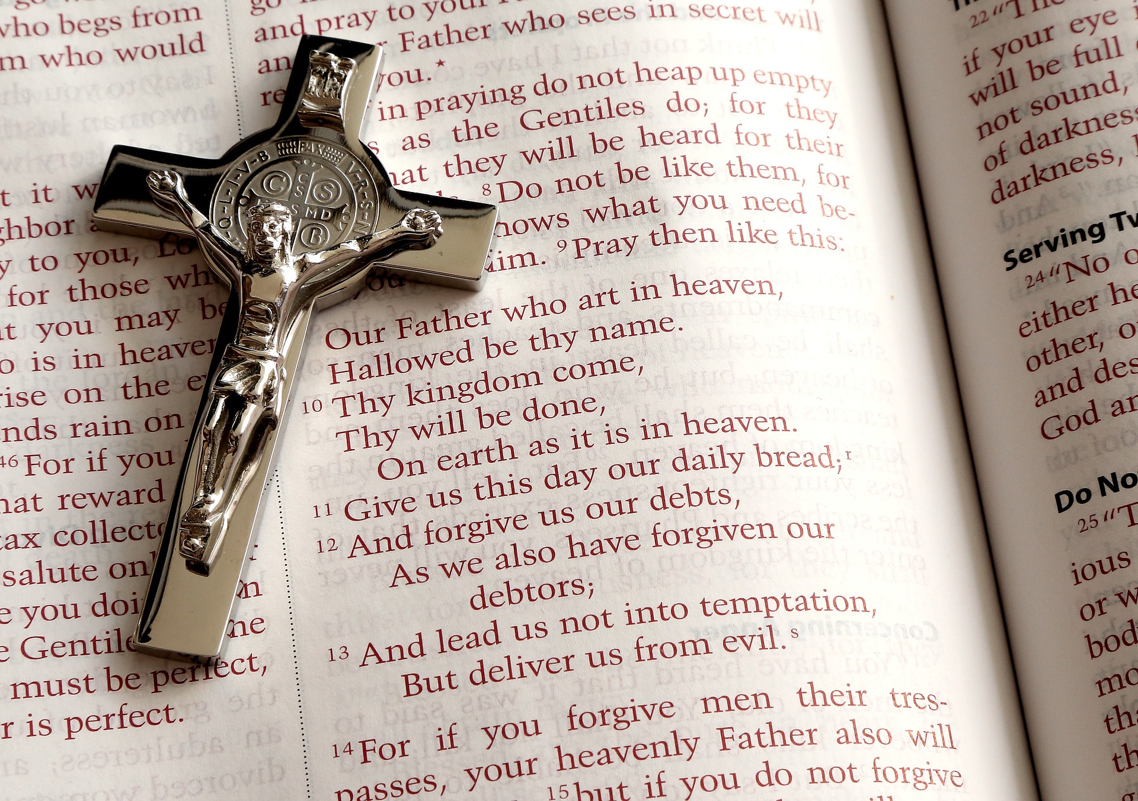
The Lord’s Prayer
Notes:
Slide 5: This prayer, often called the Lord’s Prayer, is used by Christians all over the world. The words are a little tricky in places, because they’re written in Bible language, and we’ll think about what they mean in a little while. It’s a good prayer to pray using the words that Jesus gave, but Jesus was also teaching his disciples some important things about what to pray – a bit like a toolkit to help them to talk to God [put toolbox on the table]

Slide 6

The Prayer Toolkit
Notes:
Slide 6: So let’s open our toolkit up and find out what Jesus meant ...... [use script p.3]
You can access the video version here or by clicking on the toolbox picture: https://youtu.be/9fvRRd7x8H0

Slide 7

….I wonder what you think about this prayer that Jesus prayed?...
…. I wonder how it helped the disciples?…..
….and how it helps Christians today?
Notes:
Slide 7: Responding (words for worship):
Let’s be still and quiet together now….
Let’s be still and quiet together now….
We’ve heard today that Jesus’ disciples wanted to learn how to pray, and that Jesus showed them how.
I wonder what you think about this prayer that Jesus prayed?
I wonder how it helped the disciples…..and how it helps Christians today?
Prayer is often a part of our times together in assembly….and it might be a part of your life at other times as well….
Prayer was important to Jesus because it helped him to know what God wanted him to do.
Jesus himself prayed in many different places, about many different things, and when he gave his friends this model, Jesus wanted them to know that talking to God – praying – should be a part of their everyday lives too. Jesus showed his disciples that they could talk to God anywhere, and at any time, about anything.
Jesus gave some good ideas to help anyone to pray in the Lord’s Prayer, and we’re going to have a go at using them to pray together using the objects from the toolbox......
If you’d prefer to pray your own prayer, or just sit quietly with your own thoughts, then that’s fine.

Slide 8
Our Lord’s Prayer
Notes:
Slide 7: Prayer [using the toolkit items, by clicking on the picture, or direct from the video: https://youtu.be/Kk656ZyfXHU ]
God in heaven
Thank you that you are more loving and bigger and greater than anyone or anything else [place crown into toolkit)
Please show us how to live our lives in ways that please you [place map into toolkit]
Thank you that you provide all that we need [place bread roll into toolkit]
Help us to show love and forgiveness to others and know what to do if things go wrong in our friendships [place spanner in toolkit]
Help us to know right from wrong so that we can be kept safe from things that might harm us [place crash helmet / high visibility vest into toolkit]
For the kingdom, the power and the glory are yours forever and ever [place star in toolkit]
Amen [close toolkit]

