Slide 1
On the journey of life….
....we are glad to be together as a school community.
Notes:
Slide 1: Use these gathering words for this term, or your usual greeting if you prefer. Why not invent some actions to make them extra memorable?!

Slide 2
As we gather today….
....may we learn from each other and hear from God.
Notes:
Slide 2: Use these gathering words for this term, or your usual greeting if you prefer. Why not invent some actions to make them extra memorable?!

Slide 3
Whose voice?
Notes:
Slide 3: Whose voice….?! Ask children to close their eyes, and select different adults in the room to say a phrase – maybe your school motto, or similar. Can children guess whose voice they are hearing?
Increase the level of challenge by speaking just one word, or allowing adults to ‘change’ their voice in some way.
‘This might seem a strange game to start our time together – but there will be a reason, which links with our story…. So let’s get on with the next part of ‘Are we nearly there yet?!’

Slide 4
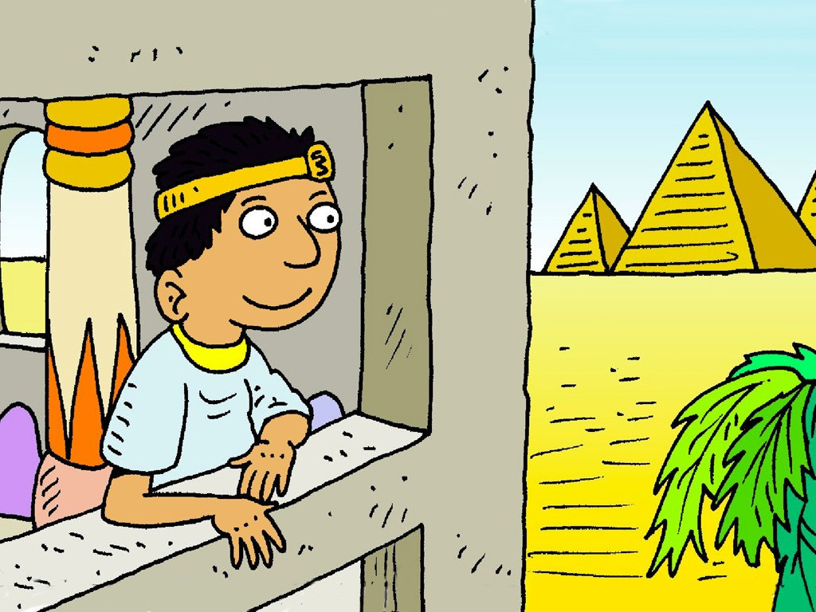
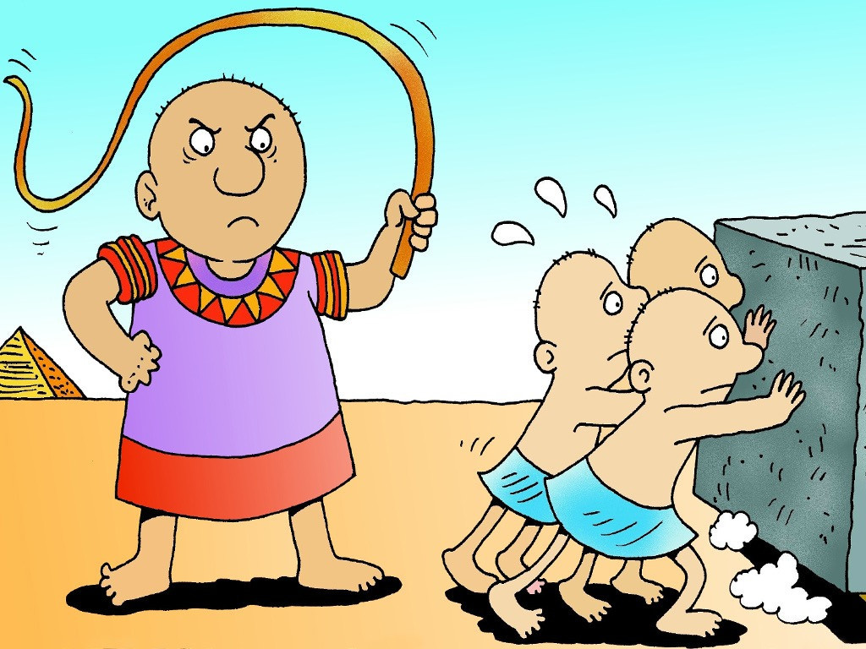
Moses: Are we nearly there yet?!
Autumn 2023
Notes:
Slide 4: As we heard last week, this term, we are going to journey with Moses wherever God takes him, and as we do, we are going to use the story of Moses to help us to become a stronger community.
We rejoin the story of Moses when he has grown up, and is living far away in a land named Moab.
He had seen just what Pharoah was doing to the people of Israel, and got into a fight with an Egyptian, then ran away – to Moab – where he has settled down and has a wife named Zipporah. So let’s pick the story up there, in Moab…..

Slide 5
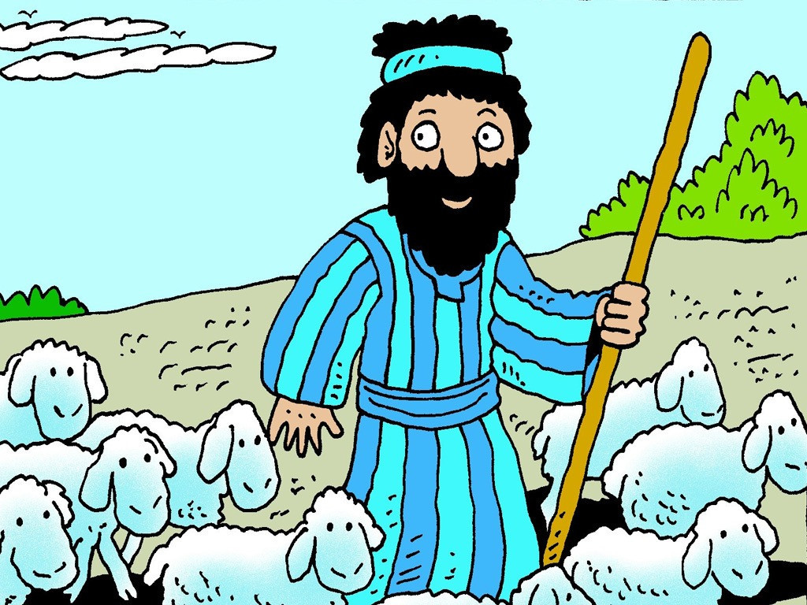
Notes:
Slide 5: One ordinary day Moses was out in the field looking after a flock of sheep belonging to his father-in-law, Jethro.
.

Slide 6
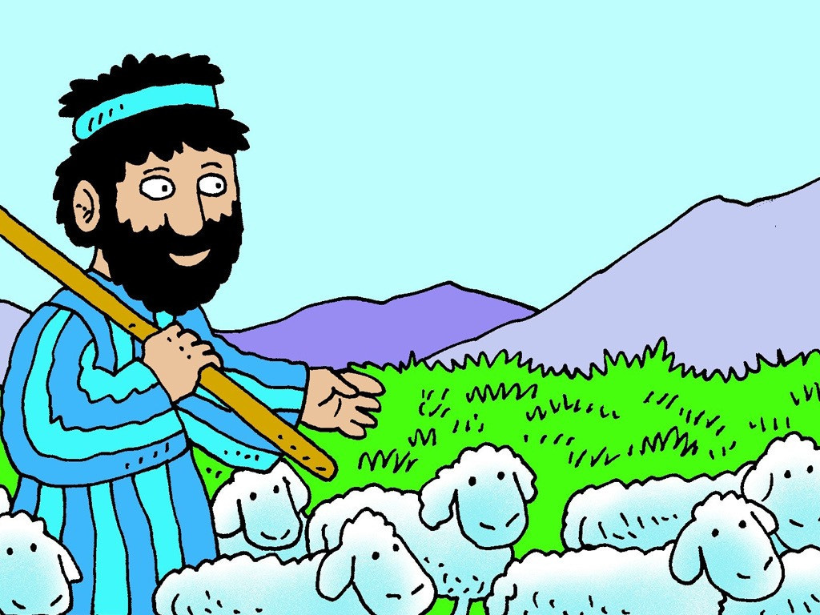
Notes:
Slide 6: Moses led the flock through the desert to Mount Horeb, where there was plenty of good grass for the sheep to eat.

Slide 7
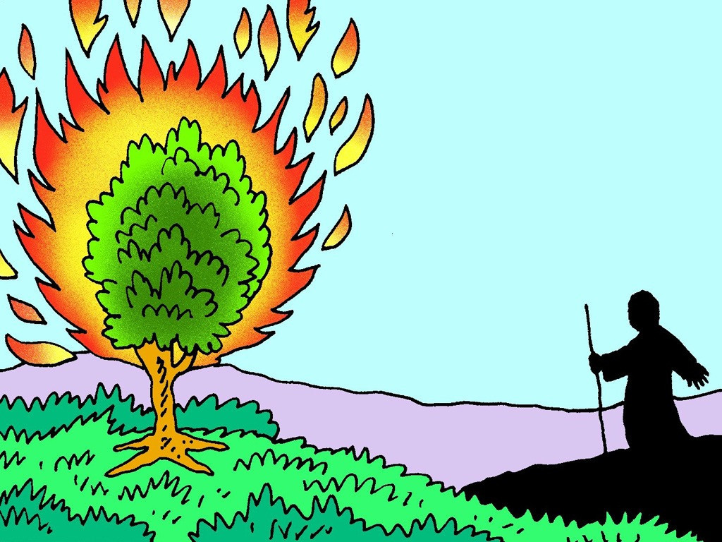
Notes:
Slide 7: Suddenly Moses saw something very strange in the distance. A green bush was on fire, but it was not burning up! He crept closer to see what it was, scared but fascinated at the same time.

Slide 8
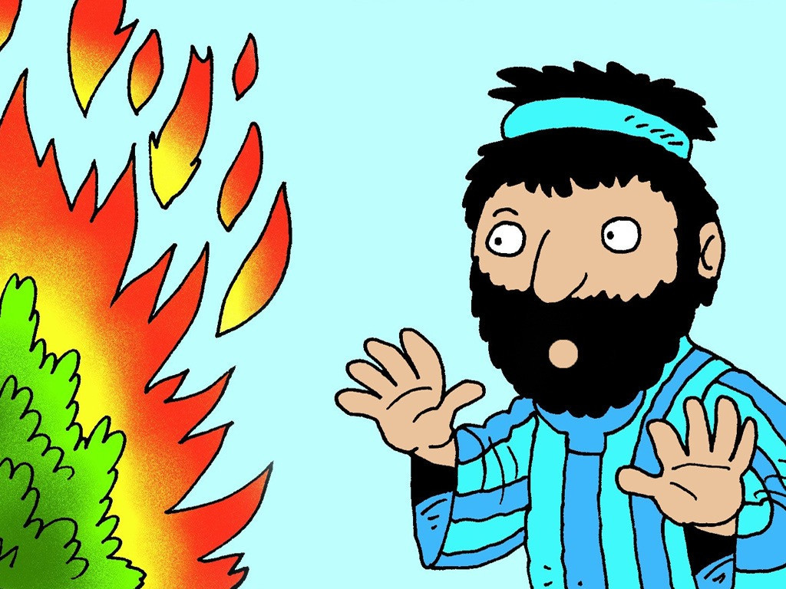
Notes:
Slide 8: He heard the voice of God calling, ‘Moses, Moses’ from out of the bush. Now he was more scared than fascinated! ‘I am here,’ he answered, his voice trembling.

Slide 9
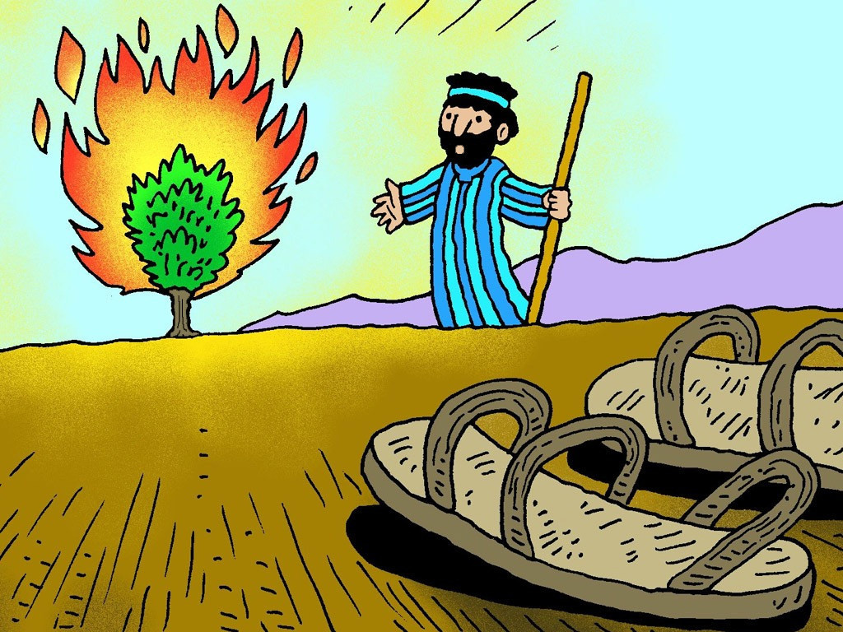
Notes:
Slide 9: God said, ‘Take off your shoes! You are standing on holy ground.’ So Moses took off his shoes and went closer to look at the burning bush.

Slide 10
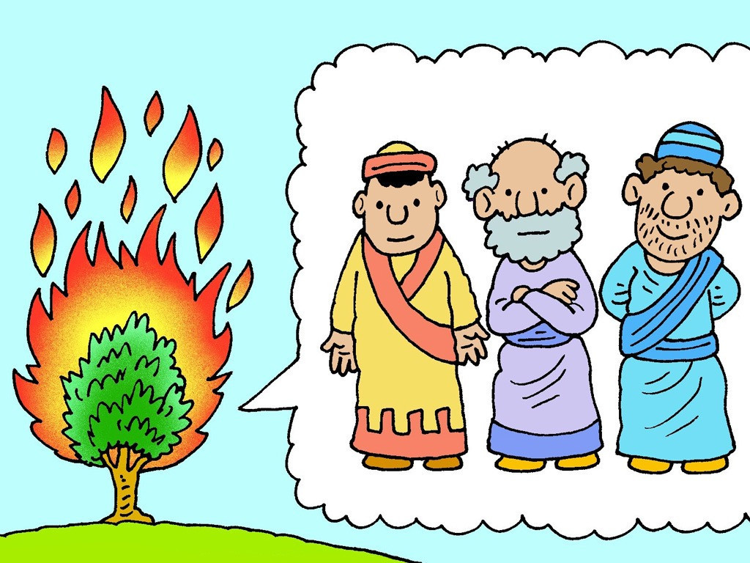
Notes:
Slide 10: God told Moses that He was the God of Abraham, Isaac and Jacob. He wanted Moses to go and tell Pharaoh to stop making the Jewish people his slaves and let them go to a land God had promised for them.
Moses knew that this was not going to be an easy job because the Pharoah was very stubborn.

Slide 11
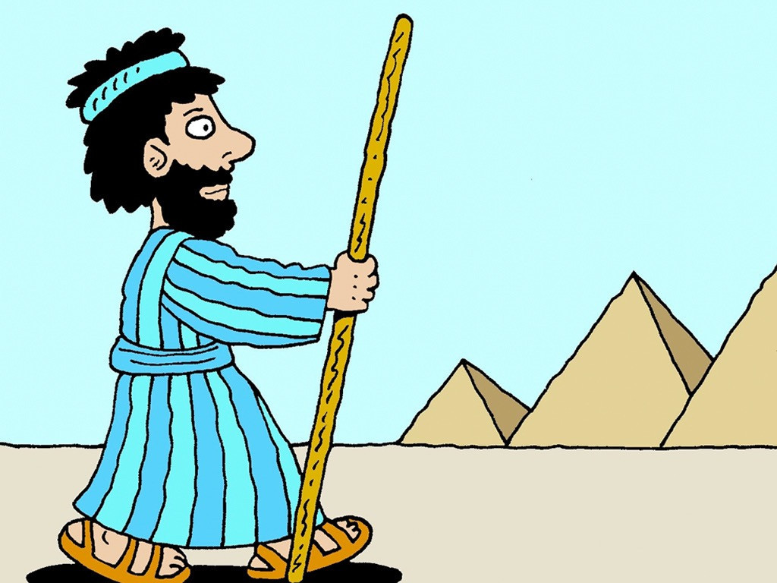
….I wonder how Moses felt, hearing God’s voice?....
….I wonder how it feels to stand on holy ground?....
….I wonder what challenges you think he will face as he visits Pharoah?.... Or how he feels about the job he’s been given to do?....
…I wonder what new challenges we might have to face this term?.....
Notes:
Slide 11: Moses listened and obeyed when God called him to lead the children of Israel out of slavery in Egypt, through the wilderness, to the land He promised them. He knew that Pharoah was a very important man and was used to getting his own way. He would be angry and difficult to persuade….. [add your own cliffhanger sound effects here!!!]
Let’s pause now and wonder together…..
I wonder…..
….how Moses felt, hearing God’s voice?.....
….how it feels to stand on ‘holy ground’?....
….what challenges you think he will face as he visits Pharoah….
….or how he feels about the job he’s been given to do?.....
…..what new challenges we might have to face this term?....
[you might want to pause here and talk together, especially about the last question – especially with younger pupils…]

Slide 12
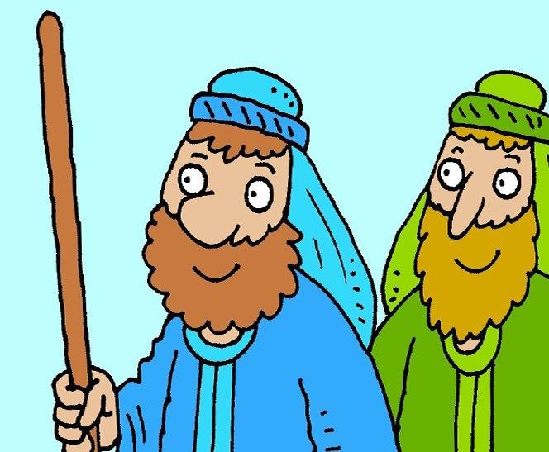
….I wonder what difference this might make?....
Notes:
Slide 12: But you’ll be glad to hear that Moses didn’t have to face this all alone.
Moses’ brother, Aaron, was right these beside him, a gift from God, to help with the important tasks that would lie ahead.
I wonder what difference this might make?
As we pause to think again, let’s bring into our minds some of those challenges we thought of a few moments ago….
What difference might it make to us to know that we are not alone?....

Slide 13
‘I will be with you.’
Notes:
Slide 13: Although Moses may have been scared at the challenge of the task that God had given him to do, God gave him a helper to go with him, his brother, Aaron.
I wonder who might help us with the challenges that we might face?....[pause and be still, or talk together]
In the book of Exodus, which tells this epic tale, we read these words, which God himself spoke to Moses:
‘I will be with you.’
I wonder what this might mean for us, as we face our new term challenges?....
I wonder how we might know that God is with us too?

Slide 14
‘I will be with you.’
Notes:
Slide 14: Prayer
I am going to use some words to help us to pray now…which you can use to help you to pray if this is something that you’re comfortable with. If not, then just continue to be still with your own thoughts.
Dear God
At the start of this new term, we all face new challenges.
Thank you that we are journeying together as a school community and that we can support each other.
But more than that, thank you for the comfort of these words that you will be with us too.
Help us to remember this as we journey through this new term.

Slide 15
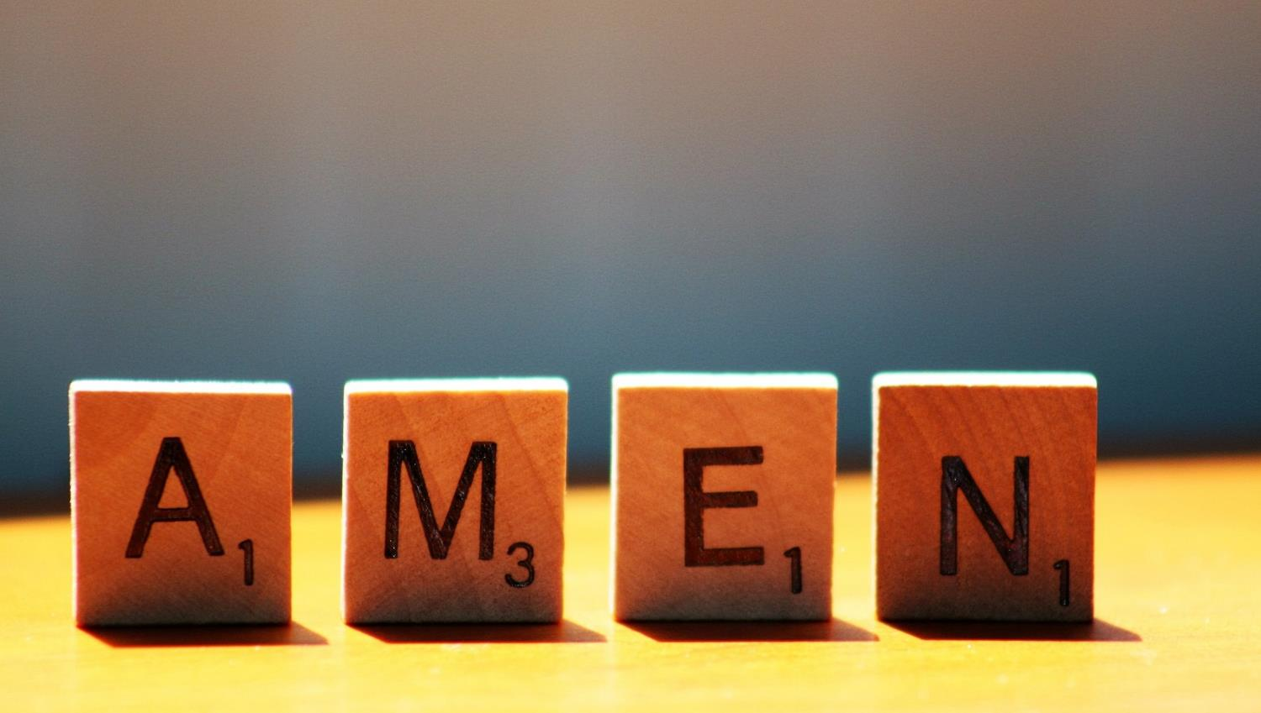

Slide 16
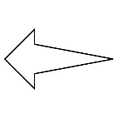
Leader: As we leave this place & time and go into the day ahead…
All: May today’s words help us to become a stronger community.
Notes:
Slide 16: Remind children of today’s key message – that we don’t face challenges alone

Slide 17
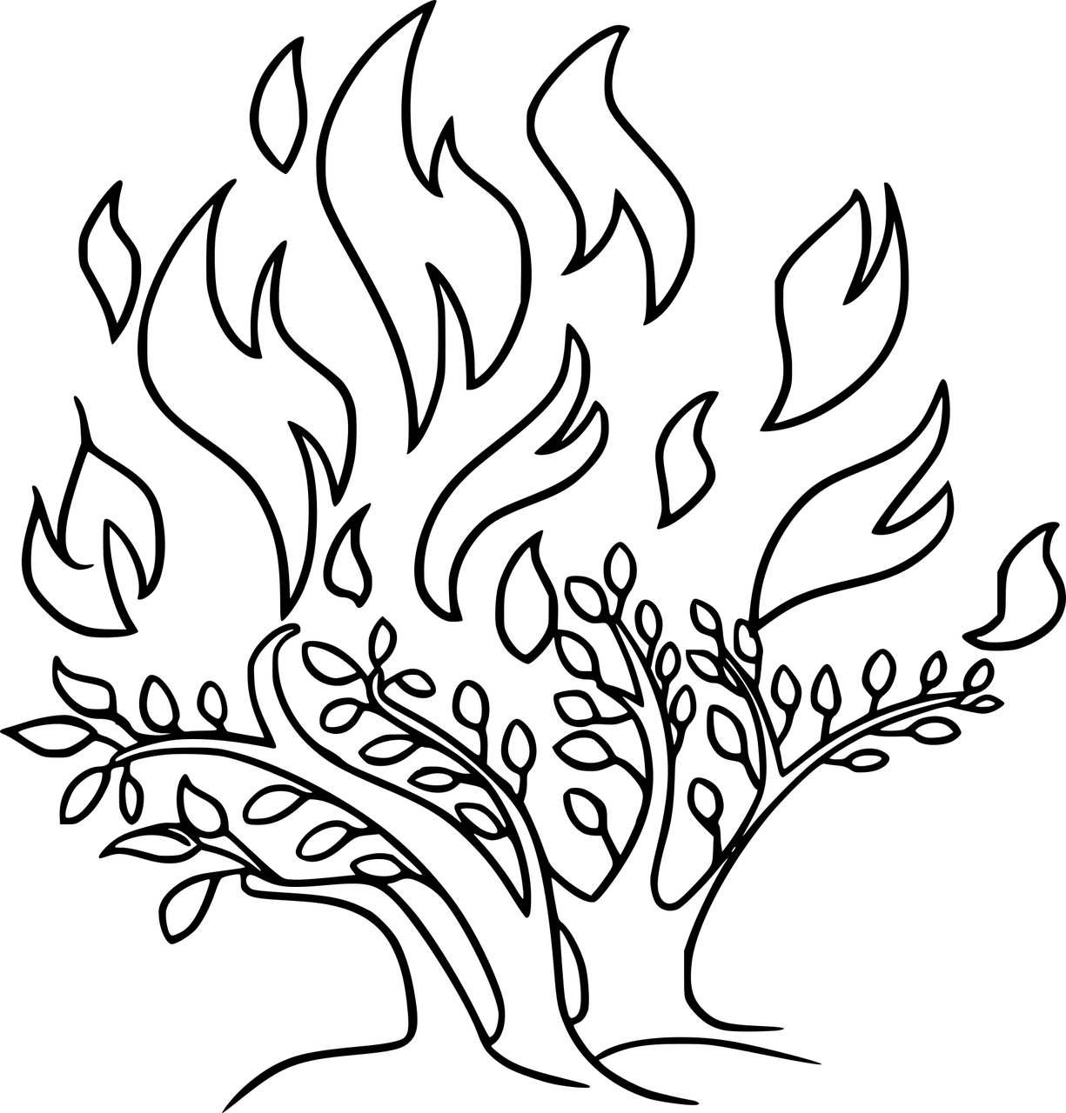
Notes:
Slide 17: Reflective prayer activity explanation
‘In our class we will….’
Make a class ‘burning bush’ with red / orange / yellow leaves showing what we are ‘responsible’ for or the new challenges we face this term or promises to support each other.
As you hang your leaf on the tree, you might want to say a quiet prayer to ask God to be your helper, or think about the people who might be there to help you.

