Slide 1
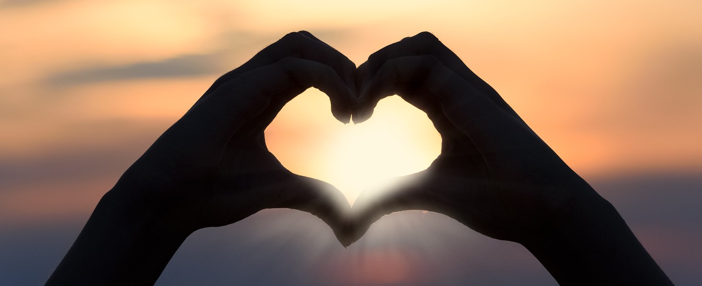
Leader: As we gather together
ALL: …we bring our hearts.
Notes:
Slide 1: Use these new gathering words for this term, or your usual greeting if you prefer. The greeting comes with BSL signing; you can view the demos using links under the slide.
Leader: As we gather together,
ALL: …we bring our hearts
Signs for greeting: click on links
Hearts: British Sign Language BSL Video Dictionary - heart

Slide 2
Leader: As we gather together
ALL: …we share our thoughts.
Notes:
Slide 2: Use these new gathering words for this term, or your usual greeting if you prefer. The greeting comes with BSL signing; you can view the demos using links under the slide.
Leader: As we gather together,
ALL: …we share our thoughts.
Signs for greeting: click on links
Thoughts: British Sign Language BSL Video Dictionary - thought

Slide 3
Leader: As community together
ALL: …we serve one another.
Notes:
Slide 3: Use these new gathering words for this term, or your usual greeting if you prefer. The greeting comes with BSL signing; you can view the demos using links under the slide.
Leader: As community together,
ALL: …we serve one another.

Slide 4
Name
that
!
tune
Notes:
Slide 2: We’re going to start our time together today, as we often do, with a game. I’m going to play you a snippet of music – and you have to try to guess what it is from the little bit that you hear. Some of them are songs from our school collection – others are tunes that you may recognise from other places, such as films or the radio [play your selection]

Slide 5
Songs from
the heart
Notes:
Slide 3: This term, we are starting a new term of themes, called Songs from the heart. We will be finding out more about one of the most famous song-writers of all time, who wrote much of the book called Psalms, in the Bible; a man named David. As well as these songs being really special for Jewish and Christian people (who share them in their holy books), the words David wrote are also very human – often a response to what was happening in his life at the time. So there will be ideas and emotions we can all identify with! For millennia, these Psalms have helped people to express what’s in their hearts – and we hope that the same will be true for us. So, let’s find out some more about David – and what made him ‘sing’!

Slide 6
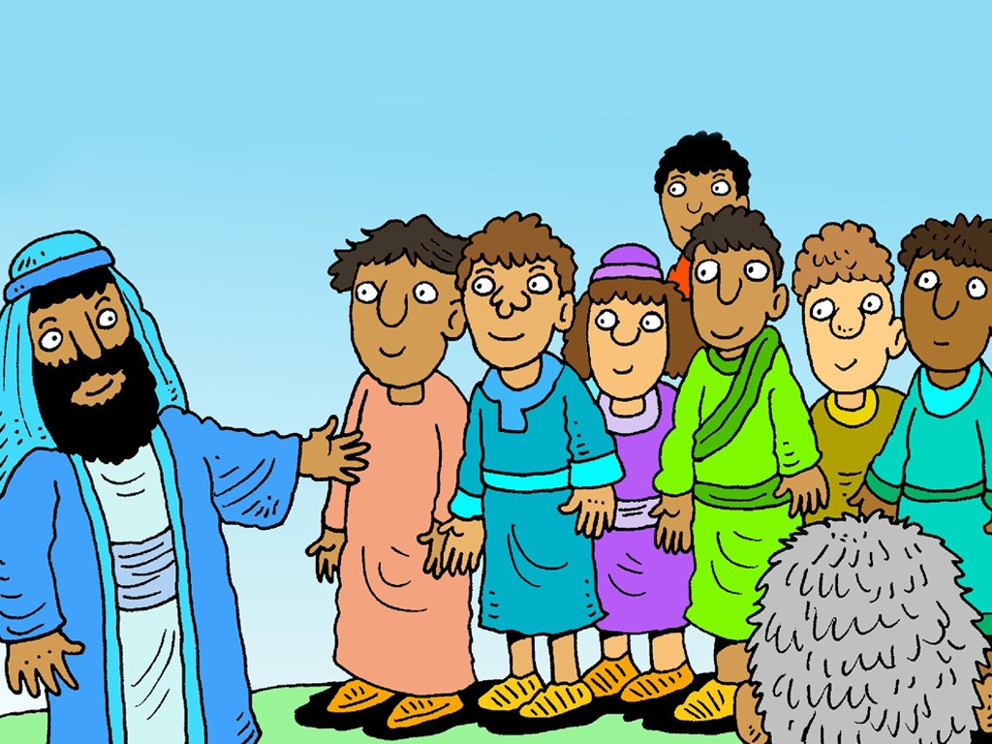
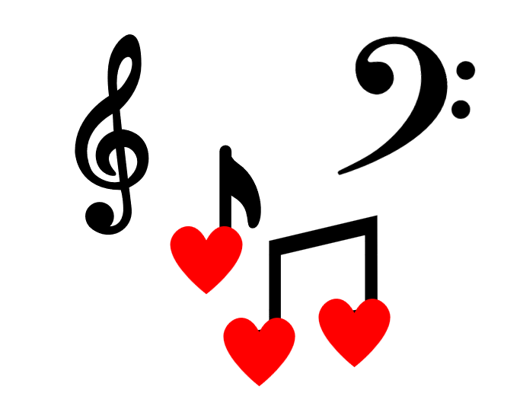
Songs from the heart
Notes:
Slide 4: This is David’s story – which helps explain his Songs from the heart.

Slide 7
Notes:
Slide 5: A man called Jesse had eight sons. [Let’s count them, just to make sure!]

Slide 8
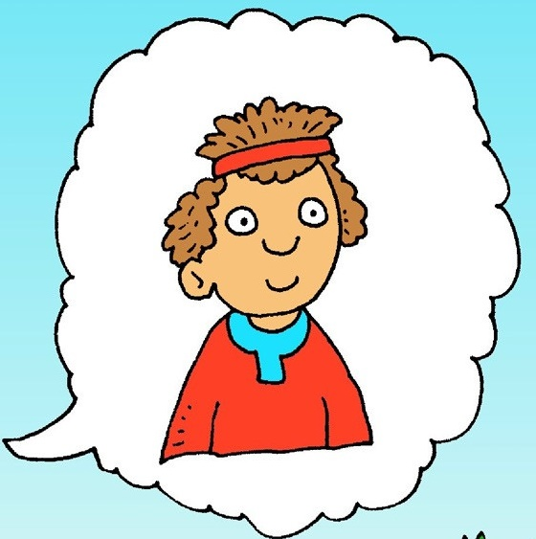
I wonder if you’ve ever felt like this?
Notes:
Slide 6: David was the youngest of them all, and looked after the family’s sheep out in the fields. Like all of us, David sometimes felt small and that his brothers often got to do all the things that he wanted to do. I wonder if you’ve ever felt like this?

Slide 9
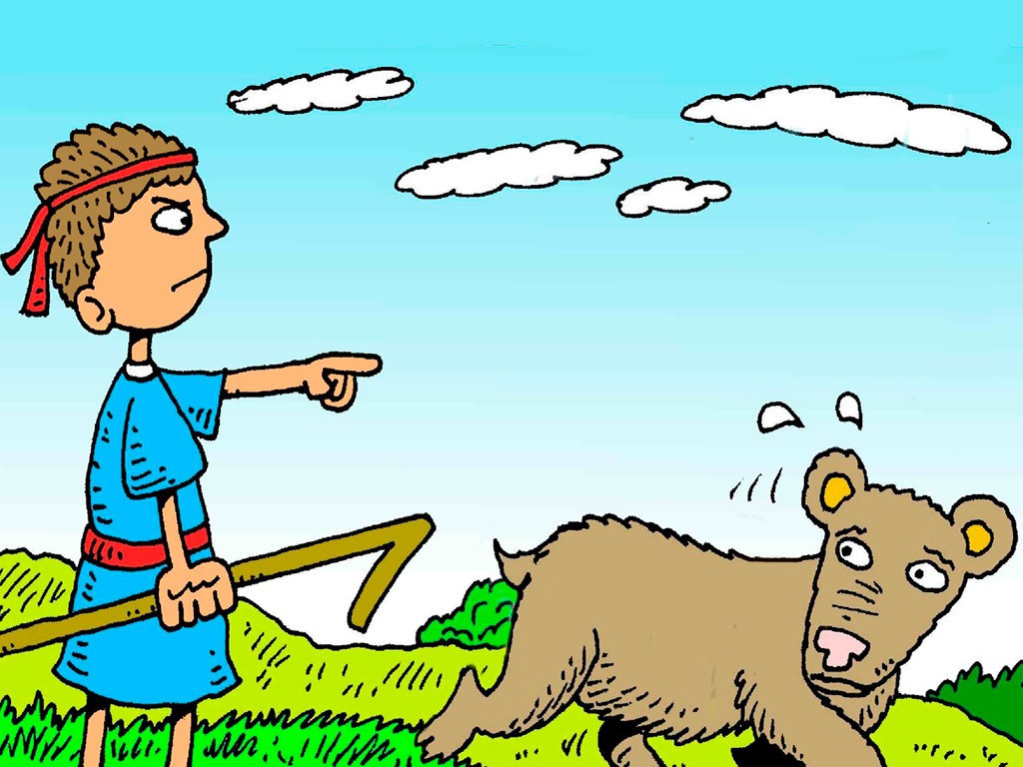
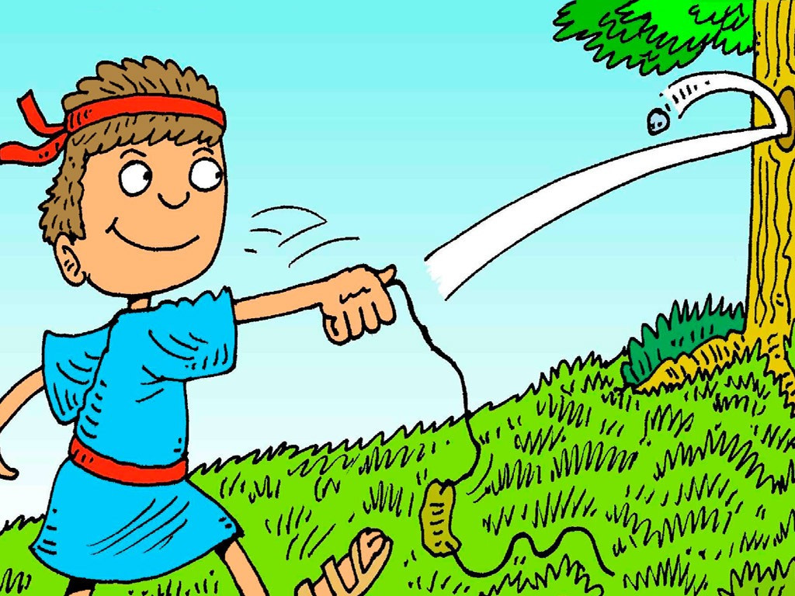
I wonder if you’ve ever needed to be brave?
Notes:
Slide 7: He watched out for wild animals that might hurt his sheep. Although he was just a boy, he was also very brave and would use his shepherd’s sling to frighten them away.
I wonder whether you’ve ever needed to be brave?
NB There is a possibility that children may disclose something here, so please use your school’s safeguarding protocols to take any appropriate action.

Slide 10
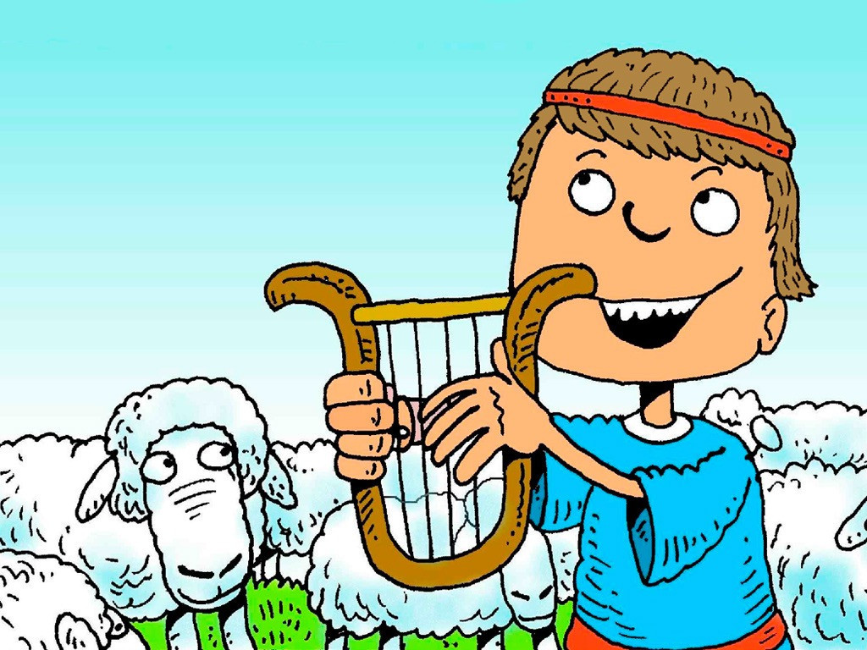
Notes:
Slide 8: One of David’s most famous songs is about how God is like a good shepherd, looking after his sheep. We’ll be hearing this special song next week!

Slide 11
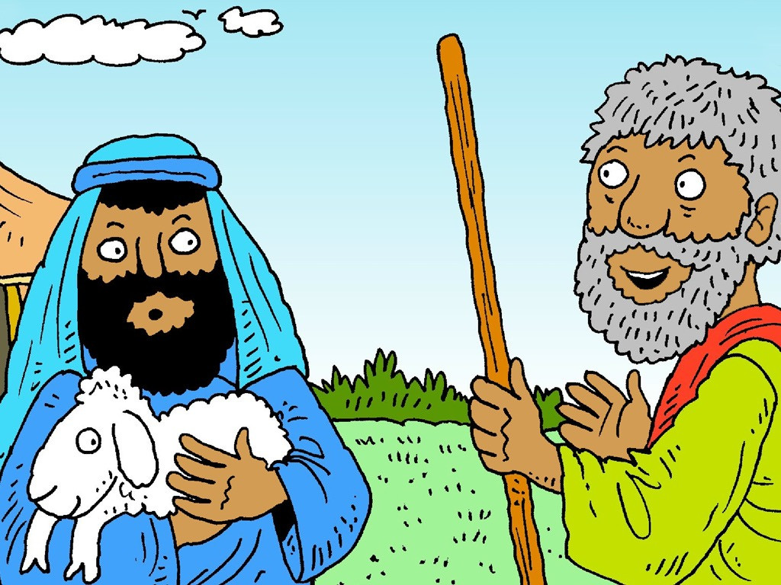
Notes:
Slide 9: One day, God’s messenger, the prophet Samuel, came to where Jesse lived in the town of Bethlehem (yes, that’s where Jesus was born, much later on in time!), and told him that God wanted one of his sons be the King of Israel.

Slide 12
Notes:
Slide 10: Samuel expected that God would choose the oldest and maybe strongest son.

Slide 13
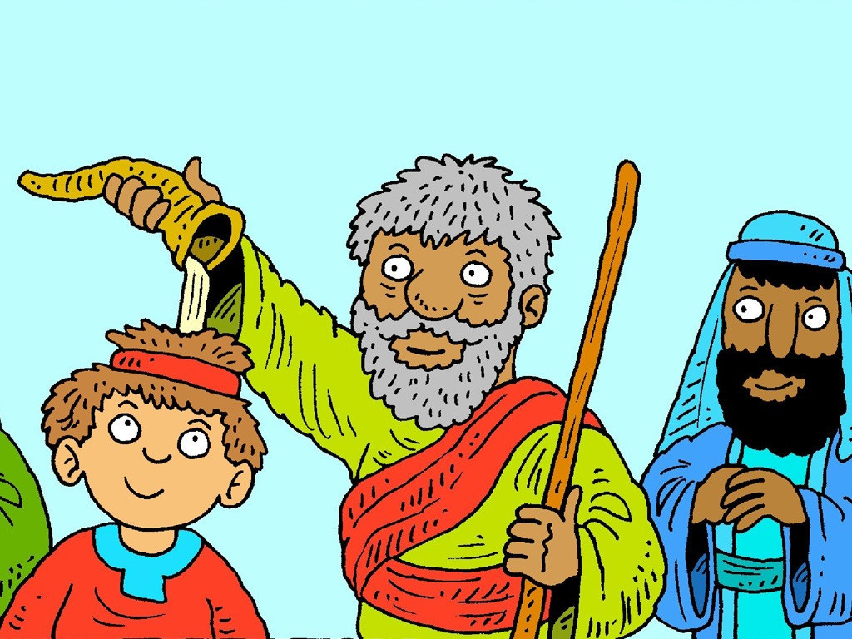
I wonder if you’ve ever been chosen for a special job?
Notes:
Slide 11: But much to his surprise, God didn’t…..He chose David, and as a sign that God had chosen him, Samuel did a very strange thing: he anointed David’s head with olive oil, pressed from the trees that grew nearby. David wouldn’t be King for quite a few years, when he was older, but he knew that he had been chosen.
I wonder if you’ve ever been chosen for a special job?

Slide 14
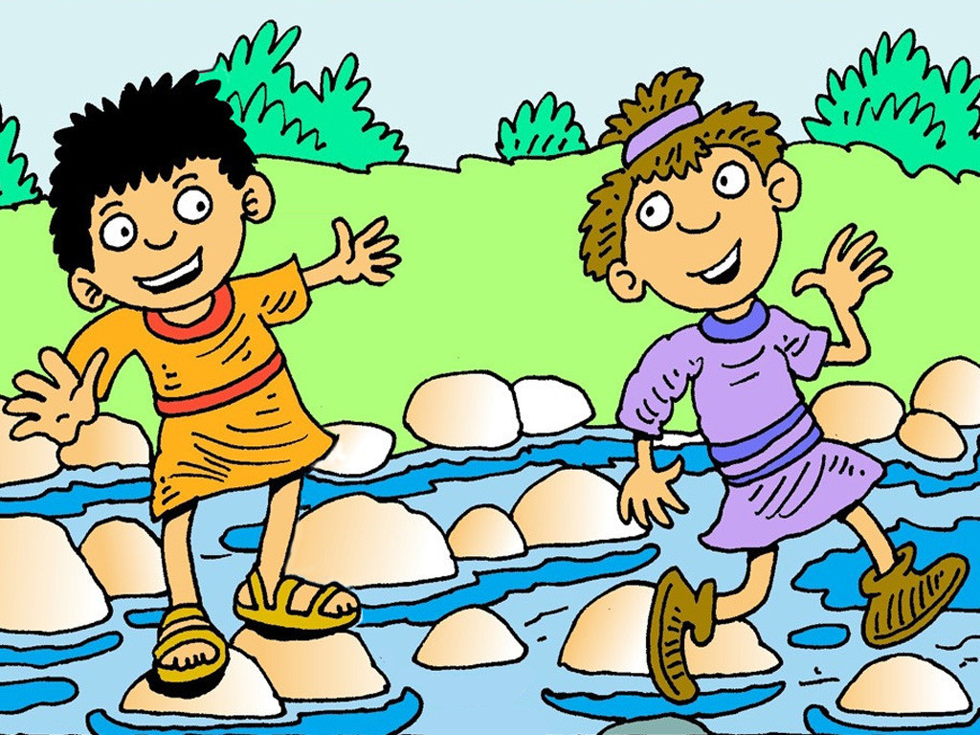
I wonder who your friends are? And what adventures you have together?!
Notes:
Slide 12: David also had a very best friend – the son of King Saul, whose name was Jonathan. They would be friends for the rest of their lives.
I wonder who your friends are? And what adventures you have together?!

Slide 15
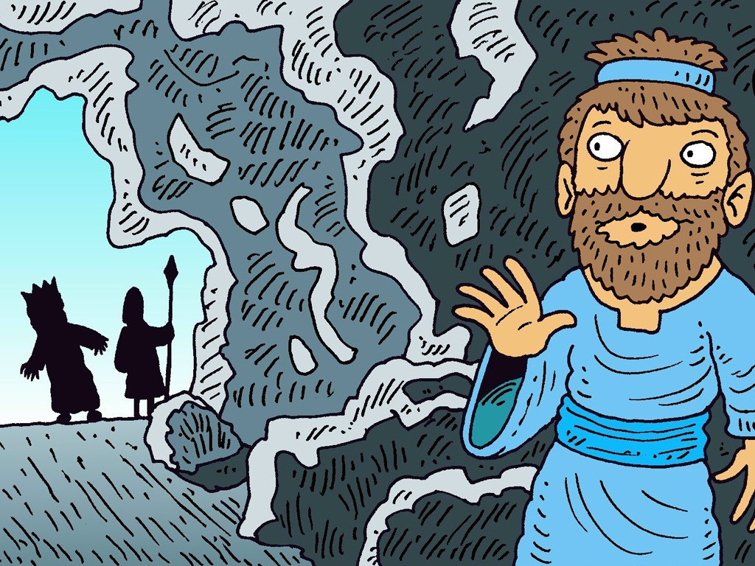
I wonder if you’ve ever been puzzled by how someone treated you, and found it hard to understand?
Notes:
Slide 13: Jonathan’s father, King Saul, was often very jealous of David – and on several occasions even tried to kill him!
I wonder if you’ve ever been puzzled by how someone treated you, and found it hard to understand?
NB There is a possibility that children may disclose something here, so please use your school’s safeguarding protocols to take any appropriate action.

Slide 16
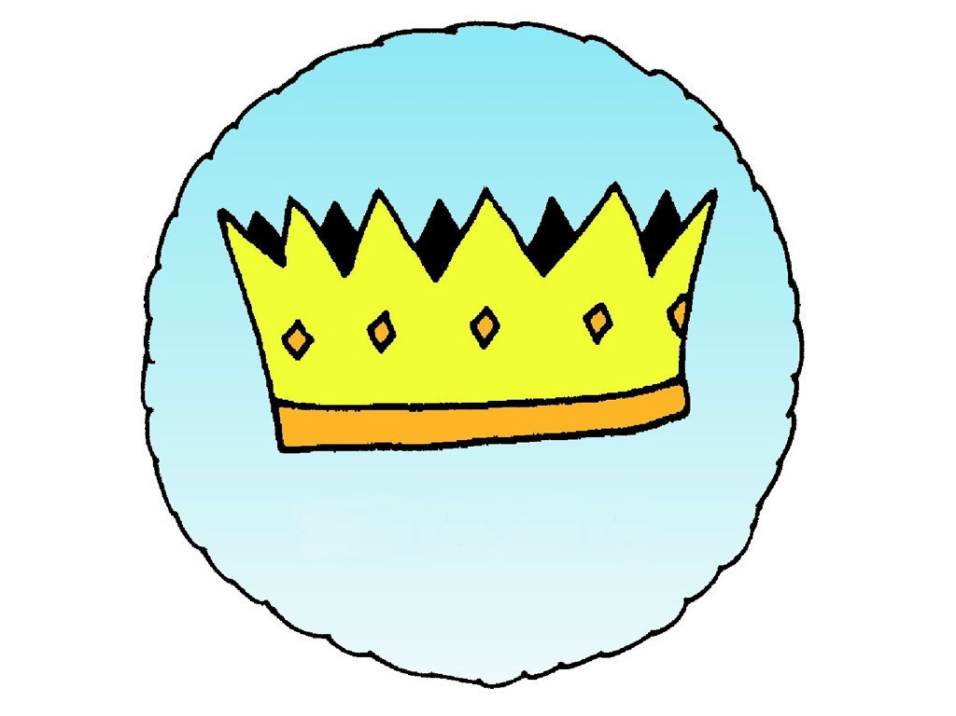
My whole being, praise the Lord!
Do not forget all his goodness*.
Notes:
Slide 16: Even when David became King, he never forgot all that he had learned in his life about God’s care of him, or stopped puzzling about the challenges that came his way. David also at many other times gave himself a good ‘talking to’ [you may need to explain what this means] reminding himself of the things that he knew to be true of God when things in his life were hard…..
Listen to these words from Psalm 103….
My whole being, praise the Lord!
Do not forget all his goodness*.
[*translation ICB, with a tweak!]
Sometimes, when things are hard, it’s good for us to be able to remind ourselves of the things we know to be true, the things we can trust: for David this was God, and many of the songs he wrote are about this. But we’ve also heard that there were many difficult things in David’s life, and so others of his songs contain puzzling feelings, and questions that David asked God.

Slide 17
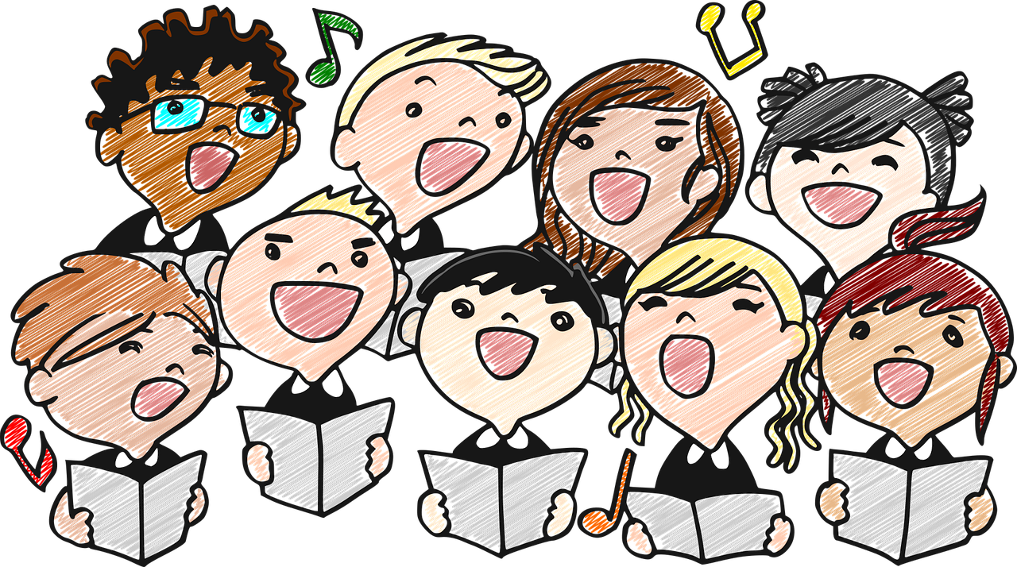
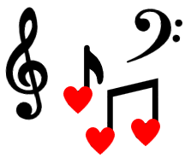
Songs from the heart
Notes:
Slide 17: I’m not sure how you might feel about singing: some of us might love it, some might not…. But whatever we might feel personally, songs and singing are, in many cultures, a way of expressing the deepest thoughts and emotions that we experience as human beings. You might have heard this in the song I played as you were coming in. [explain why this song has such meaning for you / your school community]
So as we start this new term, please don’t feel that you have to like singing to join with us, because we’re not really going to be thinking about songs. We are going to be thinking about things that we all have in common with David: we are all human beings with things we just don’t understand, challenging lives, different (and sometimes difficult) emotions and really big questions, just like David. That’s what we mean by Songs from the heart. This term we get a chance to express the things that lie deep inside our hearts, to wonder together as David did, and if we want to, to bring it all to God.

Slide 18
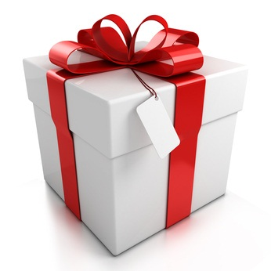
My whole being, praise the Lord!
Do not forget all his goodness*.
Notes:
Slide 18: Responding (and words for worship):
We’re going to re-use the ‘gift’ that we used last week as part of our time to reflect today.
Inside the gift, I’ve got / we’re going to collect [use which is appropriate] some things we might be grateful for – that David might have said are some of God’s goodnesses!
[collect from the children, or draw out of the box, asking children to be quiet and still as you do. You don’t need to comment on each one, especially if you have just written them down; just allow space for children to engage]

Slide 19
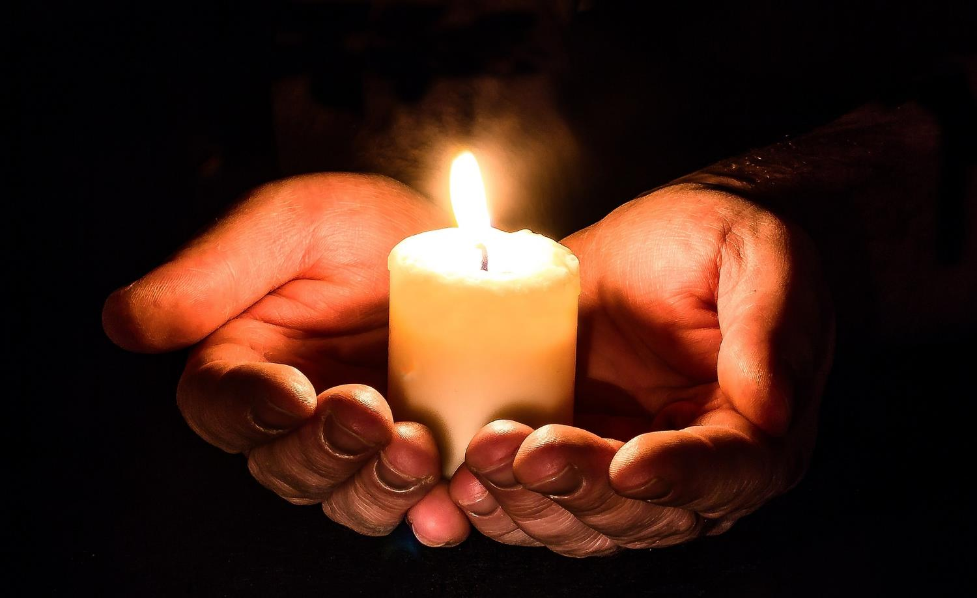
….we are grateful for this goodness.
Notes:
Slide 19: Prayer
I’m going to turn my thoughts into a prayer now, using the ideas from our Box of Goodnesses.
You might like to think quietly in your hearts, or if you’d like to pray out loud, then after I read the words from our box, please join me by saying ‘we are grateful for this goodness’

Slide 20
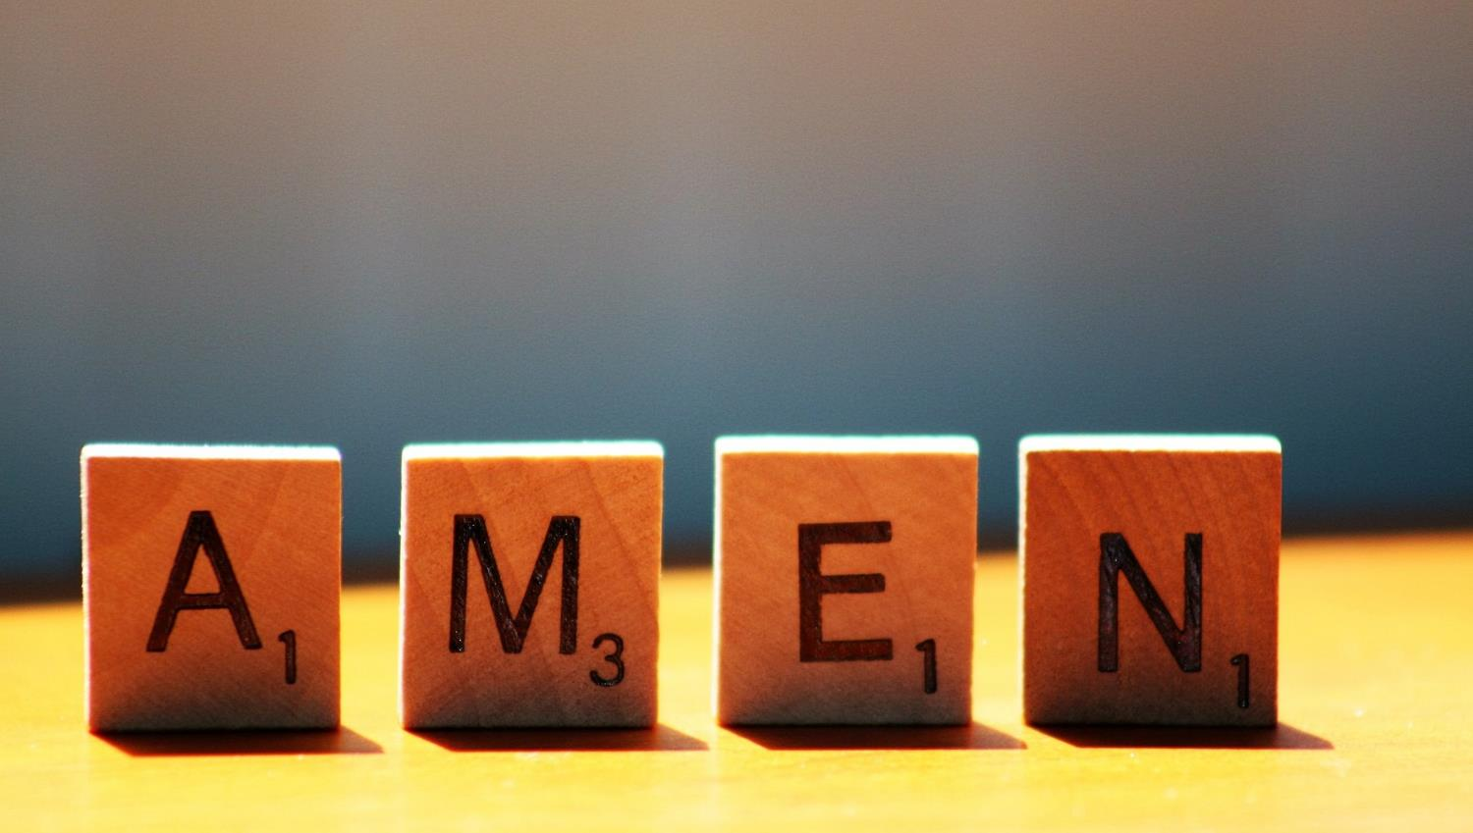

Slide 21
Leader: As we leave this place & time and go into the day ahead…
All: …may we serve one another in our thoughts and words and actions.
Notes:
Sending: Slide 21
Leader: As we leave this place and time and go into the day ahead,
All: ….may we serve one another in our thoughts and words and actions.
Signs for response: click on links
Thoughts: British Sign Language BSL Video Dictionary - thought (signbsl.com)
Words (use 3rd definition): British Sign Language BSL Video Dictionary - word (signbsl.com)
Actions: British Sign Language BSL Video Dictionary - action (signbsl.com)

Slide 22
Notes:
Ideas for classroom reflection (this week, there are a few ideas to choose from!):
‘We are grateful for these ‘goodnesses’….’: Use the present from last week, and leave slips of paper for children to write on to post into the box. When things get hard, pull one out and use them to help you to feel grateful for good things, like David did.

