Slide 1
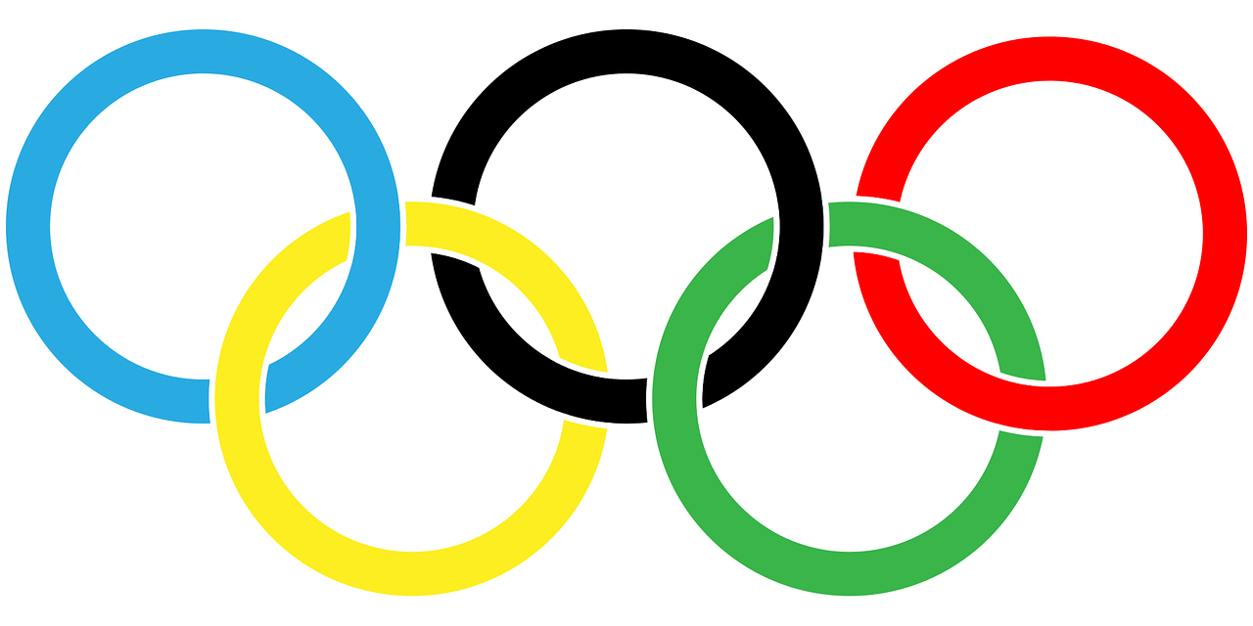
Leader: We are here together
ALL: May we ‘GO FOR GOLD!’ in our words and actions today!
Notes:
Slide 1: Use the new gathering words, which will be the same each week.
Leader: We are here together
ALL: May we ‘GO FOR GOLD!’ in our words and actions today!

Slide 2
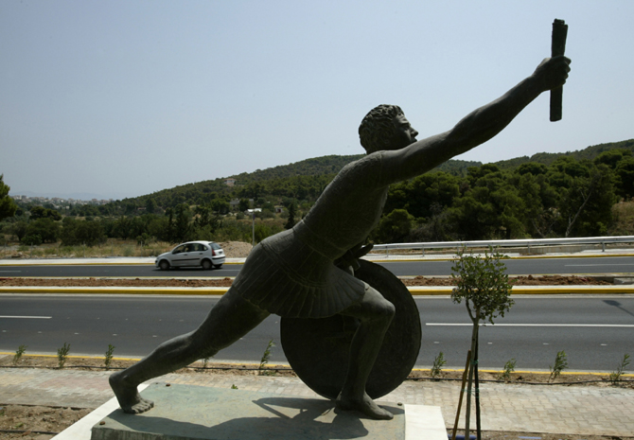
Pheidippides
Notes:
Slide 2: Last time, we used our Olympic time machine to go back in time to the Ancient Olympic Games, and had a go at javelin and discus throwing, and we heard the legend of Pheidippides.

Slide 3
The Olympics
Olympic rings © Pixabay
Notes:
Slide 3: Today, we’re going to be thinking some more about the Olympics and how things are a bit different now to the Ancient Olympic Games. In the Ancient Olympic Games, only athletes from Greece competed against each other – in the Paris 2024 Olympics, there could be competitors from around 206 nations worldwide! We’ve already found out that in Ancient Greece, there were only five main events, but in the 2024 Olympics, there will be 48 different disciplines (from 32 different sports) taking place.
As you probably have noticed already, this is the symbol for all things Olympic. We’re going to jump into our Olympic time machine again, and find out a bit about this special symbol and about how and why our Olympics started……

Slide 4
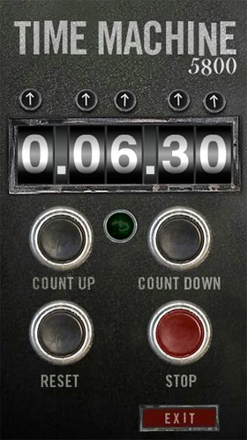
2024
CE
1894
CE
Notes:
Slide 4: We’re going back to the year 1894….

Slide 5
Notes:
Slide 5: …to Paris, France, which is where this year’s Olympics is also taking place.

Slide 6
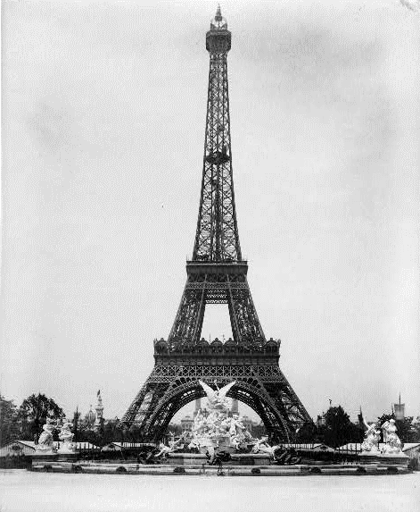
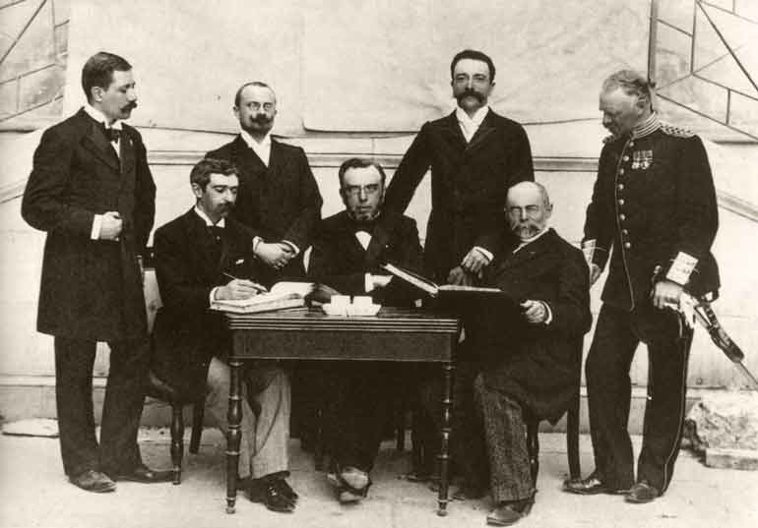
Baron Pierre de Coubertin
Notes:
Slide 6: The modern-day Olympic Games was started by this man, Baron Pierre de Coubertin, who saw an opportunity for sport to promote good relationships between nations as they competed with each other, just as had been the case in the Ancient World. He was deeply concerned about schools and was especially interested in P.E. – Physical Education – and the way that it shaped not just the body, but the mind as well. In 1894, he gathered a group of important men together to organize the first proper Olympic Games since 393 CE (that’s 393 years after the birth of Jesus).

Slide 7
The Americas
Asia
Australasia
Africa
Europe
Respect
Excellence
Friendship

Slide 8
Which sport?
Notes:
Slide 8: For this next part, I need some more keen sporting volunteers / I’ve asked the teachers to help me. Here at the front / on seats, I have some cards and written on each is a different Olympic sport from Baron de Coubertin’s first Olympics in 1896. There were only 9 events back then, you’ll be happy to know – not 48 as it will be this year! You’ve got to mime what you read – that’s pretending to do what’s on the card, without using any words – and we’ll see if everyone here can guess which sport you’re taking part in…..

Slide 9
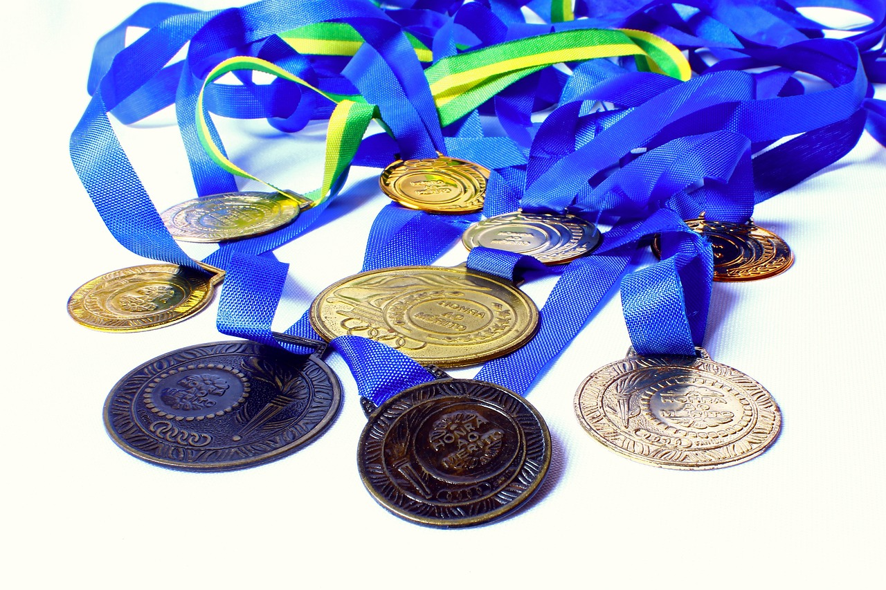
Gold: 1st Silver: 2nd Bronze: 3rd
Notes:
Slide 9: Those nine events will be happening along with 30 other sports this year, and every athlete competing will be doing their best to win an Olympic medal…. gold, silver or bronze. As well as striving to win, Olympic athletes are also expected to uphold Baron de Coubertin’s Olympic values in the way that they compete with each other.

Slide 10
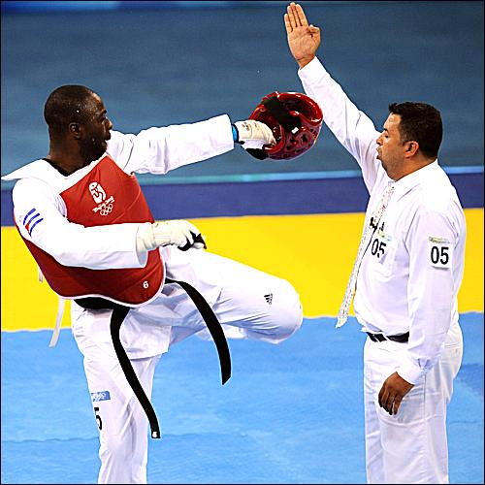
Ángel Matos
Notes:
Slide 10: There have been many stories of competitors who have forgotten this and been disqualified for cheating in some way, or for very unsporting behavior, such as Angel Matos, a Cuban taekwondo athlete, who competed in the 2008 Olympics. He kicked out at a judge in the match for the bronze medal, because he was cross at a decision the judge had made. I wonder if you’ve ever felt like this……and what you did about it? …..Well, it didn’t work out very well for Angel Matos. He – and his trainer – were banned from ever competing anywhere again because of his actions, and how they’d gone against those Olympic ideals.

Slide 11
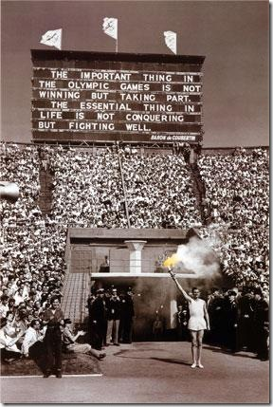
“The important thing in the Olympic Games is not winning, but taking part. The essential thing about life is not conquering, but fighting well.”
Notes:
Slide 11: Listen to these words of Baron de Coubertin:
“The important thing in the Olympic Games is not winning, but taking part.
The essential thing about life is not conquering, but fighting well.”
When he spoke these words, Baron de Coubertin was talking not just about Olympic values, but about living life itself. He believed that winning was important, but not as important as the way in which you take part. Sometimes, in our keenness to be the best that we can, it’s easy to forget that the way in which we do things says more about the sort of person we are.

Slide 12
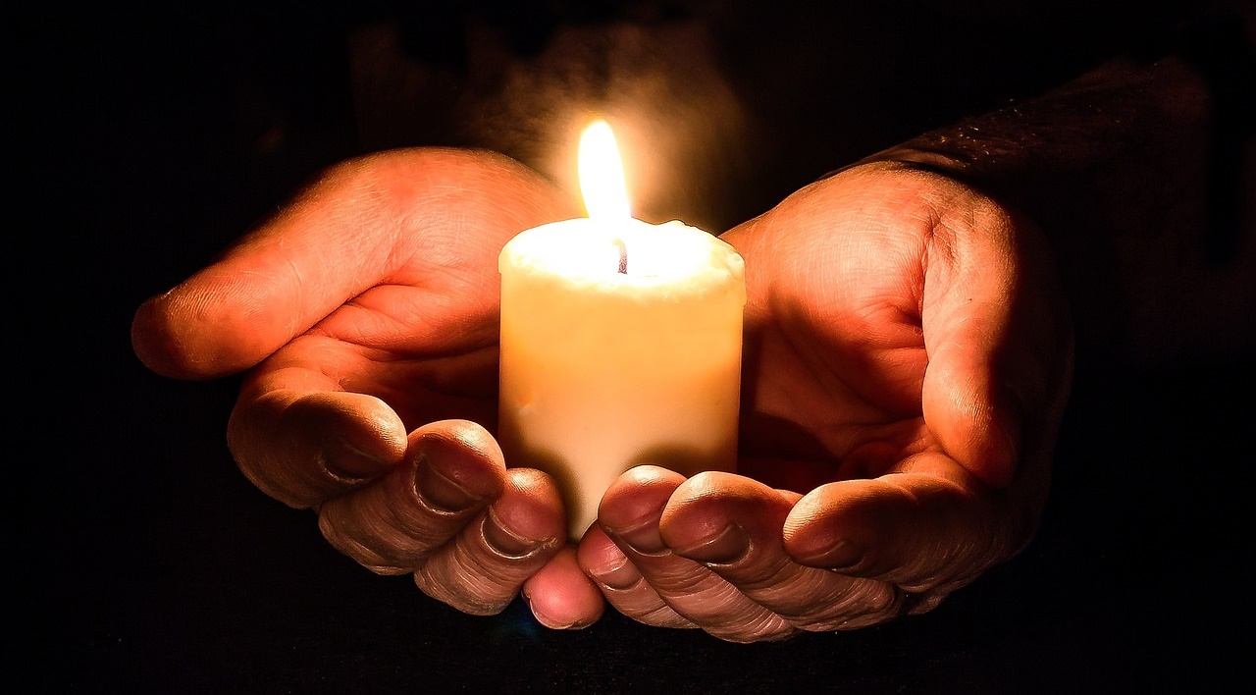
Notes:
Slide 12: Responding and words for worship
We’re going to be still with our own thoughts now……and think about how what we’ve heard might help us in our school community today….

Slide 13
Respect
Excellence
Friendship
….I wonder what difference these ideas might make to the way we behave today?....
….I wonder how we might show Baron de Coubertin’s Olympic vales of respect, excellence or friendship in our classrooms and our homes this week?....
Notes:
Slide 13: .Where you are right now, close your eyes and think…..
……how do you react when you win or are the best at something? Are you a good winner…..
….what about when someone else wins or is better than you? Are you a good loser too?......
…..It’s not easy to be good at both winning and losing!......
….I wonder what difference these ideas might make to the way we behave today?....
…I wonder how we might show Baron de Coubertin’s Olympic vales of respect, excellence or friendship in our classrooms and our homes this week?....

Slide 14
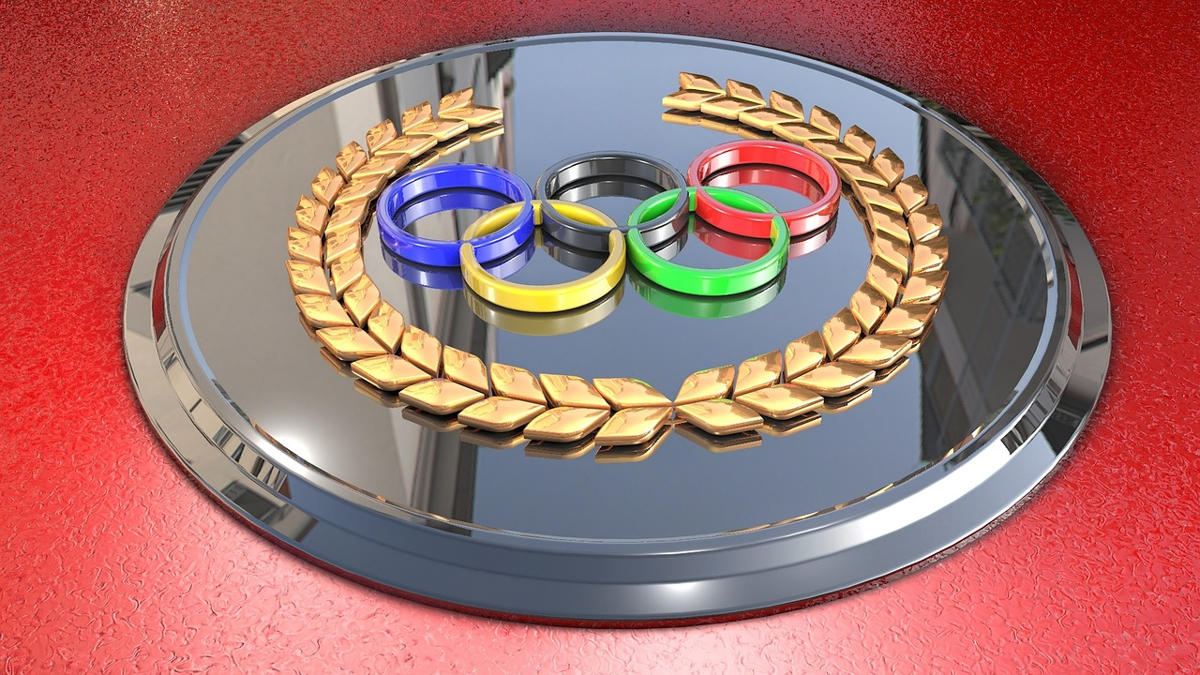
Dear God
Thank you for the Olympics, and all that’s good about them. We pray for all who will be competing this year, that they will do all they can to uphold the Olympic ideals. As we go about our work and play today, may we do the best we can, and treat others with respect and friendship.
Notes:
Slide 14: Opportunity for reflection / prayer
I’m going to pray now. If this is something that you feel comfortable doing, then find a way to make the words your own. If you don’t want to pray, then use the quiet to be still with your own thoughts.
Dear God
Thank you for the Olympics, and all that’s good about them. We pray for all who will be competing this year, that they will do all they can to uphold the Olympic ideals. As we go about our work and play today, may we do the best we can, and treat others with respect and friendship.

Slide 15
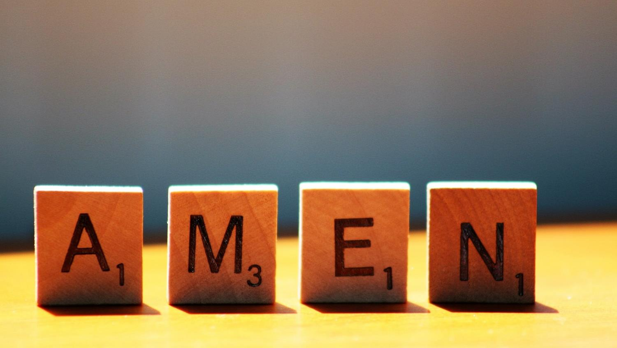

Slide 16
Leader: As we leave this place & time and go into the day ahead…
All: Let’s ‘go for gold’ in all that we do!
Notes:
Sending: Slide 16
Leader: As we leave this place & time and go into the day ahead…
All: Let’s go for gold* in all that we do!
*Again, you might need to unpick what we mean by ‘going for gold’ in the context of today’s words.

Slide 17
Notes:
Slide 17: Reflective areas
Make three gold ‘medals’ for use in your reflective area. You could ask pupils to write their ideas on each medal, or attach a ribbon to each and ‘award’ them to children who’ve demonstrated these values during the day / week. Or you could pass them around during Circle Time and ask children to share their thoughts in answer to each question.

