Slide 1





We are here together….
May our attitudes make our school community a happy place today.
Notes:
Slide 1: Teach the new gathering words for this term
Leader: We are here together
ALL: May our attitudes make our school community a happy place today.

Slide 2
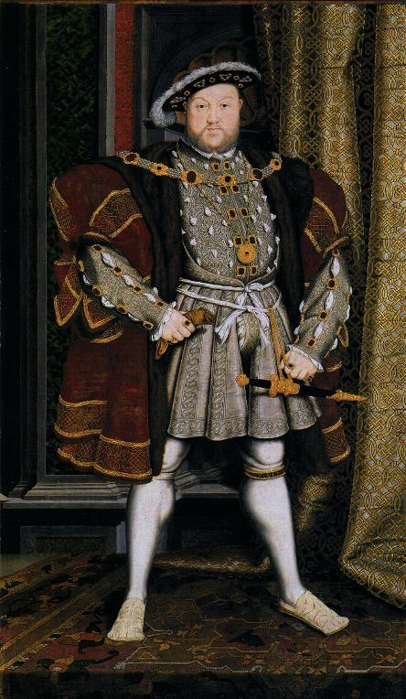
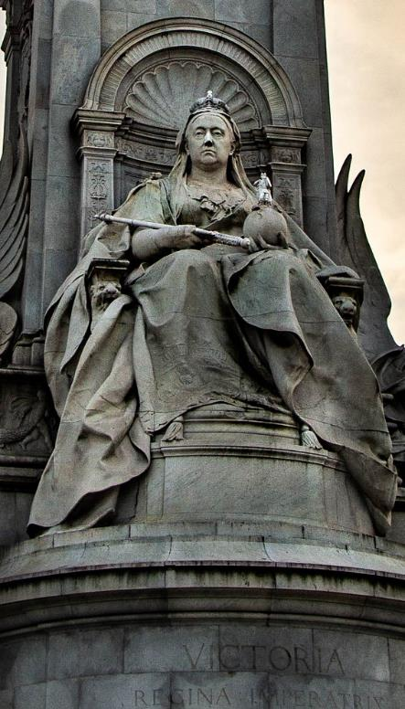
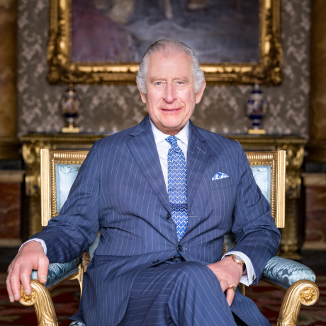
Notes:
Slide 2: Today, we’re going to think about some words that Jesus spoke about the Kingdom of God, as we begin our new term of themes.
But first, let’s think for a few moments about kings, queens – and kingdoms…... You might know these famous rulers….[King Henry VIII and Queen Victoria: if you’ve covered these periods of history in your curriculum, you may be able to flesh this out with your children] This picture is our King. He was crowned in 2023, becoming King in September 2022 after his mother, the late Queen Elizabeth II (our longest reigning monarch) died. He was 74 years old when he became King!
All three of these rulers have each had their own ideas about being a good leader – and what they wanted their kingdoms to be like.

Slide 3
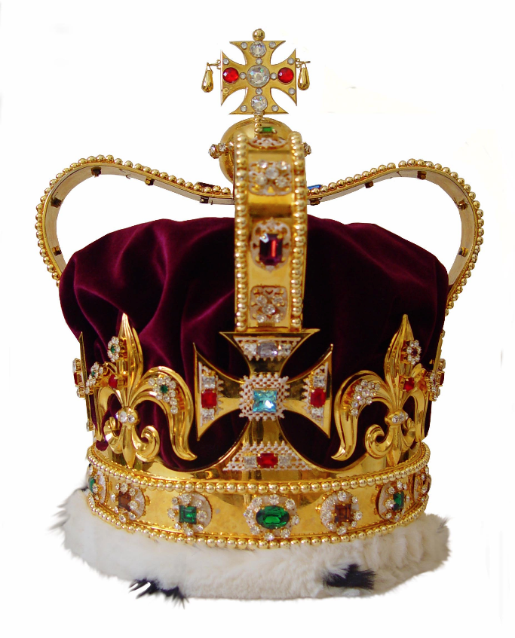
If you were King or Queen for the day, what would you decree?
Notes:
Slide 3: What would you do if you were allowed to be Queen or King for a day? Allow pupils a few moments to think, then play ‘pass the crown’ with some coronation music, and whoever is left holding the crown when you stop the music gets to share their ‘decrees’.
[Comment on their ideas – they will probably be a real mix, and are likely to show pupils’ age-appropriate ideas about being ‘in charge’ or a ‘leader’. This will help make the transition to the ideas that Jesus introduced]

Slide 4
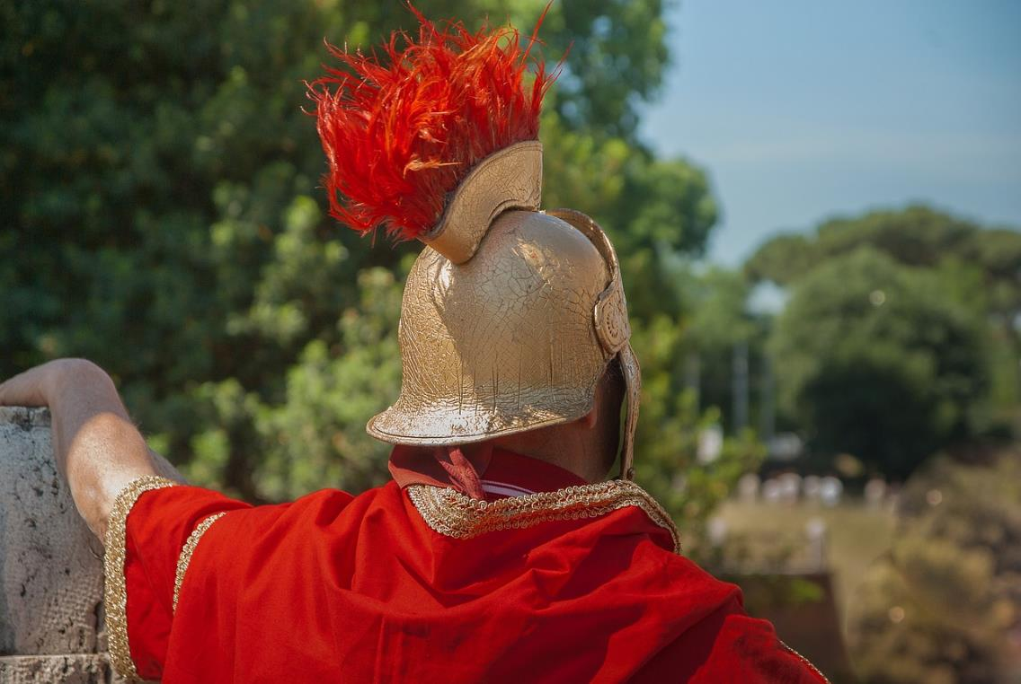
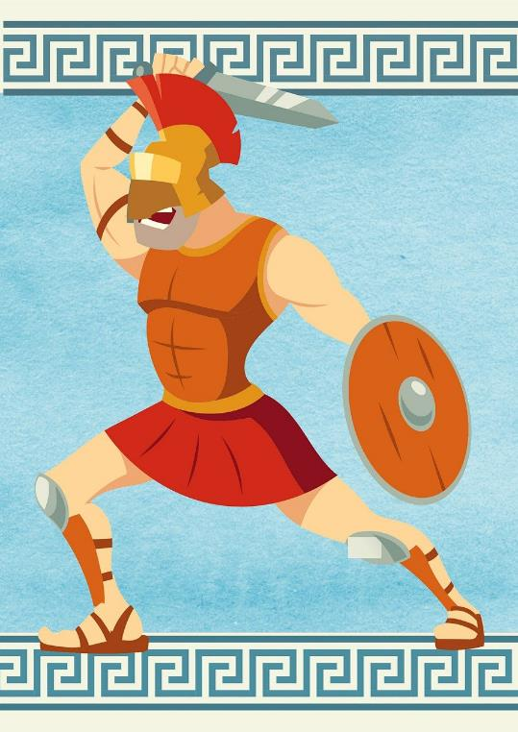
Notes:
Slide 4: Before we find out what Jesus said about God’s Kingdom, we need to spend a few moments thinking about the world in Jesus’ time, which as some of you may know, was ruled by the Roman Empire. The Roman Empire was ruled by the Caesars, who were very powerful, and literally had the power to decide who lived or died. Like most leaders at that point in history, they had to show how strong and powerful they were so that their enemies would be too frightened to fight them. The Caesars were protected by the fearsome Roman army, and history is full of stories of how cruel and unkind they were in the way they treated people, especially those whom they had conquered!
So, now let’s find out what Jesus said about God’s Kingdom…..and why some of his words were so difficult for the people to understand…..

Slide 5


Notes:
Slide 5: Use the large coins to explore which words children think are ‘God’s Kingdom’ words and which might be ‘Roman Empire’ words. Then share the Bible verses with them as well to confirm which way round the words go:
‘The last shall be first and the first shall be last’;
‘If you want to be great then you must serve others’;
‘Whoever loses their life for my sake will find their life’.
Talking time: Allow children time in small groups or with talk partners to talk about what they think Jesus was meaning. Don’t worry if they don’t fully understand, or even find it impossible – few of the people who listened to Jesus understood either!

Slide 6
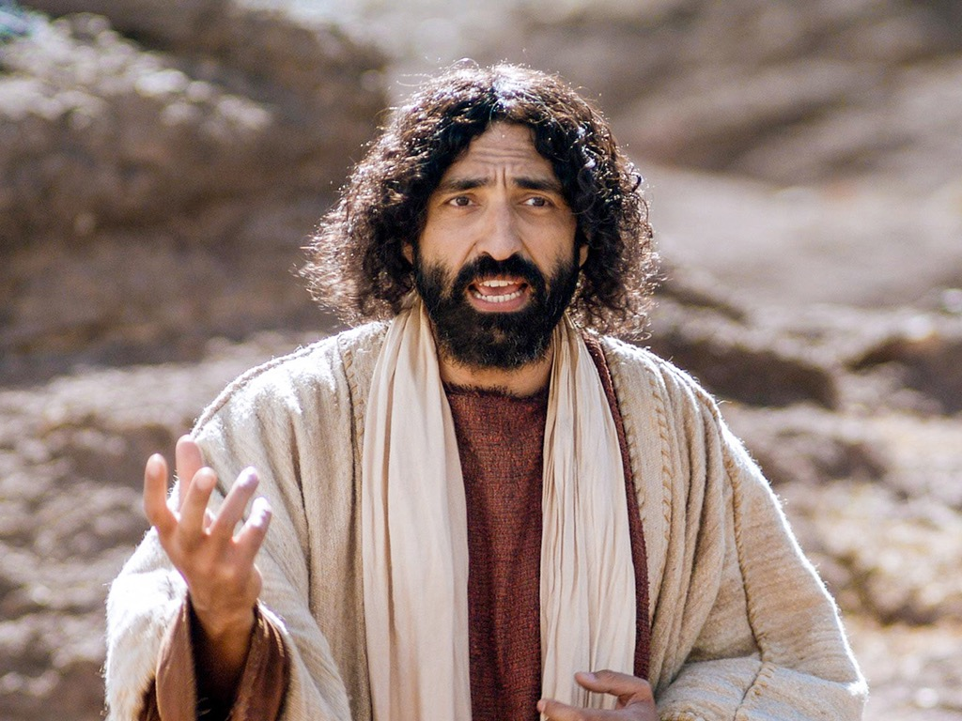

Notes:
Slide 6: Over the coming weeks, we are going to be exploring some more of Jesus’ words about God’s Kingdom, and think about how they might help us here in our school community to live well together. The words are part of a very famous part of the Bible called the ‘Sermon on the Mount’….but we’ll hear more next week!

Slide 7

….I wonder what the world might be like if these things happened?...
….I wonder how we might live out these words in the life of our school?....
Notes:
Responding (and words for worship): Slide 7
… So now we’re going to be still and quiet, as we wonder together….
….the words Jesus spoke about God’s kingdom were strange and confusing to the people who heard them…
….about being last so that you can be first…
…about giving up your life for others, to find your life….
….about serving others in order to be great….
….these were puzzling, confusing and topsy-turvy words then, and now….
….I wonder what the world might be like if these things happened?...
….I wonder how we might live out these words in the life of our school?....
I’m going to turn my thoughts into a prayer now. Make the prayer your own if you’d like to…or if you’d prefer not to pray, then just sit quietly with your own thoughts.

Slide 8

Dear God
The words that we have heard today are puzzling.
They remind us that your kingdom is different.
Help us to understand what this means through our times together this term.
Notes:
Slide 8:
Dear God
The words that we have heard today are puzzling.
They remind us that your kingdom is different.
Help us to understand what this means through our times together this term.

Slide 9


Slide 10



Leader: As we leave this place & time and go into the day ahead…
All: May these puzzling words keep us thinking…!

Slide 11

Notes:
Slide 11: Reflection areas
Put a toy crown in your reflection area. The pupils can write or draw people that are often last, overlooked or forgotten in our world, such as street cleaners, people who are too elderly to get out of their home, refugees, and place the slips of paper inside the crown. Later in the week take the children’s ideas out of the crown. How could you serve them? Are there any charities that your school supports which do this? If there any people in your school community who often get forgotten (e.g. cleaners who come in after you’ve gone home or kitchen staff who come in before school starts) Leave them a thank you note for all they do so that they feel noticed.

