Slide 1

All images copyright-free from pixabay, unless otherwise identified
Notes:
Slide 1: Growing leaves stilling exercise
Use the stilling slide if desired: the suggested words should be spoken slowly, leaving pauses inbetween to create a sense of stillness.
As you sit quietly, watch the leaves growing….[PAUSE]
Now practise slower breathing…..in…..and out…..in……and out…..keep this going as you continue to look at the leaves….[PAUSE]
You maybe notice that you are feeling calmer and more relaxed….[PAUSE]
As you breathe, think about yourself and what you bring into this time today….. [PAUSE]
We come into this special / sacred space and time to be still….to think deeply…..to be together as a school community…..
In our time together today, we will think about a question, share a story and then use it to help us to think.
But first, let’s welcome one another as we begin….

Slide 2

As we gather to share today's story.
As we gather to share today's story.
Leader: As we gather to share our story today….
All: May we grow in our understanding of ourselves and our actions.
Notes:
Slide 2: Use our new gathering words for this term, or your usual greeting if you prefer. These greetings may change slightly each week to reflect the spiritual elements that we will be exploring in each week’s materials.
Leader: As we gather to share our story today….
All: May we grow in our understanding of ourselves and our actions.

Slide 3
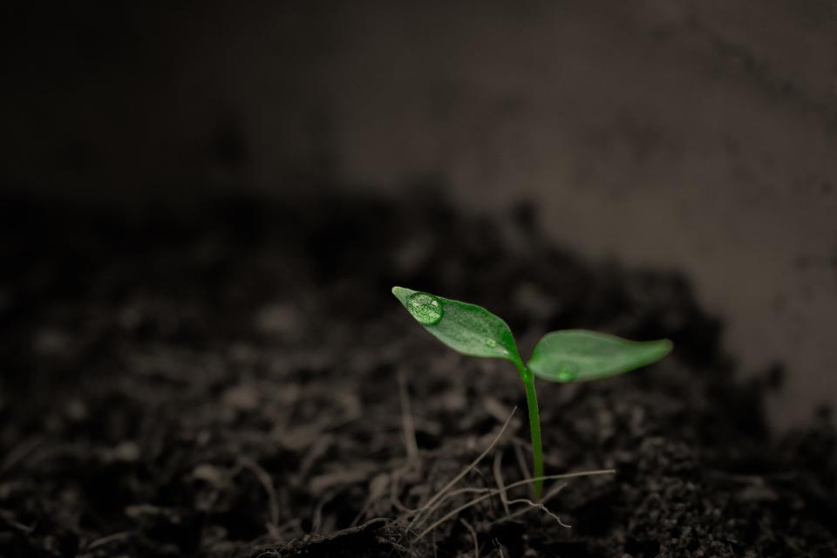
What do seeds need to help them to grow?
Notes:
Slide 3: Here’s a question to get you thinking: What do seeds need to help them to grow? Pause and talk together – this should be shared knowledge from EYFS upwards!

Slide 4
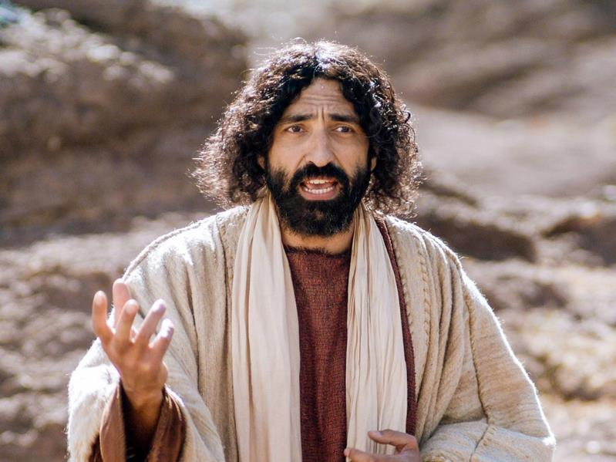

Notes:
Slide 4: We’re going to begin our time together with a story. It’s a special story called a parable, which has a hidden meaning. Jesus often used parables to teach the crowds that followed him important things about God and his Kingdom, and about how to treat each other. As with all Jesus’ parables, they’re so well written that you can hear it over and over again, and ‘hear’ something new each time! There are some parts for you to join in with. [You could also divide your class in half and have each half respond in turn. The next 2 slides are to help you teach the words. They will not repeat in the story, so you may need to encourage children to continue to join in]

Slide 5


..the rain fell…
…and the sun shone down…
Notes:
Slide 5: After I say the words ‘And then’, join in with ‘the rain fell and the sun shone down….’ Try that now….And after I say the words ‘but the seeds said…. you can say:

Slide 6
Oh no! We can’t grow!!
Notes:
Slide 6: ‘Oh no! We can’t grow!’ Try that now, using a ‘seedy’ type of voice if you want to!…. Do watch out for the final bit in the story, because it’s different – but don’t worry, you WILL know exactly what to do! [Use script on p 4. Optional: There will be some pictures to look at as we go along (slides 13-19) – but don’t forget to join in!]

Slide 7
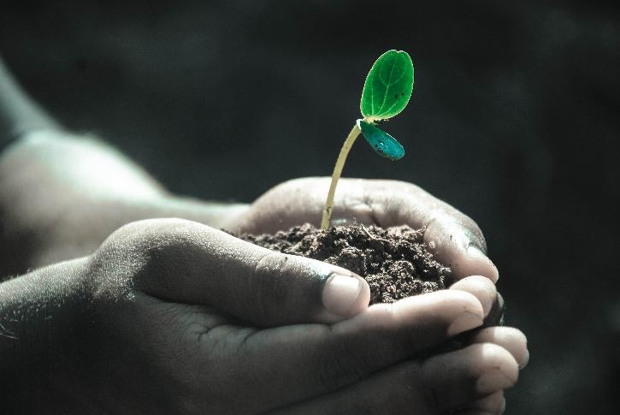
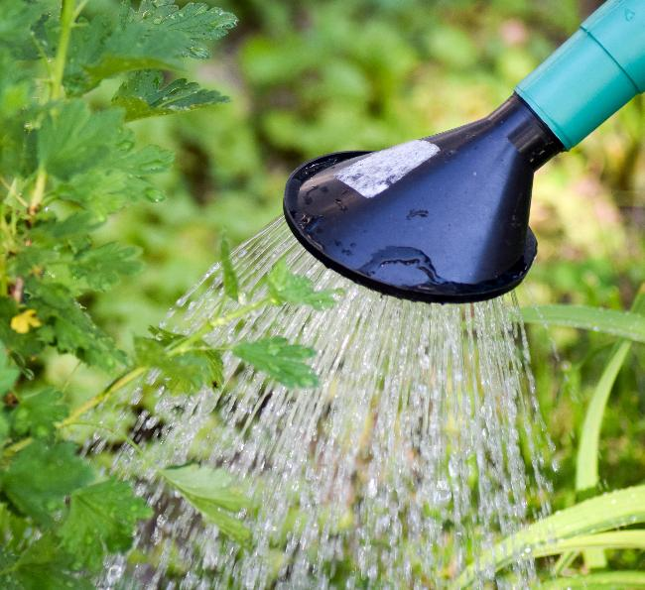
Notes:
Slide 7: Earlier on, we thought about the question: What do seeds need to help them grow? What did you think? You’re right: for seeds to grow really well, they need three things…. a safe place where their roots can go deep (unlike some of the seeds in our story) …they need water…and sunshine…and they grow even better when someone looks after them properly! And when they are grown, there will be all sorts of fruit (depending on what you planted!) and even more seeds….

Slide 8
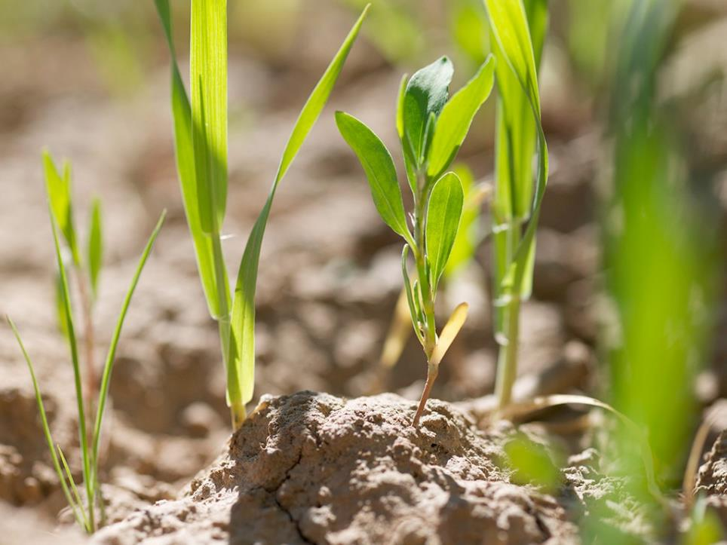
Notes:
Slide 8: Let’s go back to Jesus’ parable: After he’d told his story, Jesus explained to the people listening that the seeds that fall on good ground are like the people who listen to what God says and live in a way that pleases him, even when life is difficult. And these are difficult times, to be sure! Jesus said that people who do this will grow good fruit in their lives.

Slide 9
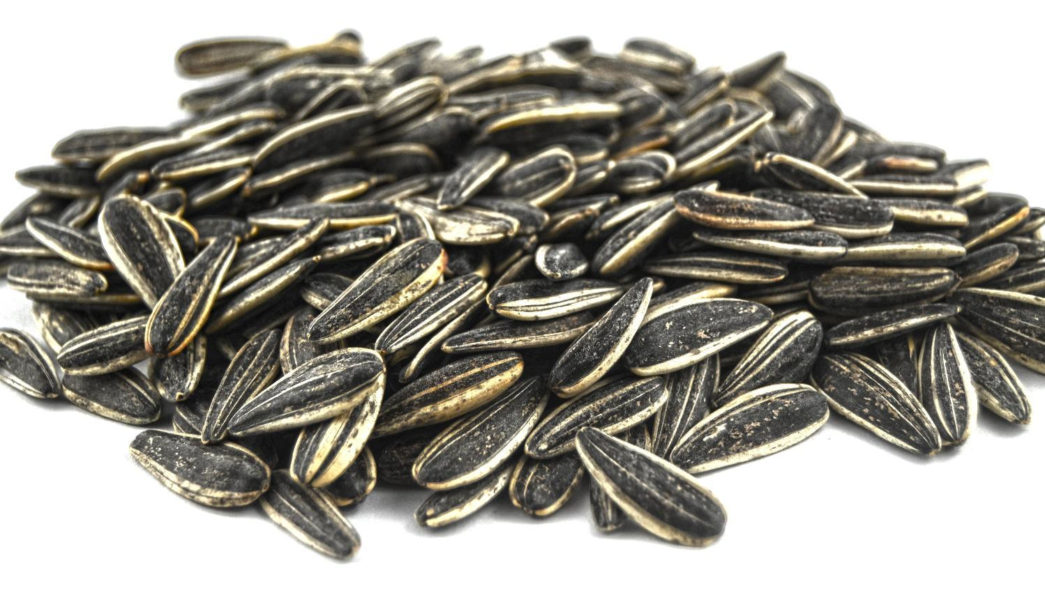
Notes:
Slide 9: “During your time with us in …….. School, we hope that we sow many seeds into your lives. Not seeds that grow in the soil, but seeds that grow in our hearts. I need a couple of ‘gardeners’ to help me now as we think about what these seeds might be for us at school…. Here are some very large seed packets, containing some very special seeds…..[invite your ‘gardeners’ up]…let’s open them….
“Like all seeds, these special seeds need to be taken care of in order for them to grow as they should: that’s the job of every person here! [Talk together about the ways in which these seeds will grow – and how this relates to us being good ‘soil’, looking after the seeds that we sow in our hearts – and the connections between thoughts, words and actions]
As Jesus said in his parable, the seeds grow in good soil: that’s having hearts and minds that will listen and learn. But to really grow well, we need to practise these things in order for them to become fully a part of us as a school community. Gardening can be hard work!! But Jesus also taught that God would help those who ask him, so in a few moments, there will be an opportunity for us to do that.

Slide 10
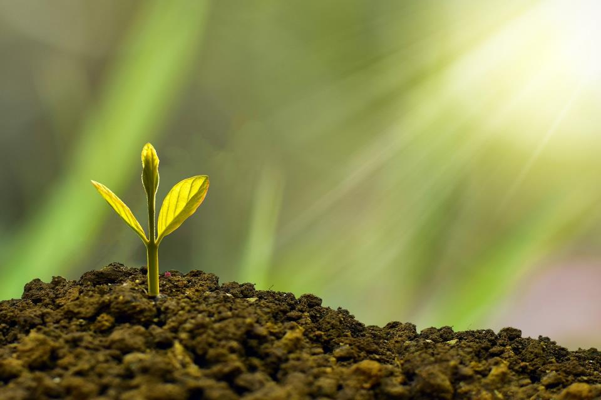
…I wonder how today’s parable has helped us to understand the things we hold deep in our hearts?...
…I wonder how being a part of this school community might help us to grow these seeds?...
Notes:
Slide 10: Responding (and words for worship)
Let’s be still and quiet together now…
…in the stillness, think about the things that you’ve heard today….
…..about the type of soil that will grow good seeds…..
….and the connections between our thoughts, our words and our actions…..
…..I wonder how today’s parable has helped us to understand the things we hold deep in our hearts?.....
….or the things that will help our seeds of [insert your school’s values here] to grow….
…..these seeds don’t need water, or soil, or sun…..
….our seeds will grow because of the attitudes we hold in our hearts….
…the words that we speak…
…..and the things that we do….our actions…..
….think about these things for yourself now, and how you might help the seeds of your heart to grow…..
…..I wonder how being a part of this school community might help us to grow these seeds?.....
I’m going to turn my thoughts into a prayer now, as I ask God to help us to put some of these ideas into practice, using some words that David the Psalm-writer wrote. He talked about the connection between our words, our hearts and our actions.
Make the prayer your own if you’d like to…or if you’d prefer not to pray, then just sit quietly with your own thoughts. There are some actions that you can join in with if you’d like to [explain these before using the words].

Slide 11
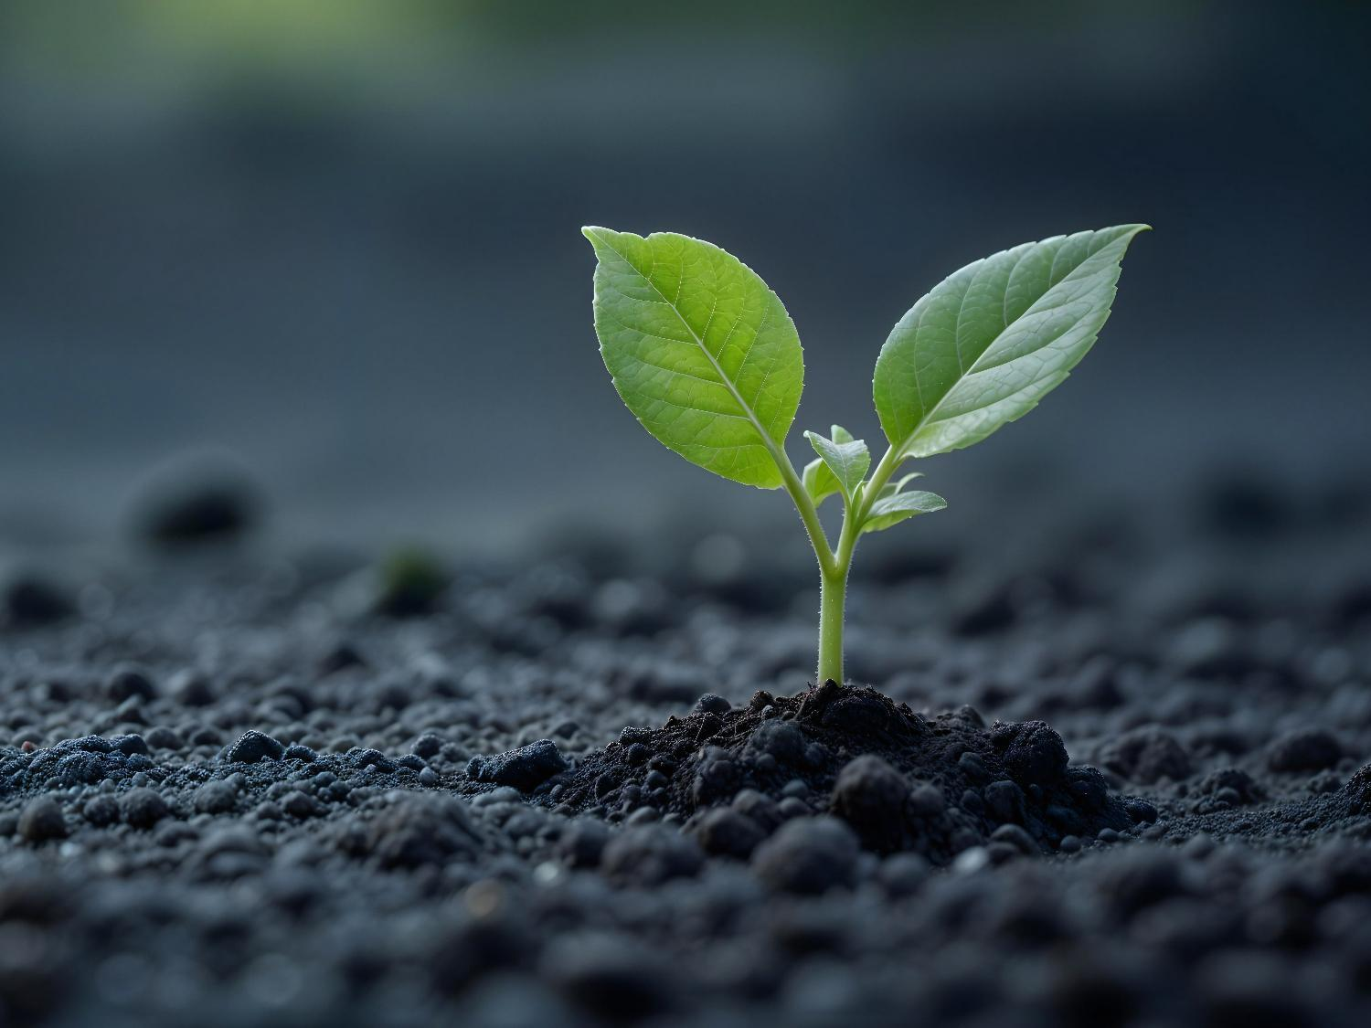
Dear God
May the words of our mouths [place your hands on your lips]
And the thoughts in our minds [place your hands on your temples]
And the attitudes in our hearts [place your hands over your heart]
Be pleasing to you [both thumbs up].
Notes:
Slide 11: [words adapted from Psalm 19:14]
Dear God
May the words of our mouths [place your hands on your lips]
And the thoughts in our minds [place your hands on your temples]
And the attitudes in our hearts [place your hands over your heart]
Be pleasing to you [both thumbs up].

Slide 12


Slide 13
Leader: As we leave this place & time and go into the day ahead…
All: May we grow well!

Slide 15
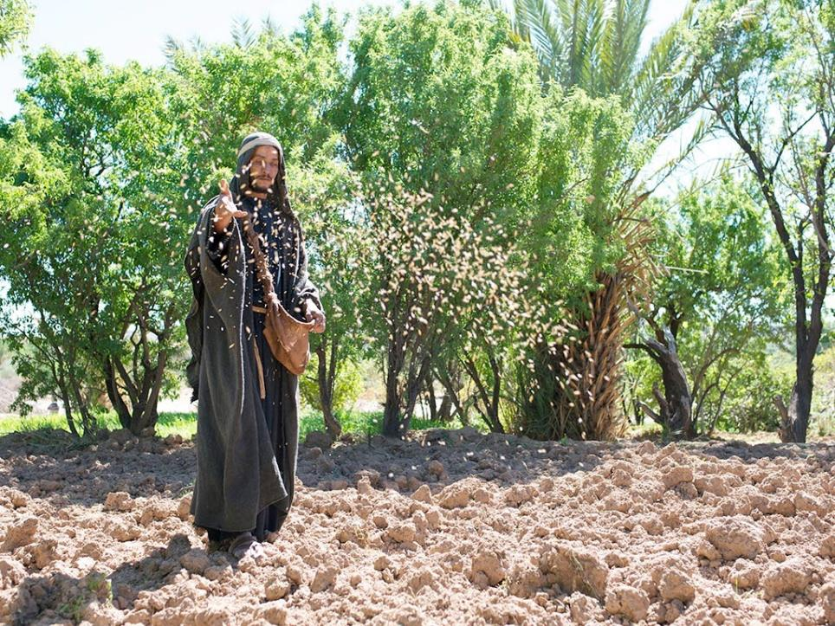
Notes:
Slide 15: ‘Once, there was a farmer who went out to sow his seeds.

Slide 16
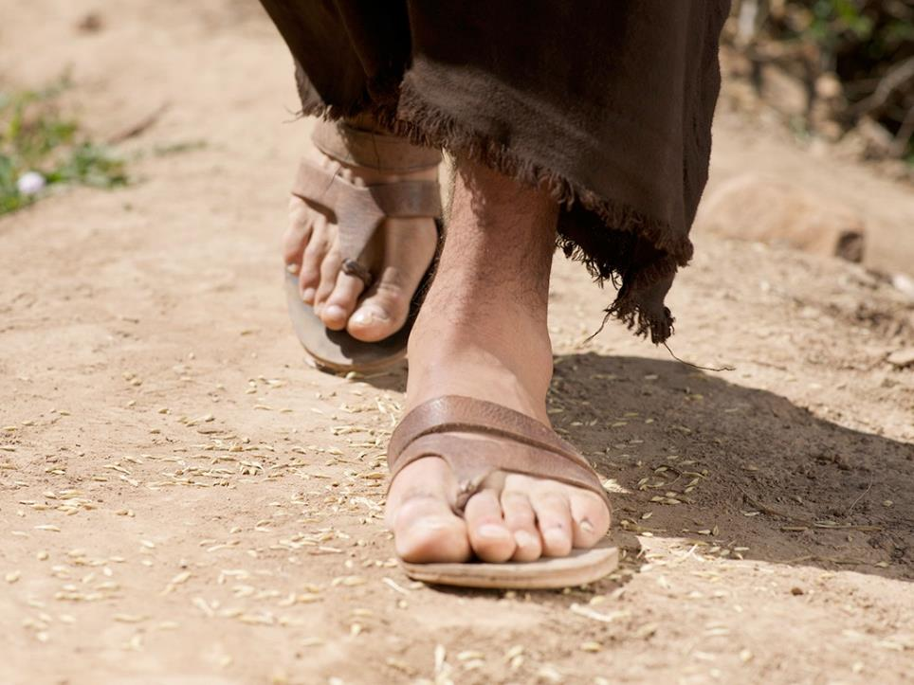
Oh no! We can’t grow!!
Notes:
Slide 16: As he was scattering the seeds, some fell along the path. And then the rain fell and the sun shone down…but the seeds said….‘Oh no! We can’t grow! And the seeds were trampled on by people’s feet as they walked by, and pecked up by birds.

Slide 17
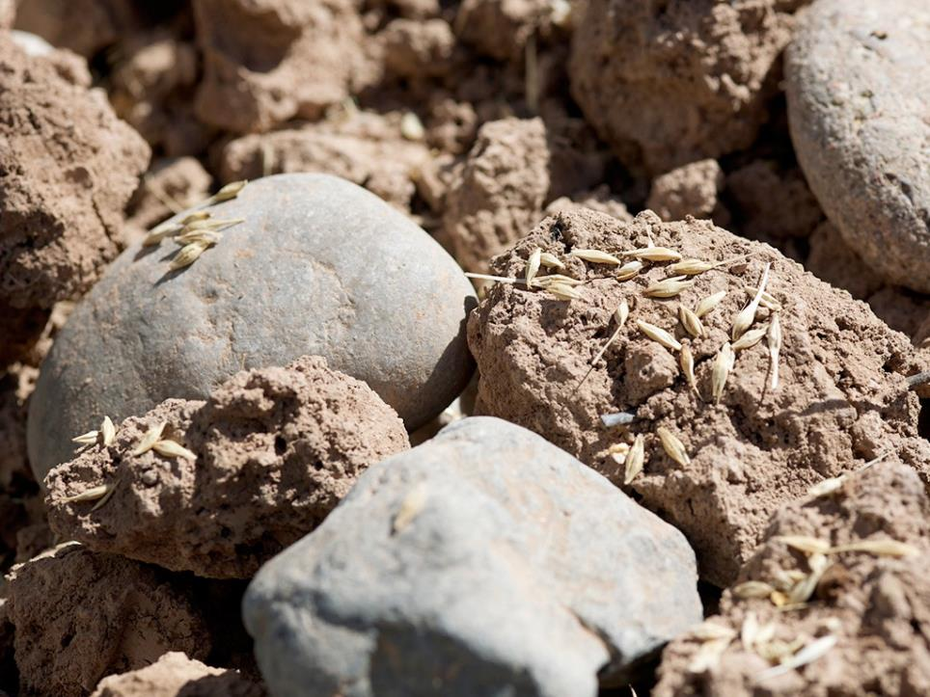
Oh no! We can’t grow!!
Notes:
Slide 17: Some more seeds fell on rocky ground. And then the rain fell and the sun shone down… but the seeds said ….‘Oh no! We can’t grow!

Slide 18
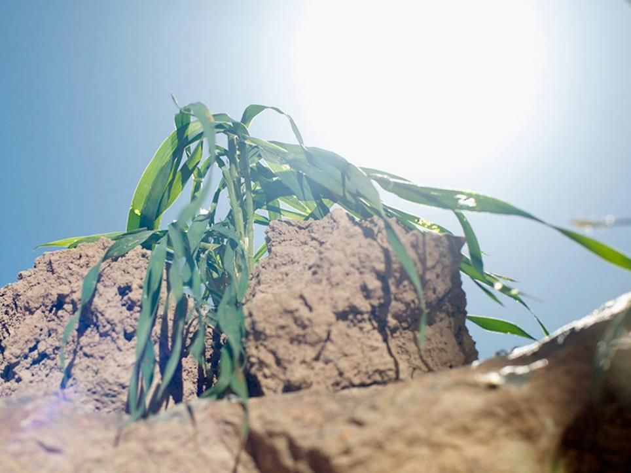
Notes:
Slide 18: And when they sprouted, there was no soil for their roots, so the little green plants dried up, withered and died.

Slide 19
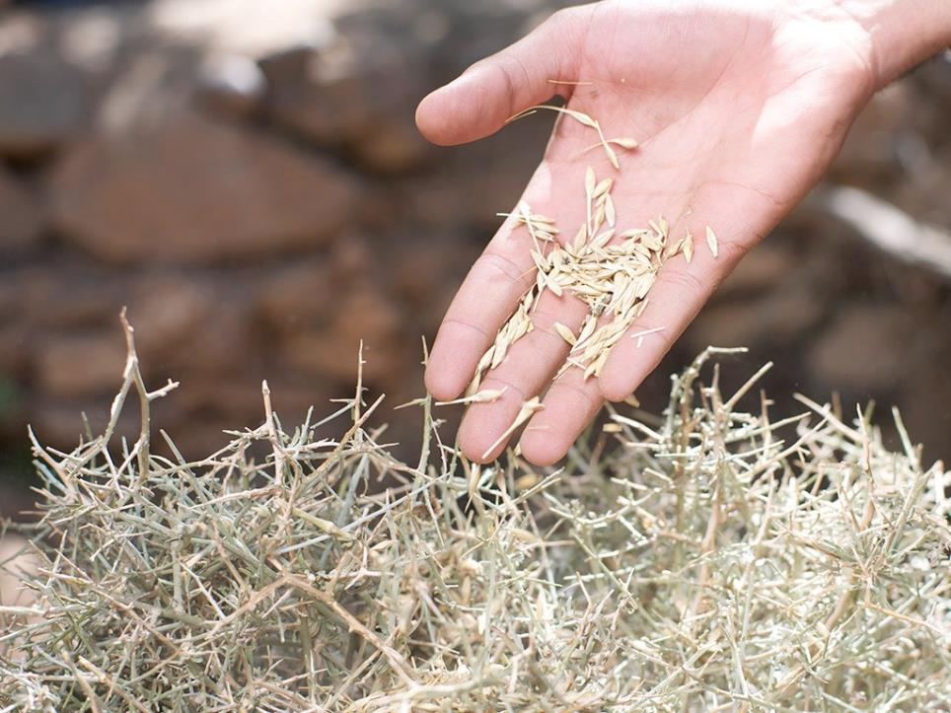
Oh no! We can’t grow!!
Notes:
Slide 19: Other seeds fell into thorny bushes, And then the rain fell and the sun shone down… but the seeds said ….‘Oh no! We can’t grow! And the thorns choked and killed the seeds.

Slide 20
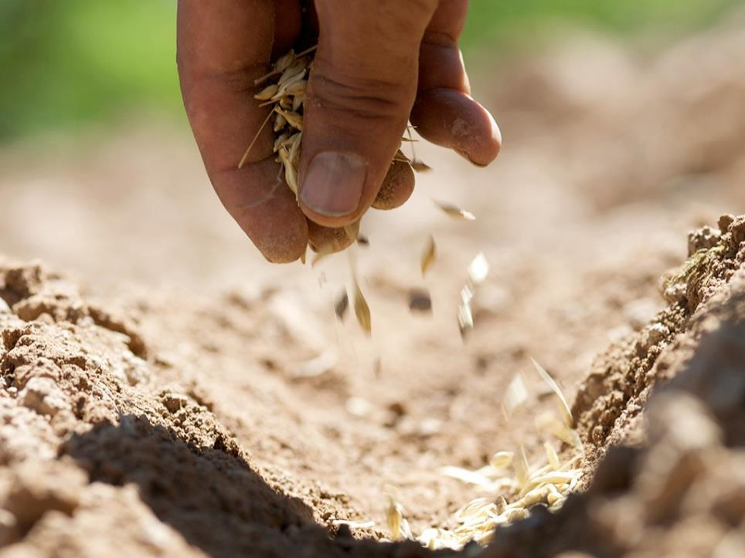
Oh yes! We CAN grow!!
Notes:
Slide 20: But some seeds fell on good soil. And then the rain fell and the sun shone down… and the seeds said ….‘Oh yes! We CAN grow!

Slide 21
Notes:
Slide 21: And so they sprouted, grew roots deep into the ground where there was water and yielded a good crop, a hundred times more than what was sown.’

Slide 22
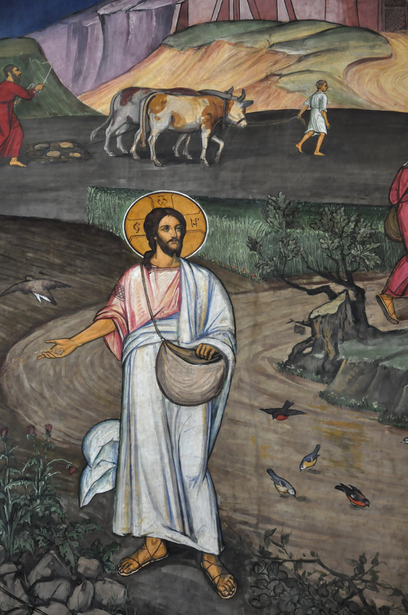
Notes:
Parable of the sower
From Brasow, Romania
Original source: https://diglib.library.vanderbilt.edu/act-imagelink.pl?RC=55021

