Slide 1





All pictures copyright-free from pixabay
Notes:
Slide 1: Candle flame stilling exercise
Use the stilling slide if desired: the suggested words should be spoken slowly, leaving pauses inbetween to create a sense of stillness.
As you sit quietly, watch the candle flame flicker….[PAUSE]
Now practise slower breathing…..in…..and out…..in……and out…..keep this going as you continue to look at the flame….[PAUSE]
You maybe notice that you are feeling calmer and more relaxed….[PAUSE]
We come into this special / sacred space and time to be still….to think deeply…..to be together as a school community…..
In our time together today, we will play a game together (though not dominoes!), share a story, talk together and then reflect together on how we might be a blessing to others this week.
But first, let’s welcome one another as we begin….

Slide 2

Leader: As we gather together today…
ALL: …we bring our thoughts and our hearts into this sacred space.
Notes:
Slide 2: Gathering
Let’s use our new greeting to say to each other as we begin….
Leader: As we gather together today….
ALL: ….we bring our thoughts and our hearts into this sacred space.
Here are BSL actions for some of the words:
Leader’s words:
Gather: https://www.signbsl.com/sign/gather (1st video)
Today: https://www.signbsl.com/sign/today (1st video)
Pupils’ response:
Thoughts: https://www.signbsl.com/sign/thoughts (1st video)
Hearts: https://www.signbsl.com/sign/heart (1st video)

Slide 3
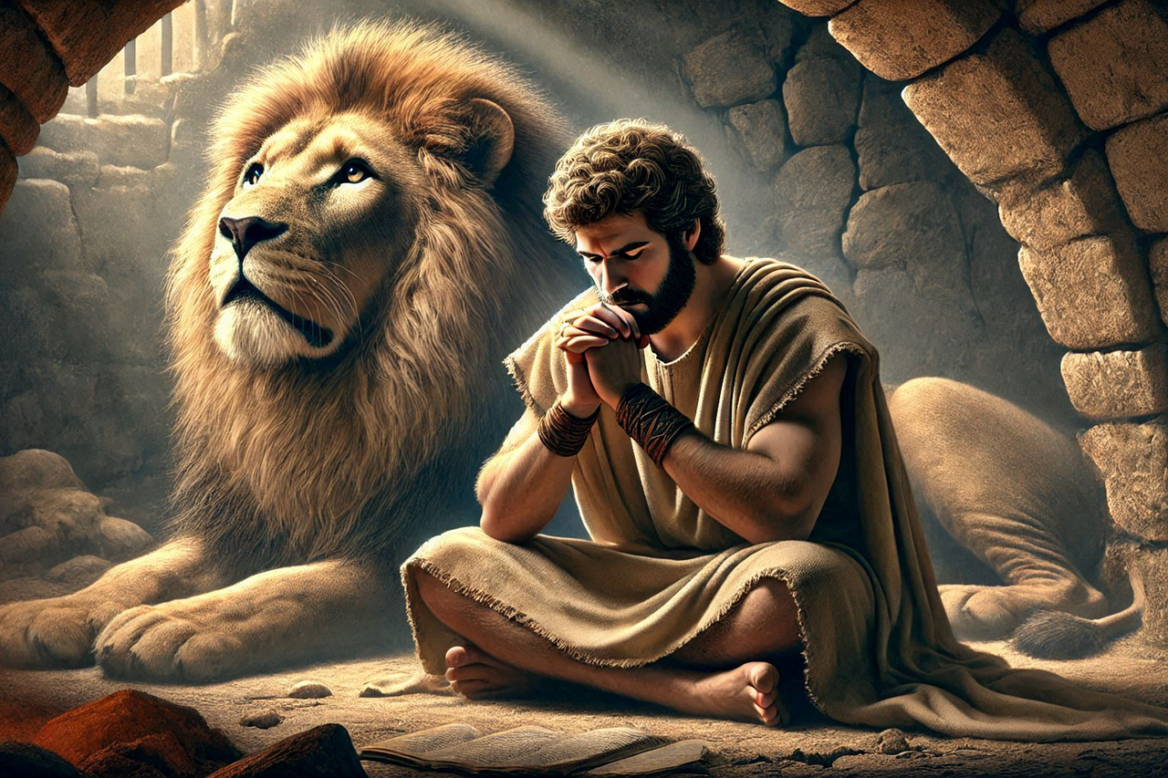
…wise people will shine like the brightness of the sky. Those who teach others to live right will shine like stars forever and ever.
Daniel 12:3
Shine like stars!
Notes:
Slide 3: Shine like stars!
Today, we begin a new series based on the story of a man named Daniel who lived through challenging times. We have called this series ‘Shine like stars!’, reminding us of words we heard last week, written in the book in the Bible that shares Daniel’s name. Let’s remind ourselves of them, because they will help us as we begin his story later:
…wise people will shine like the brightness of the sky. Those who teach others to live right will shine like stars forever and ever.
Daniel 12:3
As we begin together today, just bring back into your mind the thoughts we shared last week about how we might ‘shine like stars’….

Slide 4
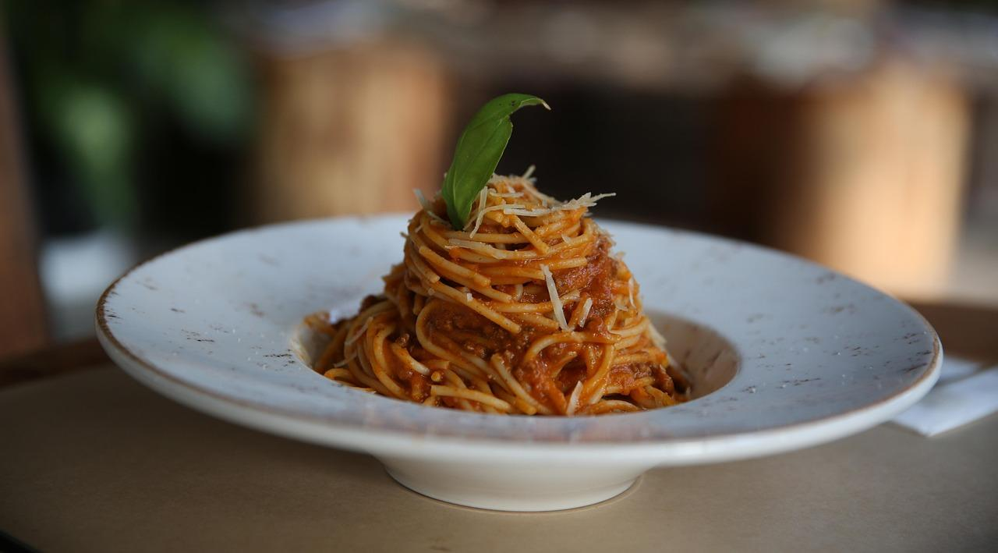
What’s on the plate?
Notes:
Slide 4: But first, we are going to begin our time together with a game. I am going to show you some pictures of different types of food, but you’re only going to see a tiny part of each. I wonder if you can guess ‘What’s on the plate?’ [the answer will appear on the slide when you click, so don’t move on too fast or you may accidentally reveal the answers before you’re ready!]

Slide 5


Notes:
Slide 5: Pizza

Slide 6
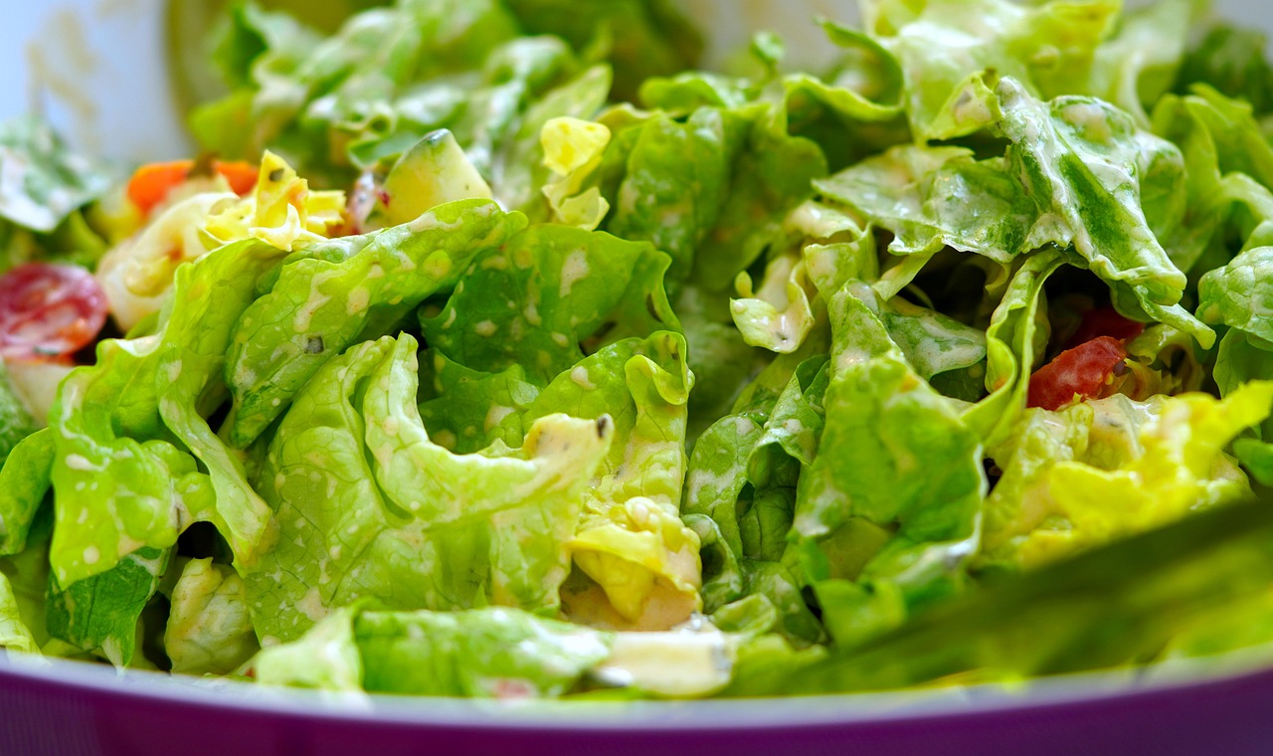
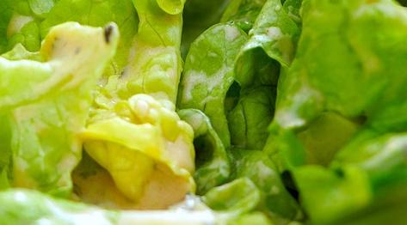
Notes:
Slide 6: Salad

Slide 7

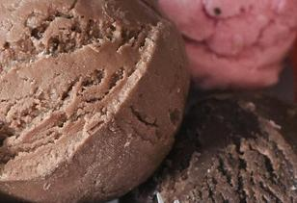
Notes:
Slide 7: Ice cream

Slide 8
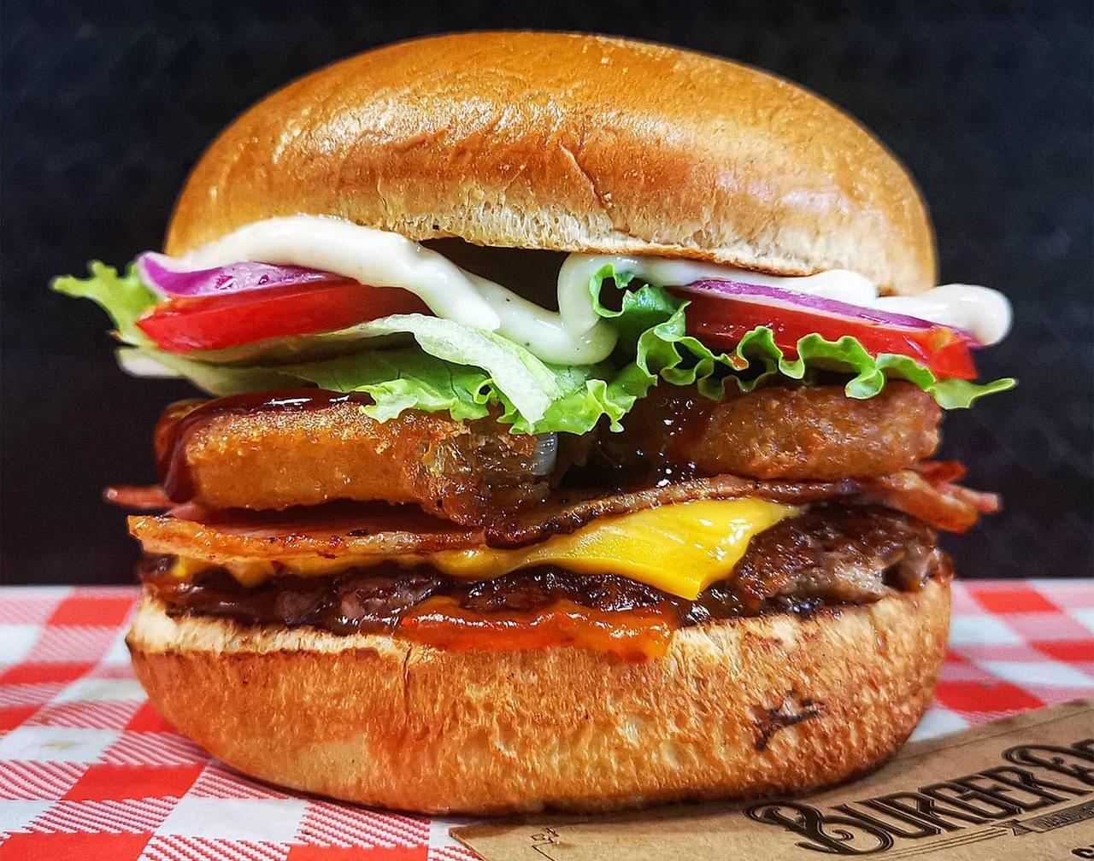
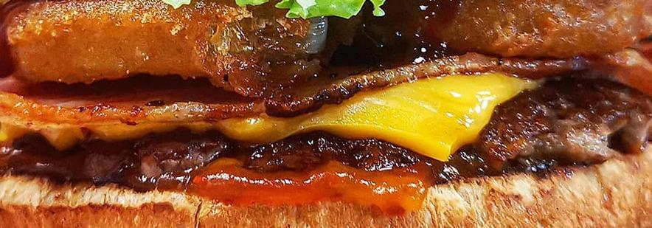
Notes:
Slide 8: Burger

Slide 9
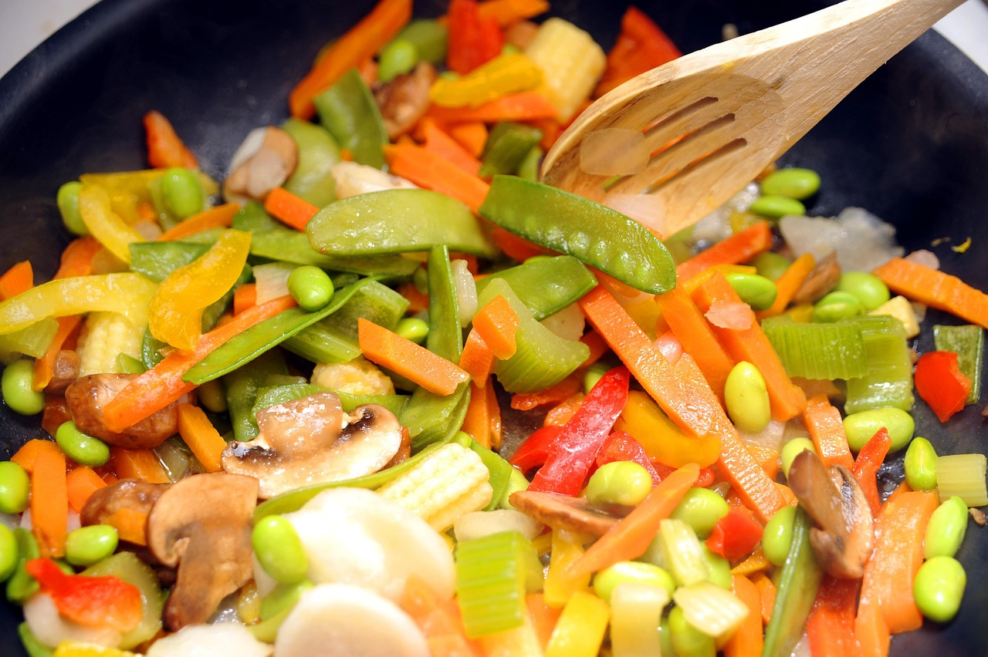
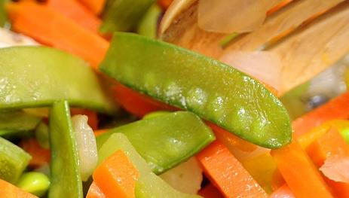
Notes:
Slide 9: Vegetable stir-fry

Slide 10
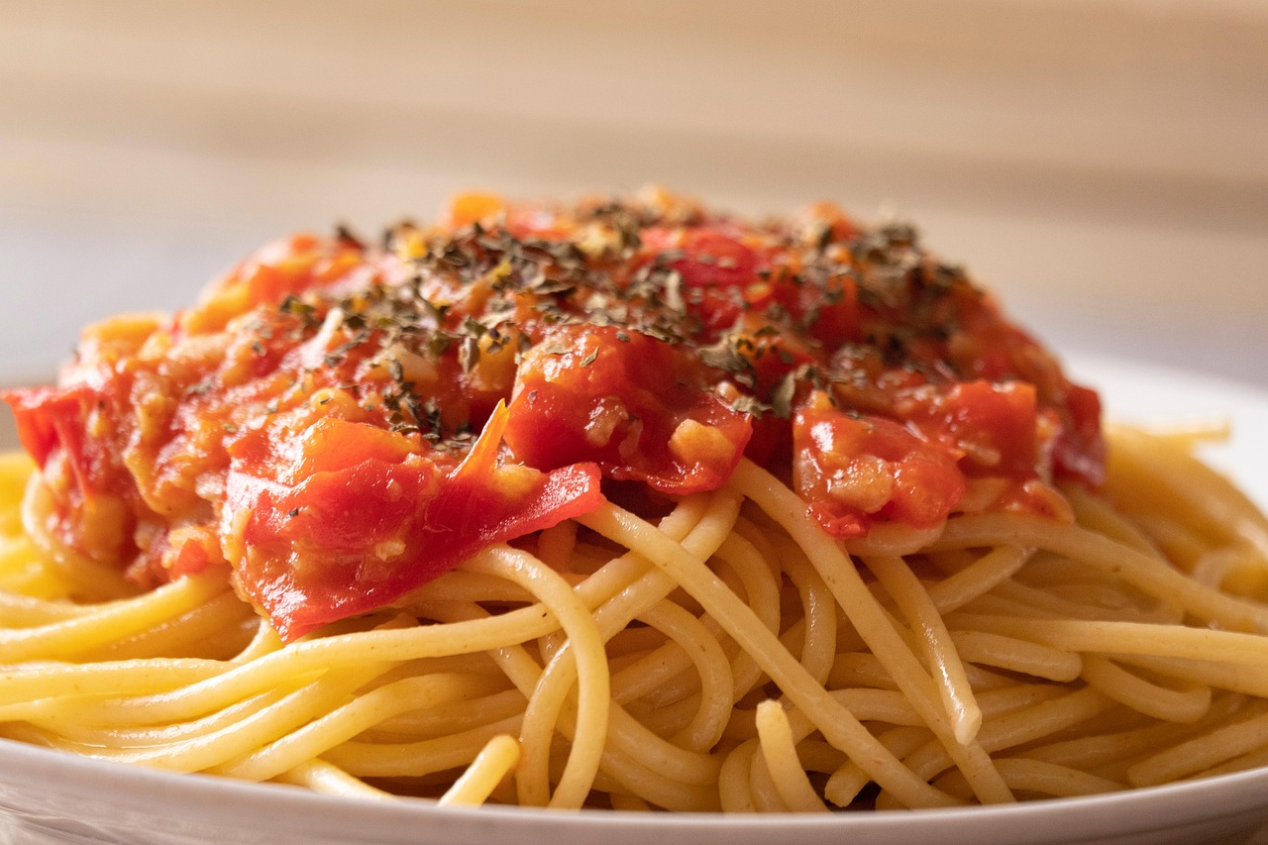
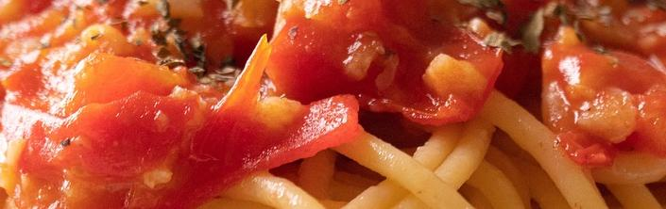
Notes:
Slide 10: Spaghetti

Slide 11

Which actions ‘shine like stars’ in the sky?
Shine like stars!
Notes:
Slide 11: So, why on earth have we been thinking about food today? Well, as always, there is a link with our story – and we’ll talk about this later on, so do try to spot the connection! Before we begin, it’s important that we understand the context for this story – the time, the place, and maybe the things that were different for people living in Daniel’s time. Some of you might already know a later part of his story, which is another story for another day!.....
As you listen to Daniel’s story today, be thinking which things that Daniel does, (his actions), shine like stars in the sky…

Slide 12
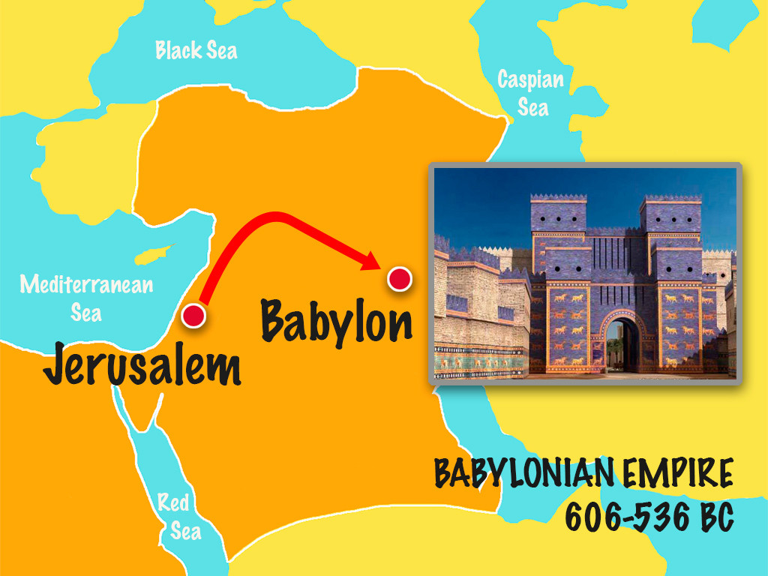

Notes:
Slide 12: In world history, this story falls in the time between the great Egyptian and Greek empires. Across millennia, great kingdoms had come, others had fallen – and so life for ordinary people was often difficult. God’s people, the Hebrews, had settled in and around Jerusalem – you might remember how they had got there, when Moses led them through the desert (where God provided manna and quails!). For a long time, there had been peace and prosperity.
But now, they were facing more difficult times. A new kingdom was on the rise, the Babylonian Empire, and they were spreading their boundaries and capturing land – and people – from all around. God’s people were captured and taken far, far away from their homeland.

Slide 13
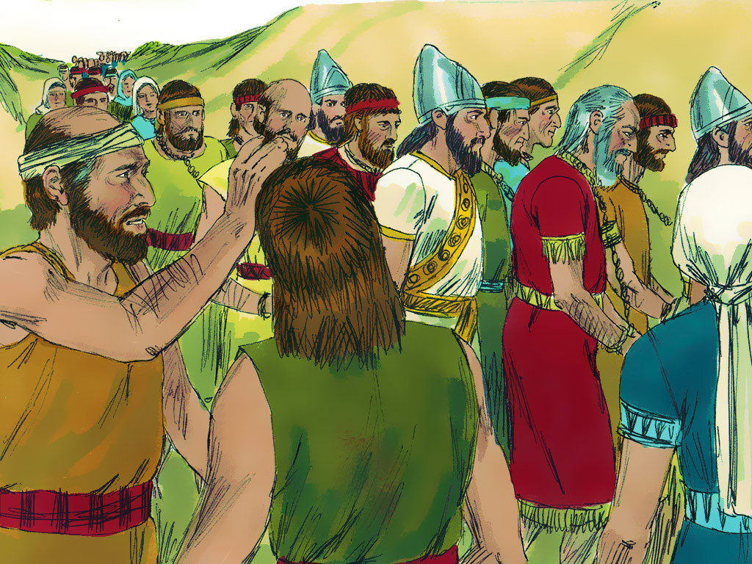
Notes:
Slide 13: Among those taken to Babylon was Daniel. Like many who were taken to Babylon, Daniel and his friends were from very important families. They were used to other people taking care of them and serving them, but now they were prisoners and slaves.

Slide 14
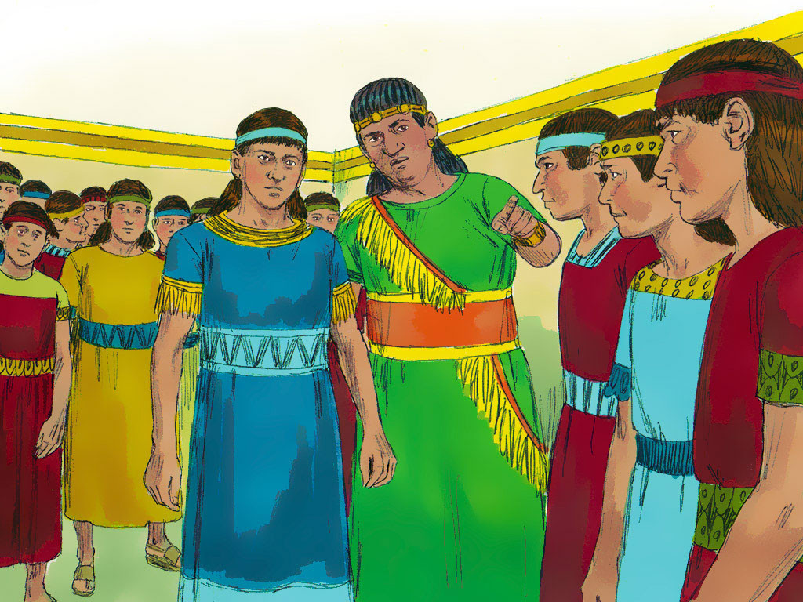
Notes:
Slide 14: King Nebuchadnezzar [Neb-ew-cad-nezz-ar] ordered Ashpenaz, his chief of staff, to select from the Hebrew prisoners the very best of the young men from royal and noble families, to serve him. They had to be strong, healthy, and clever. Among those Ashpenaz chose were Daniel and three of his friends, Hananiah, Mishael [Mish-ay-el], and Azariah.
The four young men were renamed and given Babylonian names. Daniel was renamed Belteshazzar. Hananiah was renamed Shadrach [Shad-rack]. Mishael was renamed Meshach [Me-shack]. Azariah was renamed Abednego [Abed-nay-go].

Slide 15
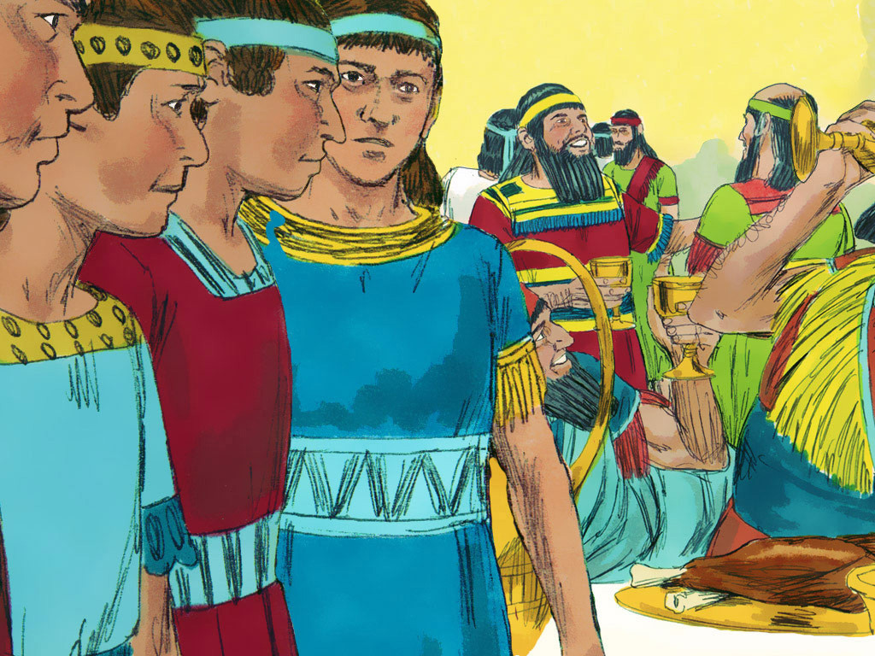
Notes:
Slide 15: These four young men were to be trained for three years in the culture, language and literature of Babylon. They would also be given food and wine from the King’s own kitchens. Daniel knew the meat being offered was not prepared according to Jewish laws, given to Moses by God.

Slide 16
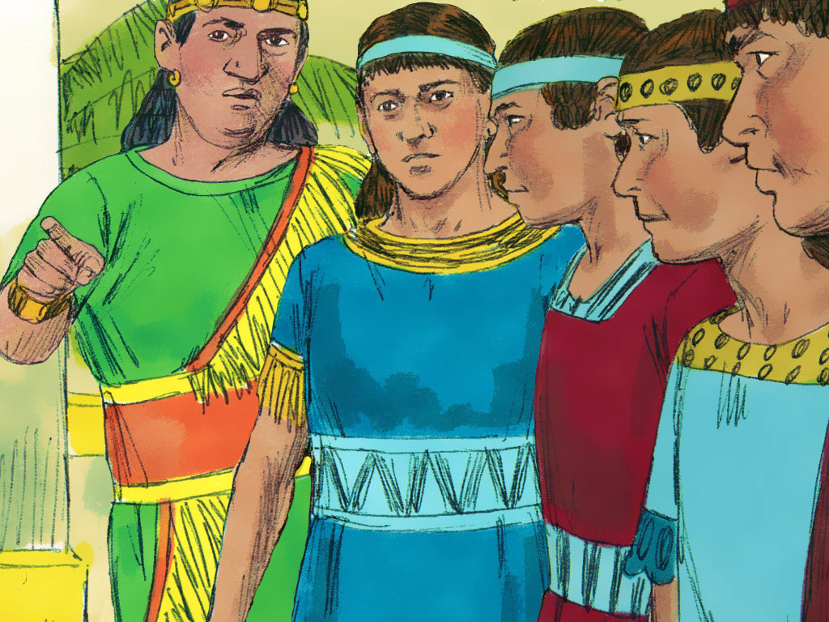
Notes:
Slide 16: Daniel politely asked the chief of staff for permission to be given different food. The chief of staff refused: ‘The king has ordered that you eat this food and wine. If you become pale and thin the king will have me beheaded.’ Daniel did not give in. He spoke with the attendant, ‘Test us for ten days on a diet of vegetables and water then compare us to the others eating the king’s food.’

Slide 17
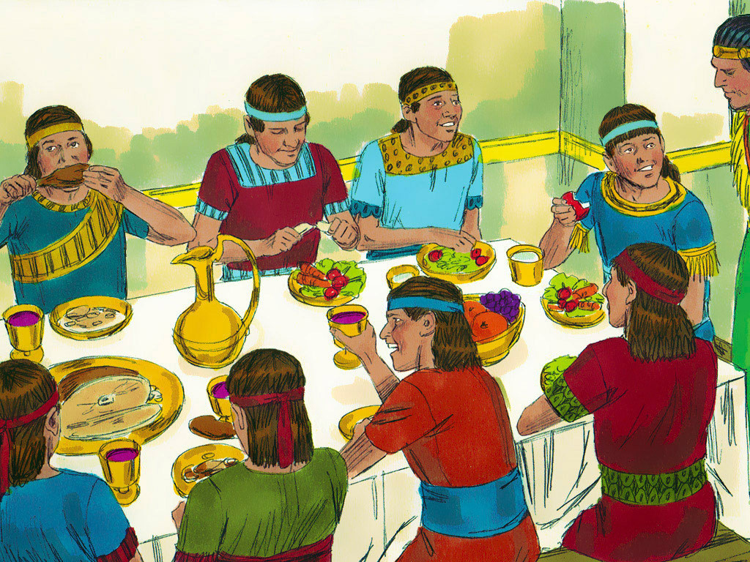
Notes:
Slide 17: So, for ten days Daniel and his three friends ate vegetables and water while the others ate the King’s rich food and drank wine. At the end of the ten days, Daniel and his three friends looked healthier and better nourished than the rest, so they were allowed to continue on their diet.

Slide 18
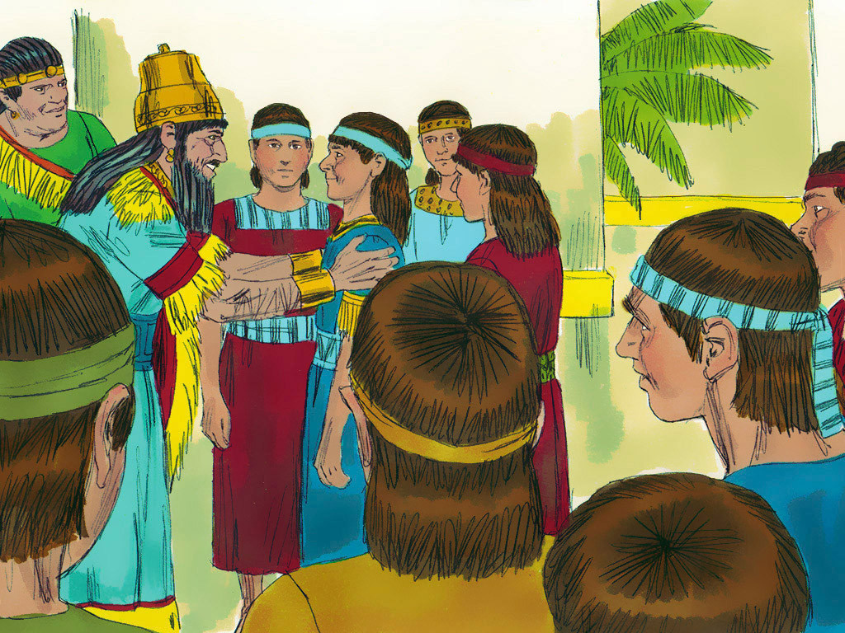
Notes:
Slide 18: Daniel and his friends studied and worked hard, and God gave them great wisdom. At the end of their training, they were presented to King Nebuchadnezzar. No one impressed the King as much as the four young men, in fact, King Nebuchadnezzar found them found them ten times better than any of his own wise men. They worked hard and served the king humbly and faithfully, without complaining. And God also gave Daniel a very special talent….. which we will hear about next week!

Slide 19
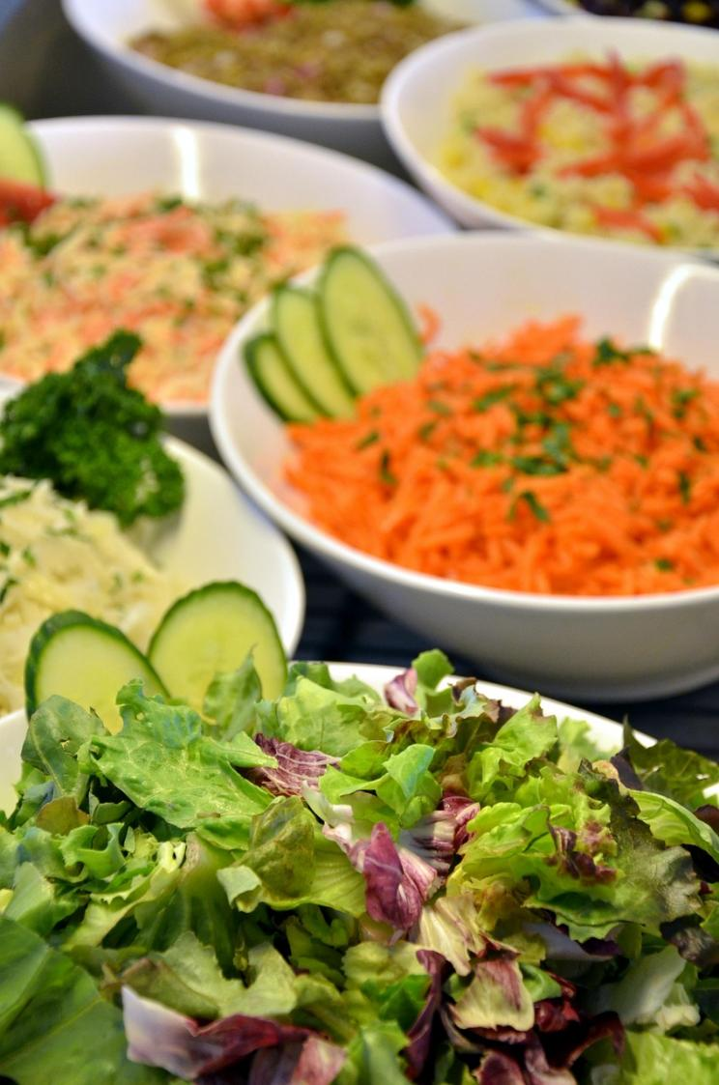
Notes:
Slide 19: So, did you spot the connection between our food game and the story?....
Daniel was very concerned about the food on his plate, because God’s people had been given some important rules about food and how it should be prepared, which is why they asked for vegetables, as they are very simple to prepare. Daniel and his friends wanted to keep to God’s rules and honour him, even in a new land. Many Jewish people today still follow these food rules, which they call kosher, which means ‘proper’.

Slide 20
Which actions ‘shine like stars’ in the sky?
Notes:
Slide 20: Here’s the question we asked earlier: Which actions ‘shine like stars’ in the sky? As we look back at Daniel’s story today, I wonder what stood out for you? [talk together – it might be:
Being brave when they were taken away from their homeland
Following God’s rules in a new place – even when it was difficult for him to do this
Studying hard in order to become wise
Serving faithfully and humbly, without complaining]
(You might want to model writing children’s ideas on the paper stars)

Slide 21

….I wonder what in Daniel’s story might inspire us to ‘shine like stars’?....
….I wonder how our school values or our ‘golden rules’ might help us to ‘shine’?....
….I wonder how God might help us to ‘shine’, if we were to ask him?....
‘God gave them great wisdom.’ Daniel 1:17
Notes:
Slide 21: Responding and words for worship
As we come towards the end of our time together today, we’re going to pause and think now….
Bring into your mind the things we’ve just talked about – the actions that we said shone like stars. We may be living some 2500 years later than Daniel, but there are things that we all might learn from how he lived…
….I wonder what in Daniel’s story might inspire us to ‘shine like stars’?....
….I wonder how our school values or our ‘golden rules’ might help us to ‘shine’?....
In our story, we might have missed some very significant words that Daniel would want us to spot before we leave today!!: ‘God gave them great wisdom’. These words in the Bible remind Christians that God helps people who want to live well, as Daniel and his friends did. So, here’s one more wondering question….
….I wonder how God might help us to ‘shine’, if we were to ask him?....
I’m going to use some words in prayer now, doing just that; asking God to help our actions to shine. If you would like to join in with the prayer, then here are the words to say, which will begin each line of the prayer:

Slide 22
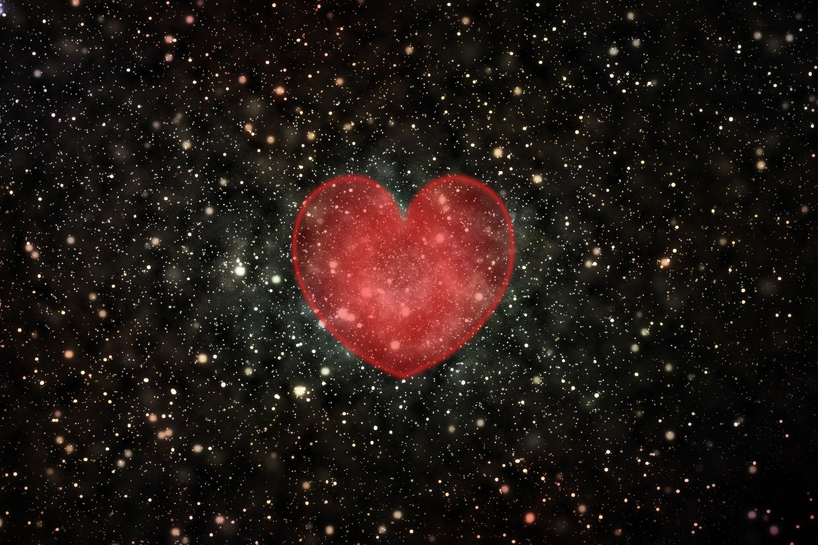
May our actions shine like stars….
Notes:
Slide 22: May our actions shine like stars….
So, I invite you to pray with me if you’d like to.
May our actions shine like stars….

Slide 23

Notes:
Slide 23: ….when we see others in need.

Slide 24
May our actions shine like stars….
Notes:
Slide 24: May we be a blessing….

Slide 25
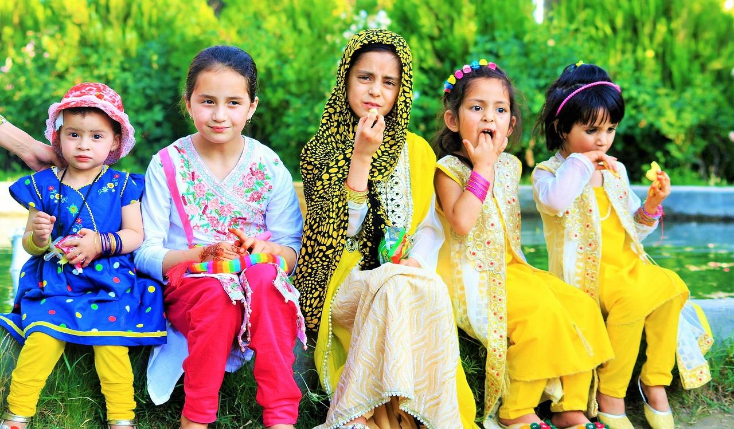
Notes:
Slide 25: ….with our friends and family.

Slide 26
May our actions shine like stars….
Notes:
Slide 26: May our actions shine like stars….

Slide 27
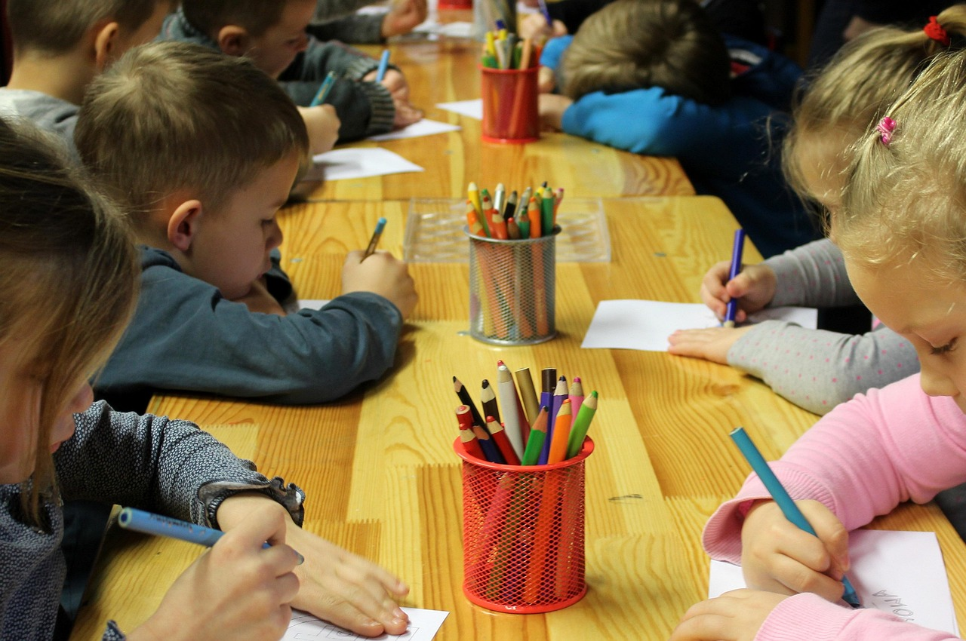
Notes:
Slide 27: ….as part of our school community.

Slide 28
May our actions shine like stars….
Notes:
Slide 28: May our actions shine like stars….

Slide 29
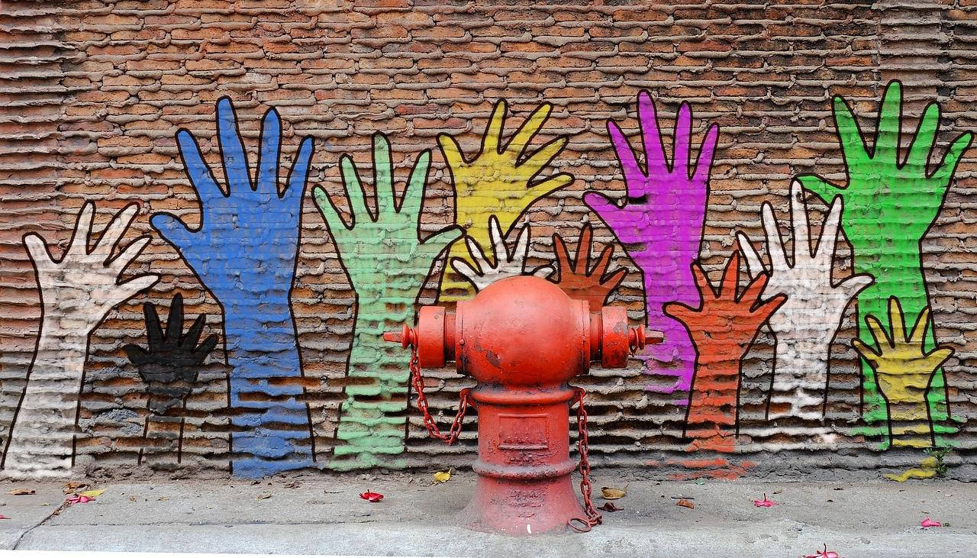
Notes:
Slide 29: ….whenever we can, wherever we can, for whoever we can!

Slide 30


Slide 31
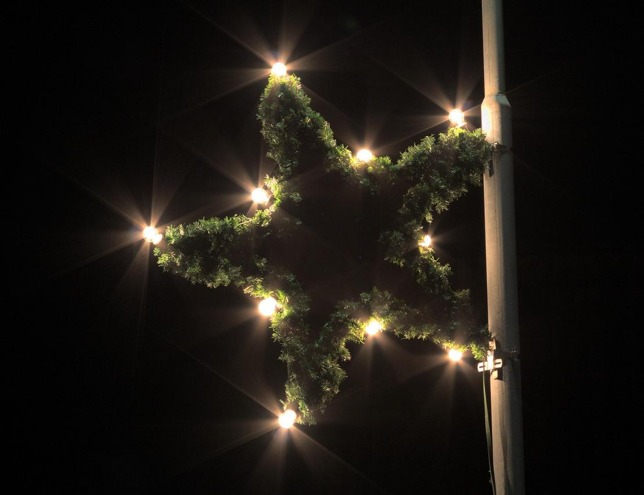


Leader: As we leave this place & time and go into the day ahead…
All: May we shine like stars!
Notes:
Sending: Slide 31
Leader: As we leave this place & time and go into the day ahead…
All: May we shine like stars!

Slide 32

Notes:
Slide 32: Reflective areas
Think: Which of the actions in the story ‘shine like stars’?
Talk: How might our actions ‘shine like stars’ this week?
Do: Take a star shape and write or draw your ideas on it. You might want to hang these up in your classroom with last week’s stars.

